Slide 1

EE-260 : Electrical Machines
Lecture#37
9.4: Separately Excited and Shunt DC Motors
9.5 Series DC Motor
Text Book: Chapter 09 DC Motors & Generators
(Stephen J. Chapman 4th Ed)
Instructor: Ms Neelma Naz
Class: BEE 12 C/D
School of Electrical Engineering and Computer Science
Department of Electrical Engineering

Slide 2
Chapter # 9
DC Motors

Slide 3
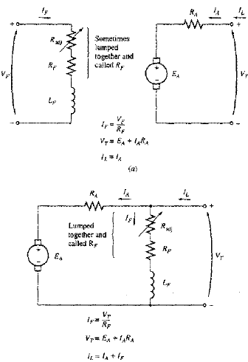

9.4: Separately Excited and Shunt DC Motors
A separately excited motor is a motor whose field circuit is supplied from a separate constant-voltage power supply.
A shunt motor is a motor whose field circuit gets its power directly across the armature terminals of the motor.
When the supply voltage is assumed constant, there is no practical difference in the behavior of these machines.
KVL for these motors is:

Slide 4
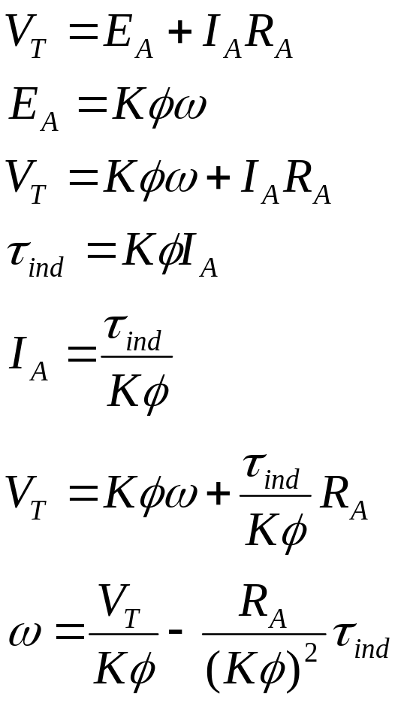
The Terminal Characteristics of a Shunt DC Motor
The terminal characteristics of a motor is the plot of its output torque versus speed.
When the load on the shaft of shunt DC motor is increased, then the load torque will exceed the torque induced in the machine, and the motor will slow down.
When the motor slows down, its internal generated voltage drops which will increase the armature current.
The increase in the armature current increases the induced torque, and finally the induced torque will be equal to the load torque at a lower mechanical speed.

Slide 5
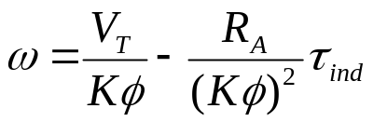
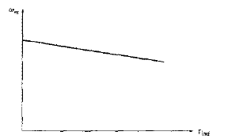
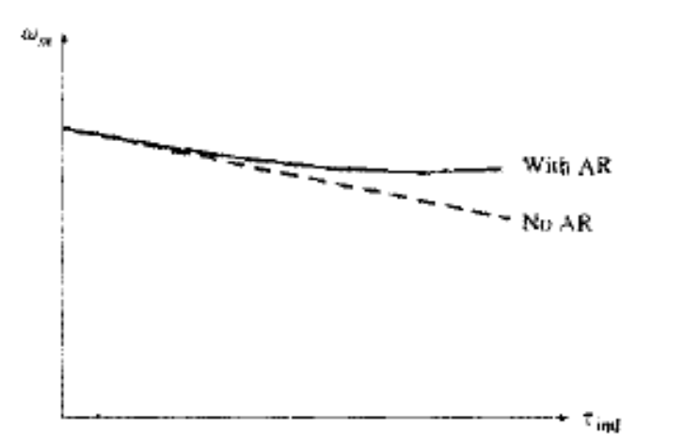
The Terminal Characteristics of a Shunt DC Motor
The final equation is just a straight line equation with a negative slope.
Another effect internal to the motor that can effect the torque-speed curve is the armature reaction.
If the motor has armature reaction, then as the load increases, the flux-weakening effect reduces its flux.
The effect of reduction in the flux is to increase motor’s speed at any given load over the speed it would run without armature reaction.

Slide 6
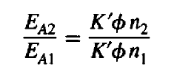
The Terminal Characteristics of a Shunt DC Motor
If a shunt motor has a compensating windings so that its flux is constant regardless of load, and the motor speed and armature reaction are known at any one value of the load, then it is possible to calculate its speed at any other value of load, as long as armature current at that load is known or can be determined.
The relationship between internal generated voltages and speeds at two different loading conditions is given by

Slide 7
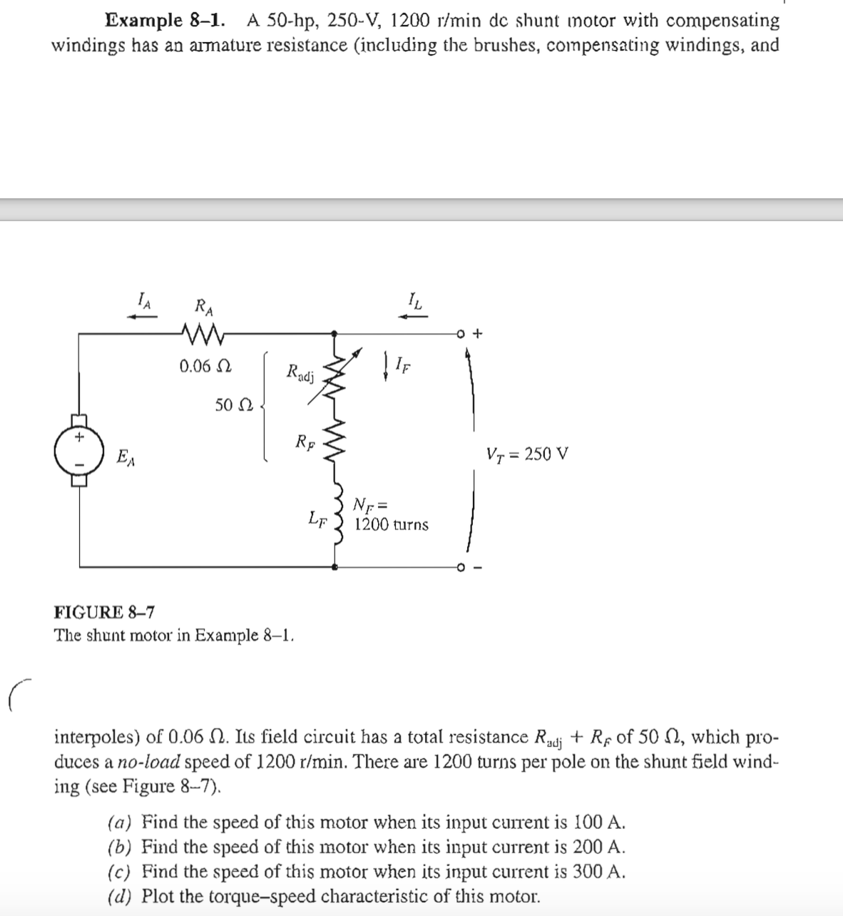
Example 8-1

Slide 8
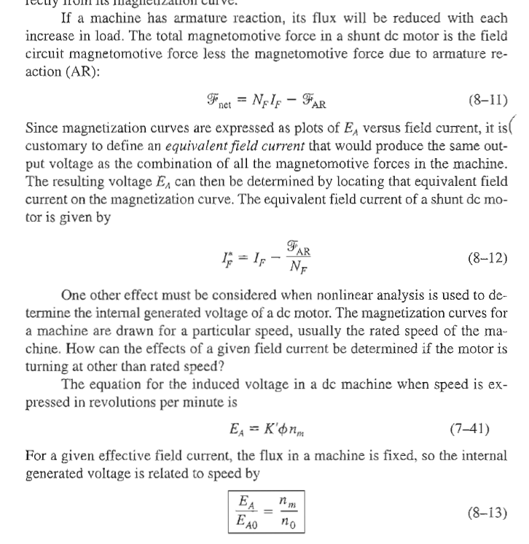
Effect of Armature Reaction

Slide 9
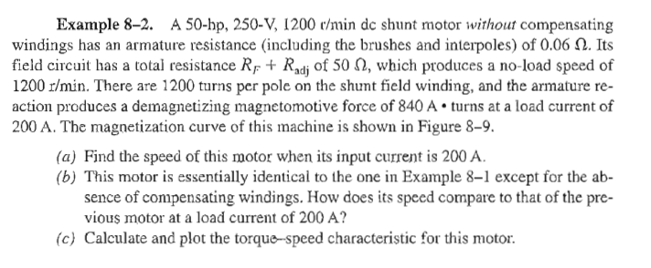
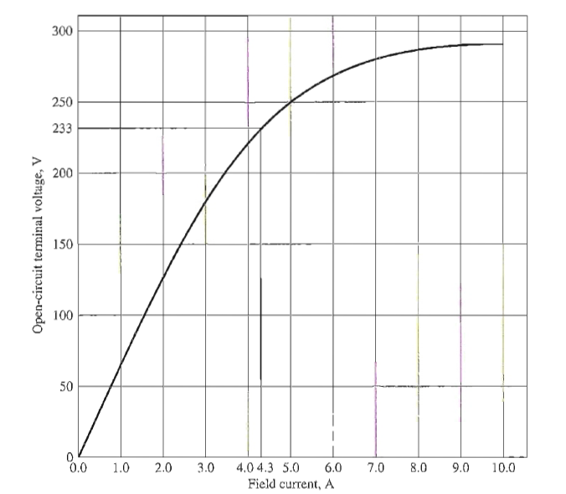
Example 8-2

Slide 10
Speed Control of Shunt DC Motors
There are two common and one less common method in use for the speed control of shunt DC motors:
Adjusting the field resistance R_{F}, and thus the field flux.
Adjusting the terminal voltage applied to the armature.
Inserting resistance in series with the armature circuit (less common).

Slide 11
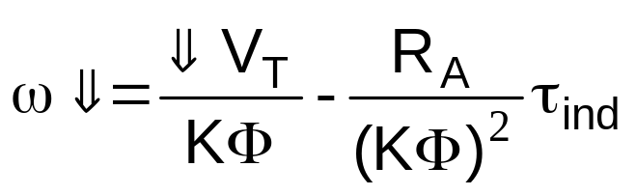
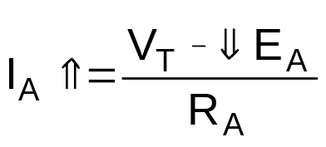
Speed control of Shunt DC Motor
Adjusting R_{F} (φ_{F})
Low I_{F}
Adjusting to
Low V_{T}
Inserting R (Adding)
in Armature
Assume V_{T}= constant:
Assume I_{F}= constant
Assume I_{F &} V_{T} are constant
R_{F}
I_{F}
φ
E_{A}=Kφ ω
T=Kφ I_{A}

Slide 12
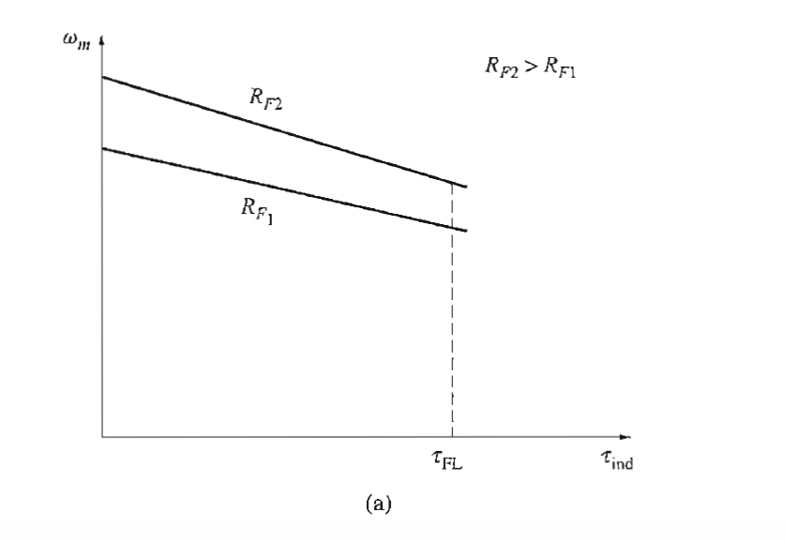
Speed control of Shunt DC Motor

Slide 13
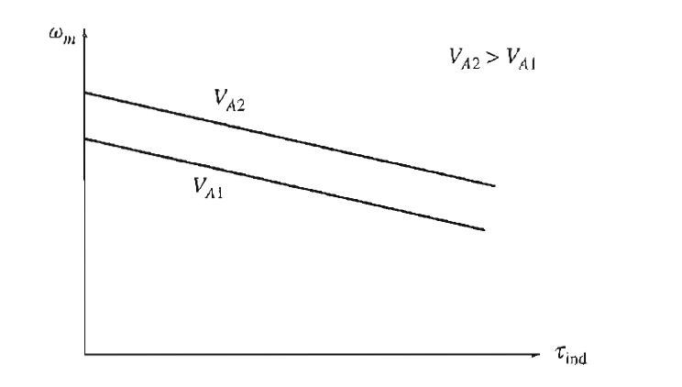
Speed control of Shunt DC Motor

Slide 14
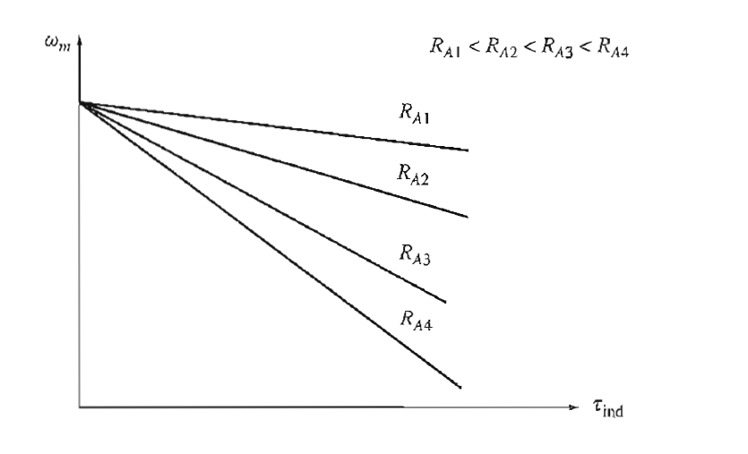
Speed control of Shunt DC Motor

Slide 15
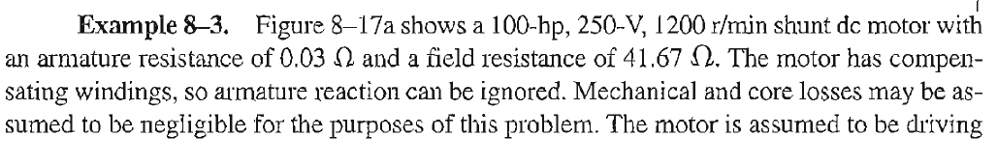
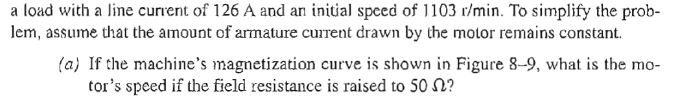
Example 8-3

Slide 16
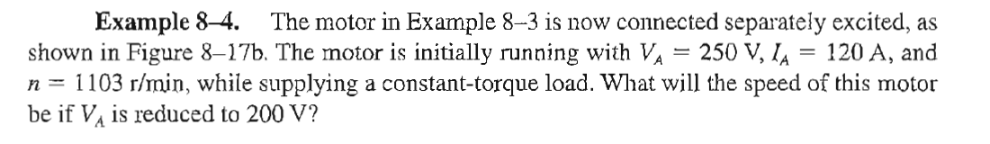
Example 8-4

Slide 17
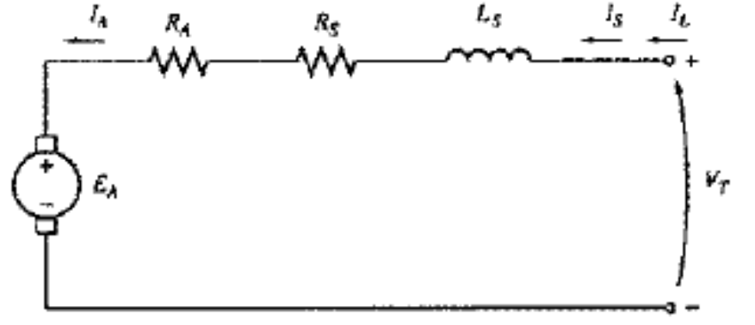
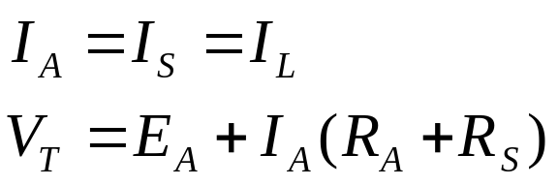
9.6: The Series DC Motor
A DC series motor is a dc motor whose field winding consists of a relatively few turns connected in series with the armature circuit.
In a series motor, the armature current, field current and line current are all the same.

Slide 18
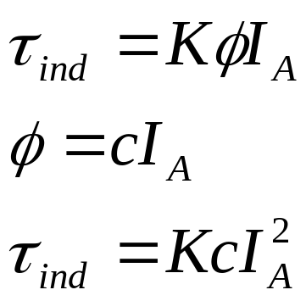
Induced Torque in DC Series Motor
The basic behavior of a series dc motor is due to the fact that the flux is directly proportional to the armature current, at least until the saturation is reached.
As the load on the motor increases, its flux increases too. However, as seen earlier, an increase in the flux of the motor causes a decrease in the speed.
The result is that motor has sharply dropping torque-speed characteristics.
The induced torque in the machine is given by:
It is easy to see that a series motor gives more torque per ampere than any other motor. It is therefore, used in the application requiring very high starting torque. E.g. starter motors in the cars, elevators motors, and tractor motors in locomotive.

Slide 19
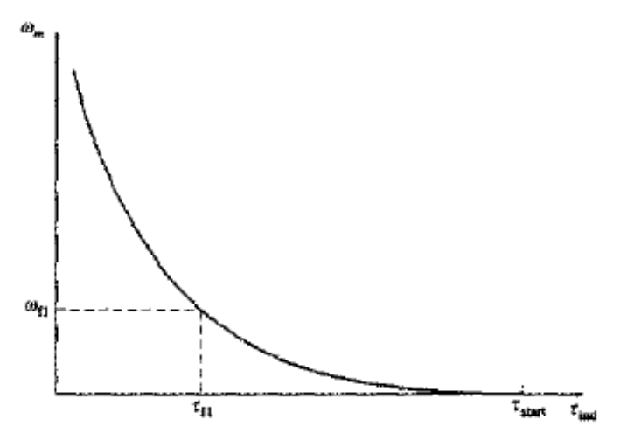
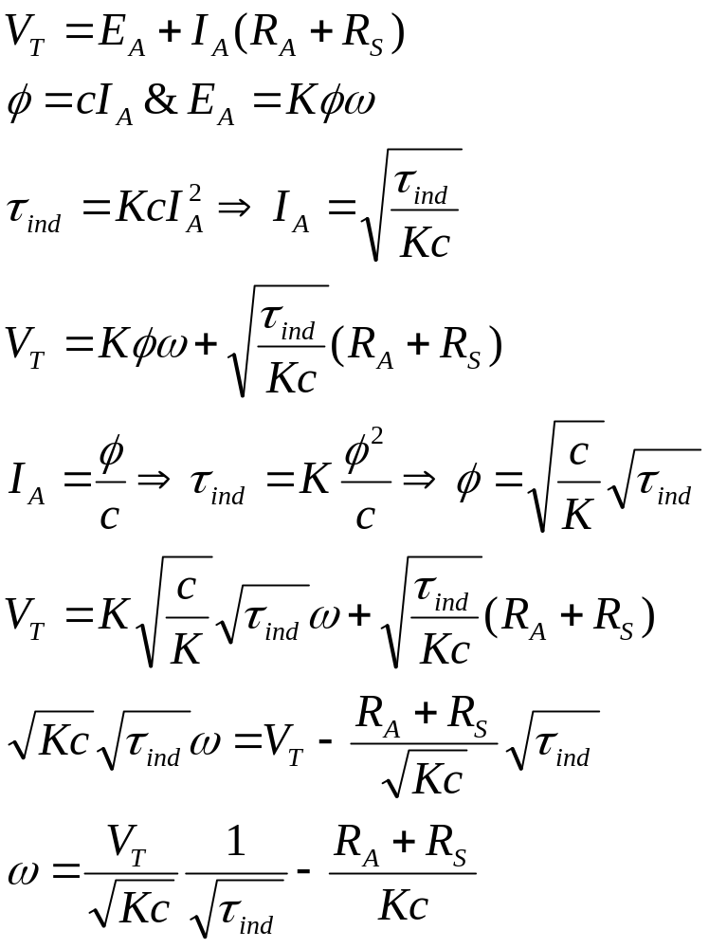
The Terminal Characteristics of a DC Series Motor
Notice that for an unsaturated series motor, the speed of the motor varies as the reciprocal of the square root of the torque. This is quite an unusual relationship.

Slide 20
The Terminal Characteristics of a DC Series Motor
One disadvantage of series motor can be seen immediately from this equation. When the torque on this motor goes to zero, its speed goes to infinity.
In practice, the torque can never go entirely to zero because of mechanical, core, and stray losses that must be overcome.
However, if no other load is connected to the motor, it can turn fast enough to seriously damage itself.
Never completely unload a series motor, and never connect one to a load by a belt or other mechanism that could break. If that were to happen and motor were to become unloaded while running, the results could be serious.

Slide 21

Conclusion
9.4: Separately Excited and Shunt DC Motors
9.6: the Series DC Motor

