Slide 1

EE-260 : Electrical Machines
Lecture#38
9.6: the Series DC Motor
9.7: the Compound DC Motor
Text Book: Chapter 09 DC Motors & Generators
(Stephen J. Chapman 4th Ed)
Instructor: Ms Neelma Naz
Class: BEE 12 C/D
School of Electrical Engineering and Computer Science
Department of Electrical Engineering

Slide 2
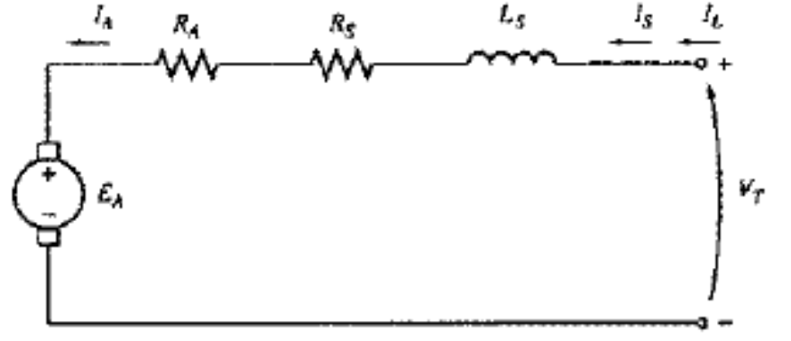
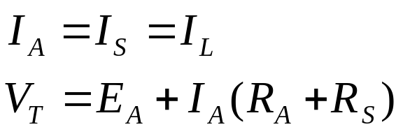
9.6: The Series DC Motor
A DC series motor is a dc motor whose field winding consists of a relatively few turns connected in series with the armature circuit.
In a series motor, the armature current, field current and line current are all the same.

Slide 3
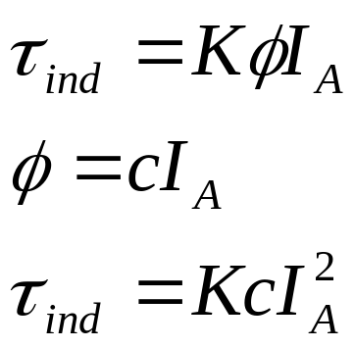
Induced Torque in DC Series Motor
The basic behavior of a series dc motor is due to the fact that the flux is directly proportional to the armature current, at least until the saturation is reached.
As the load on the motor increases, its flux increases too. However, as seen earlier, an increase in the flux of the motor causes a decrease in the speed.
The result is that motor has sharply dropping torque-speed characteristics.
The induced torque in the machine is given by:
It is easy to see that a series motor gives more torque per ampere than any other motor. It is therefore, used in the application requiring very high starting torque. E.g. starter motors in the cars, elevators motors, and tractor motors in locomotive.

Slide 4
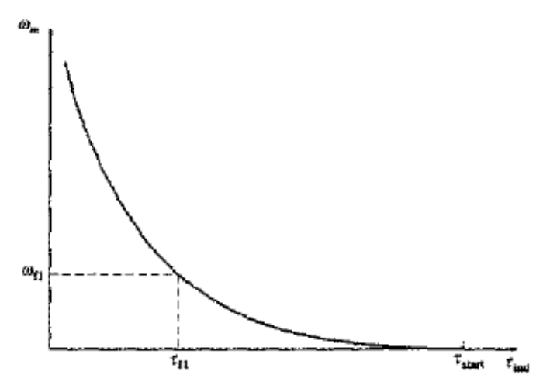
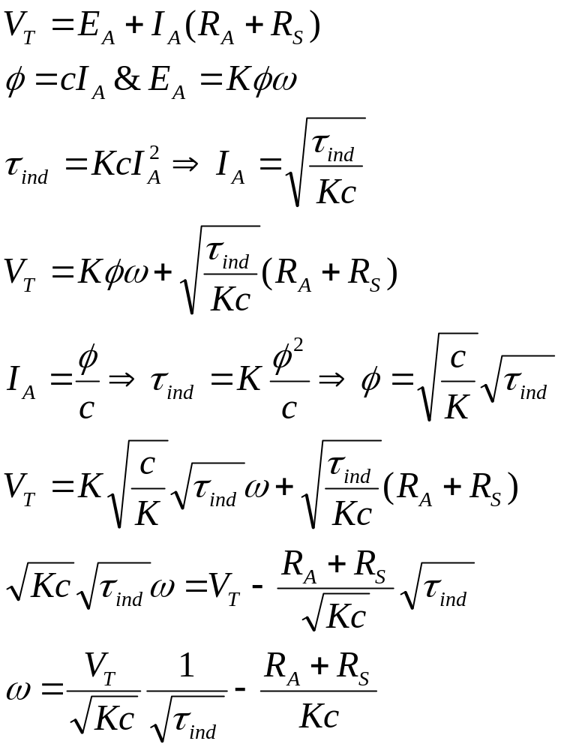
The Terminal Characteristics of a DC Series Motor
Notice that for an unsaturated series motor, the speed of the motor varies as the reciprocal of the square root of the torque. This is quite an unusual relationship.

Slide 5
The Terminal Characteristics of a DC Series Motor
One disadvantage of series motor can be seen immediately from this equation. When the torque on this motor goes to zero, its speed goes to infinity.
In practice, the torque can never go entirely to zero because of mechanical, core, and stray losses that must be overcome.
However, if no other load is connected to the motor, it can turn fast enough to seriously damage itself.
Never completely unload a series motor, and never connect one to a load by a belt or other mechanism that could break. If that were to happen and motor were to become unloaded while running, the results could be serious.

Slide 6
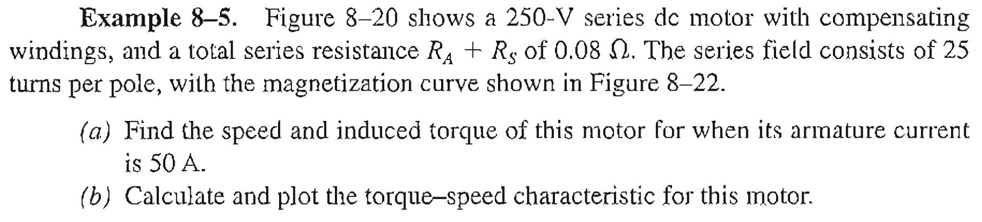
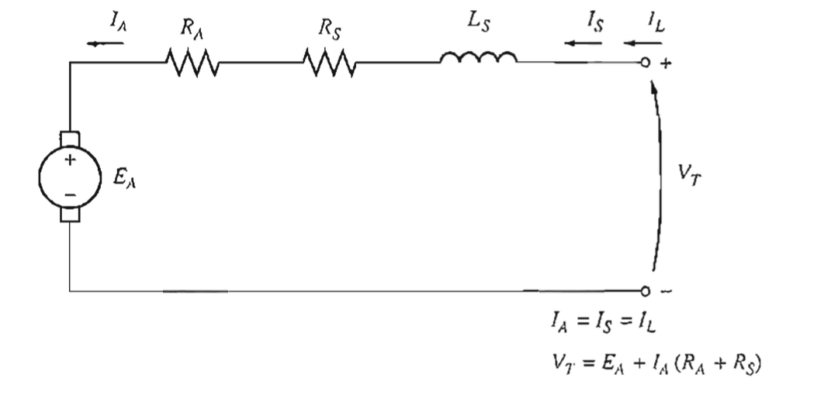
Example 9-5 (Class Activity)

Slide 7
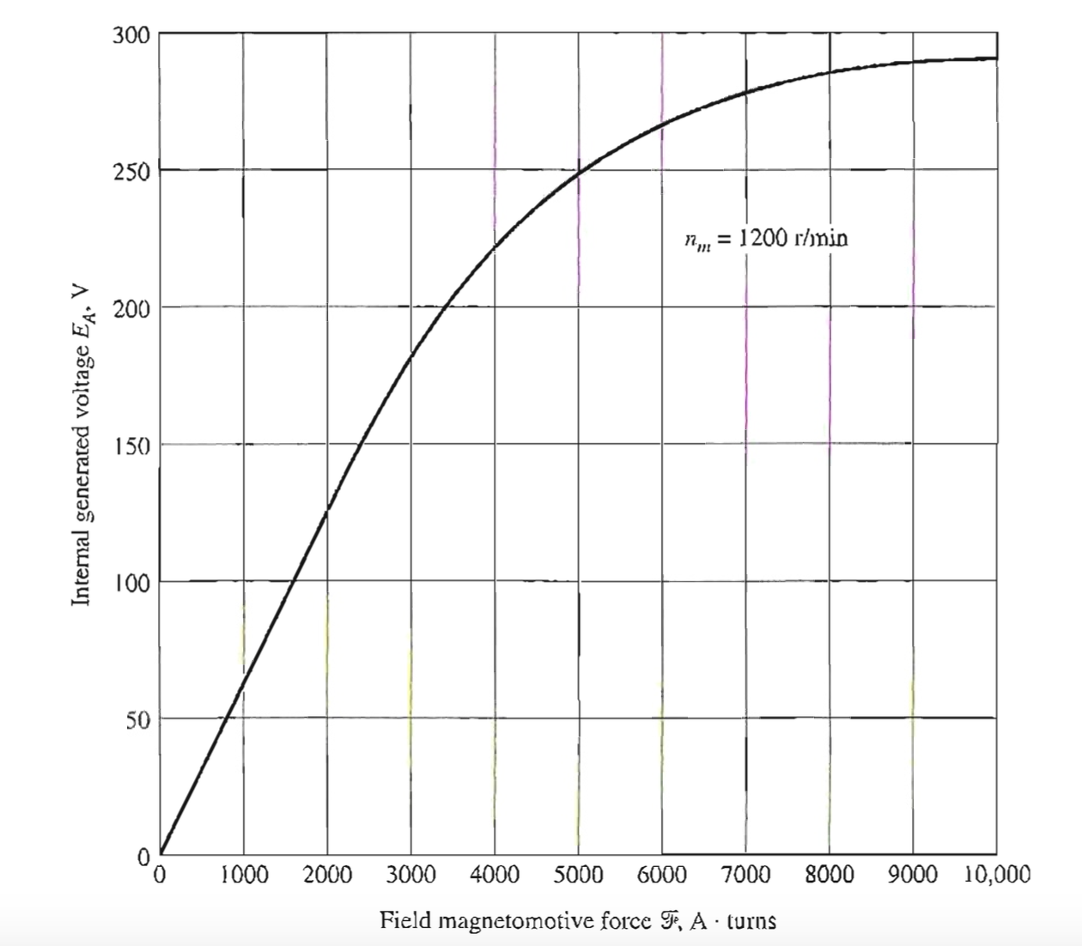

Slide 8
Speed Control of DC Series Motor
Unlike the shunt dc motor, there is only one efficient way to change the speed of a series de motor. That method is to change the terminal voltage of the motor.
If the terminal voltage is increased the first term in torque speed equation characteristics is increased resulting in higher speed for any given torque.
The speed of series dc motors can also be controlled by the insertion of a series resistor into the motor circuit.

Slide 9
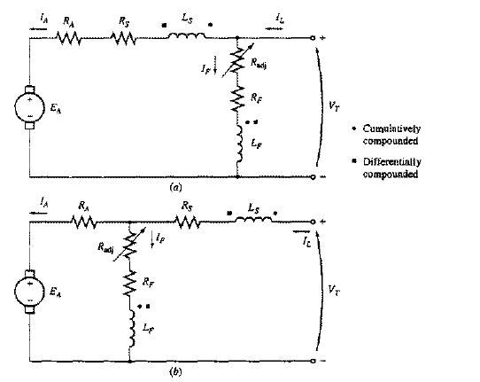
9.7: The compound dc motor
A compound dc motor is a motor with both a shunt and a series field.
A current flowing into a dot produces positive magnetomotive force.
A current flowing out of a dot produces negative magnetomotive force.
Cumulatively and Differentially Compound

Slide 10
9.7: The compound dc motor
If the current flows into the dot on one field coil and out of the dot on the other field coil, the resulting magnetomotive forces subtract.
In the figure round dots correspond to cumulative compounding and the square correspond to differential compounding.
Cumulatively and Differentially Compound

Slide 11
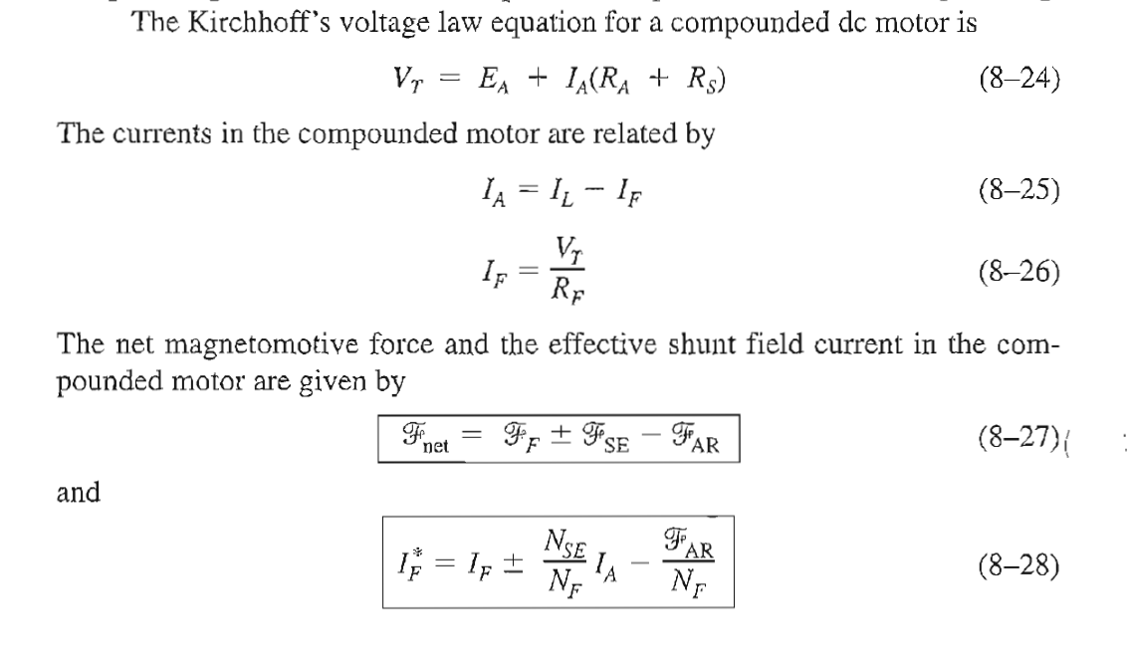
9.7: The compound dc motor
Cumulatively and Differentially Compound

Slide 12
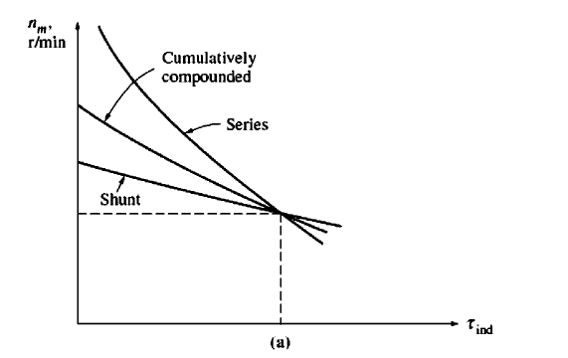
9.7: The compound dc motor
Terminal characteristics of cumulatively compounded DC Motor

Slide 13
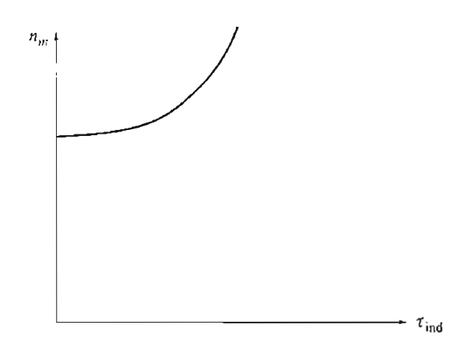
9.7: The Differentially compound dc motor
Terminal characteristics of Differentially compounded DC Motor

Slide 14
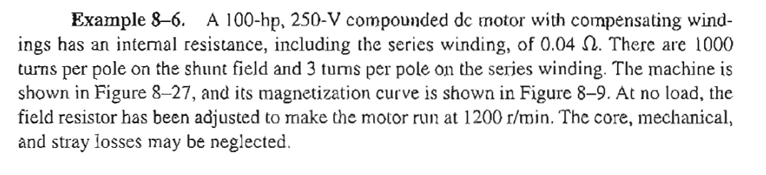
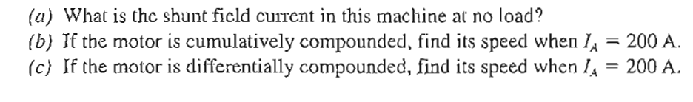
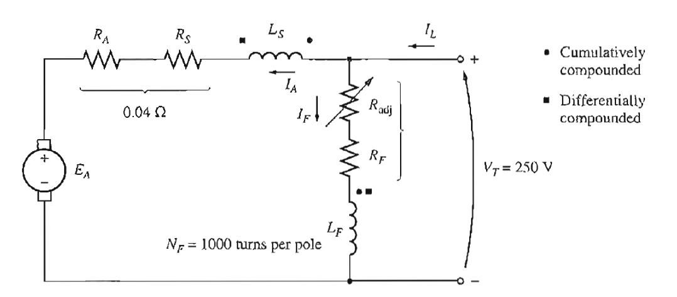
Example 8-6 (Class Activity)

Slide 15
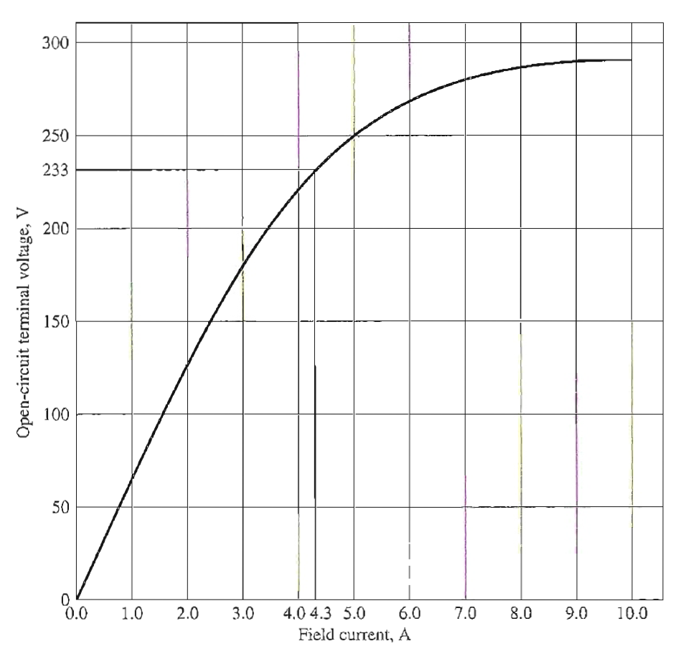
Example 8-6 (Class Activity)

Slide 16
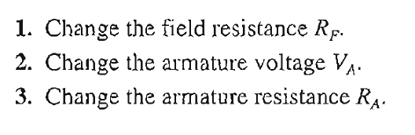
Speed Control of cumulatively compounded DC Motor

Slide 17
9.5: The Permanent Magnet DC Motor
A permanent magnet DC motor is a motor whose poles are made of permanent magnets.
Permanent magnet DC motors offer number of benefits compared with the shunt DC motors in some applications.
  Since these motor do not require field circuit, they don’t have the field circuit copper losses associated with the shunt DC motors.
  Because no field windings are required, they can be smaller than the corresponding shunt dc motors.
  PMDC motors are especially common in smaller fractional and sub fractional horse power size, where the expense and space of separate field circuit can not be justified.

Slide 18
9.5: The Permanent Magnet DC Motor
Permanent magnet DC motors also have disadvantages.
  Permanent magnets can not produce as high a flux density as an externally supplied shunt field.
  PMDC motors run the risk of demagnetization.

Slide 19
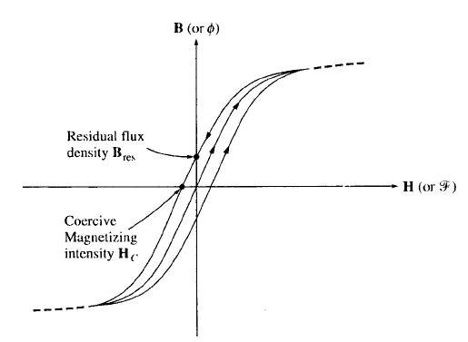
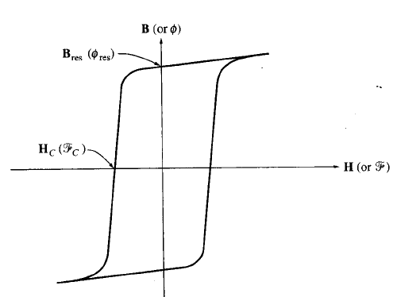
9.5: The Permanent Magnet DC Motor
Top figure is the magnetization curve of a typical ferromagnetic material for the conventional machines.
The bottom figure shows the magnetizations curve of a ferromagnetic material suitable for use in permanent magnets. Note the high residual flux density and relatively large coercive magnetizing intensity Hc.

Slide 20
Speed Control of PMDC Motor
Varying Armature Voltage
Varying Armature Resistance

Slide 21

Conclusion
9.6: the Series DC Motor
9.7: the Compound DC Motor

