Slide 1

EE-260 : Electrical Machines
Lecture#39
9.7: the Compound DC Motor
PMDC Motor
Text Book: Chapter 09 DC Motors & Generators
(Stephen J. Chapman 4th Ed)
Instructor: Ms Neelma Naz
Class: BEE 12 C/D
School of Electrical Engineering and Computer Science
Department of Electrical Engineering

Slide 2
Speed Control of DC Series Motor
Unlike the shunt dc motor, there is only one efficient way to change the speed of a series de motor. That method is to change the terminal voltage of the motor.
If the terminal voltage is increased the first term in torque speed equation characteristics is increased resulting in higher speed for any given torque.
The speed of series dc motors can also be controlled by the insertion of a series resistor into the motor circuit.

Slide 3
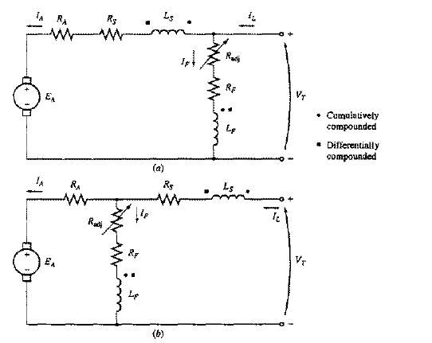
9.7: The compound dc motor
A compound dc motor is a motor with both a shunt and a series field.
A current flowing into a dot produces positive magnetomotive force.
A current flowing out of a dot produces negative magnetomotive force.
Cumulatively and Differentially Compound

Slide 4
9.7: The compound dc motor
If the current flows into the dot on one field coil and out of the dot on the other field coil, the resulting magnetomotive forces subtract.
In the figure round dots correspond to cumulative compounding and the square correspond to differential compounding.
Cumulatively and Differentially Compound

Slide 5
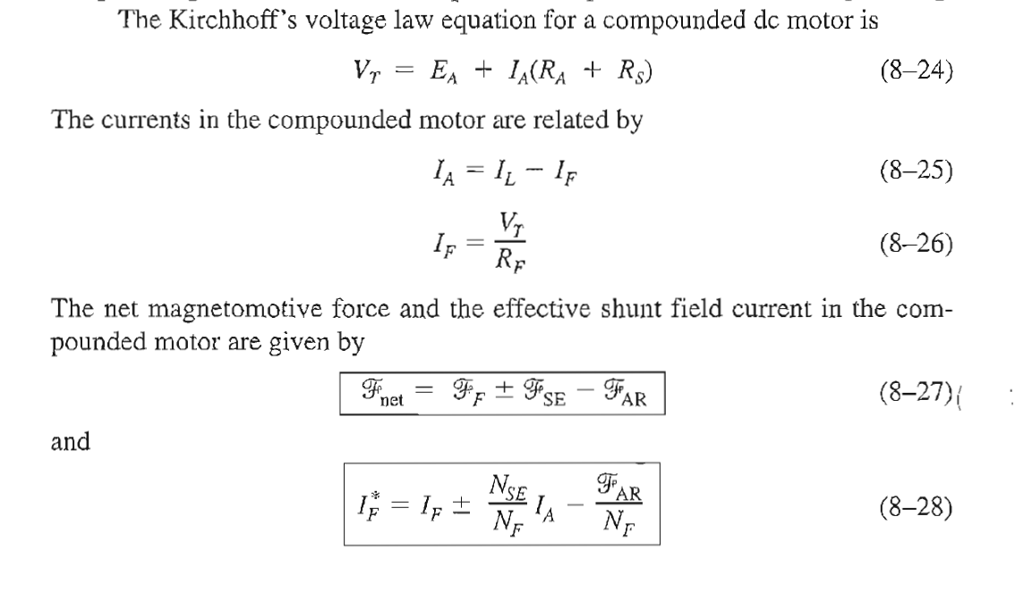
9.7: The compound dc motor
Cumulatively and Differentially Compound

Slide 6
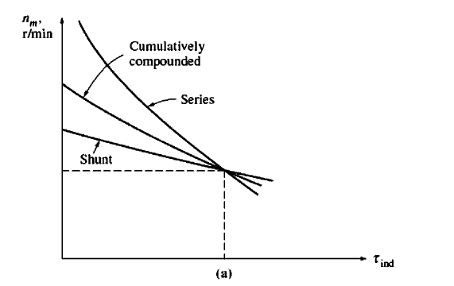
9.7: The compound dc motor
Terminal characteristics of cumulatively compounded DC Motor

Slide 7
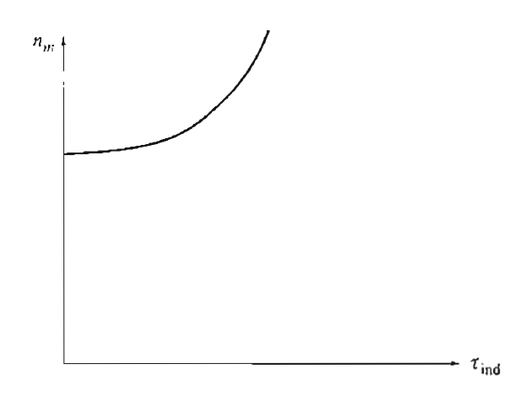
9.7: The Differentially compound dc motor
Terminal characteristics of Differentially compounded DC Motor

Slide 8
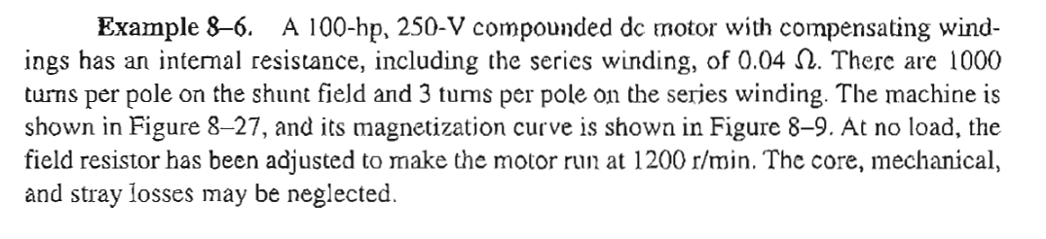
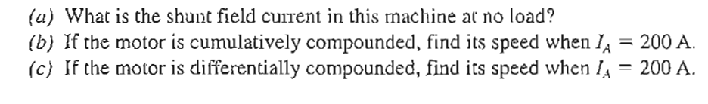
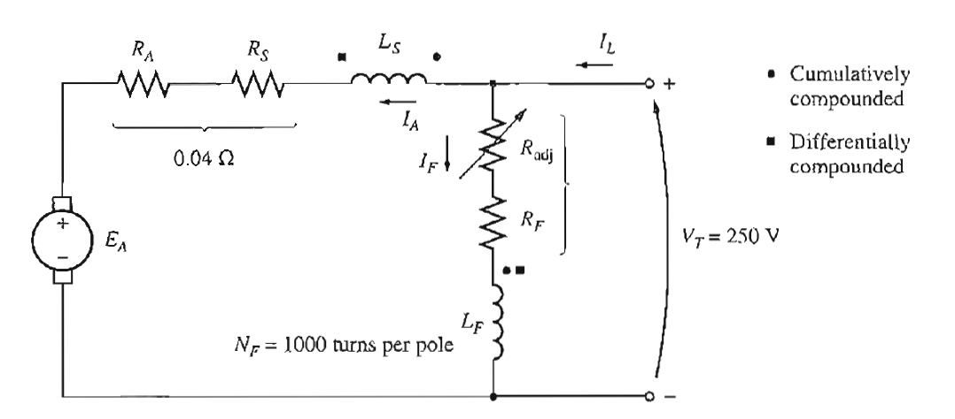
Example 8-6 (Class Activity)

Slide 9
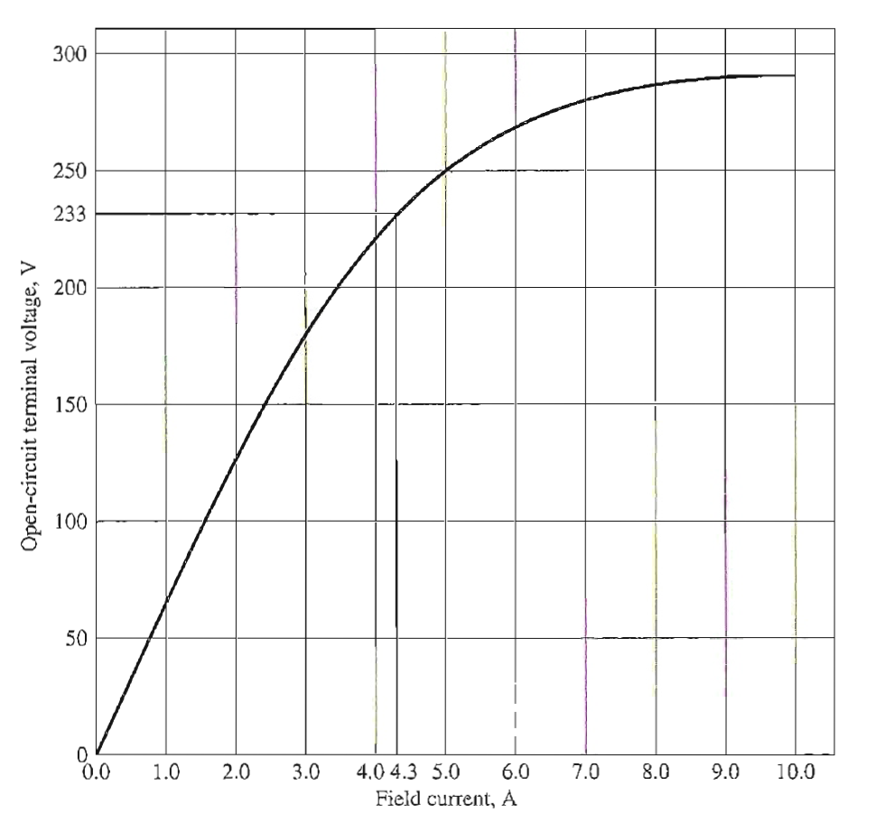
Example 8-6 (Class Activity)

Slide 10
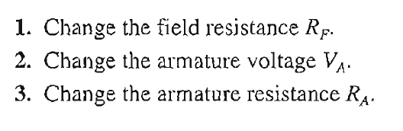
Speed Control of cumulatively compounded DC Motor

Slide 11
9.5: The Permanent Magnet DC Motor
A permanent magnet DC motor is a motor whose poles are made of permanent magnets.
Permanent magnet DC motors offer number of benefits compared with the shunt DC motors in some applications.
  Since these motor do not require field circuit, they don’t have the field circuit copper losses associated with the shunt DC motors.
  Because no field windings are required, they can be smaller than the corresponding shunt dc motors.
  PMDC motors are especially common in smaller fractional and sub fractional horse power size, where the expense and space of separate field circuit can not be justified.

Slide 12
9.5: The Permanent Magnet DC Motor
Permanent magnet DC motors also have disadvantages.
  Permanent magnets can not produce as high a flux density as an externally supplied shunt field.
  PMDC motors run the risk of demagnetization.

Slide 13
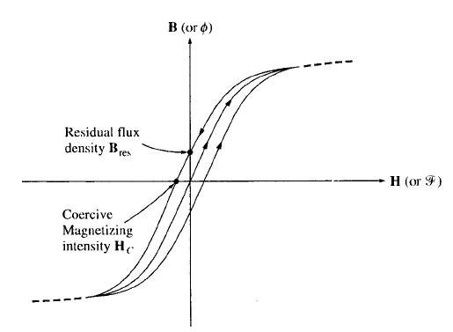
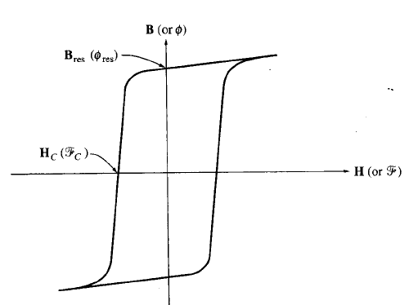
9.5: The Permanent Magnet DC Motor
Top figure is the magnetization curve of a typical ferromagnetic material for the conventional machines.
The bottom figure shows the magnetizations curve of a ferromagnetic material suitable for use in permanent magnets. Note the high residual flux density and relatively large coercive magnetizing intensity Hc.

Slide 14
Speed Control of PMDC Motor
Varying Armature Voltage
Varying Armature Resistance

Slide 15
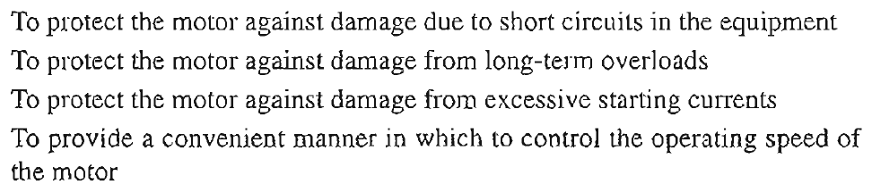
DC Motor Starters

Slide 16
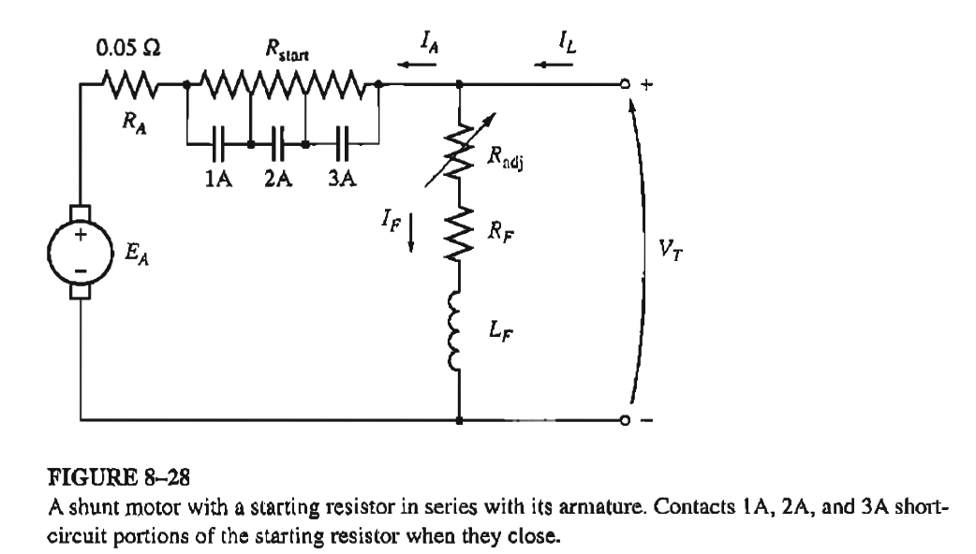
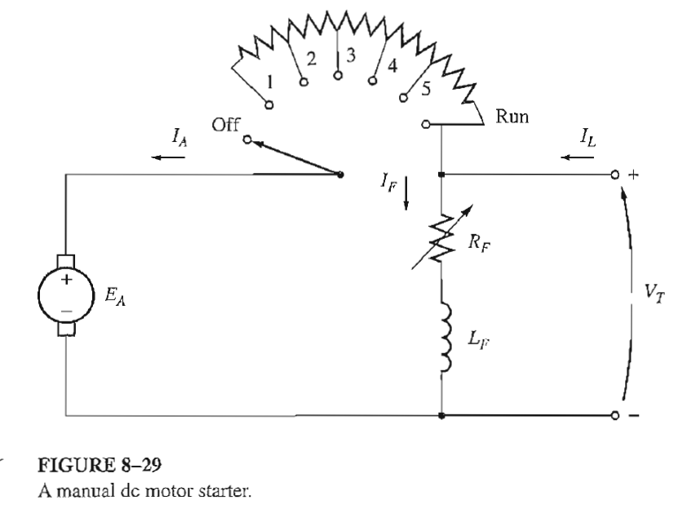
DC Motor Starters

Slide 17
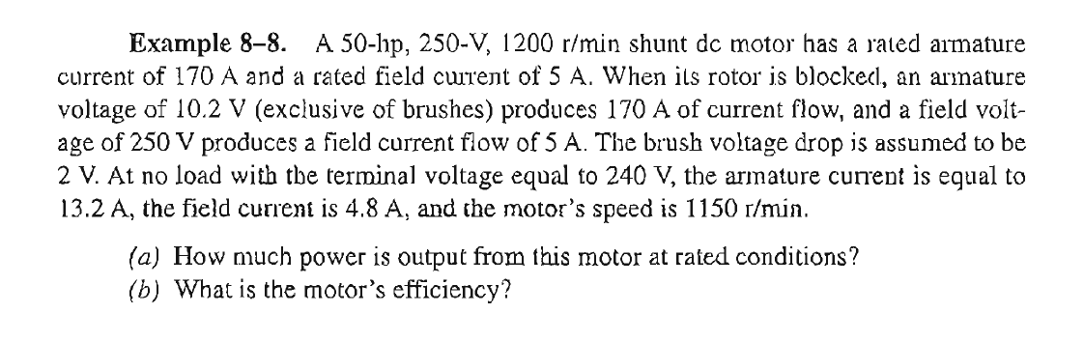
Power & Efficiency in DC Motor

Slide 18

Conclusion
9.7: the Compound DC Motor
PMDC Motor

