Slide 1

School of Electrical Engineering and Computer Science
Department of Electrical Engineering
EE-260 : Electrical Machines
Lecture#04
Text Book: Chapter 01 (Stephen J. Chapman 4th Ed)
Instructor: Ms Neelma Naz
Class: BEE 12 C/D

Slide 2
Topics to be Covered
Energy losses in ferromagnetic core
Effect of Magnetic Field on its Surroundings

Slide 3
  1. “Energy Losses in Ferromagnetic Core”
  (Page 26)

Slide 4
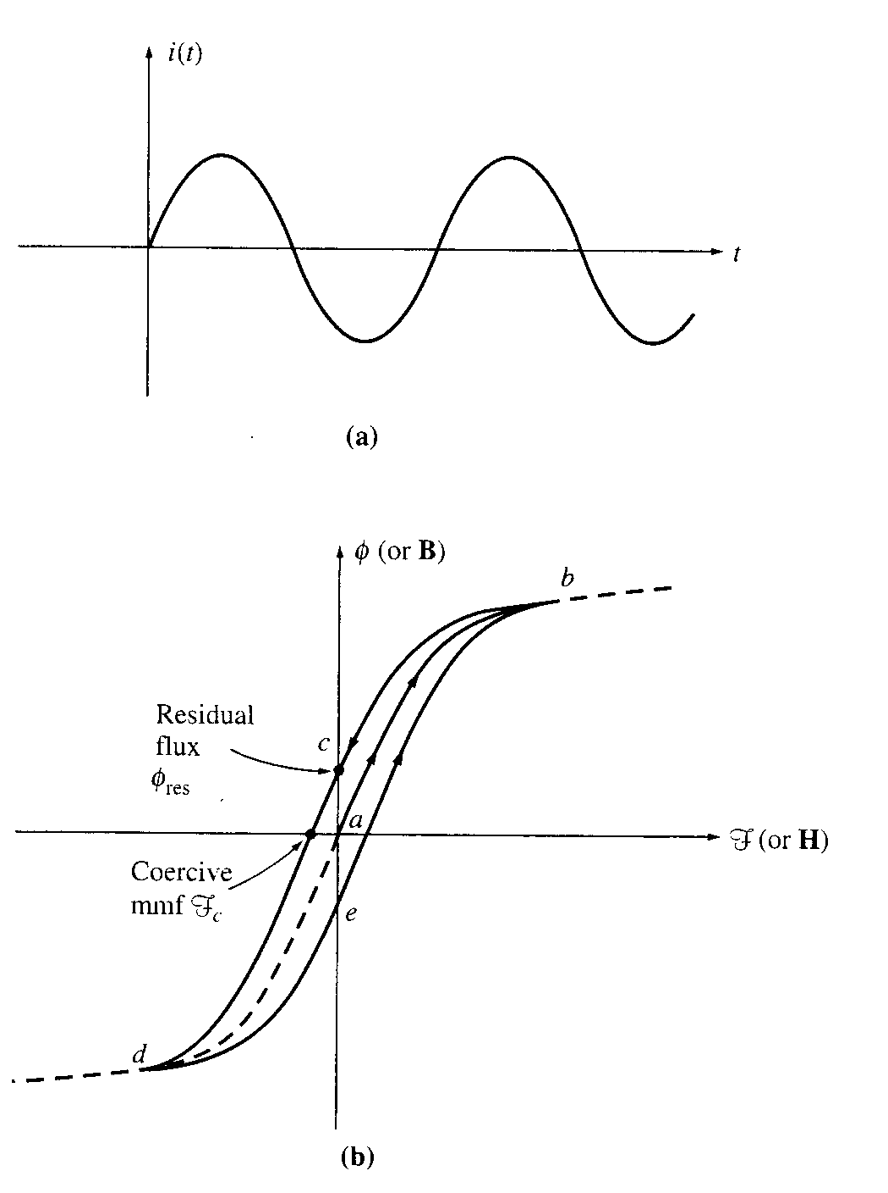
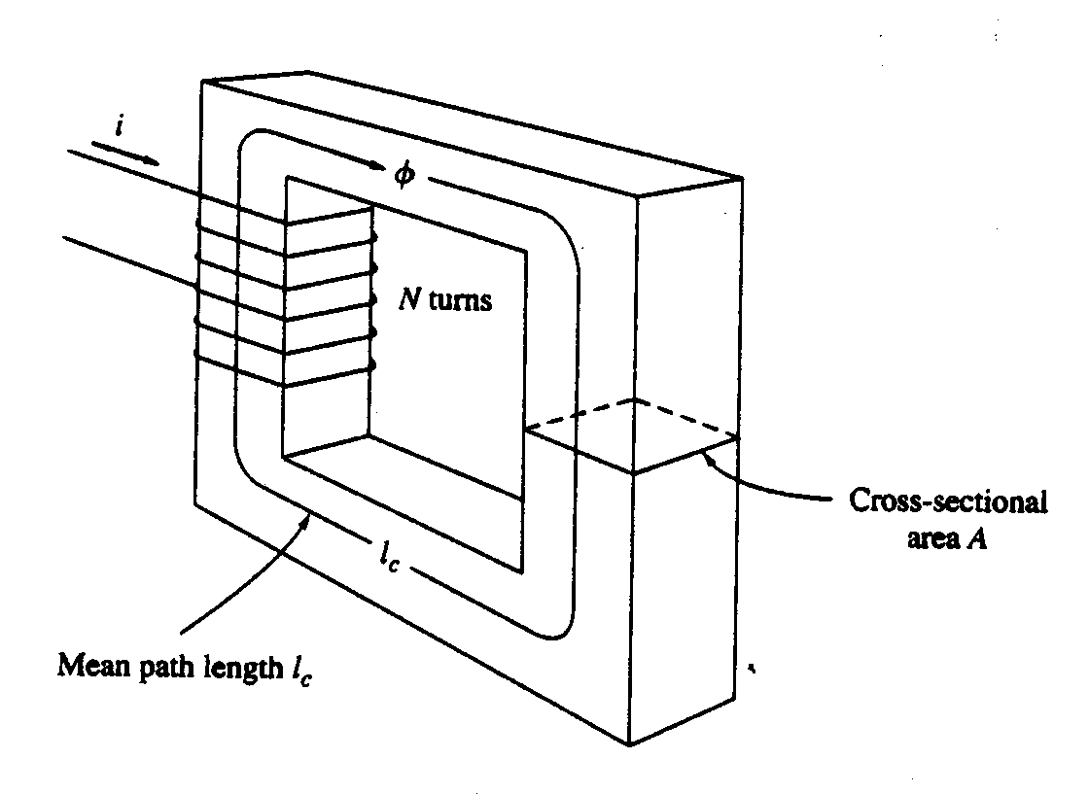
1(a) Hysteresis Loop

Slide 5
1a. Hysteresis loop
B
B-H or Hysteresis loop
i
B_{r}
saturation
3
knee point
4
5
0
1
2
0
1
2
3
t
H_{c}
H
4
5
B_{r} = Retentive flux density (due to property of retentivity)
H_{c}= Coercive field intensity (due to property of coercivity)

Slide 6
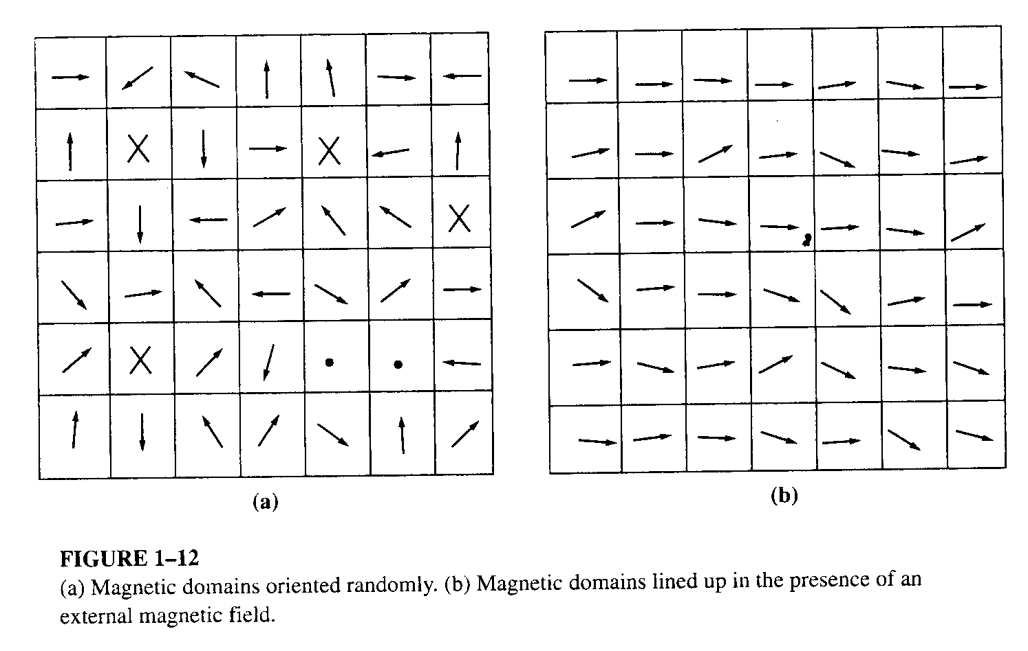
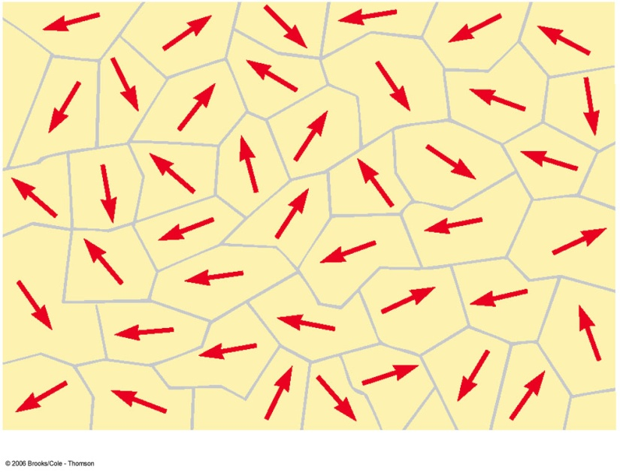
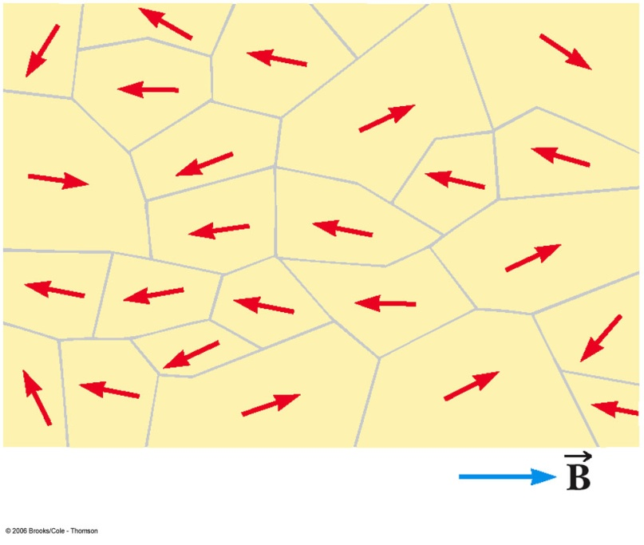
Magnetic Domains Orientation

Slide 7
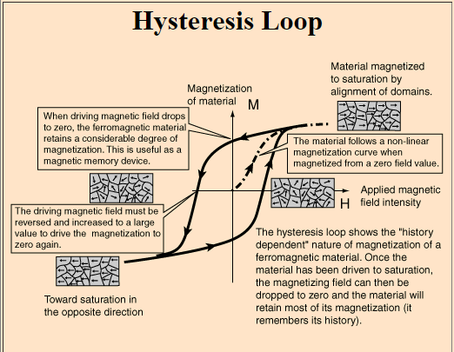
http://hyperphysics.phy-astr.gsu.edu/hbase/solids/hyst.html

Slide 8
1(b) Eddy Currents in Magnetic Field
A time changing flux induces voltage in ferromagnetic core in the same manner as it would in a coil of wire.
These voltage cause swirls of current (eddy currents) with in the iron core. Iron is a resistive material and energy will be dissipated.
(Energy loss due to eddy current is directly proportional to size of the path they follow)

Slide 9
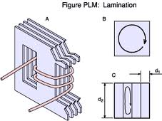
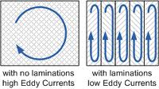
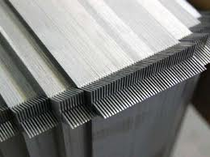
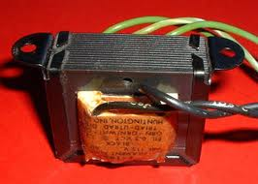
1(b). Solution

Slide 10
2.Effect of Magnetic Field on its Surroundings
The three major effects of the magnetic field on its surrounding are:
  Transformer Action: Faraday’s Law -- Induced Voltage from a Time-Changing Magnetic Field
  Motor Action: Production of Induced Force on a Wire in the presence of a magnetic field
  Generator Action: Induced Voltage on a Conductor Moving in a Magnetic Field

Slide 11
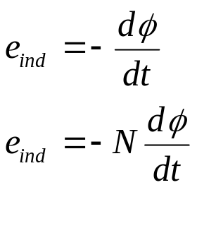

Transformer Action
Faraday’s law:
If a flux passes through a turn of a coil of wire, a voltage will be induced in the turn of wire, which is directly proportional to the rate of change of flux w.r.t. time.
By Lenz’ law, the induced voltage opposes the change that causes it; thus a minus sign is included in the equation

Slide 12
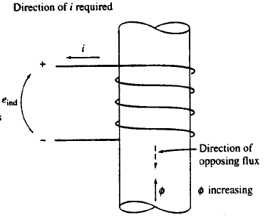
Lenz’s Law
”The direction of voltage build up in a coil is such that if the coil ends were short circuited, it would produce current that would cause a flux opposing the original change”.

Slide 13
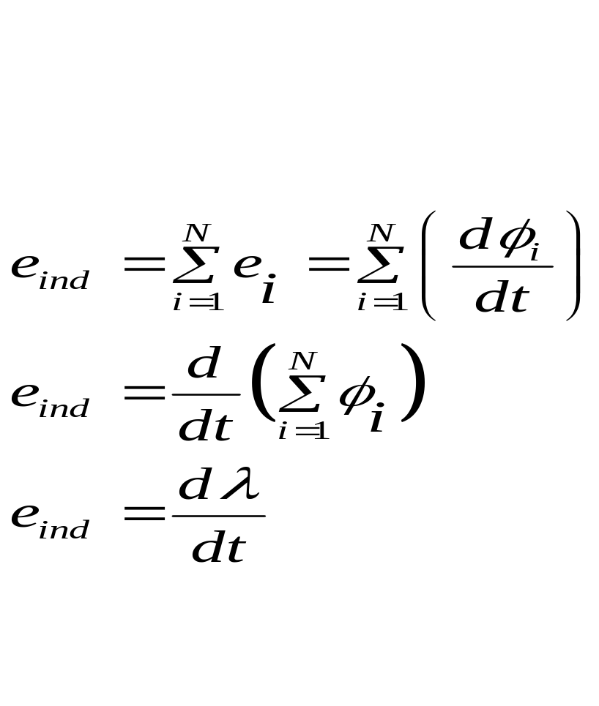
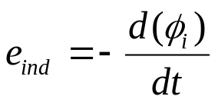
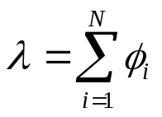
Flux Linkage in a Coil
It is assumed that the same flux is present in each turn of the coil which is practically not true
The magnitude of the voltage in i^{th} turn of coil is give by:
For N-Turns
Thus the induced voltage can be expressed in terms of Flux Linkage as well.
ø is the flux, and λ is the flux Linkage expressed in wb.

Slide 14

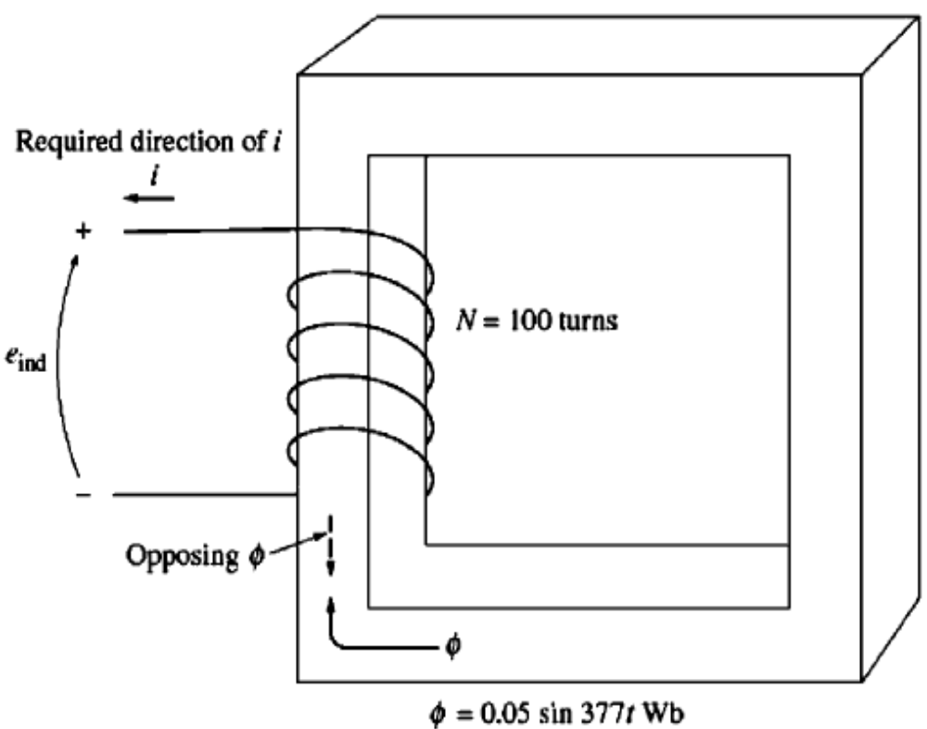
Example 1-6
Figure 1-15 shows a coil of wire wrapped around an iron core. Flux in the core is given by the equation:
If there are 100 turns on the core, what voltage is produced at the terminals of the coil?
Of what polarity is the voltage during the time when flux is increasing in the reference direction shown in the figure?
Assume that all the magnetic flux stays within the core (i.e., assume that the flux leakage is zero).
Figure 1-15

Slide 15
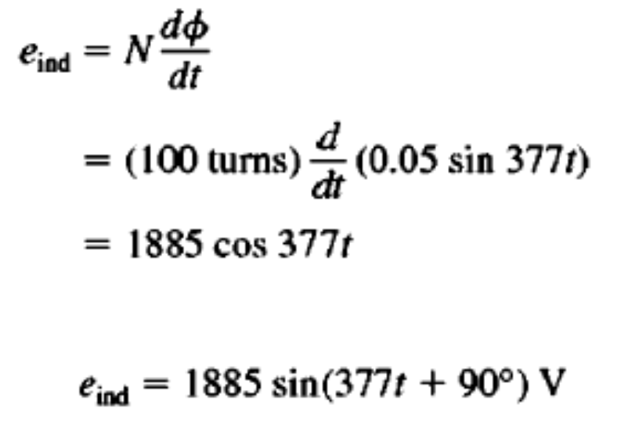
Example 1-6
Solution
Direction of the voltage while the flux is increasing in the reference direction must be positive to negative

Slide 16
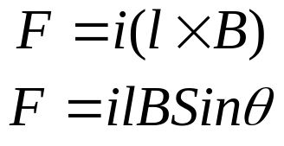
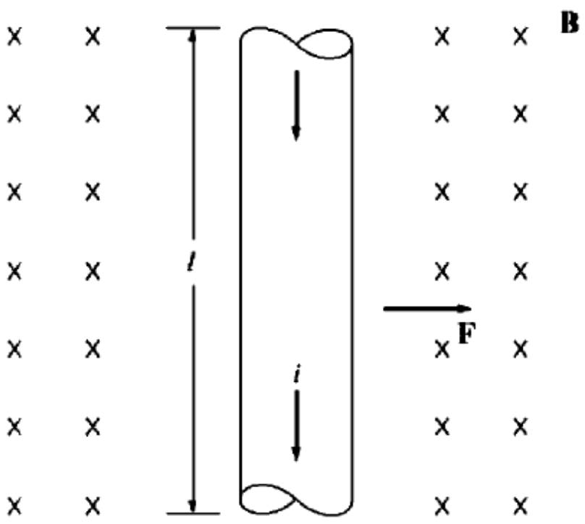
3. Production of Induced Force on a Current Carrying Wire
The force induced on the conductor is:
Fleming’s Right Hand Rule:
The thumb, forefinger, and middle finger of the right hand are extended at right angles to each other.
Direction of l defined to be in the direction of current flow
“If the index finger of right hand points in the direction of the vector l and the middle finger points in the direction of flux density vector B, then the thumb points in the direction of the resultant force F on the wire.”

Slide 17
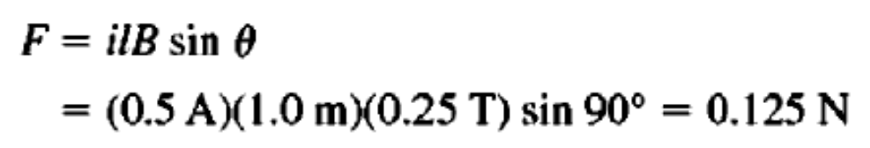

Example 1-7:
The Figure shows a wire carrying a current in the presence of magnetic field. The magnetic flux density is 0.25 T directed into the page. If the wire is 1.0 m long and carries 0.5 A of current in the direction from top of the page to the bottom of the page, what are the magnitude and direction of force induced on the wire.
Solution
The direction of the force is given by the right-hand rule as being to the right.
The magnitude is given by

Slide 18
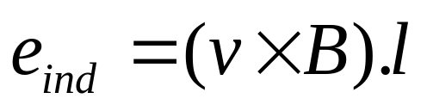
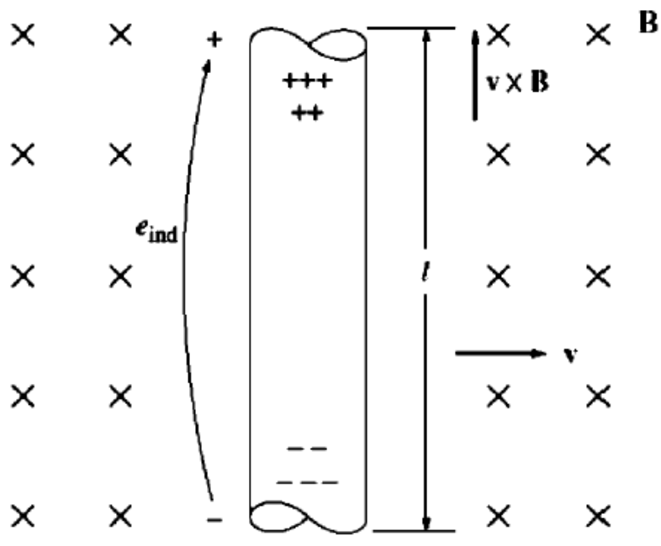
4. Production of Induced Voltage on a Conductor Moving in a Magnetic Field
The Voltage induced in a wire moving in the magnetic field is:
Fleming’s Right Hand Rule:
Vector l points along the direction of the wire toward the end making the smallest angle with respect to the vector v X B
The thumb, forefinger, and middle finger of the right hand are extended at right angles to each other.
“If the index finger points in the direction of flux, and the thumb indicates the movement of conductor, then the middle finger shows the direction of emf induced in the conductor”

Slide 19
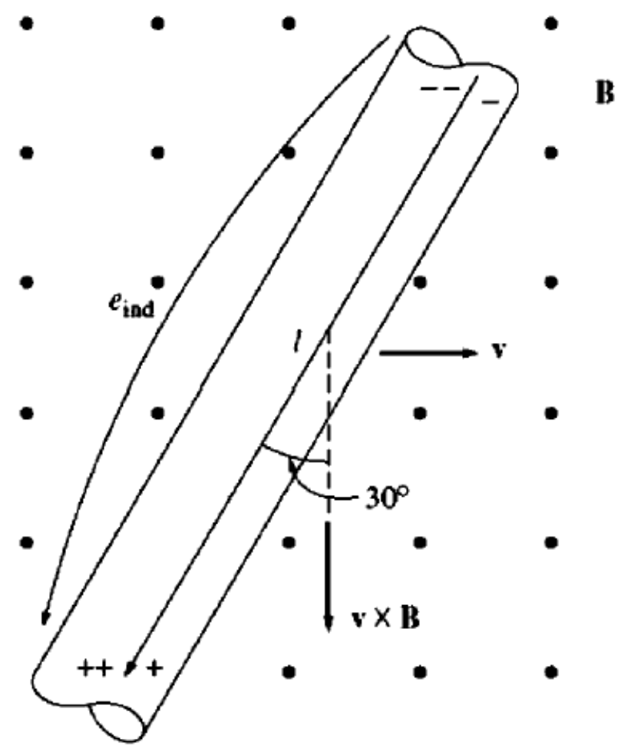
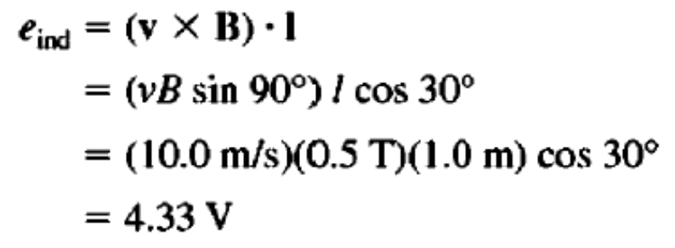
Example 1-9:
Figure shows a conductor moving with velocity of 10 m/s to the right in the presence of a magnetic field. The flux density is 0.5 T out of the page, and the wire is 1.0 m long, oriented as shown. What are the magnitude and polarity of the resulting induced voltage.
Solution
The direction of the quantity v X B is downward. The wire is not oriented on an up-down line, so choose the direction of l as shown to make the smallest possible angle with the direction of v X B. The voltage is positive at the bottom of the wire with respect to the top of the wire.
The magnitude of the voltage is:

Slide 20
The Linear DC Machine.
A Simple Example

Slide 21
Topics to be Covered
Linear Dc Machine- A simple example page#36
Starting of linear DC Machine page#37
The linear DC Machine as MOTOR page#39
Starting problem with Linear DC Machine page#42
The linear DC Machine as GENERATOR page#41
Real, Reactive and Apparent power page#47

Slide 22
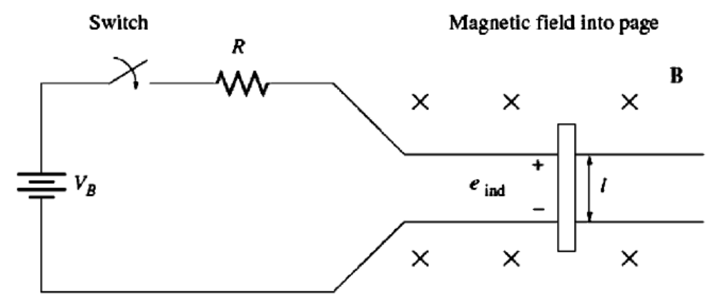
1. The Linear DC Machine- A Simple Example
switch
Magnetic field into the page
+
_
frictionless rails

Slide 23


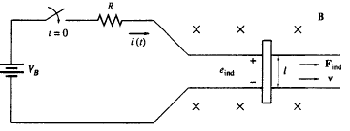


1. The Linear DC Machine- A Simple Example
Behavior of this device can be determined from application of four basic equations:
1. The equation of force on a current carrying wire in the presence of a magnetic field:
2. The equation for the voltage induced on a wire moving in a magnetic field:
3. Kirchoff’s voltage law for this machines is:
4. Newton’s Law for the bar across the track is:

Slide 24
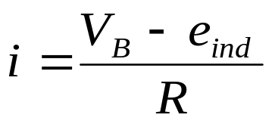



1(a). Starting of Linear DC Machine
When the switch is closed, current in the bar by KVL:
Initially the bar is at rest so v=0;
e_{ind} = 0 and i = V_{B}/R
Due to current in the bar and existence of magnetic field force is induced on the bar… to the right
or
When the bar is accelerated to velocity v , a voltage is induced in the bar.
or
Positive upwards
This induced voltage will reduce the current.

Slide 25
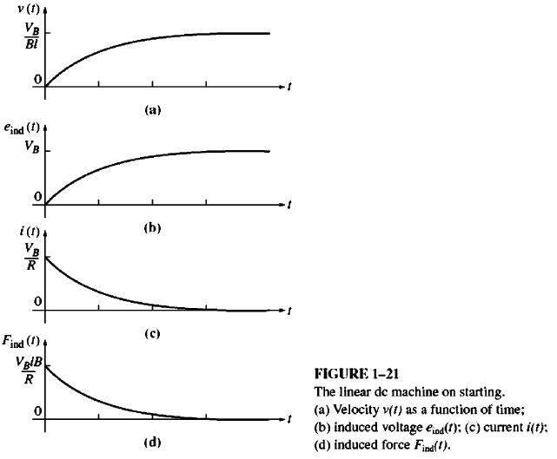
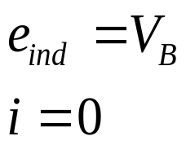
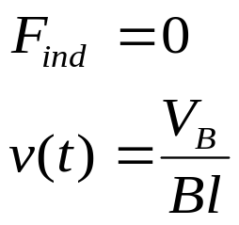
1(a). Linear DC Machine on Starting
5. As current is decreasing so Find decreases.
6. It will happen untill
7. The bar moves at a constant no-load speed, V_{B}/Bl

Slide 26


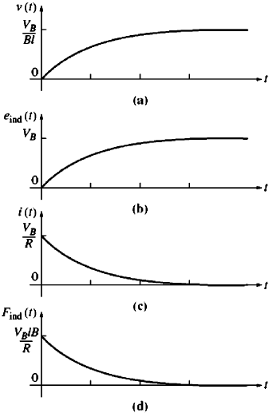
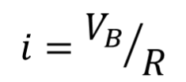
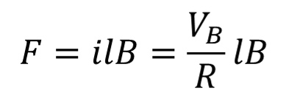
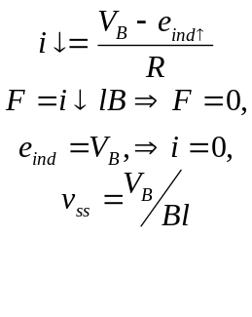



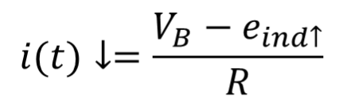







1(a). The Linear DC Machine-Starting
The bar moves at a constant no-load speed, V_{B}/Bl

Slide 27

Conclusion
Magnetic Behavior of Ferromagnetic Materials page
Energy losses in ferromagnetic core page
Effect of Magnetic Field on its Surroundings

