Slide 1

EE-260 : Electrical Machines
Lecture # 40
9.12: The Separately Excited DC Generator
9.13: the Shunt DC Generator
9.14: the Series DC Generator
Text Book: Chapter 09 DC Motors & Generators
(Stephen J. Chapman 4th Ed)
Instructor: Ms Neelma Naz
Class: BEE 12 C/D
School of Electrical Engineering and Computer Science
Department of Electrical Engineering

Slide 2
Chapter # 9
DC Generators

Slide 3
Classification of Motors
Generators
Alternating Current
(AC)
Motors
Direct Current
(DC)
Motors
Generators
Generators
Induction
Separately
Excited
Self
Excited
Synchronous
Single
Phase
Three
Phase
Shunt
Series
Compound
Split Phase
Capacitor
Squirrel
Cage
Wound
Shaded Pole

Slide 4
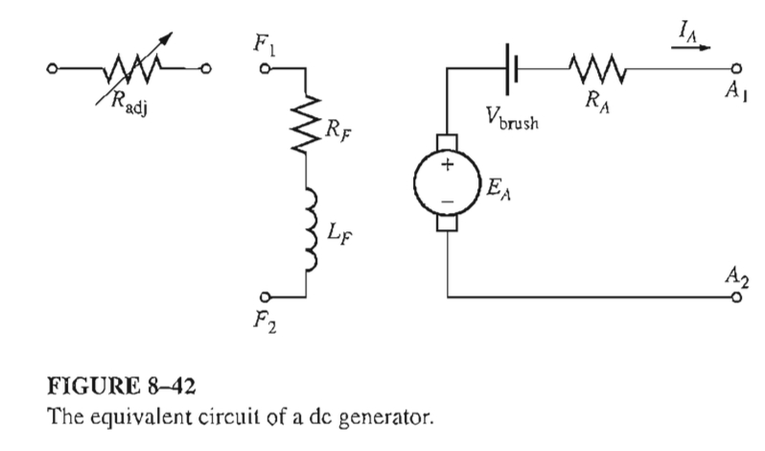
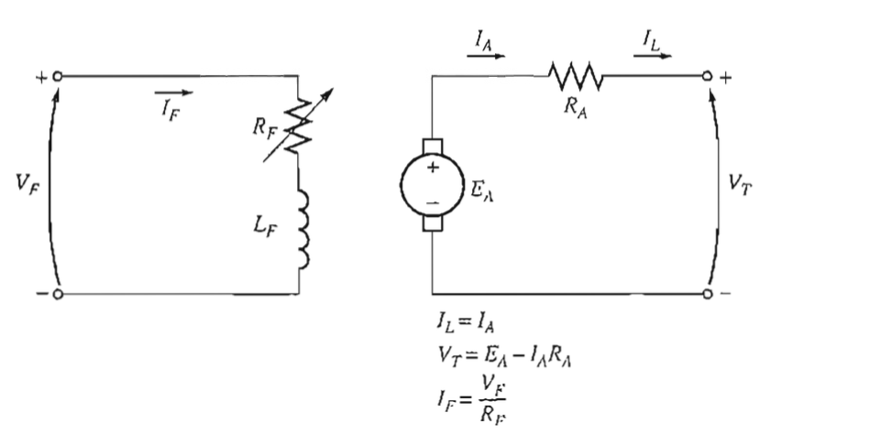
9.12: Separately Excited DC Generator

Slide 5
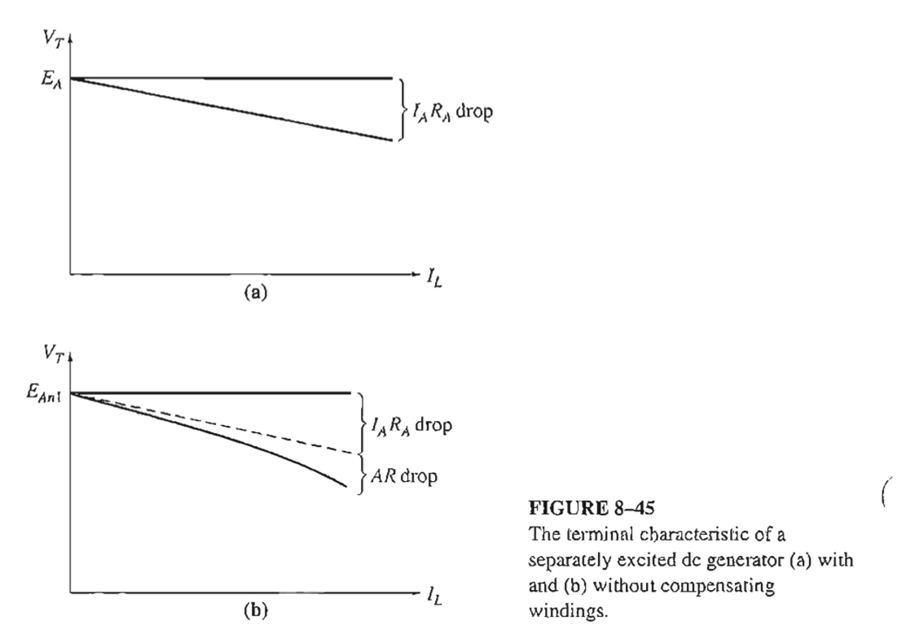
The Terminal Characteristics of a Separately Excited DC Generator

Slide 6
Terminal Voltage Control of Separately Excited DC Generator
There are two methods :
Change the speed of rotation
Change the field resistance

Slide 7
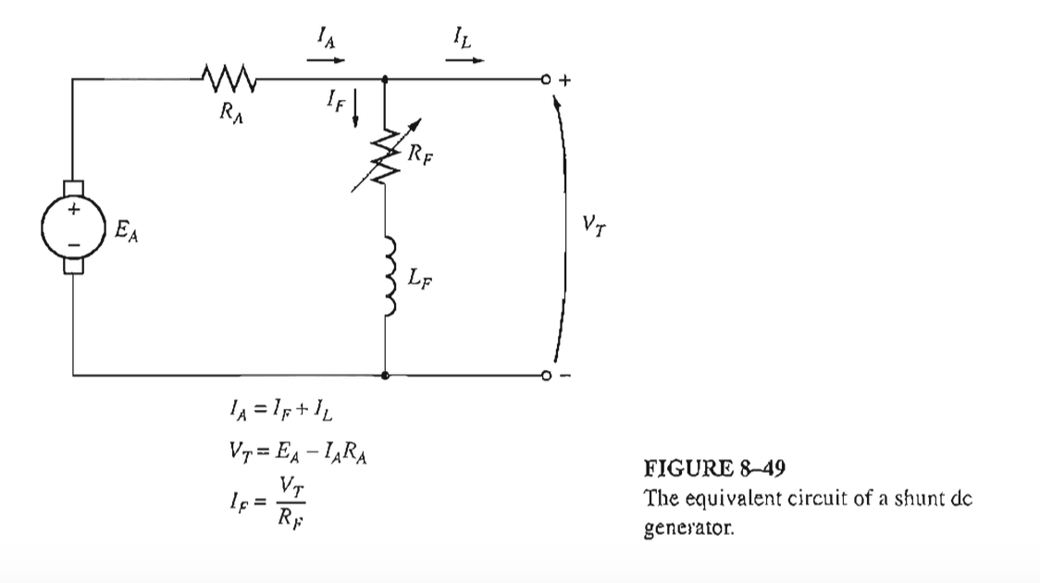

9.13: Shunt DC Generator

Slide 8
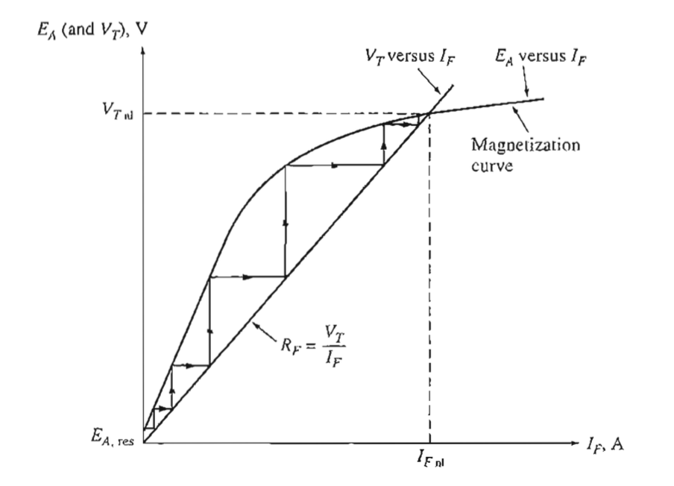
Voltage Buildup in a Shunt DC Generator
There are several possible causes for the voltage to fail to buildup during starting
(1). There may be no residual magnetic flux in the generator to start the process.
(2). The direction of rotation of generator may have been reversed or the connections of the field may have been reversed
(3). The field resistance may be adjusted to a value higher than a critical resistance

Slide 9
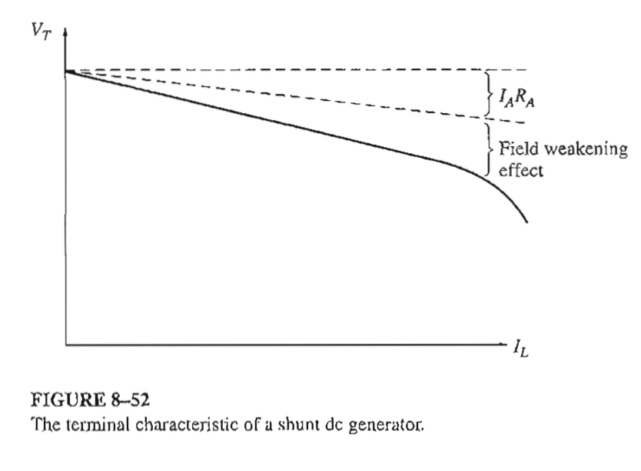
The Terminal Characteristics of a Shunt DC Generator

Slide 10
Terminal Voltage Control of Shunt DC Generator
There are two methods :
Change the speed of rotation
Change the field resistance

Slide 11
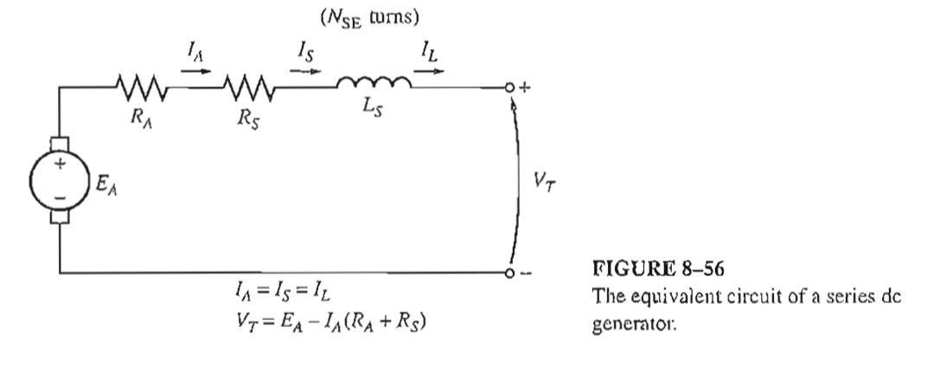
9.14: The Series DC Generator

Slide 12
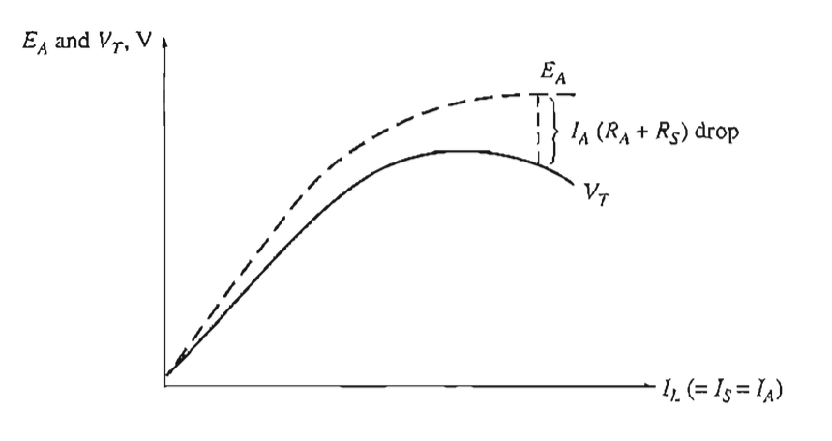
The Terminal Characteristics of a DC Series Generator

Slide 13
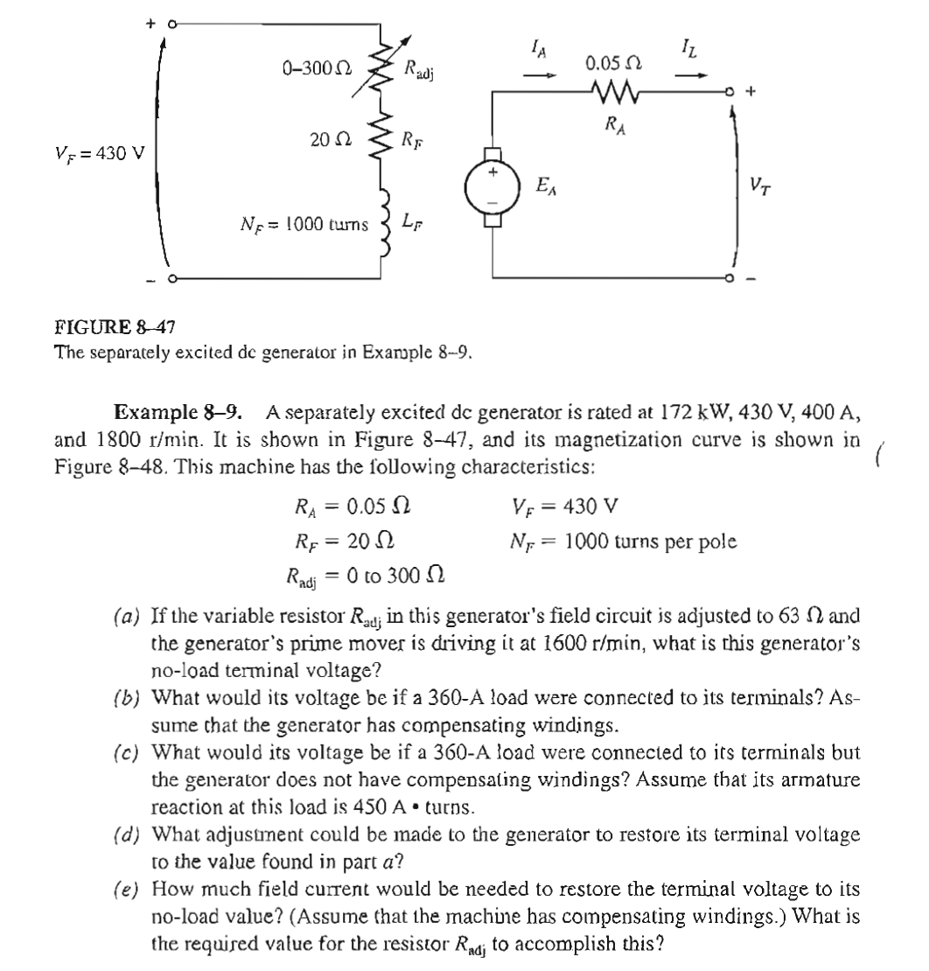
Activity

Slide 14
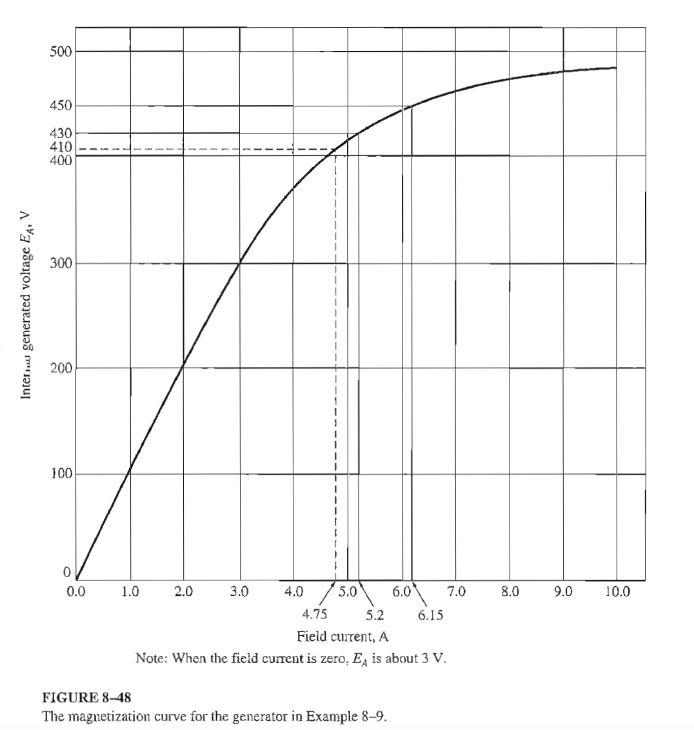
Activity

Slide 15
THE END

