Slide 1

School of Electrical Engineering and Computer Science
Department of Electrical Engineering
EE-260 : Electro-Mechanical Systems(EMS)
Lecture#41
Text Book: Chapter 10 Special Purpose Motors
(Stephen J. Chapman 4th Ed)
Instructor: Ms Neelma Naz
Class: BEE 12 C/D

Slide 2
Chapter # 10
Single Phase and Special Purpose Motors

Slide 3
An Introduction
Most home and small business do not have three phase power available. Also the power requirement of the machine is quite low in the range of a fraction of horse power. For such locations and applications all motors must run form single-phase power.
The major types of these motors are:
  Single phase induction motor
  Universal motor
  Reluctance motor
  Hysteresis motor
  Stepper motor
  Brushless dc motors

Slide 4
An Introduction
The major problem associated with the design of single-phase induction motor is that, unlike three-phase power sources, a single phase source does not produce a rotating magnetic field. Instead, the magnetic field produced by a single phase source remains stationary and pulses with time.
Since there is no net rotating magnetic field, conventional induction motors can’t function, and a special design is necessary.

Slide 5
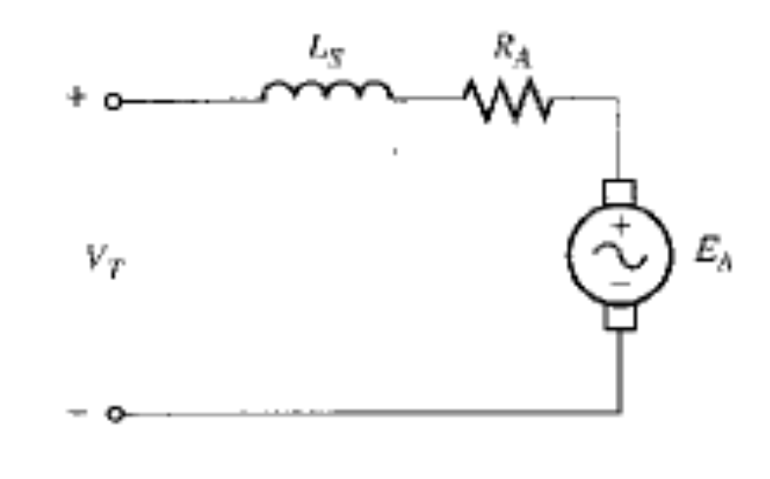
The Universal Motor
Perhaps the simplest approach to the design of a motor that will operate on a single-phase ac power source is to take a dc machine and run it from an ac supply.
If the polarity of the voltage applied is reversed, both the direction of the field flux and the direction of armature current reverses, while the resulting induced torque continues in the same direction as before.
Therefore it should be possible to achieve a pulsating but unidirectional torque from a dc motor connected to an ac power supply.

Slide 6
The Universal Motor
This type of design is practical only for the series dc motor. Since the armature current and the series current must reverse exactly the same time.
For shunt dc motors, the very high field inductance tends to delay the reversal of the field current and thus unacceptably reduce the average induced torque of the motor.
In order for a series dc motor to function effectively on ac, its field poles and stator frame must be completely laminated.
If they were not completely laminated, their core losses will be enormous.
When the poles and stator are laminated, this motor is often called universal motor, since it can run form either an ac or a dc source.

Slide 7
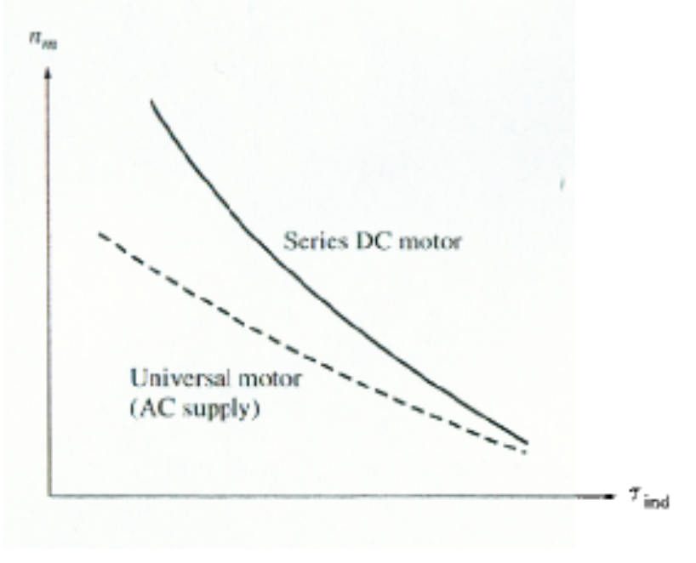
Application of Universal Motors
The universal motor has sharply drooping torque-speed characteristics of a dc series motor, so it is not suitable for constant-speed applications.
However, it is compact and gives more torque per ampere than any other single phase motor.
The Universal motors are used where light weight and high torque are important.
Typical applications for this motor are vacuum cleaners, drills, similar tools and kitchen appliances.

Slide 8
10.6: Other Types of Motors
Reluctance and Hysteresis Motor: These motors differ in rotor construction from the ones previously described, but use the same stator design. Like induction motor they can be build either single or three phase stators.
Stepper Motor: A stepper motor requires a poly-phase stator, but it does not require a three phase power supply.
Brushless DC Motor: This motor as the name suggests does not have carbon brushes and still runs on dc power supply.

Slide 9
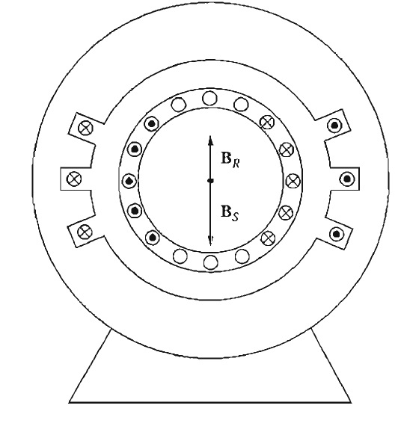
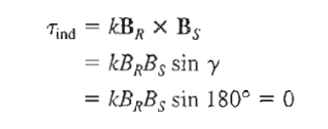
Single Phase Induction motor
Single-phase induction motors suffer from a severe handicap.
Since there is only one phase on the stator winding, the magnetic field in a single-phase induction motor does not rotate.
Instead, it pulses, getting first larger and then smaller, but always remaining in the same direction.
Because there is no rotating stator magnetic field , a single-phase induction motor has no starting torque.
Single
Phase Induction Motor
Split Phase
Capacitor
Shaded Pole

Slide 10
Stepper Motors
A stepper motor is a special type of synchronous motor which is designed to rotate a specific number of degrees for every electric pulse received by its control unit, typical steps are 7.5 or 15º per pulse.
These motors are used in many control systems, since the position of a shaft or other piece of machinery can be controlled precisely with them.

Slide 11
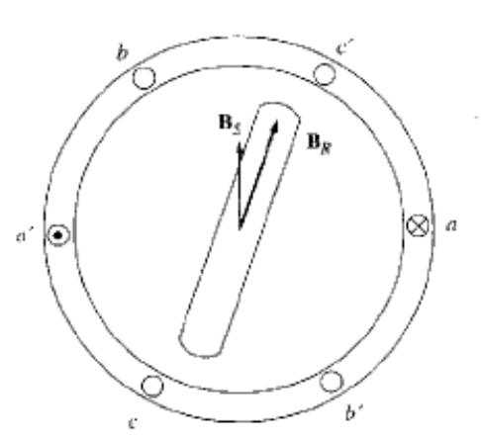
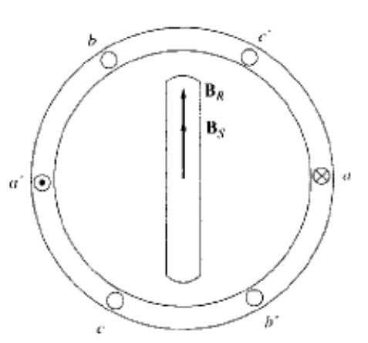
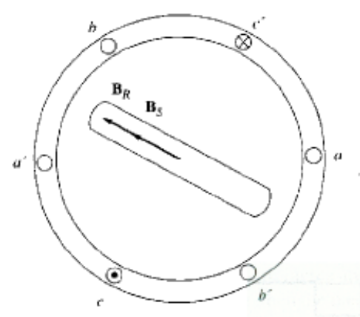
Stepper Motors
To understand the operation of a stepper motor, consider a two pole three-phase stator with a permanent magnet rotor.
If a dc voltage is applied to phase a of stator and no voltage is applied to phases b and c, then torque will be induced in the rotor which causes it to line up with the stator magnetic field B_{S}.
Now assume that phase a is turned off and a negative dc voltage is applied to phase c.
The new stator magnetic field is rotated by 60º and with respect to the previous magnetic field, and the rotor of the motor will follow it around.
Θm=(2/P)θe

Slide 12
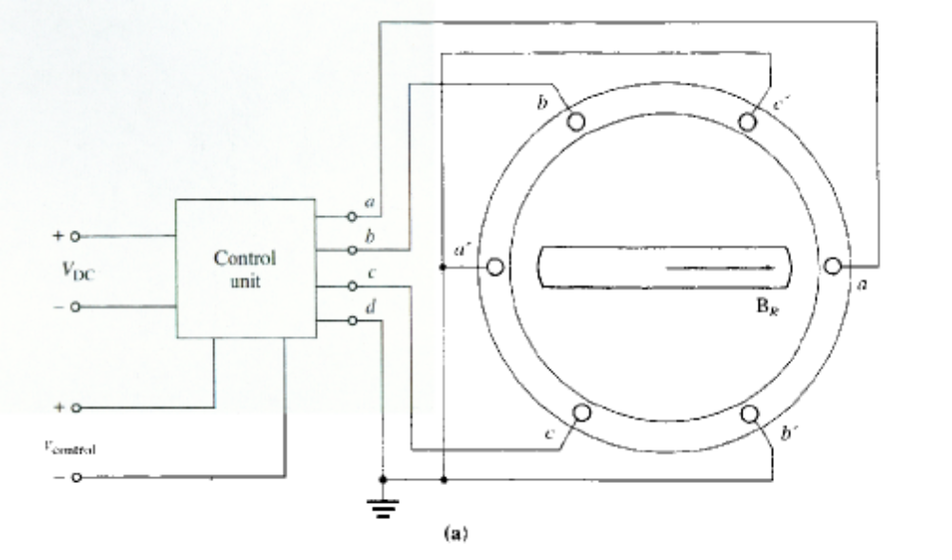
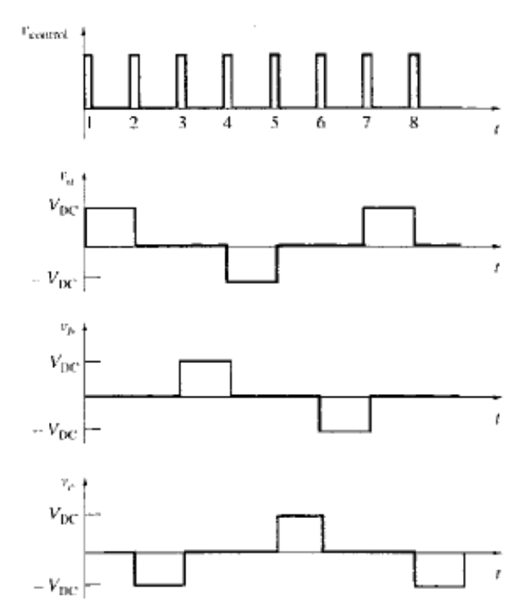
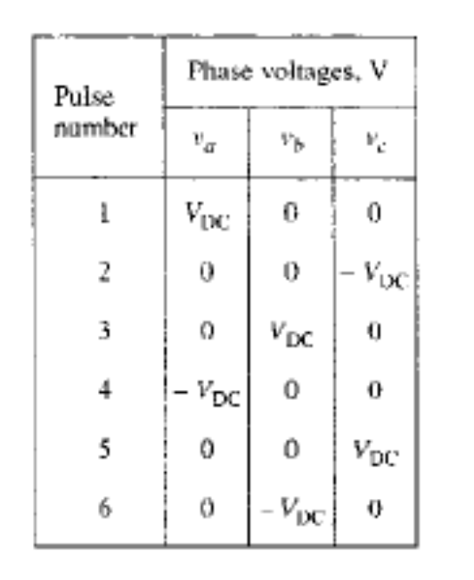

Slide 13
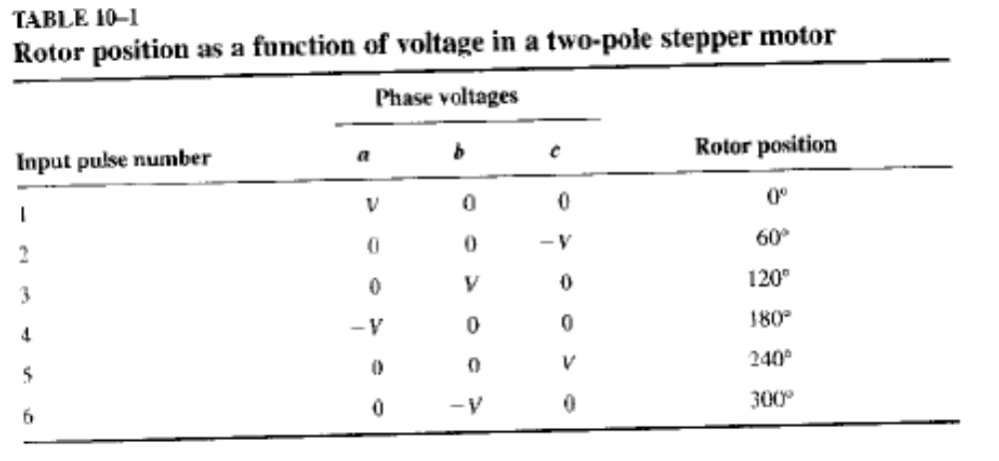
Stepper Motors
If the voltage produced by the control unit changes with each input pulse in the order shown in the Table, then the stepper motor will advance by 60º with each input pulse.

Slide 14
Brushless DC Motors
Conventional dc motors have traditionally been used in applications where dc power sources are available, such as on aircraft and automobiles. However, small dc motors of these types have number of disadvantages such as:
  The principle disadvantage is excessive sparking and brush wear.
  The high rotational speed of these motors causes increased brush wear and require regular maintenance every few thousand hours.
  If the motor must work in low pressure environment such as high altitudes in an aircraft, brush wear can be so bad that the brush require replacement after less than an hour.
  Consider a dc motor in an artificial heart--regular maintenance would require opening the patient’s chest.
  In other applications, the sparks at the brushes may creates an explosion danger.

Slide 15
Brushless DC Motors
For all such cases there is a need for a small, fast dc motor that is highly reliable and has low noise and long life.
Such motors are called Brushless dc motors, they are more like a permanent magnet stepper motor with a rotor position sensor and solid-state electronics switching circuit.
These motors are called brushless dc motors because they run from a dc power sources but don’t have commutators and brushes.
The rotor of a brushless dc motor is similar to that of a stepper motor, except that it is nonsalient. The stator can have three or more phases

Slide 16
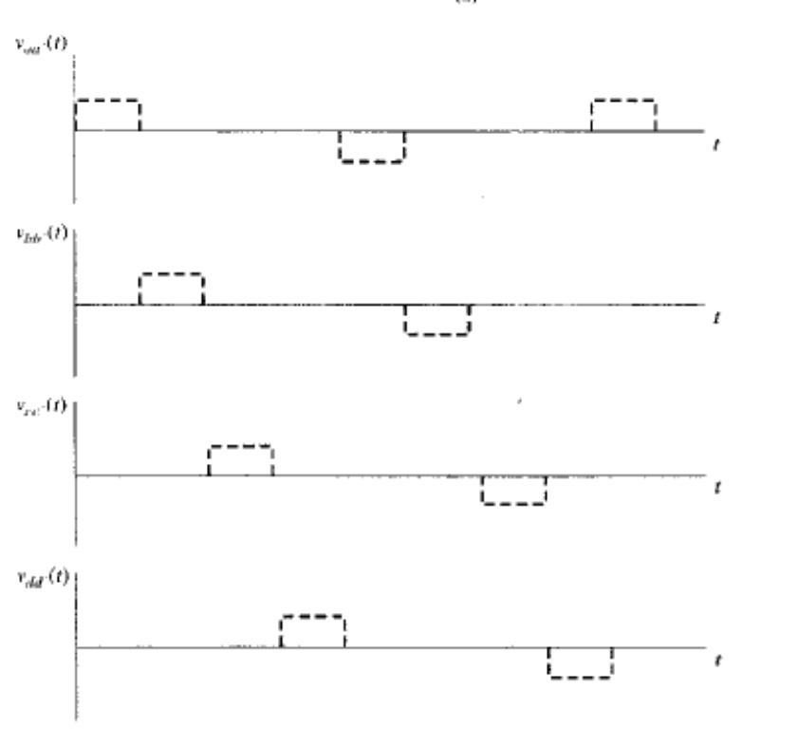
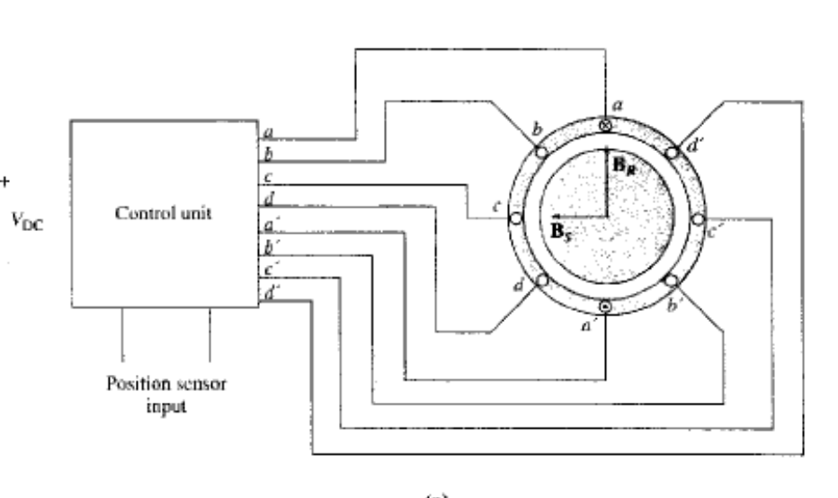
Brushless DC Motors

Slide 17
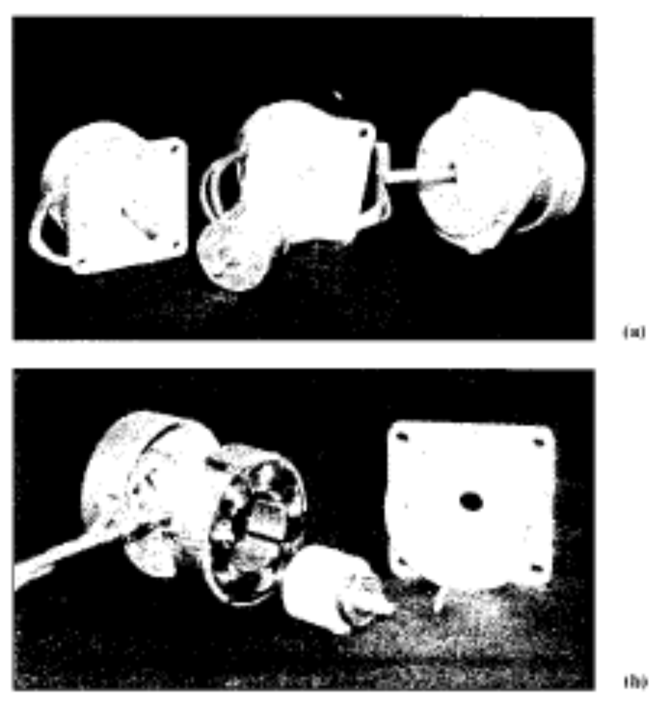
Brushless DC Motors

Slide 18

Brushless DC Motors
The basic components of a brushless dc motor are:
  The permanent magnet rotor
  A stator with three, four or more phase winding
  A rotor position sensor
  An electronic circuit to control the phases of rotor winding.
A brushless dc motor functions by energizing one stator coil at a time with a constant dc voltage. When a coil is turned on, it produces a stator magnetic field B_{S}, and a torque is produced on the rotor given by:
Which tends to align the rotor with the stator magnetic field.
At the time shown in the Figure, the stator magnetic field B_{S} points to the left and while the permanent magnet rotor magnetic field B_{R} points up, producing a counterclockwise torque on the rotor. As a result the rotor will turn to left.

Slide 19
Brushless DC Motors
If the coil a remains energized all of the time, the rotor would turn until the two magnetic fields are aligned, and then it will stop, just like a stepper motor.
The key to the operation of brushless dc motor is that it includes a position sensor, so that the control circuit will know when the rotor is almost aligned with the stator magnetic field. At that time coil a will be turned off and coil b will be turned on causing the rotor to again experience a counterclockwise torque, and to continue rotating.
This process continues indefinitely with the coils tuned on in the order a, b, c, d, -a, -b, -c, -d, etc., so the motor turns continuously.

Slide 20
Brushless DC Motors
The electronics of the control circuit can be used to control both the speed and direction of the motor.
The net effect of this design is a motor that runs from a dc power source, with full control over both the speed and direction of rotation.
Brushless dc motors are available only in small size, up to 20 W or so, but they have many advantages in the size over which they are available. Some of the major advantages include:
  Relatively high efficiency.
  Long life and high reliability
  Little or no maintenance.
  Very high speeds are possible, greater than, 50,000 rpm.
The principle disadvantage is that a brushless dc is more expensive than a comparable brush dc motor.

Slide 21


