Slide 1

School of Electrical Engineering and Computer Science
Department of Electrical Engineering
EE-260 : Electro-Mechanical Systems(EMS)
Lecture#05
Text Book: Chapter 01 (Stephen J. Chapman 4th Ed)
Instructor: Ms Neelma Naz
Class: BEE 12 C/D

Slide 2
The Linear DC Machine.
A Simple Example

Slide 3
Topics to be Covered
Linear Dc Machine- A simple example page#36
Starting of linear DC Machine page#37
The linear DC Machine as MOTOR page#39
Starting problem with Linear DC Machine page#42
The linear DC Machine as GENERATOR page#41
Real, Reactive and Apparent power page#47

Slide 4
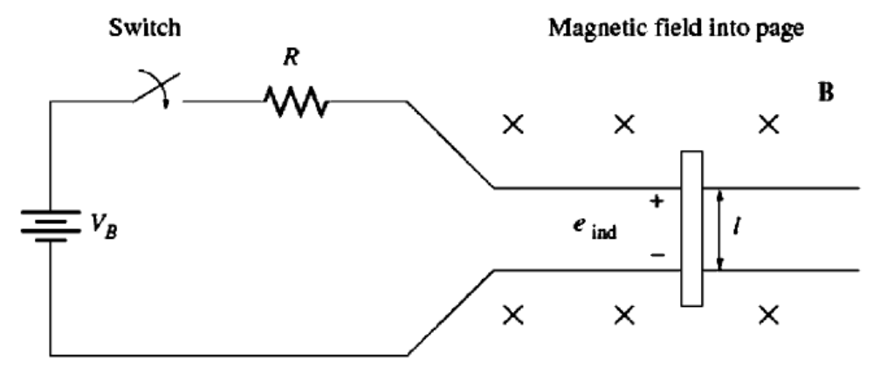
1. The Linear DC Machine- A Simple Example
switch
Magnetic field into the page
+
_
frictionless rails

Slide 5


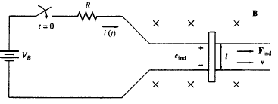


1. The Linear DC Machine- A Simple Example
Behavior of this device can be determined from application of four basic equations:
1. The equation of force on a current carrying wire in the presence of a magnetic field:
2. The equation for the voltage induced on a wire moving in a magnetic field:
3. Kirchoff’s voltage law for this machines is:
4. Newton’s Law for the bar across the track is:

Slide 6
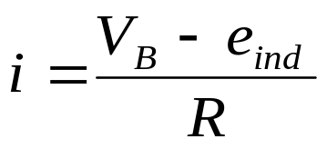



1(a). Starting of Linear DC Machine
When the switch is closed, current in the bar by KVL:
Initially the bar is at rest so v=0;
e_{ind} = 0 and i = V_{B}/R
Due to current in the bar and existence of magnetic field force is induced on the bar… to the right
or
When the bar is accelerated to velocity v , a voltage is induced in the bar.
or
Positive upwards
This induced voltage will reduce the current.

Slide 7
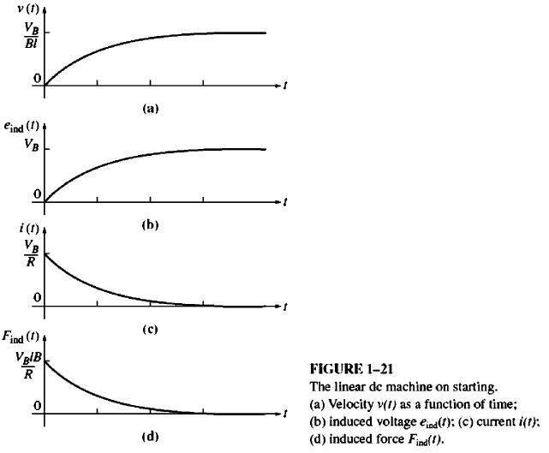
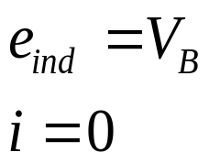
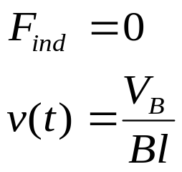
1(a). Linear DC Machine on Starting
5. As current is decreasing so Find decreases.
6. It will happen untill
7. The bar moves at a constant no-load speed, V_{B}/Bl

Slide 8


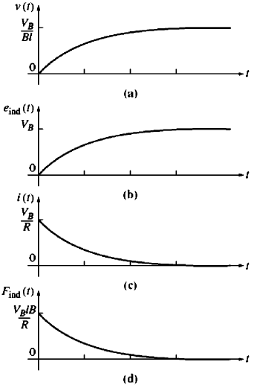
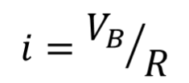
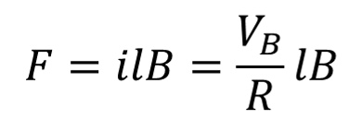
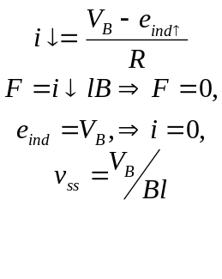



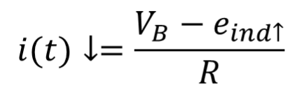







1(a). The Linear DC Machine-Starting
The bar moves at a constant no-load speed, V_{B}/Bl

Slide 9
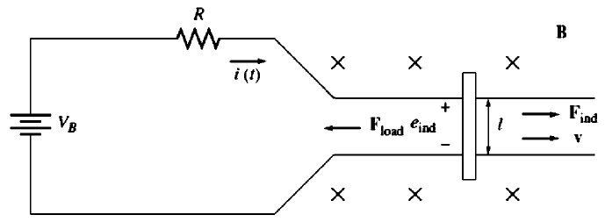

1(b). The Linear DC Machine- As a Motor
v(t) : velocity of the bar
e_{ind}(t) : induced voltage in the bar
i(t) : current through the bar;
F_{ind}(t) : induced force on the bar.

Slide 10
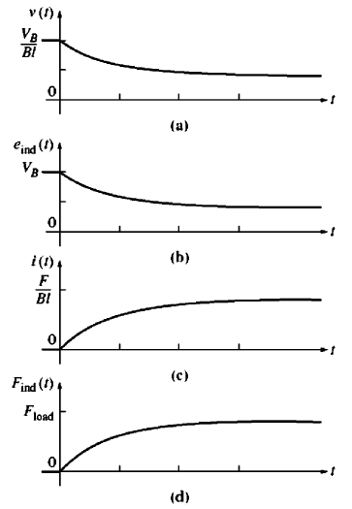
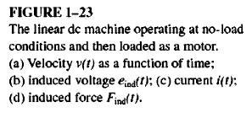
1(b). The Linear DC Machine- As a Motor
When the motor is loaded a force F_{load} is applied in direction opposite to the direction of motion.
The bar decelerates and slows down.
The induced voltage decreases and thus the current increases.
Due to increased current F_{ind} is increased until F_{ind} = F_{load} .
At this point , bar keeps moving but at lower speed.
An electric power e_{ind}i is now being converted to mechanical power F_{ind}v, and machine is acting as a motor.

Slide 11
1(b). The Linear DC Motor under Loading

Slide 12
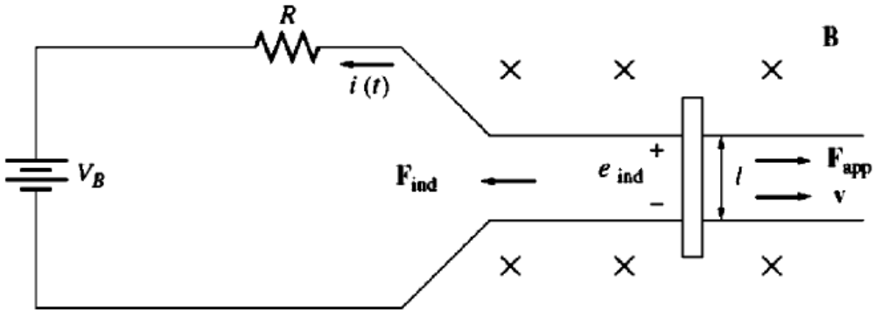
1(c). Linear DC Machine as a Generator
A force F_{app} is applied in the direction of motion of the conductor.
The bar speeds up, means v increases .
The voltage e_{ind} = vBl increases.
The current increases I = (e_{ind}-V_{b})/R, but in reverse direction.
The induced force F_{ind}= ilB increases until |F_{ind}|=|F_{app}| at a higher speed v.
An amount of mechanical power equal to F_{ind}v is now being converted to electric power e_{ind}*i and the machine is acting as a generator.

Slide 13
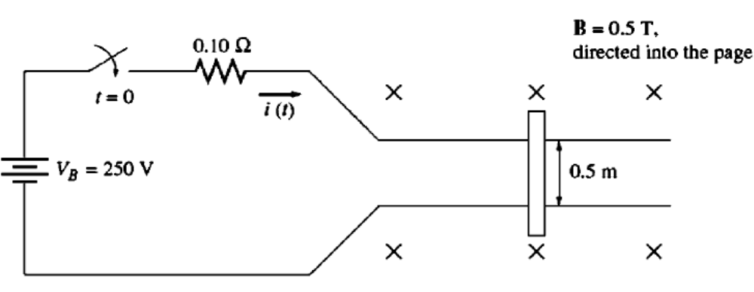
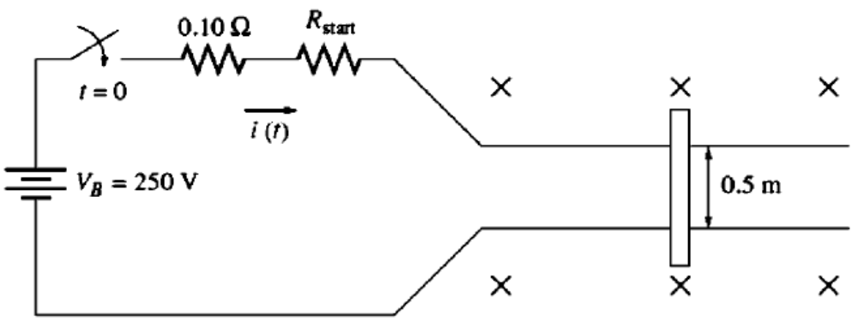
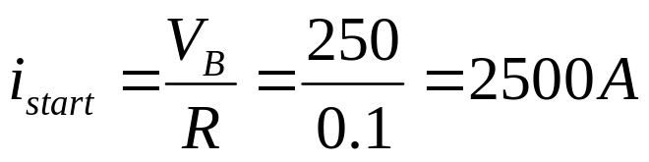
1(d). The Linear DC Machine Starting Problem
A linear DC Machine shown in the Figure is supplied by a 250- V DC source, and its internal resistance R is given by 0.10 Ω.
The resistance R models the internal resistance of the DC machine, and this is fairly reasonable internal resistance for a medium size dc motor.

Slide 14
Home Work
Example 1-10 &
Read Section 1.9. Real , Reactive & Apparent
Power In Ac Circuits

Slide 15
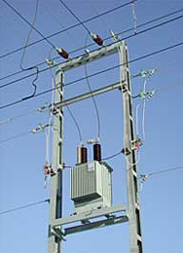
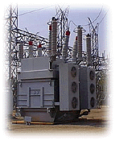
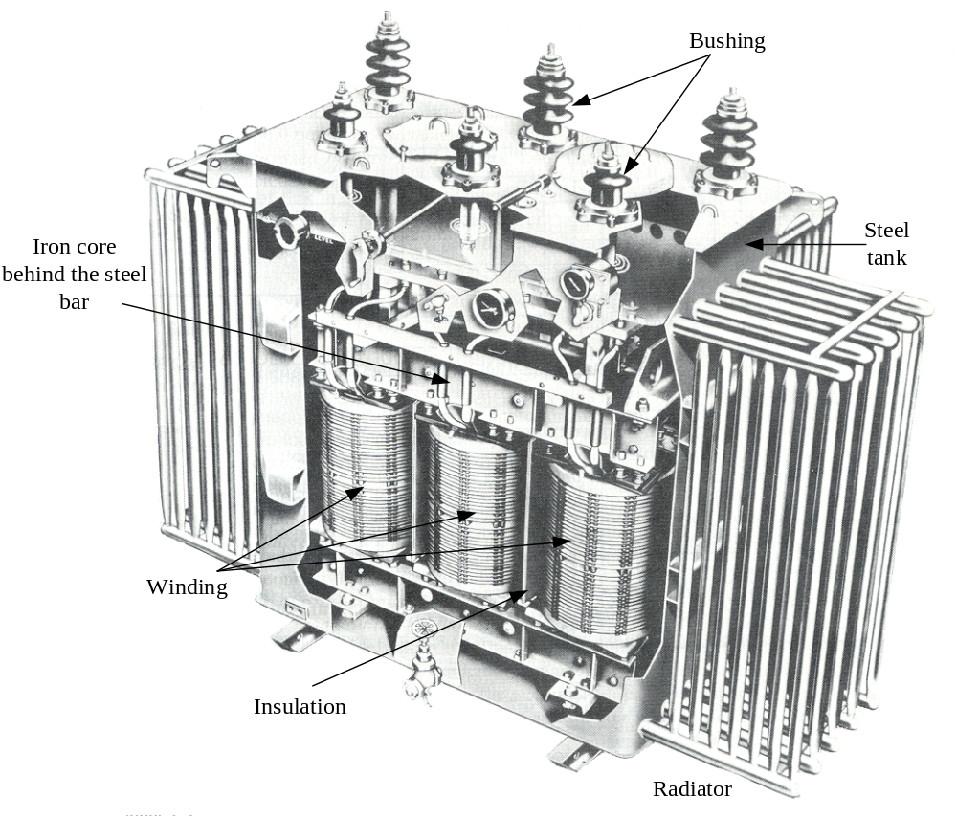
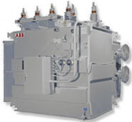
Transformers

Slide 16
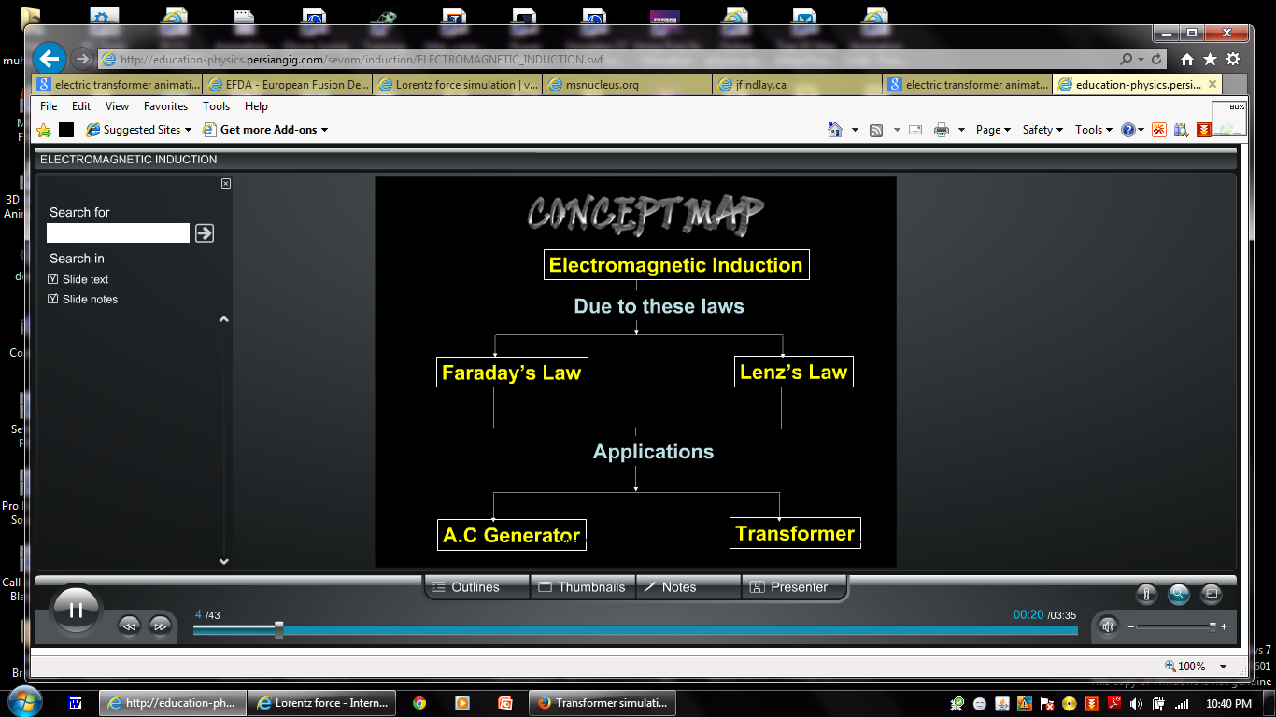

Slide 17
1. WHY TRANSFORMER ARE IMPORTANT TO MODERN LIFE
The first power distribution system in U.S was invented by Thomas A. Edison in 1882.
It was 120V dc system to supply power for incandescent light bulbs.
The power was transmitted at very low voltage level.
To avoid this problem power stations were located for every few blocks of the city.
The invention of transformer and concurrent development of ac power sources eliminated these restrictions forever.

Slide 18
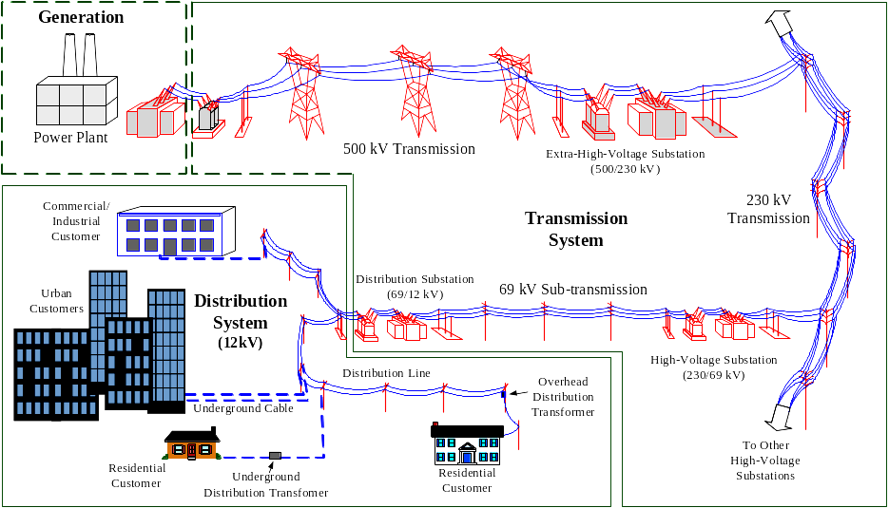
1. WHY TRANSFORMER ARE IMPORTANT TO MODERN LIFE (cont….

Slide 19
1. WHY TRANSFORMER ARE IMPORTANT TO MODERN LIFE

Slide 20
1. WHY TRANSFORMER ARE IMPORTANT TO MODERN LIFE

Slide 21
1. WHY TRANSFORMER ARE IMPORTANT TO MODERN LIFE

Slide 22
1. WHY TRANSFORMER ARE IMPORTANT TO MODERN LIFE

Slide 23
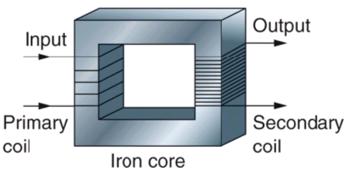
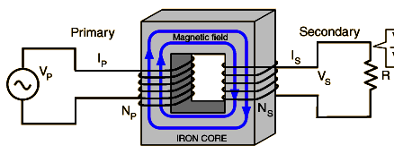
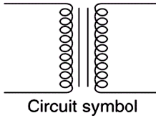
2. Construction of Transformer
A transformer is a device that changes ac electric power from one voltage level to another voltage level through the action of magnetic field. It has two windings on a ferromagnetic core.
  Primary winding – energized by connecting it to an input source
  Secondary winding – to which an electrical load is connected and from which output energy is drawn.

Slide 24
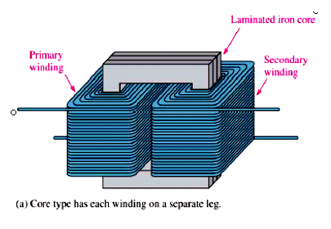
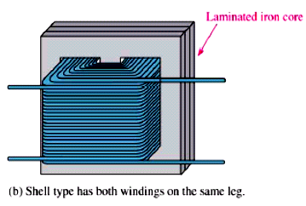
2. Types of Transformers w. r. t. Core Design
With respect to the core of the transformer, there are two types of the transformers:

Slide 25
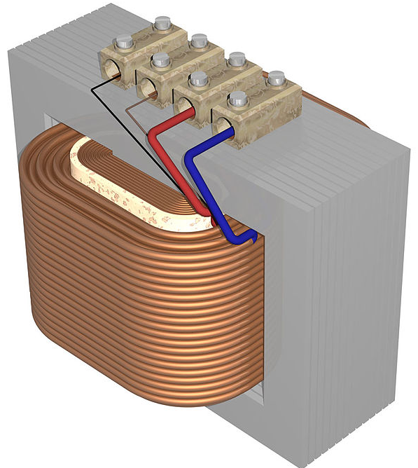
2. Types of Transformers w. r. t. Core Design (cont…..
The primary and secondary windings in a physical transformer are wrapped one on the top of the other with low voltage winding innermost. Such an arrangement serves two purposes:
  It simplifies the problem of insulating the high voltage winding from the core.
  It results in much less leakage flux than would be in the case if the two windings were separated by a distance on the core.
8

Slide 26
2. Types of Transformers w. r. t. Applications(cont…..
Unit Transformer: To step up the voltage at generation.
Substation Transformer: To step down voltage from transmission to distribution level.
Distribution Transformer: Takes distribution voltage and steps it down to final voltage at which the power is used.
Potential Transformer/Voltage Transformer (PT/VT): Is used to change the high voltage to low voltage, but can handle very small current.
Current Transformer (CT): Is used to change the primary current to much smaller secondary current but the current is directly proportional to the primary current.
Types 4 and 5 are used for instrumentation.

Slide 27

Conclusion
Linear Dc Machine- A simple example page#36

