Slide 1

School of Electrical Engineering and Computer Science
Department of Electrical Engineering
EE-260 : Electrical Machines
Lecture#07
Text Book: Chapter 02 (Stephen J. Chapman 4th Ed)
Instructor: Ms Neelma Naz
Class: BEE 12 C/D
2.4 THE Real Single Phase TRANSFORMERs
2.5 THE EQUIVALENT CIRCUIT OF A TRANSFORMER

Slide 2
Topics to be Covered
Real single phase transformers
Voltage across a Real Transformer
Magnetization current in Real Transformers
Hysteresis and eddy currents in real transformers
Current Ratio and Dot Convention

Slide 3
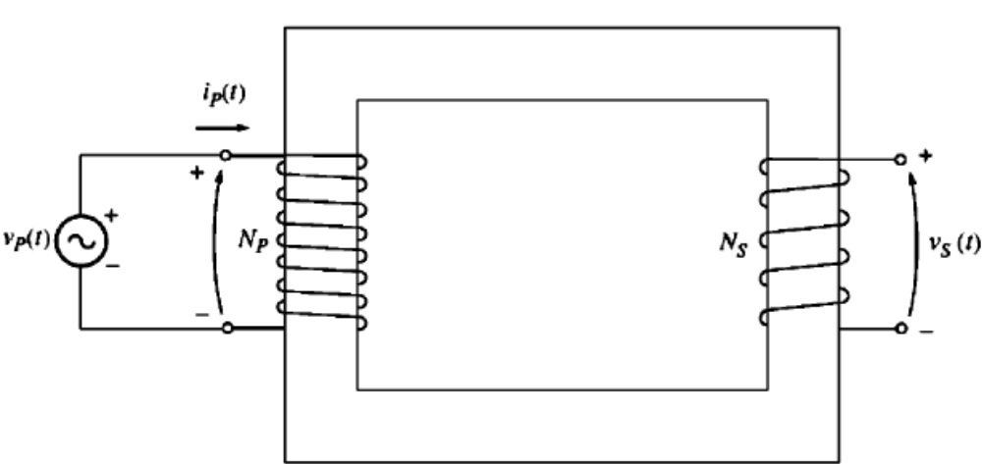
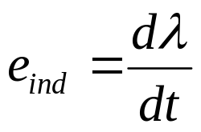
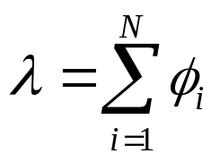
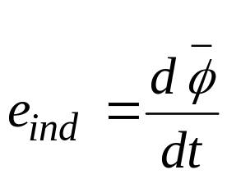
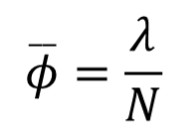
1. Real Single Phase Transformer
Primary connected to an AC source and secondary is open circuited
λ is the flux linkage in the coil across which voltage is being induced.
Total flux linkage is the sum of the flux passing through each turn in the coil added over all turns of the coil.
Thus
The average flux can be expressed as:

Slide 4
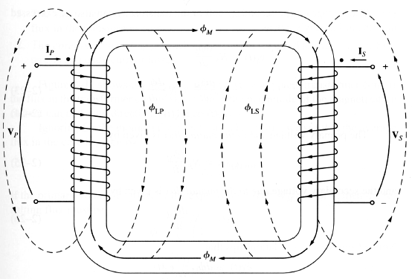
1. Real Single Phase Transformer (cont…
Figure 2-10
Page 79
Leakage flux: (φ_{L}) Flux that goes through one of the transformer windings but not the other one winding and not part of core flux
Mutual flux: (φ_{M}) Flux that remains in the core & links both windings

Slide 5
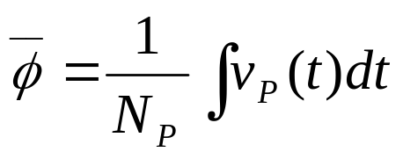
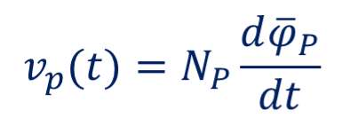
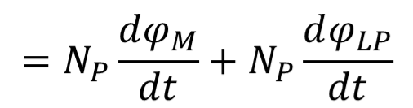
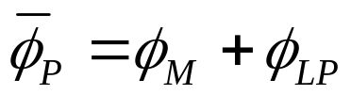

2.The Voltage Ratio Across a Real Transformer
When the voltage is applied on the primary side of the transformer then the average flux produced by this voltage is:
Some of the flux lines leave the iron core and pass through the air
The flux that goes through one of the transformer coils but not the other one is leakage flux.
The flux in the primary coil can be divided into two components

Slide 6
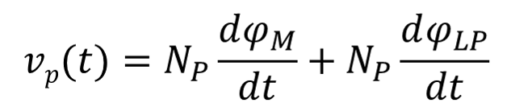
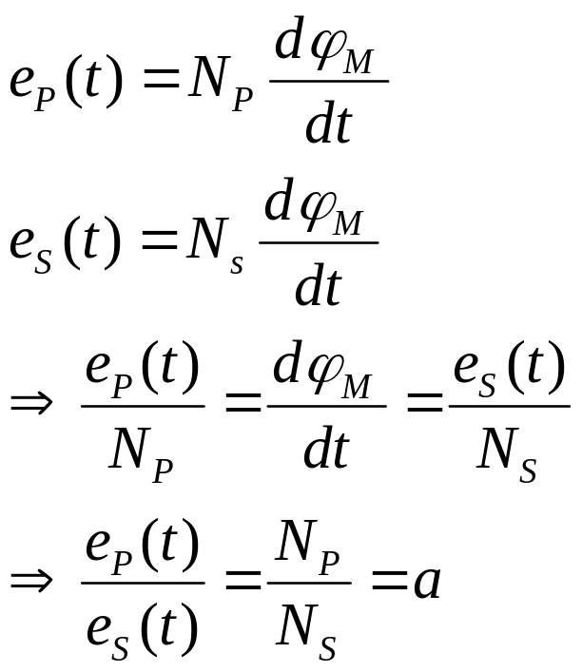

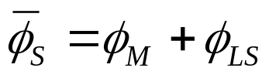
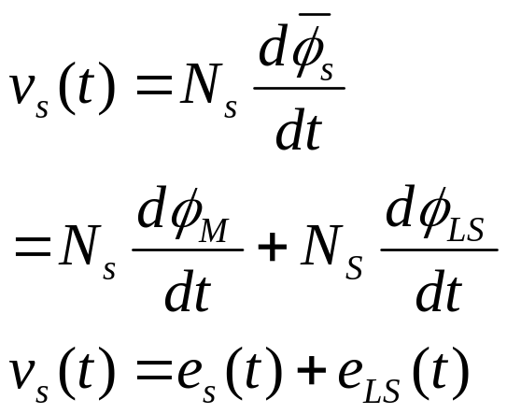
2.The Voltage Ratio Across a Real Transformer (cont…
From these equations it is obvious that:
For secondary side:
The ratio of the primary voltage caused by the mutual flux to the secondary voltage caused by the mutual flux is equal to the turn ratio of the transformer.

Slide 7
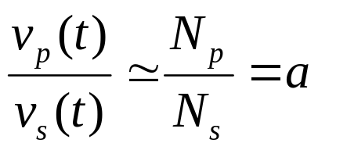
2.The Voltage Ratio Across a Real Transformer (cont….
In a good design Ø_{M} >> Ø_{LP} and Ø_{M} >> Ø_{LS.} Therefore, ratio of the total voltage on the primary of transformer to the ratio of the total voltage on the secondary of a transformer is approximately given as :
Resembles the ideal transformer.
The smaller the leakage flux, the closer the transformer will be to the ideal one.

Slide 8
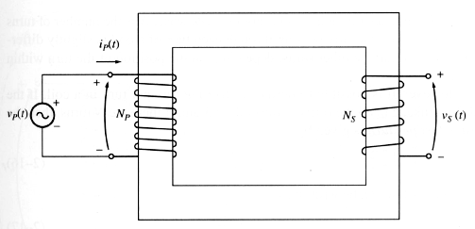
3. The Magnetization Current in Real Transformer
Open circuit (connected to the
source but load not connected).
No secondary current
When an ac power source is connected to a transformer, a current flows in its primary windings, even when the secondary winding is open (No-Load).
This no-load current is required to produce flux in the ferromagnetic core and is called excitation current (i_{ex} ) or no-load current (I_{O}). It has of two components:
The magnetization current (I_{m} ), which is the current required to
produce the flux in the transformer core
2. The core-loss current (I_{h+e} ), which is the current required to
make up for hysteresis and eddy current losses

Slide 9
3. The Magnetization Current in Real Transformer (cont…
If the value of the current required to produce a given flux is known then it is possible to construct the sketch of magnetizing current in the winding of the core.

Slide 10
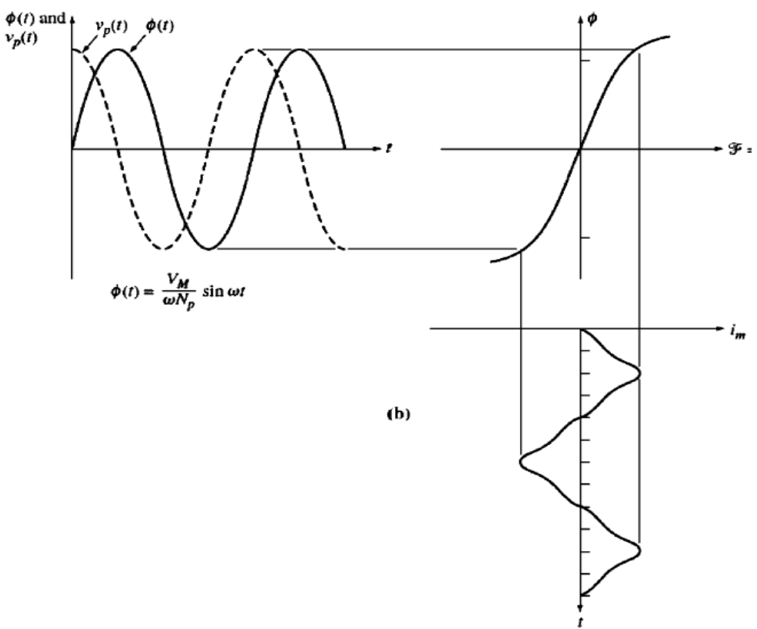
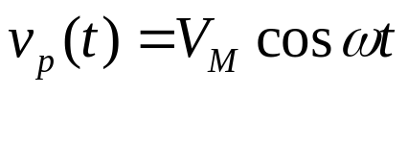
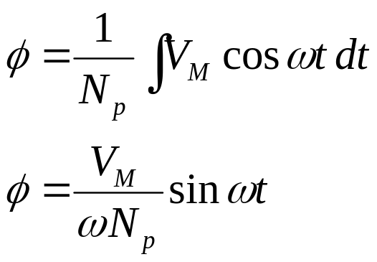
The magnetization current in the transformer core
1. The Magnetization Current in Real Transformer (cont…

Slide 11
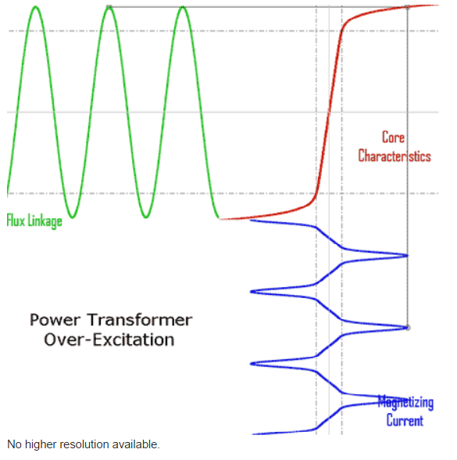
The magnetization current in the transformer core
1. The Magnetization Current in Real Transformer (cont…
http://en.wikipedia.org/wiki/File:Power_Transformer_Over-Excitation.gif

Slide 12
Observations:
    The magnetization current, i_{m}, in the transformer is not sinusoidal.
    Once the peak flux reaches the saturation point in the core, a small increase in the peak flux requires very large increase in the peak magnetization current, i_{m}.
    The magnetization current lags voltage applied by 90˚.

Slide 13
2.The Hysteresis and Eddy Current in Real Transformer
This is the current required to supply power to make up the hysteresis and eddy current losses in the core, known as core loss current.
Since the eddy currents are proportional to the rate of change of flux. Therefore, the eddy currents are largest when the flux is passing through the 0.

Slide 14
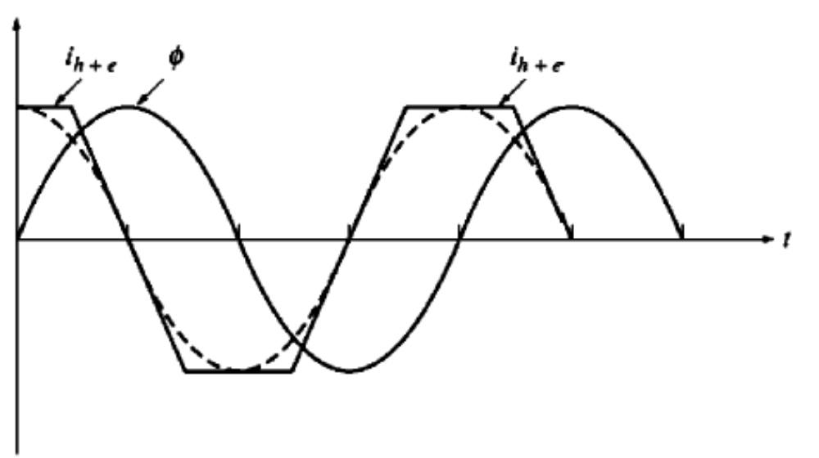
The core-loss current in a transformer
2.The Hysteresis and Eddy Current in Real Transformer (cont…
12

Slide 15
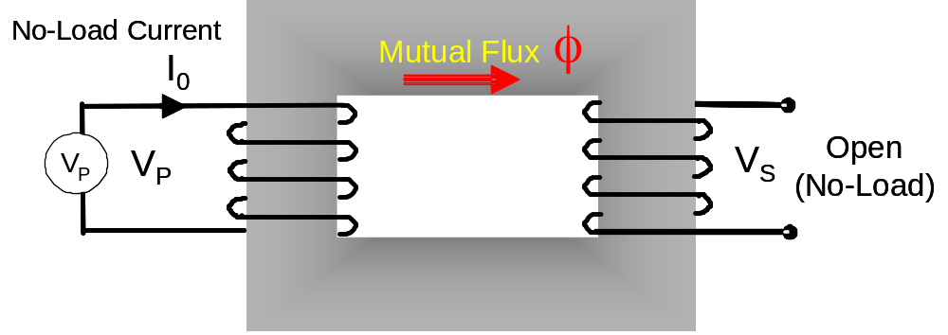
2.The Hysteresis and Eddy Current in Real Transformer (cont…
Excitation current, I_{o}= I_{ex}= I_{c} + I_{M} (Vector sum)
Core-loss current I_{C} = I_{h+e} (current required to make up for hysteresis and eddy current losses) - Resistive
Magnetization current I_{M} (current required to produce flux in the core) - Inductive
I_{c}
V_{P}
θ_{o}
I_{M}
I_{o}
Note: The eddy currents will be maximum when the core flux is passing through zero (i_{eddy} leads φ by 90⁰ ).
φ
I_{c} = I_{h+e} = Core loss α V_{P}
I_{M} α φ
13

Slide 16
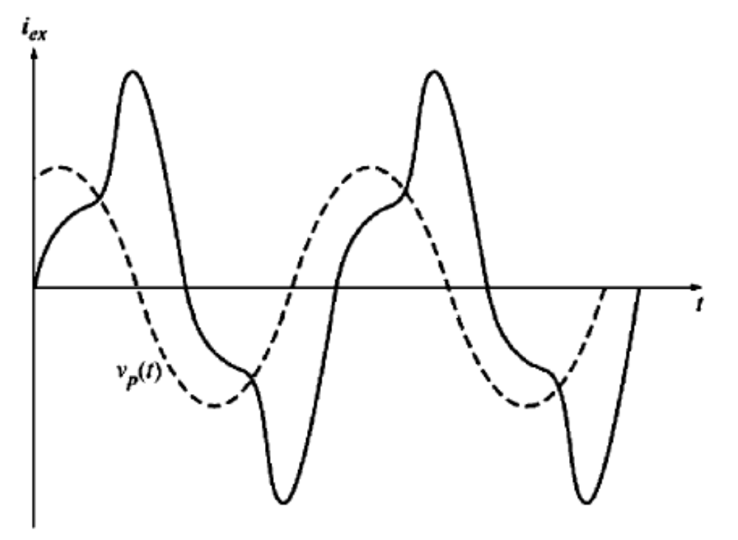
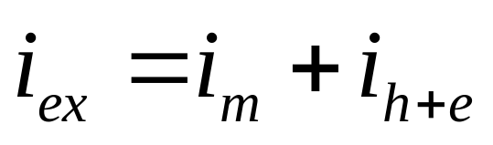
The Total No Load (Excitation) Current in Real Transformer
The total excitation current in a typical transformer core

Slide 17
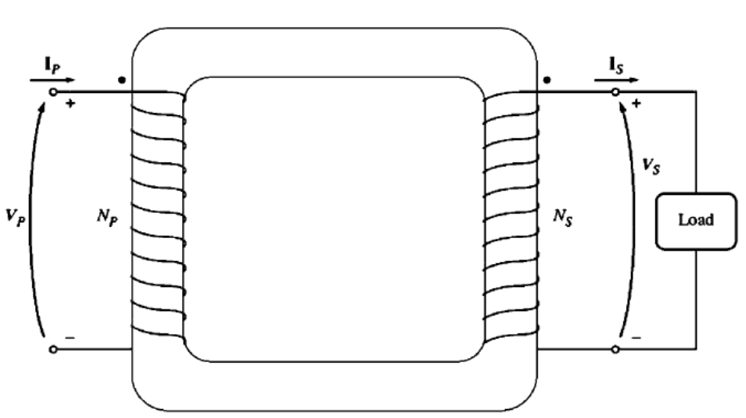
3. The Current Ratio & Dot Convention
Connect a load on the secondary side of the transformer.
A current flowing into the dotted end of the transformer produces a positive mmf.

Slide 18
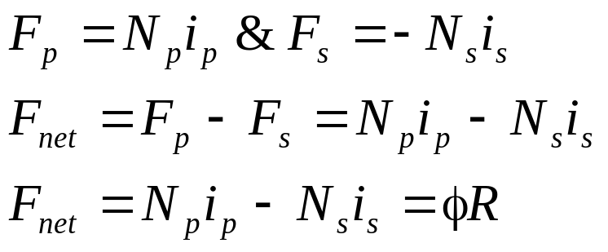
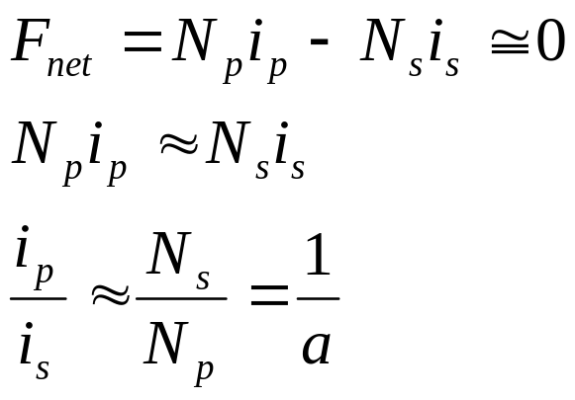
3. The Current Ratio & Dot Convention (cont…
A current flowing into the dotted end produces +ve mmf, while a current flowing into the undotted end produce a –ve mmf.
If both currents are entering the dotted end, the mmf will add to each other.
If one current enters and the other one leaves then the mmf will subtract from each other.
For a good designed transformer, R should be very small nearly zero, as long as the core is operating in unsaturated region.
In order for mmf to be zero, current must flow in to the one dotted end and out of the other dotted end.

Slide 19
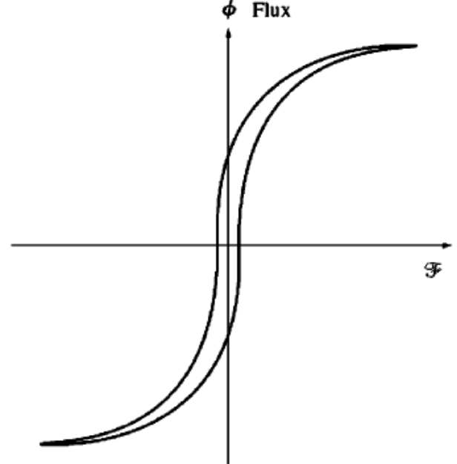
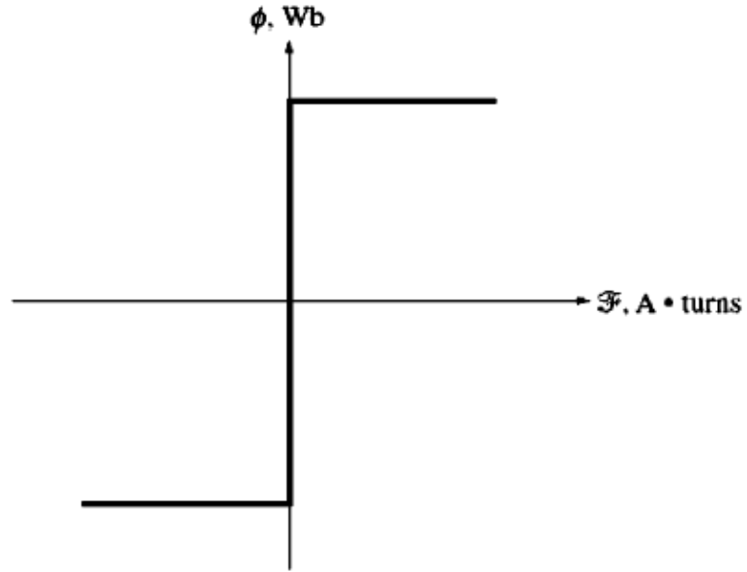
Assumptions to Convert a Real Transformer into Ideal Transformer
  The core must have no hysteresis or eddy current.
  The Magnetization curve must be an ideal one.
  The leakage flux in the core must be zero, (i.e. all the flux in the core couples both the windings).
  The resistance of the transformer winding must be zero.
Real
Ideal

Slide 20
1. The Equivalent Circuit of a Transformer
The losses that occur in real transformers have to be accounted for in any accurate model of transformer behavior. The major losses are:
  Copper Losses( I²R): The resistive heating losses in the primary and secondary winding of the transformer. They are proportional to the square of the current in the winding.
  Eddy Current Losses: These are resistive heating losses in the core and are proportional to the square of the voltage applied to the transformer.
  Hysteresis losses: These are associated with the rearrangement of the magnetic domains in the core during each half cycle and are nonlinear function of applied voltage.
  Leakage Flux(φ_{LP} φ_{LS}): The fluxes which escape the core and pass only through one of the transformer winding. These escaped fluxes produce a self inductance in the primary and secondary coil.

Slide 21
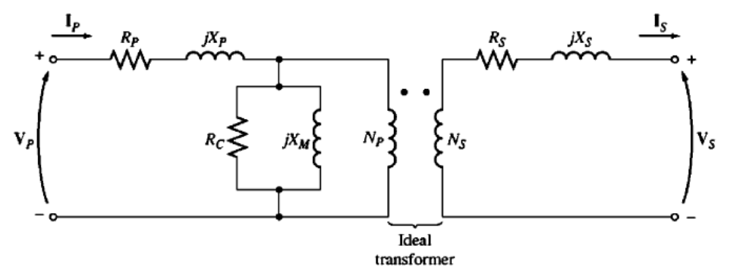
1. The Exact Equivalent Circuit Model (cont…
Copper Losses
The resistive copper losses are modeled by placing a resistance R_{P} in the primary and R_{S} in the secondary winding of the transformer.

Slide 22
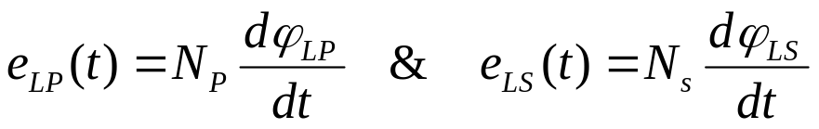

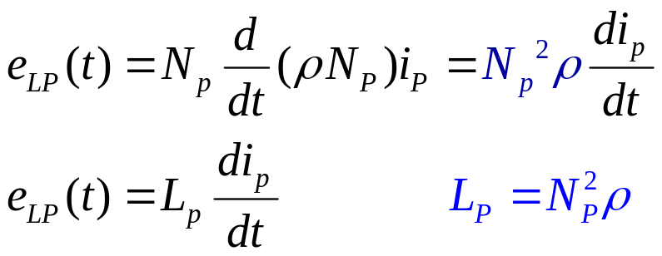
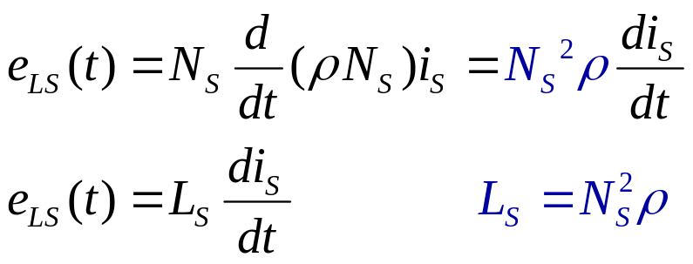
1. The Exact Equivalent Circuit Model (cont…
Leakage Flux
The flux which escapes the core and passes only through one of the transformer winding.
  L_{P}: leakage inductance of primary coil
  L_{S}:leakage inductance of secondary coil
Therefore, Leakage flux will be modeled by primary and secondary inductances.

Slide 23
1. The Exact Equivalent Circuit Model (cont…
Leakage flux modeled by primary and secondary inductances L_{P} and L_{S}.

Slide 24
The Magnetization Current in a Real Transformer
Review
Excitation current, I_{o}= I_{ex}= I_{c} + I_{M} (Vector sum)
Core-loss current I_{C} = I_{h+e} (current required to make up for hysteresis and eddy current losses) - Resistive
Magnetization current I_{M} (current required to produce flux in the core) - Inductive
I_{c}
V_{P}
q_{o}
I_{M}
I_{o}
Note: The eddy currents will be maximum when the core flux is passing through zero (i_{eddy} leads φ by 90⁰ ). Why?
f
I_{c} = I_{h+e} = Core loss α V_{P}
I_{M} α φ

Slide 25
1. The Exact Equivalent Circuit Model (cont…
(Eddy Current +Hysteresis Losses): The core loss current, i_{h+e}, is proportional to voltage applied to the core and is in phase with voltage. Therefore, can be modeled by R_{c} across primary.
The Magnetization Current: Is proportional to the voltage applied to the core (in unsaturated region) and is lagging the applied voltage by 90^{o.} So it can be modeled by a reactance connected across the winding, represented by X_{M}.
7

Slide 26
1. The Exact Equivalent Circuit Model (cont..
The X_{M} & R_{C} represent the excitation effect which includes the core loss current (eddy + hysteresis) and the magnetization current.
The X_{M} & R_{C} are placed inside, after L_{P} and R_{P}, because the voltage applied to the core is input voltage less the internal voltage drop of the winding.

Slide 27

Conclusion
Real single phase transformers
Voltage across a Real Transformer
Magnetization current in Real Transformers
Hysteresis and eddy currents in real transformers
Current Ratio and Dot Convention

