Slide 1

School of Electrical Engineering and Computer Science
Department of Electrical Engineering
EE-260 : Electrical Machines
Lecture#8
Text Book: Chapter 02 (Stephen J. Chapman 4th Ed)
Instructor: Ms Neelma Naz
Class: BEE 12 C/D
2.5 THE EQUIVALENT CIRCUIT OF A TRANSFORMER
Determining the Values of Components in the Transformer Model

Slide 2
1. The Equivalent Circuit of a Transformer
The losses that occur in real transformers have to be accounted for in any accurate model of transformer behavior. The major losses are:
  Copper Losses( I²R): The resistive heating losses in the primary and secondary winding of the transformer. They are proportional to the square of the current in the winding.
  Eddy Current Losses: These are resistive heating losses in the core and are proportional to the square of the voltage applied to the transformer.
  Hysteresis losses: These are associated with the rearrangement of the magnetic domains in the core during each half cycle and are nonlinear function of applied voltage.
  Leakage Flux(φ_{LP} φ_{LS}): The fluxes which escape the core and pass only through one of the transformer winding. These escaped fluxes produce a self inductance in the primary and secondary coil.

Slide 3
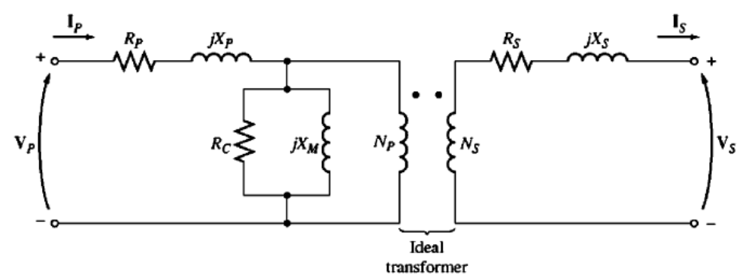
1. The Exact Equivalent Circuit Model (cont…
Copper Losses
The resistive copper losses are modeled by placing a resistance R_{P} in the primary and R_{S} in the secondary winding of the transformer.

Slide 4
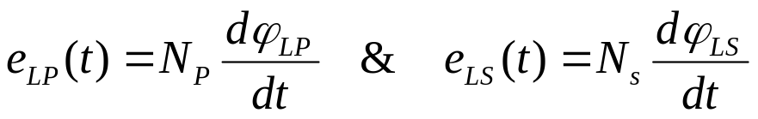

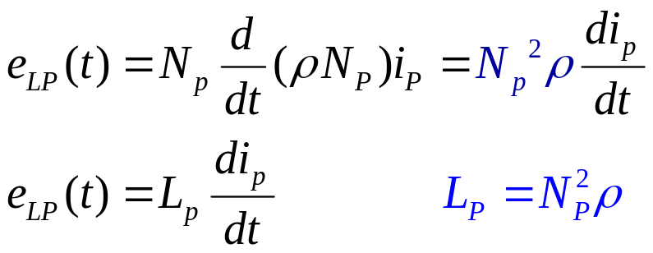
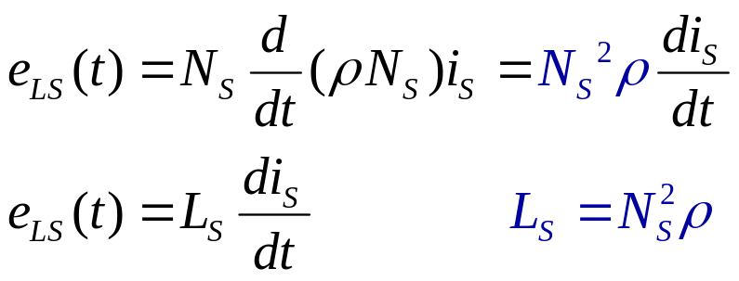
1. The Exact Equivalent Circuit Model (cont…
Leakage Flux
The flux which escapes the core and passes only through one of the transformer winding.
  L_{P}: leakage inductance of primary coil
  L_{S}:leakage inductance of secondary coil
Therefore, Leakage flux will be modeled by primary and secondary inductances.

Slide 5
1. The Exact Equivalent Circuit Model (cont…
Leakage flux modeled by primary and secondary inductances L_{P} and L_{S}.

Slide 6
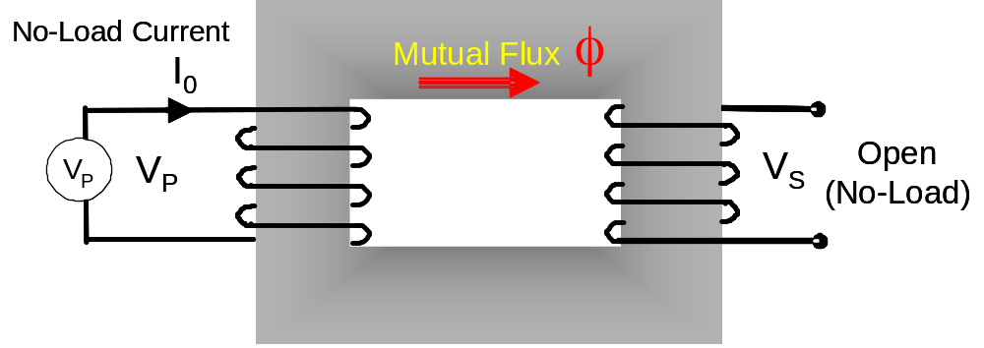
The Magnetization Current in a Real Transformer
Review
Excitation current, I_{o}= I_{ex}= I_{c} + I_{M} (Vector sum)
Core-loss current I_{C} = I_{h+e} (current required to make up for hysteresis and eddy current losses) - Resistive
Magnetization current I_{M} (current required to produce flux in the core) - Inductive
I_{c}
V_{P}
q_{o}
I_{M}
I_{o}
Note: The eddy currents will be maximum when the core flux is passing through zero (i_{eddy} leads φ by 90⁰ ). Why?
f
I_{c} = I_{h+e} = Core loss α V_{P}
I_{M} α φ

Slide 7
1. The Exact Equivalent Circuit Model (cont…
(Eddy Current +Hysteresis Losses): The core loss current, i_{h+e}, is proportional to voltage applied to the core and is in phase with voltage. Therefore, can be modeled by R_{c} across primary.
The Magnetization Current: Is proportional to the voltage applied to the core (in unsaturated region) and is lagging the applied voltage by 90^{o.} So it can be modeled by a reactance connected across the winding, represented by X_{M}.
7

Slide 8
1. The Exact Equivalent Circuit Model (cont..
The X_{M} & R_{C} represent the excitation effect which includes the core loss current (eddy + hysteresis) and the magnetization current.
The X_{M} & R_{C} are placed inside, after L_{P} and R_{P}, because the voltage applied to the core is input voltage less the internal voltage drop of the winding.

Slide 9
1. Equivalent Circuit of a Real Transformer (cont…
To analyze practical circuits containing transformers, it is important to convert the entire circuit to a single voltage level.
Therefore, the circuit must be referred either to primary or to its secondary side.

Slide 10
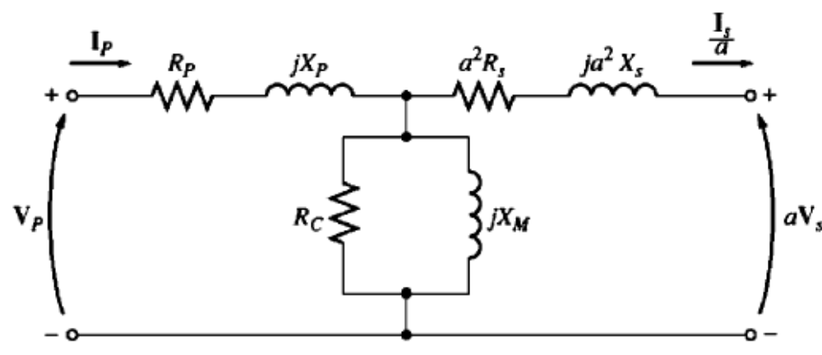
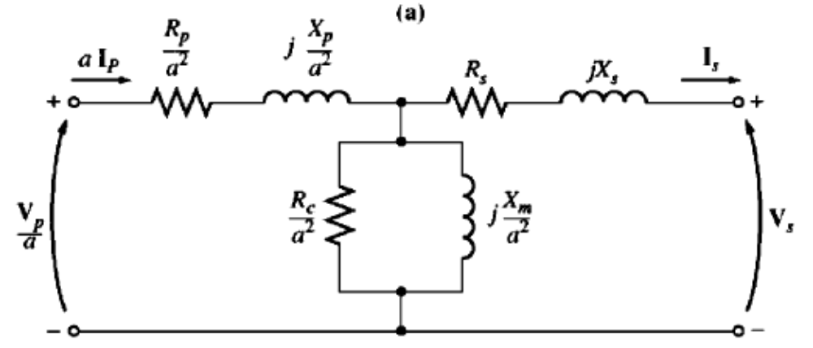
1. Equivalent Circuit of a Real Transformer (cont..
Transformer Model Referred to its Primary Voltage
Transformer Model Referred to its Secondary Voltage

Slide 11
1. Approximate Equivalent Circuit of a Transformer
I_{O} is small (at rated voltage I_{O}=3-5% of rated current) compare to I_{P} and I_{S}/a. WHY ?
R_{C} & X_{M} >>R_{P} & X_{P}
What makes R_{C} (KΩ) of very large value ?
Core Lamination
What happens if the core is not properly laminated?
Hence assume I_{P}=I_{S}/a & the T/F circuit can be approximated as
I_{P}
R_{P}
jX_{P}
I_{S}/a
a² R_{S}
a² jX_{S}
L _{lP}
I_{O}
T/F model: secondary is referred to the primary
I_{C}
I_{M}
V_{P}
aV_{S}
R_{C}
jX_{M}
Fig 2-18(a) Approximate T/F model referred to primary side

Slide 12
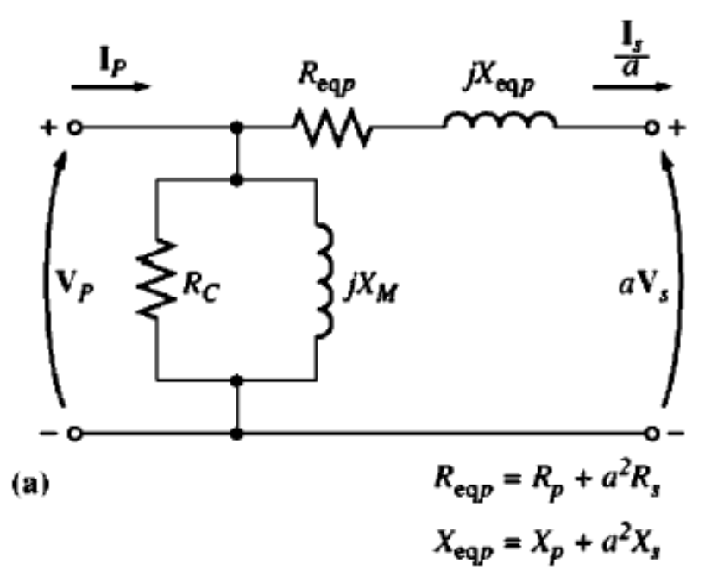
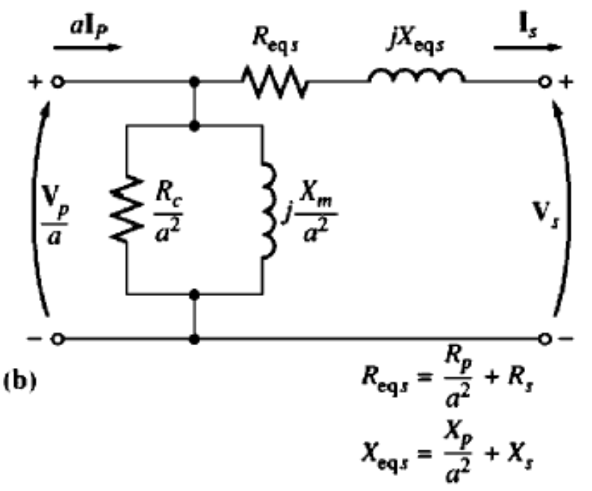
1. Approximate Equivalent Circuit of a Transformer
The excitation branch has a very small current compared to the load current, so small that under normal circumstance it causes a completely negligible voltage drop in R_{P} and X_{P}. Therefore, the excitation branch is moved to the front of the transformer
Approximate Transformer Model Referred to Primary Side
Approximate Transformer Model Referred to Secondary Side

Slide 13
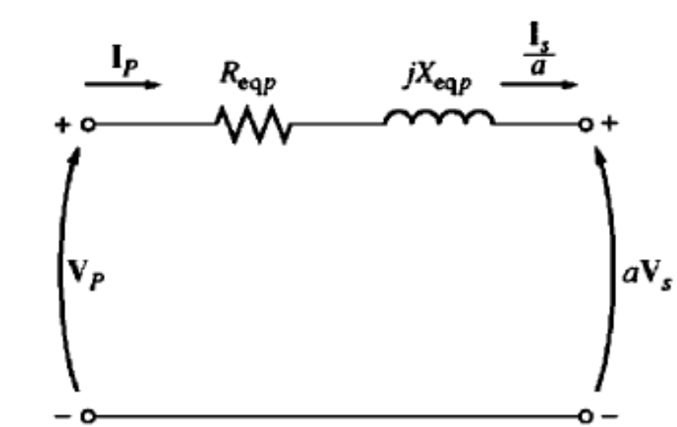
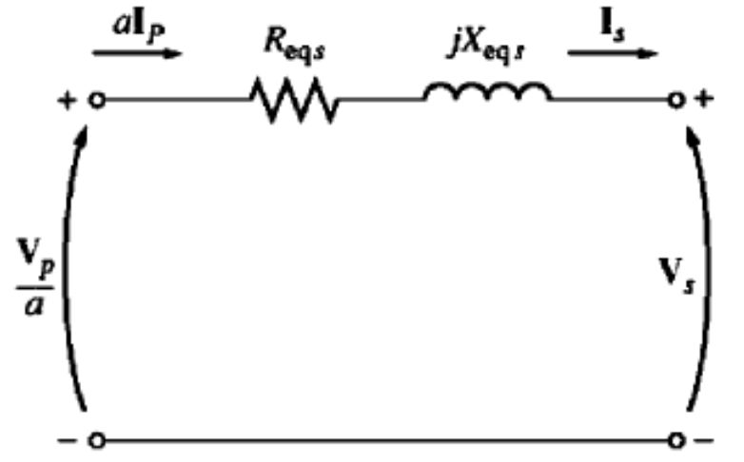
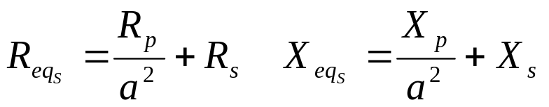

1. Simplified Equivalent Circuit of a Transformer
Excitation branch adds complexity. However, current through this branch is very small, as compared to the load current.
It causes negligible voltage drop in the R_{p} and X_{p} and hence can be neglected.

Slide 14
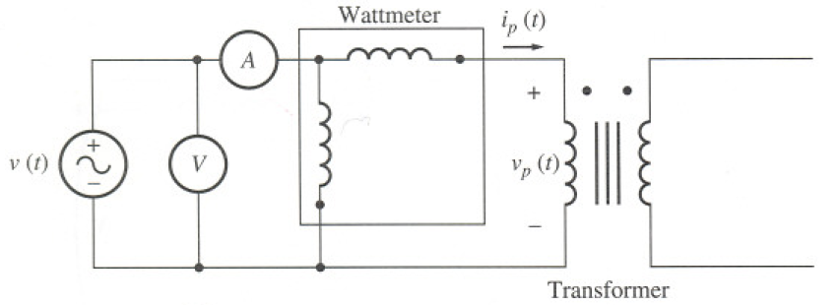
1. Determining Transformer Model’s Parameters
The parameter of the transformer model i.e., the values of resistances and inductances can be experimentally determined using two simple tests: The open circuit test and the short circuit test.
The Open Circuit Test: In this one of the winding is open circuited, and a full load rated voltage is applied to the other side.
this measurement is normally done on the low voltage side of transformer)
Notes:
In this test the high voltage side of the transformer is left open, i.e., the open circuit test is to be performer on the low-voltage side of the transformer. The open-circuit test is conducted to determine the core or iron losses and the no-load circuit parameters R₀ and X_{m} of the transformer.

Slide 15
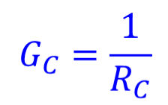

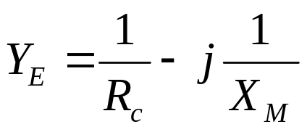
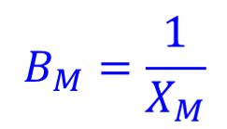
1 (a). The Open Circuit Test
R_{p} & X_{p} are too small as compared to R_{c} and X_{m}. Approximately all the voltage drops across the excitation impedance
Convenient to consider admittance of the excitation branch and then compute R_{c} and X_{m}.
Conductance of the core- loss resistor
The total excitation admittance is:
Susceptance of the magnetizing inductor

Slide 16
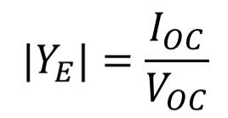
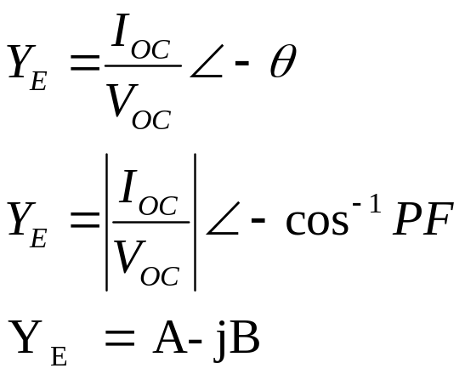
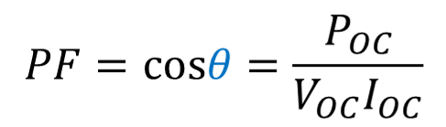
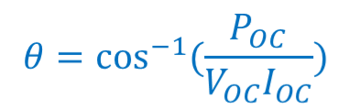
1 (a). The Open Circuit Test (cont…
Magnitude of Y_{E} referred to primary side
The admittance is
The P.F. for real transformer is always lagging. Therefore: I lags V by θ
Finally R_{C} and X_{M} can be obtained

Slide 17
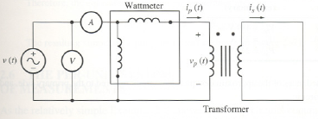
1.b. Short Circuit Test
In this test the low voltage terminals of the transformer are short circuited.
Apply a variable voltage source to high voltage side. Fairly low voltages are applied on this side and are adjusted such that current in short circuited winding is equal to rated current.
Caution: Make sure to keep the applied voltage at a safe level, otherwise you could burn the transformer’s winding.
(this measurement is normally done on the high voltage side of transformer)

Slide 18
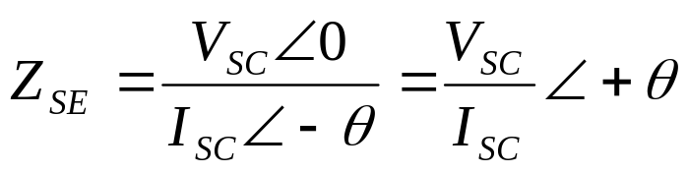
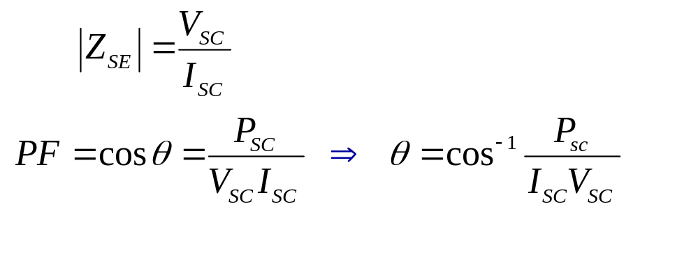
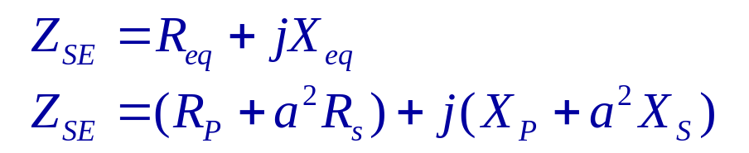
1.b. Short Circuit Test (cont…
The input voltage, current, and power are measured.
Negligible current flows through the excitation branch as the input voltage is very low.
Ignoring the excitation current, voltage drop can be attributed to series elements in the circuit.
Magnitude and angle of the series impedances referred to the primary side of the transformer is
The series impedance Z_{SE} is :

Slide 19
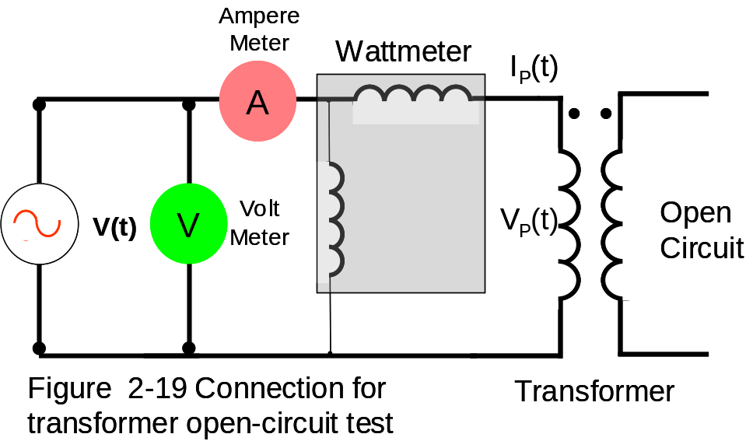
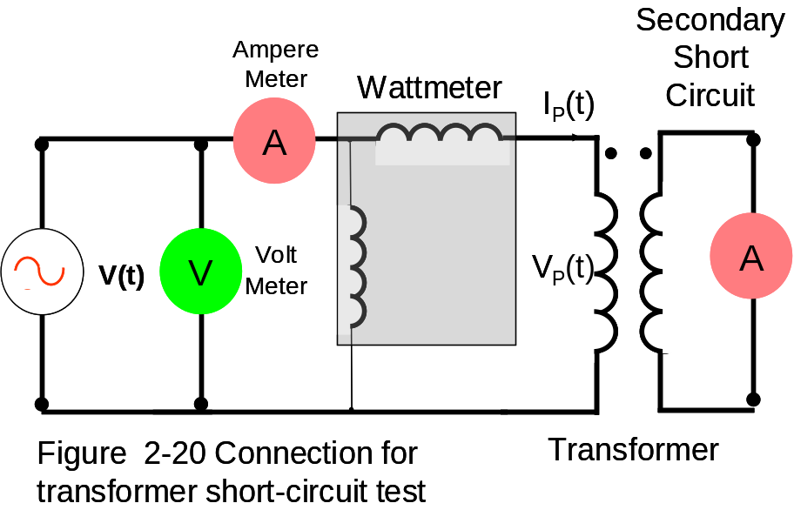
Page#90 Determining the Values of Components in the Transformer Model
Tests : Find Values of Components
Open Circuit Test
Short Circuit Test
Apply rated primary (input) Voltage
Apply Low voltages at input
I_{O} No-Load current flows primary
Full load I_{P} & I_{S} current flows
Wattmeter reads …..?
Core losses
Wattmeter reads I²R (Copper)

Slide 20
Example 2-2:
The equivalent circuit impedance of a 20 kVA, 8000/240 V. 60 HZ transformer are to be determined. The open circuit test test was performed on the secondary side of the transformer, and short circuit test was performed on the primary side of the transformer, and the following data were taken. Find the impedance of the approximate equivalent circuit referred to primary side, and sketch the circuit.
Open-circuit test (on secondary) | Short-circuit test (on primary)
V_{oc}= 240 V | V_{sc}= 489 V
I_{oc}=7.133 A | I_{sc}= 2.5 A
P_{oc}= 400 W | P_{sc}= 240 W

Slide 21
Example 2-2:
The equivalent circuit impedance of a 20 kVA, 8000/240 V. 60 HZ transformer are to be determined. The open circuit test and short circuit test were performed on the primary side of the transformer, and the following data were taken. Find the impedance of the approximate equivalent circuit referred to primary side, and sketch the circuit.
Open-circuit test (on primary) | Short-circuit test (on primary)
V_{oc}= 8000 V | V_{sc}= 489 V
I_{oc}=0.214 A | I_{sc}= 2.5 A
P_{oc}= 400 W | P_{sc}= 240 W

Slide 22
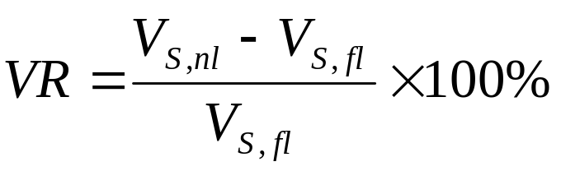
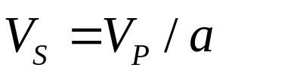
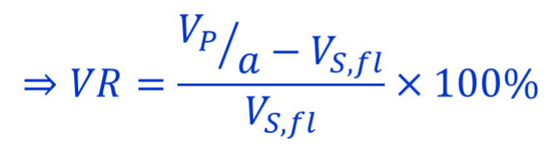
Transformer Voltage Regulation and Efficiency
Due to series impedance in the transformer, the output voltage of the transformer varies with the load even if input voltage remains constant.
Full-load voltage regulation is a quantity that compares the output voltage of the transformer at no load with the output voltage at full load
Low voltage regulation means smaller winding impedance.
For an ideal transformer, VR = 0 %
Since at no load:
Sometimes high-impedance and high-voltage regulation transformers are used to reduce the fault currents in a circuit

Slide 23
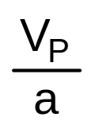
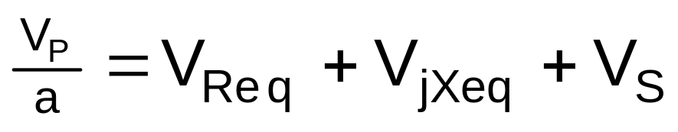
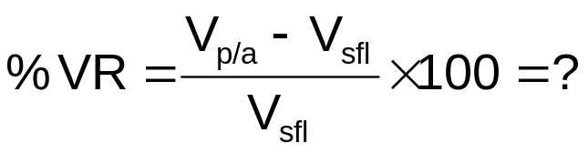
2. The Transformer Phasor Diagram
Fig 2-26 (page 101) Vector Dig
Lagging Power Factor
I_{S}
∠-θ
V_{Req}
V_{jXeq}
L
o
a
d
Lagging
Power Factor
Load
=R_{eq}I_{S}
=X_{eq}I_{S}
V_{S}
Phase relation between I_{S} & V_{Req} ?
Phase relation between I_{S} & V_{Xeq} ?
V_{S} is assumed to be at angle 0º ( V_{S}∠-θ). All other voltages & currents are compared to this reference
V_{P}/a
V_{Req}
V_{S}
V_{jXeq}
V_{P}/a > V_{S}
I_{S}
Positive

Slide 24
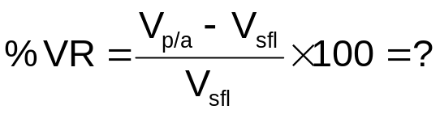
Fig 2-27(a) Vector Dig
Unity Power Factor
2. The Transformer Phasor Diagram
(cont...
I_{S}
∠-θ
V_{Req}
V_{jXeq}
=R_{eq}I_{S}
=X_{eq}I_{S}
L
o
a
d
Unity
Power Factor
Load
V_{S}
V_{P}/a
V_{jXeq}
V_{P}/a > V_{S}
V_{Req}
I_{S}
V_{S}
Fida Muhammad (Air University)
Positive

Slide 25
2. The Transformer Phasor Diagram
(cont…
Fig 2-27(a) Vector Dig
Leading PF
I_{S}
∠θ
V_{Req}
V_{jXeq}
L
o
a
d
Leading
Power Factor
Load
=R_{eq}I_{S}
=X_{eq}I_{S}
V_{S}
V_{jXeq}
V_{P}/a
V_{P}/a <V_{S}
I_{S}
Negative
V_{Req}
V_{S}

Slide 26
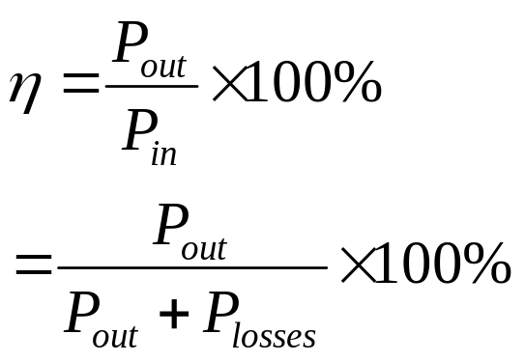
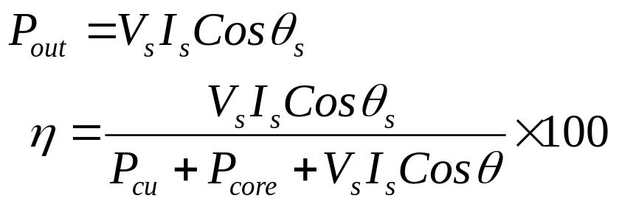
3. Transformer Efficiency
The efficiency is given by:
From the transformer equivalent circuit efficiency can be easily calculated
The power losses comprise
  Copper losses
  Hystersis losses
  Eddy current losses
  At any given load efficiency can be calculated as:
The efficiency for a power transformer is between 0.9 to 0.99.

Slide 27
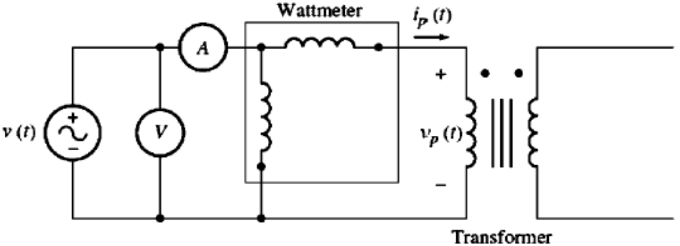
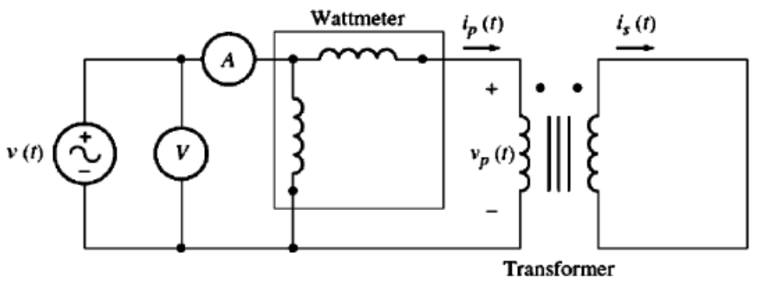
Example 2-5:
A 15 kVA, 2300/230-V transformer is to be tested to determine its excitation branch components, its series impedance and its voltage regulation. The test data listed in the table have been taken from the primary side of the transformer.
The data have been taken by using the connections shown in the following Figures.
Open-ckt test | Short-ckt test
V_{oc}=2300 V | V_{sc}=47 V
I_{oc}=0.21 A | I_{sc}=6.0 A
P_{oc}= 50 W | P_{sc}= 160 W

Slide 28

Conclusion
Equivalent Circuit of Transformer
Determining the transformer model parameters

