Slide 1

School of Electrical Engineering and Computer Science
Department of Electrical Engineering
EE-260 : Electrical Machines
Lecture#9
Text Book: Chapter 02 (Stephen J. Chapman 4th Ed)
Instructor: Ms Neelma Naz
Class: BEE 12 C/D
Determining the Values of Components in the Transformer Model
TRANSFORMER Phasor Diagrams, Efficiency

Slide 2
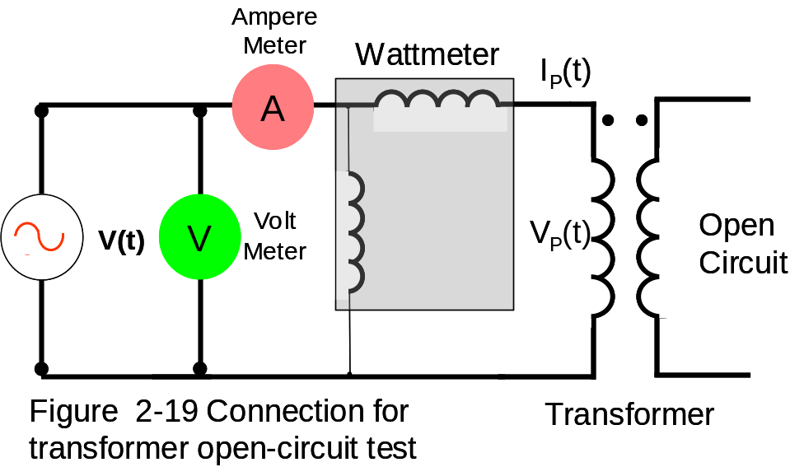
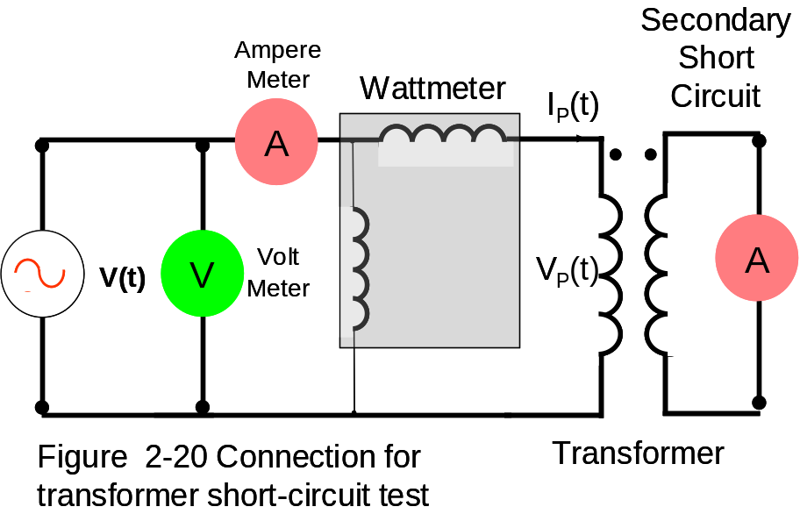
Page#90 Determining the Values of Components in the Transformer Model
Tests : Find Values of Components
Open Circuit Test
Short Circuit Test
Apply rated primary (input) Voltage
Apply Low voltages at input
I_{O} No-Load current flows primary
Full load I_{P} & I_{S} current flows
Wattmeter reads …..?
Core losses
Wattmeter reads I²R (Copper)

Slide 3
Example 2-2:
The equivalent circuit impedance of a 20 kVA, 8000/240 V. 60 HZ transformer are to be determined. The open circuit test test was performed on the secondary side of the transformer, and short circuit test was performed on the primary side of the transformer, and the following data were taken. Find the impedance of the approximate equivalent circuit referred to primary side, and sketch the circuit.
Open-circuit test (on secondary) | Short-circuit test (on primary)
V_{oc}= 240 V | V_{sc}= 489 V
I_{oc}=7.133 A | I_{sc}= 2.5 A
P_{oc}= 400 W | P_{sc}= 240 W

Slide 4
Example 2-2:
The equivalent circuit impedance of a 20 kVA, 8000/240 V. 60 HZ transformer are to be determined. The open circuit test and short circuit test were performed on the primary side of the transformer, and the following data were taken. Find the impedance of the approximate equivalent circuit referred to primary side, and sketch the circuit.
Open-circuit test (on primary) | Short-circuit test (on primary)
V_{oc}= 8000 V | V_{sc}= 489 V
I_{oc}=0.214 A | I_{sc}= 2.5 A
P_{oc}= 400 W | P_{sc}= 240 W

Slide 5
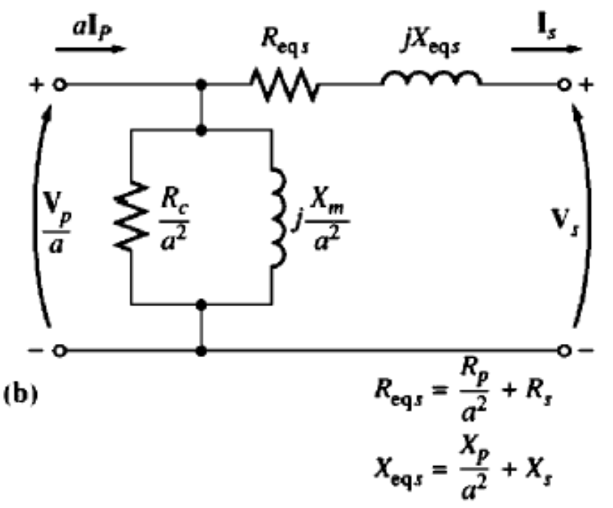
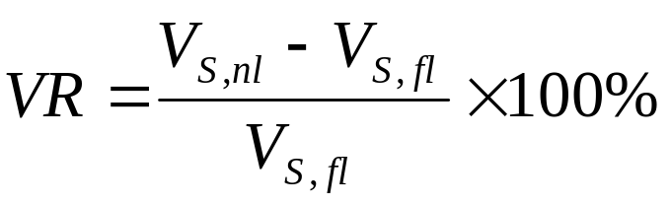
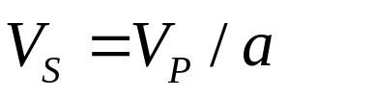
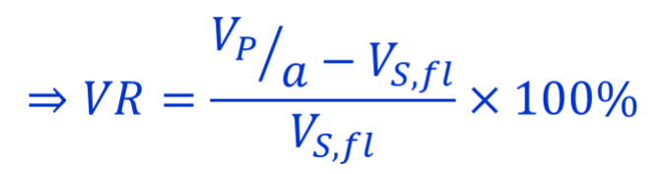
Transformer Voltage Regulation and Efficiency
Due to series impedance in the transformer, the output voltage of the transformer varies with the load even if input voltage remains constant.
Full-load voltage regulation is a quantity that compares the output voltage of the transformer at no load with the output voltage at full load
Low voltage regulation means smaller winding impedance.
For an ideal transformer, VR = 0 %
Since at no load:
Sometimes high-impedance and high-voltage regulation transformers are used to reduce the fault currents in a circuit

Slide 6
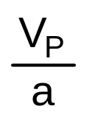
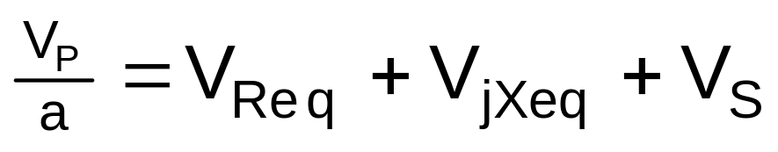
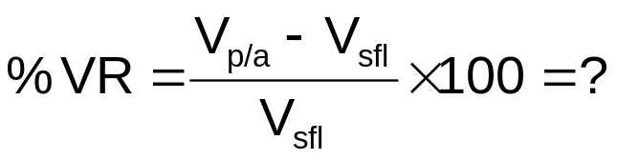
2. The Transformer Phasor Diagram
Fig 2-26 (page 101) Vector Dig
Lagging Power Factor
I_{S}
∠-θ
V_{Req}
V_{jXeq}
L
o
a
d
Lagging
Power Factor
Load
=R_{eq}I_{S}
=X_{eq}I_{S}
V_{S}
Phase relation between I_{S} & V_{Req} ?
Phase relation between I_{S} & V_{Xeq} ?
V_{S} is assumed to be at angle 0º ( V_{S}∠-θ). All other voltages & currents are compared to this reference
V_{P}/a
V_{Req}
V_{S}
V_{jXeq}
V_{P}/a > V_{S}
I_{S}
Positive

Slide 7
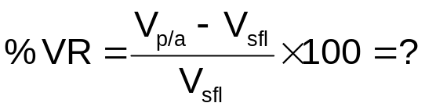
Fig 2-27(a) Vector Dig
Unity Power Factor
2. The Transformer Phasor Diagram
(cont...
I_{S}
∠-θ
V_{Req}
V_{jXeq}
=R_{eq}I_{S}
=X_{eq}I_{S}
L
o
a
d
Unity
Power Factor
Load
V_{S}
V_{P}/a
V_{jXeq}
V_{P}/a > V_{S}
V_{Req}
I_{S}
V_{S}
Fida Muhammad (Air University)
Positive

Slide 8
2. The Transformer Phasor Diagram
(cont…
Fig 2-27(a) Vector Dig
Leading PF
I_{S}
∠θ
V_{Req}
V_{jXeq}
L
o
a
d
Leading
Power Factor
Load
=R_{eq}I_{S}
=X_{eq}I_{S}
V_{S}
V_{jXeq}
V_{P}/a
V_{P}/a <V_{S}
I_{S}
Negative
V_{Req}
V_{S}

Slide 9
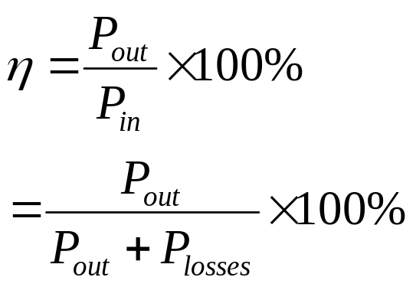
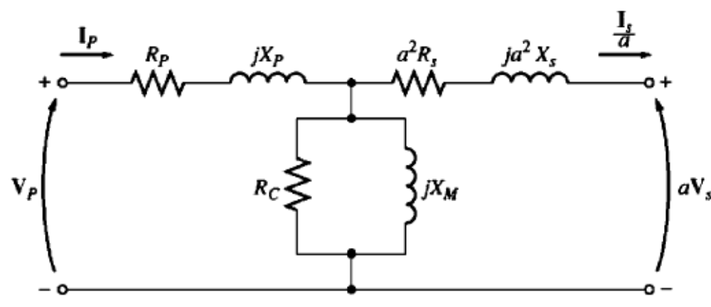
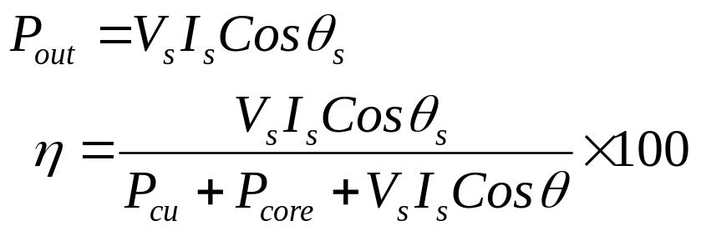
3. Transformer Efficiency
The efficiency is given by:
From the transformer equivalent circuit efficiency can be easily calculated
The power losses comprise
  Copper losses
  Hystersis losses
  Eddy current losses
  At any given load efficiency can be calculated as:
The efficiency for a power transformer is between 0.9 to 0.99.

Slide 10
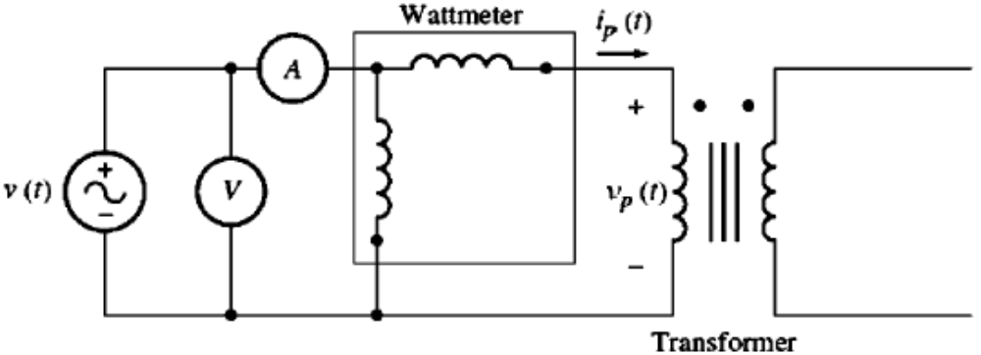
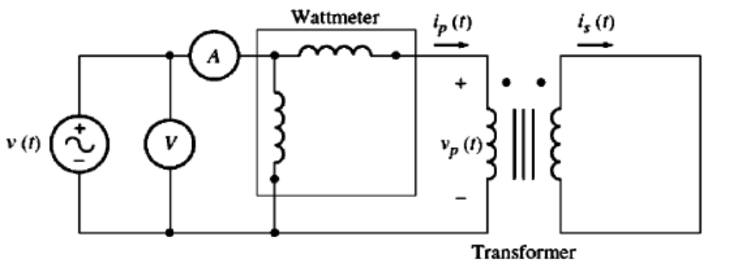
Example 2-5:
A 15 kVA, 2300/230-V transformer is to be tested to determine its excitation branch components, its series impedance and its voltage regulation. The test data listed in the table have been taken from the primary side of the transformer.
The data have been taken by using the connections shown in the following Figures.
Open-ckt test | Short-ckt test
V_{oc}=2300 V | V_{sc}=47 V
I_{oc}=0.21 A | I_{sc}=6.0 A
P_{oc}= 50 W | P_{sc}= 160 W

Slide 11

Conclusion
OCT & SCT
Transformer Voltage Regulation and Efficiency

