Slide 1

Machine Learning for Optimized Field-Oriented Control of PMSM Drives
Group Members:
Danial Ahmad (331388)
Muhammad Umer (345834)
Hassan Rizwan (335753)
Syeda Fatima Zahra (334379)

Slide 2
Introduction
Fundamentals of PMSM
Applications
Robotics
Electric Drives
Computer Peripherals
Numerically Controlled Machines

Slide 3
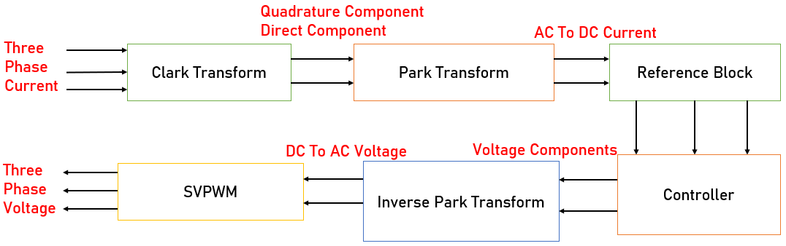
Principle of Vector Control
Uses current & voltage measurements to control a motor
Direct and quadrature axis
Quadrature component generates all the torque

Slide 4
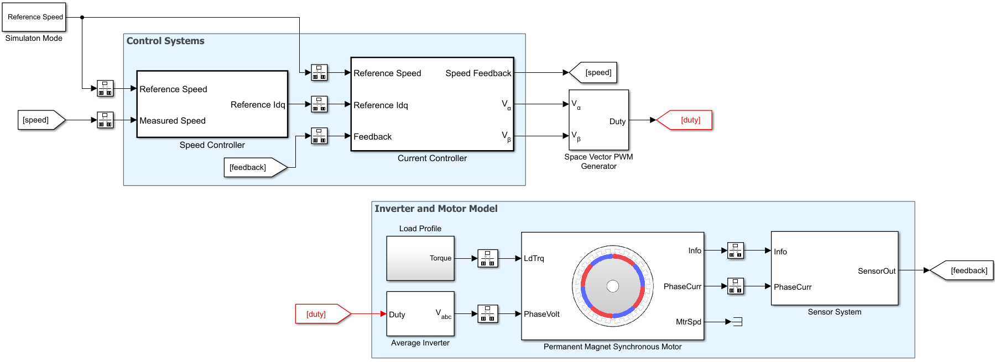
Model
Area under focus
Rate transitions to mitigate convergence issues

Slide 5
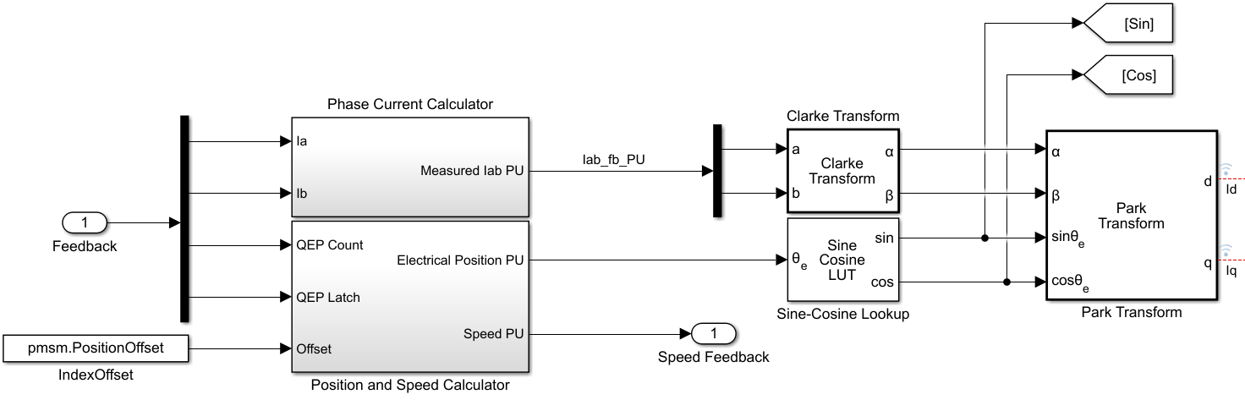
Feedback Components
To synchronous reference frame

Slide 6
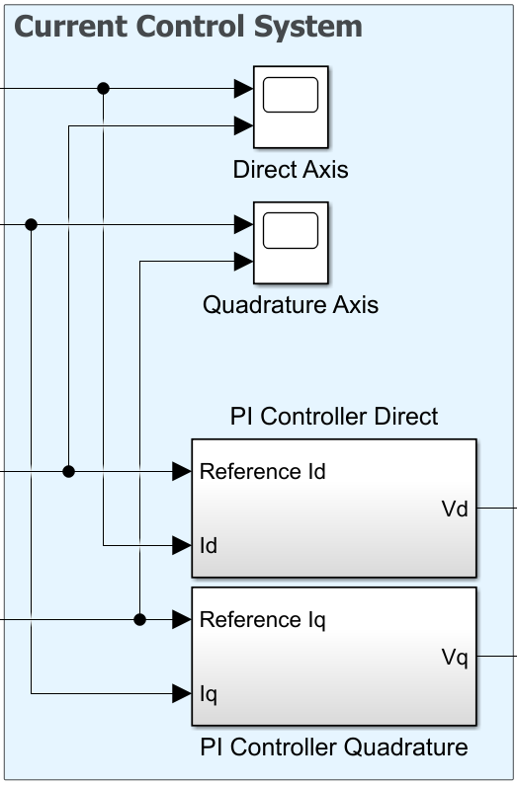
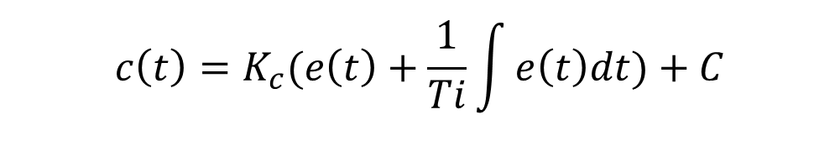
PI Controller
Estimates error by taking the difference between the output
Faster response time than I-only control
Stops the system from fluctuating
$$c\left(t\right)=K_{c}(e\left(t\right)+\frac{1}{Ti}\int{e\left(t\right)dt})+C$$

Slide 7
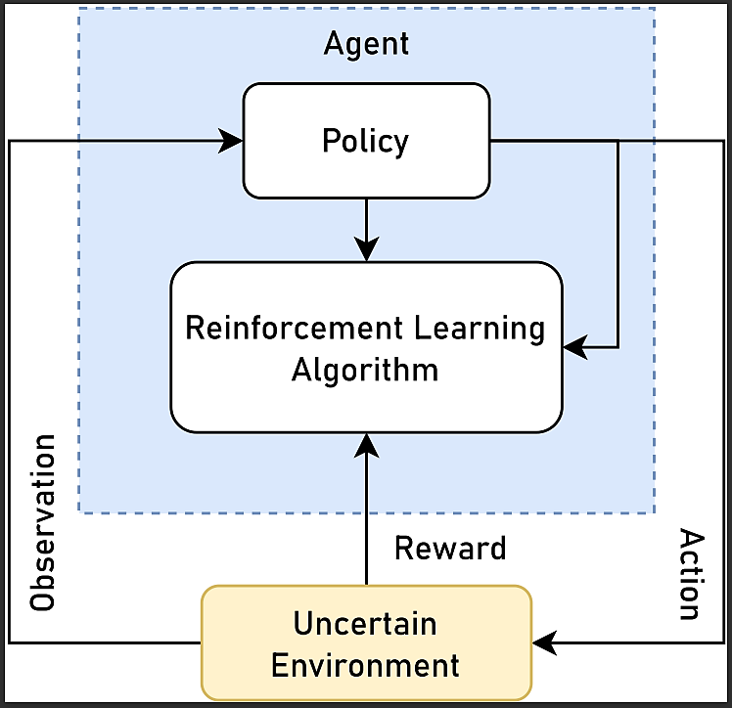
Reinforcement Learning
Reward-based learning
Reinforcement Learning Agent Characteristics
Lesser mathematical complexity
Captures state of the environment

Slide 8
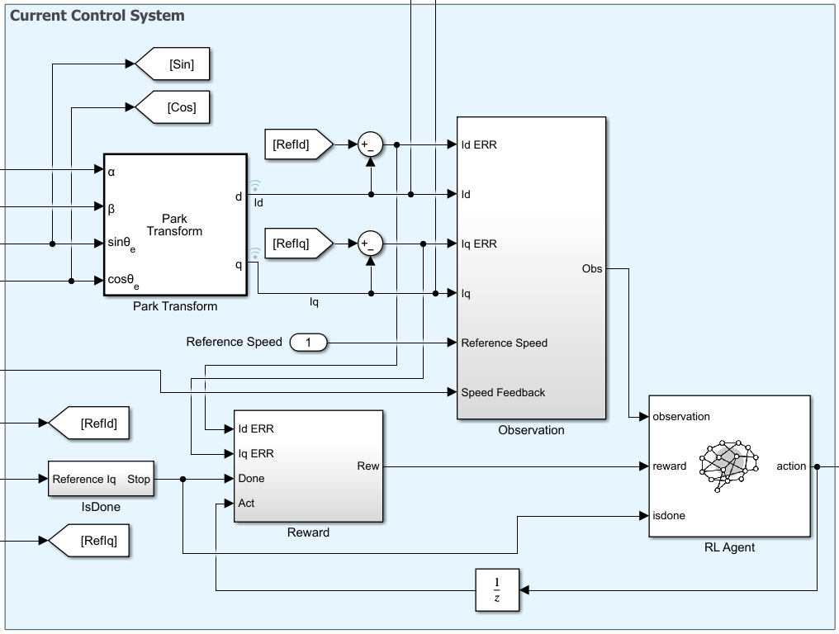
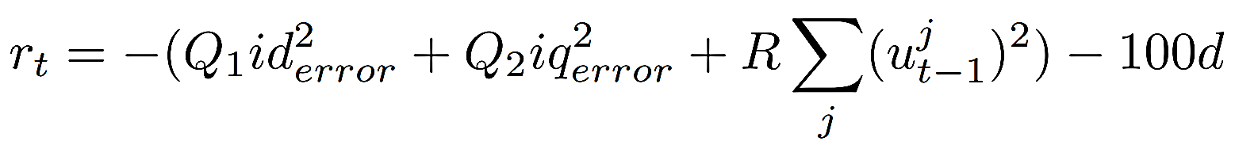
RL Controller
Observation
Captures state of the environment
Reward
Long-term reward maximization
Termination
Divergence

Slide 9
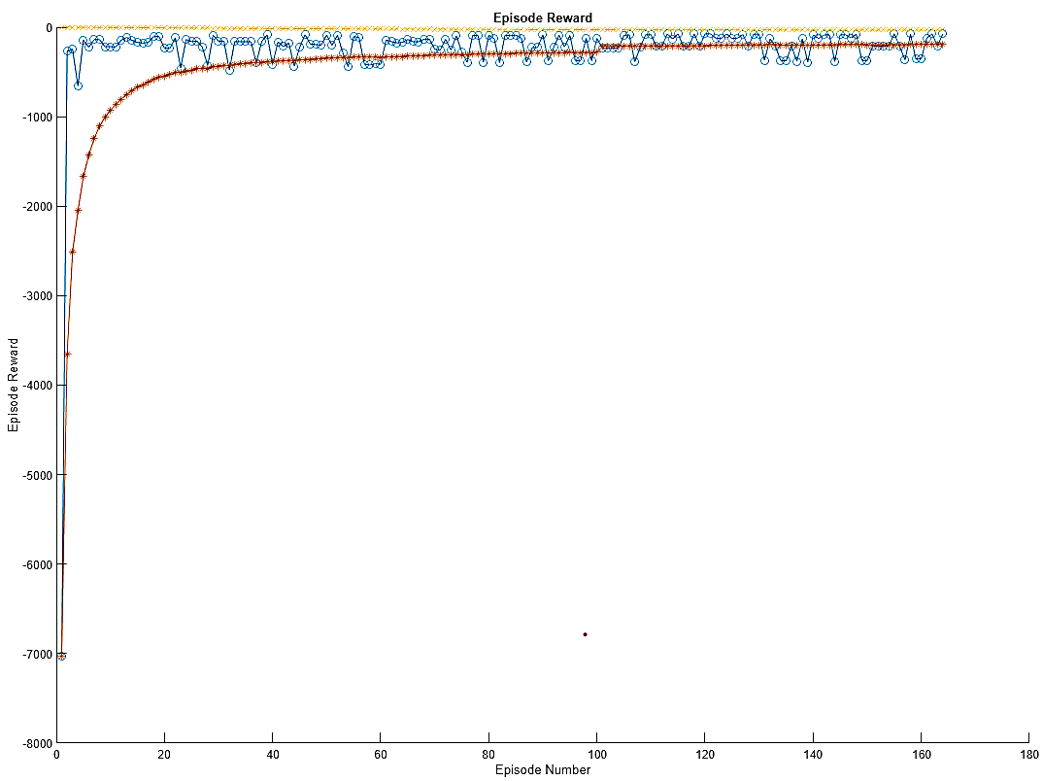
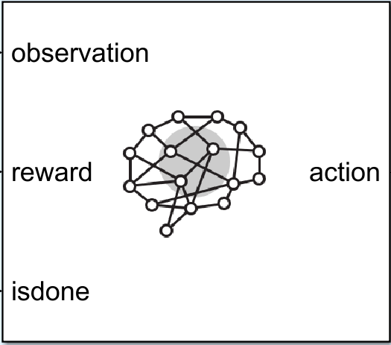
Training
Episode Manager
Inverse reward function
Memory issues

Slide 10
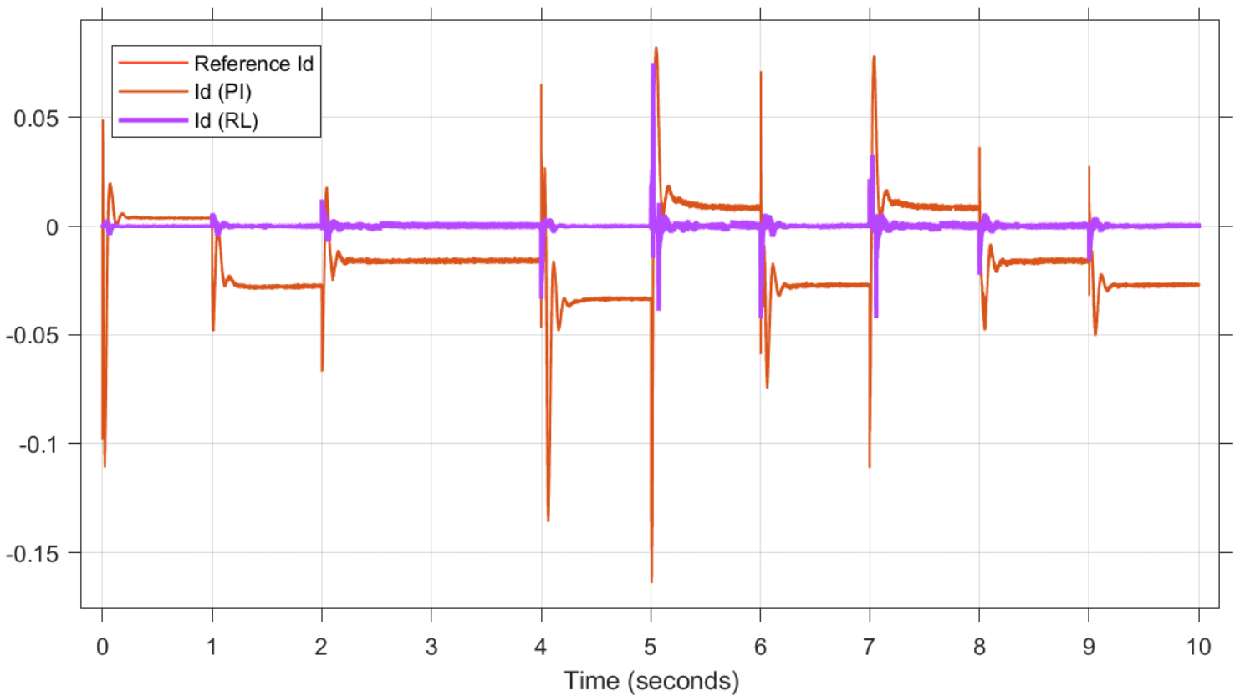

Direct Current $I_{d}$

Slide 11
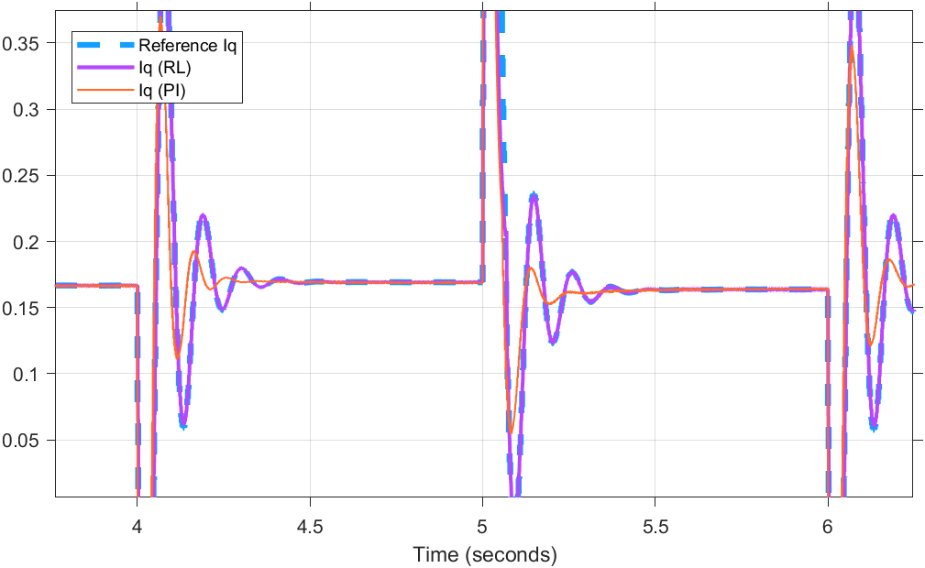
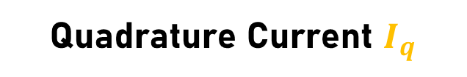
Quadrature Current $I_{q}$

Slide 12
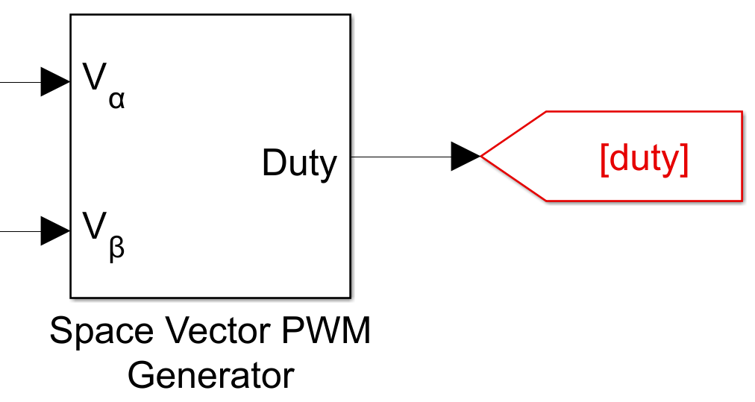
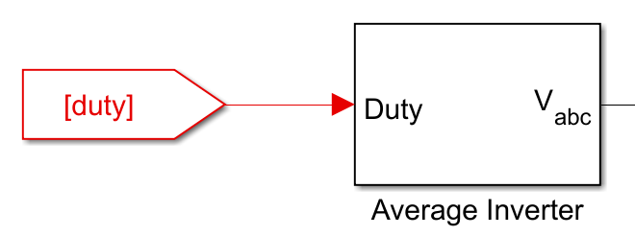

Space Vector PWM
& Average Inverter
Space Vector PWM
Utilizes DC bus voltage more efficiently
Provides a constant switching frequency
Average Inverter
Converts DC to 3$φ$ AC
Dependent on duty cycle

Slide 13
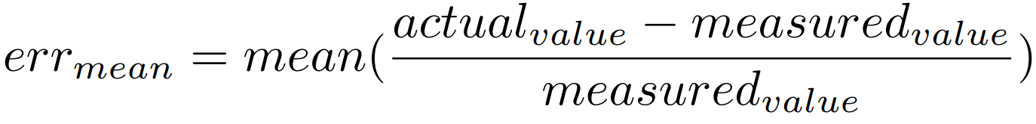
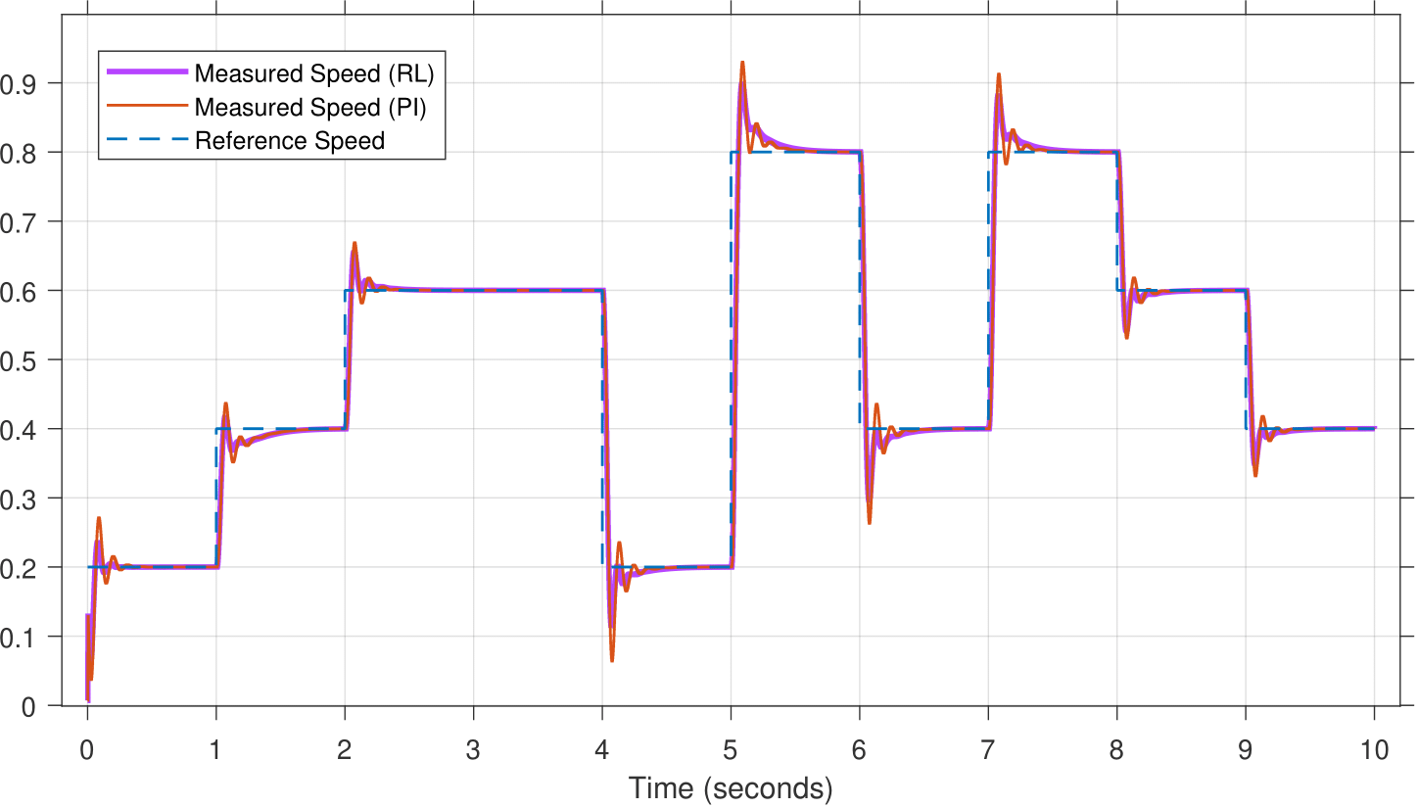
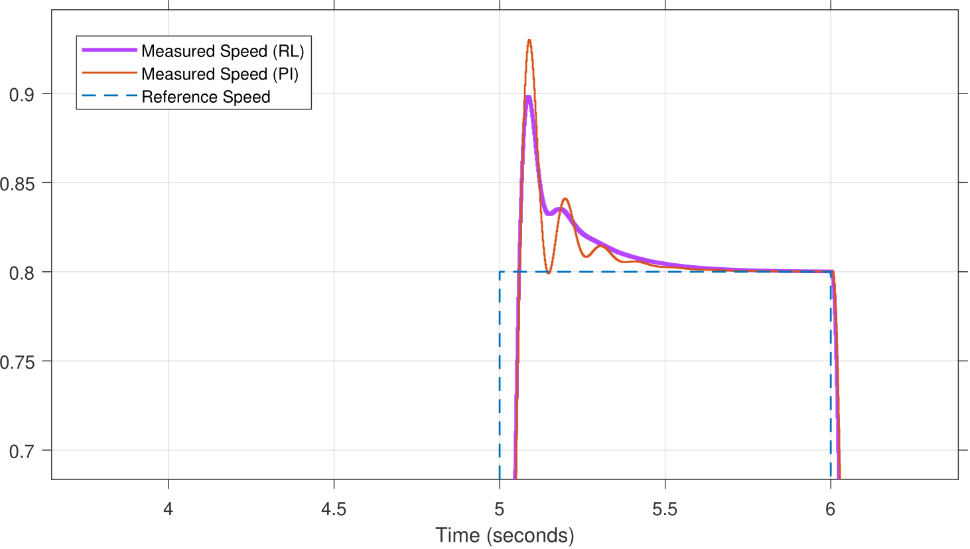
Results
Mean Relative Error
Improvement of 0.94% of quadrature current and speed

Slide 14
Conclusion
TD3 controller is more efficient than PI controller
Lesser Mean relative error in quadrature current and speed
Lesser ripples observed in the RL controller
Speed curve is smoother

Slide 15

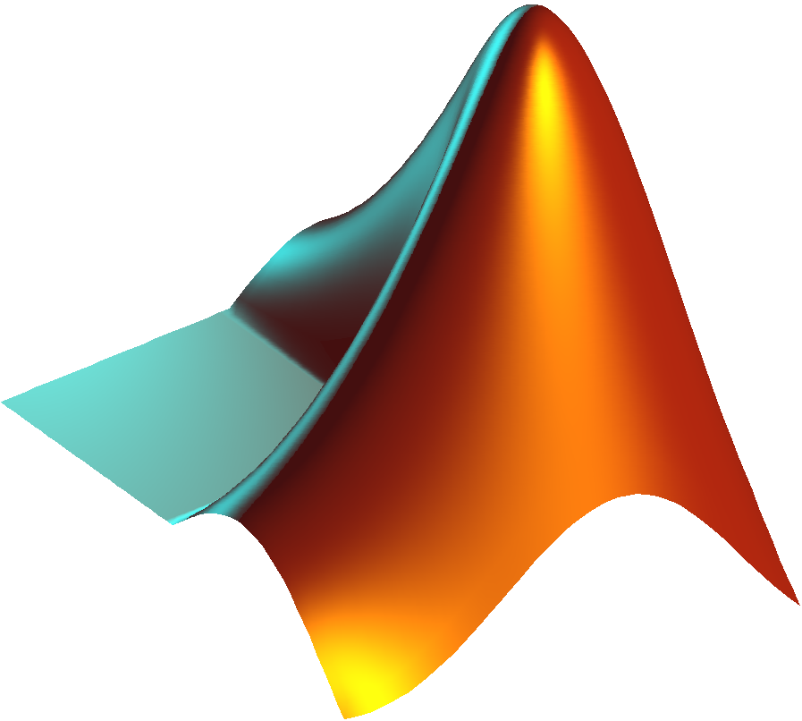
References
Song, Zhe, Jun Yang, Xuesong Mei, Tao Tao, and Muxun Xu. "Deep reinforcement learning for permanent magnet synchronous motor speed control systems." Neural Computing and Applications 33, no. 10 (2021): 5409-5418.
Madhu, Remitha K., and Anna Mathew. "Matlab/simulink model of field-oriented control of pmsm drive using space vectors." International Journal of Advances in Engineering & Technology 6, no. 3 (2013): 1355.
Kumar, Rajesh, R. A. Gupta, and Ajay Kr Bansal. "Identification and control of PMSM using artificial neural network." In 2007 IEEE International Symposium on Industrial Electronics, pp. 30-35. IEEE, 2007.
Field-Oriented Control of PMSM Using Quadrature Encoder (Link)
Twin-Delayed Deep Deterministic Policy Gradient Agents (Link)

Slide 16
Feedback
Thank You
Any Questions?

