Slide 1
LEC_AB

Slide 2
Lecture No 1
Chapter No 10
Feedback

Slide 3
IN THIS CHAPTER YOU WILL LEARN
The general structure of the negative-feedback amplifier and the basic principle that underlies its operation.
2. The advantages of negative feedback, how these come about, and at what cost.
3. The appropriate feedback topology to employ with each of the four amplifier types: voltage, current, trans-conductance, and trans-resistance amplifiers.
4. An intuitive and insightful approach for the analysis of practical feedback amplifier circuits.
5. Why and how negative-feedback amplifiers can become unstable (i.e. oscillate) and how to design the circuit to ensure stable performance

Slide 4
Topics to be covered
10.0 Introduction
10.1 The General Feedback Structure
10.2 Some Properties of Negative Feedback
10.3 The Four Basic Feedback Topologies
10.4 The Feedback Voltage Amplifier (Series—Shunt)
10.5 The Feedback Trans-conductance Amplifier (Series—Series)
10.6 The Feedback Trans-resistance Amplifier (Shunt—Shunt)
10.7 The Feedback Current Amplifier (Shunt—Series)
10.8 Summary of the Feedback Analysis Method
10.9 Determining the Loop Gain
Introduction to bode plot and root locus
10.10 The Stability Problem
10.11 Effect of Feedback on the Amplifier Poles
10.12 Stability Study Using Bode Plots
10.13 Frequency Compensation

Slide 5
Lecture No 1
10.0 Introduction
10.1 The General Feedback Structure
10.2 Some Properties of Negative Feedback

Slide 6
Lecture No 2
10.3 The Four Basic Feedback Topologies
10.4 The Feedback Voltage Amplifier (Series—Shunt)

Slide 7
Lecture No 3
10.5 The Feedback Transconductance Amplifier (Series—Series)
10.6 The Feedback Transresistance Amplifier (Shunt—Shunt)

Slide 8
Lecture No 4
10.6 The Feedback Transresistance Amplifier (Shunt—Shunt)
10.7 The Feedback Current Amplifier (Shunt—Series)

Slide 9
Lecture No 5
10.9 Determining the Loop Gain
10.10 The Stability Problem

Slide 10
Lecture No 6
10.11 Effect of Feedback on the Amplifier Poles
10.12 Stability Study Using Bode Plots
10.13 Frequency Compensation

Slide 11
Introduction

Slide 15
The General Feedback Structure

Slide 17
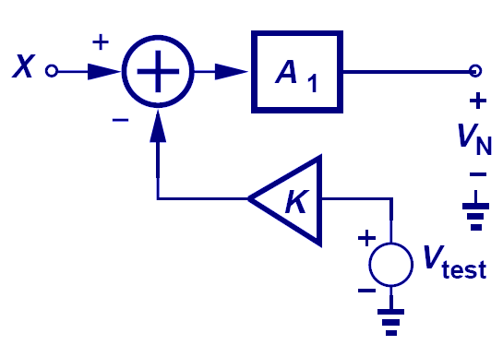

Loop Gain Measurement
$$β$$
When the input is grounded, and the loop is broken at an arbitrary location, the loop gain is measured to be βA₁.

Slide 21
Closed loop gain is smaller then open loop gain

Slide 28
Some Properties of Negative Feedback

Slide 31
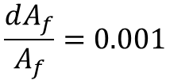


$$A=1000$$
$$\frac{dA}{A}=0.1$$
$$\frac{dA_{f}}{A_{f}}=0.001$$

Slide 32
Solution of MSE EE-313 Fall-2022

Slide 33
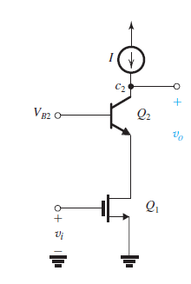
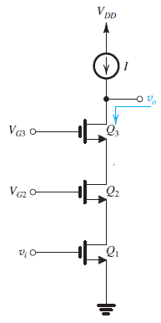
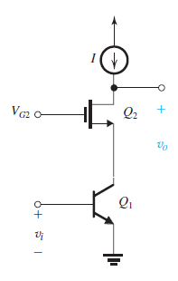
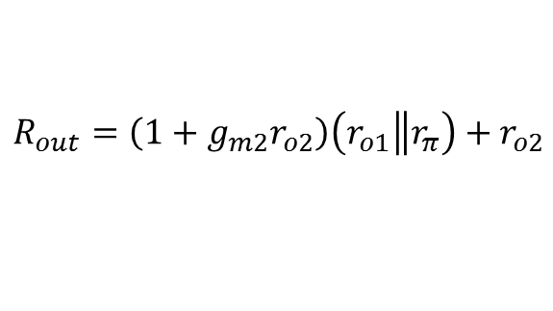


Question 1 (a). Find expressions for output resistance of the following circuits, assuming that the current source is ideal. . (Marks 5, 5, 5)
$$R_{out}=\left(1+g_{m2}r_{o2}\right)\left(r_{o1}\left\|r_{π}\right.\right)+r_{o2}$$
$$R_{out}=r_{o1}\left(g_{m2}r_{o2}\right)\left(g_{m3}r_{o3}\right)$$
$$R_{out}=\left(1+g_{m1}r_{o1}\right)\left(r_{02}\right)+r_{o1}$$

Slide 34
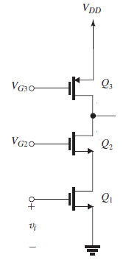
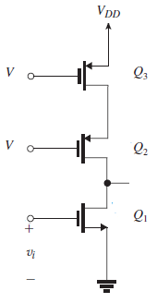
Question 1 (b). Find expressions for gains of the following circuits (Marks 5, 5)
Here current source is cascaded , Amplifier is not
Here current source is cascaded , Amplifier is not
$$A_{V}=\left(g_{m1}\right)\left(r_{o1}\left\|r_{O3}\left(g_{m2}r_{o2}\right)\right.\right)$$
$$A_{V}=\left(g_{m1}\right)\left(r_{o3}\left\|r_{O1}\left(g_{m2}r_{o2}\right)\right.\right)$$

Slide 35
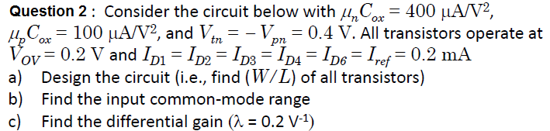



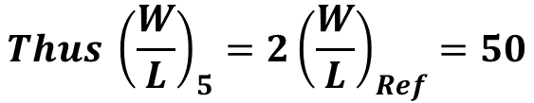
$$\frac{W}{L} for NMOS; μ_{n}C_{ox}=400{μA}/{V^{2}}$$
$$For Q_{ref}, Q_{1} {, Q_{1},Q}_{7} current is 0.2 mA;also given V_{OV}=0.2$$
$${\left(\frac{W}{L}\right)}_{ref}={\left(\frac{W}{L}\right)}_{1}={\left(\frac{W}{L}\right)}_{2}={\left(\frac{W}{L}\right)}_{7}=25$$
$$But through Q_{5} double the current is flowing$$
$$That is I_{D1}=2I_{Ref}=0.4mA$$
$$Thus {\left(\frac{W}{L}\right)}_{5}=2{\left(\frac{W}{L}\right)}_{Ref}=50$$

Slide 36

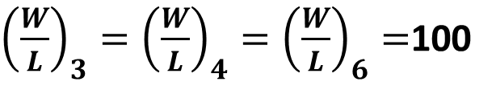
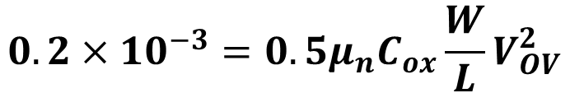
$$\frac{W}{L} for PMOS$$
$$PMOS : Q_{3}, Q_{4}. and Q_{6}(all have same I_{D}and V_{OV})$$
$$0.2×{10}^{−3}=0.5μ_{n}C_{ox}\frac{W}{L}V_{OV}^{2}$$
${\left(\frac{W}{L}\right)}_{3}={\left(\frac{W}{L}\right)}_{4}={\left(\frac{W}{L}\right)}_{6}=$100

Slide 37






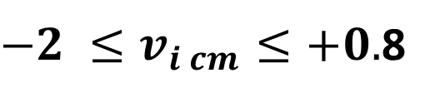

$−2 ≤v_{i cm}≤+0.$8
Lower
$$V_{gs} of Q_{5}= V_{t}+V_{OV}=0.4+0.2=0.6$$
$$V_{gs}−V_{s}=0.6 →V_{gs}=−0.4$$
$V_{s1}=V_{SS}+ V_{OV}=−1+0.2=−0.$8
$$V_{gs} of Q_{1}= 0.6→→V_{g1}−V_{s}=0.6$$
$$Therefore V_{g1(min)}=−0.2$$
Higher
$V_{gs} of Q_{3}= {0.6 →→V}_{s3}−V_{OV1}=0.$4
$$V_{gd}=V_{T}= V_{g1}−V_{d1}=0.4$$
$Therefore V_{g1(max)}=0.$8

Slide 38
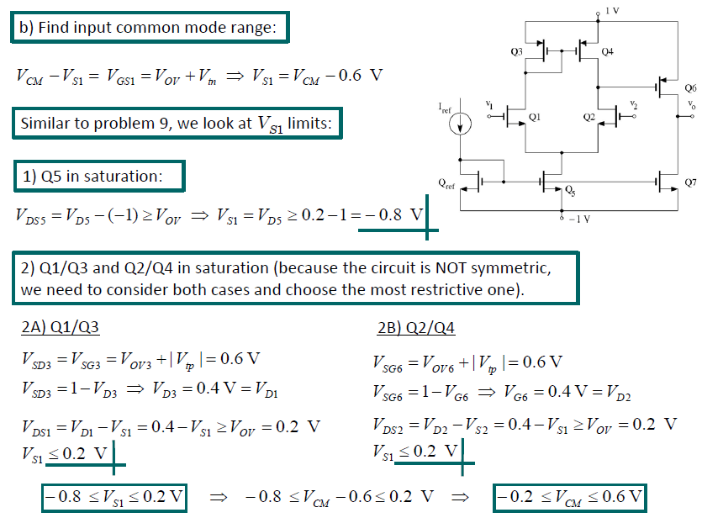

Slide 42
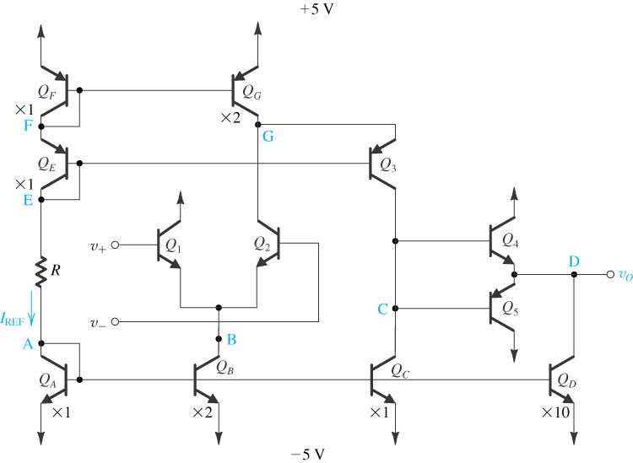

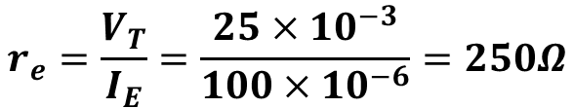

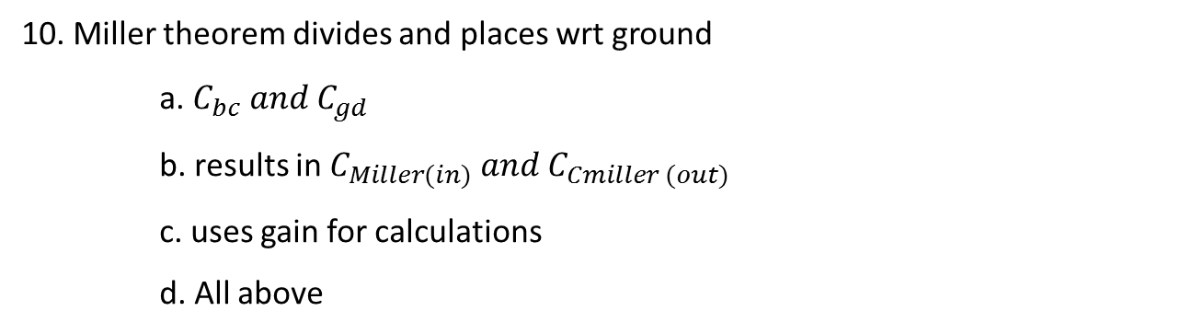
Question 3: All transistors have
(a) Find value of R
(b) Input differential resistance
(c) All currents
(d) Voltage gain
$$\left(a\right) R=\frac{5−\left(5\right)−2.1}{{100×100}^{−6}}=79KΩ$$
$$\left(b\right) For calculating R_{id}$$
$$r_{e}=\frac{V_{T}}{I_{E}}=\frac{{25×10}^{−3}}{100×{10}^{−6}}=250Ω$$
$$R_{id}=2\left(1+β\right)r_{e}$$
$$R_{id}=2×\left(1+100\right)×250=50.5kΩ$$

Slide 43



$$\left(c\right) Calculating all currents$$
$$I_{D}=1mA$$
$$I_{QG}=I_{B}=200μA$$
$$I_{QF}=I_{QE}=I_{QA}=I_{Q1}=I_{Q2}=I_{QC}=100μA$$

Slide 44

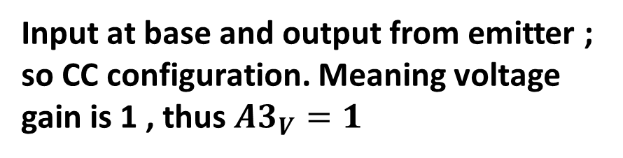

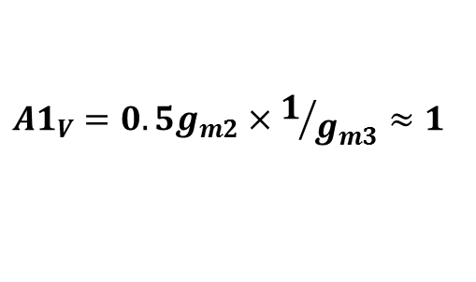
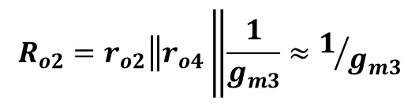
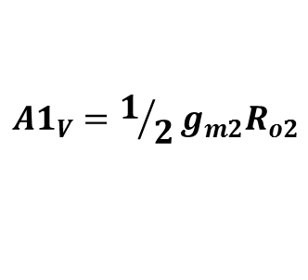

Push-pull Amplifier
Dual input single output differential amplifier
$${A1}_{V}=1/2g_{m2}R_{o2}$$
$$R_{o2}=r_{o2}\left\|r_{o4}\right.\left\|\frac{1}{g_{m3}}≈1/{g_{m3}}\right.$$
$${A1}_{V}=0.5g_{m2}{×1/{g_{m3}}≈1}_{}$$
$${A2}_{V}=1/2g_{m3}R_{o3}$$
Input at base and output from emitter ; so CC configuration. Meaning voltage gain is 1 , thus ${A3}_{V}=1$
$$R_{o3}=r_{o3}\left\|r_{oc}\right.\left\|\left(1+β\right)\left(r_{oD}\left\|r_{o4}\right.\right)\right.$$
$$≈3300\frac{V}{V}$$

Slide 45
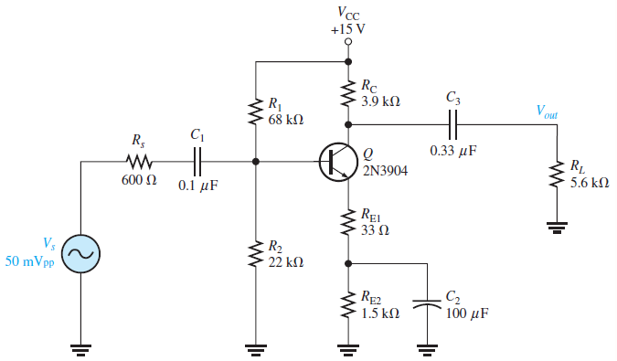








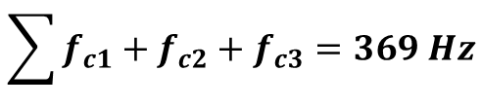



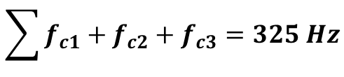
Q4. Calculate all three lower critical frequency due to the input RC circuit. Assumed re = 9.6Ω and β=200
$$I_{B}=9.1454×{10}^{−6}$$
$$I_{E}=1.838×{10}^{−3}$$
$r_{e}=$13.624
$$R_{B}=16622$$
$$V_{B}=3.67V$$
This is included now
$$f_{c1}=241 Hz$$
$$f_{c3}=50.76 Hz$$
With This re = 9.6 Ω
$$f_{c2}=33.14 Hz$$
$$f_{c1}=282 Hz$$
$$f_{c2}=36 Hz$$
$$f_{c3}=50.76 Hz$$
$$\sum{f_{c1}+f_{c2}+f_{c3}=325 Hz}$$
$$\sum{f_{c1}+f_{c2}+f_{c3}=369 Hz}$$

Slide 46
MSE CLASS AVERAGES
SECTION | HIGHEST | LOWEST | CLASS AVERAGE
BEE-12 A | 94 | 09 | 57
BEE12-B | 90 | 06 | 39
BEE-12-C | 99 | 16 | 49
Course Average = 48.33

