Slide 1
Lecture No 1
Chapter No 10
Feedback

Slide 2
IN THIS CHAPTER YOU WILL LEARN
The general structure of the negative-feedback amplifier and the basic principle that underlies its operation.
2. The advantages of negative feedback, how these come about, and at what cost.
3. The appropriate feedback topology to employ with each of the four amplifier types: voltage, current, trans-conductance, and trans-resistance amplifiers.
4. An intuitive and insightful approach for the analysis of practical feedback amplifier circuits.
5. Why and how negative-feedback amplifiers can become unstable (i.e. oscillate) and how to design the circuit to ensure stable performance

Slide 3
Topics to be covered
10.0 Introduction
10.1 The General Feedback Structure
10.2 Some Properties of Negative Feedback
10.3 The Four Basic Feedback Topologies
10.4 The Feedback Voltage Amplifier (Series—Shunt)
10.5 The Feedback Trans-conductance Amplifier (Series—Series)
10.6 The Feedback Trans-resistance Amplifier (Shunt—Shunt)
10.7 The Feedback Current Amplifier (Shunt—Series)
10.8 Summary of the Feedback Analysis Method
10.9 Determining the Loop Gain
Introduction to bode plot and root locus
10.10 The Stability Problem
10.11 Effect of Feedback on the Amplifier Poles
10.12 Stability Study Using Bode Plots
10.13 Frequency Compensation

Slide 4
Lecture No 1
10.0 Introduction
10.1 The General Feedback Structure
10.2 Some Properties of Negative Feedback

Slide 5
Lecture No 2
10.3 The Four Basic Feedback Topologies
10.4 The Feedback Voltage Amplifier (Series—Shunt)

Slide 6
Lecture No 3
10.5 The Feedback Transconductance Amplifier (Series—Series)
10.6 The Feedback Transresistance Amplifier (Shunt—Shunt)

Slide 7
Lecture No 4
10.6 The Feedback Transresistance Amplifier (Shunt—Shunt)
10.7 The Feedback Current Amplifier (Shunt—Series)

Slide 8
Lecture No 5
10.9 Determining the Loop Gain
10.10 The Stability Problem

Slide 9
Lecture No 6
10.11 Effect of Feedback on the Amplifier Poles
10.12 Stability Study Using Bode Plots
10.13 Frequency Compensation

Slide 10
Introduction

Slide 11
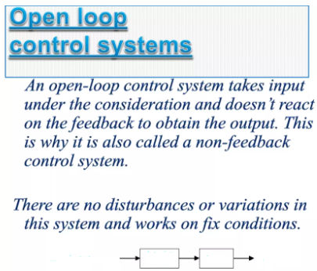
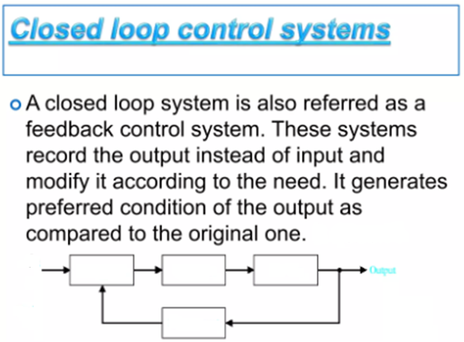
Open & Close loop systems

Slide 12
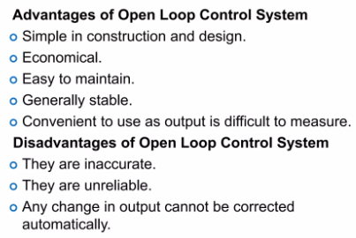

Slide 13
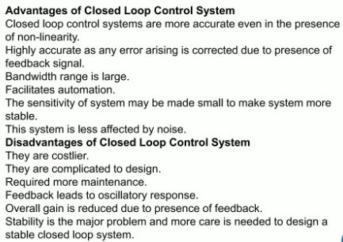

Slide 14
Introduction

Slide 15
(Merits and demerits )

Slide 16
The General Feedback Structure

Slide 18
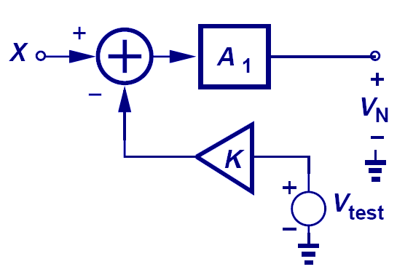

Loop Gain Measurement
$$β$$
When the input is grounded, and the loop is broken at an arbitrary location, the loop gain is measured to be βA₁.

Slide 20

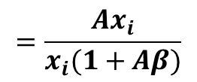



$$A_{f}=\frac{x_{o}}{x_{S}}$$
$$=\frac{Ax_{i}}{x_{i}+x_{f}}$$
$$=\frac{Ax_{i}}{x_{i}+βx_{o}}$$
$$=\frac{Ax_{i}}{x_{i}+β{Ax}_{i}}$$
$$=\frac{Ax_{i}}{x_{i}(1+Aβ)}$$

Slide 21
Definition of each term of Closed-loop Gain equation

Slide 22
Closed loop gain is smaller then open loop gain

Slide 23
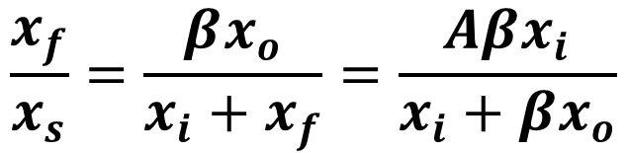
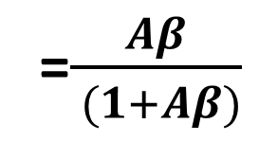
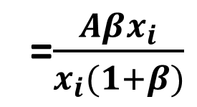

Manipulating the 3-basic equation we can get the ratios ; feedback to signal and input to signal
$$\frac{x_{f}}{x_{s}}=\frac{βx_{o}}{x_{i}+x_{f}}=\frac{Aβx_{i}}{x_{i}+βx_{o}}$$
$$=\frac{Aβx_{i}}{x_{i}+Aβx_{i}}$$
=$\frac{Aβx_{i}}{x_{i}(1+β)}$
=$\frac{Aβ}{ (1+Aβ)}$

Slide 24
Further analysis of the two ratios

Slide 25

Feedback to signal ratio: ${x_{f}}/{x_{S}}$

Slide 26

input to signal ratio: ${x_{i}}/{x_{S}}$

Slide 30
Some Properties of Negative Feedback

Slide 33
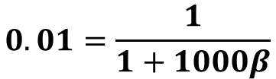


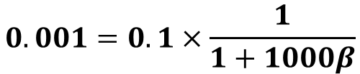
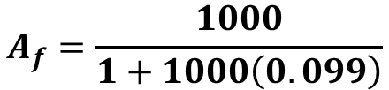
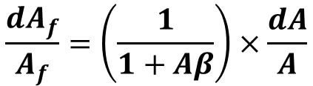
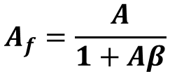
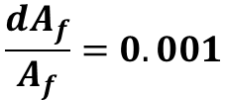



From Given data
$$A=1000;$$
$$\frac{dA}{A}=0.1;$$
$$\frac{dA_{f}}{A_{f}}=0.001$$
$$A_{f}=\frac{A}{1+Aβ}$$
$$A_{f}=\frac{1000}{1+1000\left(0.099\right)}$$
$$A_{f}=\frac{1000}{1+99}=10{ V}/V$$
$$\frac{dA_{f}}{A_{f}}=\left(\frac{1}{1+Aβ}\right)×\frac{dA}{A}$$
$$0.001=0.1×\frac{1}{1+1000β}$$
$$0.01=\frac{1}{1+1000β}$$
$$100=1+1000β$$
$$β=0.099$$

Slide 34
Bandwidth extension
Substituting the value of A (s) from above

Slide 35
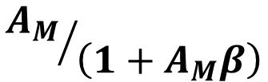
The above equation shows that the feedback amplifier will have a reduced mid-band gain
$${A_{M}}/{\left(1+A_{M}β\right)}$$
And the above upper 3-dB frequency given by

Slide 37
Thus we see that BW is enhanced with the FB
Closed Loop
Open Loop
Negative
Feedback
Although negative feedback lowers the gain by (1+KA₀), it also extends the bandwidth by the same amount.

Slide 38


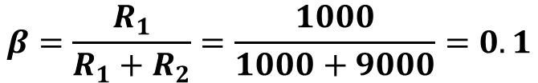
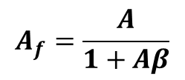

$$A=10000$$
$$Lower frequency gain ;that is A_{f}$$
$$ω_{Hf}=ω_{H}\left(1+Aβ\right)=100\left(1+10000×0.1\right)=100.1kHz$$
$$A_{f}=\frac{A}{1+Aβ}$$
$$β=\frac{R_{1}}{R_{1}+R_{2}}=\frac{1000}{1000+9000}=0.1$$
$$A_{f}=\frac{10000}{1+1000×0.1}=9.99V/V$$
Ans. 9.99 V/V; 100.1 kHz

Slide 40
The signal-to-interference ratio
for this amplifier is
we assume that it is possible to build another amplifier stage with gain that does not suffer from the interference problem. If this is the case, then we may precede our original amplifier by the clean amplifier and apply negative feedback around the overall cascade of such an amount as to keep the overall gain constant. The output voltage of the circuit can be found by superposition

Slide 44
Example: Open Loop Parameters

Slide 45
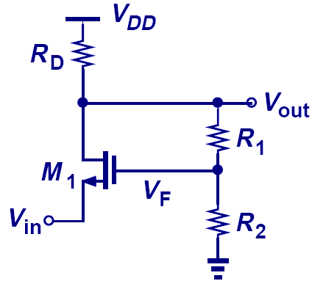
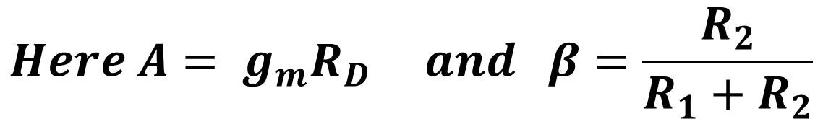
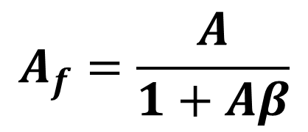
Example: Closed Loop Voltage Gain
$$A_{f}=\frac{A}{1+Aβ}$$
$$Here A= g_{m}R_{D} and β=\frac{R_{2}}{R_{1}+R_{2}}$$

Slide 46
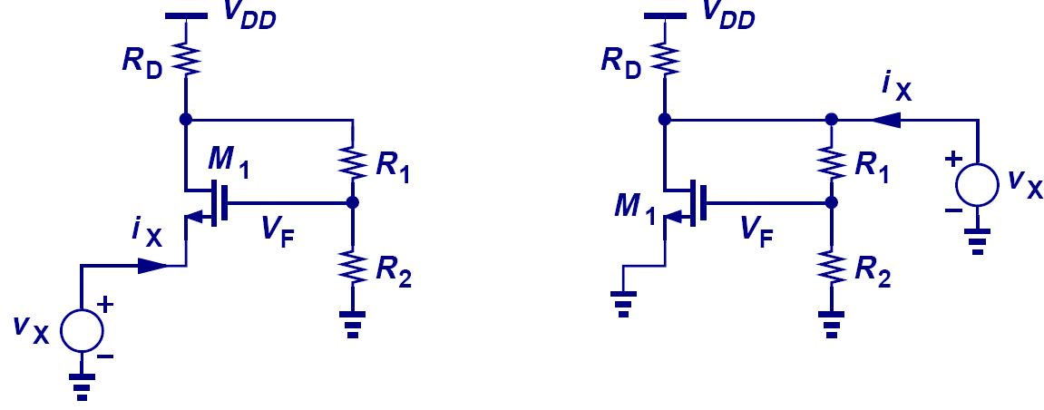
Example: Closed Loop I/O Impedance

