Slide 1
Chapter No 10

Slide 2
What we have studied so far
What is feedback
General structure /block diagram of feedback network
Characteristics/ benefits of feedback
Today we will study
Four feedback topologies

Slide 3
Based on the quantity to be amplified (voltage or current)
- and on the desired form of output (voltage or current), amplifiers can be classified into four categories.
In the following slides, we shall review this amplifier classification and point out the feedback topology appropriate in each case.

Slide 4
VOLTAGE
Trans-resistance
Trans- conductance
Current

Slide 5
Voltage
Trans-Resistance
Trans-conductance
Current

Slide 7
Some circuit examples

Slide 8
Before applying feedback in each type of amplifiers , we must first understand two basic things.
How (i) sampling/sensing and (ii) mixing will be done in each type of amplifier.
The subsequent slides just gives an overview of these concepts

Slide 9
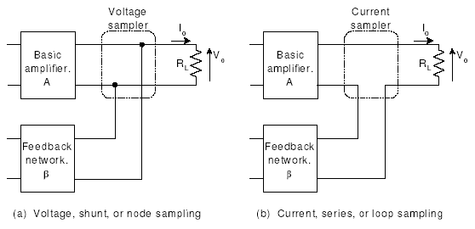
Sensing Voltage
The output voltage is sampled by connecting the feedback network in shunt across the output.
Type of connection is referred to as voltage or shunt or node sampling.
In order sense a voltage across two terminals, a voltmeter with ideally infinite impedance is used

Slide 11
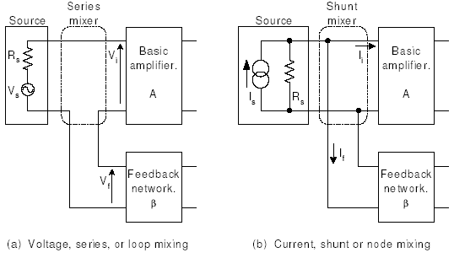
Comparator or Mixer Network
The feedback voltage is mixed in series with the input signal voltage.

Slide 14
Sensing and mixing current
current feedback is mixed with current source in shunt configuration
The output current is sampled by connecting the feedback network in series with the output

Slide 17
Since there can be four types of amplifiers,
There will be an appropriate feedback topology applicable for each type of amplifier.
Thus there will be four feedback topologies.

Slide 18
MIX -- SENSE
(i/p) (o/p)
Mixing
sensing

Slide 19
1.

Slide 20
Basic operation and examples

Slide 21
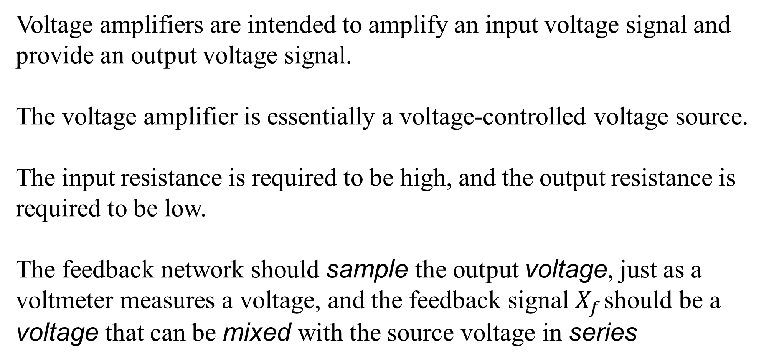
Voltage amplifiers are intended to amplify an input voltage signal and provide an output voltage signal.
The voltage amplifier is essentially a voltage-controlled voltage source.
The input resistance is required to be high, and the output resistance is required to be low.
The feedback network should sample the output voltage, just as a voltmeter measures a voltage, and the feedback signal $X_{f}$ should be a voltage that can be mixed with the source voltage in series

Slide 22
Because of the series connection at the input and the parallel or shunt connection at the output, this feedback topology is also known as series–shunt feedback.
As will be shown, this topology not only stabilizes the voltage gain but also results in a higher input resistance (intuitively, a result of the series connection at the input) and a lower output resistance (intuitively, a result of the parallel connection at the output), which are desirable properties for a voltage amplifier.

Slide 23
EXAMPLES

Slide 24
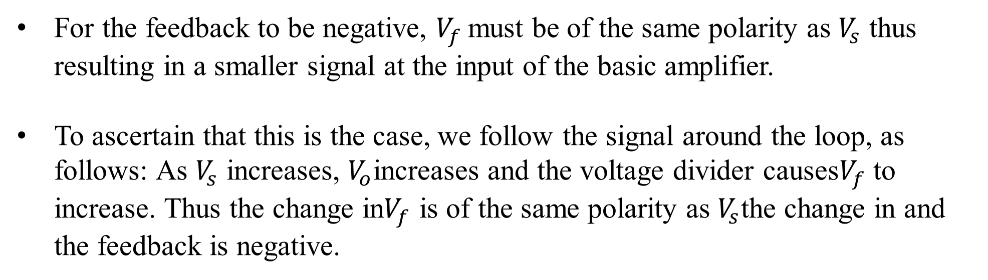
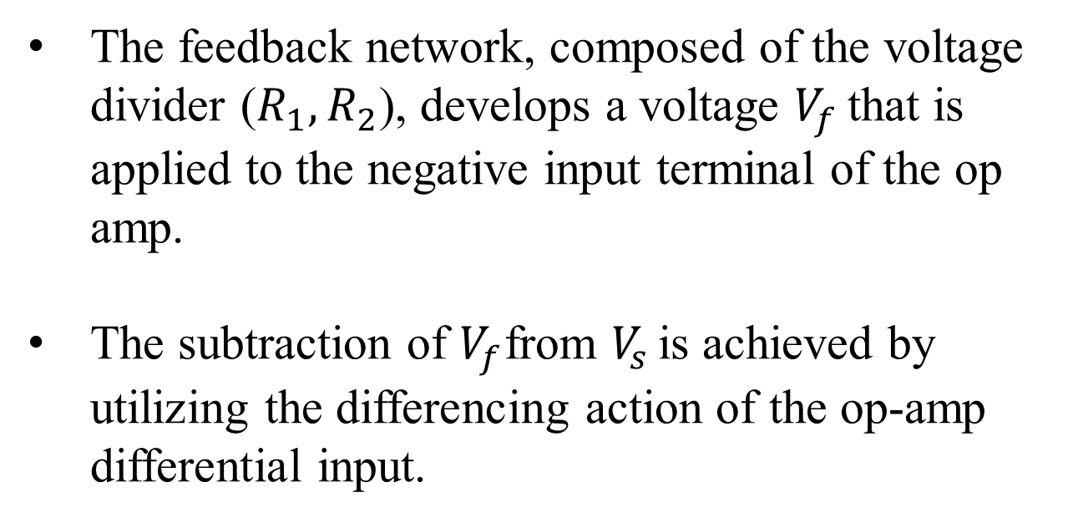
The feedback network, composed of the voltage divider ($R_{1},R_{2}$), develops a voltage $V_{f }$that is applied to the negative input terminal of the op amp.
The subtraction of $V_{f}$from $V_{s }$is achieved by utilizing the differencing action of the op-amp differential input.
For the feedback to be negative, $V_{f }$must be of the same polarity as $V_{s}$ thus resulting in a smaller signal at the input of the basic amplifier.
To ascertain that this is the case, we follow the signal around the loop, as follows: As $V_{s}$ increases, $V_{o}$increases and the voltage divider causes$V_{f}$ to increase. Thus the change in$V_{f}$ is of the same polarity as $V_{s}$the change in and the feedback is negative.

Slide 25
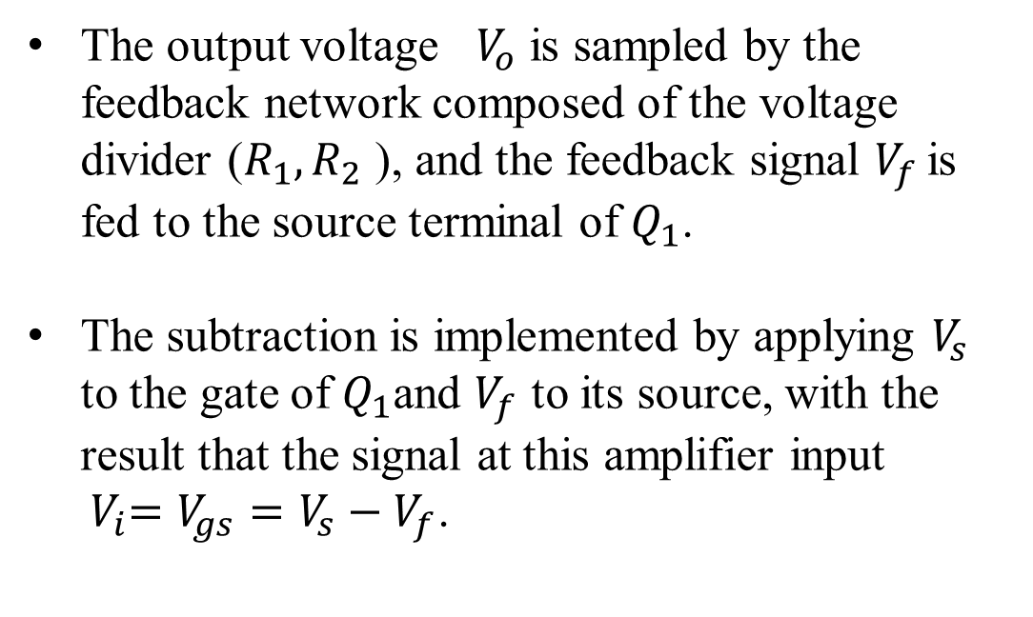
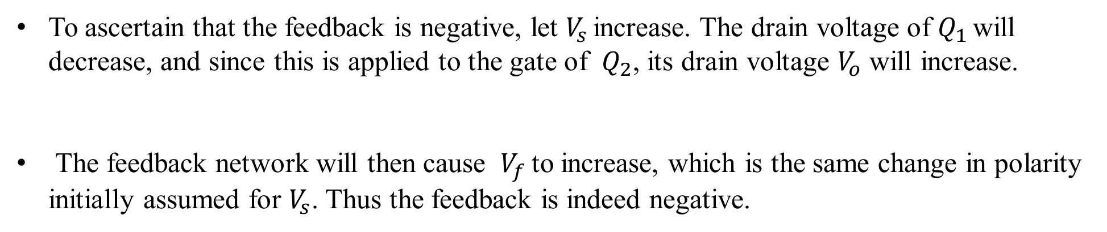
The output voltage $V_{o}$ is sampled by the feedback network composed of the voltage divider ($R_{1}, R_{2}$ ), and the feedback signal $V_{f }$is fed to the source terminal of $Q_{1}$.
The subtraction is implemented by applying $V_{s}$ to the gate of $Q_{1}$and $V_{f}$ to its source, with the result that the signal at this amplifier input
${ V}_{i}=V_{gs}=V_{s}−V_{f}$.
To ascertain that the feedback is negative, let $V_{s }$increase. The drain voltage of $Q_{1 }$will decrease, and since this is applied to the gate of $Q_{2}$, its drain voltage $V_{o}$ will increase.
The feedback network will then cause $V_{f }$to increase, which is the same change in polarity initially assumed for $V_{s}$. Thus the feedback is indeed negative.

Slide 26
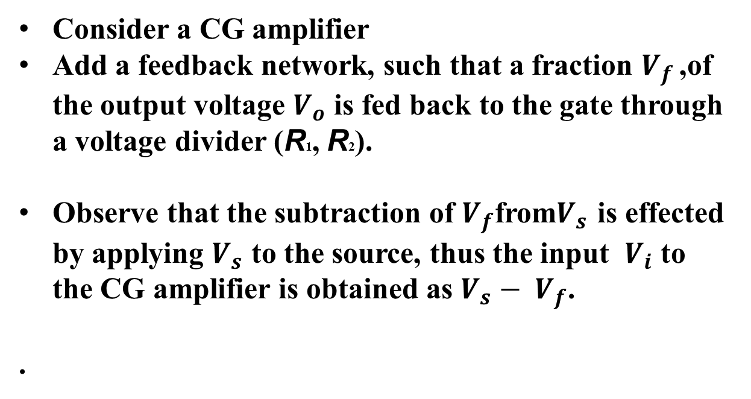
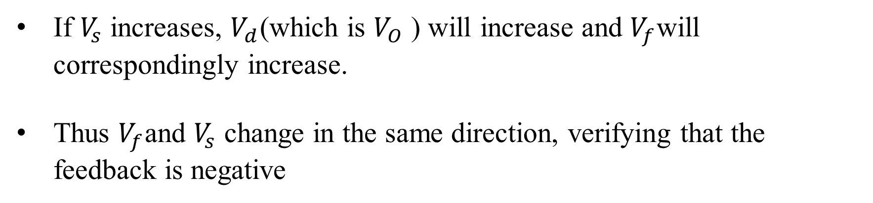
Consider a CG amplifier
Add a feedback network, such that a fraction $V_{f }$,of the output voltage $V_{o}$ is fed back to the gate through a voltage divider (R1, R2).
Observe that the subtraction of $V_{f}$from$V_{s}$ is effected by applying $V_{s}$ to the source, thus the input $V_{i}$ to the CG amplifier is obtained as $V_{s}− V_{f}$.
.
If $V_{s}$ increases, $V_{d}$(which is $V_{O}$ ) will increase and $V_{f}$will correspondingly increase.
Thus $V_{f}$and $V_{s}$ change in the same direction, verifying that the feedback is negative

Slide 27

Example: Open Loop Parameters
$$V_{G}$$

Slide 28
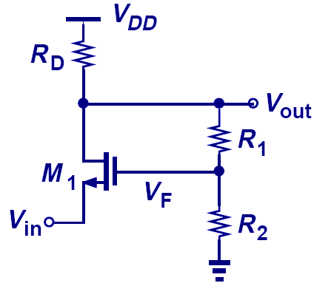

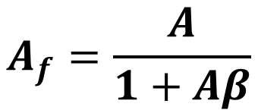
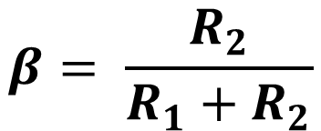
Example: Closed Loop Voltage Gain
$$β= \frac{R_{2}}{R_{1}+R_{2}}$$
$$A_{f}=\frac{A}{1+Aβ}$$
Substitute the values of A and $β$

Slide 29
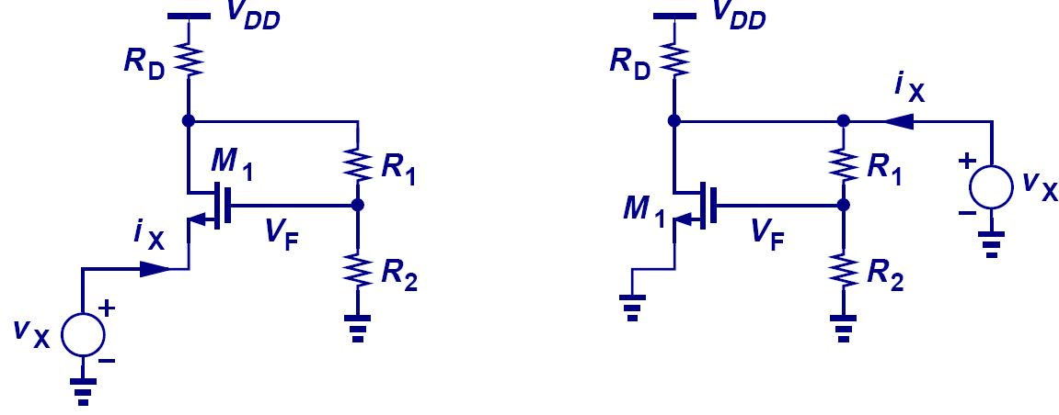
Example: Closed Loop I/O Impedance
Being voltage amplifier so series mixing and shunt sampling results in

Slide 30
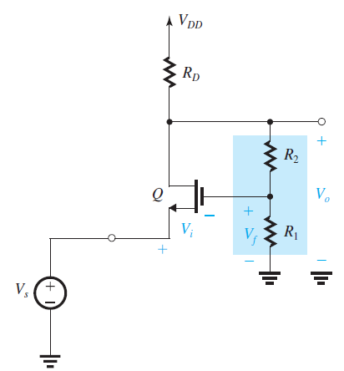

Slide 32
2.

Slide 33
The input signal in a current amplifier is essentially a current, and thus the signal source is most conveniently represented by its Norton equivalent.
The output quantity of interest is current; hence the feedback network should sample the output current, just as a current meter measures a current.
The feedback signal should be in current form so that it may be mixed in shunt with the source current.
Thus the feedback topology most suitable for a current amplifier is the current-mixing, current-sampling topology, Because of the parallel (or shunt) connection at the input, and the series connection at the output, this feedback topology is also known as shunt–series feedback
This topology not only stabilizes the current gain but also results in a lower input resistance, and a higher output resistance

Slide 34
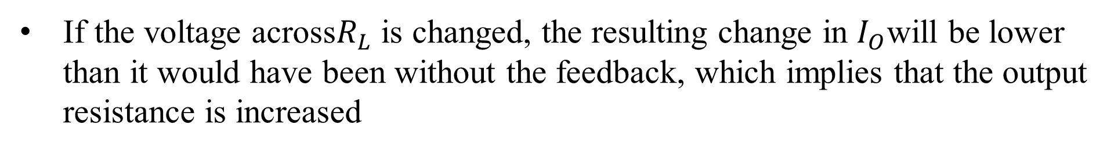
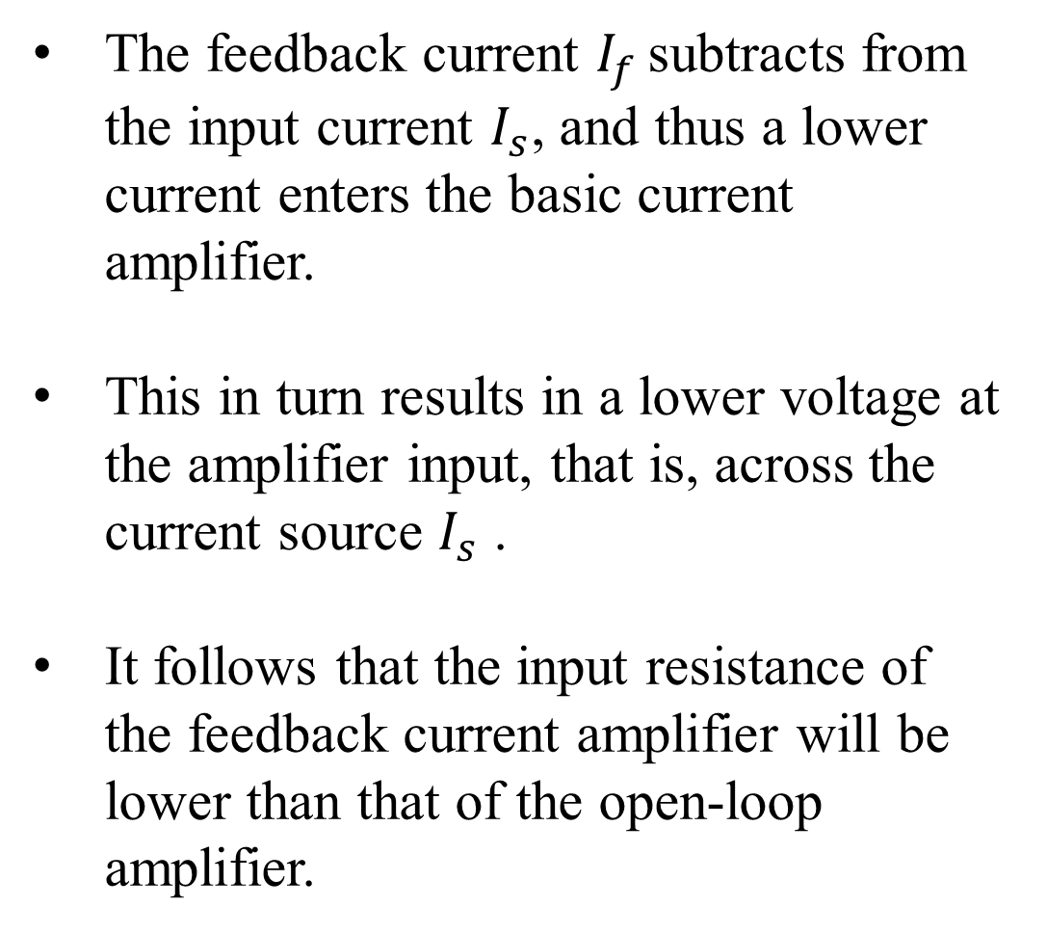
The feedback current $I_{f }$subtracts from the input current $I_{s}$, and thus a lower current enters the basic current amplifier.
This in turn results in a lower voltage at the amplifier input, that is, across the current source $I_{s}$ .
It follows that the input resistance of the feedback current amplifier will be lower than that of the open-loop amplifier.
If the voltage across$R_{L}$ is changed, the resulting change in $I_{O}$will be lower than it would have been without the feedback, which implies that the output resistance is increased

Slide 35
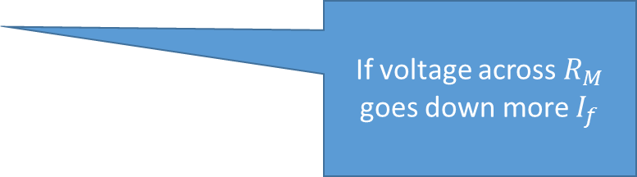
If voltage across $R_{M}$ goes down more $I_{f}$

Slide 36
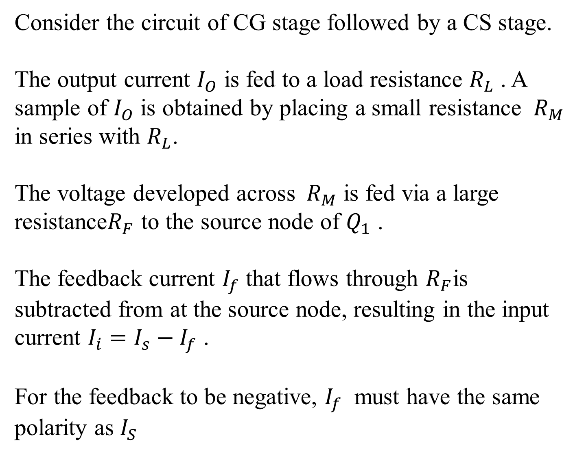
Consider the circuit of CG stage followed by a CS stage.
The output current $I_{O}$ is fed to a load resistance $R_{L}$ . A sample of $I_{O}$ is obtained by placing a small resistance ${ R}_{M}$ in series with $R_{L}$.
The voltage developed across${ R}_{M}$ is fed via a large resistance$R_{F}$ to the source node of $Q_{1}$ .
The feedback current $I_{f}$ that flows through $R_{F}$is subtracted from at the source node, resulting in the input current $I_{i}=I_{s}−I_{f}$ .
For the feedback to be negative, $I_{f}$ must have the same polarity as $I_{S}$

Slide 37



$$i=\frac{1}{2}K_{n}^{/}{\left(v_{g}−v_{s}−V_{T}\right)}^{2}$$
$$I_{O}=−g_{m2}v_{gs2}$$
$$But v_{gs2} is given by R_{D}I_{i}$$

Slide 38
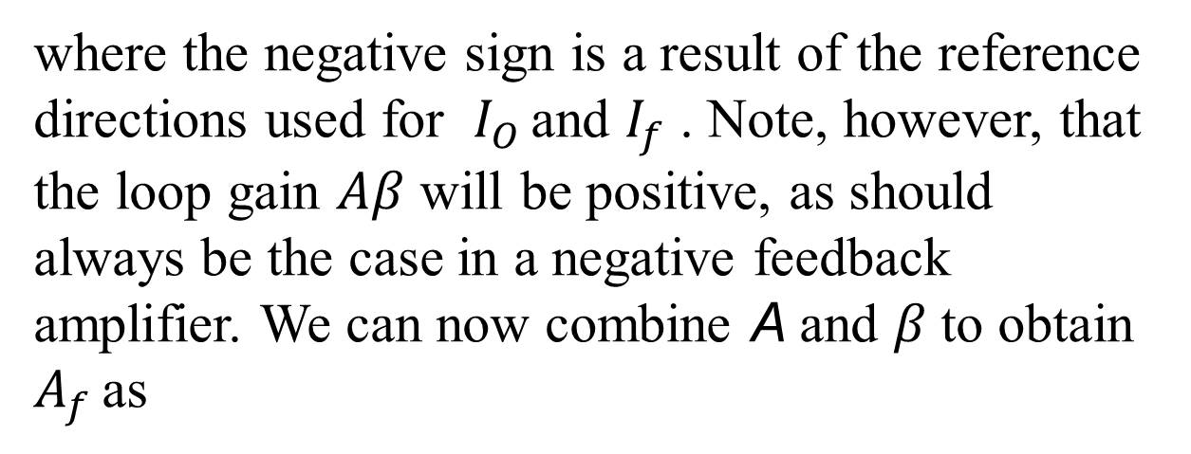
where the negative sign is a result of the reference directions used for $I_{O }$and $I_{f}$ . Note, however, that the loop gain $Aβ$ will be positive, as should always be the case in a negative feedback amplifier. We can now combine A and $β$to obtain $A_{f }$as

Slide 40
Lecture sections A & B 1st December 2022

Slide 41
3.
Trans-conductance Amplifier
Current Output
Voltage input
(Thevenin Source)
Voltage mixing-Current sensing
Series-Series Feedback Topology
Input Resistance increases-Output resistance also increases

Slide 42
Example:1

Slide 43
Example:2

Slide 44
Trans-resistance
4.
Current mixing-Voltage sensing
Parallel-Parallel Feedback Topology
Input Resistance decreases-Output resistance also decreases

Slide 45
Example:1

Slide 46

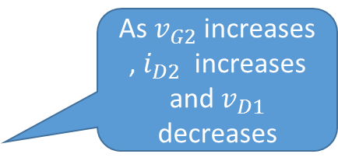
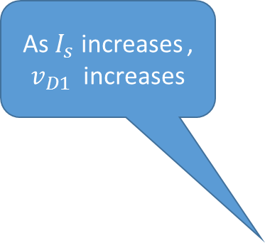
As $v_{G2}$ increases , $i_{D2}$ increases and $v_{D1}$ decreases
Example:2
As $I_{s}$ increases , $v_{D1}$ increases
$I_{f}$ increases , Thus negative FeedBack

Slide 48
Moving from idealized models to practical models

Slide 49
Our study of feedback topologies has been based on idealized models for the feedback network, always assuming that the I/O impedances of this network are very large or very small depending on the type of feedback.

Slide 50
In practice, however, the finite I/O impedances of the feedback network may considerably alter the performance of the circuit, thereby necessitating analysis techniques to account for these effects.
In such cases, we say the feedback network “loads” the forward amplifier and the “loading effects” must be determined.

Slide 51
Voltage –voltage amp. analysis

Slide 52
This is our basic (Ideal) voltage – voltage amplifier block diagram
Series Mixing
Shunt Sampling
Voltage Mixing
Voltage Sampling

Slide 53
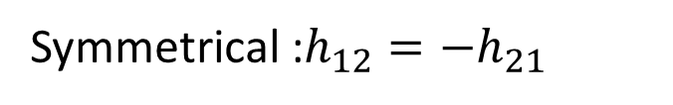
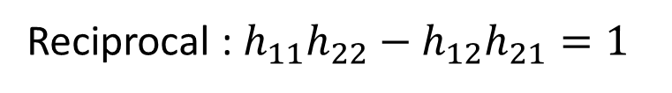
Introduction to Two Port Networks
Hybrid Parameters:
$$V_{1} and I_{2} are the dependent variables$$
$$I_{1} and V_{2} are the independent variables$$
$$V_{1}=h_{11}I_{1}+h_{12}V_{2}$$
$$I_{2}=h_{21}I_{1}+h_{22}V_{2}$$
Resistance
Reverse Voltage Gain
I₁ = 0
V₂ = 0
Conductance
Forward Current Gain
Reciprocal : $h_{11}h_{22}−h_{12}h_{21}=1$
Symmetrical :$h_{12}=−h_{21}$
V₂ = 0
I₁ = 0
Notes:
The H parameters are used almost solely in electronics. These parameters are used in the equivalent circuit
Of a transistor. As you will see, the H parameter equations directly set-up so as to describe the device in terms
Of the h_{ij} parameters which are given by the manufacturer. You will use this material in junior electronics.

Slide 54
These equations are used for constructing $β$ circuit
$$V_{1}=h_{11}I_{1}+h_{12}V_{2}$$
$$I_{2}=h_{21}I_{1}+h_{22}V_{2}$$
Using two-port network analysis converted feedback circuit ($β−Circuit)$ into equivalent model

Slide 55
The current source $h_{21}I_{1}$ represents the forward transmission of the feedback network. Since the feedback network is usually passive, its forward transmission can be neglected in comparison to the much larger forward transmission of the basic amplifier

Slide 56
$$R_{S} R_{L}, h_{11}and h_{22} are taken inside circuit A$$
Now my circuit looks similar to basic circuit and I can apply my standard formulas

Slide 57
V₂ = 0
I₁ = 0

Slide 58
Example of applying these concepts

Slide 61
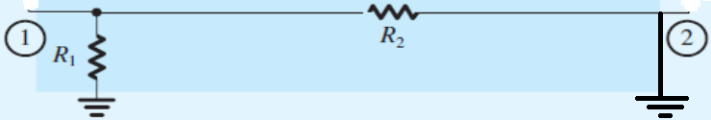
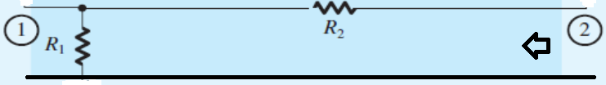
Calculation of h-parameters of $β−network$

Slide 64
SUMMARY
We observe that the feedback network- $β$consists of $R_{1} and R_{2}$.
This network samples the output voltage $V_{O}$ and provides a voltage signal (across $R_{1}$) that is mixed in series with the input source $V_{S}$. (so the topology is voltage-voltage)
The A circuit can be easily obtained by using procedure in two-port network (h-parameters)
Observe that the loading effect of the feedback network at the input side is obtained by short-circuiting port 2 of the feedback network (because it is connected in shunt) and looking into port 1, with the result that $R_{11}=R_{1}∖∖R_{2}$.
The loading effect of the feedback network at the output side is found by open-circuiting
port 1 (because it is connected in series) and looking into port 2, with the result that $R_{22}=R_{2}+R_{1}$
Now by just applying our standard formulas we get all desired parameters

Slide 65
Example No 2

Slide 66
Can we determine the Topology and the Polarity as well, if not known already

Slide 69
Infinite so neglected

