Slide 1
Lec Dec-2

Slide 2
Trans-conductance Amplifier
Series-Series

Slide 4
Trans-conductance Amplifiers
Transconductance amplifier – accepts input voltage and generates output current.
Norton Source Output
Voltage-mixing / current-sampling – topology is most suitable for transconductance amps.
Is also known as series-series feedback.
Provides high input resistance/high output resistance.

Slide 9
Ideal series-series feedback (cont.)
Feedback Topologies
1. Gain of feedback amplifier
2. Input resistance with feedback
3.Output resistance with feedback

Slide 11
Two Port Networks
The Z parameter equations can be expressed in matrix form as follows.
z₁₁ is the impedance seen looking into port 1
when port 2 is open.
z₁₂ is a transfer impedance. It is the ratio of the
voltage at port 1 to the current at port 2 when
port 1 is open.
z₂₁ is a transfer impedance. It is the ratio of the
voltage at port 2 to the current at port 1 when
port 2 is open.
z₂₂ is the impedance seen looking into port 2
when port 1 is open.

Slide 13
Note now it is in series

Slide 18
Now lets find a systematic and generalized way of approaching a practical circuit

Slide 19
Inclusion of I/O Effects in feedback topologies
We present a methodology here that allows the analysis of the four feedback topologies even if the I/O impedances of the forward amplifier or the feedback network depart from their ideal values. The methodology is based on a formal proof that is somewhat handled previously using two-port network .
Our methodology proceeds in six steps:
1. Identify the forward amplifier.
2. Identify the feedback network.
3. Break the feedback network according to the rules described below.
4. Calculate the open-loop parameters.
5. Determine the feedback factor according to the rules described below
6. Calculate the closed-loop parameters

Slide 20
The third step is carried out by “duplicating” the feedback network at both the input and the output of the overall system
The copy tied to the output is called the “sense duplicate” and that connected to the input, the “return duplicate.”
We must also decide what to do with the output port of the former and the input port of the latter, i.e., whether to short or open these ports.

Slide 21
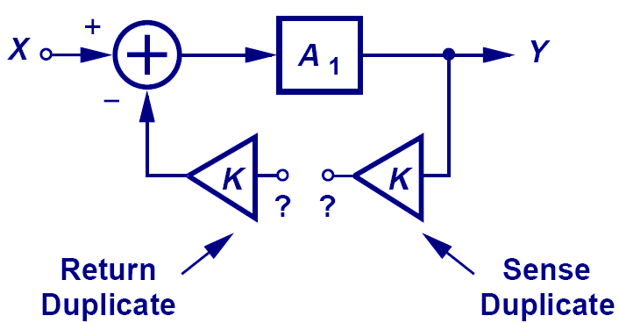
How to Break a Loop
The correct way of breaking a loop is such that the loop does not know it has been broken. Therefore, we need to present the feedback network to both the input and the output of the feedforward amplifier.

Slide 22
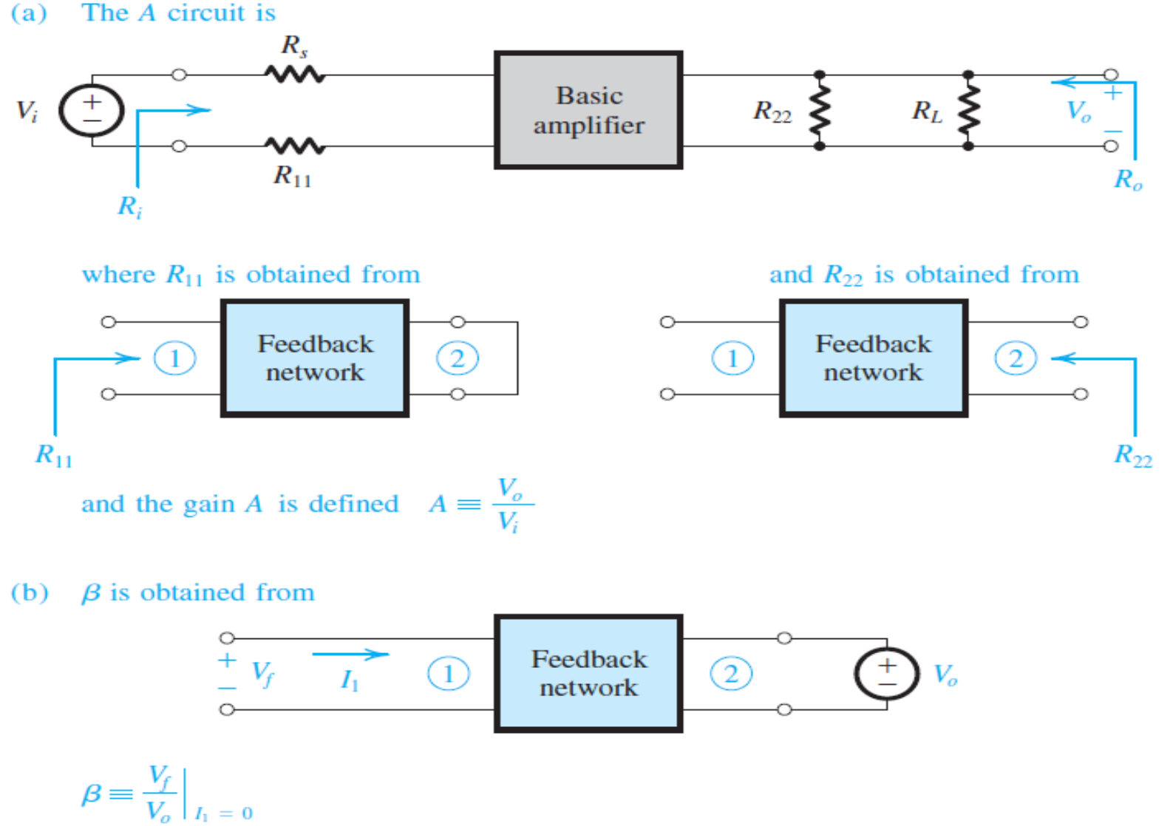
Simplified rule
If shunt connection short circuit the port
If series connection open circuit the port

Slide 23
Voltage -voltage

Slide 24
Trans-conductance Amplifier
Voltage mixing – current sensing
Series-Series

Slide 26
Trans-resistance Amplifier
Current mixing –Voltage sensing
Parallel -parallel

Slide 28
The Feedback Current Amplifier
(Shunt–Series)
Current mixing – current sensing

Slide 30
Voltage
Trans-resistance
Current
Trans-conductance

Slide 31
Calculation of feedback factor
Depending on the type of feedback, the output port of the feedback network is shorted or opened, and the ratio of the output current or voltage to the input is defined as the feedback factor. For example, in a voltage-voltage feedback topology, the output port of the feedback network is open
Trans-Resistance
Trans-Conductance

Slide 32
Breaking
Finding feedback
Voltage Amplifier

Slide 33
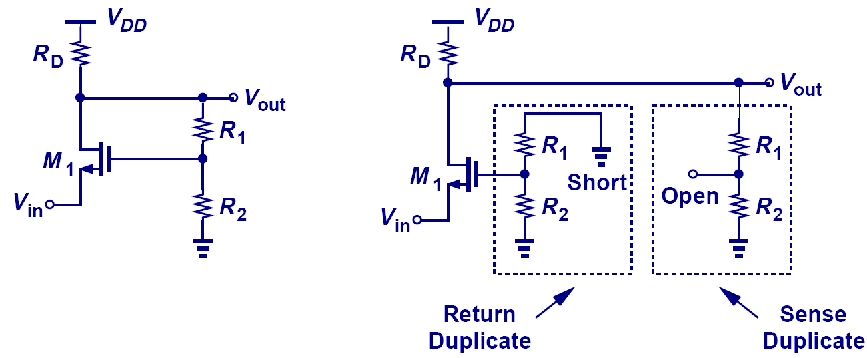
Breaking the Loop Example I

Slide 34
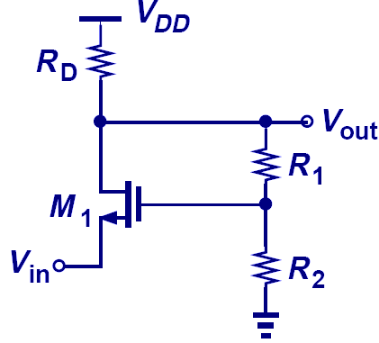
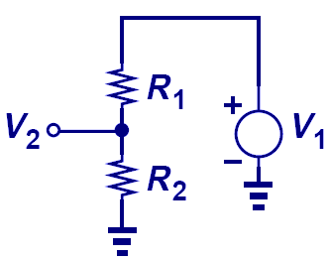
Feedback Factor Example I

Slide 35
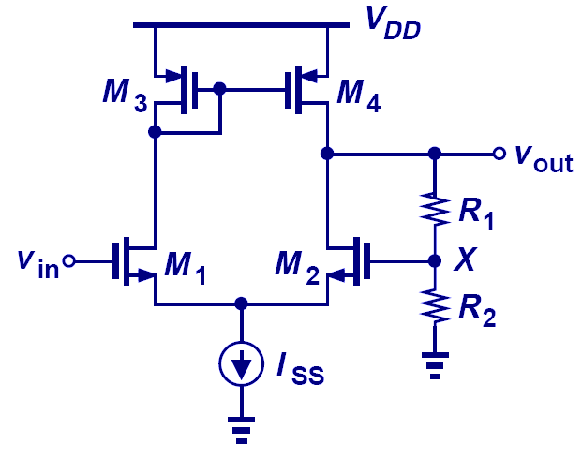
Polarity of Feedback Example I
Negative Feedback

Slide 36
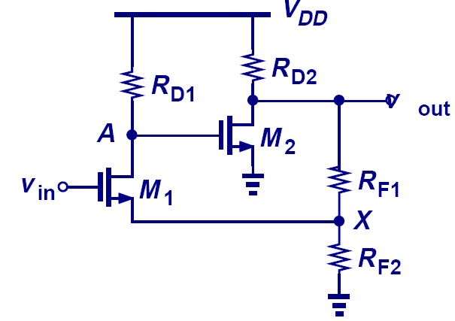
Polarity of Feedback Example II
Negative Feedback

Slide 37
Feedback relationship
Feedback Topologies
 | Gain | Input resistance | Output resistance
Without feedback | A | R_{i} | R_{o}
Series-shunt
Series-series
Shunt-shunt
Shunt-series

