Slide 1


Slide 2
Compensators

Slide 3
Introduction
If a system is unstable
It is then required to reconsider the structure of the system and redesign the system.
The design problems, therefore, become those of improving system performance by insertion of a compensator.
Compensator: A compensator is an additional component or circuit that is inserted into a control system to equalize or compensate for a deficient performance.

Slide 4
Introduction
Necessities of compensation
A system may be unsatisfactory in：
Stability.
Speed of response.
Steady-state error.
Thus the design of a system is concerned with the alteration of the frequency response or the root locus of the system in order to obtain a suitable system performance.

Slide 5
Compensation via Root Locus
Performance measures in the time domain:
Peak time;
Overshoot;
Settling time for a step input;
Steady-state error for test inputs
These performance specifications can be defined in terms of the desirable location of the poles and zeros of the closed-loop.
Root locus method can be used to find a suitable compensator G_{c}(s) so that the resultant root locus results in the desired closed-loop root configuration.

Slide 6
Compensation via Root Locus
The design by the root-locus method is based on reshaping the root locus of the system by adding poles and zeros to the system’s open-loop transfer function and forcing the root loci to pass through desired closed-loop poles in the s plane.
The characteristic of the root-locus design is its being based on the assumption that the closed-loop system has a pair of dominant closed-loop poles.
This means that the effects of zeros and additional poles do not affect the response characteristics very much.

Slide 7
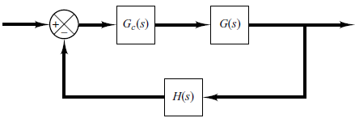
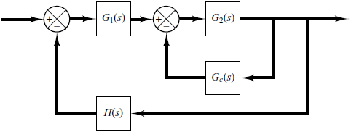
Compensator Configurations
Compensation schemes commonly used for feedback control systems are:
Series Compensation
Parallel Compensation

Slide 8
Compensator Configurations
The choice between series compensation and parallel compensation depends on
the nature of the signals
the power levels at various points
available components
the designer’s experience
economic considerations and so on.

Slide 9
Commonly Used Compensators
Among the many kinds of compensators, widely employed compensators are the
lead compensators
lag compensators
lag–lead compensators

Slide 10
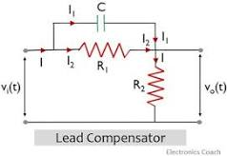
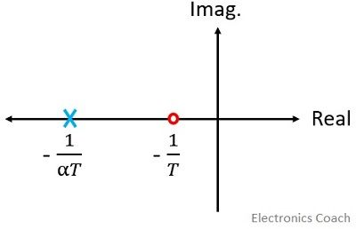
lead compensators
Definition: A lead compensator is an electrical circuit that when provided with a sinusoidal input generates a sinusoidal signal as output with a phase lead in comparison to that of the applied sinusoidal signal.
A lead network has a pole and a dominating zero.
A dominating zero is defined as the one which is nearest to the origin than all the other zeros. For a lead network, the poles and zeros must be present on the negative real axis of the s-plane.
Note the zero will be on right of pole

Slide 11
Advantages of Lead Compensator
we have discussed that lead compensator introduces a dominant zero and a pole to the transfer function. Hence this improves damping of the overall system.
The enhanced damping of the system supports less overshoot along with less rise time and settling time. Therefore, the transient response gets improved.
The addition of lead network improves phase margin.
A system with lead network provides a quick response as it increases bandwidth thereby providing a faster response.
Lead networks do not disturb the steady-state error of the system.
It maximizes the velocity constant of the system.

Slide 12
Disadvantages of Lead Compensator
The introduction of the lead network in the system adds some attenuation to it. Thus to compensate the attenuation there must be an additional gain enhancement. But with an increase in gain, the requirement of more element increases. This leads to cause cost enhancement as well as more weight and greater space.
The lead network reduces the overshoot, this increases the conditions of undershoot. This sometimes makes the system conditionally stable.
A single lead network offers a lead angle of about 60°. Thus for the higher lead of around 70 to 90° multiple lead compensator is required to be added with the system.
The lead network increases bandwidth but with increased bandwidth, the system becomes more susceptible to noise.

Slide 13
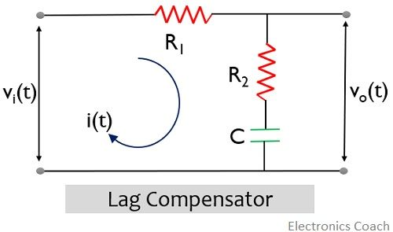
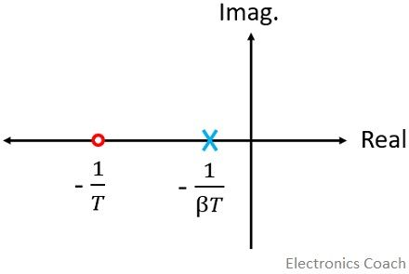
lag compensators
The phase lag compensator performs just reverse operation as that of the Lead compensator . It introduces a phase lag in the steady-state output when the input signal is provided to it.
A lag compensator has zero and dominating pole. A dominating pole is the pole present nearest to the origin in comparison to all the other poles in the s-plane. And the poles and zeros must be present on the negative real axis.

Slide 14
Advantages of Lag Compensator
A phase lag network offers high gain at low frequency. Thus, it performs the function of a low pass filter.
The introduction of this network increases the steady-state performance of the system.
The lag network offers a reduction in bandwidth and this provides longer rise time and settling time and so the transient response.

Slide 15
Disadvantages of Lag Compensator
In lag compensator, the attenuation offered by it shifts the gain crossover frequency to a lower point, thereby decreasing the bandwidth.
Though the system response is longer due to decreased bandwidth; however, the response is quite slow.
A control system with a lag network shows more sensitivity towards variation in the parameters than a system with a lead network.
Like in lead compensator, in lag compensator also, due to the addition of external network, some attenuation is introduced. So, the overall gain must be increased to handle the attenuation. But this will increase the requirement of more elements and so the cost and space requirement.

Slide 16
Commonly Used Compensators
lag–lead compensators
In a lag–lead network, both phase lag and phase lead occur in the output but in different frequency regions.
Phase lag occurs in the low-frequency region and phase lead occurs in the high-frequency region.

Slide 17
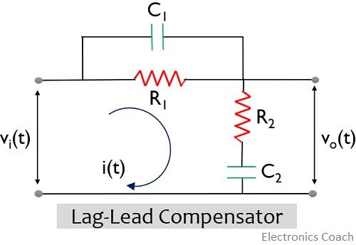
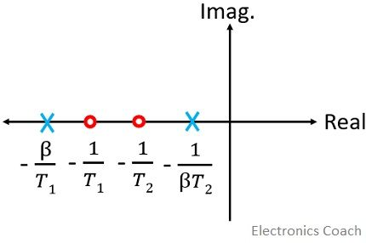
Need for Lag Lead Compensator
Generally, compensation in a control system is majorly done for two main reasons. Like for an absolutely unstable system, compensation is done in order to stabilize the system.
While sometimes the system is stable still, we don’t achieve the desired performance where the desired performance depends on various system parameters.
The figure above shows the pole-zero plot of the lag lead compensator:

Slide 18
The lead characteristics of the cascaded compensator provide improvement in the overall bandwidth.
Also, due to the use of the lag network, the steady-state performance of the system gets improved.
So, we can say, a lag lead network provides a quick response with good accuracy. The low-frequency gain of the system is increased with this network, thereby improving the steady-state response. Hence, we use a combination of lag and lead network as a compensator to provide required compensation to the control system.

Slide 19
Compensators Design
Using root locus techniques, we have seen how the pole positions of a closed loop can be adjusted by varying a parameter

Slide 20
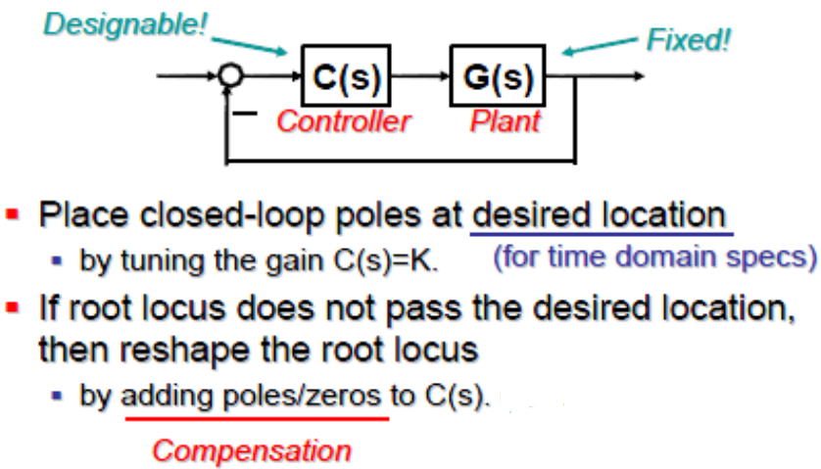
Closed Loop Designed Using Root Locus

Slide 21
General Effect of Addition of Poles

Slide 22
General Effect of Addition of Zeros

Slide 23
Effect of Addition of Poles on Root Locus
The addition of a pole to the open-loop transfer function has the effect of pulling the root locus to the right, tending to lower the system’s relative stability and to slow down the settling of the response.

Slide 24
Effect of Addition of poles
Add a Pole at -1

Slide 25
Effect of Addition of poles

Slide 26
Effect of Addition of Zeros on Root Locus
The addition of a zero to the open-loop transfer function has the effect of pulling the root locus to the left, tending to make the system more stable and to speed up the settling of the response.
Physically, the addition of a zero in the feed forward transfer function means the addition of derivative control to the system.
The effect of such control is to introduce a degree of anticipation into the system and speed up the transient response.

Slide 27
Effect of Addition of zeros
Add a zero at -3

Slide 28
Effect of Addition of zeros
Add a zero at -3
Continued…..

Slide 29
Some Remarks

Slide 30
Lead/Lag Compensation
Lead/Lag compensation is very similar to PD/PI, or PID control.
The lead compensator plays the same role as the PD controller, reshaping the root locus to improve the transient response.
Lag and PI compensation are similar and have the same response: to improve the steady state accuracy of the closed-loop system.
Both PID and lead/lag compensation can be used successfully, and can be combined.

Slide 31
Lead and Lag Compensator

Slide 32
Examples

Slide 33
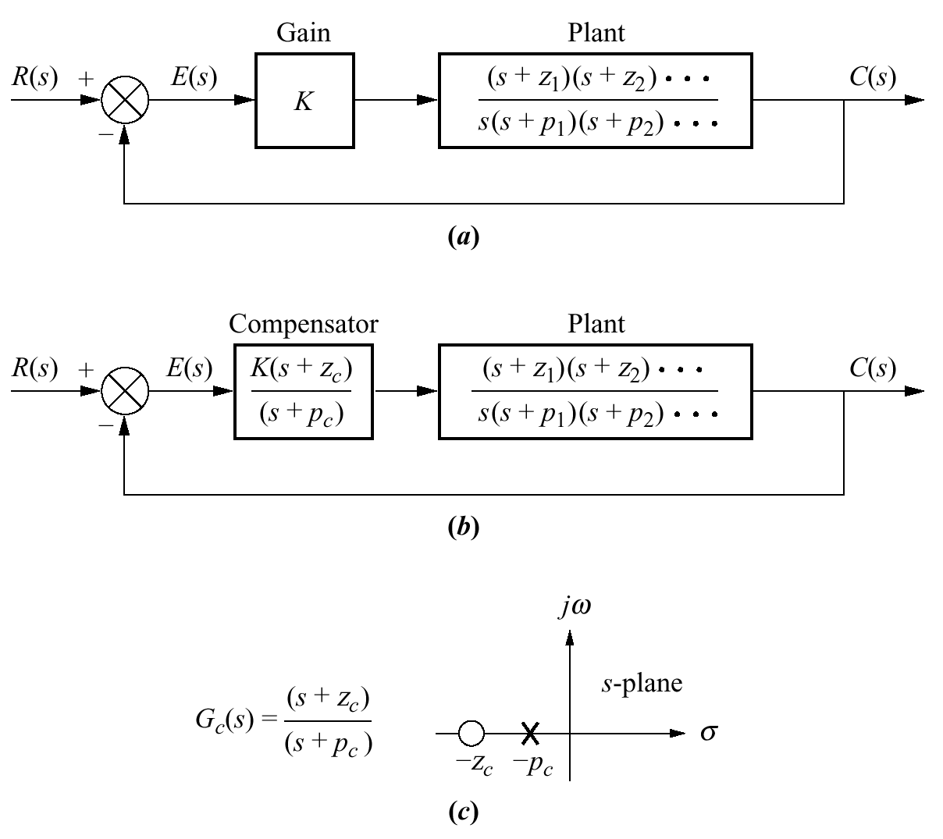
Lag Compensator
uncompensated:
original
compensated:
added pole and zero

Slide 34
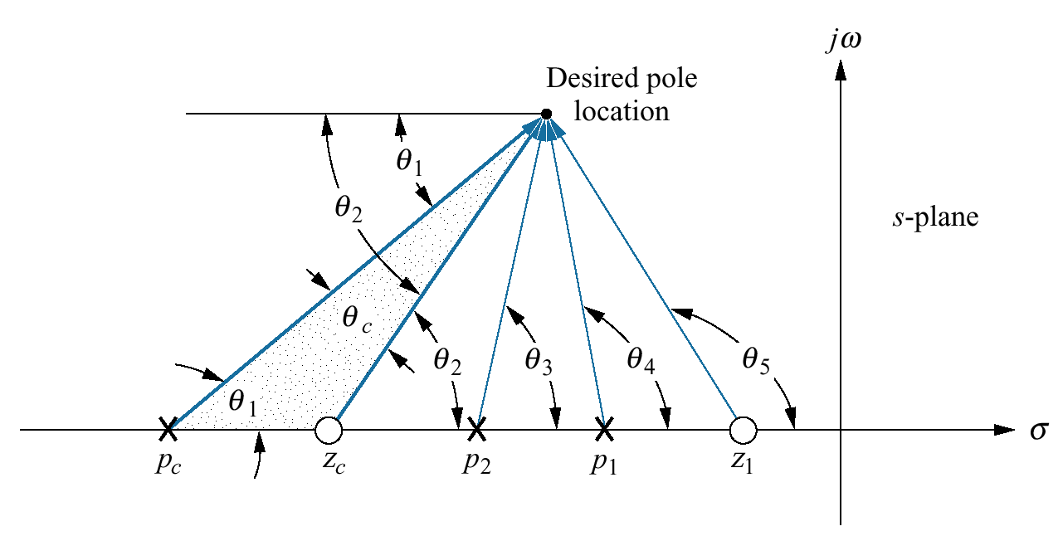
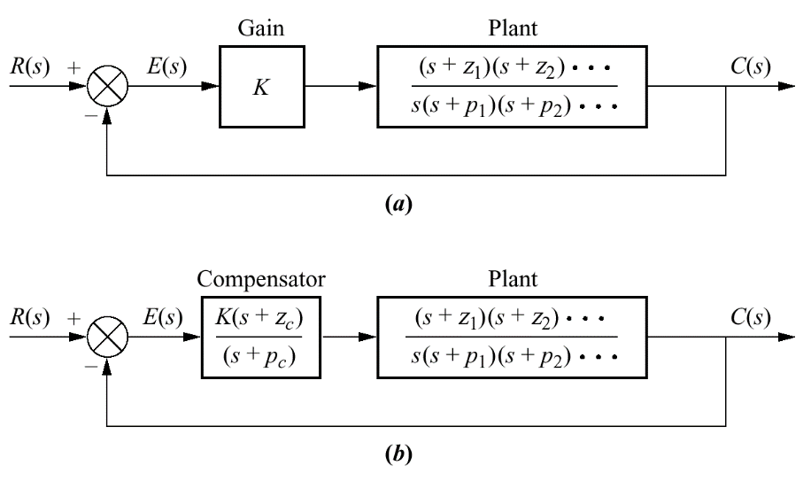
Lead Compensator

Slide 35
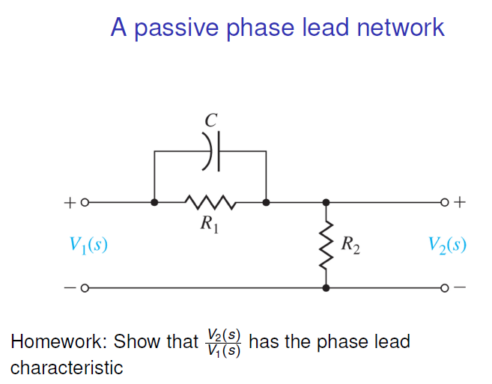

Slide 38
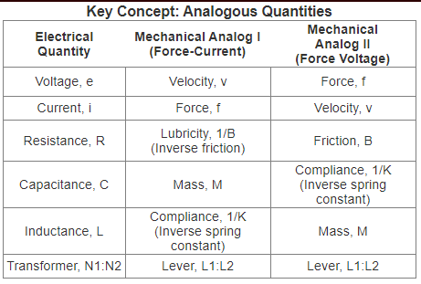
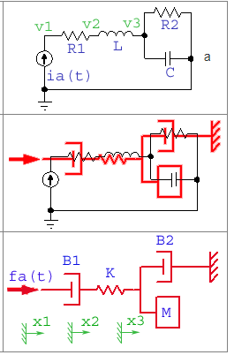
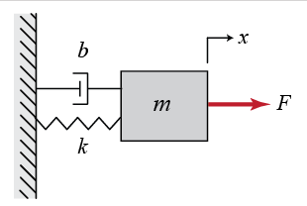
Analogous Electrical and Mechanical Systems
Conversion from Electrical to Mechanical and vice versa

Slide 39
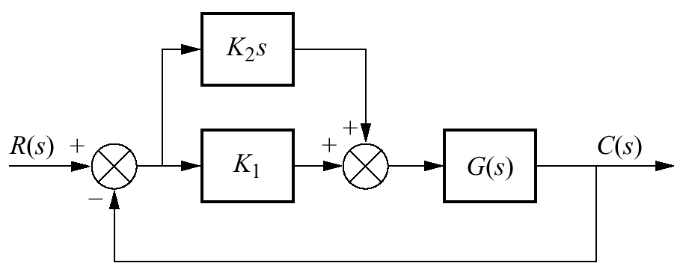
Proportional + Derivative (PD)

Slide 40
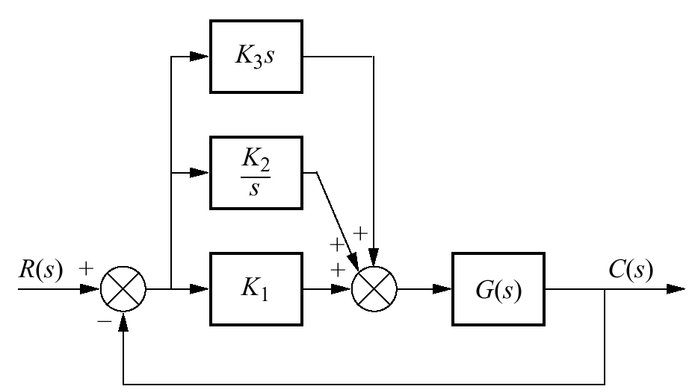
Proportional + Integral+ Derivative (PID)

Slide 41
Output Stages and Power Amplifiers
Chapter No 11

Slide 42
IN THIS CHAPTER YOU WILL LEARN
The classification of amplifier output stages on the basis of the fraction of the cycle of an input sine wave during which the transistor conducts.
2 Analysis and design of a variety of output-stage types ranging from the simple but power-inefficient emitter follower (class A) to the popular push–pull class AB circuit in both bipolar and CMOS technologies.
3. Thermal considerations in the design and fabrication of high-output power circuits.
4. Useful and interesting circuit techniques employed in the design of power amplifiers.
5. Special types of MOS transistors optimized for high-power applications

Slide 43
Introduction
One important aspect of an amplifier is output resistance.
This affects its ability to deliver a load without loss of gain (or significant loss).
Large signals are of interest and --small-signal models cannot be applied.
Most challenging aspect of output stage design is efficiency.
Power dissipation is highly correlated to internal junction temperature

Slide 44
Power De-rating
For example, a transistor such as the TIP31 having a quoted maximum power output PTOT of 40W can only handle 40W of power IF the case temperature (slightly less than the junction temperature) is kept below 25°C. The performance of a power transistor is closely dependant on its ability to dissipate the heat generated at the collector base junction. Minimising the problem of heat is approached in two main ways:
1. By operating the transistor in the most efficient way possible, that is by choosing a class of biasing that gives high efficiency and is least wasteful of power.
2. By ensuring that the heat produced by the transistor can be removed and effectively transferred to the surrounding air as quickly as possible.

Slide 45
a. Shows a tube of heat-sink compound.
b. Shows a TO220 clip on heat-sink.
c. Shows a TIP31 transistor, which has a TO220 package type, ready for mounting.
d. Shows the metal body of the transistor smeared with heat-sink compound. This is essential to create efficient heat transfer between the transistor and heat-sink.
e. Shows the transistor fitted to the heat-sink.
f. Shows an alternative method of mounting, used when the metal body of the transistor

Slide 46
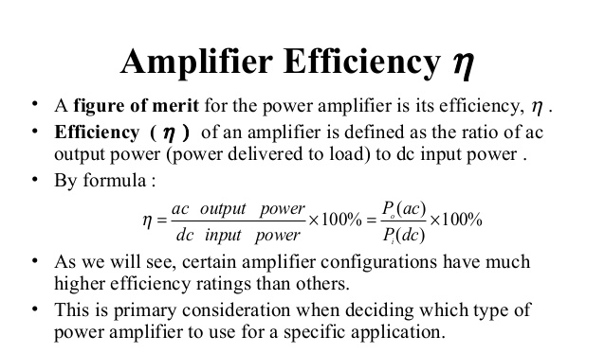

Slide 47
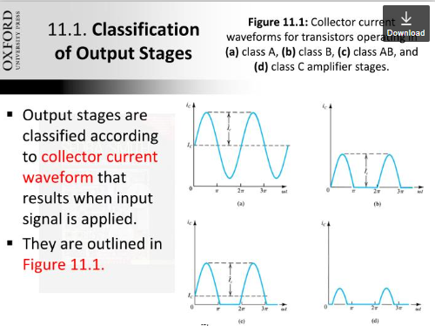
Classification of Amplifiers
Collector current waveforms for transistors operating in (a) class A,
(b) class B, (c) class AB, and (d) class C amplifier stages

Slide 48
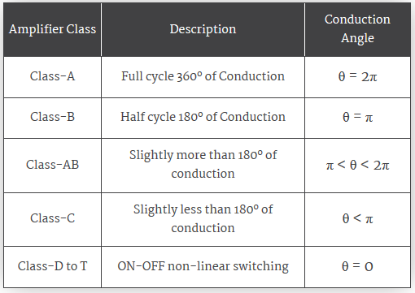
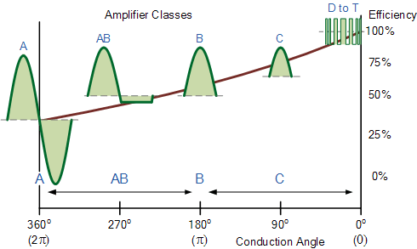
Classification of Amplifiers

Slide 49
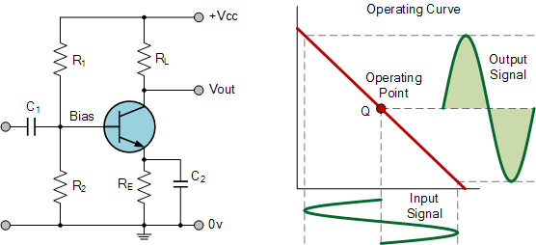
Class A amplifiers
Class-A amplifiers are inefficient. A maximum theoretical efficiency of 25% is obtainable using usual configurations, but 50% is the maximum for a transformer or inductively coupled configuration.

Slide 50
To achieve high linearity and gain, the output stage of a class A amplifier is biased “ON” (conducting) all the time.
As a class A amplifier operates in the linear portion of its characteristic curves, the single output device conducts through a full 360 degrees of the output waveform.
Since a class A amplifier operates in the linear region, the transistors base (or gate) DC biasing voltage should by chosen properly to ensure correct operation and low distortion. However, as the output device is “ON” at all times, it is constantly carrying current, which represents a continuous loss of power in the amplifier.
Due to this continuous loss of power class A amplifiers create tremendous amounts of heat adding to their very low efficiency at around 25%, making them impractical for high-power amplifications. Also due to the high idling current of the amplifier, the power supply must be sized accordingly and be well filtered to avoid any amplifier hum and noise.

Slide 51
Class A amplifier Biasing
Class A amplifiers are biased with a DC voltage applied across the transistor base-emitter junction so that their quiescent (or no signal) operating point is on a linear part of the transistor’s characteristics.
Also, the signal waveform applied to the base should not drive the transistor either into saturation or into cut-off. If this were allowed to happen it would cause the waveform peaks to be flattened, causing distortion.

Slide 52
Class A amplifier Biasing
In class A biasing, the collector voltage is kept at approximately half the supply voltage, however this means that the transistor is permanently passing collector current, even when no signal is applied, so power is being wasted, and although class A provides for very low distortion, it is also relatively inefficient in its use of power.

Slide 53
Class B amplifiers

Slide 54
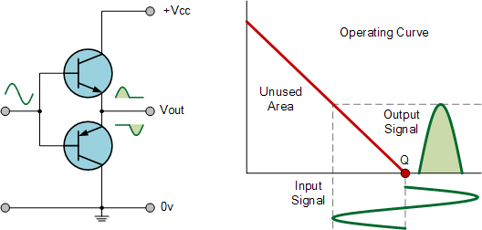
Class B amplifier
Class B amplifiers were invented as a solution to the efficiency and heating problems associated with the previous class A amplifier.
The basic class B amplifier uses two complimentary transistors either bipolar of FET for each half of the waveform with its output stage configured in a “push-pull” type arrangement, so that each transistor device amplifies only half of the output waveform.
In the class B amplifier, there is no DC base bias current as its quiescent current is zero, so that the dc power is small and therefore its efficiency is much higher than that of the class A amplifier. However, the price paid for the improvement in the efficiency is in the linearity of the switching device.

Slide 55
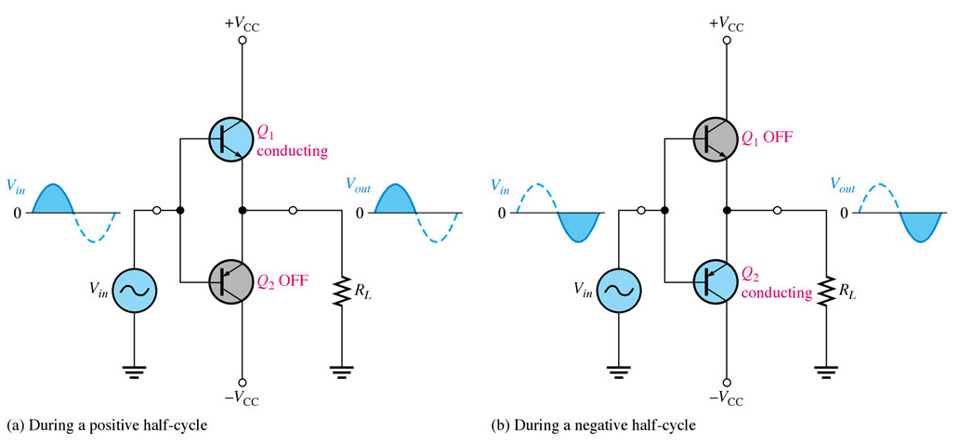
Class-B amplifier

Slide 56
Transfer Characteristics of Class B amplifier

Slide 57
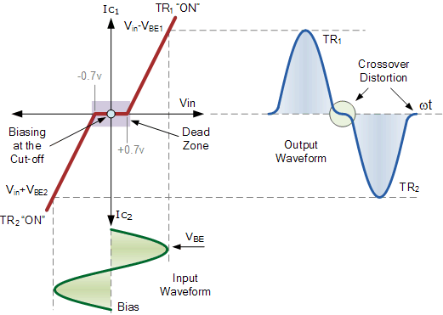

Slide 58
When the input signal goes positive, the positive biased transistor conducts while the negative transistor is switched “OFF”. Likewise, when the input signal goes negative, the positive transistor switches “OFF” while the negative biased transistor turns “ON” and conducts the negative portion of the signal.
Thus the transistor conducts only half of the time, either on positive or negative half cycle of the input signal.
Then we can see that each transistor device of the class B amplifier only conducts through one half or 180 degrees of the output waveform in strict time alternation, but as the output stage has devices for both halves of the signal waveform the two halves are combined together to produce the full linear output waveform.

Slide 59
This push-pull design of amplifier is obviously more efficient than Class A, at about 50%, but the problem with the class B amplifier design is that it can create distortion at the zero-crossing point of the waveform due to the transistors dead band of input base voltages from -0.7V to +0.7.
Recall that it takes a base-emitter voltage of about 0.7 volts to get a bipolar transistor to start conducting. Then in a class B amplifier, the output transistor is not “biased” to an “ON” state of operation until this voltage is exceeded.
This means that the part of the waveform which falls within this 0.7 volt window will not be reproduced accurately making the class B amplifier unsuitable for precision audio amplifier applications.
To overcome this zero-crossing distortion (also known as Crossover Distortion) class AB amplifiers were developed.

Slide 60
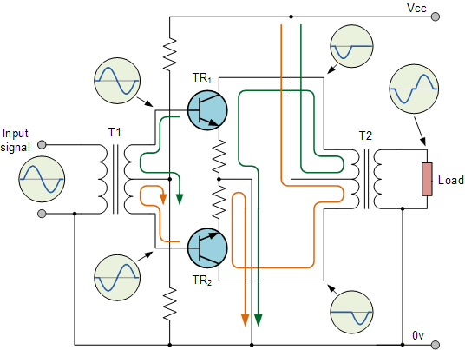
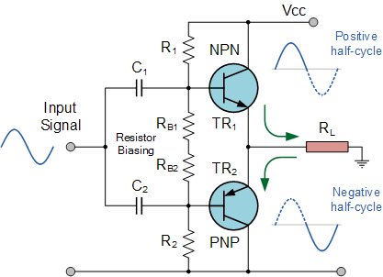
TRANSFORMER COUPLED PUSH-PULL

Slide 61
A practical circuit example

Slide 62
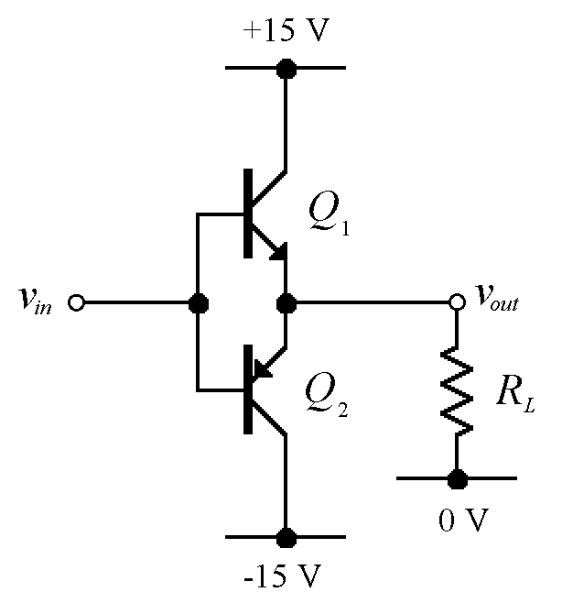
Class B Efficiency
Average power drawn from the positive supply:
I_{C1}
A/R_{L}
A sin(θ)
0
π
2π
Phase, θ

Slide 63
By symmetry, power drawn from +ve and –ve supplies will be the same. Total power, therefore:
Load power:
Efficiency:

Slide 64
Class AB Amplifier

Slide 65
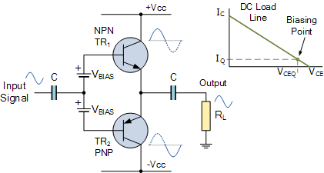
Class -AB

Slide 66
As its name suggests, the Class AB Amplifier is a combination of the “Class A” and the “Class B” type amplifiers . The AB classification of amplifier is currently one of the most common used types of audio power amplifier design.
The class AB amplifier is a variation of a class B amplifier as described above, except that both devices are allowed to conduct at the same time around the waveforms crossover point eliminating the crossover distortion problems of the previous class B amplifier.

Slide 67
The two transistors have a very small bias voltage, typically at 5 to 10% of the quiescent current to bias the transistors just above its cut-off point. Then the conducting device, either bipolar of FET, will be “ON” for more than one half cycle, but much less than one full cycle of the input signal. Therefore, in a class AB amplifier design each of the push-pull transistors is conducting for slightly more than the half cycle of conduction in class B, but much less than the full cycle of conduction of class A.
In other words, the conduction angle of a class AB amplifier is somewhere between 180º and 360º depending upon the chosen bias point as shown.

Slide 68
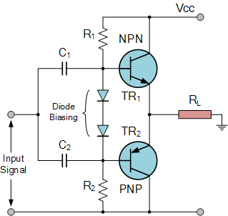
Class AB Amplifier Biasing
This very small diode biasing voltage causes both transistors to slightly conduct even when no input signal is present. An input signal waveform will cause the transistors to operate as normal in their active region thereby eliminating any crossover distortion present in pure Class B amplifier designs.
A small collector current will flow when there is no input signal but it is much less than that for the Class A amplifier configuration. This means then that the transistor will be “ON” for more than half a cycle of the waveform but much less than a full cycle giving a conduction angle of between 180 to 360º or 50 to 100% of the input signal depending upon the amount of additional biasing used

Slide 69
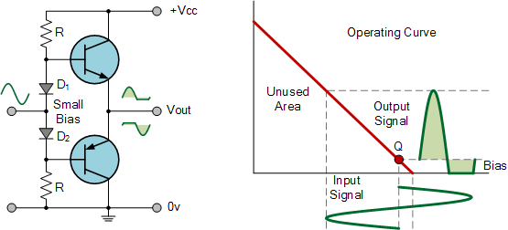
Class AB Amplifier

Slide 70
The advantage of this small bias voltage, provided by series diodes or resistors, is that the crossover distortion created by the class B amplifier characteristics is overcome, without the inefficiencies of the class A amplifier design. So the class AB amplifier is a good compromise between class A and class B in terms of efficiency and linearity, with conversion efficiencies reaching about 50% to 60%.

Slide 71
Transfer Characteristics of class AB amplifiers

Slide 72
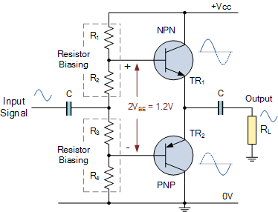
Class AB: Resistor Biasing

Slide 73
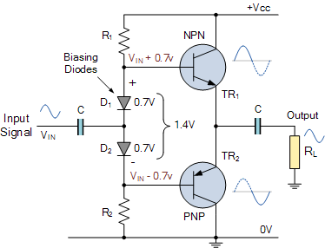
Class AB :Diode Biasing

Slide 74
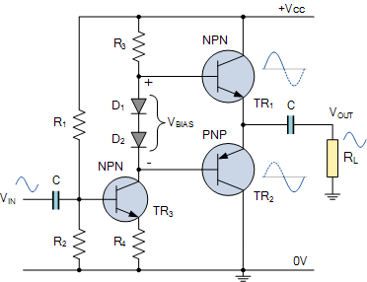
Class AB Amplifier Driver Stage

Slide 75
Class C Amplifier

Slide 76
The Class C Amplifier design has the greatest efficiency but the poorest linearity of the classes of amplifiers mentioned here. The previous classes, A, B and AB are considered linear amplifiers, as the output signals amplitude and phase are linearly related to the input signals amplitude and phase.
However, the class C amplifier is heavily biased so that the output current is zero for more than one half of an input sinusoidal signal cycle with the transistor idling at its cut-off point. In other words, the conduction angle for the transistor is significantly less than 180 degrees, and is generally around the 90 degrees area.
While this form of transistor biasing gives a much improved efficiency of around 80% to the amplifier, it introduces a very heavy distortion of the output signal. Therefore, class C amplifiers are not suitable for use as audio amplifiers.

Slide 77
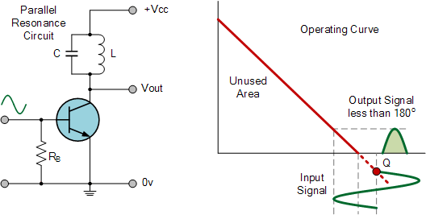
Class C Amplifier

Slide 78

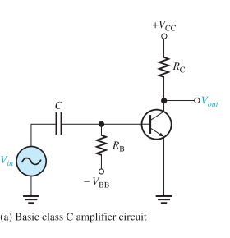
Class C amplifiers
Class C amplifiers are biased so that conduction occurs for much less than 180o
Class C amplifiers are more efficient than either class A , B, or AB
The output amplitude is a nonlinear function of the input, so class C amplifiers are not used for linear amplification.
They are generally used in radio frequency (RF) applications, including resonance circuits
Basic Class C Operation
A class C amplifier is normally operated with a resonant circuit load, so the resistive load is used only for the purpose of illustrating the concept.
The ac source voltage has a peak value that exceeds the barrier potential of the base-emitter junction for a short time near the positive peak of each cycle,

Slide 79
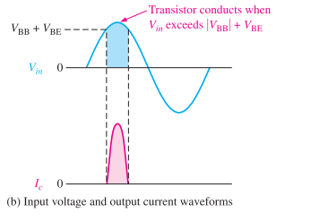
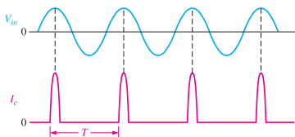

Class C amplifiers
Basic Class C Operation
During this short interval, the transistor is turned on.
The power dissipation of the transistor in a class C amplifier is low because it is on for only a small percentage of the input cycle
The power dissipation during the on time is
The power dissipation averaged over the entire cycle is

Slide 80
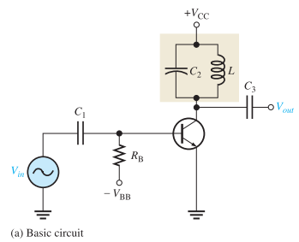
Tuned Class C Operation
Because the collector voltage (output) is not a replica of the input, the resistively loaded class C amplifier alone is of no value in linear applications.
It is therefore necessary to use a class C amplifier with a parallel resonant circuit (tank), as shown
The short pulse of collector current on each cycle of the input initiates and sustains the oscillation of the tank circuit so that an output sinusoidal voltage is produced

Slide 81
Summary
Output stages are classified according to the transistor conduction angle: class A (360^{O}), class AB (slightly more than 180^{O}), class B (180^{O}), and class C (less than 180^{O}).
The most common class A output stage is the emitter-follower. It is biased at a current greater than the peak load current.
The class A output stage dissipates its maximum power under quiescent conditions (v_{O} = 0). It achieves a maximum power conversion efficiency of 25%,

Slide 82
Summary
The class B stage is biased at zero current, and thus dissipates no power in quiescence.
The class B stage can achieve a power conversion efficiency as high as 78.5%.
The class B stage suffers from crossover distortion.
The class AB output stage is biased at a small current; thus both transistors conduct for small input signals, and crossover distortion is virtually eliminated.

Slide 83
Summary
Except for an additional small quiescent power dissipation, the power relationships of the class AB stage are similar to those in class B.
To guard against the possibility of thermal runaway, the bias voltage of the class AB circuit is made to vary with temperature in the same manner as does V_{BE} of the output transistors.

Slide 84
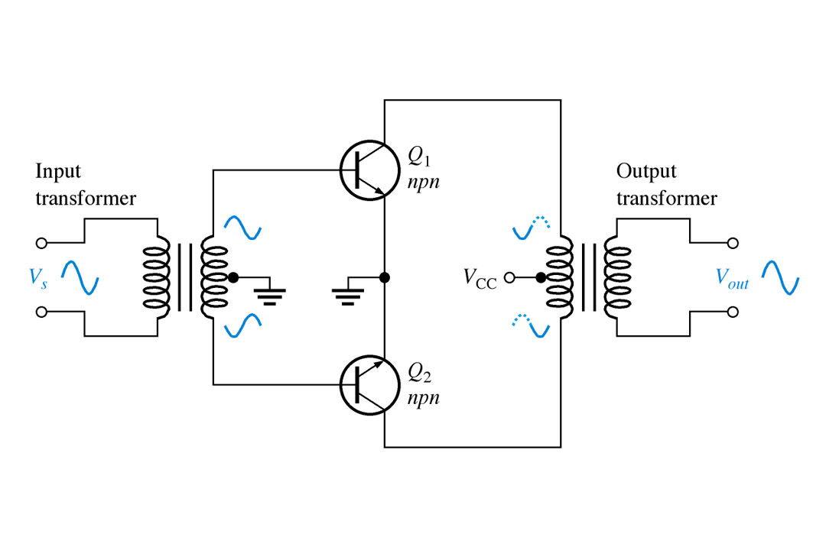

Slide 85
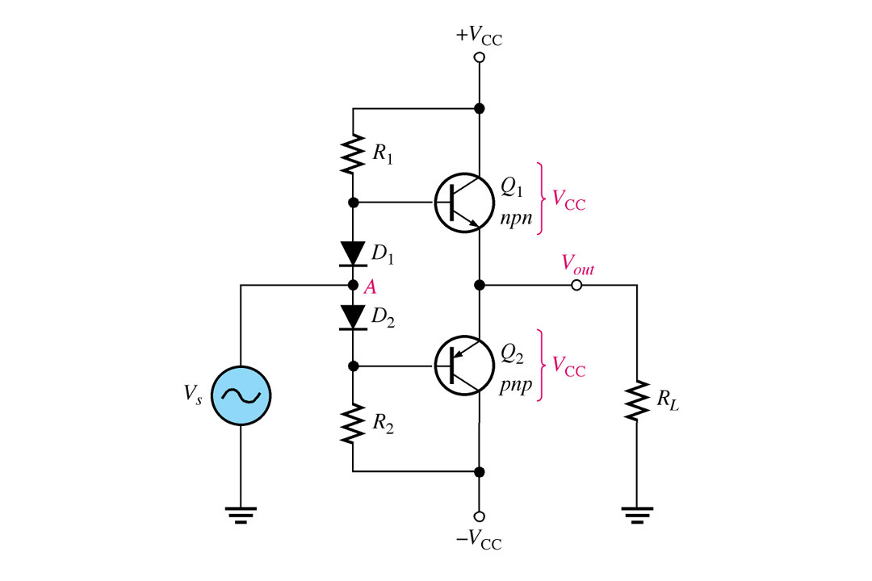

Slide 86
Power Transistors

Slide 87
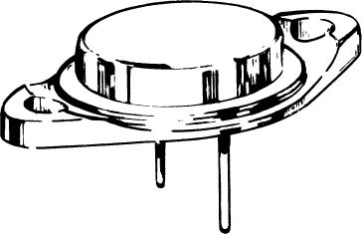
Power Transistors
Transistors that are required to conduct large currents and dissipate large power, differ in their physical structure and packing from their small signal counter part
The popular TO3 package for power transistors. The case is metal with a diameter of about 2.2 cm; the outside dimension of the “seating plane” is about 4 cm. The seating plane has two holes for screws to bolt it to a heat sink. The collector is electrically connected to the case. Therefore an electrically insulating but thermally conducting spacer is used between the transistor case and the “heat sink.”

Slide 88
Power transistors dissipate large amount of power in their collector base junction
This dissipated power is converted into heat which in-turn raises junction temperature ($T_{j}$)
($T_{j}$) must not be allowed to exceed a specified maximum temperature $T_{j−max}$, otherwise the transistor could suffer permanent damage.
For silicon devices $T_{j−max}$ is in the range of ${150}^{0} to {200}^{0} C$

Slide 89
Case-I: The transistor is operating in free-air & there is no special arrangement for cooling
The heat dissipated in the transistor junction will be conducted from junction to the casing and from casing to the ambient
When the transistor dissipate $P_{D}$ watts; the temperature rise of the junction relative to ambient is expressed as $T_{J}−T_{A}=θ_{JA}P_{D}$
Where $θ_{JA}$ is the thermal resistance between junction and the ambient
Electrical equivalent circuit of the thermal-conduction
process;

Slide 90
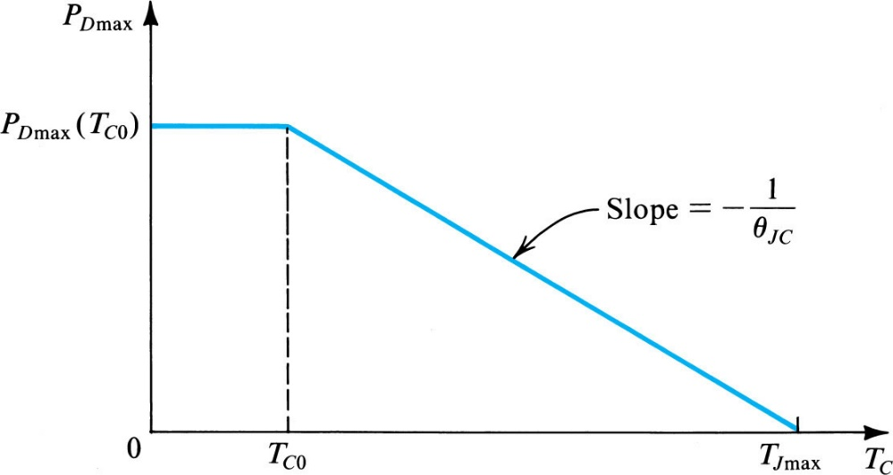
Power dissipation versus Temperature
The manufacturer usually specifies;
Maximum junction temperature $T_{J−max}$
Maximum power dissipation at a particular ambient temperature $T_{AO}$
The thermal resistance
In addition a power derating graph is also provided

Slide 92
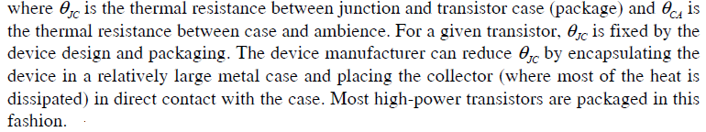
Transistor Case and Heat Sink
The thermal resistance between junction and ambience,$θ_{jA}$ can be expressed as
$$T_{Junction} − T_{Ambient}=P_{D}\left(θ_{Junction−Casing}+θ_{Casing−Sink}+θ_{Sink−Ambient}\right)$$

Slide 93
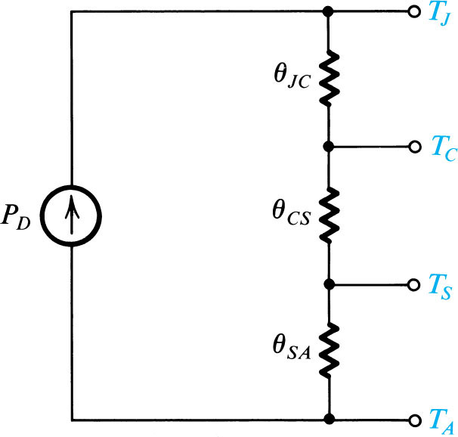
$T_{j}=Junction Temp$ $T_{c}=Casing Temp.$
$T_{S}=$ Temp of Heat Sink
$T_{A}=$ Ambient Temp
Electrical analog of the thermal conduction process when a heat sink is utilized.

Slide 97
$$θ_{JA}=θ_{JC}+θ_{CS}+θ_{SA}$$
But $θ_{CS}+θ_{SA}=θ_{CA}$
And for infinite heat sink $θ_{CA}= 0 Thus θ_{JA} would now be equal to θ_{JC}$

Slide 98
Use of compound devices
To increase the current gain of the output-stage transistors, and thus reduce the required base current drive, the Darlington configuration shown in the Fig. is frequently used to replace
the npn transistor of the class AB stage.
The Darlington configuration is equivalent to a single npn transistor having $β≅β_{1}β_{2}$ but almost twice the value of VBE.
a VBE multiplier for biasing

Slide 99
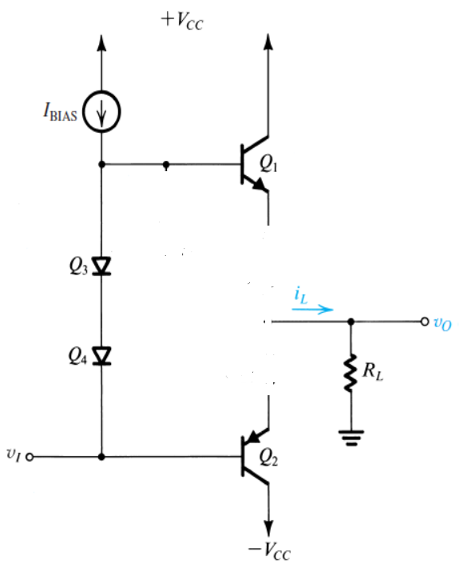

Class AB: Short-circuit protection
I need to device a technique to rob this Bias current off from the Q1 in case of short circuit condition
Now I need to make this transistor conduct and pass all the Bias current as its collector current

Slide 100
Short-Circuit Protection
Figure shows a class AB output stage equipped with protection against the effect of Short circuiting the output while the stage is sourcing current.
The large current that flows through Q1 in the event of a short circuit will develop a voltage drop across RE1 of sufficient value to turn Q5 on.
The collector of Q5 will then conduct most of the current IBIAS, robbing Q1 of its base drive. The current through Q1 will thus be reduced to a safe operating level.

Slide 102
Thermal Shutdown
In addition to short-circuit protection, most IC power amplifiers are usually equipped with a circuit that senses the temperature of the chip and turns on a transistor in the event that the temperature exceeds a safe preset value. The turned-on transistor is connected in such a way that it absorbs the bias current of the amplifier, thus virtually shutting down its operation.

Slide 103
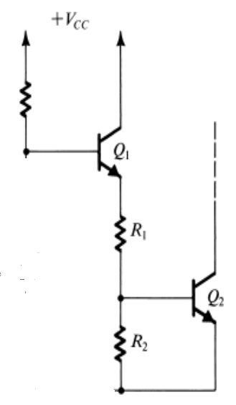
Thermal Shutdown Circuit

Slide 104
Thermal Shutdown
Figure shows a thermal-shutdown circuit. Here, transistor Q2 is normally off. As the chip temperature rises, the combination of the positive temperature coefficient of zener diode Z1 and the negative temperature coefficient of VBE1 causes the voltage at the emitter of Q1 to rise. This in turn raises the voltage at the base of Q2 to the point at which Q2 turns on.

