Slide 1


Slide 2
Welcome back

Slide 3
Instructor’s introduction
Instructor Name : Dr. Shakeel Alvi
Teaching Experience
05 years at CAE (College of Aeronautical Engineering), NUST
08 years at SEECS, NUST
01 year GWU- USA
Work Experience: 35 years in PAF
Office : Old SEECS library
Lectures on : Tuesday , Thursday, Friday
Email: shakeel.alvi@seecs.edu.pk
Office telephone: 051-9085-2251

Slide 4
Instructor’s introduction
Academic
Awards
PhD : Wireless Communications :Pakistan
MS : Telecommunications & Computers : USA
MS : War studies : Pak
BE : Avionics : Pakistan
BS: Strategic Studies : Pak
Navigational Aids: USA
Satellite Communications : UK
Project management: Pak
Contract management : Pak
Financial management: Pak
Senior Engineering Management : Pak
Roll of Honor (USAF-USA)
TI(M); Govt. of Pakistan
3 times CAS Commendations (PAF)
Merit Certificate (ZABIST-University)
Publications
Publications : 4 Journal papers

Slide 5
What is rationale of studying this subject
LCA
ENA
ECD
EDC
In previous semesters
Resistors, Capacitor, Inductor, and their various combination
steady-state and transient response
Then we studied two types of discrete components
Diodes and transistor(BJT & FET)
Now we will move to integrated circuits

Slide 6
Electronic Circuit Design : EE-313 (BEE-12 A, B & C)
Course details
•Code: EE313
•Name: Electronic Circuit Design
•Credit hours: 3+1
•Lecture days:
–Monday, Thursday & Fridays – CR_13 & CR_14
•Lab day:
–Monday /Tuesday (Advance Electronics Lab-IAEC)

Slide 8
Grading (Provisional )
•Theoretical part: 75%
–Quizzes: 10%
–Assignments: (5-10)%
–MSE (25-30)%
–End Semester Exam – (45-50)%
•Lab – 25%
–
* Weightages can be changed

Slide 9
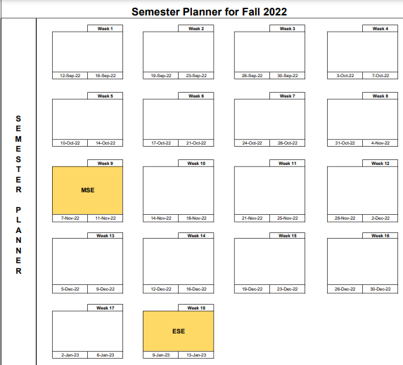

Slide 11
Class-room Rules
Punctuality
Attendance will not be marked for late comers
Switch OFF phones, NO texting, whatsapp, etc
Copying UNACCEPTABLE, no exceptions
Un-announced quizzes
Avoid talking among yourselves
Late submission of assignment will result in marks deduction
As per PEC/HEC rules all labs must be done

Slide 13
If we complete the course before scheduled time then!
We will have a look at
Applications of Operational Amplifier
Oscillator
Modulators
Active filters
Introduction to IC design software (Glade, Cadence, Google Skywater

Slide 15
General sequence of the Lectures
1
Introduction to Chapter
Aims / objective
2
Mathematical Analysis
Problem solving
3
Simulations
Practical /Labs
Assignments

Slide 16
Brief review of EDC (EE-215)
EE-215 is prerequisite of EE-313
We studied Three non-linear devices two of which can be used as an amplifier
Diode
BJT
MOSFET
We will review few of basic concepts to refresh our memories

Slide 17
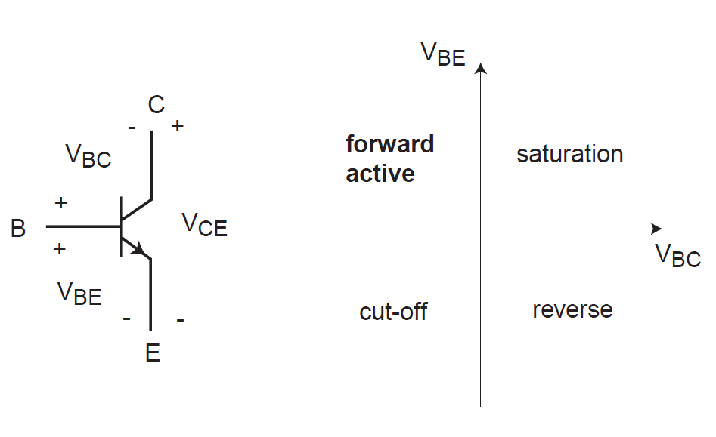
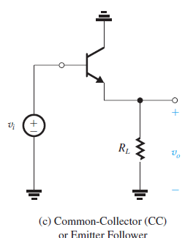
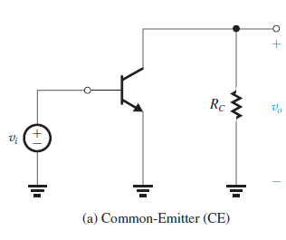
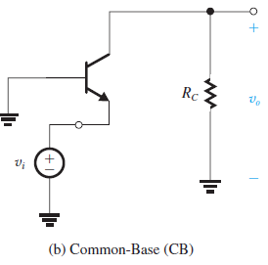
BJT Modes of Operation
Three Basic Configurations

Slide 18
Note in above figures biasing and Load resistances are not shown; But generally these would be part of impedance calculations

Slide 19
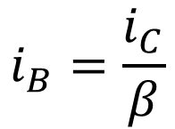
NPN Transistor: Emitter Current
$$i_{B}=\frac{i_{C}}{β}$$
α is called the common-base current gain.

Slide 20
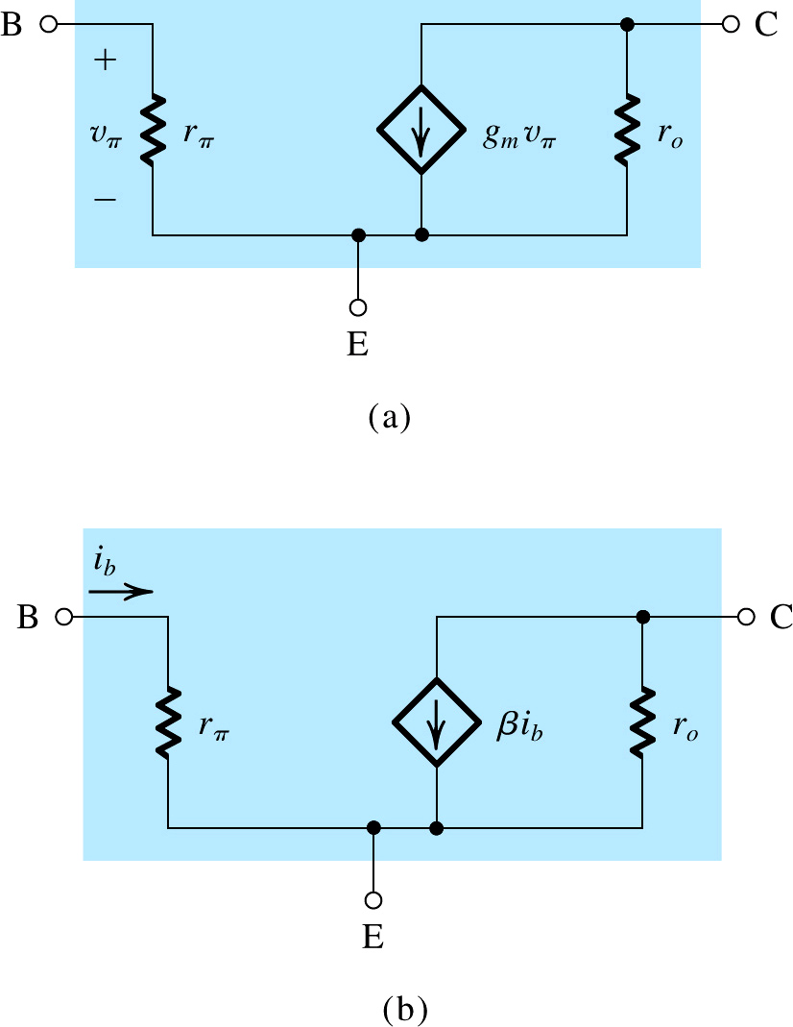
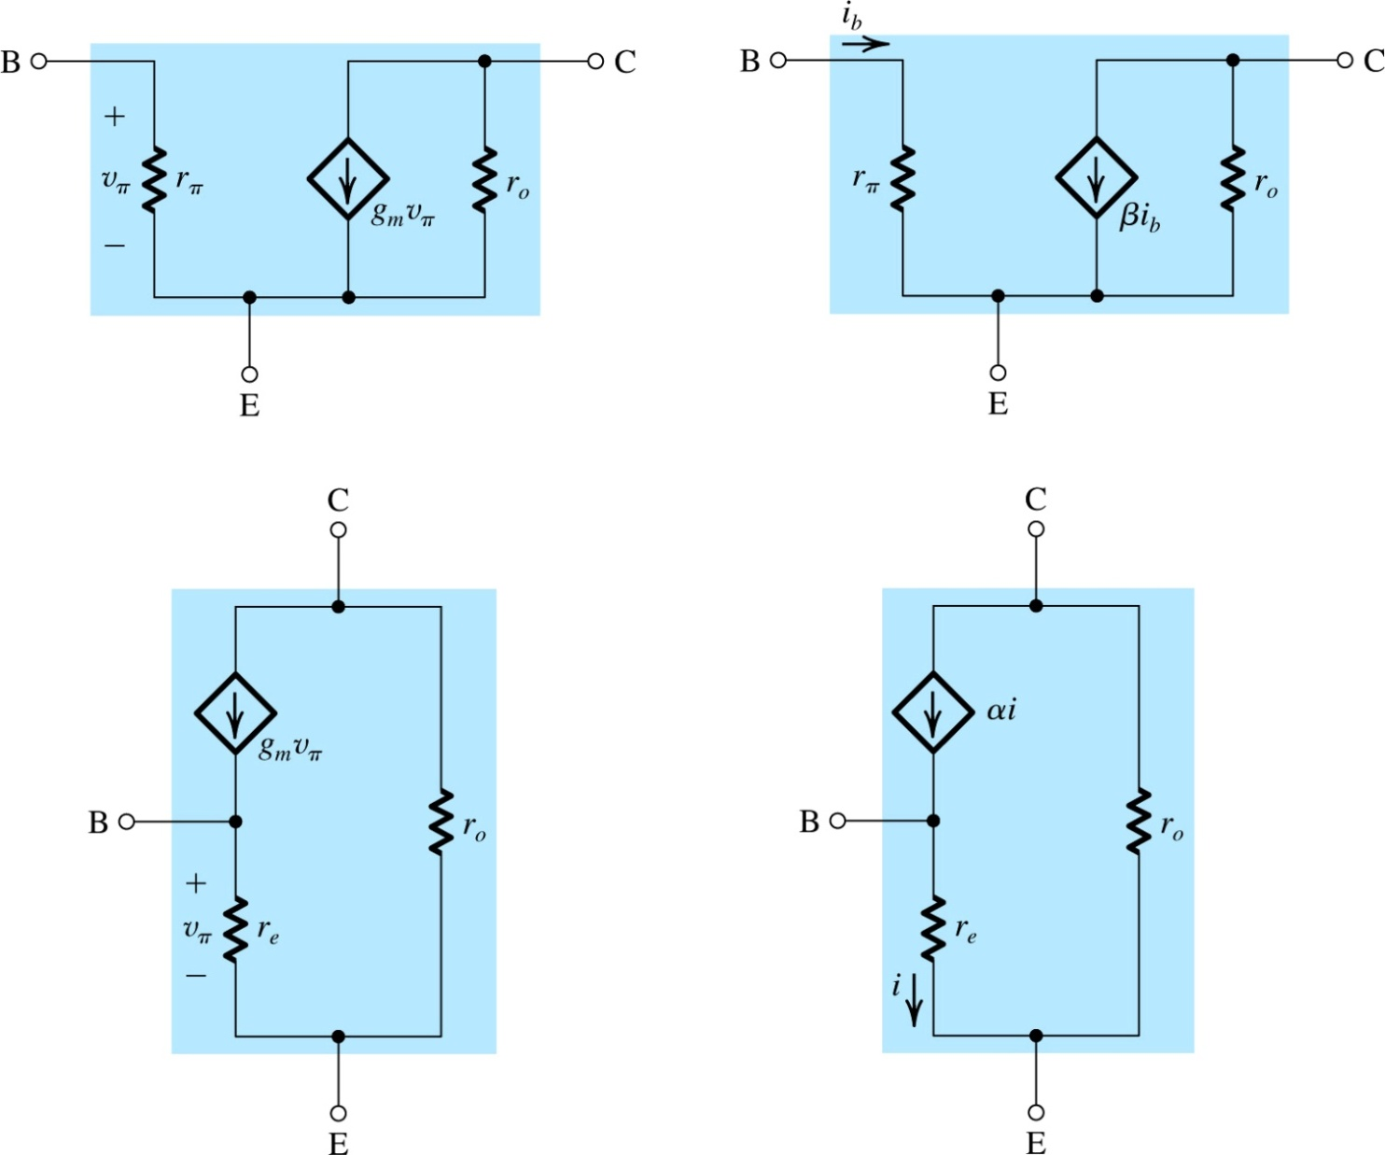
Small-Signal Models with, the Early Effect

Slide 21
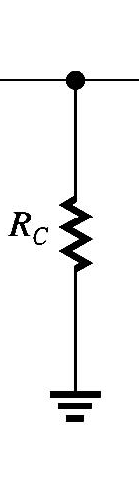
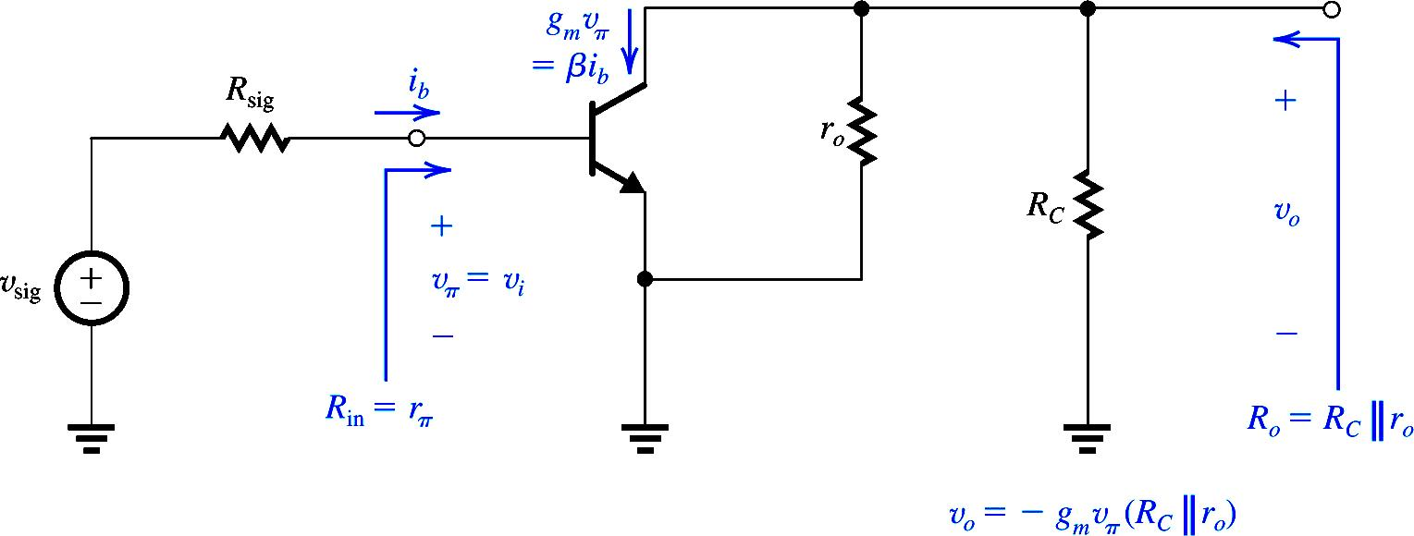
CE Amplifier (Another method)
Performing the Analysis Directly on the Circuit
R_{L}

Slide 22
MOSFET

Slide 24
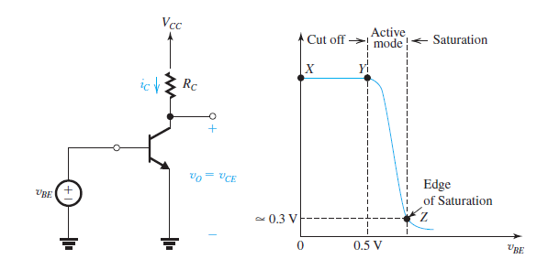
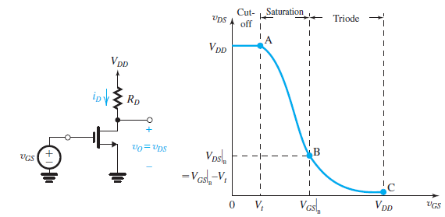
VTCs BJT & MOSFET
BJT Active region
=
MOS saturation region

Slide 25
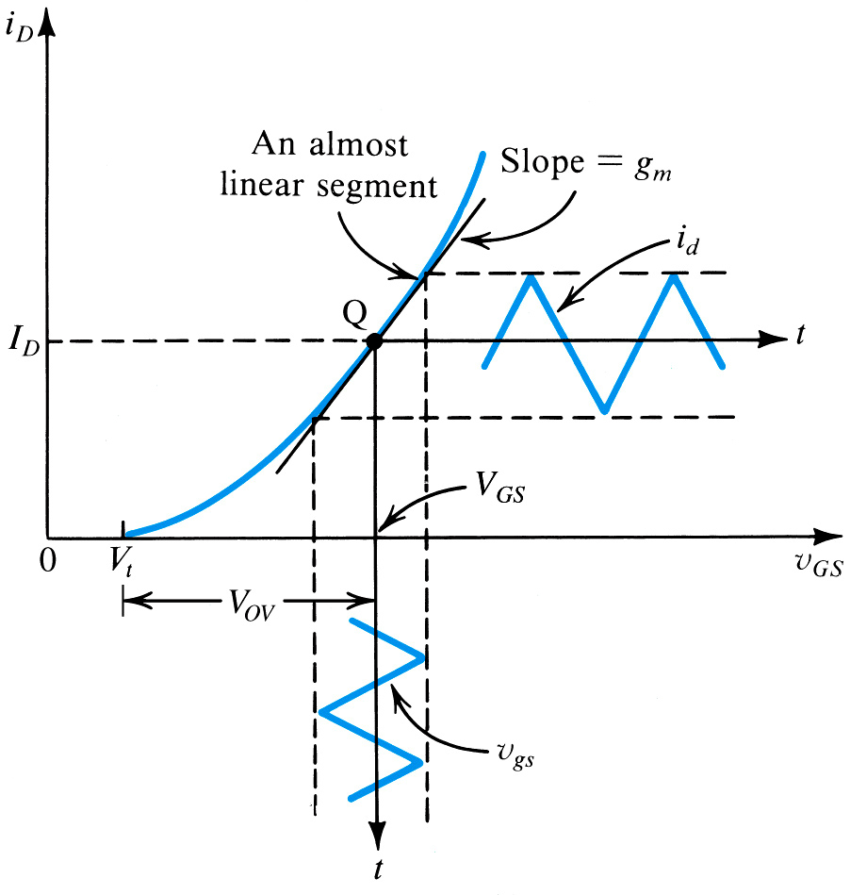
Graphical Interpretation of Small –Signal Operation
g_{m} is equal to the slope of i_{D} – v_{GS} characteristic curve at the bias point

Slide 26
Alternate expression for g_{m}
g_{m} is dependent on three design parameters---- W/L, V_{OV}, and I_{D;} two of which can be chosen independently by the designer

Slide 27
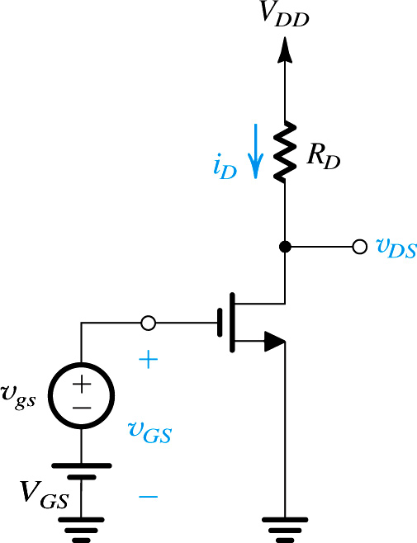
The Voltage Gain

Slide 28
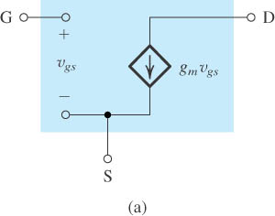
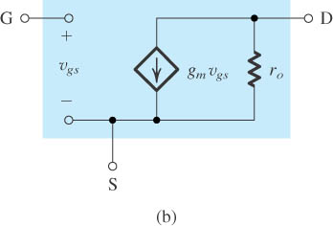
The Small-Signal Models
Neglecting the channel-length modulation effect
Including the effect of channel-length modulation, modeled by output resistance r_{o} = |V_{A}| /I_{D}.

Slide 29
Biasing Objectives (BJT)
Biasing is Establishing a constant current (I_{C}) in the collector of the BJT
I_{C} should be insensitive to variations in temperature and β
Maximum signal swing by optimally placing the operating point in the i_{C} – v_{CE} plane

Slide 30
Biasing in MOSFET Amplifier Circuits
Establishing a stable and predictable dc drain current (I_{D}), and a drain to source voltage (V_{DS}) to ensure operation in saturation region.
I_{D} has to be insensitive to temperature variations.
Maximum signal swing by optimal choice of operating point.

Slide 31
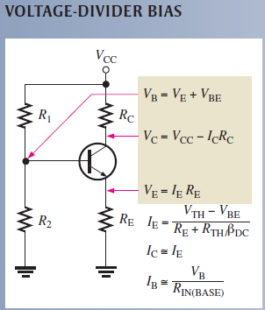
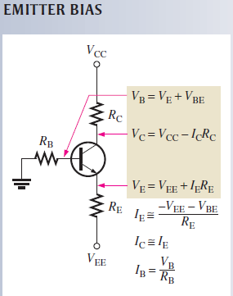
Some examples of Biasing

Slide 32
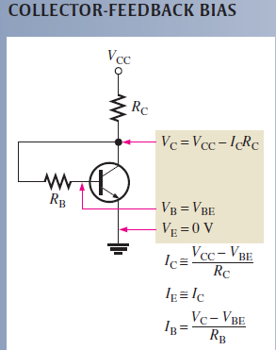
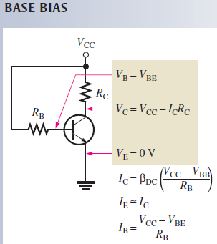
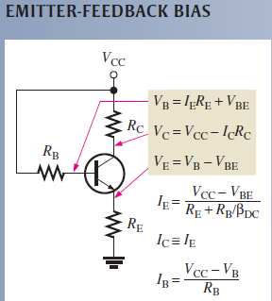

Slide 33
Biasing with Constant current source

Slide 34
Understanding some concept of EE-215 with the help of Simulations (LTSpice)

