Slide 1


Slide 2
Chapter No 7

Slide 3
We are gradually move from discrete to to integrated circuit technology for this we analyze various building blocks

Slide 4
Introduction
IN THIS CHAPTER WE WILL LEARN
The basic integrated-circuit (IC) design philosophy and how it differs from that for discrete-circuit design.
The basic gain cells of IC amplifiers, namely, the CS and CE amplifiers with current-source loads.
How to increase the gain realized in the basic gain cells by employing the principle of cascoding.
Analysis and design of the cascode amplifier and the cascode current source in both their MOS and bipolar forms.

Slide 5
Introduction …cont.
How current sources are used to bias IC amplifiers and how the reference current generated in one location is replicated at various other locations on the IC chip by using current mirrors.
Some ingenious analog circuit design techniques that result in current mirrors with vastly improved characteristics.
How to pair transistors to realize amplifiers with characteristics superior to those obtained from a single-transistor stage.

Slide 6
Building Blocks of Integrated-Circuit Amplifiers
7.1 IC Design Philosophy (opportunities & limitations)
7.2 The Basic Gain Cell (single CS &CE, their intrinsic gains)
7.3 The Cascode Amplifier
7.4 IC Biasing—Current Sources, Current Mirrors, and Current-Steering Circuits
7.5 Current-Mirror Circuits with Improved Performance
7.6 Some Useful Transistor Pairings

Slide 7
7.1. Integrated Circuit Design Philosophy
Integrated-circuit fabrication technology imposes constraints on – and provides opportunities to – the circuit designer.
large capacitors are not available
very small capacitors are easy to fabricate
Large resistor are also not feasible
One objective is to realize as many functions as possible using MOS/BJT transistors only.
Reduction of device size is of great concern.
In this text, focus is placed on CMOS circuit fabrication.

Slide 8
7.2. The Basic Gain Cell
Two types of basic gain cells exist:
Common-source (CS)
Common-emitter (CE)
Both are loaded with constant-current source.
This is done because of difficulties associated with fabrication of exact resistances.
It also facilitates increased gain.
These circuits are referred to as current-source loaded / active loaded.

Slide 9
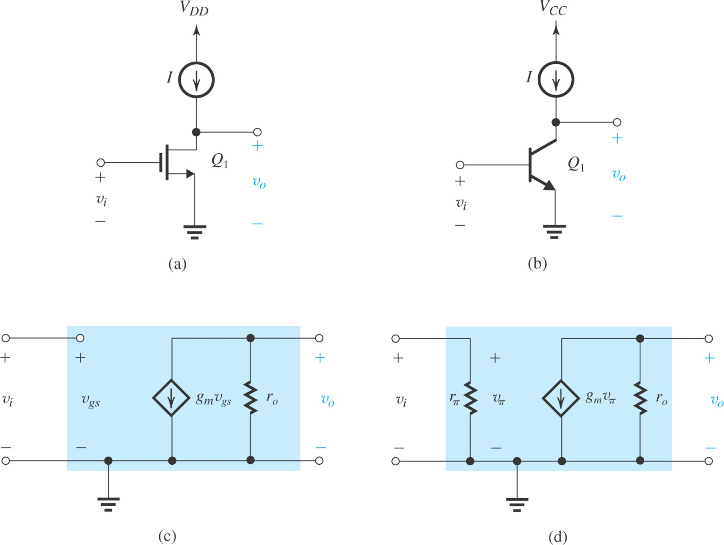
current-source- or active-loaded common-source amplifier
current-source- or active-loaded common-emitter amplifier

Slide 10
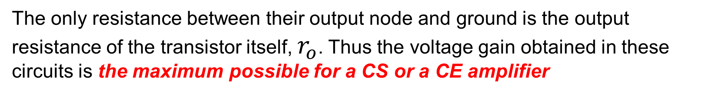
Gain cells will be part of larger circuits in which negative feedback is utilized to fix the values of $V_{DS}, V_{GS}$ and $V_{BE}, V_{CE}$.
we shall assume that the MOS transistor is biased to operate in the saturation region and that the BJT is biased to operate in the active region. We will often refer to both the MOSFET and the BJT as operating in the “active region.”
Observe that since the current-source load is assumed to be ideal, it is represented in the models by an infinite resistance. Practical current sources will have finite output resistance
The only resistance between their output node and ground is the output resistance of the transistor itself, $r_{o}$. Thus the voltage gain obtained in these circuits is the maximum possible for a CS or a CE amplifier

Slide 11
7.2. The Basic Gain Cell
Both formula for MOS and BJT seem same , but are actually different

Slide 12
7.2.2. The Intrinsic Gain
For the BJT, one can derive a formulate for the intrinsic gain A_{vo} = g_{m}r_{o} using the formulas below.
A₀ is simply ratio of the Early Voltage (V_{A}) and thermal voltage (V_{T})
The value of V_{A} ranges from 5V to 35V for modern technologies.
The value of A₀ ranges from 200V/V to 5000V/V, as such.

Slide 13
7.2.2. The Intrinsic Gain(MOS-device)
There are three possible expressions for g_{m}, two are particularly useful here.

Slide 14
7.2.2. The Intrinsic Gain (MOS)

Slide 15
7.2.2. The Intrinsic Gain
The expression (7.13) is one most comparable to the BJT (7.9).
Note the following points:
The quantity of V_{OV}/2 is a design parameter.
Its value has been decreasing with technological developments.
The numerator quantity is both process dependent (through V_{A}’) and device dependent (through L).
Its value has been decreasing with technological developments.
From (7.14) we see that A₀ may be increased by using a longer MOSFET and operating at lower V_{OV}.
This is not without trade-offs (refer to textbook).

Slide 16
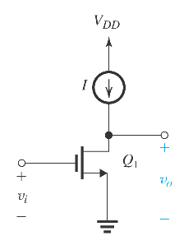
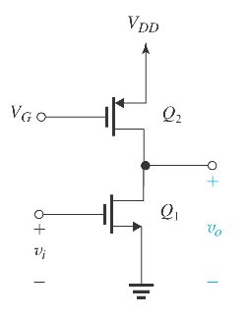
Effect of the Output Resistance of the Current-Source Load
The current-source load of the CS amplifier in Figure (left) can be implemented using a PMOS transistor biased in the saturation region to provide the required current I, as shown in Figure (right)

Slide 17
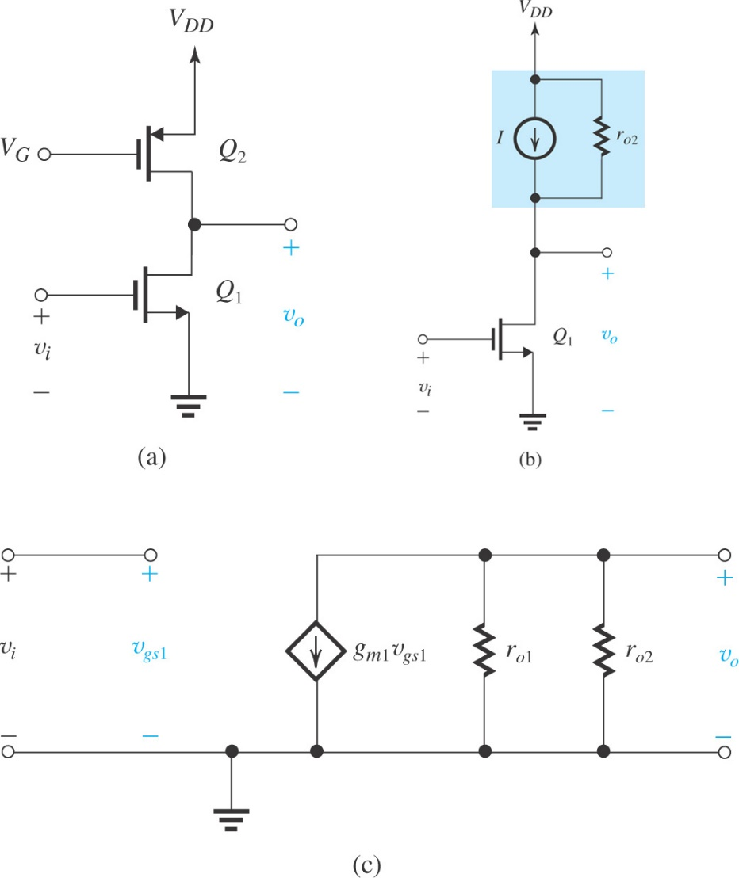
Effect of the Output Resistance of the Current-Source Load
(a): The CS amplifier with the current-source load implemented with a
p-channel MOSFET Q₂ ;
(b) the circuit with Q₂ replaced with its large-signal model; and
(c) small-signal equivalent circuit of the amplifier.

Slide 18
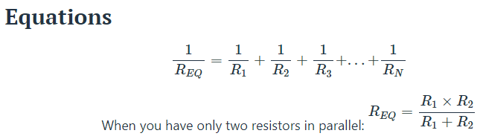
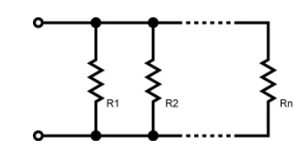
Effect of Parallel resistance
Resistor 1 | Resistor 2 | Resistor3 | Parallel/ effective
100 | 100 | 100 | 33.33333333
10000 | 10000000 | 50 | 49.75099626
500 | 5000 | 50000 | 450.4504505

Slide 19
7.2.2 Comparison of Intrinsic Gains of BJT & MOS
BJT
MOS
It is important to note that for a given bipolar-transistor fabrication process, is independent of the transistor junction area and of its bias current. This is not the case for the MOSFET

Slide 20
Summary
Integrated-circuit fabrication technology offers the circuit designer many exciting opportunities, the most important of which is the large number of inexpensive small-area MOS transistors. An overriding concern for IC designers, however, is the minimization of chip area or “silicon real estate.” As a result, large-valued resistors and capacitors are virtually absent.
The basic gain cell of IC amplifier is the CS (CE) amplifier with a current-source load. For an ideal current-source load (i.e. one with infinite output resistance), the transistor operates in an open-circuit fashion and thus provides the maximum gain possible: A_{vo} = -g_{m}r_{o} = -A₀.

Slide 21
Summary
The intrinsic gain A₀ is given by A₀ = V_{A} / V_{T} for a BJT and A₀ = V_{A}/(V_{OV}/2) for a MOSFET. For a BJT, A₀ is constant independent of bias current and device dimensions. For a MOSFET, A₀ is inversely proportional to I_{D}^{1/2}.
Simple current-source loads reduce the gain realized in the basic gain cell because of their finite resistance (usually comparable to the value of r_{o} of the amplifying transistor).

Slide 22
MOSFET
BJT

