Slide 1


Slide 2
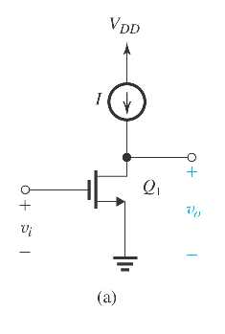
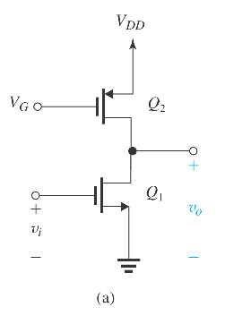
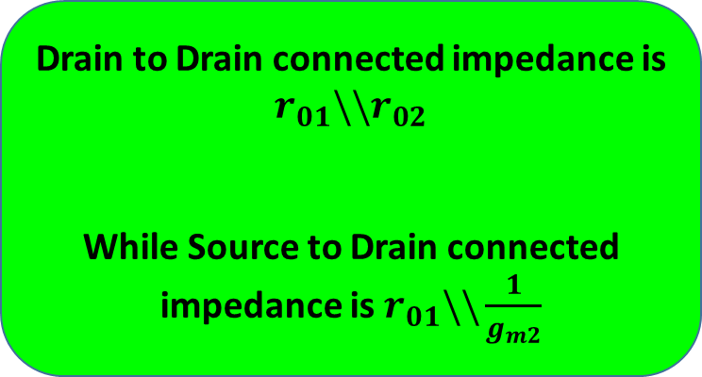
7.2.3. Effect of the Output Resistance of the Current-Source Load
The current-source load of the CS amplifier in Figure on left can be implemented using a PMOS transistor biased in the saturation region to provide the required current I, as shown in Figure on right.
Why PMOS as current source for NMOS amplifier and vice versa ?
Drain to Drain connected impedance is $r_{01}\backslash \backslash r_{02}$
While Source to Drain connected impedance is $r_{01}\backslash \backslash \frac{1}{g_{m2}}$

Slide 3
Some basic concepts of gain/input & output impedances of discrete amplifiers

Slide 13
Back to Topic from text book

Slide 14
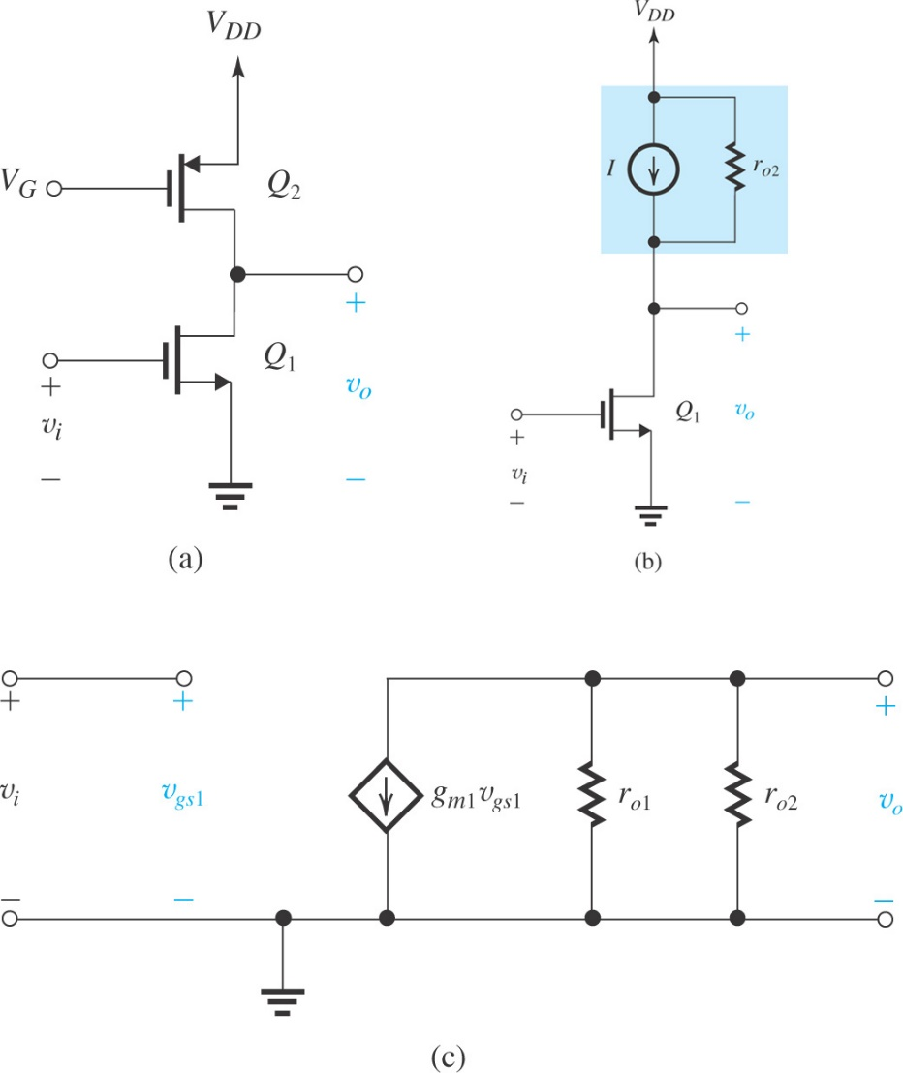

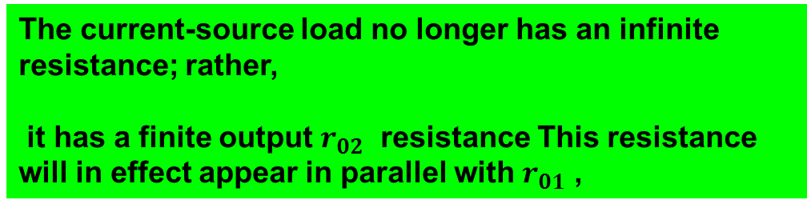
What was the Effect of the Output Resistance of the Current-Source Load
The current-source load no longer has an infinite resistance; rather,
it has a finite output $r_{02}$ resistance This resistance will in effect appear in parallel with $r_{01}$ ,
Gain Reduces to
And if

Slide 15
Problem :
The practical (non-ideal) constant-current source (active-load) has reduce the intrinsic gain of my basic gain cell (CS or CE)

Slide 16
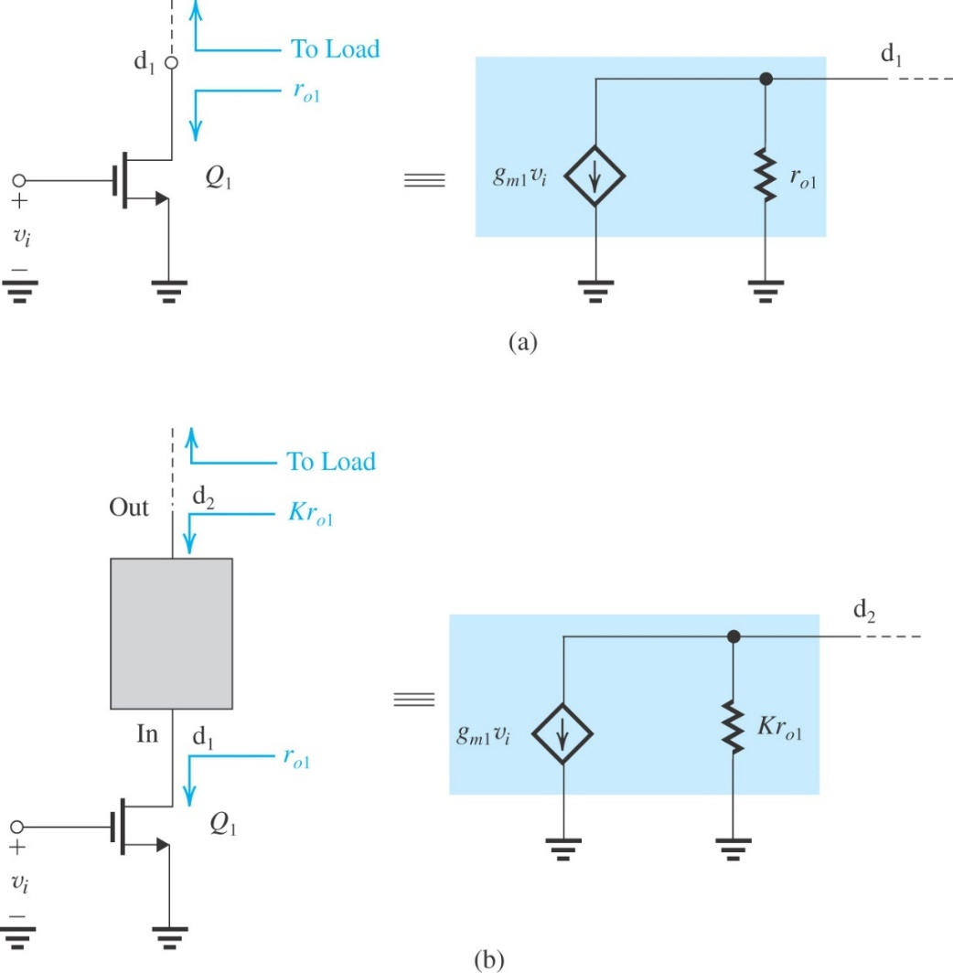
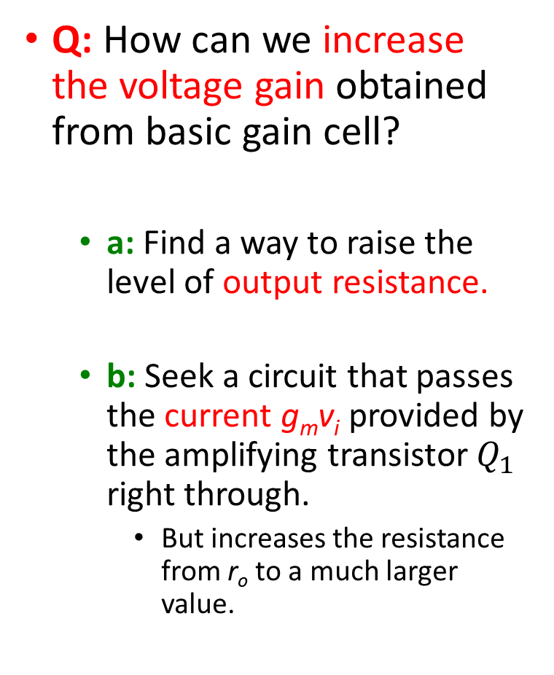
Increasing the Gain of the Basic Cell
Q: How can we increase the voltage gain obtained from basic gain cell?
a: Find a way to raise the level of output resistance.
b: Seek a circuit that passes the current g_{m}v_{i} provided by the amplifying transistor $Q_{1}$ right through.
But increases the resistance from r_{o} to a much larger value.
To increase the voltage gain realized in the basic gain cell, shown as a black box is connected between d₁ and the load

Slide 17
Increasing the Gain of the Basic Cell
The black box of Figure is actually a current buffer
Two important comments:
It is not sufficient to raise output resistance of amplifying transistor only. We will have to raise the output resistance of the active load as well
Placing CG (or a CB) circuit on top of the CS (or CE) amplifying transistor to implement the current-buffering action is called cascoding.

Slide 18
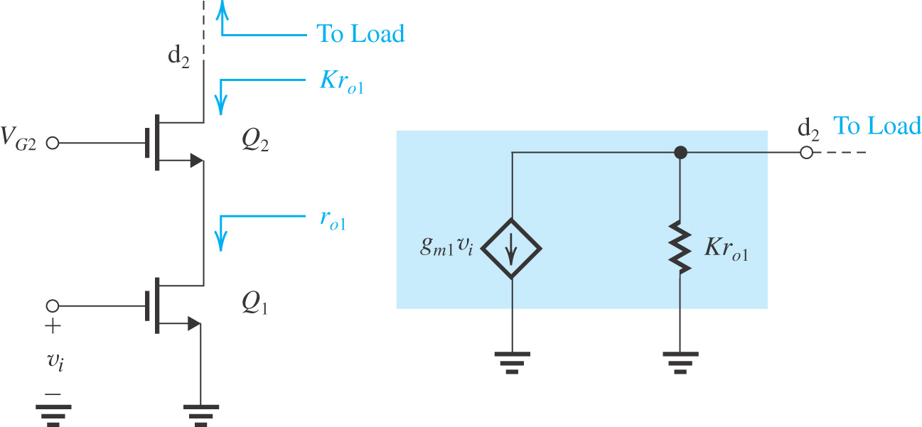
The Cascode Amplifier
Cascoding refers to the use of a transistor connected in the common-gate (or the common-base) configuration to provide current buffering for the output of a common-source (or a common-emitter) amplifying transistor
The current-buffering action is implemented using a transistor Q₂ connected in the CG configuration. Here V_{G2} is the dc bias voltage.
Previous
Thus, the cascode transistor passes the current to the output node while raising the resistance level by a factor K. We will derive an expression
for K.

Slide 19
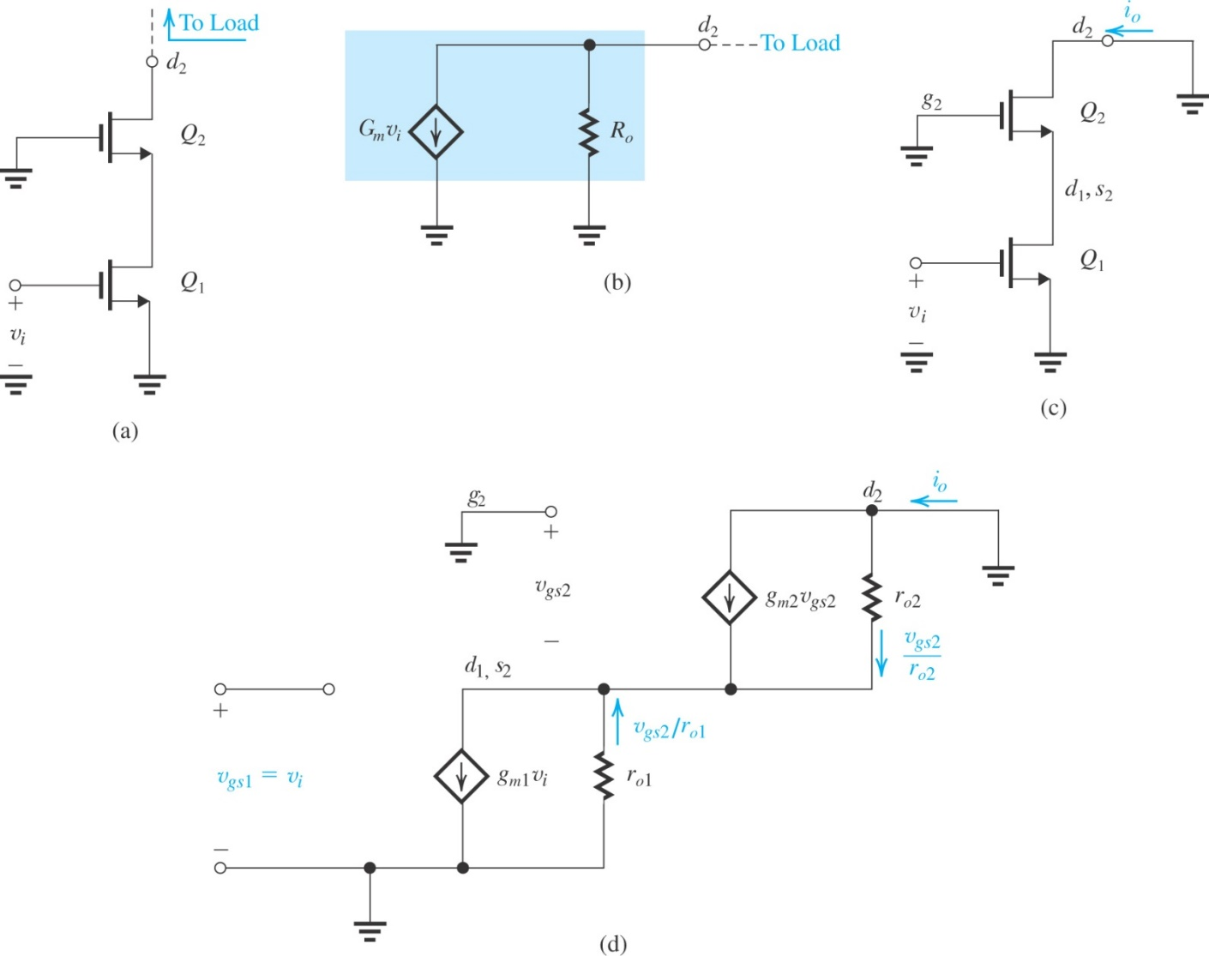
The MOS Cascode
A MOS cascode amplifier prepared for small-signal calculations
(b) output equivalent circuit of the amplifier in (a);
(c) the cascode amplifier with the output short-circuited to determine G_{m};
(d) equivalent circuit of the situation in (c).

Slide 20
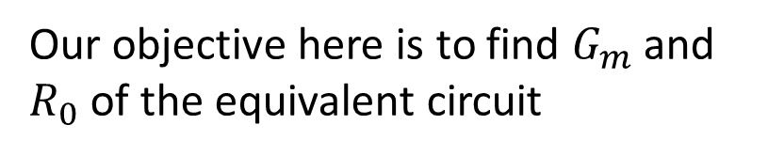
The MOS Cascode
Our objective here is to find $G_{m}$ and $R_{0}$ of the equivalent circuit

Slide 21

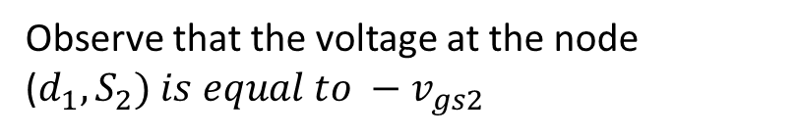
The MOS Cascode
Observe that the voltage at the node ($d_{1}, S_{2}) is equal to −v_{gs2}$
Writing node equation for this node
Here we proved that currents of two transistors are same
1

Slide 22

Here we proved that this current is also equal to output current , proving that
$G_{m}=g_{m1}$
As
And thus

Slide 23
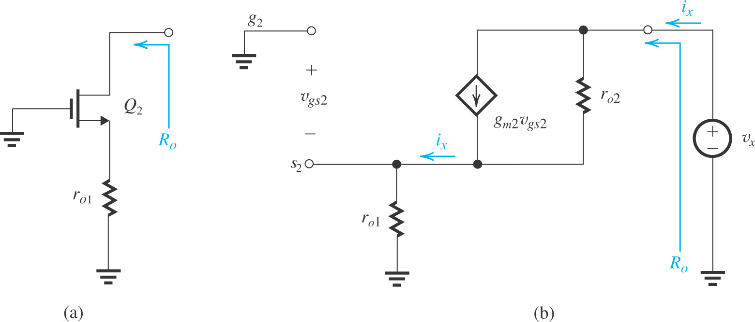

Determining the output resistance of the MOS cascode amplifier.
Why the circuit reduced to one shown on left?
For determining $R_{out}$ we apply a test voltage at the output and put input source to zero that is $v_{gs1}$ is now zero
The output resistance
can be obtained as

Slide 25
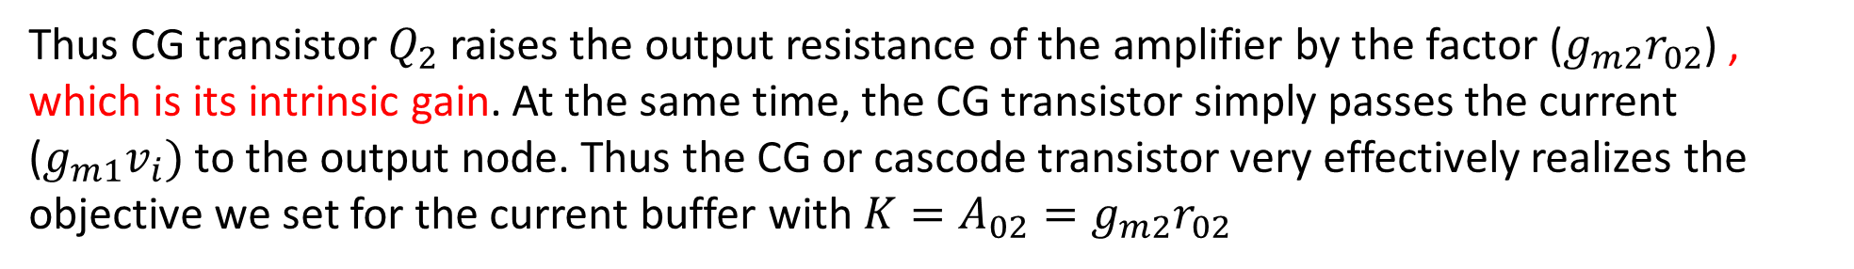

Thus CG transistor $Q_{2}$ raises the output resistance of the amplifier by the factor ($g_{m2}r_{02}$) , which is its intrinsic gain. At the same time, the CG transistor simply passes the current ($g_{m1}v_{i})$ to the output node. Thus the CG or cascode transistor very effectively realizes the objective we set for the current buffer with $K=A_{02}=g_{m2}r_{02}$
Voltage Gain:
If the cascode amplifier is loaded with an ideal constant-current source, the voltage gain realized can be found from the equivalent circuit as on the right
Thus cascading results in increasing the gain magnitude from $A_{0} to A_{0}^{2}$

Slide 26
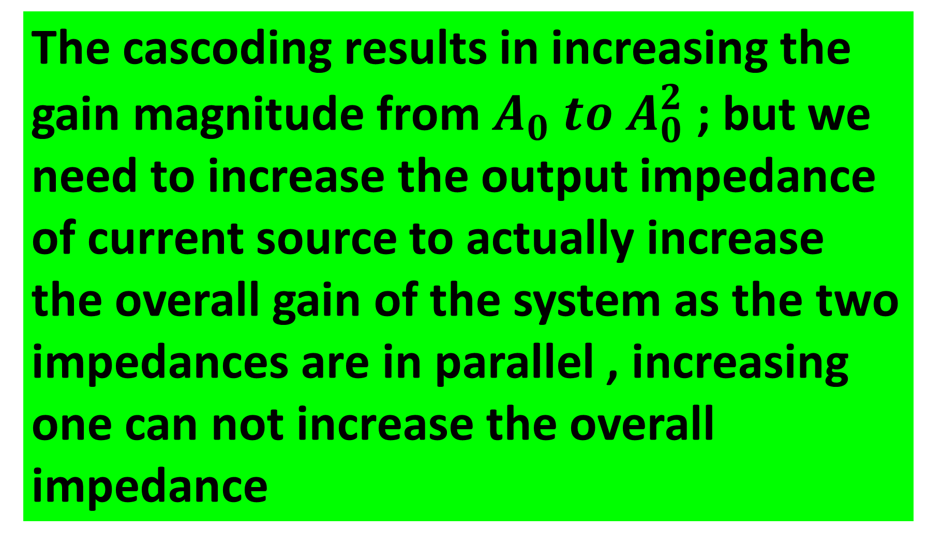
The cascoding results in increasing the gain magnitude from $A_{0} to A_{0}^{2}$ ; but we need to increase the output impedance of current source to actually increase the overall gain of the system as the two impedances are in parallel , increasing one can not increase the overall impedance

Slide 27
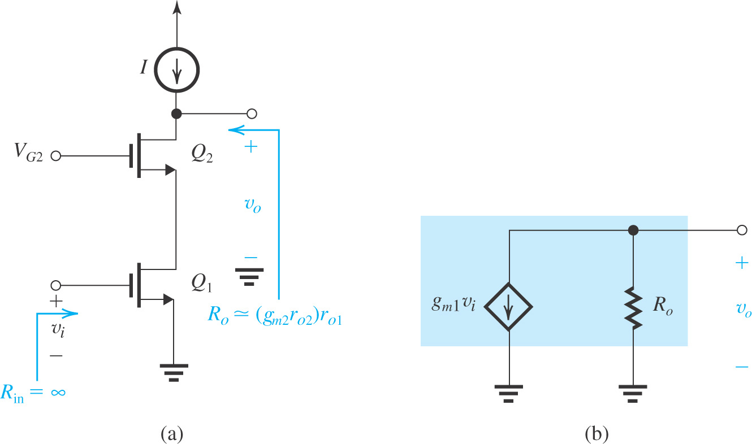
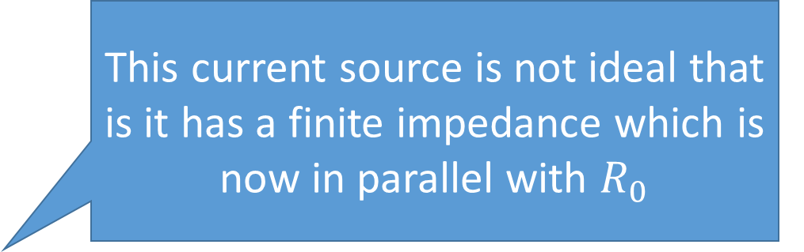
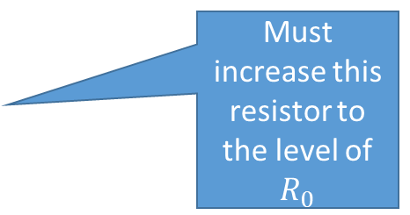
Cascoding current source as well
Non Ideal current source
This current source is not ideal that is it has a finite impedance which is now in parallel with $R_{0}$
Must increase this resistor to the level of $R_{0}$
Cascode Amplifier

Slide 28
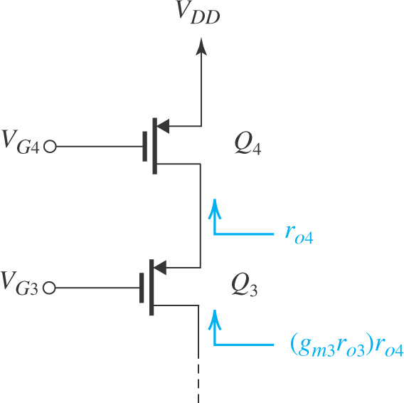
Cascoding current source as well
Employing a cascode transistor Q₃ to raise the output resistance of the current source Q₄.
Cascoding may be employed to raise the output resistance of the current-source load as shown in Figure .
Here, Q₄ is the current-source transistor and Q₃ is the CG cascode transistor.
Voltage V_{G3} and V_{G4} are the dc bias voltages.
The cascode transistor (Q₃) multiplies the output resistance of Q₄, r_{o4} to provide an output resistance for the cascode current source of…
R_{o} = (g_{m3}r_{o3})r_{o4}

Slide 29
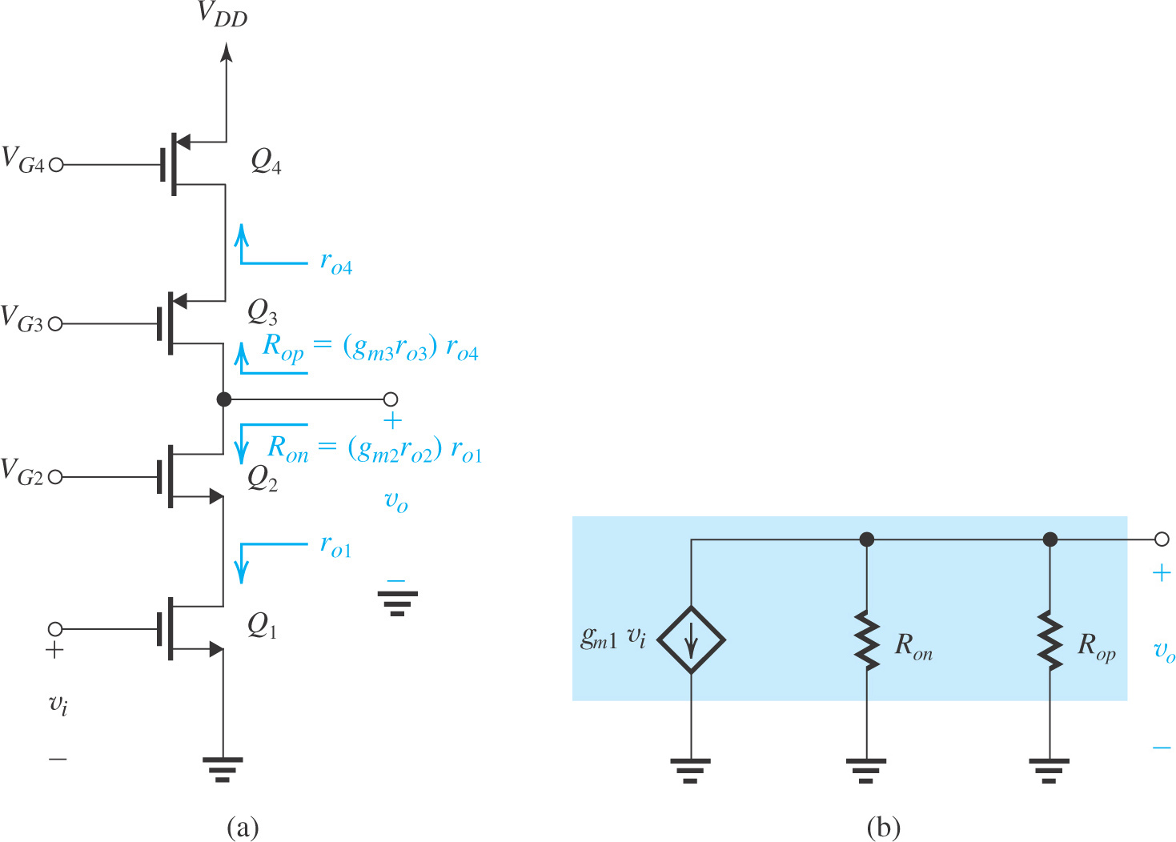
Combining a cascode amplifier with a cascode current source results in the circuit shown in Figure
A cascode amplifier with a cascode current-source load.

Slide 30
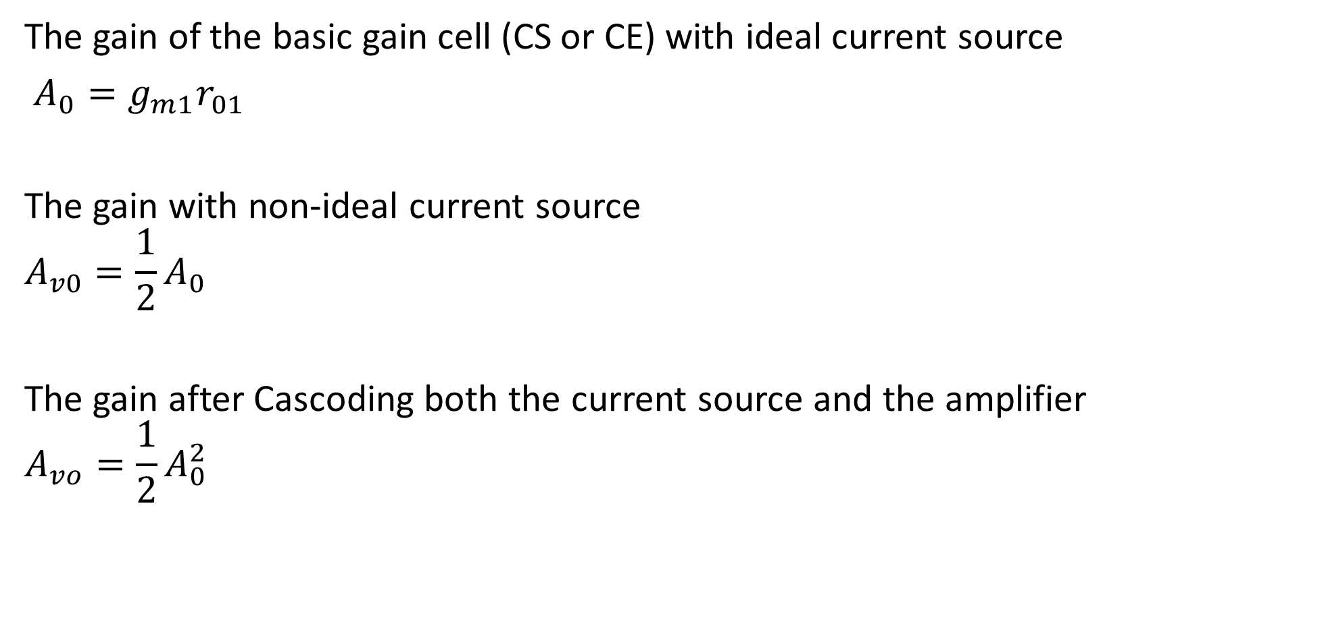
Summary
The gain of the basic gain cell (CS or CE) with ideal current source
$A_{0}=g_{m1}r_{01}$
The gain with non-ideal current source
$$A_{v0}=\frac{1}{2}A_{0}$$
The gain after Cascoding both the current source and the amplifier
$$A_{vo}=\frac{1}{2}A_{0}^{2}$$

Slide 31
Solve and understand this example

Slide 32

$$100μA$$

