Slide 1


Slide 2
Current sources, Mirrors & current steering
Lecture

Slide 3
7.4. IC Biasing – Current Sources, Current Mirrors, and Current-Steering Circuits
Biasing in integrated-circuit design is based on the use of constant-current sources.
On an IC chip with a number of amplifier stages, a constant dc current (reference current) is generated at one location and is then replicated at various other locations for biasing.
This is known as current steering.
This approach has the advantage that the effort expended on generating a predictable and stable reference current need not be repeated.

Slide 5
BASIC PRINCIPLE
The current mirrors uses the principle that if the gate –source potential of two identical MOS transistors are equal then the current flown through their Drain terminals should be the same
NMOS current mirrors are used as current sinks and PMOS current mirrors are used as current sources
There is variety of current mirror circuits available, each of them having their own advantages and applications

Slide 6
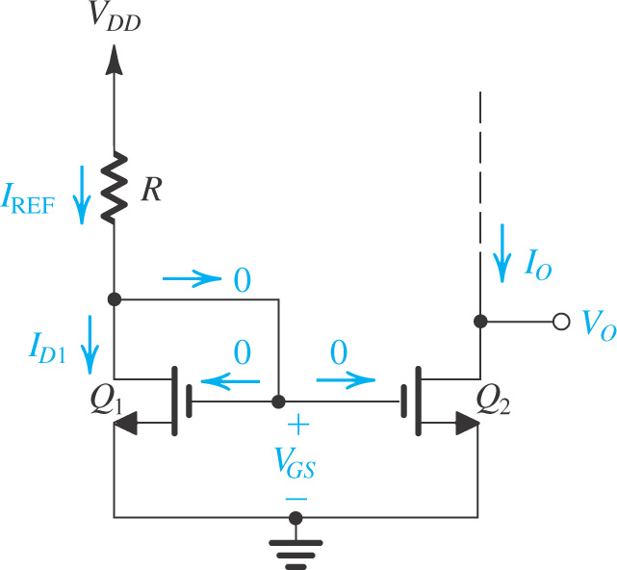
For proper operation, the output terminal, that is, the drain of Q₂, must be connected to a circuit that ensures that Q₂ operates in saturation.

Slide 7
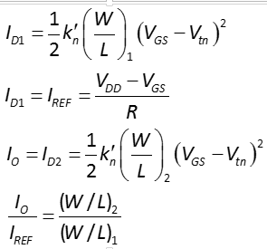
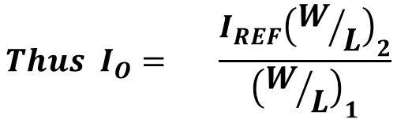
The Basic MOSFET Current Source: Transfer Ratio
$$Thus{ I}_{O}= \frac{I_{REF}{\left(W/L\right)}_{2}}{{\left(W/L\right)}_{1}}$$

Slide 8
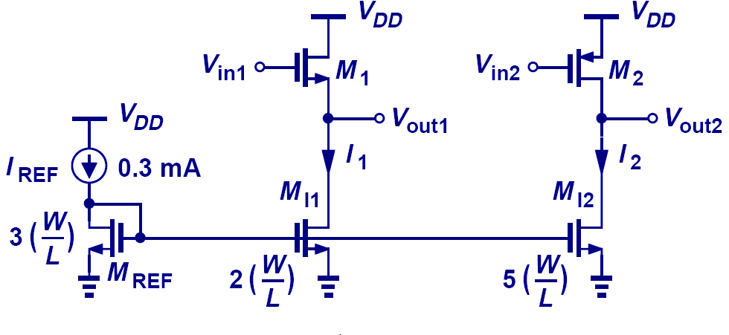

Example: Current Scaling
Can you guess the values of $I_{1} and I_{2}$
MOS current mirrors can also scale I_{REF} up or down (I₁ = 0.2mA, I₂ = 0.5mA).

Slide 9
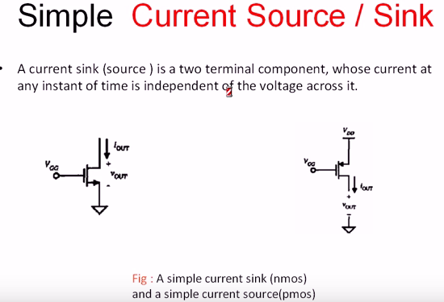
Basic concept of current source & sink

Slide 10
PMOS Source

Slide 11
NMOS –Sinks

Slide 12

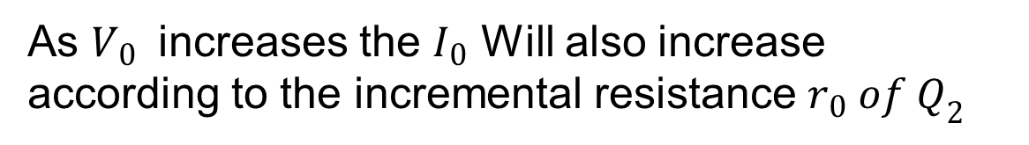
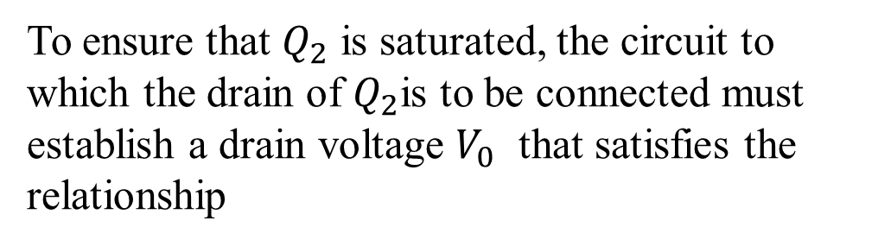
Effect of $V_{0} on I_{0}$
To ensure that $Q_{2}$ is saturated, the circuit to which the drain of $Q_{2}$is to be connected must establish a drain voltage $V_{0}$ that satisfies the relationship
channel-length modulation can have a significant effect on the operation of the current source.
As $V_{0 }$ increases the $I_{0}$ Will also increase according to the incremental resistance $r_{0} of Q_{2}$

Slide 13

MOS Current-steering circuits
As mentioned earlier, once a constant current has been generated, it can be replicated to provide dc bias or load currents for the various amplifier stages in an IC.
$$Q_{1} and R$$
Determine Reference current
Q1, Q2 and Q3 FORMS TWO OUTPUT CURRENT MIRRORS
Circuit
Circuit
To ensure operation in the saturation region, the voltages at the drains of Q2 and Q3 are
constrained as

Slide 14
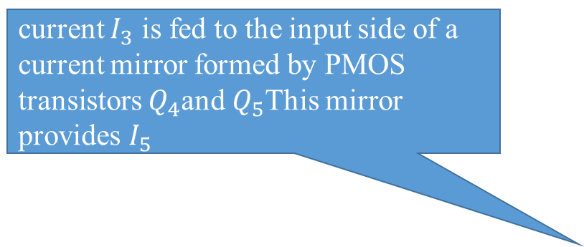
current $I_{3}$ is fed to the input side of a current mirror formed by PMOS transistors $Q_{4}$and $Q_{5}$This mirror provides $I_{5}$
Amplifier circuit
Amplifier circuit
while Q2 pulls its current I2, from a circuit , Q5 pushes its current I5 into a circuit . Thus Q5 is appropriately called a current source, whereas Q2 should more properly be called a current sink.

Slide 15
BJT-CURRENT MIRRORS

Slide 16
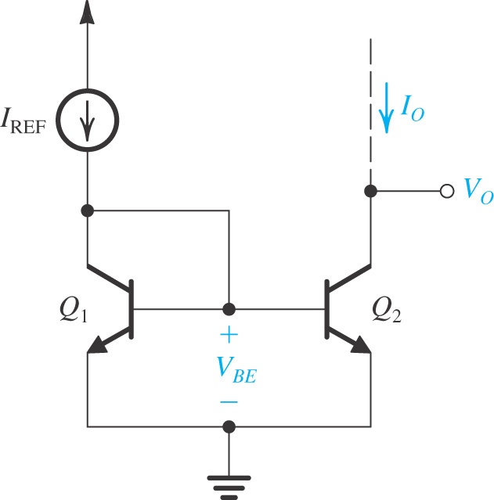
The basic BJT current mirror is shown
It works in a fashion very similar to the MOS mirror. However, with two important differences:
The non-zero base current of the BJT (or, equivalently, the finite β ) causes an error in the current transfer ratio of the BJT mirror .
The current transfer ratio is determined by the relative areas of the emitter-based junctions of Q₁ and Q₂.
Recall MOS Mirror

Slide 17
Case 1: β sufficiently high that we can neglect the base currents
To obtain a current transfer ratio other than unity, say m, we simply arrange that the area of the EBJ of Q2 is m times that of Q1 In this case

Slide 18
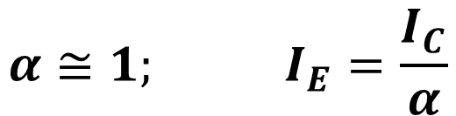
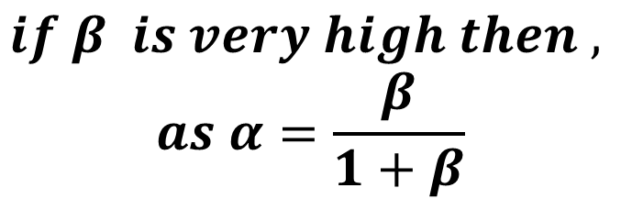


$$if β is very high then ,$$
$$as α=\frac{β}{1+β}$$
$$α≅1; I_{E}=\frac{I_{C}}{α}$$
$$I_{E}≅I_{C} and I_{B}≈0$$
$${Since I}_{E}=I_{C}+I_{B}$$

Slide 19
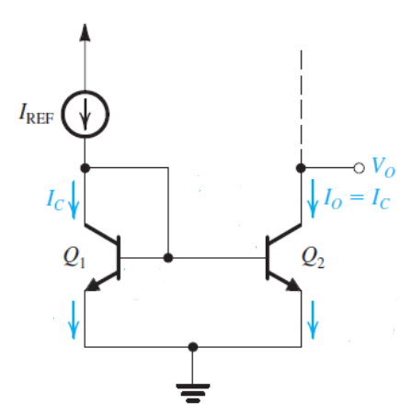
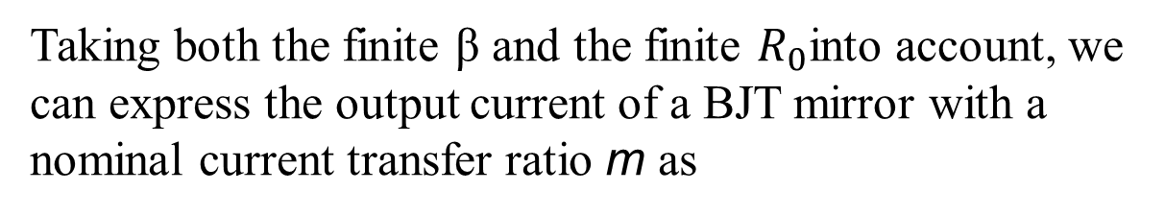
Case 2: the effect of finite transistor β on the current transfer ratio
Taking both the finite β and the finite $R_{0}$into account, we can express the output current of a BJT mirror with a nominal current transfer ratio m as

Slide 20
Summary

Slide 21
BJT –Current Steering
Source
Two parallel transistors so double current
Sink

Slide 24
LECTURE

Slide 26


Unity transfer ratio mean m=1
$={10}^{−3}×\left[\frac{1}{1+\frac{1+1}{100}}\right]\left(1+\frac{5−0.7}{100}\right)$=1.02 mA
$$R_{O}=r_{02}=\frac{V_{A2}}{I_{0}}=\frac{100}{{10}^{−3}}≈100KΩ$$

Slide 27
BJT Current Mirror……Cont

Slide 28
Current-Mirror Circuits with Improved Performance

Slide 29
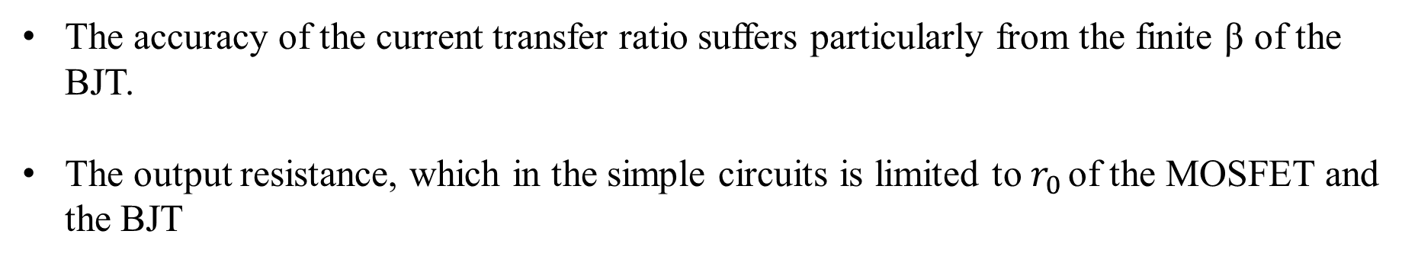
Introduction:
Two performance parameters need to be addressed:
The accuracy of the current transfer ratio suffers particularly from the finite β of the BJT.
The output resistance, which in the simple circuits is limited to $r_{0 }$of the MOSFET and the BJT
Improvements can be incorporated by following means:
Cascode MOS Mirror
Previous sections demonstrate the cascoding of transistors may be used to increase gain and acquire “better” performance.
A Bipolar Mirror with Base-Current Compensation
Base-current compensation may be used to eliminate the effect of bias current on mirror operation. In other words, how may its operation be made more like the MOS implementation.

Slide 30


Cascoding
Figure shows the basic cascode current mirror. Observe that in addition to the diode connected transistor Q1, which forms the basic mirror Q1–Q2, another diode-connected transistor, Q4, is used to provide a suitable bias voltage for the gate of the cascode transistor Q3.
To determine the output resistance of the cascode mirror at the drain of Q3, we assume that the voltages across Q1 and Q4 are constant, and thus the signal voltages at the gates of Q2 and Q3 will be zero.
Thus Ro will be that of the cascode current source formed
by Q2 and Q3,
$$V_{DS}=V_{GS}−V_{t}$$
$$But Gate of V_{G3} is=2V_{GS}=2V_{OV}+2V_{t}$$
$$V_{DS}={2V}_{OV}+2V_{t}−V_{t}$$

Slide 31
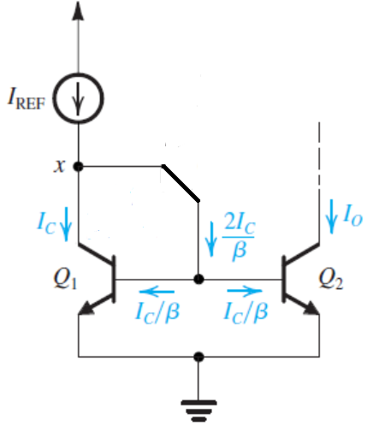
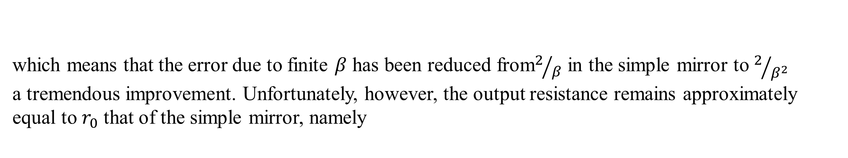
A Bipolar Mirror with Base-Current Compensation
which means that the error due to finite $β$ has been reduced from$2/β$ in the simple mirror to $2/{β^{2}}$ a tremendous improvement. Unfortunately, however, the output resistance remains approximately equal to $r_{0}$ that of the simple mirror, namely

Slide 32
Still the same

Slide 33
The Wilson Current Mirror
A simple modification of the basic bipolar mirror results in both reducing the β dependence and increasing the output resistance. The resulting circuit, known as the Wilson mirror

Slide 34

$R_{0}$ Calculations

Slide 36
The Widlar Current Source
It differs from the basic current mirror circuit in an important way: A resistor RE is included in the emitter lead of Q2. Neglecting base currents we can write
where we have assumed that Q1 and Q2 are matched devices. Combining Eqs.
But
The Widlar current source provides an area-efficient way to implement a low-valued constant-current source that also has a high output resistance

Slide 37
If you want very small output current , then the resistance required will be very large

Slide 39
Some Useful Transistor Pairings
The cascode configuration studied in Section 7.3 combines CS and CG MOS transistors (CE and CB bipolar transistors) to great advantage.
The key to the superior performance of the resulting combination is that the transistor pairing is done in a way that maximizes the advantages and minimizes the shortcomings of each of the two individual configurations.
In this section we present a number of other such transistor pairings. In each case the transistor pair can be thought of as a compound device; thus the resulting amplifier may be considered as a single stage.

Slide 40
Some Useful Transistor Pairings
The CC–CE, CD–CS, and CD–CE
Configurations
The CC–CB and CD–CG Configurations

Slide 41
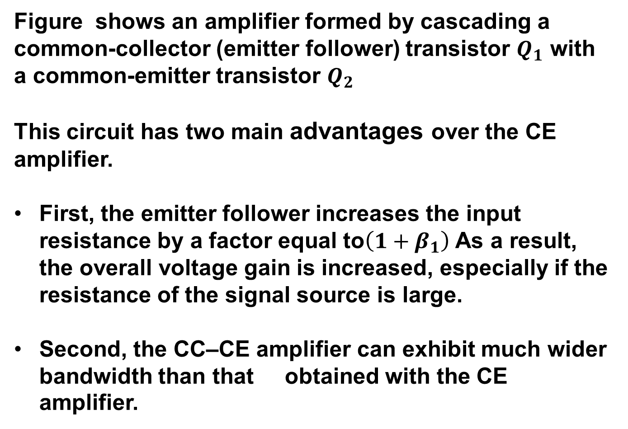
1. The CC–CE Configurations
Figure shows an amplifier formed by cascading a common-collector (emitter follower) transistor $Q_{1}$ with a common-emitter transistor $Q_{2}$
This circuit has two main advantages over the CE amplifier.
First, the emitter follower increases the input resistance by a factor equal to$\left(1+β_{1}\right)$ As a result, the overall voltage gain is increased, especially if the resistance of the signal source is large.
Second, the CC–CE amplifier can exhibit much wider bandwidth than that obtained with the CE amplifier.

Slide 42
1. The CD–CS Configurations
The MOS counterpart of the CC–CE amplifier, namely, the CD–CS configuration, is shown.
Here, the CS amplifier alone has an infinite input resistance,
The sole purpose for adding the source-follower stage is to increase the amplifier bandwidth,

Slide 43
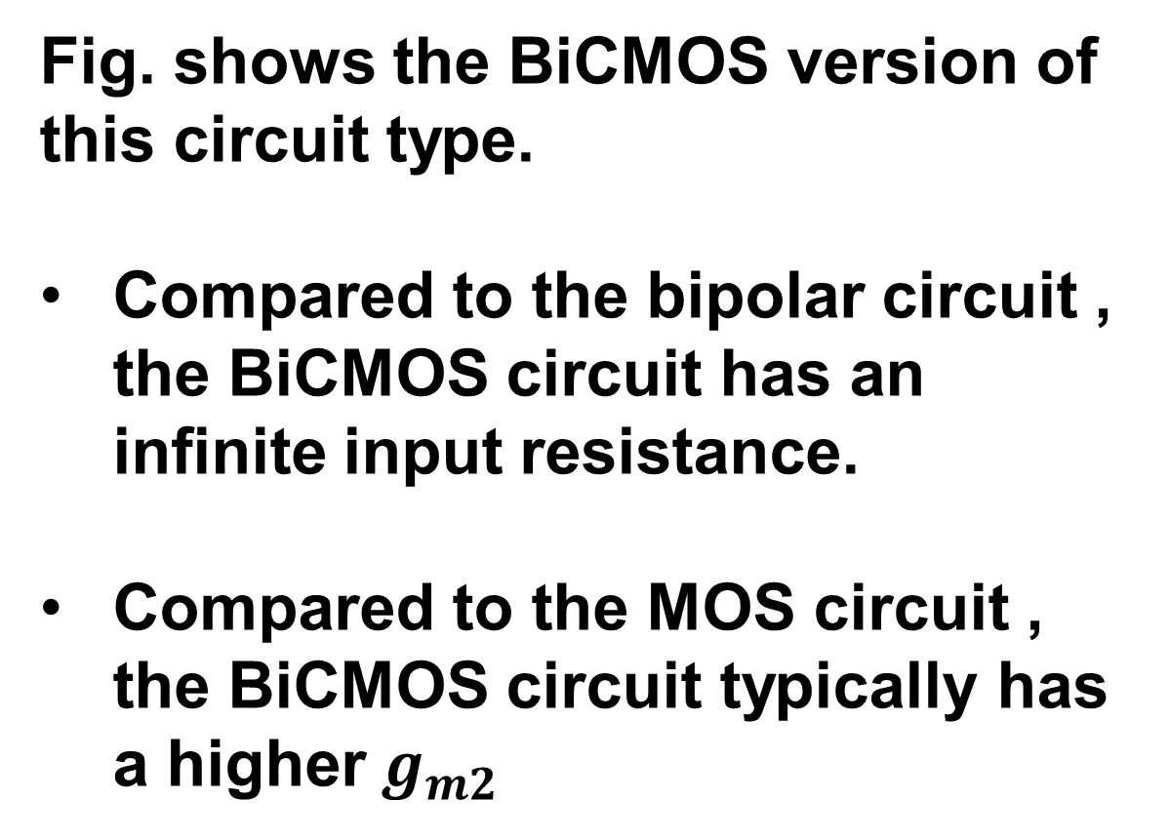
1. The CC–CE Configurations
Fig. shows the BiCMOS version of this circuit type.
Compared to the bipolar circuit , the BiCMOS circuit has an infinite input resistance.
Compared to the MOS circuit , the BiCMOS circuit typically has a higher${ g}_{m2}$

Slide 44
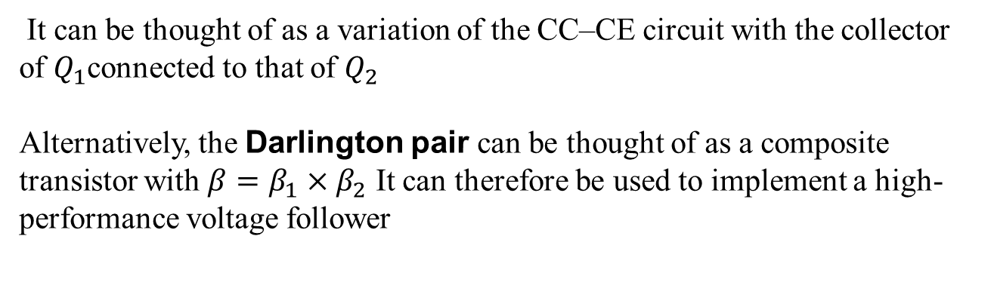
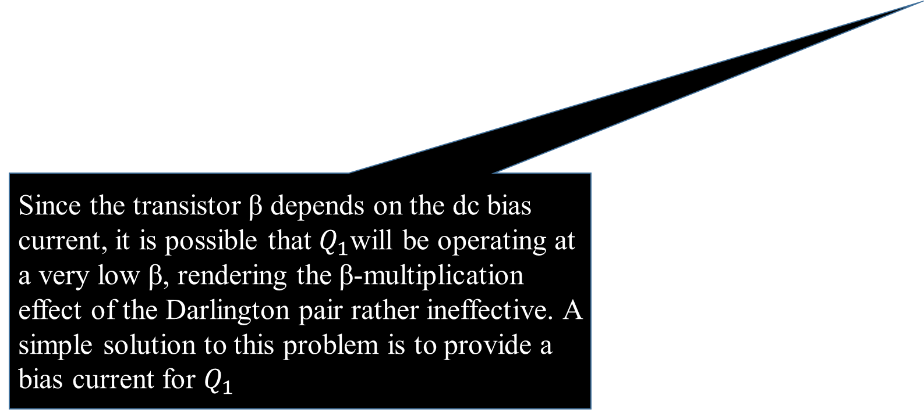
The Darlington Configuration
1. The CC–CE Configurations (Variation )
It can be thought of as a variation of the CC–CE circuit with the collector of $Q_{1}$connected to that of $Q_{2}$
Alternatively, the Darlington pair can be thought of as a composite transistor with $β=β_{1}×β_{2}$ It can therefore be used to implement a high-performance voltage follower
Note that in this application the circuit can be considered as the cascade connection of two common-collector transistors (i.e., a CC–CC
configuration).
Since the transistor β depends on the dc bias current, it is possible that $Q_{1}$will be operating at a very low β, rendering the β-multiplication effect of the Darlington pair rather ineffective. A simple solution to this problem is to provide a bias current for $Q_{1}$

Slide 45
The CC–CB and CD–CG Configurations

Slide 46
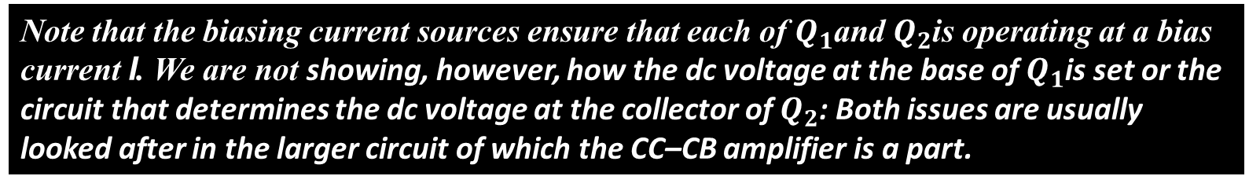
Cascading an emitter follower with a common-base amplifier, results in a circuit with a low-frequency gain approximately equal to that of the CB but with
the problem of the low input resistance of the CB solved by the buffering action of the CC stage.
It will be shown in Chapter 9 that this circuit exhibits wider bandwidth than that obtained with a CE amplifier of the same gain
Note that the biasing current sources ensure that each of $Q_{1}$and $Q_{2}$is operating at a bias current I. We are not showing, however, how the dc voltage at the base of $Q_{1}$is set or the circuit that determines the dc voltage at the collector of $Q_{2}$: Both issues are usually looked after in the larger circuit of which the CC–CB amplifier is a part.

Slide 47
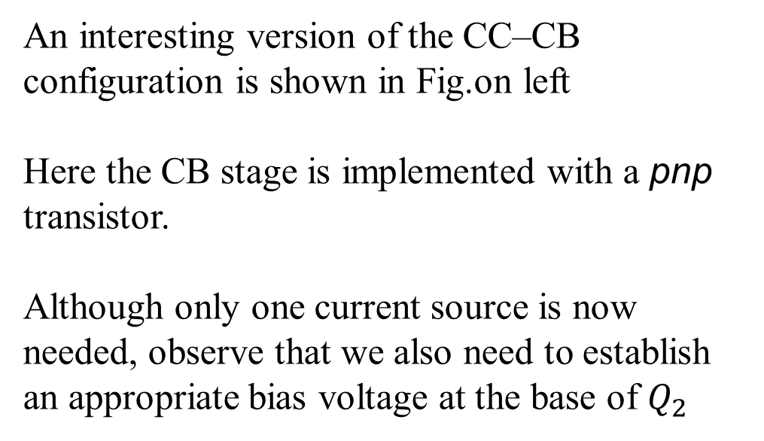
An interesting version of the CC–CB configuration is shown in Fig.on left
Here the CB stage is implemented with a pnp transistor.
Although only one current source is now needed, observe that we also need to establish an appropriate bias voltage at the base of $Q_{2}$
The MOSFET version of the circuit is the CD–CG amplifier

Slide 48
Assignment No 2 (CLO-1) (Submission date 10th October 2022)
Do all examples and exercise starting from page 542 to page 552) of your text book “Microelectronics Circuits” 6th edition by Sedra & Smith
You are also given an assignment( Assignment 3) to be submitted on 5th Oct. The asc. Files have been emailed to all three section.

Slide 50
We observe that using the Widlar circuit allows the generation of a small constant current using relatively small resistors
$V_{BE}$ for both the transistors not same
Now $V_{E}=0.115$; and $V_{BE2}=0.585$
0.115 V less then Q1

Slide 51
Out put Resistance

Slide 54
The Darlington Configuration
In one package
(a) The Darlington configuration; (b) voltage follower using the Darlington configuration; (c) the Darlington follower with a bias current I supplied to Q1 to ensure that its β remains high.

