Slide 1
Quiz 2
SOLUTION

Slide 2








$$I_{D}=\frac{1}{2}×μ_{n}C_{ox}\frac{W}{L}{\left(V_{OV}\right)}^{2}$$
$$R_{0}=g_{m}{\left(r_{0}\right)}^{2}$$
$${2V}_{GS}$$
$$V_{DS}≥V_{GS}−V_{t}$$
$$V_{OUT(min)}=2V_{OV}+V_{t}$$
$${1V}_{GS}$$
$$2V_{OV}=2V_{GS}−2V_{t}$$
$$But Gate of V_{G3} is=2V_{GS}=2V_{OV}+2V_{t}$$
$$V_{DS}={2V}_{OV}+2V_{t}−V_{t}$$

Slide 3



$$V_{OV}=V_{GS1}−V_{th}=0.7−0.5=0.2V$$
$$V_{D1}=V_{S2}=V_{G2}−V_{th}−V_{OV}$$
$${Given is V}_{th}=0.5$$
$$=1.0−0.5 −0.2=0.3V$$
$$The lowest V_{DS2} can go is \left|V_{OV}\right|=0.2V$$
$$V_{D4}=V_{S3}=1.5$$
$$Therefore V_{O min}=V_{DS1}+V_{DS2}=0.3+0.2=0.5V$$
0.2
$$V_{SG4}=0.7$$
$$\left(1.3 to 0.5\right)$$
$$V_{D4}=V_{S3}=V_{G3}+V_{th}+V_{OV}$$
0.2
$$=0.8+0.5+0.2 =1.5V$$
$V_{D1}=V_{S2}=0.$3
${Therefore V}_{SG3}=$1.5 -0.8=0.7
$$V_{SD3} can go as low as \left|V_{OV}\right| So$$
$V_{O(max)}$=$V_{D4}−V_{SD3min}=1.5−0.2=1.3V$

Slide 4
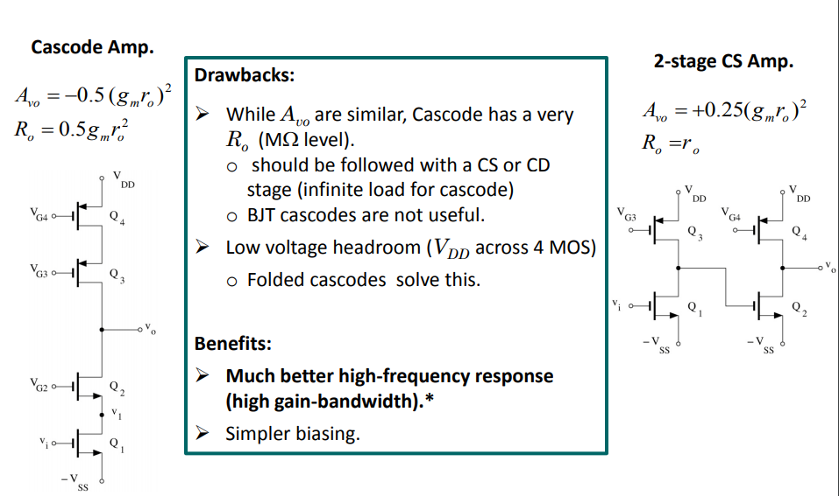








Ideal Source
Ideal Source
$$A_{vo}={\left(g_{m}r_{o}\right)}^{2}$$
$$A_{vo}={\left(g_{m}r_{0}\right)}^{2}$$
$$R_{out}=g_{m}{\left(r_{o}\right)}^{2}$$
$$R_{o}=r_{o}$$
Non – Ideal Source
Non – Ideal Source
$$A_{v}=A_{1}×A_{2}$$
$$A_{1}=\frac{1}{2}g_{m}r_{0}$$
$$A_{2}=\frac{1}{2}g_{m}r_{0}$$
$$R_{O}=0.5r_{o}$$

Slide 5
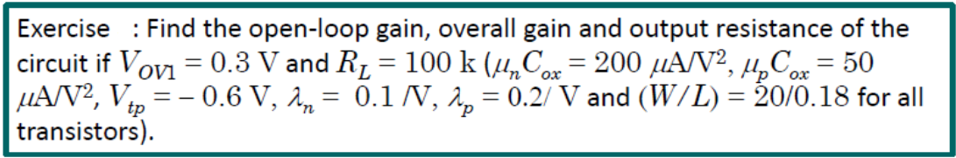

$$=1 mA$$

Slide 7
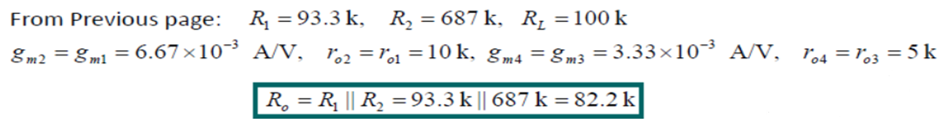
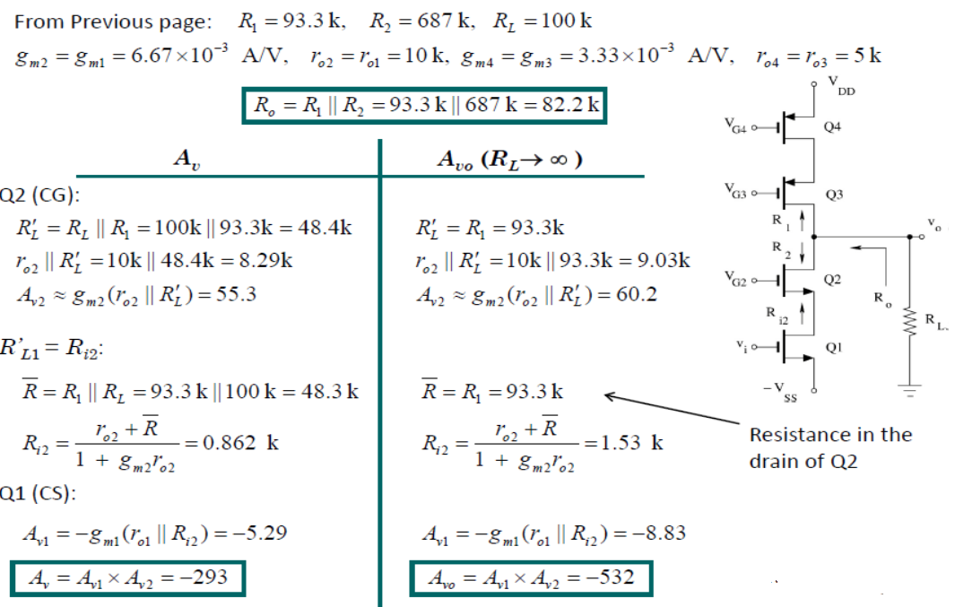
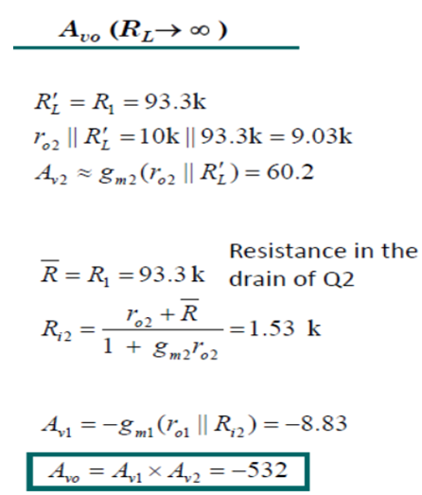

Slide 8
Summary of Chapter No:7

Slide 32
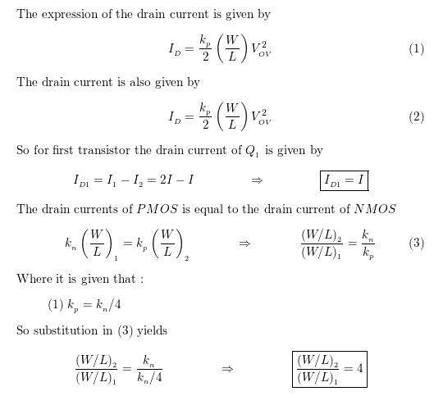

Slide 33
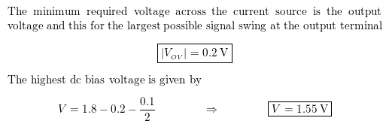
1.8 V
0.2 ${=V}_{OV}$
0.1/2 Signal swing
What is the highest dc bias voltage here

Slide 34
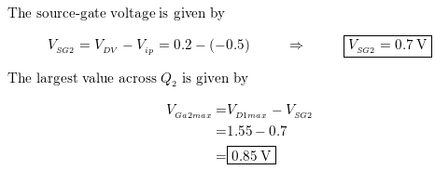
$V_{T}=$0.5
$V_{OV}$=0.2
$$V_{GS}−V_{T}=V_{OV}$$
0.2
-0.5
1.8 V
0.2 ${=V}_{OV}$
0.1/2 Signal swing
1.55
0.85

Slide 35

0.2 ${=V}_{OV4}$
0.2 ${=V}_{OV5}$

Slide 36
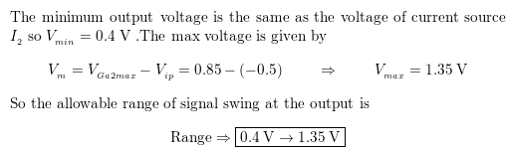
i.e. max and min o/p
1.8 V
0.2 ${=V}_{OV}$
0.1/2 Signal swing
1.55
0.85
0.2 ${=V}_{OV4}$
0.2 ${=V}_{OV5}$

