Slide 1
Chapter No8_1

Slide 2
What we studied so far
Philosophy of integrated circuits
Basic gain cells
Cascoding
Currents sources and mirrors
Improving basic current sources
Other transistor combinations

Slide 3
Differential Amplifier
Chapter No 8

Slide 4
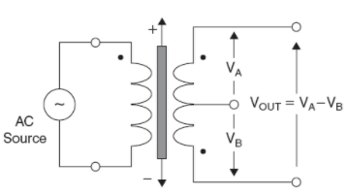
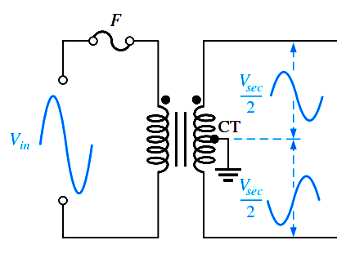
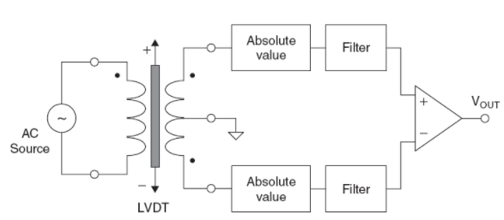
Differential Inputs generation

Slide 5
Why Differential?
One of the most widely used analog block
High-performance mixed-signal circuits
A mixed-signal integrated circuit is any integrated circuit that has both analog circuits and digital circuits on a single semiconductor die. ... Mixed-signal circuits or systems are typically cost-effective solutions for building any modern consumer electronics, industrial, medical, measurement, space etc.
Differential circuits are much less sensitive to noise and interference than single-ended circuits.
Differential configuration enables us to bias the amplifier and to couple amplifier stages together without the need for bypass and coupling capacitors

Slide 6

Interference and noise in signals
In telecommunications, an interference is that which modifies a signal in a disruptive manner, as it travels along a communication channel between its source and receiver. The term is often used to refer to the addition of unwanted signals to a useful signal. Common examples include:
Electromagnetic interference (EMI)
Co-channel interference (CCI), also known as crosstalk
Adjacent-channel interference (ACI)
Intersymbol interference (ISI)
Inter-carrier interference (ICI), caused by doppler shift in OFDM modulation (multitone modulation).
Common-mode interference (CMI)
Conducted interference
Noise is a form of interference but not all interference is noise.

Slide 7
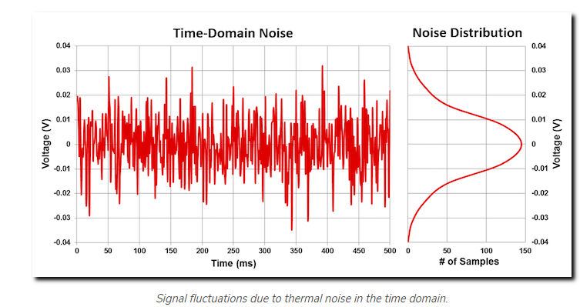
Thermal Noise
Thermal noise is generated naturally by thermal agitation of electrons in a conductor commonly found in opto-electronic devices. ... In communication, thermal noise has a major influence to the quality of the receiver. The lower the thermal noise the higher and more expensive is receiver sensitivity.

Slide 9
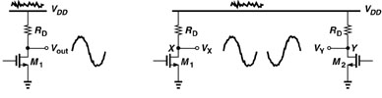
Example
Diff circuit more immune to noise
e.g. Power Supply Noise
Single-Ended:
Supply varies by ΔV ⇒ Vout changes by approx. same amount
Differential (symmetric circuit)
Noise on supply affects V_{X} and V_{Y}, not V_{X}-V_{Y} (V_{out})
High-Noise Immunity – rejects common signal (noise)

Slide 10
Another advantage of diff amp.
In a single CS amplifier, the maximum swing is V_{DD}-(V_{GS}-V_{TH})
In a differential pair it can be shown that the swing of V_{X}-V_{Y} can reach 2[V_{DD}-(V_{GS}-V_{TH})].

Slide 11
Differential Amplifier: Config. & modes
Configurations
Modes of Operation
Common mode
Differential mode
Dual input balanced output differential amplifier.
Dual input, unbalanced output differential amplifier.
Single input, balanced output differential amplifier.
Single input, unbalanced output differential amplifier.

Slide 12
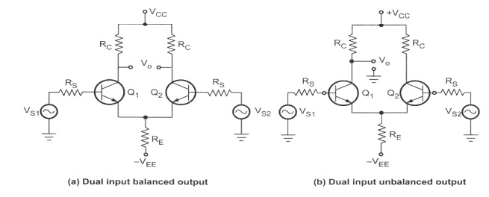
Configurations

Slide 13
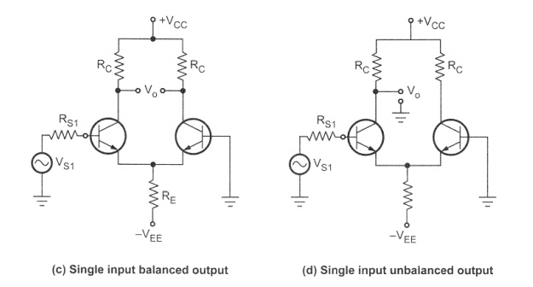
Configurations

Slide 14
DIFFERENTIAL AMPLIFIER definitions
Common mode rejection ratio (CMRR)
CMRR is a measure of how well the differential amplifier rejects the common-mode input voltage in favor of the differential-input voltage.
Input common-mode range (ICMR)
The input common-mode range is the range of common-mode voltages over which the differential amplifier continues to sense and amplify the difference signal with the same gain.
Typically, the ICMR is defined by the common-mode voltage range over which all MOSFETs remain in the saturation region.
Output offset voltage (V_{OS}(out))
The output offset voltage is the voltage which appears at the output of the differential amplifier when the input terminals are connected together.
Input offset voltage (V_{OS}(in) = VOS)
The input offset voltage is equal to the output offset voltage divided by the differential voltage gain.

Slide 15
Circuit diagrams of basic differential Pairs
Basic MOS differential Pair
Basic BJT differential Pair

Slide 16
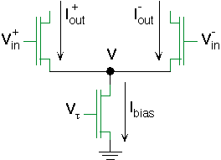
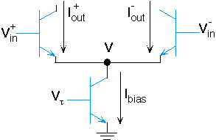
Differential Transistor Pairs
MOSFET Diff-Pair
BJT Diff-Pair
The bottom transistor (the one with I_{bias}) sets the total current
The upper two transistors compete for a fraction of this current

Slide 17
COMMON MODE OPERATION

Slide 18
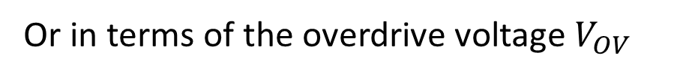
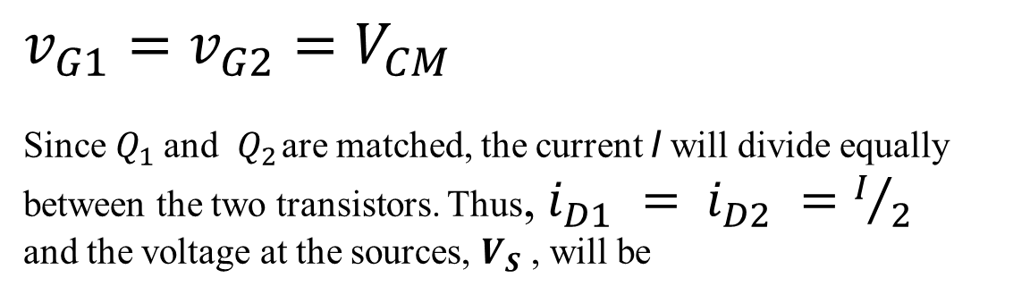

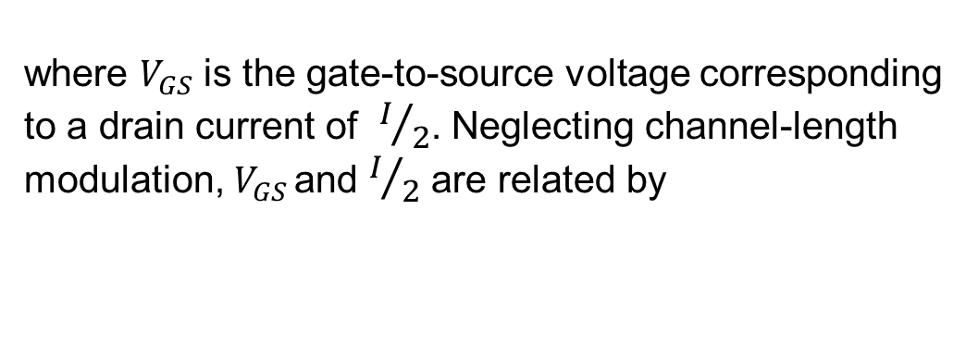
$v_{G1}=v_{G2}=V_{CM}$
Since $Q_{1}$ and $Q_{2}$ are matched, the current I will divide equally
between the two transistors. Thus, $i_{D1} = i_{D2} =I/2$
and the voltage at the sources, $V_{S}$ , will be
$$V_{S}=V_{CM}− V_{GS}$$
where $V_{GS}$is the gate-to-source voltage corresponding to a drain current of $I/2$. Neglecting channel-length modulation, $V_{GS}$ and $I/2$ are related by
Or in terms of the overdrive voltage $V_{OV}$

Slide 19
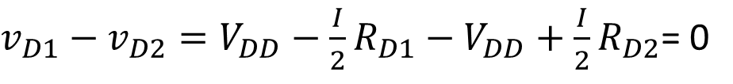

$$v_{D1}−v_{D2}=V_{DD}−\frac{I}{2}R_{D}−\left(V_{DD}−\frac{I}{2}R_{D}\right)$$
$v_{D1}−v_{D2}=V_{DD}−\frac{I}{2}R_{D1}−V_{DD}+\frac{I}{2}R_{D2}$= 0

Slide 20
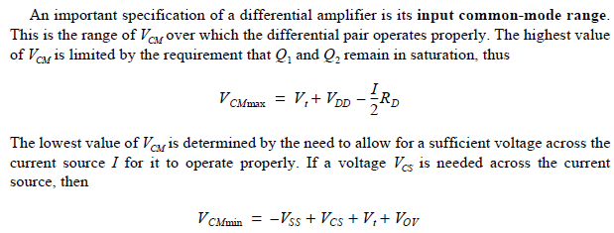
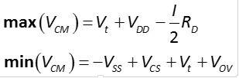




Input common-mode range
$$V_{DS}≥V_{GS}−V_{t}$$
$$V_{GM min}−V_{S}−V_{t}=V_{OV}−V_{SS}$$
$$V_{G}−V_{S}−V_{t}=V_{OV}−V_{SS}$$
$$V_{G}=V_{S}+V_{t}+V_{OV}−V_{SS}$$

