Slide 1
Chapter 8_2
Derivation of drain current equations in terms of differential input voltage

Slide 2
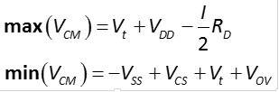
What we studied so far in Differential Amp.
Modes of Operation
Common mode
Common mode range of input signal

Slide 3
What we studied so far in Differential Amp.
Modes of Operation
Differential mode
Differential Input Range

Slide 4
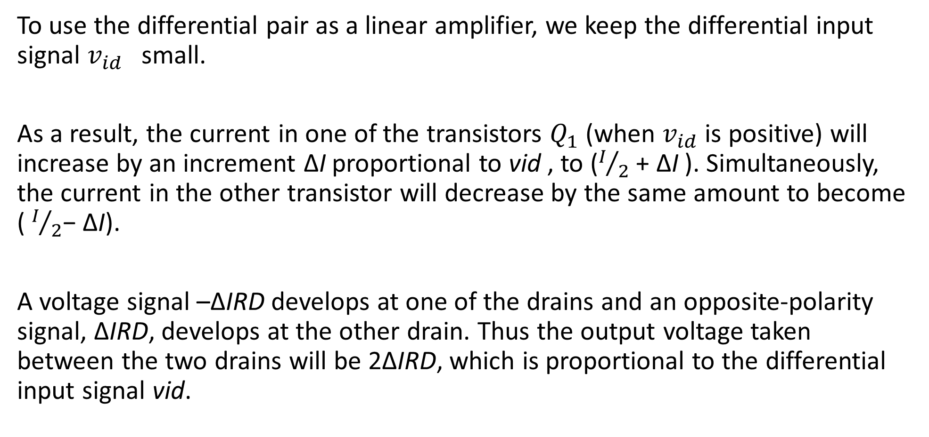
To use the differential pair as a linear amplifier, we keep the differential input signal $v_{id}$small.
As a result, the current in one of the transistors $Q_{1}$ (when $v_{id}$ is positive) will increase by an increment ΔI proportional to vid , to ($I/2$ + ΔI ). Simultaneously, the current in the other transistor will decrease by the same amount to become ( $I/2$− ΔI).
A voltage signal –ΔIRD develops at one of the drains and an opposite-polarity signal, ΔIRD, develops at the other drain. Thus the output voltage taken between the two drains will be 2ΔIRD, which is proportional to the differential input signal vid.

Slide 5

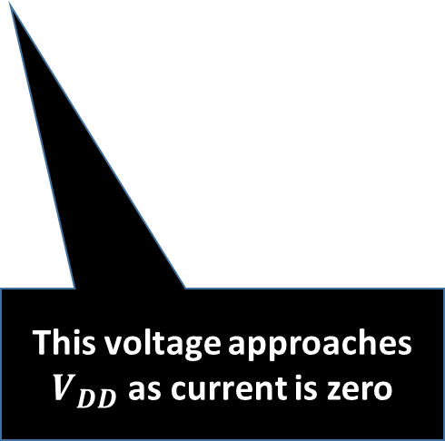

Differential Amplifier with differential input
$$V_{Y}= V_{DD}$$
This voltage goes down as current in this branch increases
$$V_{X}= V_{DD} −R_{D}×I_{SS}$$
This voltage approaches $V_{DD}$ as current is zero

Slide 7
Large-Signal Operation
Objective is to derive expressions for drain current i_{D1} and i_{D2} in terms of differential signal v_{id} = v_{G1} – v_{G2}.
Assumptions:
Perfectly Matched
Channel-length Modulation is Neglected
Load Independence
Saturation Region

Slide 8
Large-Signal Operation (1)
Step #1:
Expression drain currents for Q₁ and Q₂.
Step #2:
Take the square roots of both sides of both
Step #3:
Subtract two equations and perform appropriate substitution.

Slide 9
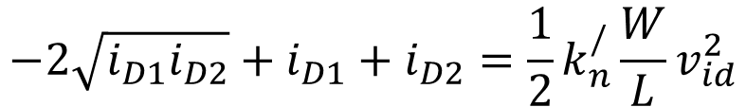
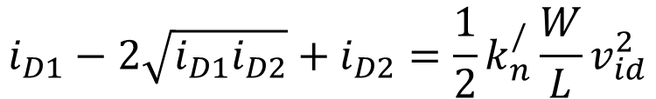

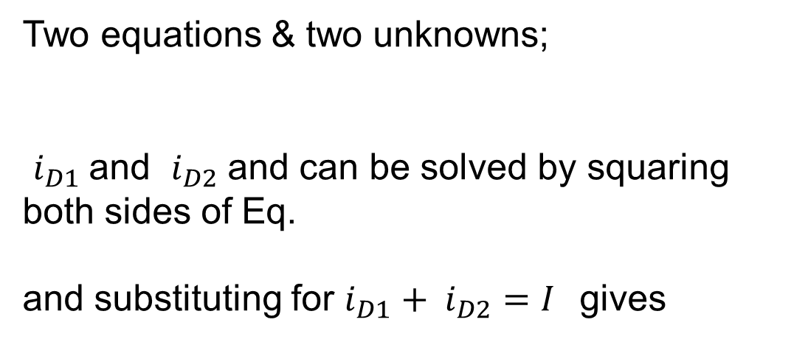
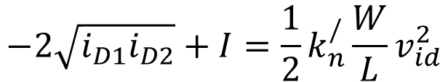
step #4:
Two equations & two unknowns;
$i_{D1}$ and $i_{D2}$ and can be solved by squaring both sides of Eq.
and substituting for $i_{D1}+ i_{D2}=I$gives
$${\left(a−b\right)}^{2}=a^{2}−2ab+b^{2}$$
$$i_{D1}−2\sqrt{i_{D1}i_{D2}}+i_{D2}=\frac{1}{2}k_{n}^{/}\frac{W}{L}v_{id}^{2}$$
$$−2\sqrt{i_{D1}i_{D2}}+i_{D1}+i_{D2}=\frac{1}{2}k_{n}^{/}\frac{W}{L}v_{id}^{2}$$
$$−2\sqrt{i_{D1}i_{D2}}+I=\frac{1}{2}k_{n}^{/}\frac{W}{L}v_{id}^{2}$$

Slide 10

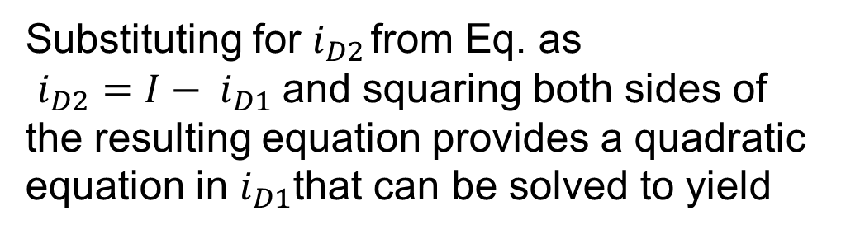
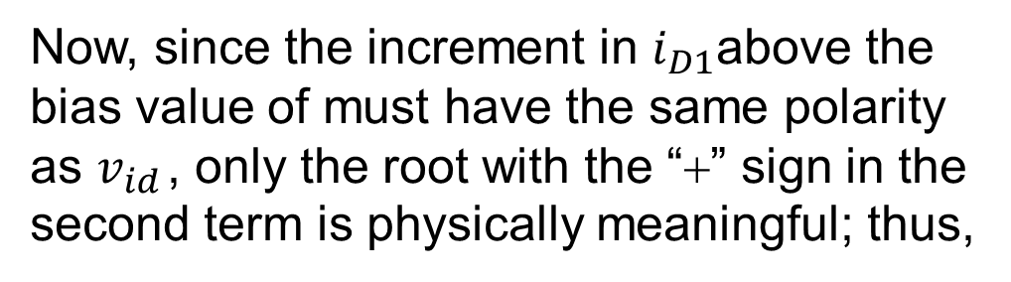
Substituting for $i_{D2}$ from Eq. as
$i_{D2}=I− i_{D1}$and squaring both sides of the resulting equation provides a quadratic equation in $i_{D1}$that can be solved to yield
Now, since the increment in $i_{D1}$above the bias value of must have the same polarity as $v_{id}$ , only the root with the “+” sign in the second term is physically meaningful; thus,
And $i_{D2}$ will be

Slide 11

Large-Signal Operation
In terms of $V_{OV}$
Transfer characteristics of above two equations are nonlinear.
Linear amplification is desirable and v_{id} will be as small as possible.
For a given value of V_{OV}, the only option is to keep v_{id}/2 much smaller than V_{OV}.

Slide 12
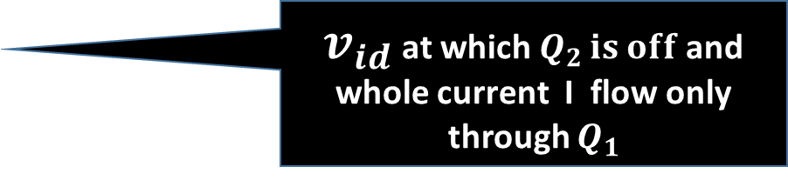
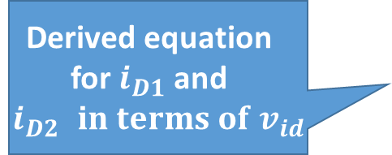
Large-Signal Operation
Derived equation for $i_{D1}$ and $i_{D2 }in terms of v_{id}$
Linear Region
Plot Transfer characteristics of above equations and found it to be nonlinear.
$v_{id}$ at which $Q_{2 }is off$and whole current I flow only through $Q_{1}$

Slide 13
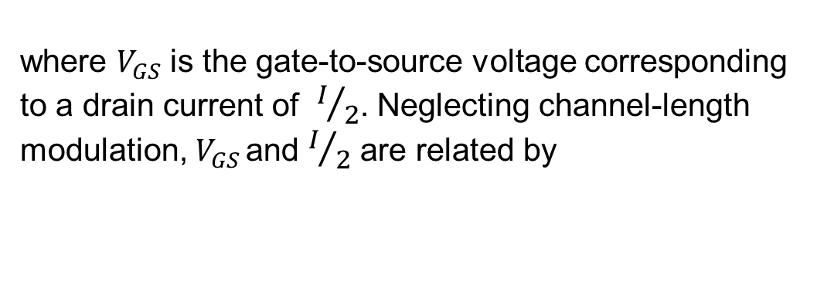
Analysis
linearity can be increased by increasing the overdrive voltage VOV at which each of Q1 and Q2 is operating.
The linear range of operation can be extended by operating the MOSFETs at a higher VOV (by using smaller ratios) at the expense of reducing gm and hence the gain. ($g_{m}={{2I}_{D}}/{V_{OV}}$)
This trade-off is based on the assumption that the bias current I is being kept constant.
The bias current can, of course, be increased to obtain a higher gm.
The expense for doing this, however, is increased power dissipation, a serious limitation in IC design

Slide 14
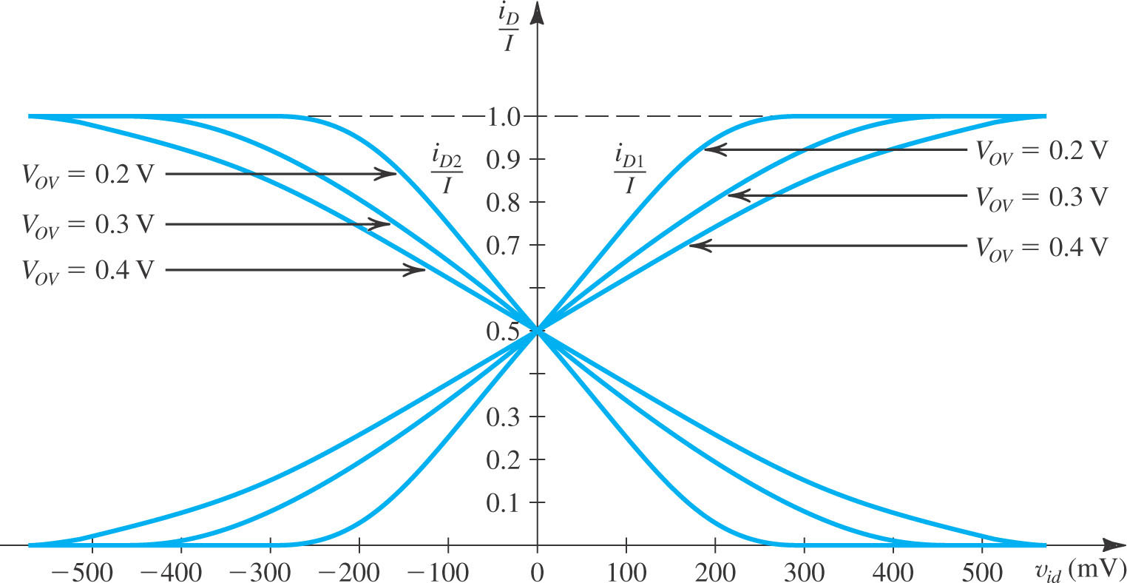

Slide 15
Hint : partially solved in following slides

Slide 16
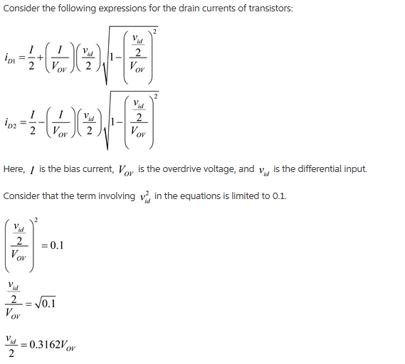
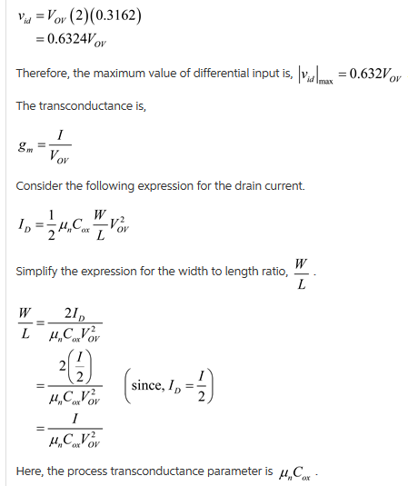
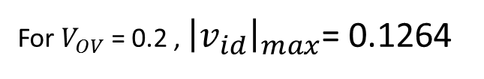
For $V_{OV}$ = 0.2 , ${\left|v_{id}\right|}_{max}$= 0.1264

Slide 17
Substitute the values and calculate the answers

