Slide 1
Lecture 8_3

Slide 2
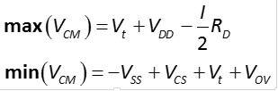
What we studied so far in Differential Amp.
Modes of Operation
Common mode
Common mode range of input signal

Slide 3
What we studied so far in Differential Amp.
Modes of Operation
Differential mode
Differential Input Range

Slide 4
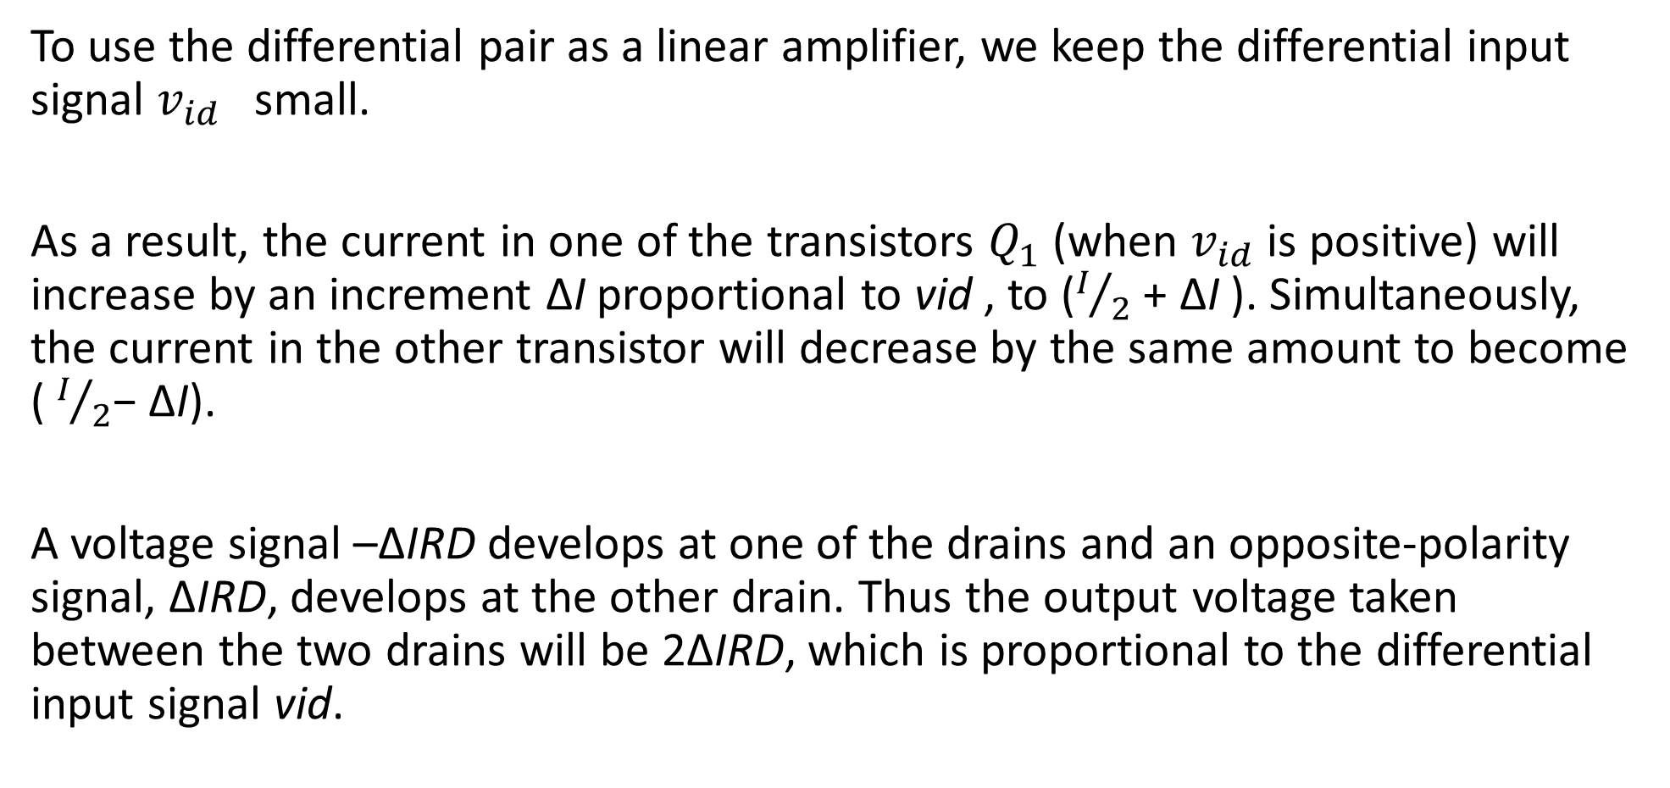
To use the differential pair as a linear amplifier, we keep the differential input signal $v_{id}$small.
As a result, the current in one of the transistors $Q_{1}$ (when $v_{id}$ is positive) will increase by an increment ΔI proportional to vid , to ($I/2$ + ΔI ). Simultaneously, the current in the other transistor will decrease by the same amount to become ( $I/2$− ΔI).
A voltage signal –ΔIRD develops at one of the drains and an opposite-polarity signal, ΔIRD, develops at the other drain. Thus the output voltage taken between the two drains will be 2ΔIRD, which is proportional to the differential input signal vid.

Slide 5

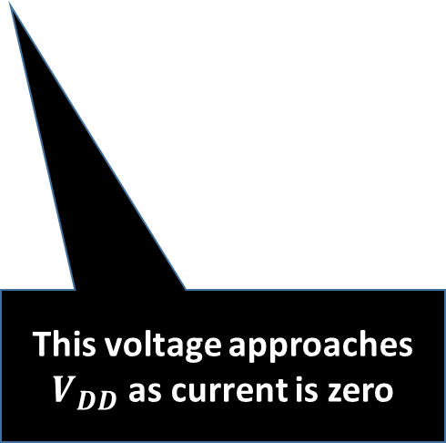

Differential Amplifier with differential input
$$V_{Y}= V_{DD}$$
This voltage goes down as current in this branch increases
In common mode operation, both outputs remained the same as same input were applied
$$V_{X}= V_{DD} −R_{D}×I_{SS}$$
This voltage approaches $V_{DD}$ as current is zero

Slide 6
One current increases while other decreases
One voltage increases while other decreases

Slide 7
Large-Signal Operation
Objective is to derive expressions for drain current i_{D1} and i_{D2} in terms of differential signal v_{id} = v_{G1} – v_{G2}.
Assumptions:
Perfectly Matched
Channel-length Modulation is Neglected
Load Independence
Saturation Region

Slide 8
Large-Signal Operation (1)
Step #1:
Expression drain currents for Q₁ and Q₂.
Step #2:
Take the square roots of both sides of both
Step #3:
Subtract two equations and perform appropriate substitution.

Slide 9
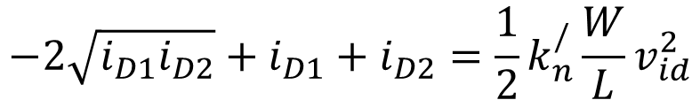
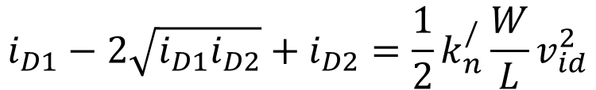

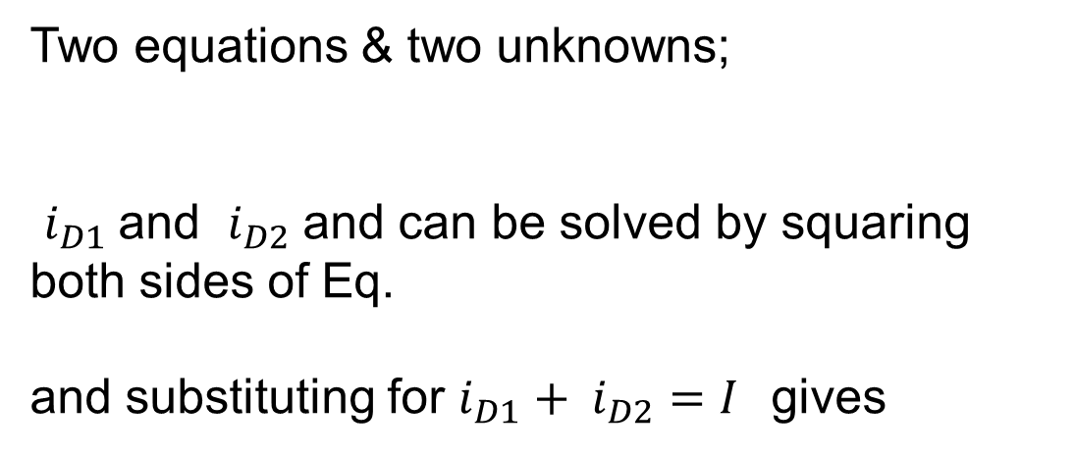
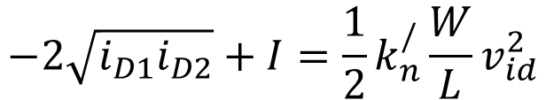
step #4:
Two equations & two unknowns;
$i_{D1}$ and $i_{D2}$ and can be solved by squaring both sides of Eq.
and substituting for $i_{D1}+ i_{D2}=I$gives
$${\left(a−b\right)}^{2}=a^{2}−2ab+b^{2}$$
$$i_{D1}−2\sqrt{i_{D1}i_{D2}}+i_{D2}=\frac{1}{2}k_{n}^{/}\frac{W}{L}v_{id}^{2}$$
$$−2\sqrt{i_{D1}i_{D2}}+i_{D1}+i_{D2}=\frac{1}{2}k_{n}^{/}\frac{W}{L}v_{id}^{2}$$
$$−2\sqrt{i_{D1}i_{D2}}+I=\frac{1}{2}k_{n}^{/}\frac{W}{L}v_{id}^{2}$$

Slide 10

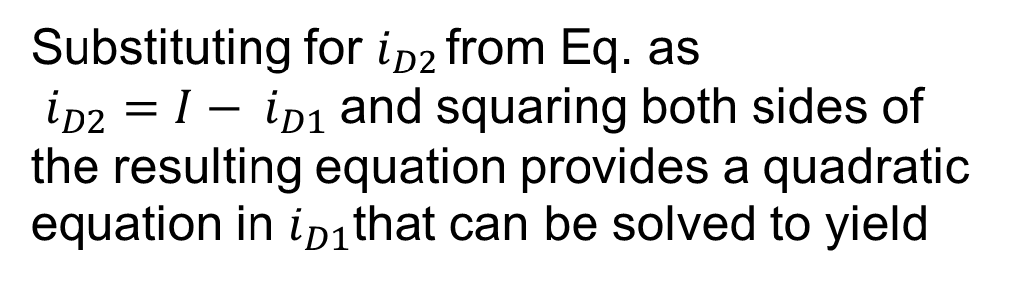
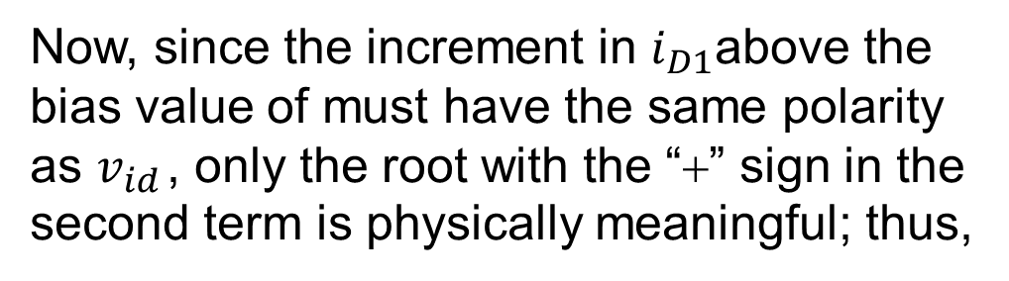
Substituting for $i_{D2}$ from Eq. as
$i_{D2}=I− i_{D1}$and squaring both sides of the resulting equation provides a quadratic equation in $i_{D1}$that can be solved to yield
Now, since the increment in $i_{D1}$above the bias value of must have the same polarity as $v_{id}$ , only the root with the “+” sign in the second term is physically meaningful; thus,
And $i_{D2}$ will be

Slide 11

Large-Signal Operation
In terms of $V_{OV}$
Transfer characteristics of above two equations are nonlinear.
Linear amplification is desirable and v_{id} will be as small as possible.
For a given value of V_{OV}, the only option is to keep v_{id}/2 much smaller than V_{OV}.

Slide 12
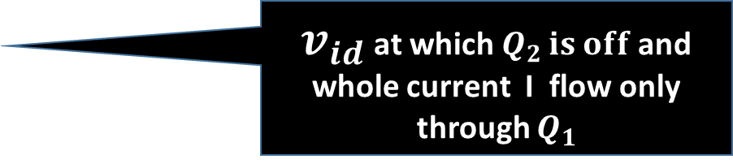
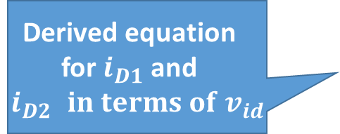
Large-Signal Operation
Derived equation for $i_{D1}$ and $i_{D2 }in terms of v_{id}$
Linear Region
Plot Transfer characteristics of above equations and found it to be nonlinear.
$v_{id}$ at which $Q_{2 }is off$and whole current I flow only through $Q_{1}$

Slide 13
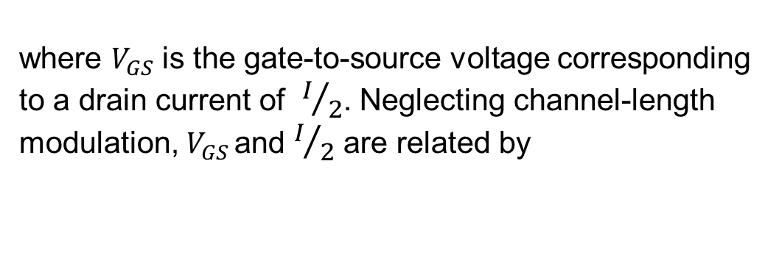
Analysis
linearity can be increased by increasing the overdrive voltage VOV at which each of Q1 and Q2 is operating.
The linear range of operation can be extended by operating the MOSFETs at a higher VOV (by using smaller ratios) at the expense of reducing gm and hence the gain. ($g_{m}={{2I}_{D}}/{V_{OV}}$)
This trade-off is based on the assumption that the bias current I is being kept constant.
The bias current can, of course, be increased to obtain a higher gm.
The expense for doing this, however, is increased power dissipation, a serious limitation in IC design

Slide 14
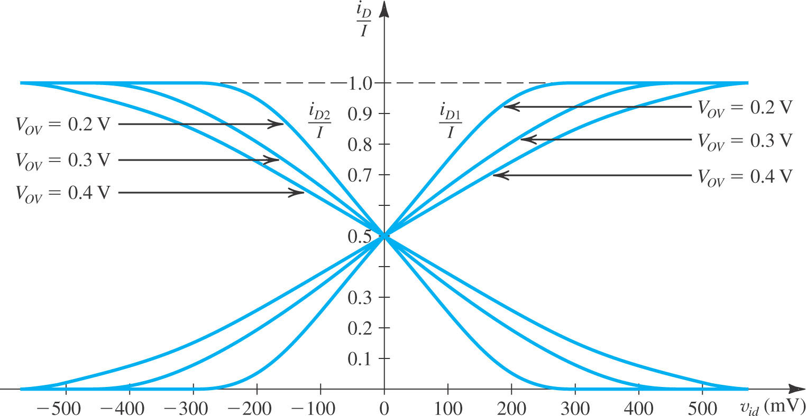

Slide 15
Hint : partially solved in following slides

Slide 16
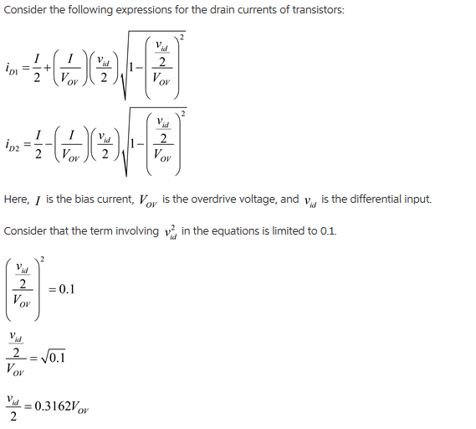
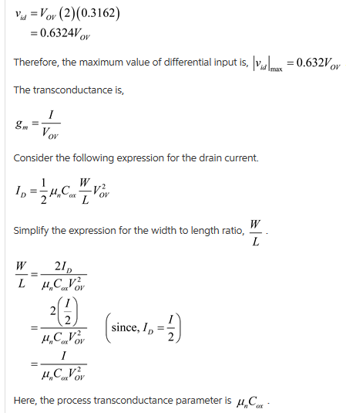
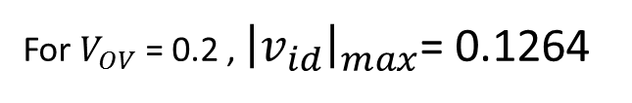
For $V_{OV}$ = 0.2 , ${\left|v_{id}\right|}_{max}$= 0.1264

Slide 17
Substitute the values and calculate the answers

Slide 18
Small Signal Operation
Objective here would be to find small signal differential gain

Slide 19
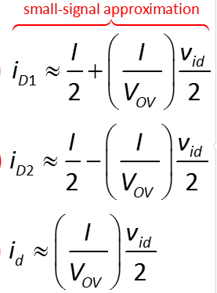
Linear amplification is desirable and v_{id} will be as small as possible.
For a given value of V_{OV}, the only option is to keep v_{id}/2 much smaller than V_{OV}.
ac current

Slide 20
when two complementary
supplies are utilized, VCM is typically 0 V.
Inputs to differential Amplifier

Slide 21

The differential input signal $v_{id}$ is applied in a complementary manner; that is, $V_{G1}$ is increased by ${v_{id}}/2$and $V_{G2}$ is decreased by ${v_{id}}/2$
Circuit for small signal analysis

Slide 22
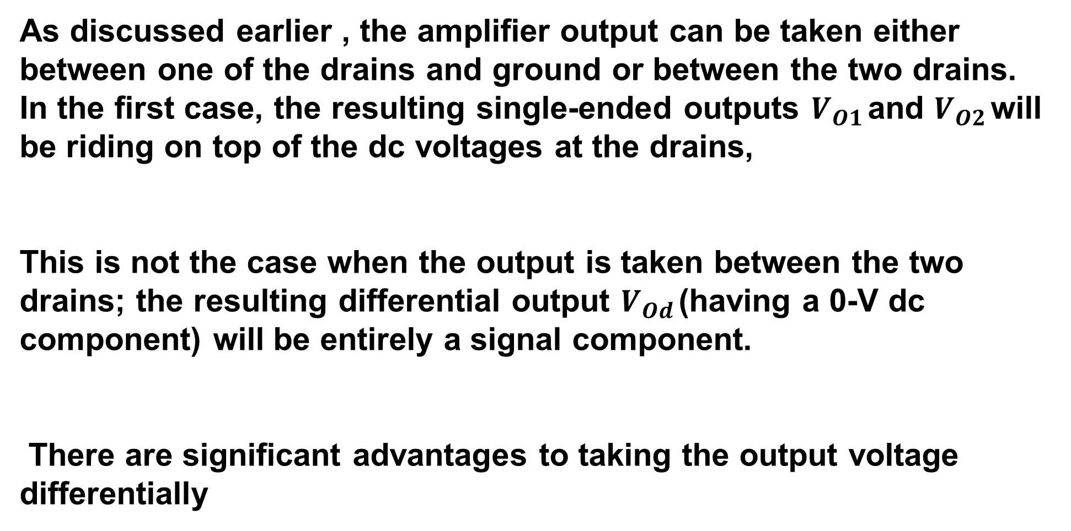
As discussed earlier , the amplifier output can be taken either between one of the drains and ground or between the two drains. In the first case, the resulting single-ended outputs $V_{O1}$ and $V_{O2}$ will be riding on top of the dc voltages at the drains,
This is not the case when the output is taken between the two drains; the resulting differential output $V_{Od}$ (having a 0-V dc component) will be entirely a signal component.
There are significant advantages to taking the output voltage differentially

Slide 23
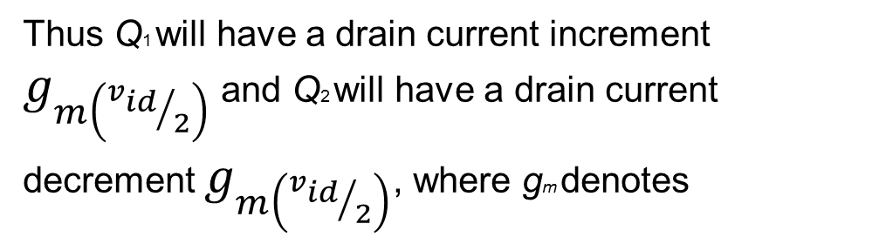
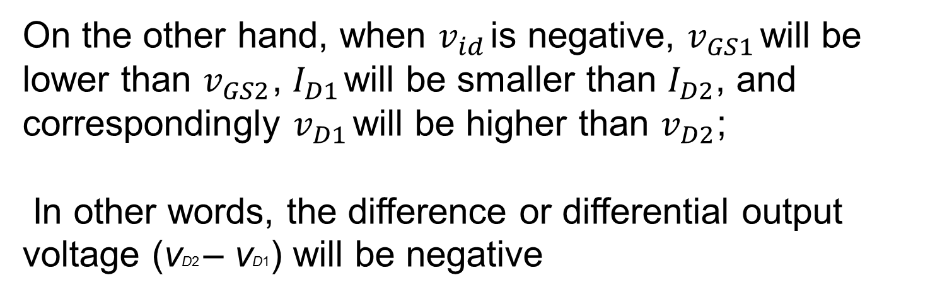
Thus Q1 will have a drain current increment $g_{m\left({v_{id}}/2\right)}$ and Q2 will have a drain current decrement $g_{m\left({v_{id}}/2\right)}$, where gm denotes
we simply pass the two current signals
through a pair of matched resistors, $R_{D}$ and thus obtaining the drain voltage signals
From the symmetry of the circuit and because of the balanced manner in which vid is applied, we observe that the signal voltage at the joint source connection must be zero, acting as a sort of virtual ground

Slide 25
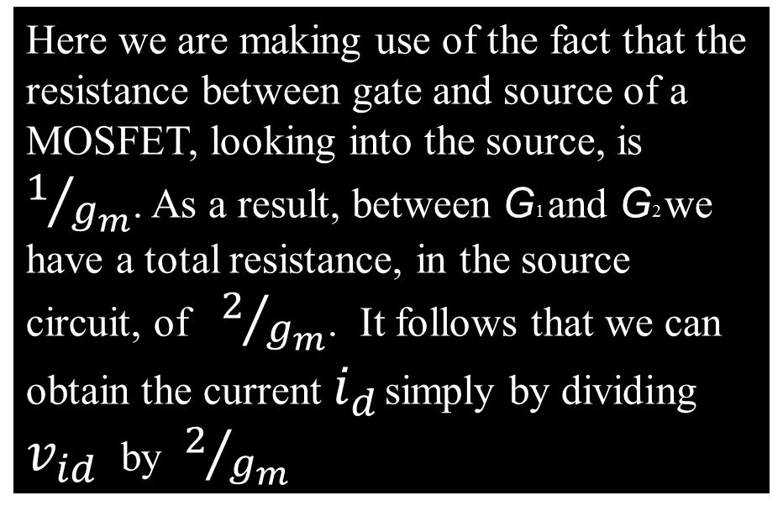
An alternative way of looking at the small signal operation of the circuit.
Here we are making use of the fact that the resistance between gate and source of a MOSFET, looking into the source, is $1/{g_{m}}$. As a result, between G1 and G2 we have a total resistance, in the source circuit, of $2/{g_{m}}$. It follows that we can obtain the current $i_{d}$ simply by dividing $v_{id}$ by $2/{g_{m}}$

Slide 26
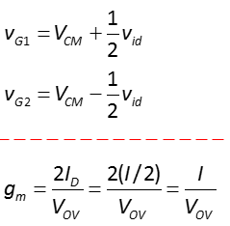
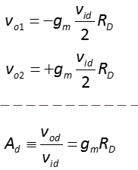
Differential Gain summary

Slide 28
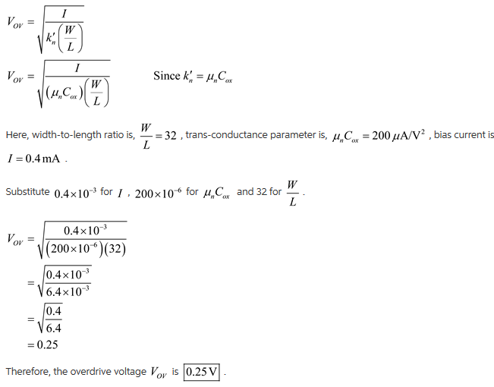
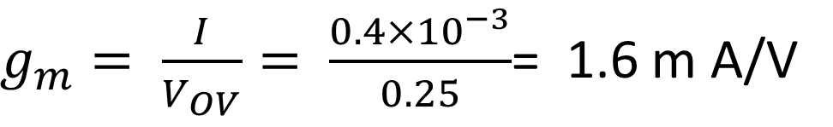

$g_{m}= \frac{I}{V_{OV}}= \frac{0.4×{10}^{−3}}{0.25}$= 1.6 m A/V
$$r_{0}= \frac{V_{A}}{I_{D}}$$
$$A_{d}= g_{m}\left(R_{D} //r_{0}\right)$$

Slide 29
Lecture cont…….

Slide 30
Differential Gain summary
Complimentary inputs
Outputs
Trans-conductance
Differential voltage gain

Slide 31
The Differential Half-Circuit
When a symmetrical differential amplifier is fed with a differential signal in a balanced manner, its performance can be determined by considering only half the circuit.
Two separate circuits can be drawn: One each for
i) common mode
ii) differential mode

Slide 32
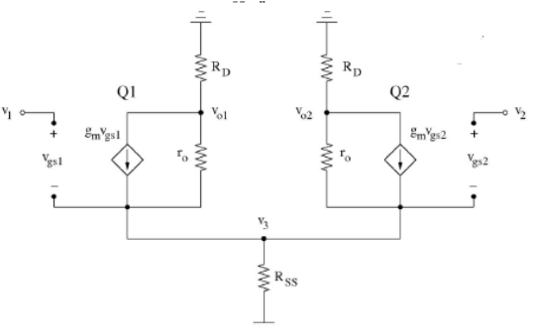

Slide 35
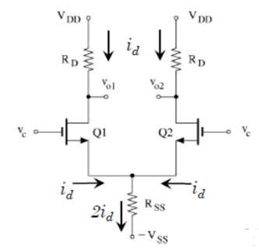
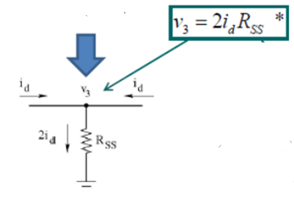

Slide 36
Now we can calculate the common mode gain as if solving CS amp. with source degeneration resistance

Slide 37
The equivalent differential half-circuit will have its source grounded, a result of the virtual ground that appears on the common sources’ terminal of the MOSFETs in the differential pair.
Note that is operating at a drain bias current of (I/2) and an overdrive voltage

Slide 41
SUMMARY

Slide 46
