Slide 1
Lecture 8_4

Slide 2
The Differential Amplifier with Current-Source Loads

Slide 3
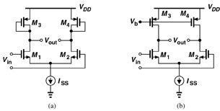

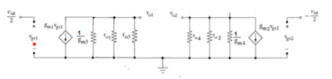
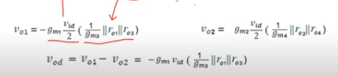
MOS Loads
(a) Diode-connected load
(b) Current-Source load

Slide 4
To obtain higher gain, the passive resistances $R_{D}$ can be replaced with current sources

Slide 5
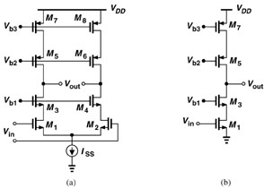
Solution to low-gain problem: Cascoding

Slide 7
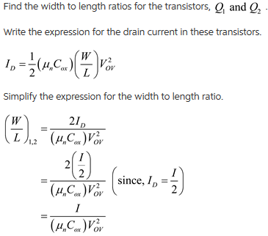

Slide 8
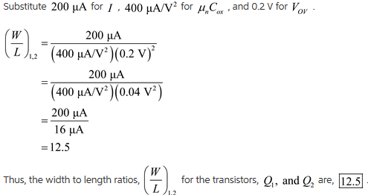

Slide 9

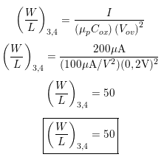
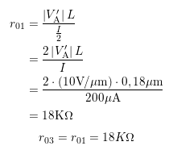
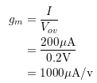
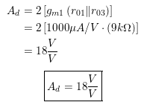

Slide 10
Cascode Differential Amplifier

Slide 11
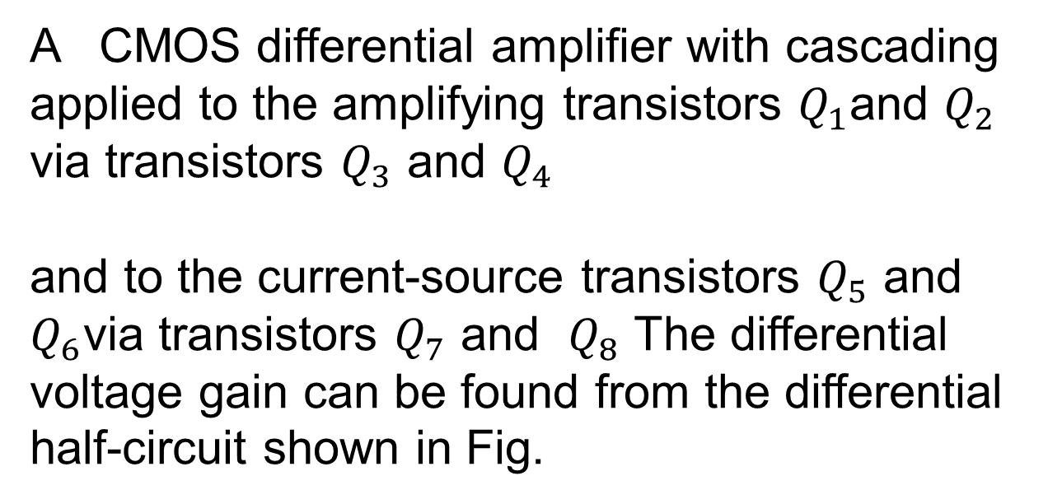
The gain of the differential amplifier can be increased by utilizing the cascode configuration
A CMOS differential amplifier with cascading applied to the amplifying transistors $Q_{1}$and $Q_{2}$ via transistors $Q_{3}$ and $Q_{4}$
and to the current-source transistors $Q_{5}$ and $Q_{6}$via transistors $Q_{7}$ and $Q_{8}$ The differential voltage gain can be found from the differential half-circuit shown in Fig.

Slide 14
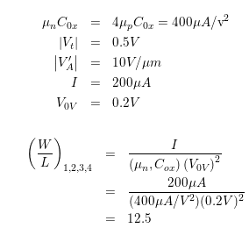
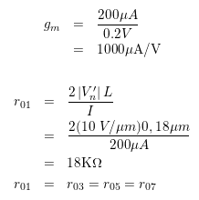
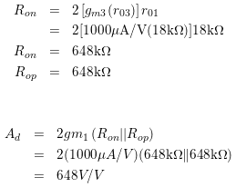
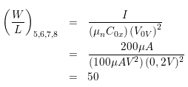

Slide 15
Common-Mode Gain and Common-Mode Rejection Ratio (CMRR)

Slide 16

Part 1: Effect due to resistance $R_{SS}$ of a non-ideal current source

Slide 17
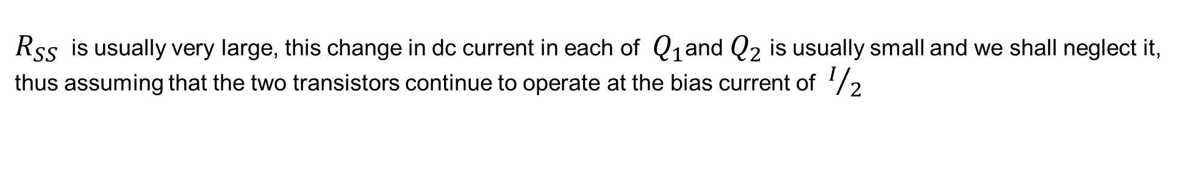

$R_{SS}$ is usually very large, this change in dc current in each of $Q_{1}$and $Q_{2}$ is usually small and we shall neglect it, thus assuming that the two transistors continue to operate at the bias current of $I/2$
consider the more realistic situation of the current source having a finite output Resistance $R_{SS}$ , the common-mode gain will no longer be zero

Slide 18
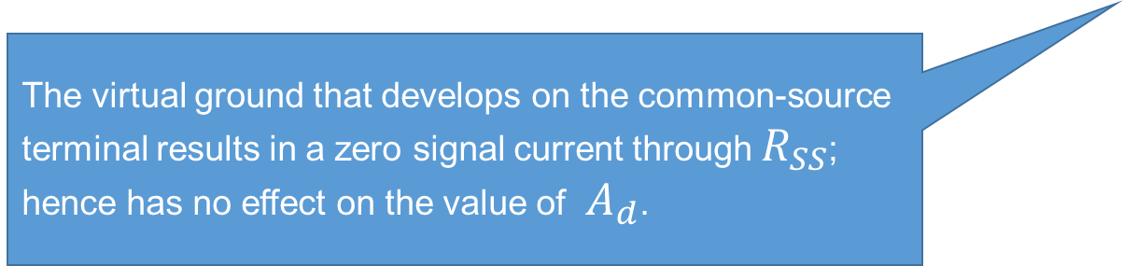
Thus the differential output voltage will remain free of common-mode interference
Unfortunately, however, this will not be the case if the circuit is not perfectly symmetrical
The virtual ground that develops on the common-source terminal results in a zero signal current through $R_{SS}$; hence has no effect on the value of $A_{d}$.

Slide 19

Effect of $R_{D}$ Mismatch

Slide 21
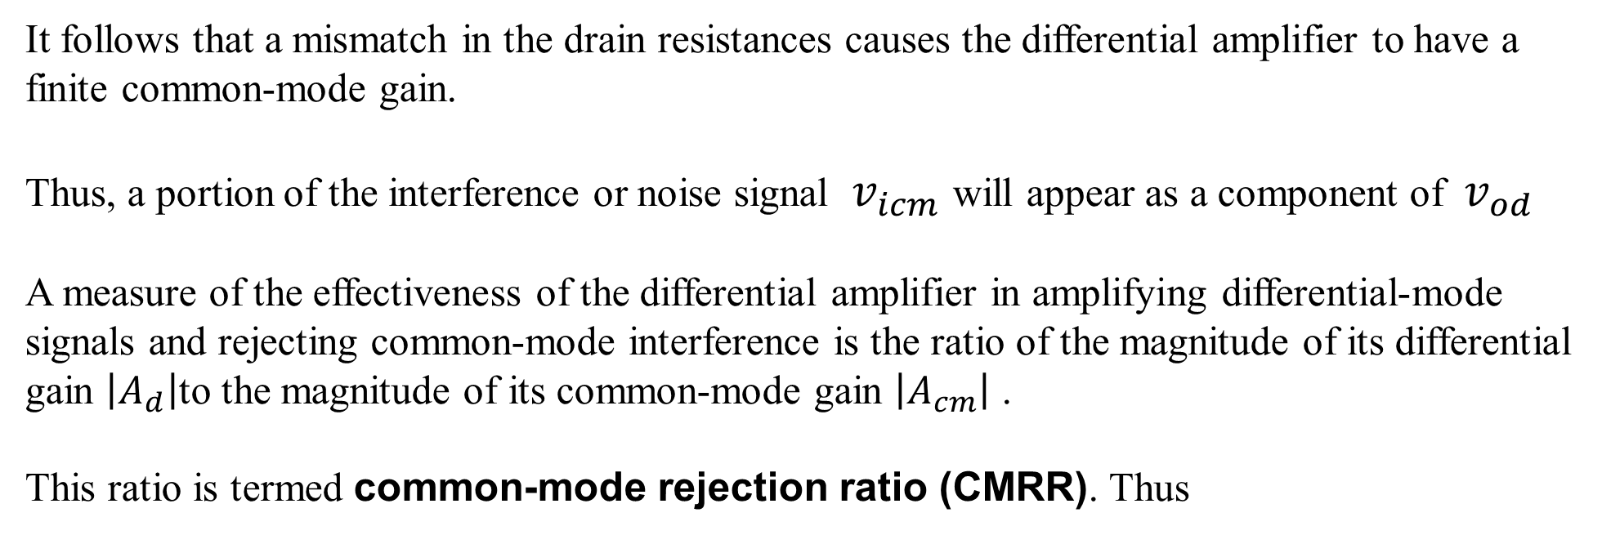
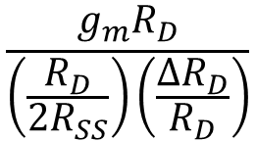
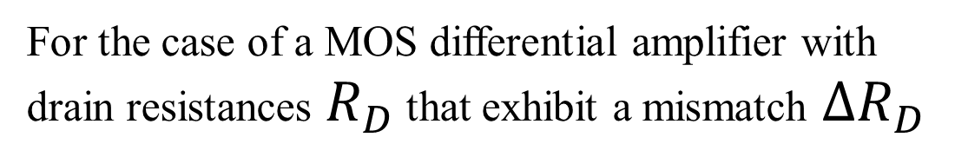
It follows that a mismatch in the drain resistances causes the differential amplifier to have a
finite common-mode gain.
Thus, a portion of the interference or noise signal $v_{icm}$ will appear as a component of $v_{od}$
A measure of the effectiveness of the differential amplifier in amplifying differential-mode signals and rejecting common-mode interference is the ratio of the magnitude of its differential gain $\left|A_{d}\right|$to the magnitude of its common-mode gain $\left|A_{cm}\right|$ .
This ratio is termed common-mode rejection ratio (CMRR). Thus
For the case of a MOS differential amplifier with drain resistances $R_{D}$ that exhibit a mismatch $∆R_{D}$
$$\frac{g_{m}R_{D}}{\left(\frac{R_{D}}{{2R}_{SS}}\right)\left(\frac{{∆R}_{D}}{R_{D}}\right)}$$

Slide 23
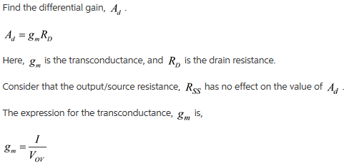

Slide 24
