Slide 1


Slide 2
Frequency Response of BJT
LOW AND HIGH FREQUENCY RESPONSE OF BJT AMPLIFIER
(Chapter No 9)

Slide 3
Sequence
Introduction
Definitions of some terms
Examples solving
Low Frequency Response of BJT
Examples solving
High Frequency response of BJT
Examples solving
Miller Effect
Examples solving
Summary
Verbal Quiz

Slide 4
1. Introduction

Slide 5
Introduction
IN THIS CHAPTER YOU WILL LEARN
How coupling and bypass capacitors cause the gain of discrete circuit amplifiers to fall off at low frequencies, and how to obtain an estimate of the frequency f_{L} at which the gain decreases by 3dB below its value at midband.
The internal capacitive effects present in the BJT and how to model these effects by adding capacitances to the hybrid model of the transistor .
The high-frequency limitation on the gain of the CE amplifiers and how the gain falloff and the upper 3-dB frequency f_{H} are mostly determined by the small capacitances between the collector and base.

Slide 6
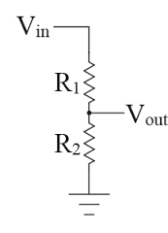
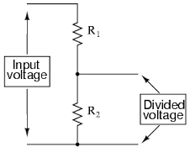
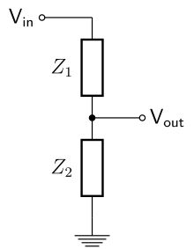
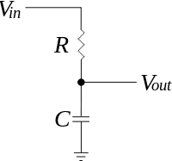


Introduction
Independent of Frequency effect

Slide 7
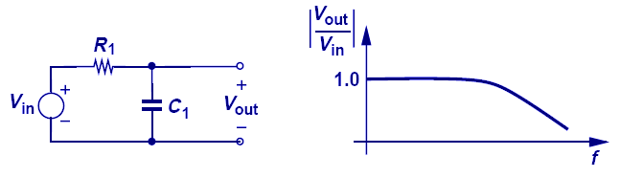
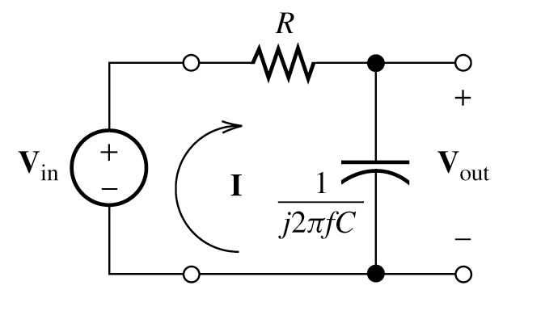
Gain Roll-off: Simple Low-pass Filter
Introduction
In this simple example, as frequency increases the impedance of C₁ decreases and the voltage divider consists of C₁ and R₁ attenuates V_{in} to a greater extent at the output.

Slide 8




A Low Pass Filter circuit consisting of a resistor of 4k7Ω in series with a capacitor of 47nF is connected across a 10v sinusoidal supply. Calculate the output voltage ( V_{OUT} ) at a frequency of 100Hz and again at frequency of 10,000Hz or 10kHz.
Voltage Output at a Frequency of 100Hz.
Voltage Output at a Frequency of 10,000Hz (10kHz).
We can see from the results above, that as the frequency applied to the RC network increases from 100Hz to 10kHz, the voltage dropped across the capacitor and therefore the output voltage ( V_{OUT} ) from the circuit decreases from 9.9v to 0.718v.

Slide 9
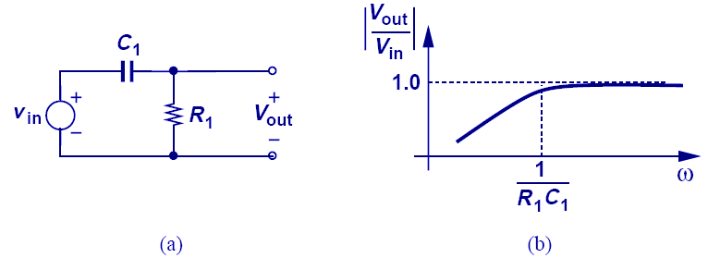
High-Pass Filter Response
Introduction
The voltage division between a resistor and a capacitor can be configured such that the gain at low frequency is reduced.
9

Slide 10
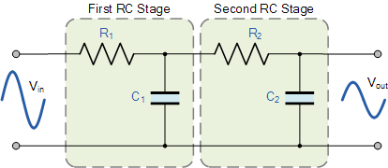
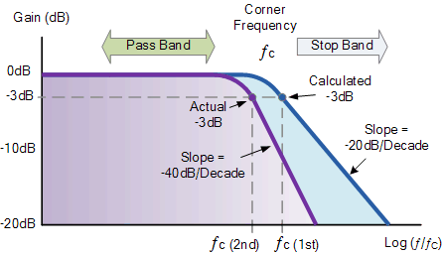

Second-order Low Pass Filter

Slide 11
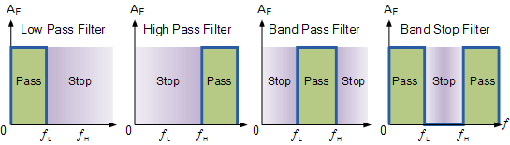
General Ideal filter Responses

Slide 12
Why frequency of Operation Important?
General Examples:
Cellular communication
Satellite communication
TV channel broad cast

Slide 13
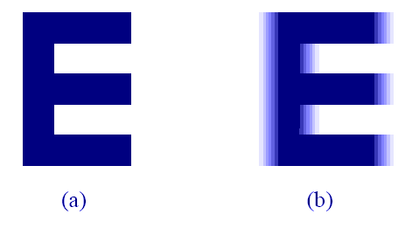
Why Bandwidth of a circuit important?
Introduction
High Bandwidth
Low Bandwidth
Video signals without sufficient bandwidth become fuzzy as they fail to abruptly change the contrast of pictures from complete white into complete black.

Slide 14
Why Bandwidth of a circuit important?
Introduction
Second Example could be of Telephone in which, the audio bandwidth used is 300 to 4K Hz. (Whereas the actual audio bandwidth is 20 to 20 k Hz)
The result is different sound when you hear some body on phone
Advantage : save channel bandwidth
But in high quality music system we want maximum audio spectrum

Slide 15
Conclusion
In designing an amplifier beside Gain, Biasing for maximum swing, input/output impedances another important factor is its frequency response and bandwidth
We must know what frequencies we need to amplify and what would be the bandwidth of my system
There are external and internal capacitances in BJT, which is effect the gain of the amplifier

Slide 16
2. Some useful definitions

Slide 17
The Decibel (dB)
Definitions
A logarithmic measurement of the ratio of power or voltage
Power gain is expressed in dB by the formula:
Where A_{p} is the actual power gain, Pout/Pin
Voltage gain is expressed by:
If A_{v} is greater than 1, the dB is +ve, and if A_{v} is less than 1, the dB gain is –ve value & usually called attenuation

Slide 18


Definitions
The reactance and impedance of a capacitor are respectively
Impedance in S domain
where
C is the capacitance, and
s is the complex frequency.

Slide 19
Gain and input/output resistances

Slide 20
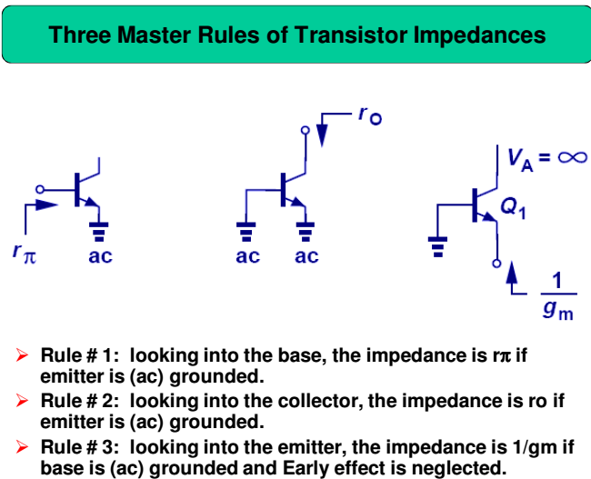
Without any biasing or load resistances
Also = re

Slide 21
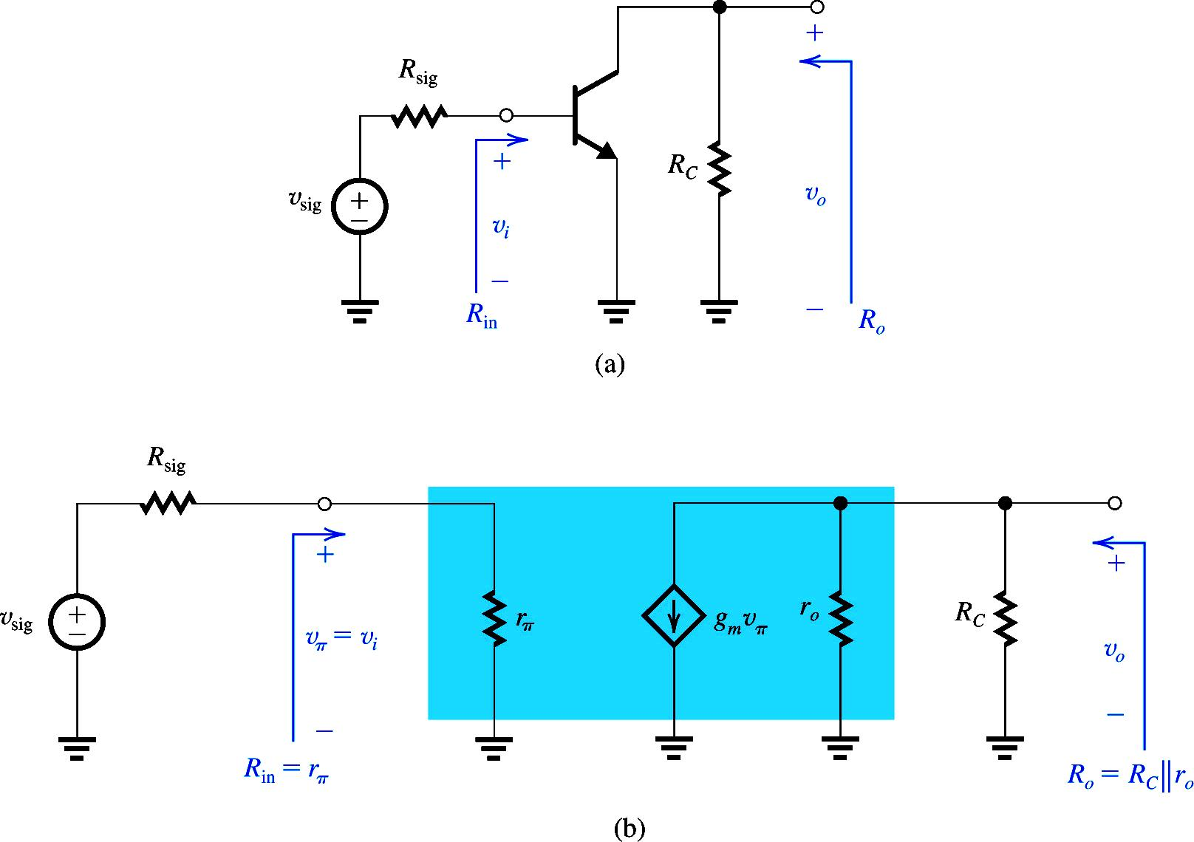

CE Amplifier
$$R_{L}$$

Slide 22
CE Amplifier (Alternate Gain Expressions)
$$R_{L}$$

Slide 23
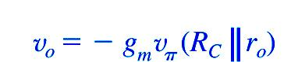
CE Amplifier (Alternate Gain Expressions)
R_{L}

Slide 24
Poles, Zeros and Bode Plot
General form of transfer function in S domain
The Z1, Z2, …Zn are roots of the numerator and are called zeros of the transfer function
P1, P2, … Pn are the roots of the denominator and are called poles of the transfer function

Slide 25
EXAMPLE
An amplifier has a voltage transfer function
Find the poles and zeros and sketch the magnitude of the gain versus frequency.
Solution
Zeros are at s=0 and s=∞
And poles are at
and

Slide 26
db
60 db
40 db
20 db
ῳ rad/s

Slide 27
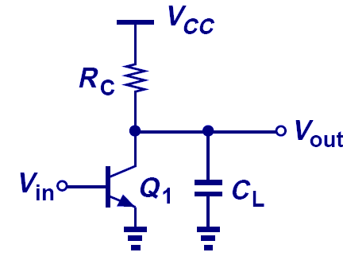
Amplifier Figure of Merit (FOM)
Definitions
The gain-bandwidth product is commonly used to benchmark amplifiers.
We wish to maximize both the gain and the bandwidth.
Power consumption is also an important attribute.
We wish to minimize the power consumption.
Operation at low Temp, low V_{CC}, and with small C_{L} → superior FOM

Slide 28
3. Low Frequency Response (LFR) of BJT

Slide 29
LFR
Previously assumed that gain is constant and independent of frequency.
implied that bandwidth was infinite
this is not true
Middle-frequency band (midband?) is the range of frequencies over which device gain is constant.

Slide 30
BJT frequency response can be divided into following areas
Response due to external capacitance (low frequency response)
Due to coupling capacitor
Due to by-pass capacitor
Response due to internal capacitance (High frequency response)

Slide 31
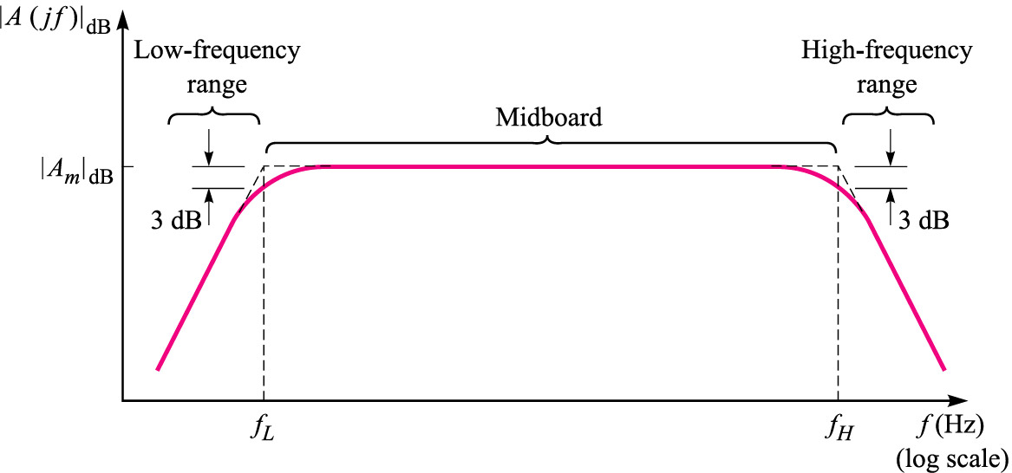
Amplifier gain vs frequency
Midband range
Gain falls of due to the effects of stray capacitance and transistor capacitance effects
Gain falls of due to the effects of C_{C} and C_{E}

Slide 32
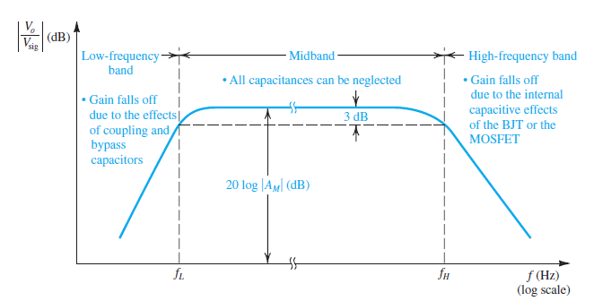
The graph delineates the three frequency bands relevant to frequency-response determination

Slide 33
Figure in previous slide indicates that at lower frequencies, the magnitude of the amplifier gain falls off. This occurs because the coupling and bypass capacitors no longer have low impedances
as the frequency of the input signal is lowered, the reactance 1/jω C of each of these capacitors becomes significant and,, this results in a decrease in the overall voltage gain of the amplifier
We will be particularly interested in the determination of the frequency fL, which defines the lower end of the midband. It is usually defined as the frequency at which the gain drops by 3 dB below its value in midband.

Slide 34
Figure indicates also that the gain of the amplifier falls off at the high-frequency end. This is due to internal capacitive effects in the BJT
We will be specifically interested in the determination of the frequency fH, which defines the upper end of the midband. It is defined as the frequency at which the gain drops by 3 dB below its midband value
Thus, the amplifier bandwidth is defined by fL and fH

Slide 35
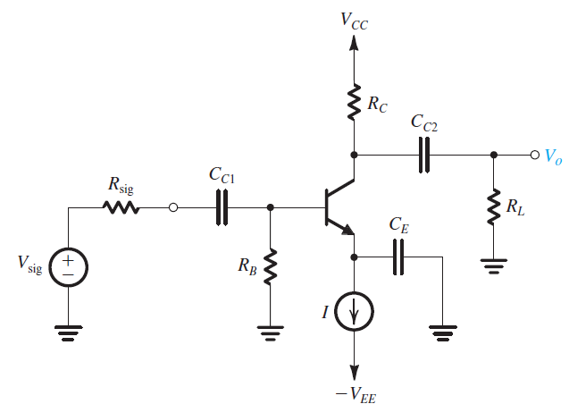
The CE Amplifier
Figure shows common-emitter amplifier.
coupling capacitors C_{C1} and C_{C2}
emitter bypass capacitor C_{E}
Effect of these capacitors felt at low frequencies.
Objective is to determine amplifier gain and transfer function.

Slide 36
Considering the Effect of Each of the Three Capacitors Separately
Although this is not an accurate analysis but will enable us to gain insight into the effect of these capacitances
While considering the effect of one of the external capacitor , In this analysis the other two are shorted.

Slide 37


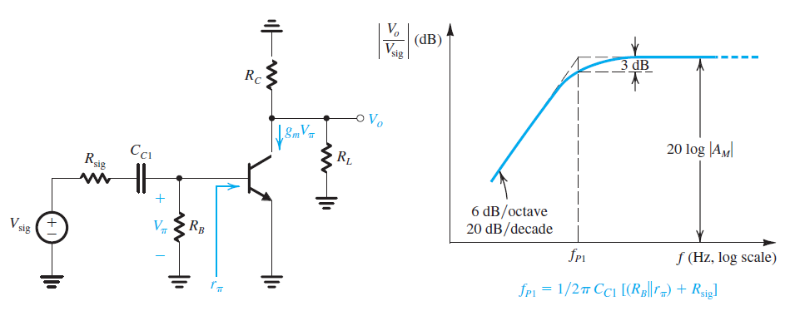
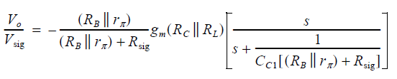
Coupling Cap replaced by a short
Voltage at the base
Emitter-Bypass Cap replaced by a short
Voltage Gain Including the effect of Cc1

Slide 38


Fall in Gain due to high pass filter
Mid-Band Gain
The ends of capacitor sees these resistors

Slide 39

Note that we have denoted the midband gain AM,
Note at Midband there is no effect of any of the capacitors
Recall from previous lectures

Slide 40
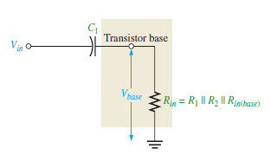
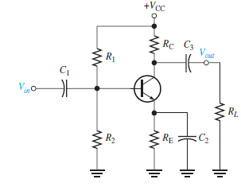


The Input RC Circuit
Same Explanation by another method-2
High Pass Filter
lower cutoff frequency

Slide 41
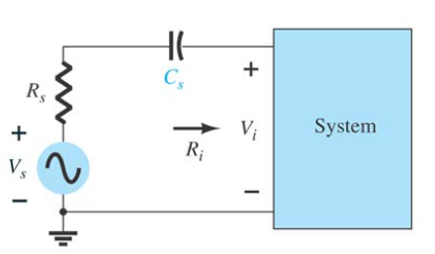

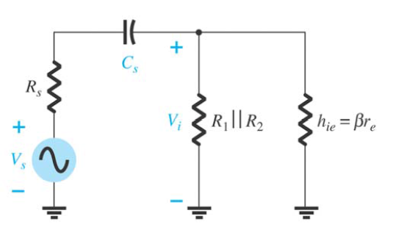

Since Cs is normally connected between the applied source and the active device, the total resistance is now Rs + Ri, and the cutoff frequency will be modified to be as:
Same things third angle
Effect of Cs
At mid or high frequencies, the reactance of the capacitor will be sufficiently small to permit a short-circuit approximation for the element. The voltage Vi will then be related to Vs by

Slide 42
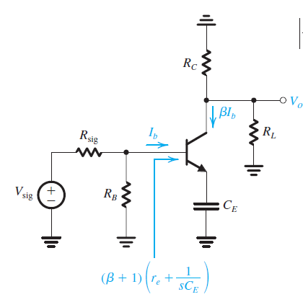

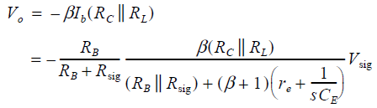
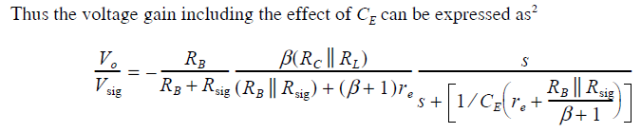
Next, we consider the effect of CE. For this purpose we assume that CC1 and CC2 are acting as perfect short circuits and thus obtain the circuit.

Slide 43

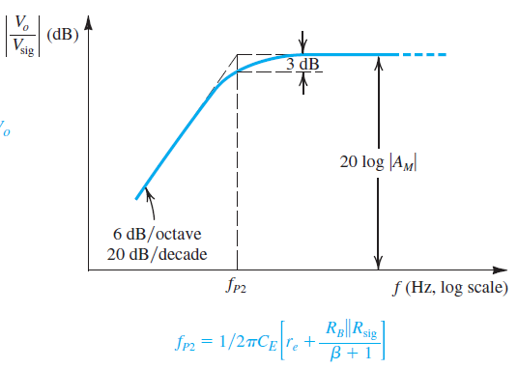

Slide 44
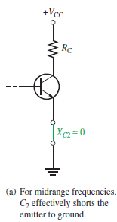
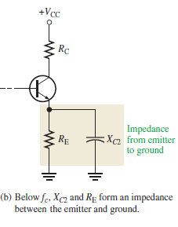
By-Pass Re Capacitor
Same Explanation by another method-2

Slide 45
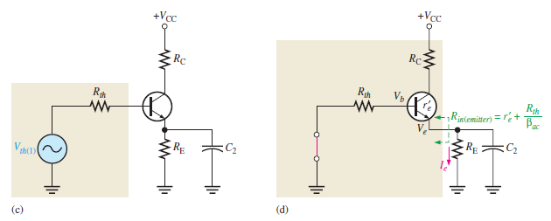
Same Explanation by another method-2

Slide 46
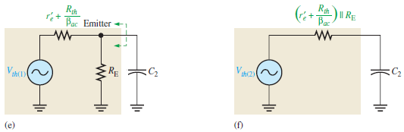
Same Explanation by another method-2

