Slide 1
Hangman Game
Digital Logic Design (EE-221)
12/31/2021 – 8:10 pm
1

Slide 2
Group Members
Imran Haider
Tariq Umar
CMS: 332569
CMS: 334943
Muhammad Ahmed
Mohsin
Muhammad
Umer
CMS: 333060
CMS: 345834
12/31/2021 – 8:13 pm
2

Slide 3
Table of Contents
1
Introduction
2
Design
3
Working
4
Hardware Issues
5
Conclusion
12/31/2021 – 8:44 pm
3

Slide 4
Introduction
Hangman Game – A Brief Overview
A Game of Guesswork
Total Number of Tries = 2 * Total Characters
Relation with Digital Logic Design
12/31/2021 – 8:56 pm
4

Slide 5
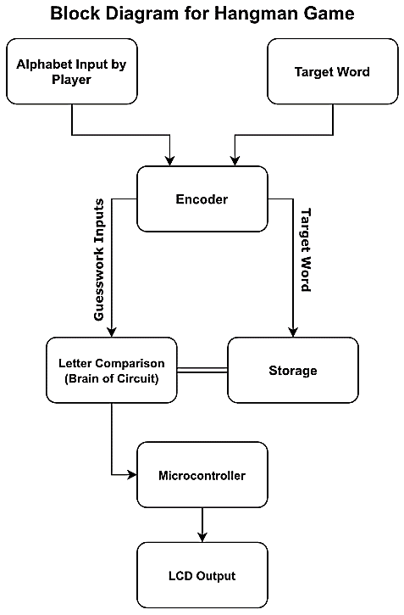
Pipeline
12/31/2021 – 9:13 pm
5

Slide 6
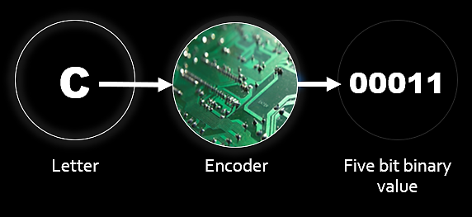
Design: Encoder
12/31/2021 – 9:23 pm
6

Slide 7
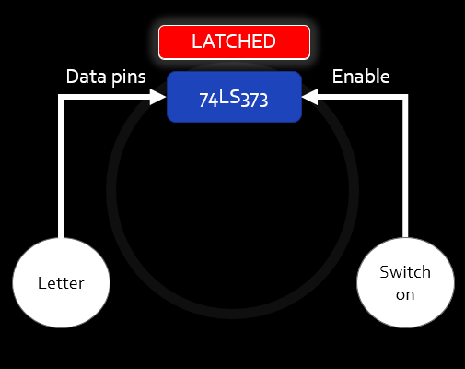
Design: Storage
Latches were used to store the target word
Each word has 7 alphabets
Each alphabet is encoded into 5 bits
12/31/2021 – 9:33 pm
7

Slide 8
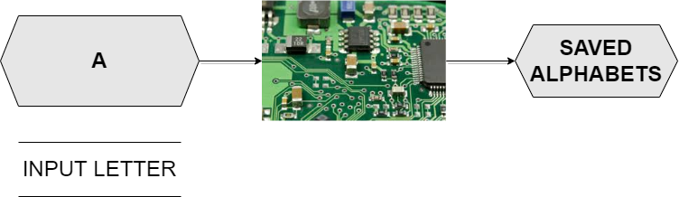
Design: Comparator
12/31/2021 – 9:54 pm
8

Slide 9
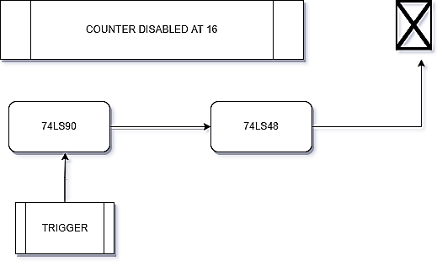
Design: Counter
7 Segment
Display
14
Decade Counter
Decoder
Each button-press triggers the counter
12/31/2021 – 9:57 pm
9

Slide 10
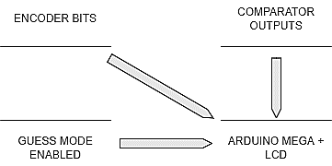
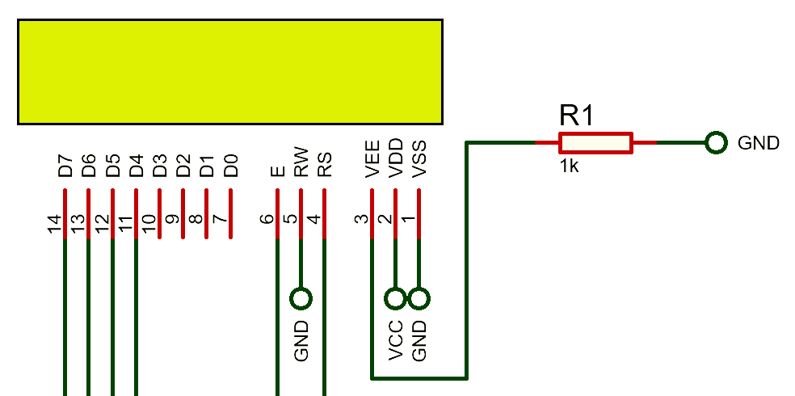
Design: LCD Display
16x2
LCD
12/31/2021 – 9:58 pm
10

Slide 11
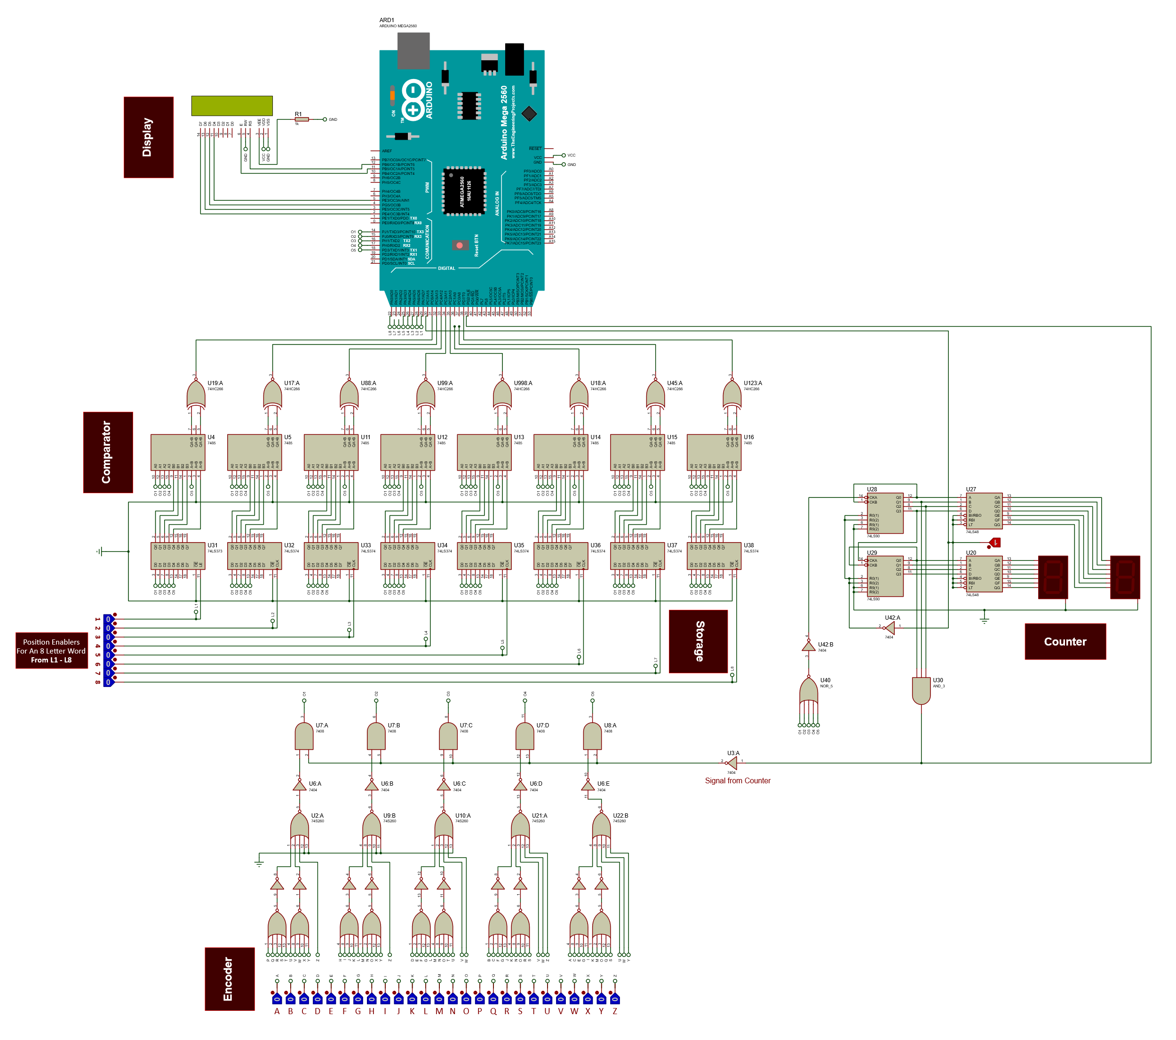
Simulation
12/31/2021 – 9:56 pm
11

Slide 12
Issues Encountered
Issue of Voltage Levels of Signals
Issues in Individual ICs
74LS Family Open Characteristics
Difficult to Debug
12/31/2021 – 10:10 pm
12

Slide 13
Conclusion
The Gap between Implementations and Simulations
Learnt Practical Applications of Digital Logic
Learnt the Art of Debugging Complex Circuits
Learnt Digital Logic Design, copium
12/31/2021 – 10:12 pm
13

Slide 14
Demo!
12/31/2021 – 10:15 pm
14

