Slide 1

Chapter4: Combinational Logic
Lecture1- Analysis of Combinational Circuits
Engr. Arshad Nazir, Asst Prof
Dept of Electrical Engineering
SEECS

Slide 2
Objectives
Introduction to Combinational Circuits
Analyze Combinational Logic Circuits of Moderate Complexity
Study design steps for Combinational Circuits and design Combinational Logic Circuits of Moderate Complexity i.e BCD to Excess-3 Code Converter using Classical Design Method

Slide 3
Chapter Contents
Combinational Circuits
Analysis Procedure
Design Procedure
Binary Adder-Subtractor
Decimal Adder
Binary Multiplier
Magnitude Comparator
Decoders
Encoders
Priority Encoder
Multiplexers
Tri-state gates

Slide 4
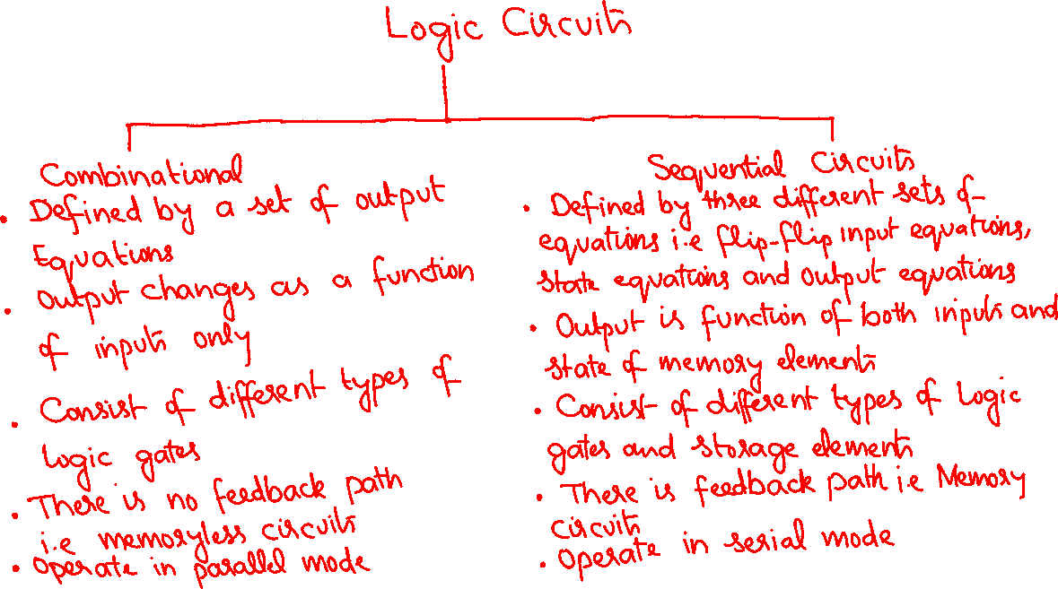

Slide 5
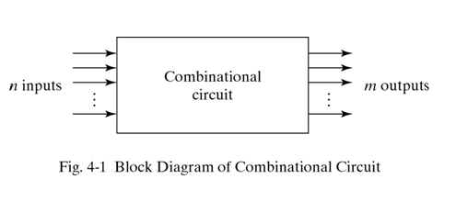
Combinational Circuits
Logic circuits for digital system may be combinational or sequential
A combinational circuit consists of logic gates whose outputs are a function of the current inputs
Sequential circuits
contain storage elements in addition to logic gates
the outputs are a function of the current inputs and
the state of the memory (storage) elements
The state of storage elements, in turn, is a function of
previous inputs so outputs also depend on past inputs
They have feedback connection
1
7
3

Slide 6
Combinational Circuits
For n input variables there are 2^{n} possible binary input combinations
For each possible input combination there is one possible output value
The most important standard MSI combinational circuits (discussed in this chapter) are adders, sub tractors, comparators, decoders/ demultiplexers, encoders, multiplexers, and tri-state gates.
If the storage registers are included with the combinational gates then this circuit is considered as sequential circuit

Slide 7
Analysis Procedure
The analysis of a combinational circuit requires that we determine function that the circuit implements
The first step in analysis procedure is to make sure that the given circuit is combinational and not sequential (No feedback path)
To obtain the output Boolean function from a logic diagram we proceed as follows
Label all gate outputs that are a function of input variables with arbitrary symbols. Determine the Boolean function for each gate output
Label the gates that are a function of input variables and previously labeled gates with other arbitrary symbols. Find the Boolean function of these gates
Repeat the above process (step 2) until the outputs of the circuit are obtained
By repeated substitution of previously defined functions, obtain the output Boolean functions in terms of input variables

Slide 8
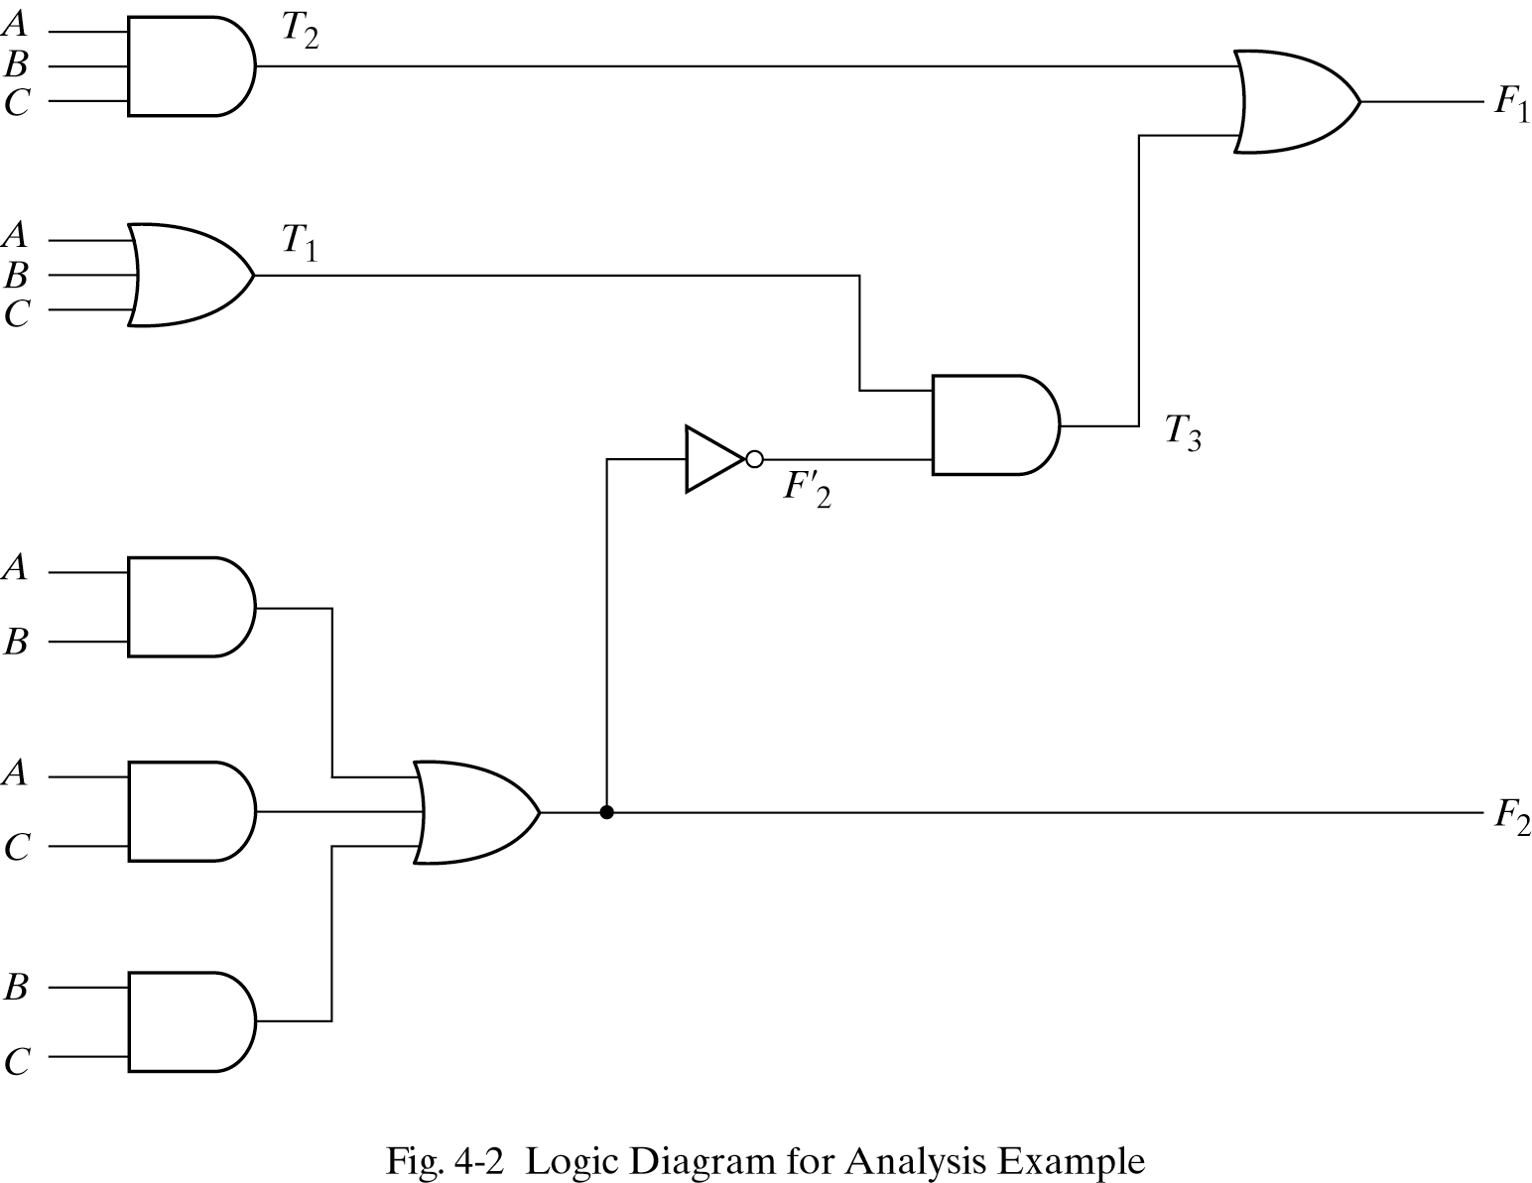
Analysis Procedure-Example

Slide 9
Analysis Procedure Example
The circuit has three binary inputs- A, B and C and two binary outputs- F₁ and F₂
The outputs of various gates are labeled with intermediate symbols
The output of gates that are a function of input variables are T₁ and T₂
Output F₂ can be easily derived from the input variables
The Boolean function for these three outputs are:
F₂ = AB + AC + BC
T₁ = A + B + C
T₂ = ABC
Next we consider output of gates that are a function of already defined symbols
T₃ = F'₂T₁
F₁ = T₃+T₂

Slide 10

Analysis Procedure Example Cont…
To obtain F₁ as a function of A,B and C, from a series of substitutions proceed as follows
F₁ = T₃+T₂
= F₂'T₁+ABC
=(AB+AC+BC)'(A+B+C)+ABC
=(A'+B')(A'+C')(B'+C')(A+B+C)+ABC
=(A'+B'C')(AB'+AC'+BC'+B'C)+ABC
=A'BC'+A'B'C+AB'C'+ABC
These functions F₁ and F₂ implement circuit of a Full-Adder (FA). Where:
F₁ is the sum
F₂ is the carry

Slide 11
Derivation of the Truth Table
The derivation of the truth table for the circuit is a straightforward process once the output Boolean functions are known
To obtain the truth table directly from the logic diagram without going through the derivations of the Boolean functions, we proceed as follows:
Determine the number of input variables in the circuit. For n inputs, form the 2^{n} possible input combinations and list binary numbers from 0 to 2^{n} – 1 in a table
Label the outputs of selected gates with arbitrary symbols
Obtain the truth table for the outputs of those gates that are a function of the input variables only
Proceed to obtain the truth table for the outputs of those gates that are function of previously defined values until the columns for all outputs are determined

Slide 12
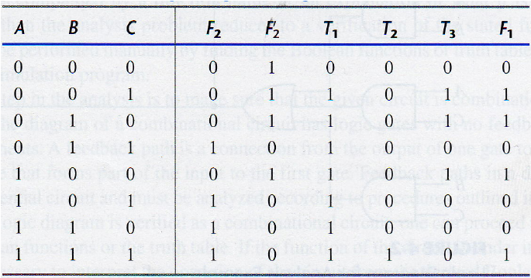


Truth Table for Figure 4-2
F₂ equal to 1 for any combination that has 2 or 3 inputs equal to 1
F₂' is the complement of F2
T₁ and T₂ are the OR and AND functions of input variables respectively
T₃ = 1, when T₁ and F₂' are equal to 1
F₁ = 1, when either T₂ or T₃ or both are equal to 1

Slide 13
Design Procedure
The design procedure of combinational circuits involves following steps
State the problem (Circuit specifications)
From the circuit specifications determine the inputs and outputs for the circuit design
The input and output variables are assigned alphabetic symbols
Derive the truth table that gives the relationship between inputs and outputs
Derive the simplified Boolean functions (simplify by algebraic manipulation or K-map method) for each output variable as a function of input variables
Draw the logic diagram and verify the correctness of the design
The design should be optimized i.e use minimum gates with fewer fan in of gates and lesser propagation delay. This will result in low cost but fast design.

Slide 14
Practical Design Considerations
Logic minimization must consider practical design constraints such as:
number of gates
number of inputs to a gate
propagation delay of signal through the gates
number of interconnections
limitations of the driving capabilities of each gate
In most cases the simplification begins by satisfying an elementary objective – producing the simplified Boolean function in a standard form, and the proceed with further steps to meet other performance criteria

Slide 15
Code Conversion example
Different digital systems use different types of codes
It is sometimes necessary to use the output of one system as the input to another
A conversion circuit must be inserted between the two systems if each uses different codes for the same information
A code converter is a circuit that makes the two systems compatible even though each uses a different binary code
To convert from binary code A to binary code B, the input lines (of combinational circuit) must supply the bit combination of elements as specified by code A and the output lines must generate the corresponding bit combination of code B

Slide 16
Code Conversion Example: BCD to Excess-3 Code Converter
Each code uses four bits to represent a decimal digit, there must be four input variables and four output variables
Designate the four input binary variables by the symbols A,B,C,D and the four output variables by w, x, y and z.
The truth table relating the input and output variable is made (shown in next slide)
Four binary variables have 16 possible bit combinations but only 10 are listed in the truth table as remaining 6 combinations not listed are don’t care conditions. These have no me.aning in BCD

Slide 17

Code conversion Example :Truth Table

Slide 18
Map Simplification of Output Functions
There are four outputs, each as a function of four input variables.
There are four maps, each representing one of the outputs, to obtain simplified Boolean functions.
The 1’s marked inside the squares are obtained from the minterms that make the output equal to 1
The 1’s are obtained from the truth table by going over the output columns one at a time.
The 6 don’t care minterms 10 through 15 are marked with an X or d.

Slide 19
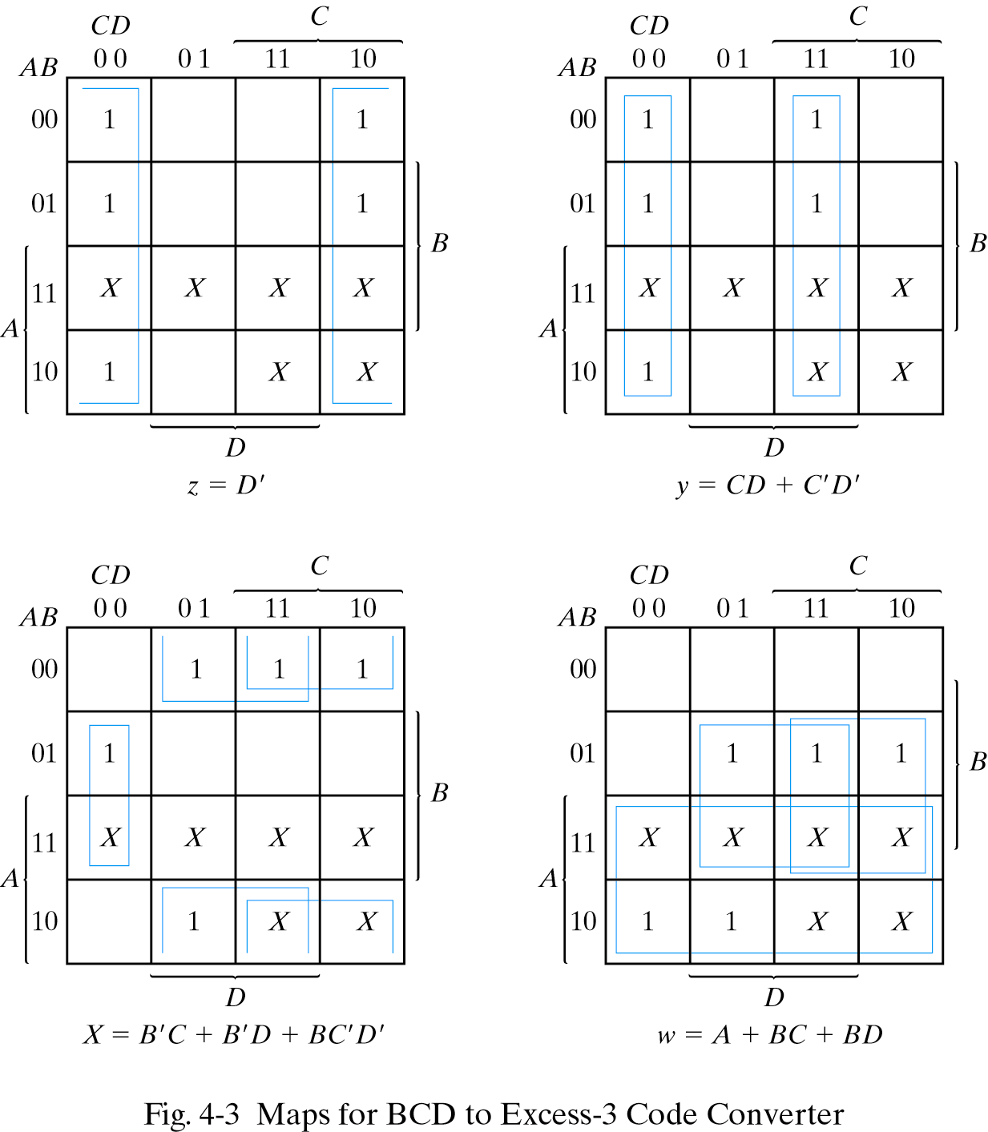

Slide 20
BCD to Excess-3 Code Converter
The simplified functions
z = D'
y = CD +C'D‘
x = B'C + B'D+BC'D'
w = A+BC+BD
A two-level logic diagram may be obtained directly from the above Boolean expressions but there are various other possibilities for logic diagram that implements this circuit
Another implementation
z = D'
y = CD +C'D' = CD + (C+D)'
x = B'C + B'D+BC'D' = B'(C+D) +B(C+D)'
w = A+BC+BD

Slide 21
BCD to Excess-3 Code Converter
The purpose this manipulation is to use common gates for two or more outputs
This is implemented with three levels of gates
OR gate with output C+D is used to implement partially each of three outputs
Implementation with original sum of products require seven AND gates and three OR gates whereas after manipulation we require four AND gates and four OR gates
In this way the logical circuit has been implemented in a much economical way.

Slide 22
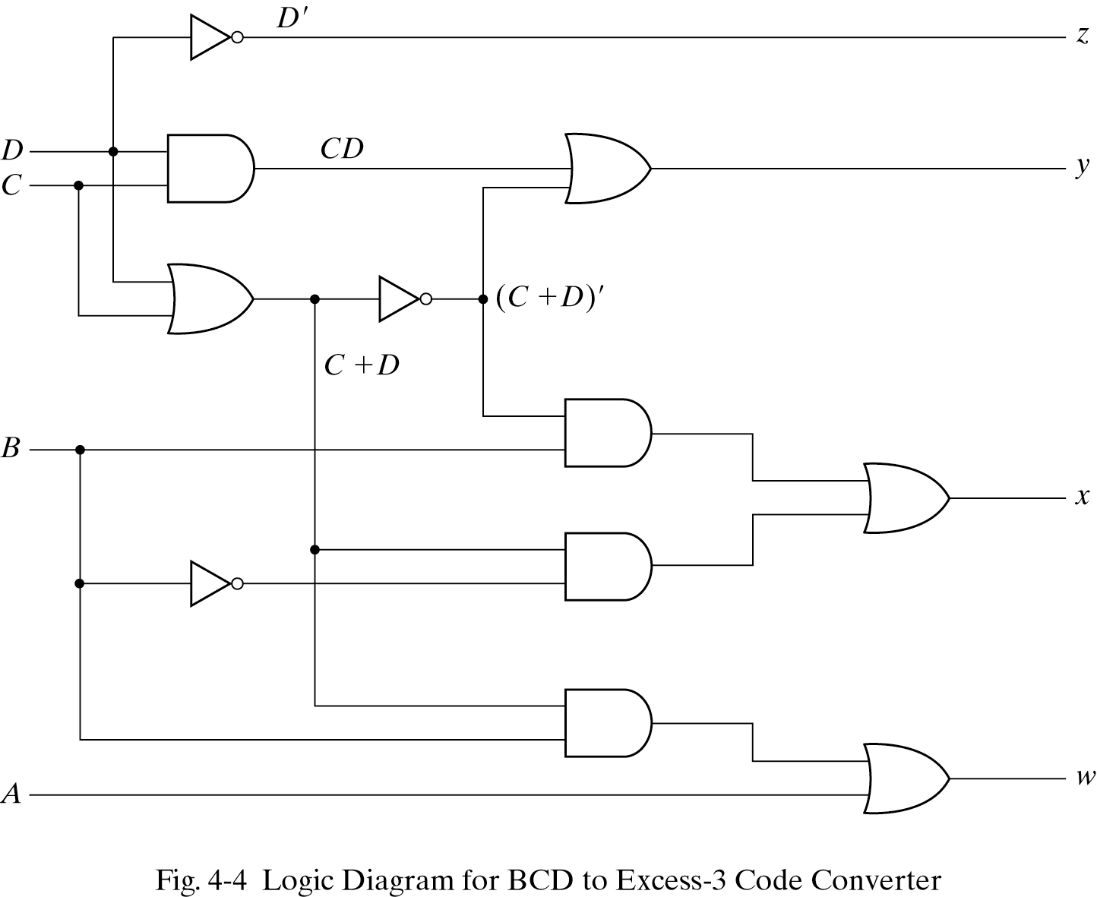

Slide 23
The End

