Slide 1

Chapter4: Combinational Logic
Lecture2- Design 4-bit Ripple Carry Binary Adder-Subtractor Circuit
Engr. Arshad Nazir, Asst Prof
Dept of Electrical Engineering
SEECS

Slide 2
Objectives
Study Half and Full Adders
Design 4-Bit Ripple Carry Binary Adder-subtractor design using Full-Adders

Slide 3
Binary Adder-Subtractor
Digital computers perform various arithmetic operations
The most basic arithmetic operation is the addition of two binary digits
When both augend and addend bits to be added are equal to 1, the binary sum consists of two digits (1+1=10). The higher significant bit of this result is called a carry. This carry is added to the next higher order pair of significant bits.
A combinational circuit that performs the addition of two bits and produces SUM and Carry is called a half adder (HA).

Slide 4
Half Adder
Half adder adds two binary bits and produces SUM and Carry so it requires two inputs and two outputs
0+0=0 ; 0+1=1 ; 1+0=1 ; 1+1=10
The input variables designate the augend and addend bit, the output variables produce the sum (S) and carry (C)
The truth table for half adder is shown. The C output is 1 only when both inputs are 1. The S output represents the least significant bit of the sum

Slide 5
Half Adder Output Expressions
The simplified sum of products expressions are:
S = x'y+xy'
C = xy
It can be implemented in sum of products. It can also be implemented with an exclusive-OR and an AND gate
S=x⊕y= (x+y)(x'+y')
S' = xy+x'y'= C+ x'y'
S = (C+x'y')'
C = xy= (x'+y')'

Slide 6
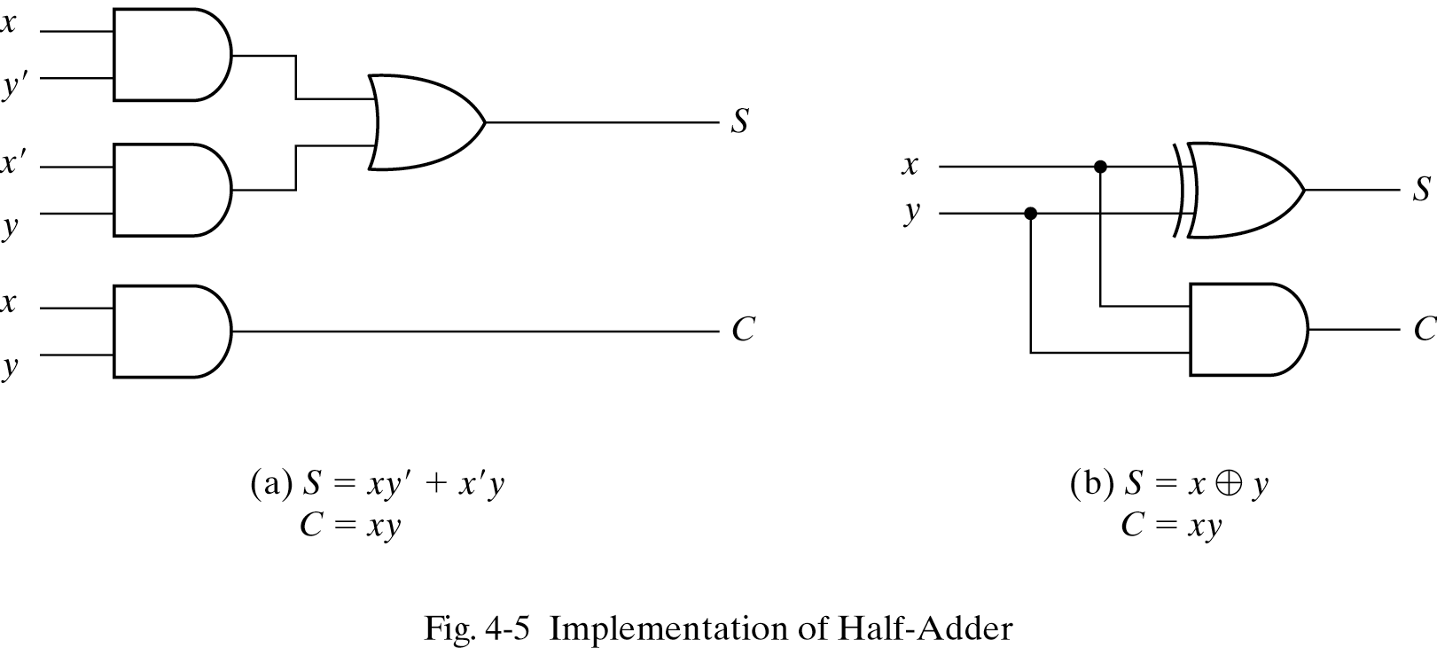

Slide 7
Full Adder
A Full-Adder (FA) is a combinational circuit that forms the arithmetic sum of three bits (three input bits).
Two of the input variables x, y represents the two significant bits to be added
The third input z represents the carry bit from the previous lower significant position
Two output bits are necessary designated by the symbol S for sum and C for carry
When all input bits are 0, the output is 0
The S output is equal to 1 when only one input is equal to 1 or when all three inputs are equal to 1
The C output has a carry of 1 if two or three inputs are equal to 1

Slide 8
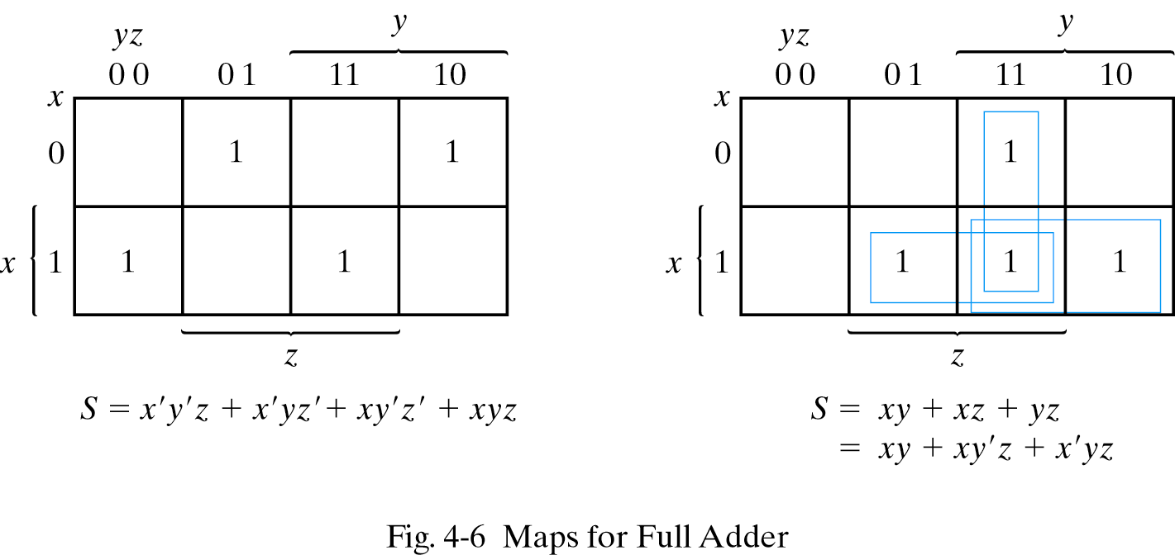
C

Slide 9
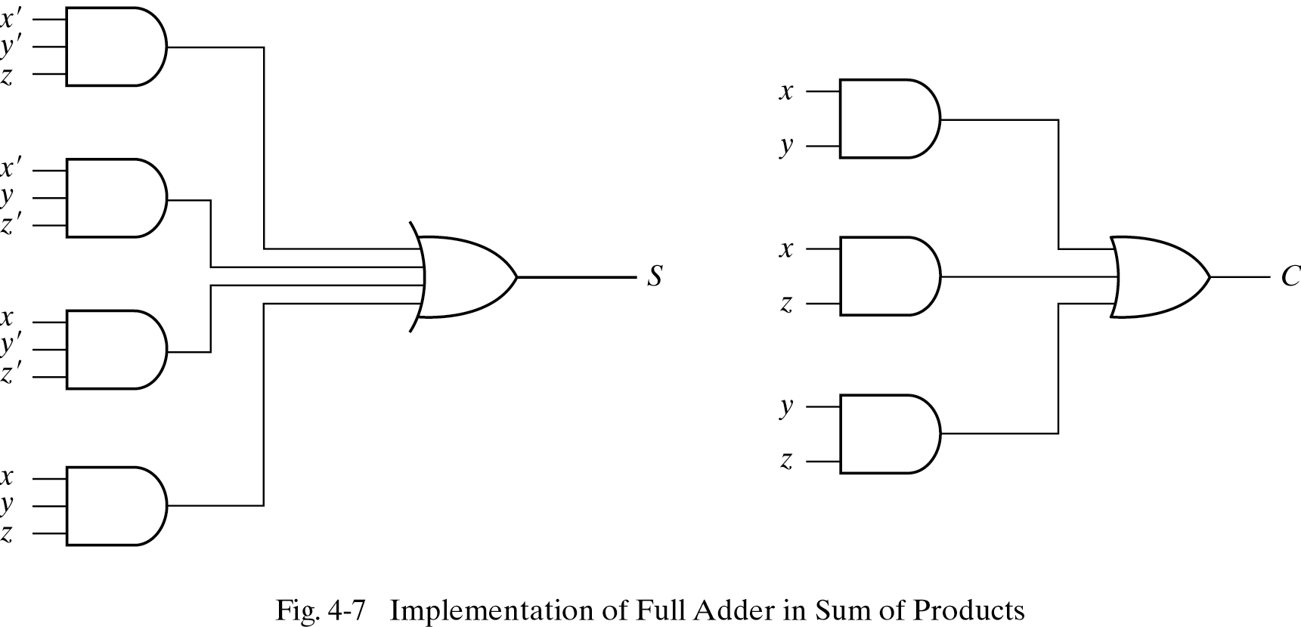
Simplified Output Expressions for Full Adder
The simplified expressions for full adder are
S = x' y' z + x' y z' + x y' z' + x y z
C = xy + xz + yz

Slide 10
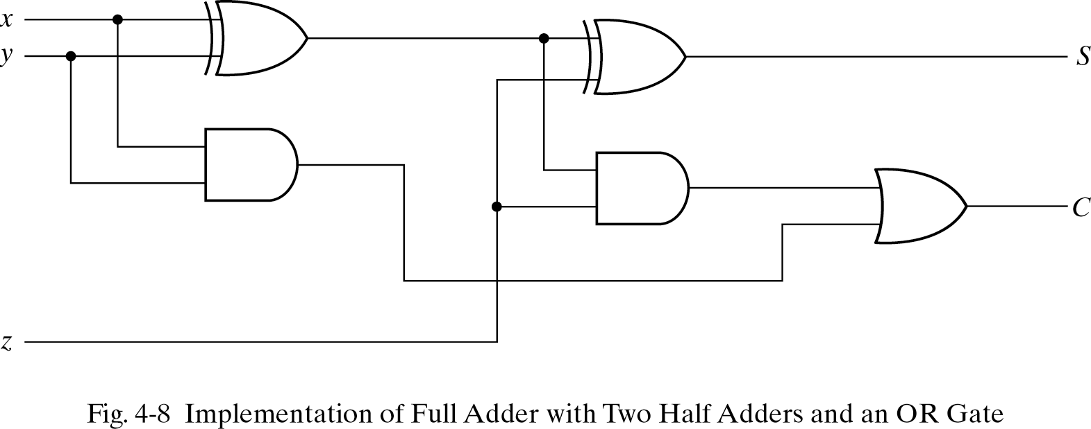
Full Adder with Two Half Adders
Full adder can also be implemented with two half adders and an OR gate. The S output from the second half adder is the exclusive-OR of z and the output of the first half adder giving
S = z ⊕ (x ⊕ y)
= z'(xy'+x'y)+z(xy'+x'y)'
=z'(xy'+x'y)+z(xy+x'y')
= xy'z'+x'yz'+xyz+x'y'z
C = z(xy'+x'y)+xy
= xy'z+x'yz+ xy

Slide 11
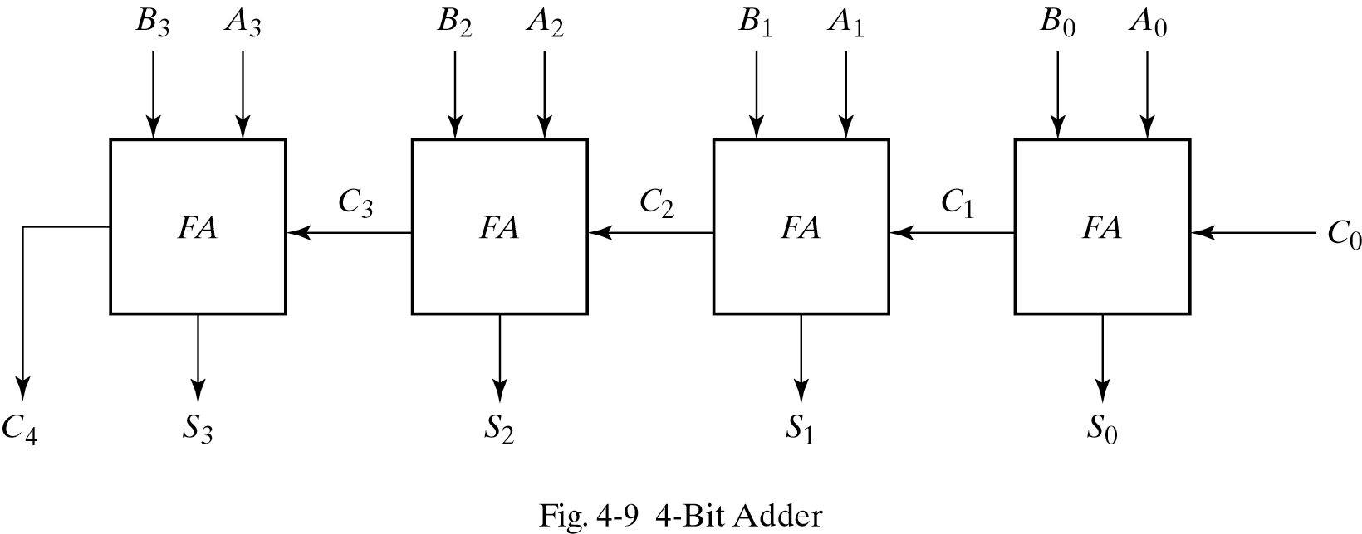
4-Bit Binary Adder
A binary adder is a digital circuit that produces the arithmetic sum of two binary numbers.
A binary adder can be implemented using multiple full adders (FA) connected in cascade with the output carry from each full adder to the input carry of the next full adder in the chain

Slide 12
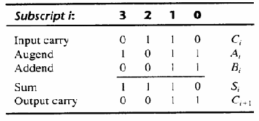
4-Bit Binary Adder
The augend bits of A and the addend bits of B are designated by subscript numbers from right to left, with subscript 0 denoting the least significant bit
The carries are connected in a chain through the full adders
The S outputs generate the required sum bits

Slide 13
4-Bit Binary Adder
Consider the two binary numbers, A= 1011 and B= 0011
Their sum S= 1110 is formed with four-bit adders
The bits are added with full adders, starting from the least significant position (subscript 0), to form the sum bit and carry bit
The input carry C₀ in the least significant position must be 0
The value of C_{i+1} in any position is the output carry of the that full adder stage and it is transferred into the input carry of the full adder that adds the bits one higher significant position higher.
The sum bits are thus generated starting from the
rightmost position and are available as soon as the
corresponding previous carry bit is generated.
All the carries must be generated for the correct sum
bits to appear at the outputs
Subscript i | 3 | 2 | 1 | 0
Input carry | 0 | 1 | 1 | 0 | C_{i}
Augend | 1 | 0 | 1 | 1 | A_{i}
Addend | 0 | 0 | 1 | 1 | B_{i}
Sum | 1 | 1 | 1 | 0 | S_{i}
Output carry | 0 | 0 | 1 | 1 | C_{i+1}

Slide 14
Carry Propagation
The addition of two binary numbers in parallel implies that all the bits of the augend and addend are available for computation at the same time
In any combinational circuit, the signal must propagate through the gates before the correct output is available in the output terminals.
The Total propagation time = propagation delay of a typical gate X the number of gate levels
The longest propagation delay time in a binary adder is the time it takes the carry to propagate through the full adders.
This is because each bit of the sum output depends on the value of the input carry. This makes the binary adder very slow.

Slide 15
Carry Propagation
Since each bit of the sum output depends on the value of input carry, the value of S_{i} in any given stage in the adder will be in its steady state final value only after the input carry to the stage has been propagated
Consider output S₃ in Figure 4-9. Inputs A₃ and B₃ are available as soon as input signals are applied to the adder, however input carry C₃ doesn’t settle to its final value until C₂ is available from the previous stage
Similarly, C₂ has to wait for C₁ and so on down to C₀
In this way only after the carry propagates and ripples through all stages will the last output S₃ and carry C₄ settle to their final correct value

Slide 16
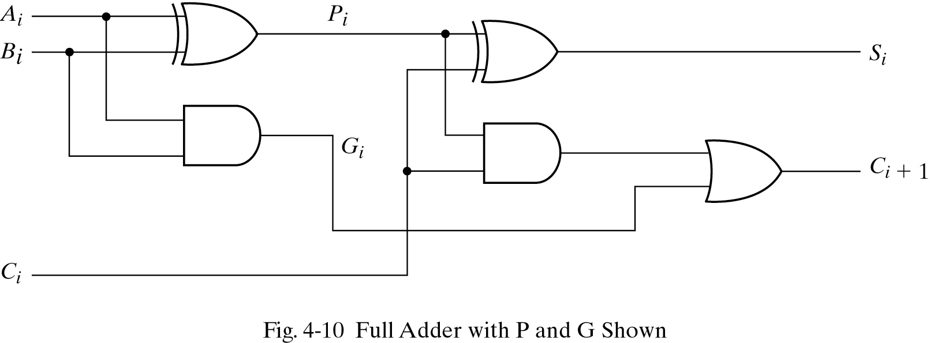
Carry Propagation
The number of gate levels for the carry propagation can be found from the circuit of the full adder
The input and output variables use the subscript i to denote a typical stage in the adder
The signals at P_{i} and G_{i} settle to their steady state values after they propagate through their respective gates

Slide 17
Carry Propagation
These two signals are common to all full adders and depend only on the augend and addend bits
The signal from the input carry C_{i} to the output carry C_{i+1} propagates through an AND gate and an OR gate, which constitutes two gate levels
If there are four full adders in the adder, the output carry C₄ would have 2 x 4 = 8 gate levels from C₀ to C₄.
For an n-bit adder, there are 2n gate levels for the carry to propagate from input to output
The outputs of a combinational circuit will not be correct unless the signals are given enough time to propagate through the gates connected from inputs to outputs
All other arithmetic operations are implemented by successive additions, the time consumed during the addition process is very critical.

Slide 18
Carry Propagation
One choice to reduce the carry propagation delay is to employ faster gates but the most widely used technique for reducing the carry propagation time in parallel adder is principle of carry lookahead
Consider the circuit of full adder shown in fig 4-10
If we define two binary variables
carry propagate: P_{i} = A_{i}⊕B_{i} (Term associated with the propagation of carry from C_{i} to C_{i+1})
carry generate: G_{i} = A_{i}B_{i} (Produces 1 when both Ai and Bi are 1)
Output sum and carry can be expressed as
sum: S_{i} = P_{i}⊕C_{i}
carry: C_{i+1} = G_{i}+P_{i}C_{i}

Slide 19
Carry Propagation
We now write the Boolean functions for the carry outputs of each stage and substitute for each C_{i}, its value from the previous equation
C_{o}= input carry
C₁ = G₀+P₀C₀
C₂ = G₁+P₁C₁
= G₁+P₁(G₀+P₀C₀)
= G₁+P₁G₀+P₁P₀C₀
C₃ = G₂+P₂C₂
= G₂+P₂G₁+P₂P₁G₀+ P₂P₁P₀C₀
C₄ = G₃+P₃C₃
=G₃+P₃G₂+P₃P₂G₁+P₃P₂P₁G₀+P₃P₂P₁P₀C₀
Since the Boolean function for each output carry is expressed in sum of products, each function can be implemented with one level of AND gates followed by an OR gate (or by two-level NAND)

Slide 20
Carry Look ahead Generator
The four Boolean functions for C₁, C₂, C₃ ,and C₄ are implemented in the carry look ahead generator shown in Figure 4-11
Here C₄ doesn’t have to wait for C₃, C₂ and C₁ to propagate and C₄ is propagated at the same time as C₁, C₂, and C₃.

Slide 21
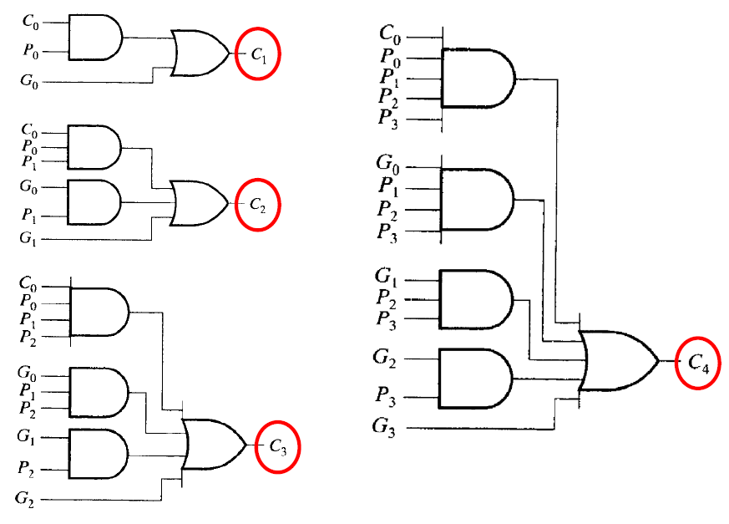
Carry Look ahead Generator
Fig 4-11 Logic Diagram of Carry Look ahead Generator

Slide 22
4-Bit Adder with Carry Look ahead
The construction of 4-bit adder with a carry lookahead generator is shown in Figure 4-12
Each sum output requires two exclusive-OR gates.
The output of first exclusive-OR gate generates the P_{i} variable and the AND gate generates the G_{i} variable
The carries are propagated through the carry look ahead generator and applied as inputs to the second exclusive-OR gate
All outputs carries are generated after a delay through two levels of gates
Outputs S₁ through S₃ have equal propagation delay times

Slide 23
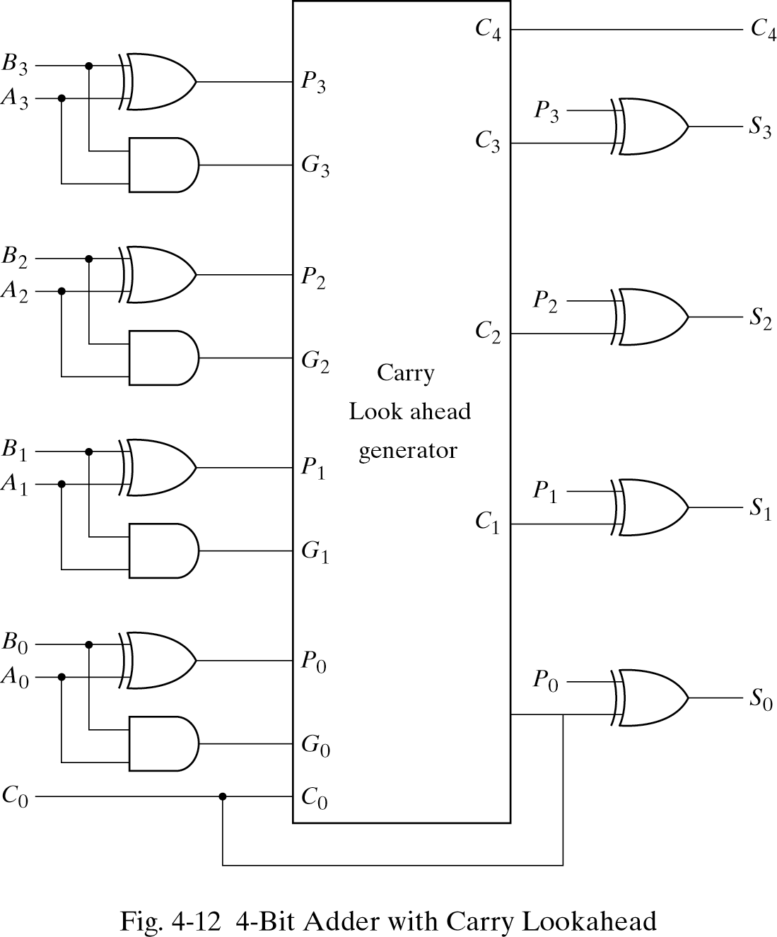
4-Bit Adder with Carry Look ahead

Slide 24
Binary Subtractor
The subtraction of unsigned binary numbers can be easily done by means of complements.(section 1-5)
A-B = A+(2’s complement of B)
The 2’s complement can be obtained by taking the 1’s complement and adding 1 to least significant pair of bits
To obtain 2’s complement, the 1’s complement can be implemented with inverters and one can be added to the sum through the input carry

Slide 25
Binary Subtractor
The circuit for subtracting A – B consists of an adder with inverters placed between each data input B and the corresponding input of full adder
The input carry C₀ must be equal to 1 when performing subtraction
The operation thus performed becomes A plus the 1’s complement of B plus 1 (A+1’s complement of B+1). This is equal to A plus 2’s complement of B (A+2’s complement of B)
For unsigned numbers this gives A – B if A ≥ B or the 2’s complement of (B – A) if A<B

Slide 26
Binary Subtractor
The addition and subtraction operation can be combined into one circuit with one common binary adder
This is done by including an exclusive-OR gate with each full adder
The mode input M controls the operation. When M=0, we have B⊕0= B. The full adder receives the value of B, the input carry is 0 and the circuit performs A+B
When M=1, we have B⊕1= B’. The full adder receives the value of B’, the input carry C₀ is 1 and the circuit performs A plus the 2’s complement of B. (A+1’s complement of B+1).
The exclusive-OR with output V is for detecting an overflow (detail later, in overflow)

Slide 27
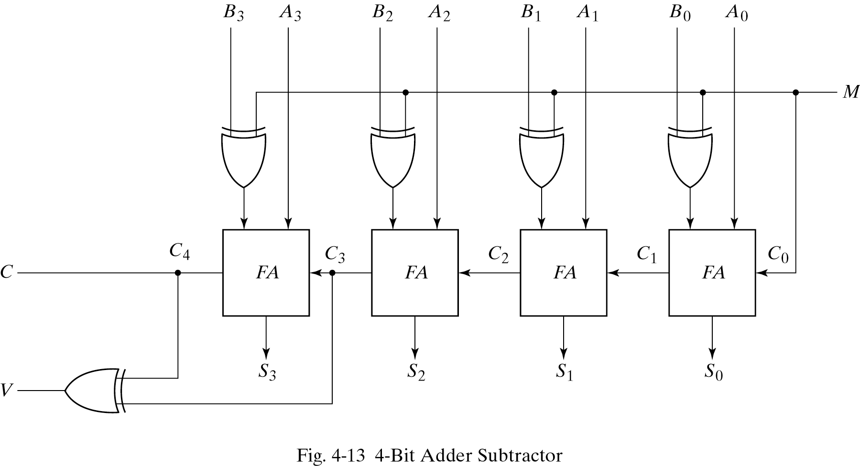

Slide 28
The End

