Slide 1

Chapter4: Combinational Logic
Lecture3- Design 4-bit Lookahead Carry Binary Adder-Subtractor Circuit
Engr. Arshad Nazir, Asst Prof
Dept of Electrical Engineering
SEECS

Slide 2
Objectives
Explore the problems associated with Ripple Carry Adder Design
Redesign an alternate 4-Bit Binary Adder-Subtractor Circuit i.e. Look ahead Carry Binary Adder to overcome long propagation delays encountered in the previous adder design
Study overflow in arithmetic circuits

Slide 3
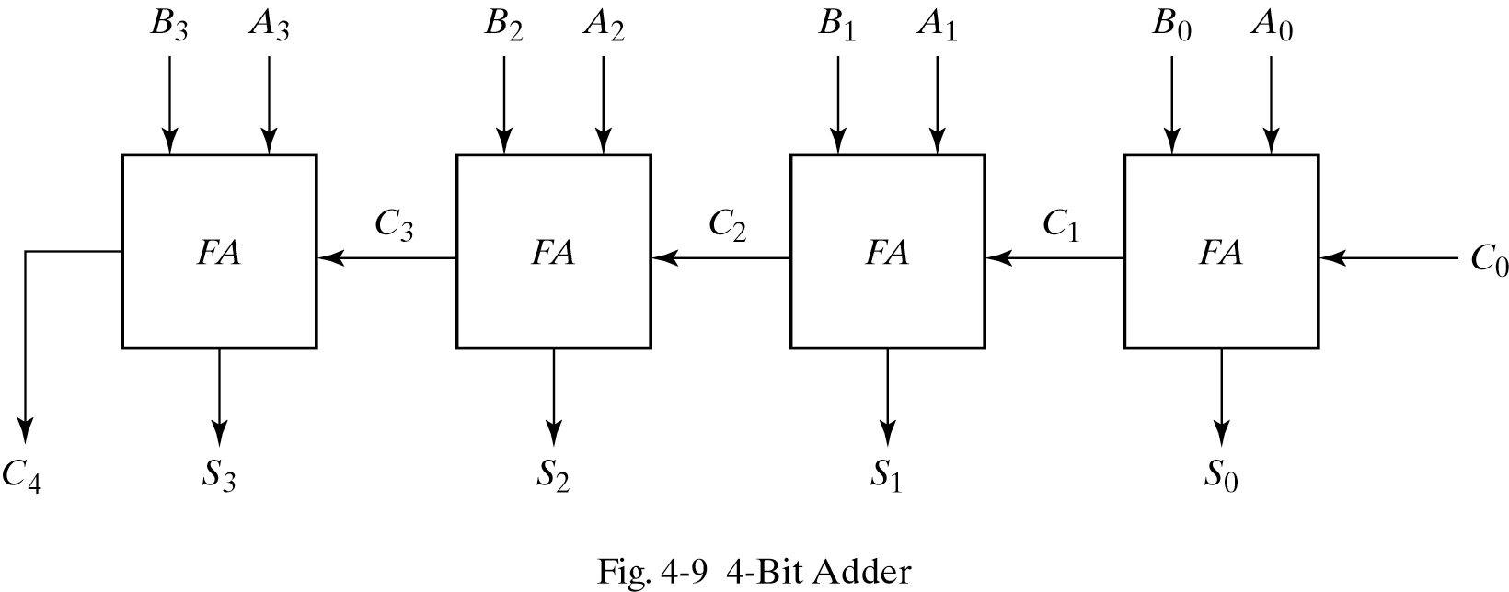
4-Bit Binary Adder
A binary adder is a digital circuit that produces the arithmetic sum of two binary numbers.
A binary adder can be implemented using multiple full adders (FA) connected in cascade with the output carry from each full adder to the input carry of the next full adder in the chain

Slide 4
Carry Propagation
The addition of two binary numbers in parallel implies that all the bits of the augend and addend are available for computation at the same time
In any combinational circuit, the signal must propagate through the gates before the correct output is available in the output terminals.
The Total propagation time = propagation delay of a typical gate X the number of gate levels
The longest propagation delay time in a binary adder is the time it takes the carry to propagate through the full adders.
This is because each bit of the sum output depends on the value of the input carry. This makes the binary adder very slow.

Slide 5
Carry Propagation
Since each bit of the sum output depends on the value of input carry, the value of S_{i} in any given stage in the adder will be in its steady state final value only after the input carry to the stage has been propagated
Consider output S₃ in Figure 4-9. Inputs A₃ and B₃ are available as soon as input signals are applied to the adder, however input carry C₃ doesn’t settle to its final value until C₂ is available from the previous stage
Similarly C₂ has to wait for C₁ and so on down to C₀
In this way only after the carry propagates and ripples through all stages will the last output S₃ and carry C₄ settle to their final correct value

Slide 6
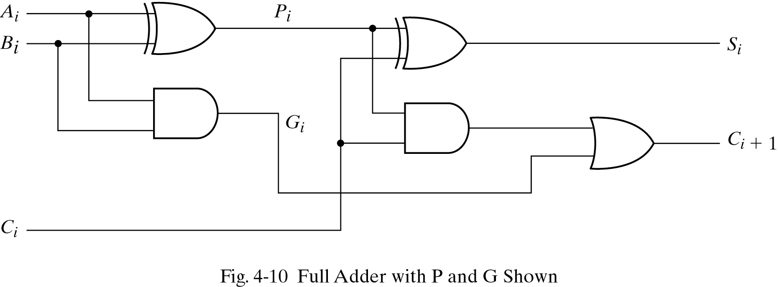
Carry Propagation
The number of gate levels for the carry propagation can be found from the circuit of the full adder
The input and output variables use the subscript i to denote a typical stage in the adder
The signals at P_{i} and G_{i} settle to their steady state values after they propagate through their respective gates

Slide 7
Carry Propagation
These two signals are common to all full adders and depend only on the augend and addend bits
The signal from the input carry C_{i} to the output carry C_{i+1} propagates through an AND gate and an OR gate, which constitutes two gate levels
If there are four full adders in the adder, the output carry C₄ would have 2 x 4 = 8 gate levels from C₀ to C₄.
For an n-bit adder, there are 2n gate levels for the carry to propagate from input to output
The outputs of a combinational circuit will not be correct unless the signals are given enough time to propagate through the gates connected from inputs to outputs
All other arithmetic operations are implemented by successive additions, the time consumed during the addition process is very critical.

Slide 8
Carry Propagation
One choice to reduce the carry propagation delay is to employ faster gates but the most widely used technique for reducing the carry propagation time in parallel adder is principle of carry lookahead
Consider the circuit of full adder shown in fig 4-10
If we define two binary variables
carry propagate: P_{i} = A_{i}⊕B_{i} (Term associated with the propagation of carry from C_{i} to C_{i+1})
carry generate: G_{i} = A_{i}B_{i} (Produces 1 when both Ai and Bi are 1)
Output sum and carry can be expressed as
sum: S_{i} = P_{i}⊕C_{i}
Carry: C_{i+1} = G_{i}+P_{i}C_{i}

Slide 9
Carry Propagation
We now write the Boolean functions for the carry outputs of each stage and substitute for each C_{i}, its value from the previous equation
C_{o}= input carry
C₁ = G₀+P₀C₀
C₂ = G₁+P₁C₁
= G₁+P₁(G₀+P₀C₀)
= G₁+P₁G₀+P₁P₀C₀
C₃ = G₂+P₂C₂
= G₂+P₂G₁+P₂P₁G₀+ P₂P₁P₀C₀
C₄ = G₃+P₃C₃
=G₃+P₃G₂+P₃P₂G₁+P₃P₂P₁G₀+P₃P₂P₁P₀C₀
Since the Boolean function for each output carry is expressed in sum of products, each function can be implemented with one level of AND gates followed by an OR gate (or by two-level NAND)

Slide 10
Carry Look ahead Generator
The four Boolean functions for C₁, C₂, C₃ ,and C₄ are implemented in the carry look ahead generator shown in Figure 4-11
Here C₄ doesn’t have to wait for C₃, C₂ and C₁ to propagate and C₄ is propagated at the same time as C₁, C₂, and C₃.

Slide 11
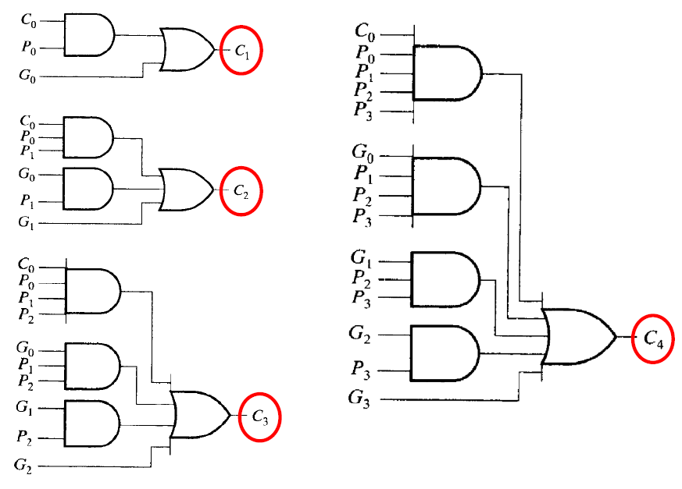
Carry Look ahead Generator
Fig 4-11 Logic Diagram of Carry Look ahead Generator

Slide 12
4-Bit Adder with Carry Look ahead
The construction of 4-bit adder with a carry lookahead generator is shown in Figure 4-12
Each sum output requires two exclusive-OR gates.
The output of first exclusive-OR gate generates the P_{i} variable and the AND gate generates the G_{i} variable
The carries are propagated through the carry look ahead generator and applied as inputs to the second exclusive-OR gate
All outputs carries are generated after a delay through two levels of gates
Outputs S₁ through S₃ have equal propagation delay times

Slide 13
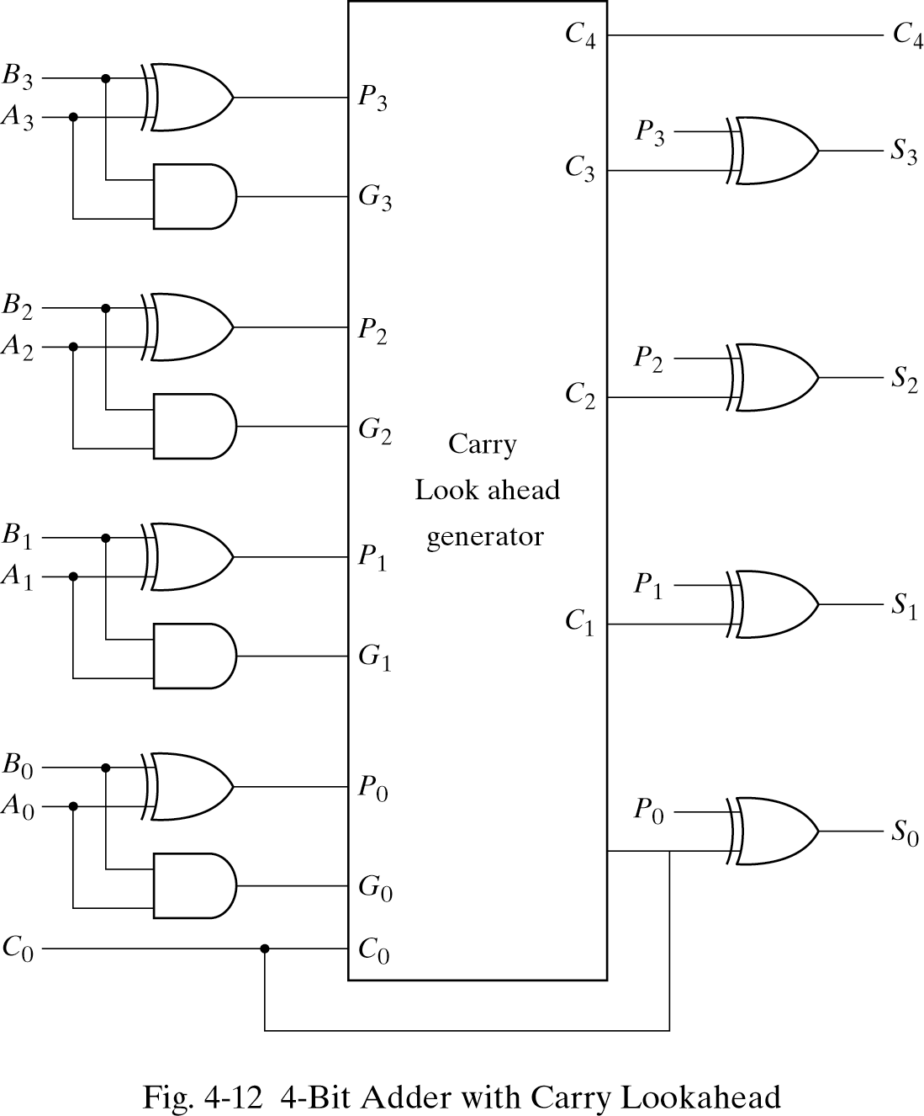
4-Bit Adder with Carry Look ahead

Slide 14
Binary Subtractor
The subtraction of unsigned binary numbers can be easily done by means of complements.(section 1-5)
A-B = A+(2’s complement of B)
The 2’s complement can be obtained by taking the 1’s complement and adding 1 to least significant pair of bits
To obtain 2’s complement, the 1’s complement can be implemented with inverters and one can be added to the sum through the input carry

Slide 15
Binary Subtractor
The circuit for subtracting A – B consists of an adder with inverters placed between each data input B and the corresponding input of full adder
The input carry C₀ must be equal to 1 when performing subtraction
The operation thus performed becomes A plus the 1’s complement of B plus 1 (A+1’s complement of B+1). This is equal to A plus 2’s complement of B (A+2’s complement of B)
For unsigned numbers this gives A – B if A ≥ B or the 2’s complement of (B – A) if A<B

Slide 16
Binary Subtractor
The addition and subtraction operation can be combined into one circuit with one common binary adder
This is done by including an exclusive-OR gate with each full adder
The mode input M controls the operation. When M=0, we have B⊕0= B. The full adder receives the value of B, the input carry is 0 and the circuit performs A+B
When M=1, we have B⊕1= B’. The full adder receives the value of B’, the input carry C₀ is 1 and the circuit performs A plus the 2’s complement of B. (A+1’s complement of B+1).
The exclusive-OR with output V is for detecting an overflow (detail later, in overflow)

Slide 17
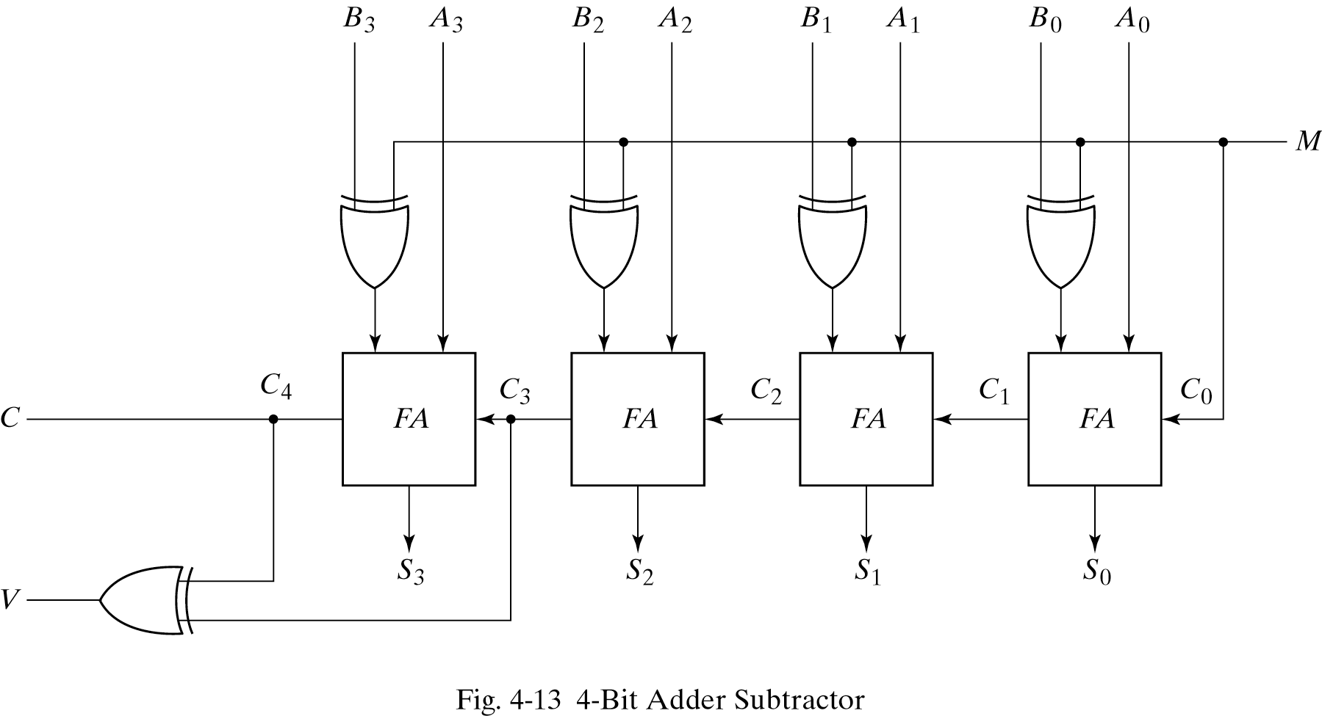

Slide 18
Overflow
When two numbers of n digits are added and sum occupies n+1 digits we say that an overflow occurred
Overflow is problem in digital computers because the number of bits that hold the number (limited storage) is finite and a result that contains n+1 can’t be accommodated.
The detection of an overflow after the addition of two binary numbers depends on whether the numbers are considered to be signed or unsigned
When two unsigned numbers are added an overflow is detected from the end carry out of the most significant position
In the case of signed numbers, the leftmost bit always represent the sign and negative numbers are in 2’s complement form

Slide 19
Overflow
When two signed numbers are added, the sign bit is treated as part of the number and end carry doesn’t indicate an overflow
An overflow can’t occur after an addition if one number is positive and the other is negative, since adding a positive number to a negative number produces a result which is smaller than the larger of the two original numbers.
An overflow may occur if the two numbers added are both positive or both negative
For n-bit registers, the range of numbers (signed numbers) that each register can accommodate is from binary 2^{n-1}-1 to binary –2^{n-1}.

Slide 20
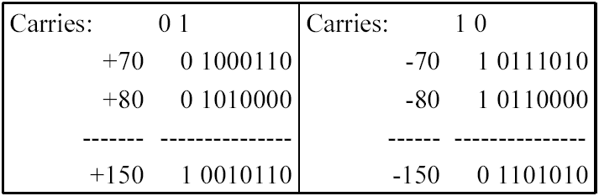
Overflow
For 8-bit registers, the range of numbers that each register can accommodate is from binary +127 to binary –128
Consider two signed numbers +70 and +80 stored in two 8-bit registers. The sum of two numbers is +150 which exceeds the capacity of eight bit register
Note: Negative numbers are in 2’s complement form

Slide 21
Overflow
If we just consider the 8-bit result from the last example, we go wrong as we
Add two positive numbers and obtain a negative number
Add two negative numbers and obtain a positive number
The carry out of sign bit position is taken as the sign bit of the result, then the 9-bit answer so obtained will be correct. This answer can’t be accommodated within 8-bits we say that an overflow has occurred
An overflow has occurred if carry into the sign bit position and carry out of the sign bit position are not equal. This can be found by applying the two carries to an exclusive-OR gate. 1 at the output of the gate indicates overflow
V=0, no overflow; V=1, overflow

Slide 22
The End

