Slide 1
CS212 – Object Oriented
Programming
Introduction
Dr Khuram Shazhad
mkhuram.shahzad@seecs.edu.pk
Office: A-308

Slide 2
Outline
Course Objectives
Learning Outcomes
Course Outline
Labs
Grading
Books

Slide 3
Course Objectives
To familiarize the students with the basic concepts and techniques forming the Object Oriented Programming Paradigm.
To enable students to identify, analyze and use the different object oriented constructs to solve real world problems.

Slide 4
Learning Outcomes
Understand the difference between
Demonstrate the ability to create and use OOP constructs to map real world scenarios
Develop programs using object oriented techniques
Use the latest IDEs to enable quick development, testing, documentation, and packaging of programs

Slide 5
Difference OOP Vs POP?
Object Oriented Programming
Deal with Data
Programs divided into objects
Need more memory
Bottom up approach
Access specifier
Public, private, protected, default
Overloading
Function and operator overloading
Highly Secure
Encapsulation & Abstraction
C++, Java, Python
Procedure Oriented Programming
Deal with algorithms
Programs divided into functions
Need less memory
Top down approach
Does not have access specifier
No Overloading
Less Secure
C, VB, Basic

Slide 6
Course Outline
Week | Topic(s)
1-2 | Programming Basics, Introduction to Object Oriented Programming
3 | Introduction to Object Oriented Programming using Classes and Objects
4 | Member Functions, Setter and Getter Methods
5 | Copy Constructor, Revision
6 | OHT 1
7 | Friend Functions and Classes, Static Class Members
8-9 | Operator Overloading, Inheritance, Case Study
10 - 11 | Virtual Functions, Polymorphism, Dynamic Conversion
12 | OHT 2
13 | Abstract Classes, Destructors
14 | Template Functions, Exception Handling
15 | Standard Template Library (STL)
16-17 | Case Studies
18 | End Semester Exam

Slide 7
Grading
Theory - 75%
40% OHTS - 02
10% Quizzes - 06
10% Assignments - 03
40% Final Exam
Labs - 25 %
70% Lab Tasks
30% Project

Slide 8
Books
C++ How To Program, Deitel& Deitel, Edition: 9/10
C++, The Complete Reference, Herbert Schildt

Slide 9
Class Etiquettes
Respect each others
Keep your mobiles switched off
Be careful of class timing
Late comer may be not allowed
Delay talks with colleagues
Try to avoid questions during a lecture
Ask questions at the end of a lecture
Avoid interruption in class

Slide 10
SEECS/NUST Etiquettes
It is far better to fail than to Cheat
Plagiarism is strictly Prohibited
Required Class attendance is 75%

Slide 11
Consultation Hours/Location
Thursday: 11 am – 01pm
(Any other day – By appointment only)
Office: Room A308, 2nd Floor SEECS Faculty Block

Slide 12
CS212 – Object Oriented
Programming
Intro. to Objects

Slide 13

At the end of the day…
Computers just manipulate 0’s and 1’s
But binary is hard (for humans) to work with

Slide 14
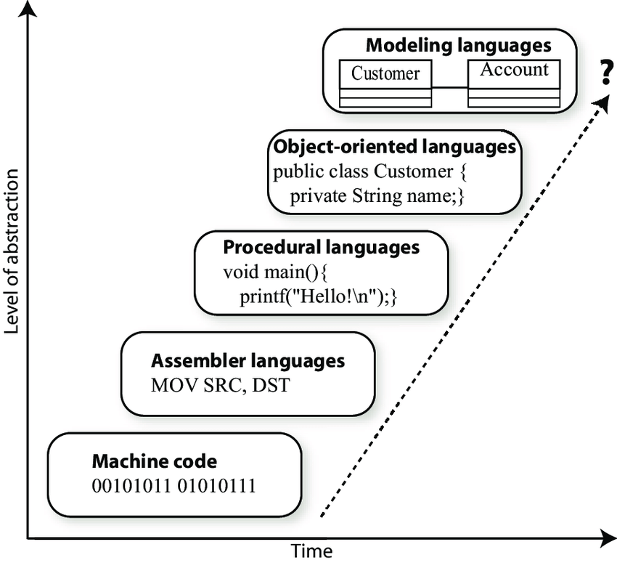
Towards a higher level of abstraction
Declarative languages (Haskell, Prolog...)
OO languages (C++, Java, Python...)
Procedural languages (C, Fortran, COBOL...)
Assembly languages
Binary code

Slide 15
There are always trade-offs
High-level languages
Simpler to write & understand
More library support, data structures
Low-level languages
Closer to hardware
More efficient
What about C++?

Slide 16
Programming Paradigm
Programming provides solution(program) to a real-world problem using computational models
Programming paradigm is a mental view of the problem and its solution

Slide 17
Procedural Programming
f()
f()

Slide 18
Procedural Programming
f() x
f() x

Slide 19
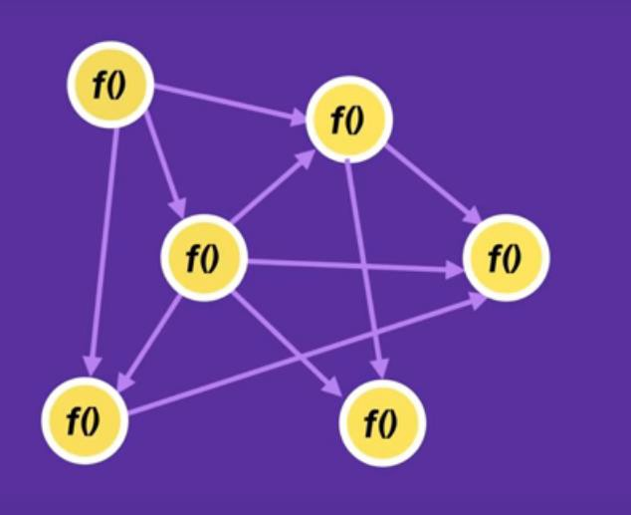
Procedural Programming

Slide 20

Procedural Programming
SPAGHETTI CODE

Slide 21
OOP Approach
The fundamental idea behind object-oriented
language is to combine into a single unit both
data and
the functions that operate on that data.
Such a unit is called an object

Slide 22
Object Oriented Programming (OOP)
f() x
f() x

Slide 23
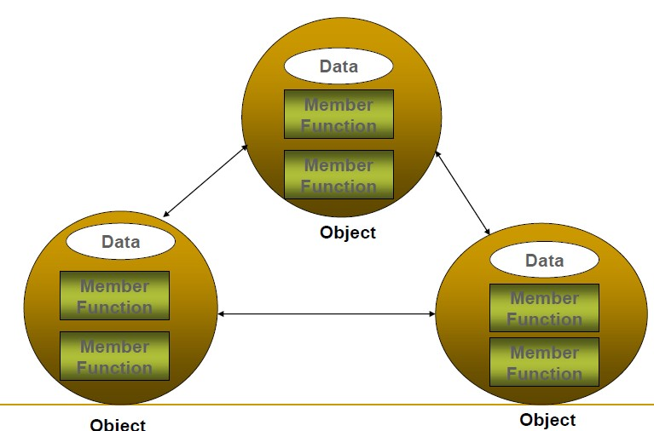
OOP Approach

Slide 24
Object Oriented Programming (OOP) Paradigm
“Object Oriented programming is an approach of problem solving where all computations are carried out using objects”
Object?

Slide 25
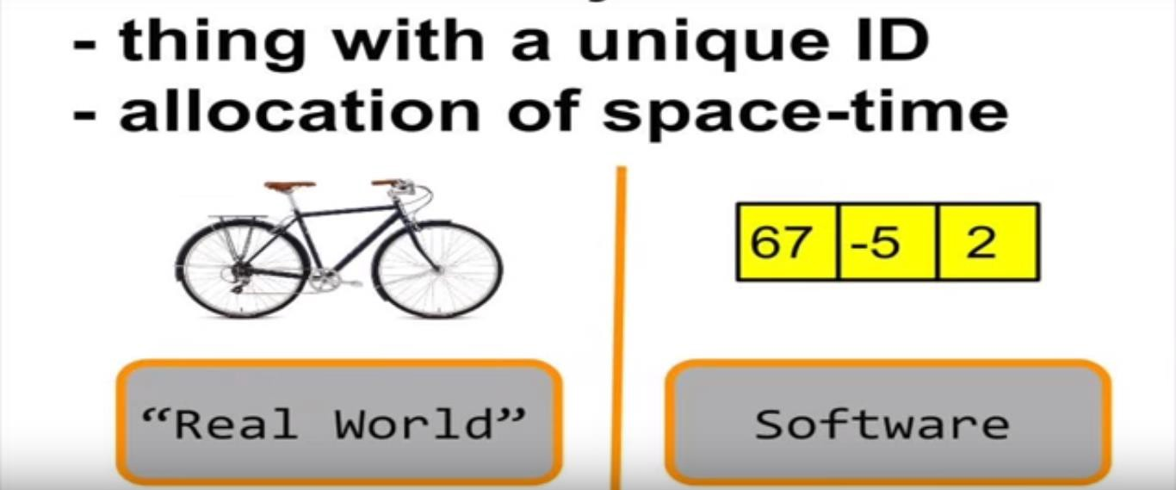
Object?

Slide 26
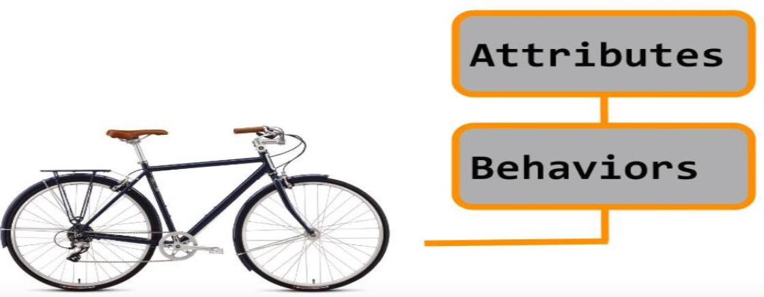
Object

Slide 27
Attributes & Behaviors in OOP
Almost any noun can be reasonably
represented as a software object in terms of
attributes (e.g., name, color and size)
and behaviors (e.g., calculating, moving and
communicating).

Slide 28
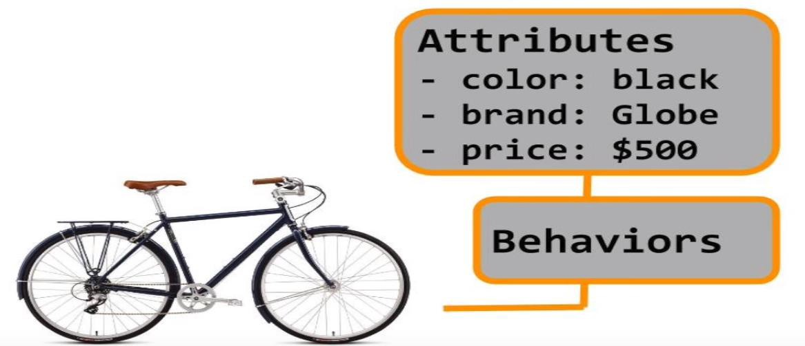
Static Properties

Slide 29
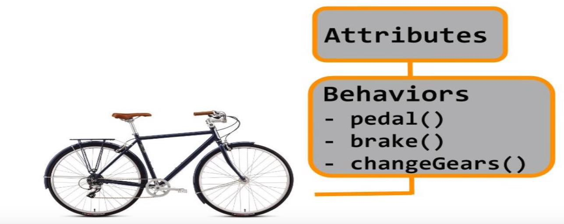
Dynamic properties

Slide 30
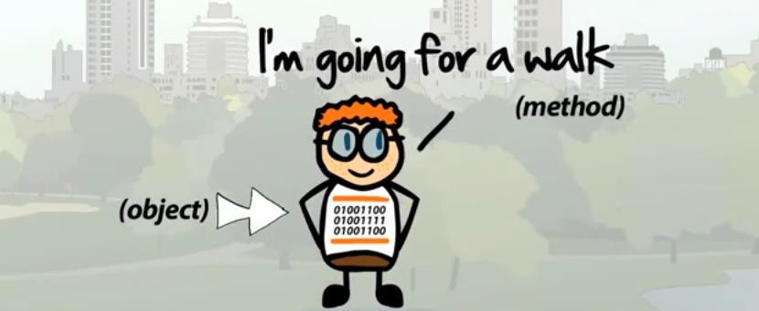
Example (Person as an Object)
Attributes
age Name address
Behavior
Walk()
Run() Teach()

Slide 31
Class
Close your eyes for a minute and think about what do you understand when you hear the word “chair”
We know that chairs have properties like :
seating capacities,
back,
number legs
shape
color
a degree of softness and so on so forth

Slide 32
Example (Chair as an Object)
The idea of the chair allows you to recognize a chair. However, the definition does not exist
However, if you look around the room, there are several chairs are in the room, and each chair is an object. Each of these objects is an example of that thing called the Chair (class)
A class is a description of a kind of thing.
An object is an actual thing

Slide 33
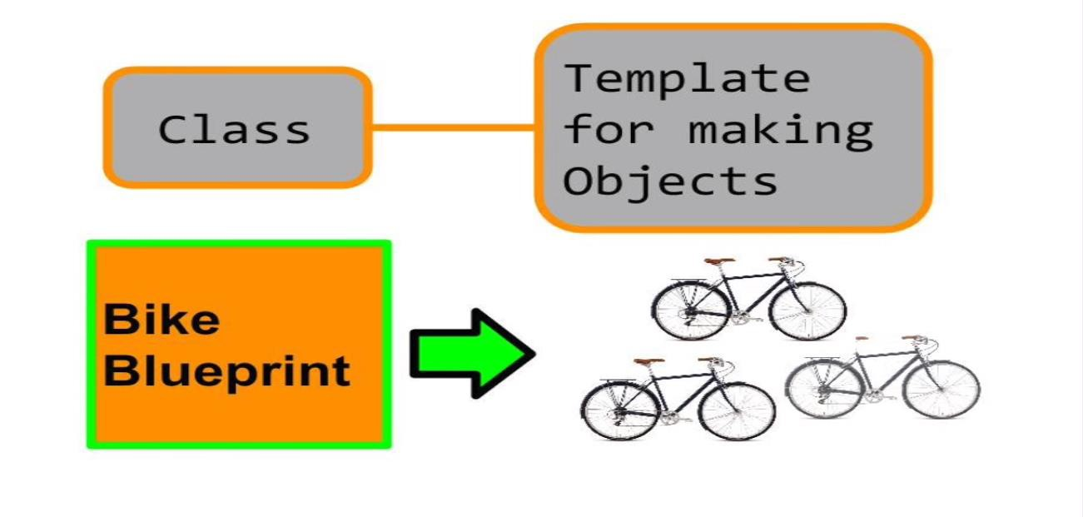
Class

Slide 34
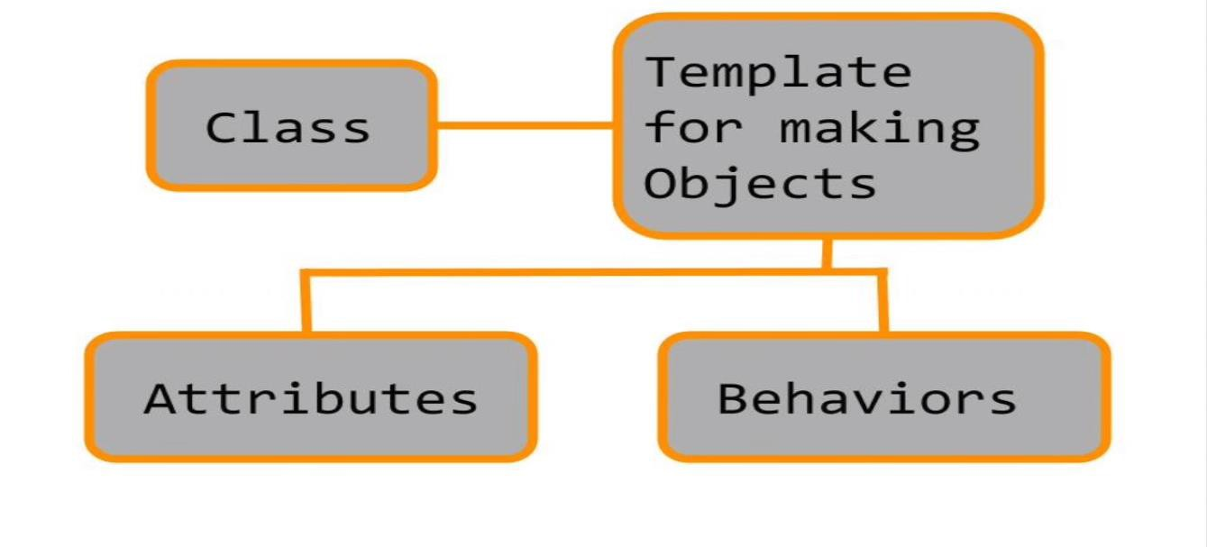
Class

Slide 35
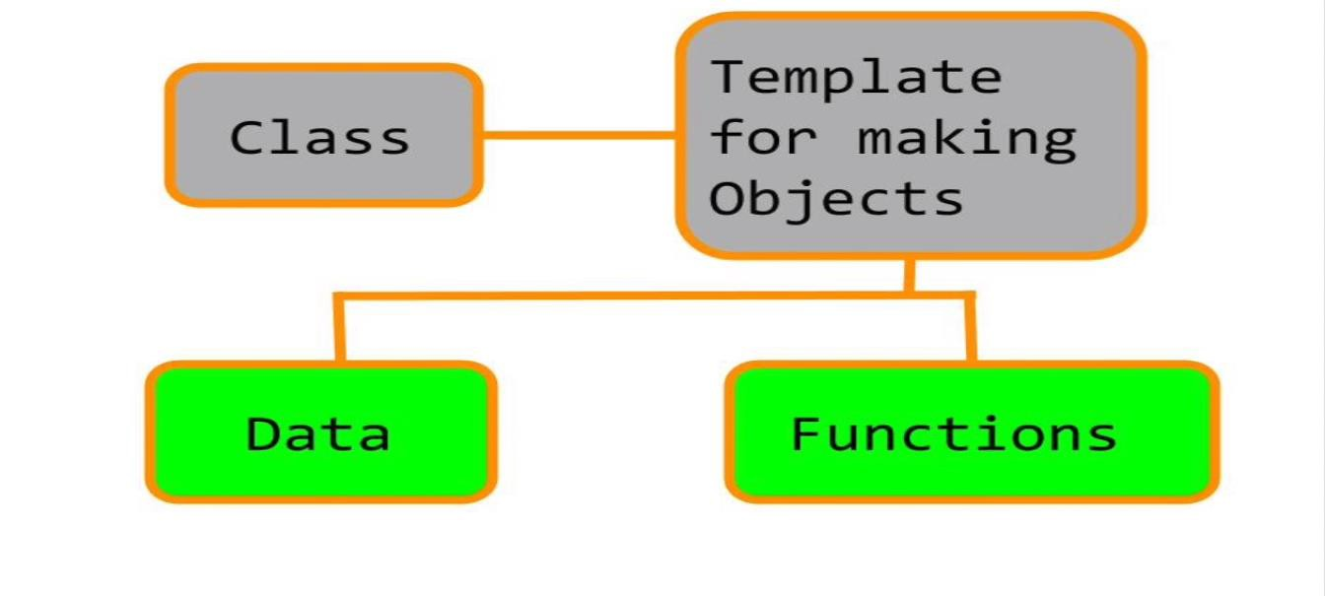
Class in OOP

Slide 36
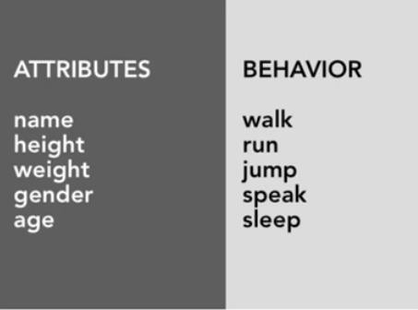
Class

Slide 37
Concept of a “Class” in OOP
A key aspect of Object Oriented Programming is
the use of Classes
A class is a specification/model of an object
You can “think of a class as a concept” and
an object as “Realization of that concept”

Slide 38
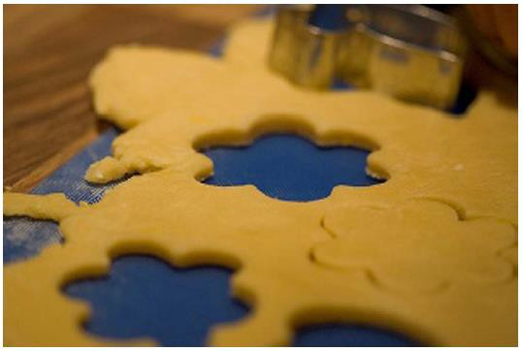
Class
A class is like a cookie cutter; it defines the
shape of objects
Objects are like cookies; they are instances of the class
Photograph courtesy of Guillaume Brialon on Flickr

Slide 39
Class
The world is full of objects
Many objects have always existed. New objects come to existence
and others cease to exist
Mankind chose to classify objects i.e. name groups of objects based on their attributes and their relationships
For example:
All things have been classed as either living things or non-living things
Some living things are classed as vertebrae's and others as non-vertebrae’s
A group of things like TVs, computers, phones etc are classified as electronics
PCs, laptops, tablets and servers can be classified as computers as a subgroup of
electronics
•
In the real world, only objects interact with objects

Slide 40

Class
Remember: A CLASS is ONLY a definition. It describes a set of qualifiers that describe what the objects that belong to that class look like
The things that are tangible and exist are the Objects. Objects may belong to a classification.

Slide 41
What is an Object in OOP ?
Objects have properties also called as
attributes
Tasks performed by an object are expressed as methods

Slide 42
Class: Summary
A class defines the abstract characteristics of a
group of similar objects
Attributes(fields or properties)
Behaviors(methods or functions).
A class is a user-defined type.
A class is a blueprint or template to build a specific type of object
Every object is built from a class.
Can be used to create objects: Variables of the class type

Slide 43
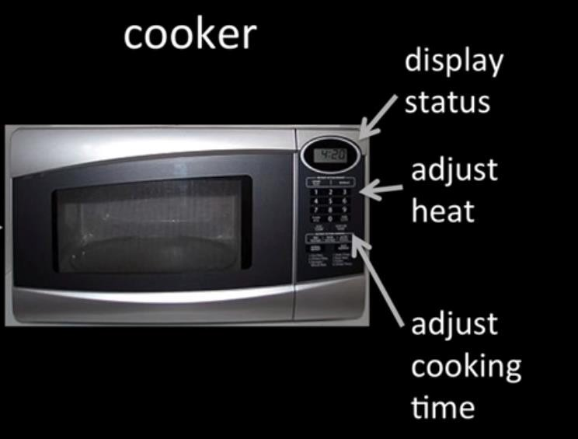
What is a “Microwave”?
An oven that uses microwaves
to heat food
It has a door
It has a rotating trey inside
It is a keypad based HMI
It has a light in the oven
Has a power rating

Slide 44
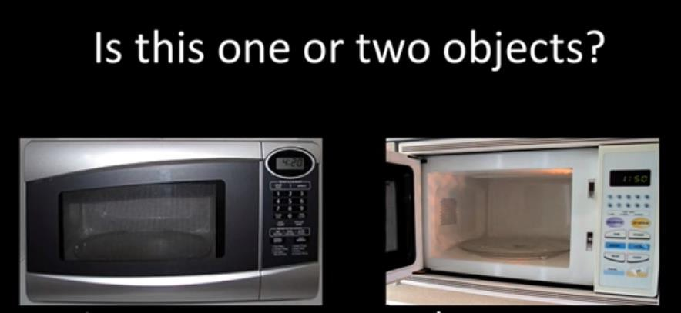
Object or Class?
These are two objects. Call them Microwave 1 and Microwave 2
You can call them My microwave and Ali’s microwave so on and so forth
Both belong to the CLASS microwave, which does not exist

Slide 45
OOP: Real World Modeling
In physical world we deal with objects such as
cars and people
Such kind of objects are not like the data and
are not like the functions
Complex real world objects have both attributes and behavior

Slide 46
OOP Approach
Identify objects that the problem is concerned
with,
– e.g. Sports Application (Sportsman would be the object),
Produce a detailed design for each new data type (Objects) including the operations that can be performed on each object
Express logic of your program in terms of objects and kinds of operations they allow

Slide 47
OOP Approach

Slide 48
Online Booking: Tennis Court
Court
User
Booking

Slide 49
Online Booking: Tennis Court
Attribute(Variables)
COLOR, SURFACE, DIMENSION
Court
Functionality(Functions)
DO COURT BOOKING(), COURT CLEANING

Slide 50
Student Management System
Roll number
Attributes
Name
Marks
Student
Curricular
performance
Behavior:
Extra curricular performance

Slide 51
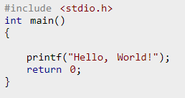
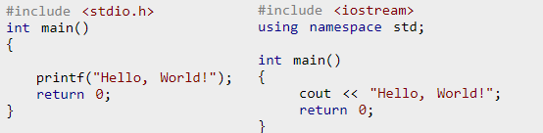
Basic Structure C and C++

Slide 52
Class
A class is a programmer-defined data type. It consists of data members and functions which operate on that data.
Data Members define Object attributes
Member Functions define Object Behavior
“Class” is an Object-Oriented Programming Concept

Slide 53
C++ Class – Declaration
To declare a class
– The class keyword is used
The declaration is enclosed in braces {};
The class definition ends with a semicolon
Every piece of code inside the braces is called ‘class body’
The class body thus contains class members

Slide 54
C++ Class – Declaration
Class classname
{
………….
…………
…………….
};

Slide 55
C++ Class – Example
class Time {
Private:and Public: are member-access specifiers.
private:
int hour; // 0 - 23
int minute; // 0 - 59
hour, minute, and second are data members.
int second; // 0 - 59
public:
Time();
setTime, printMilitary, and printStandard are member functions. Time is the constructor.
void setTime( int, int, int );
void printMilitary();
void printStandard();
};

Slide 56
C++ Class – Body
Every piece of code inside the braces is called
‘class body’
The class body thus contains class members

Slide 57
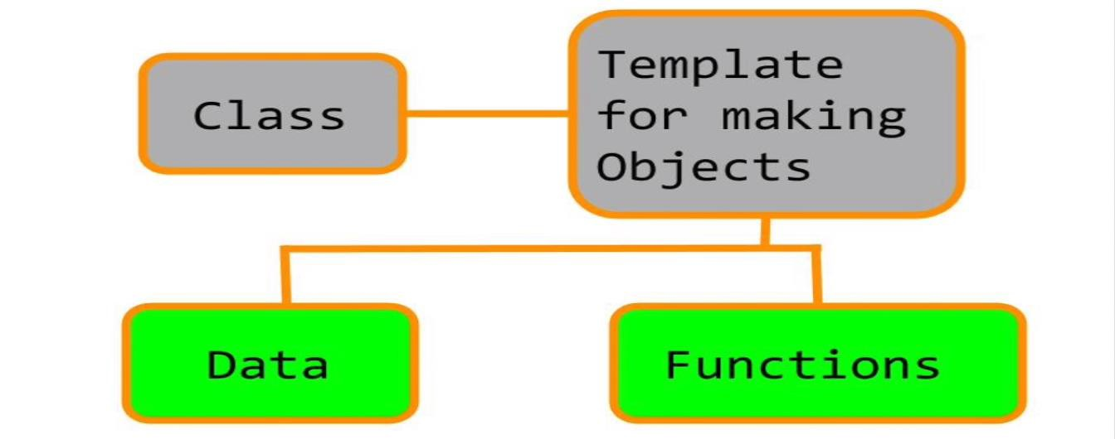
C++ Class – Body
Every piece of code inside the braces is called
‘class body’
The class body thus contains class members

Slide 58
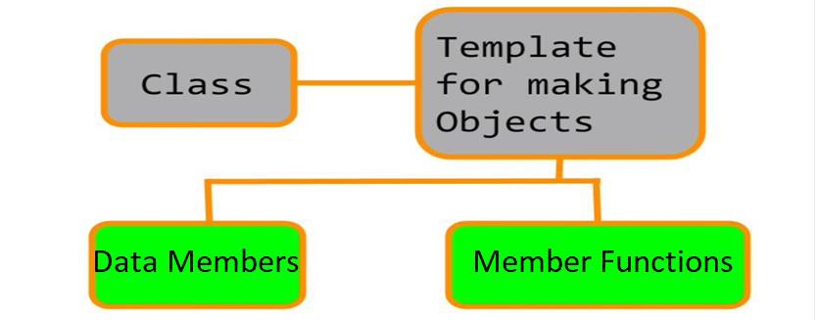
C++ Class – Body
Every piece of code inside the braces is called
‘class body’
The class body thus contains class members

Slide 59
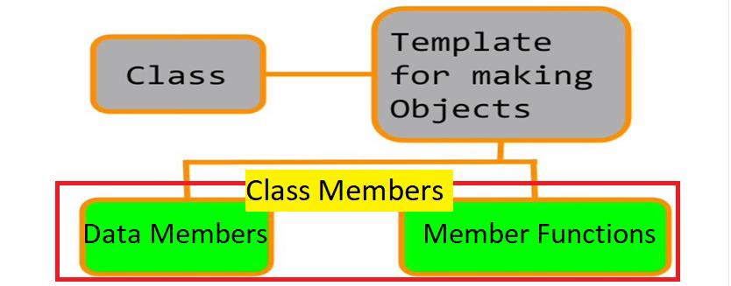
C++ Class – Body
Every piece of code inside the braces is called
‘class body’
The class body thus contains class members

Slide 60
Class
Class Student
{
Attributes
Roll number
Name
Marks
Behavior:
Curricular performance
Extra curricular performance
} ;
57

Slide 61
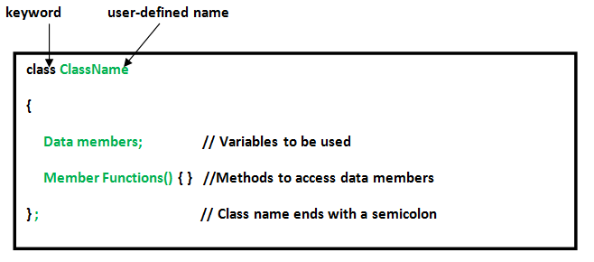
C++ Class – Body

Slide 62
C++ Class – Class Members
A class’s declaration declares the class’s members,
which may consist of
The data members
The constructor & destructor functions
Specialized member functions
Other member functions
Include the functionality that can be invoked on the object of
this class (or type)

Slide 63
C++ Class – Data Members
A data member can be of any valid C++ data type. For example
Ordinary variable – primitive type
An instance variable of another class – programmer defined type
A pointer or reference variable

Slide 64
C++ Access Modifiers
Three types of Access Modifiers:
private: public: protected:
The scope of an access modifier continues until another access modifier is mentioned explicitly
There is a colon after every access modifier

Slide 65
C++ Access Modifiers
class Base {
public:
// public members go here
protected:
// protected members go here private:
// private members go here
};

Slide 66
public:
Public members can be accessed by member functions as well as by functions that declare the objects of that class.
Normally, for classes, those member functions are made public which must interact with the outside world.

Slide 67
private:
Private members can only be accessed by member
functions.
– This means they can only be accessed in the member function body.
Remember the ‘members’ mean both variables
and functions.
By default all class members are private, unless
declared otherwise.

Slide 68
public: OR private:
It is not compulsory for all members functions to be
public and all data members to be private.
Some member functions can also be private.
Similarly, data members can also be public.
– Violation of Encapsulation principle

