Slide 1
CS212 – Object Oriented Programming
Dynamic Memory Allocation
An application of pointers
Week – 10
Dr. Khuram Shazhad
mkhuram.shahzad@seecs.edu.pk
Office: A-308
1

Slide 2
Outline
C++ Memory Allocation
C++ Static and Automatic allocation
Issues with C++ Static and Automatic allocation
Dynamic memory allocation
Dangling Pointers
2

Slide 3


C++ Memory Allocation
Lesson 1
3

Slide 4
C++ Memory Allocation
C++ supports three basic types of memory allocation
Static memory allocation
Automatic memory allocation
Dynamic memory allocation

Slide 5
Scenario – Where we need DMA
Arrays
Suppose you need to store 3 variables of certain data type
DMA – A pointer is a variable whose value is the address of another variable
Uses
Pointers allow to refer to the same space in the memory from multiple locations. This will also allow you to save space by sharing components in your data structures.
Dynamic memory allocation
Allows you to set array size dynamically during the run time rather than at compile time. This helps in the situations where you/program does not know in advance the number of items (variable values) to be stored.

Slide 6
Example – DMA using Arrays
#include <iostream>
using namespace std;
// Driver Code
int main()
{
int size;
int *ptr;
cout<<"Enter no. of values you want to store (size of array):"<<endl;
cin>>size;
ptr = new int[size];
cout<<"Enter values to be stored in the array:"<<endl;
for(int i=0;i<size;i++)
{
cin>>ptr[i];
}
cout<<"values in the array are:"<<endl;
for(int i=0;i<size;i++)
{
cout<<ptr[i]<<endl;
}
return 0;
}
Enter no. of values you want to store (size of array):
3
Enter values to be stored in the array:
1
2
3
values in the array are:
1
2
3
For DMA using objects see slide 49

Slide 7
C++ Memory Allocation
Static memory allocation happens for static and global variables. Memory for these types of variables is allocated once when your program is run and persists throughout the life of your program.
Automatic
memory allocation happens for
function parameters and local variables. Memory for these types of variables is allocated when the relevant block is entered, and freed when the block is exited, as many times as necessary.
Dynamic memory allocation is the topic of this lecture.

Slide 8
C++ Static and Automatic allocation
Lesson 1a
6

Slide 9
C++ Static and Automatic allocation
Both static and automatic allocation have two things in common:
The size of the variable / array must be known at compile time.
Memory allocation and deallocation happens automatically (when the variable is instantiated / destroyed).

Slide 10
Issues with C++ Static and Automatic allocation
Lesson 1b
8

Slide 11
Static and Automatic allocation Issues
Most of the time, this is just fine. However, this may cause problems, usually when dealing with external (user or file) input.
If we have to declare the size of everything at compile time, the best we can do is try to make a guess about the maximum size of variables:

Slide 12
Static and Automatic allocation Issues
For example:
we may want to use a string to hold someone’s name, but we do not know how long their name is until they enter it.
Or we may want to read in a number of records from disk, but we don’t know in advance how many records there are.
Or we may be creating a game, with a variable number of monsters (that changes over time as some monsters die) trying to kill the player.

Slide 13
Static and Automatic allocation Issues
char name[25]; // let's hope their name is less than 25 chars!
This is a poor solution for following reasons??
Wasted Memory
Stack Overflow
Array Overflow

Slide 14
Wasted Memory
First,
it leads to wasted memory if the
variables aren’t actually used.
For example, if we allocate 25 chars for every name, but names on average are only 12 chars long

Slide 15
Stack Overflow
Second
, most normal variables (including
fixed arrays) are allocated in a portion of memory called the stack.
The amount of stack memory for a program is generally quite small -- Visual Studio defaults the stack size to 1MB. If you exceed this number, stack overflow will result, and the operating system will probably close down the program.

Slide 16
Stack Overflow
1 int main()
2 {
int array[1000000];
}
Being limited to just 1MB of memory would be problematic for many programs, especially those that deal with graphics.
// allocate 1 million integers (probably 4MB of memory)

Slide 17
Array Overflows
Third, it can lead to artificial limitations and/or array overflows.
What happens when the user tries to read in
600 records from disk, but we’ve only
500
allocated records?
– Error
memory for a maximum of
– Unexpected behaviour

Slide 18
Dynamic memory allocation
Lesson 2
16

Slide 19
Dynamic memory allocation
Fortunately,
these problems are
easily
addressed via dynamic memory allocation.
Dynamic
memory allocation is a way for
running programs to request memory from the operating system when needed.

Slide 20
Dynamic Memory Allocation
All of the code you've written up to now allocates space for data at compile time
Restrictive, and it's often wasteful
Int arry[2]; However if you need to enter 3 numbers?
Int arry[5]; you only use 2 numbers
Allocate the memory you need to store

Slide 21
Dynamic memory allocation
This
memory does not come from the
program’s limited stack memory -- instead, it is allocated from a much larger pool of memory managed by the operating system called the heap.
On modern machines, the heap can be
gigabytes in size.

Slide 22
Heap and Stack
Lesson 3
20

Slide 23
Heap segment
The heap segment (also known as the “free store”) keeps track of memory used for dynamic memory allocation.
In C++, when you use the new operator to allocate memory, this memory is allocated in the application’s heap segment.
Once memory is allocated in the heap, you can access it via the pointer that operator new returns

Slide 24
Stack and Heap
Stack : is a common name for the memory space in which automatic variables (and often function parameters) are allocated
Heap: is a common name for the "free store", the memory space where dynamic objects are allocated
An object in a heap is not scope dependent, it dies when you tell it to. Meanwhile, an object on the stack is destroyed automatically when its scope ends

Slide 25
Dynamically allocating single variables
Lesson 5
23

Slide 26
Dynamically allocating single variables
To allocate a single variable dynamically, we use the the new operator:
new int; // dynamically allocate an integer (and discard the result)

Slide 27
Dynamically allocating single variables
In the above case, we’re requesting an integer’s worth of memory from the operating system. The new operator creates the object using that memory, and then returns a pointer containing the address of the memory that has been allocated.

Slide 28
Dynamically allocating single variables
Most often, we’ll assign the return value to our own pointer variable so we can access the allocated memory later.
int *ptr = new int;
// dynamically allocate an integer and assign the address to ptr so we can ac cess it later

Slide 29
Dynamically allocating single variables
We can then dereference the pointer to access the memory:
*ptr = 7; // assign value of 7 to allocate d memory

Slide 30
Initializing dynamically allocated variable
Lesson 6
28

Slide 31
Initializing dynamically allocated variable
int *ptr1 = new int (5);
OR
int *ptr = new int;
*ptr = 7;

Slide 32
Deleting dynamically allocated variable
Lesson 7
30

Slide 33
Deleting dynamically allocated variable
Unlike
static or automatic memory, the
program itself is responsible for requesting and disposing of dynamically allocated memory.
C++ to free the memory for reuse.
When we are done | with | a | dynamically
allocated variable, we | need | to | explicitly tell

Slide 34
Deleting dynamically allocated variable
delete ptr;
// return the memory pointed to by ptr to the op erating system
ptr = 0;
// set ptr to be a null pointer (use nullptr instead of 0 in C++11)
This statement deallocates the memory associated with the integer, returning the memory to the heap.

Slide 35
Deleting dynamically allocated variable
The delete operator does not actually delete anything. It simply returns the memory being pointed to back to the operating system. The operating system is then free to reassign that memory to another application (or to this application again later).

Slide 36

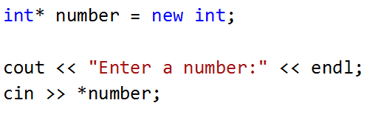
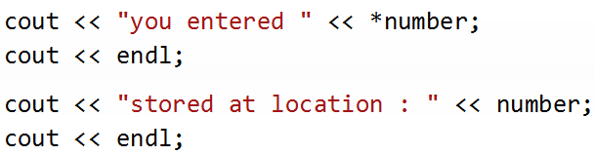

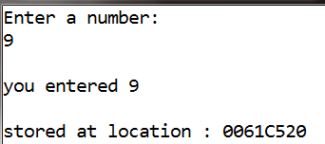
Dynamically Allocated Integers
CS212 Object Oriented Programming in
C++
34

Slide 37
Dangling Pointers
Lesson 8
35

Slide 38
Dangling pointers
#include <iostream> Using namespace std; int main()
{
int *ptr = new int;
*ptr = 7; delete ptr;
// return the memory to the operating system. ptr is now a dangling
pointer.
cout << *ptr; // Dereferencing a dangling pointer will cause undefi
ned behavior
delete ptr; // trying to deallocate the memory again will also lead t o undefined behavior.
return 0;
}

Slide 39
Dynamically allocating arrays
37

Slide 40
Dynamically Allocated Arrays
To allocate an array dynamically we use array form of new and delete
new[]
delete[]
pstring = new char[20]; II Allocate a string of
twenty characters

Slide 41
Dynamically Allocated Arrays
This allocates space for a char array of 20 characters and stores its address in pstring.
To remove the array that you've just created in the free store, you must use the delete operator.
The statement to do so looks like this:
delete [] pstring; II Delete array pointed to by pstring

Slide 42
Dynamically Allocated Arrays
void main(){
{ //block starts
int i;
} // block ends, i gets destroyed
cout<<“example of stack”;
}
-----------------------------------------------------------------------------
Int main(){
int* p1 = new int [20]; free store
// int array is allocated on the
// This array will be there until
// now the memory in the free store
delete [] p1; gets released.
}

Slide 43
Dynamically allocating objects
41

Slide 44
Dynamically Allocated Objects
We can also dynamically allocate objects.
we can use new to create objects while the program is running.
The new operator allocates storage of the proper size, calls the default constructor to initialize the object and returns a pointer to the type specified to the right of the new operator.
If new is unable to find sufficient space in memory for the object, it indicated that n error occurred by throwing an exception

Slide 45

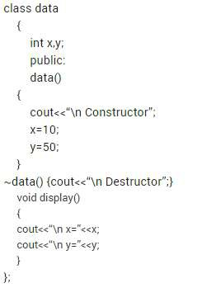

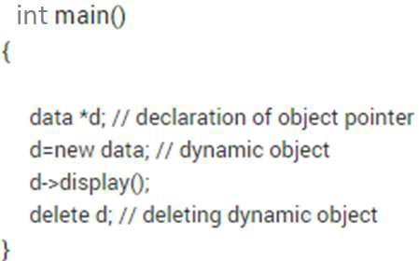


Dynamically Allocated Objects

Slide 46
Dynamically Allocated Objects
The new operator allocates storage of the proper size for an object of type data, calls the default constructor to initialize the object and returns a pointer to the type specified to the right of the new operator (data*).
If new is unable to find sufficient space in memory for the object, it indicated that n error occurred by throwing an exception

Slide 47
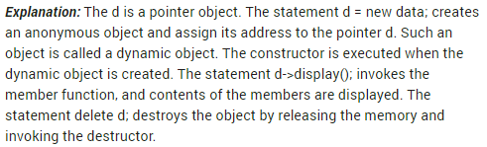
Dynamically Allocated Objects

Slide 48

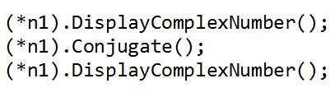
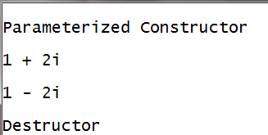
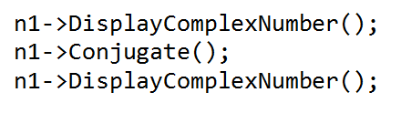

Dynamically Allocated Objects
CS212 Object Oriented Programming in
C++
46

Slide 49
Dynamically Allocated Objects

Slide 50
Dynamic Memory Allocation Hazards
Memory Leaks
A memory leak occurs when you allocate memory using new and fail to release it when you're done with it.
The effect is that your program gradually consumes more and more of the free store, with the program potentially failing at the point when all of the free store has been allocated and yet another request for memory is made.
delete operation at an appropriate place in your program immediately after you've used the new operator.

Slide 51
Summary
Dynamically allocated memory has no scope and will stay allocated until you deallocate it or the program terminates.
Be careful not to dereference dangling or null pointers.

