Slide 1
CS212 – Object Oriented Programming
Polymorphism
Week 10-11
Dr. Khuram Shazhad
mkhuram.shahzad@seecs.edu.pk
Office: A-308

Slide 2
Outline
Inheritance:
Ways to invoke inherited functions
Polymorphism
Casting
Static Binding
Dynamic Binding
Virtual Functions

Slide 3

Inheritance
Lesson 1

Slide 4
Inheritance
What happens when we create a class?
What is a derived class composed of?
It is composed of multiple parts:
one part for each inherited class,
and a part for itself.
derived

Slide 5


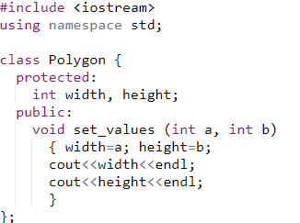
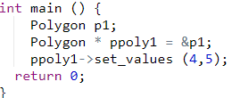
Class Polygon: Example 2
CS212 Object Oriented Programming in
C++
4
5
8

Slide 6

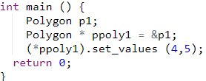
Class Polygon: Example 3
CS212 Object Oriented Programming in
C++
4
5
9

Slide 7
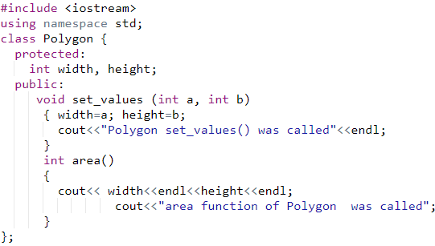
Example 4: Class Polygon
CS212 Object Oriented Programming in ₁₀
C++

Slide 8
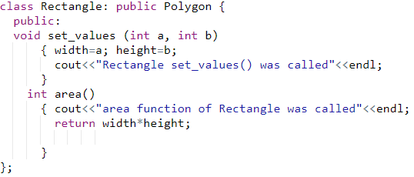
Class Rectangle
CS212 Object Oriented Programming in
_{C++} 11

Slide 9
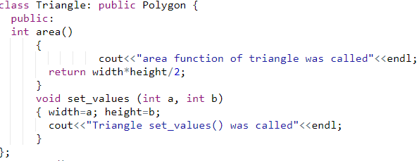
Class Triangle
CS212 Object Oriented Programming in
_{C++} 12

Slide 10
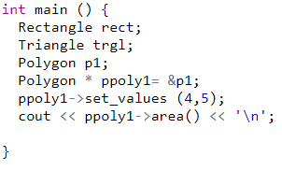
Example 4 Output
Polygon set_values() was
called
area function of Polygon
was called
CS212 Object Oriented Programming in
_{C++} 13

Slide 11
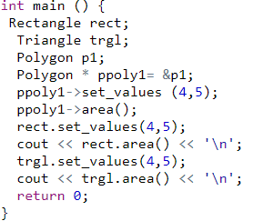
utput
amming in ₁₄
Polygon set_values() was
Example 4 O^{called}
area function of Polygon
was called
Rectangle set_values() was called
area function of Rectangle was called
20
Triangle set_values() was called
area function of triangle
was called 10
CS212 Object Oriented Progr
C++

Slide 12
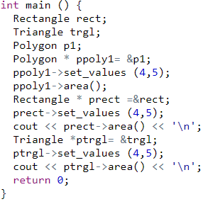
15
Polygon set_values()
Example 4
was called
area function of Polygon
was called
Rectangle set_values() was called
area function of Rectangle was called 20
Triangle set_values() was called
area function of triangle
was called 10
CS212 Object Oriented Programming in
C++

Slide 13
Polymorphism
Lesson 2

Slide 14
Types
Polymorphism
Compile Time
Run Time
Function Overloading
Operator Overloading
Virtual Functions
Function overriding by virtual functions
To achieve polymorphism
Notes:
Two same function in base and derived class, when we create object compiler get confuse which one to call. Therefore we declare base class function as virtual so compiler will not call it.
Function overriding with virtual functions to achieve polymorphism

Slide 15
Function overloading
int main() {
ApnaSchool obj;
obj.fun();
obj.fun(4);
obj.fun(4.5);
return 0;
}
#include <iostream>
using namespace std;
class ApnaSchool
{
public:
void fun()
{
cout<<"no argument"<<endl;
}
void fun(int x)
{
cout<<"int argument"<<endl;
}
void fun(double y)
{
cout<<"double argument"<<endl;
}
};

Slide 16
Operator Overloading
#include <iostream>
using namespace std;
class Complex
{
private:
int real, imag;
public:
Complex(int r=0, int i=0)
{
real=r; imag=i;
}
Complex operator + (Complex const &obj)
{
Complex res;
res.imag = imag + obj.imag;
res.real = real + obj.real;
return res;
}
void display()
{
cout<< real<<" + i" << imag<<endl;
}
};
int main() {
Complex c1(12,7), c2(6,7);
Complex c3 = c1+c2;
c3.display();
return 0;
}

Slide 17
Polymorphism
#include <iostream>
using namespace std;
class base
{
public:
void print(){
cout<<"base class print fun"<<endl;
}
void display(){
cout<<"base class display fun"<<endl;
}
};
class derived: public base
{
public:
void print(){
cout<<"derived class print fun"<<endl;
}
void display(){
cout<<"derived e class display fun"<<endl;
}
};
int main() {
base *baseptr;
derived d;
baseptr = &d;
baseptr -> print();
baseptr -> display();
return 0;
}
base class print fun
base class display fun
How to fix it?

Slide 18
Polymorphism
The process of representing one Form in multiple forms is known as Polymorphism.
Here one form represent original form or original method always resides in base class and multiple forms represent overridden method which resides in derived classes.

Slide 19
Real life Example
Suppose if you are in classroom then at that time you behave like a student
When you are in market at that time you behave like a customer
When you are at your home at that time you behave like a son or daughter.
You are one person and have different types of behaviors at different times.

Slide 20
Types of Polymorphism
One function with same name but with different functionality.
Polymorphism can be static or dynamic
Static polymorphism is also known as early binding or static binding or compile-time polymorphism
Dynamic polymorphism is also known as late binding or dynamic binding or run-time polymorphism

Slide 21
Static Polymorphism
In Static polymorphism or static binding, memory will be allocated at compile-time.
In static polymorphism, object is bound to the function call at the compile time itself.
We can achieve static polymorphism by
Function overloading
operator overloading
function overriding

Slide 22
Dynamic Polymorphism
In Dynamic polymorphism or dynamic binding, memory will be allocated at run-time.
In dynamic polymorphism, object is bound to the function call only at the run time.
We can achieve dynamic polymorphism by
Virtual Functions

Slide 23

Static Binding

Slide 24

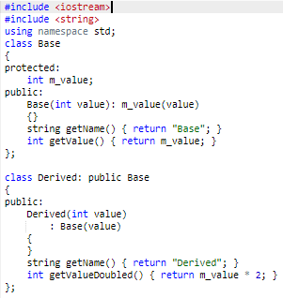
Another Example

Slide 25
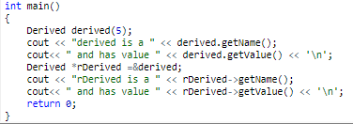
Another Example
This produces the following output: derived is a Derived and has value 5 rDerived is a Derived and has value 5

Slide 26
Inheritance
What happens when we create a class?
What is a derived class composed of?
It is composed of multiple parts:
one part for each inherited class,
and a part for itself.
derived

Slide 27
Casting base class pointer to derived
class object
However, since Derived has a Base part, a more interesting question is whether C++ will let us set a Base pointer (or reference) to a Derived object.
It turns out, we can!

Slide 28
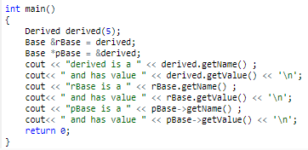
Casting base class pointer to derived
class object
This produces the following output: derived is a Derived and has value 5 rBase is a Base and has value 5 pBase is a Base and has value 5

Slide 29
Casting base class pointer to derived
class object
a base-class pointer can be used to point to an object of any class derived from that base
Pointers to objects of derived class are type
compatible with pointers to objects of base class
CS212 Object Oriented Programming in
C++

Slide 30
Casting base class pointer to derived
class object
As rBase and pBase are a Base reference and pointer, they can only see members of Base (or any classes that Base inherited). So even though Derived::getName() shadows (hides) Base::getName() for Derived objects, the Base pointer/reference can not see Derived::getName().
Consequently, they call Base::getName(), which is why rBase and pBase report that they are a Base rather than a
Derived.
Note that this also means it is not possible to call Derived::getValueDoubled() using rBase or pBase. They are unable to see anything in Derived.

Slide 31
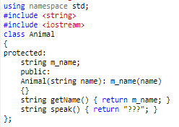
Animal Class example

Slide 32
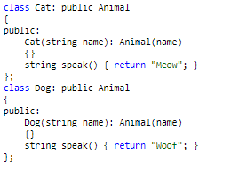
Animal Class child classes

Slide 33
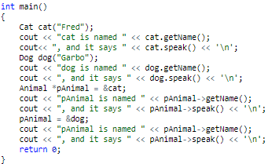
Test Class

Slide 34
Output
cat is named Fred, and it says Meow dog
is named Garbo, and it says
is named Fred, and it says
Woof pAnimal
???
pAnimal is named Garbo, and it says ???

Slide 35
Static Binding
The compiler ignores the contents of pointer
Chooses the member function that matches
the type of pointer
This
is a compile time decision
(called static binding).

Slide 36
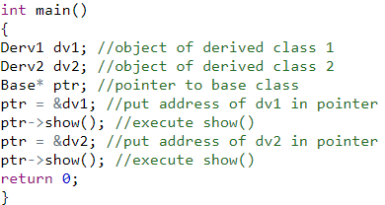
Example Static binding
Base
Base

Slide 37
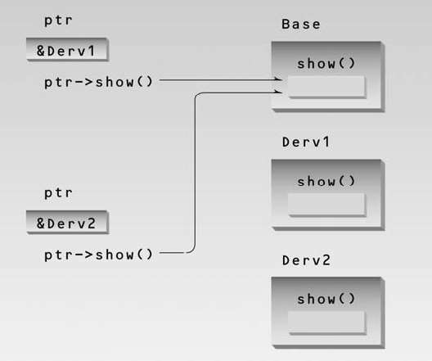
Static Binding/Non Virtual Access
CS212 Object Oriented Programming in
C++

Slide 38

Array of objects

Slide 39
Array of Objects
How to apply some function to all objects of a class?
– Array of objects
CS212 Object Oriented Programming in
C++

Slide 40
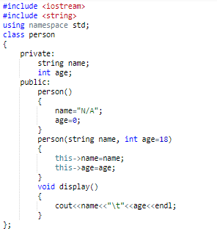
Array of Objects

Slide 41
Array of Objects
Create an array of Persons that holds objects of type Person

Slide 42


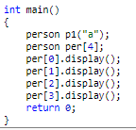
Constructor?
N/A 0
N/A 0
N/A 0
N/A 0

Slide 43

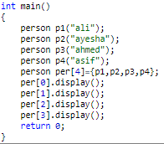
Constructor?
ali
18
ayesha ahmed
18
18
asif
18

Slide 44

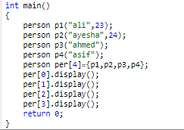
Constructor?
ali
23
ayesha ahmed
24
18
asif
18

Slide 45

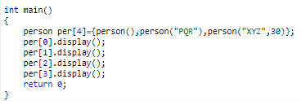
Constructor?
N/A PQR XYZ
N/A
0
18
30
0

Slide 46
Animal Class example

Slide 47
Animal Class child classes

Slide 48
Animal Class - Example
Create Animal Test class that declares 2 arrays of 3 cats and 3 dogs each.
Because arrays can only hold objects of one type, without a pointer or reference to a base class, you’d have to create a different array for each derived type

Slide 49
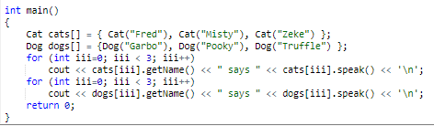
Test Class with Array of Objects

Slide 50

Late Binding

Slide 51
Casting base class pointer to derived
class object
Now, consider what would happen if we had 30 different types of animals.
We’d need 30 arrays, one for each type of
animal!

Slide 52
Late Binding
We took a look at a number of examples where using pointers or references to a base class had the potential to simplify code.
However, in every case, we ran up against the problem that the base pointer or reference was only able to call the base version of a function, not a derived version.
In next lesson, we will show how to address
this issue using virtual functions.

Slide 53

Virtual Functions

Slide 54
Virtual Functions
A virtual function is a function in a base class that is
declared using the keyword virtual.
Defining in a base class a virtual function, with another version in a derived class, signals to the compiler that we don't want static linkage for this function.
Compiler selects the function based on contents of
the pointer, not the type of the pointer (Late Binding)
CS212 Object Oriented Programming in
_{C++} 20

Slide 55
Virtual Functions
When a virtual function is invoked by a base class pointer, the type of object being pointed at determines which version of the function is called.
The keyword virtual is only required in the base class, but many programmers use it in derived classes simply to remind themselves that the function is virtual.
CS212 Object Oriented Programming in
_{C++} 21

Slide 56
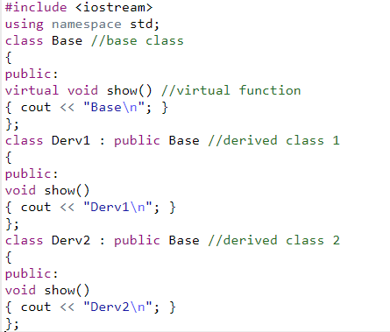
Example 7
CS212 Object Oriented Programming in
_{C++} 22

Slide 57
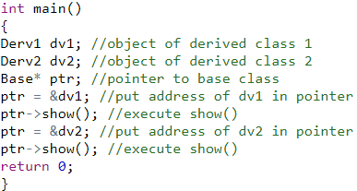
Example 7 Output
Derv1
Derv2
_{C++} 23

Slide 58
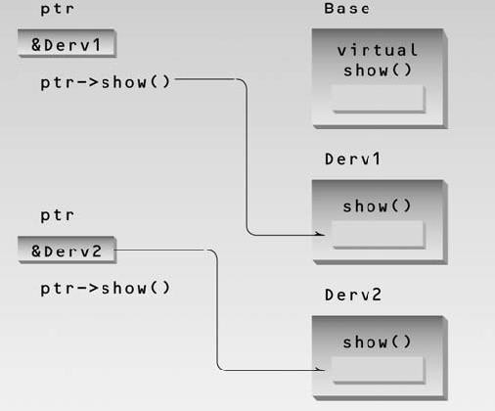
Example 7 Virtual pointer access
CS212 Object Oriented Programming in
C++
24

Slide 59

Polymorphism

Slide 60
Polymorphism
One of the key features of class inheritance is that a pointer to a derived class is type-compatible with a pointer to its base class
– Any child of a class, can be stored in a pointer to that of
a parent
Polymorphism makes use of this feature.
CS212 Object Oriented Programming in
_{C++} 26

Slide 61
Polymorphism
The word polymorphism means having many forms. Polymorphism occurs when there is a hierarchy of classes and they are related by inheritance.
function to be executed depending on the type of object that invokes the function.
C++ polymorphism | means that | a | call to a
member function | will cause | a | different
CS212 Object Oriented Programming in
_{C++} 27

Slide 62
Polymorphism vs. Inheritance
Inheritance is required in order to achieve polymorphism (we must have class hierarchies).
Re-using class definitions via extension and redefinition
Polymorphism is not required in order to achieve
inheritance.
An object of class A acts as an object of class B (an ancestor to A).

Slide 63
Summary: Polymorphism
Put common code and variables up into base classes
Use public inheritance for polymorphism
Polymorphism depends on dynamic binding

Slide 64
Virtual Function – Summary
A virtual function makes its class a polymorphic base class.
Derived classes can override virtual functions.
Virtual functions called through base class pointers will be
resolved at run-time.
The idea is, virtual functions are called according to the type of object pointed or referred, not according to the type of pointer or reference. In other words, virtual functions are resolved late, at runtime.
That is, the contents of the pointer is used instead of its type.
Objects of any of the base and derived classes, may be
instantiated.
CS212 Object Oriented Programming in
_{C++} 30

Slide 65
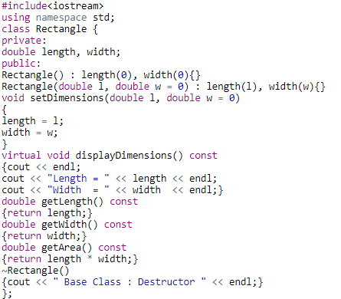
Overridden functions Example 5
CS212 Object Oriented Programming in
C++
31

Slide 66
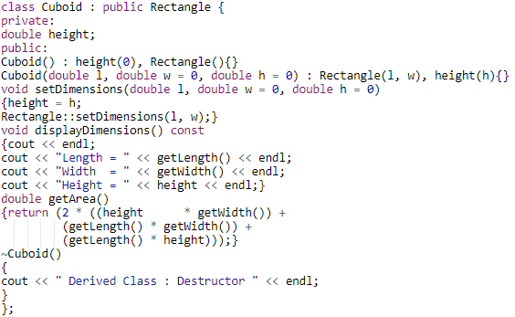
Overridden functions Example 5
Cuboid Class

Slide 67
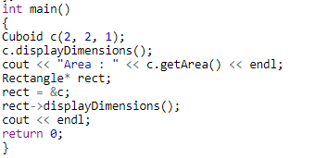
Overridden functions Example 5 with
Virtual Function Output
Length = 2
Width = 2
Height = 1
Area : 16
Length = 2
Width = 2
Height = 1
Derived Class : Destructor Base Class : Destructor
CS212 Object Oriented Programming in
_{C++} 33

Slide 68
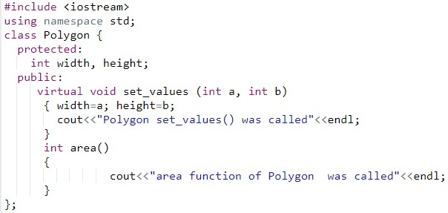
Example 6a- Class Polygon with 1 Virtual Function

Slide 69
Example 6a- Class Rectangle
_{C++} 35

Slide 70
Example 6a- Class Triangle
_{C++} 36

Slide 71
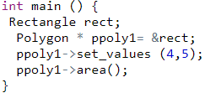
Example 6a- Class Polygon with 1
Virtual Function Output
Rectangle set_values() was called
area function of
Polygon was called
CS212 Object Oriented Programming in ₃₇
C++

Slide 72
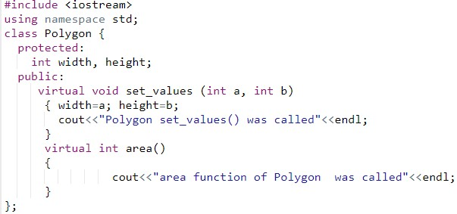
Example 6b- Class Polygon with 2 Virtual Functions

Slide 73
Example 6b- Class Polygon with 2
Virtual Functions
Output
Rectangle set_values() was called
area function of Rectangle was called
CS212 Object Oriented Programming in
C++ ³
9

