Slide 1
CS212 – Object Oriented Programming
Abstract Classes
Week 10-11
Dr. Khuram Shazhad
mkhuram.shahzad@seecs.edu.pk
Office: A-308

Slide 2
Outline
Abstract Classes
Pure Virtual Function
Abstract Classes

Slide 3
Pure Virtual Function
A pure virtual function is a virtual function whose declaration ends with = 0 e.g.
class Data {
// ...
virtual void function() = 0;
// ...
};
OR
class Data {
// ...
virtual float calculateArea() = 0;
// ...
};
40

Slide 4
Pure Virtual Function
The equal sign here has nothing to do with assignment; the value 0 is not assigned to anything.
The =0 syntax is simply how we tell the compiler that a virtual function will be pure.
41

Slide 5
Pure Virtual Function
How can we make it clear to someone using our family of classes that we don’t want anyone to instantiate objects of the base class?
– We could just say this in the documentation, and count on the users of the class to remember.
How can we can do that? By placing at least one pure virtual function in the base class.
42

Slide 6
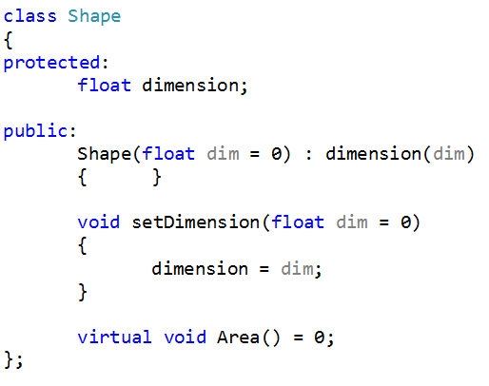
Example 8 – Abstract Class
CS212 Object Oriented Programming in
_{C++} 43

Slide 7
Abstract Class
The purpose of an abstract class is to provide an appropriate base class from which other classes can inherit.
Abstract classes cannot be used to instantiate objects and serves only as an interface.
Attempting to instantiate an object of an abstract
class causes a compilation error.
CS212 Object Oriented Programming in
_{C++} 44

Slide 8
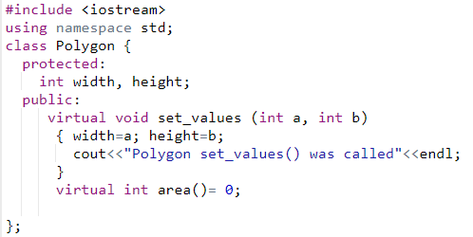
Example 9- Abstract Class Polygon
45

Slide 9
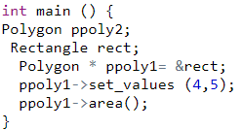
Example 9- Attempting to instantiate an object of an abstract class: Output Error

Slide 10
Example 9- Attempting to instantiate
an object of an abstract class: Output
Error
Now if in main() you attempt to create objects of
class Base, the compiler will complain that you’re trying to instantiate an object of an abstract class. It will also tell you the name of the pure virtual function that makes it an abstract class.
CS212 Object Oriented Programming in
C++

Slide 11
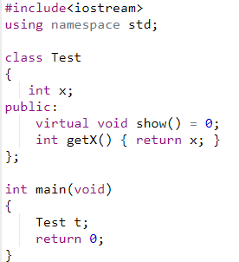
Example
CS212 Object Oriented Programming
C++
in

Slide 12
Abstract Class
If a subclass of an Abstract Class needs to be instantiated, it has to implement each of the virtual functions
– which means that it supports the interface declared by the ABC.
Failure to override a pure virtual function in a derived class, then attempting to instantiate objects of that class, is a compilation error.
If we do not override the pure virtual function in derived class, then derived class also becomes abstract class.
Classes that can be used to instantiate objects are
called concrete classes
CS212 Object Oriented Programming in
C++

Slide 13
Example 11- Abstract Class Polygon
CS212 Object Oriented Programming in
C++

Slide 14
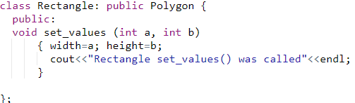

Example 11- Failure to override a pure virtual function in a derived class

Slide 15
Example 11- Failure to override a pure virtual function in a derived class
Once you’ve placed a pure virtual function in the base class, you must override it in all the derived classes from which you want to instantiate objects.
If a class doesn’t override the pure virtual function, it becomes an abstract class itself, and you can’t instantiate objects from it (although you might from classes derived from it).
For consistency, you may want to make all the virtual functions in the base class pure.
CS212 Object Oriented Programming in
C++

Slide 16
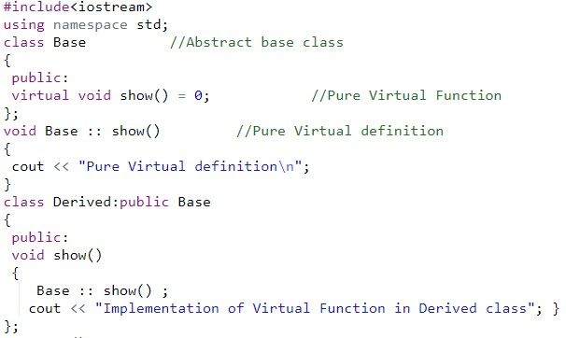
Example 12: Pure virtual Function Definition

Slide 17
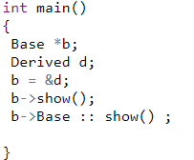
Example 12 Output
Pure Virtual definition
Implementation of Virtual Function in Derived class
Pure Virtual definition
CS212 Object Oriented Programming in
C++

Slide 18
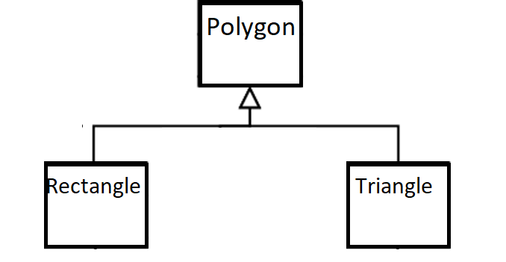
Class Polygon Example 13
CS212 Object Oriented Programming in
C++

Slide 19
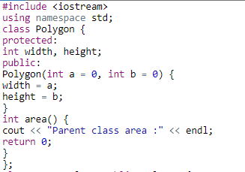
Example 13 Class Polygon
CS212 Object Oriented Programming in
C++

Slide 20
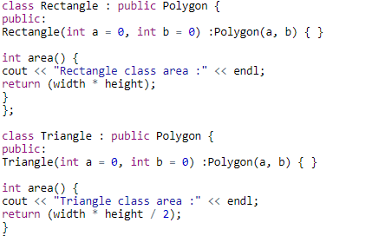
Example 13 Class Rectangle and Triangle

Slide 21
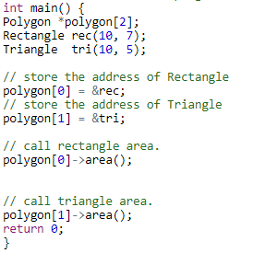
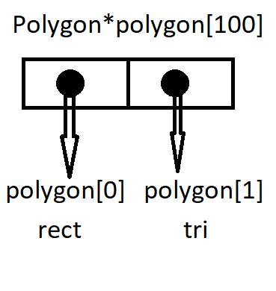
Example 13 Using Arrays
CS212 Object Oriented Programming in
C++
Parent class area
Parent class area

Slide 22
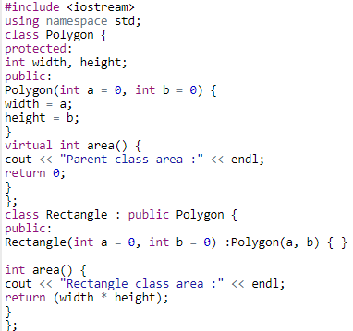
Example 14 Class Polygon 1 virtual Function

Slide 23
Example 14 Class Rectangle and Triangle

Slide 24
Example 14 Using Arrays
CS212 Object Oriented Programming in
C++
Rectangle class
area : Triangle class area :

Slide 25
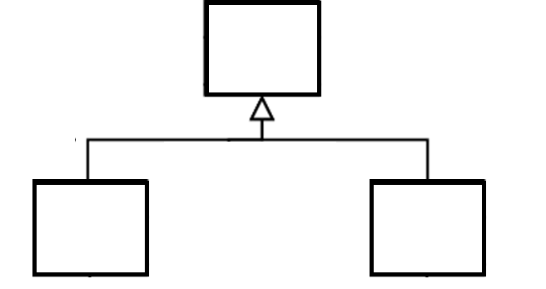
Example 15
Base
Derv1
Derv2
CS212 Object Oriented Programming in
C++

Slide 26
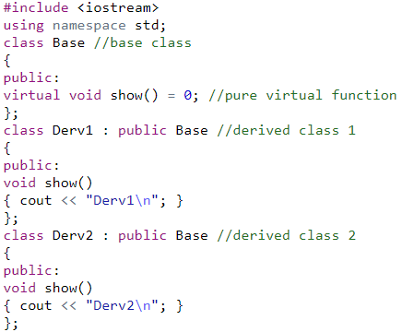
Example 15
CS212 Object Oriented Programming in
C++

Slide 27
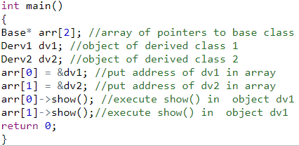
Example 15 Using Arrays- Output
Derv1 Derv2
CS212 Object Oriented Programming in
C++

Slide 28
Class Polygon Example 16
CS212 Object Oriented Programming in
C++

Slide 29
Class Polygon Example 16
Make an Abstract Class Polygon
Width
Height
Area()
Set_values()

Slide 30
Class Polygon 1 virtual Function

Slide 31
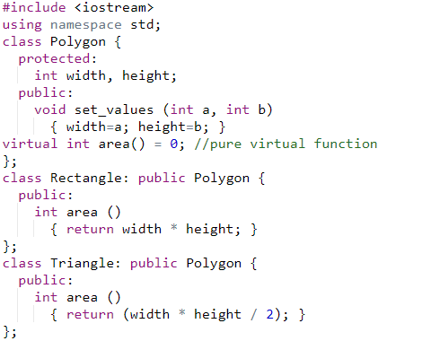
Example 16- Abstract Class Polygon
CS212 Object Oriented Programming in
C++

Slide 32
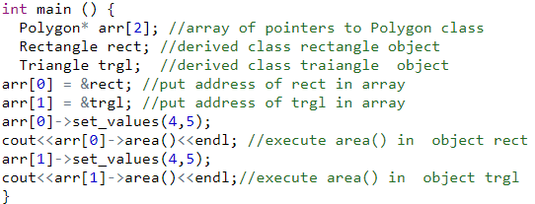
Example 15- Using Arrays Output
20
10

