Slide 1

Object Oriented Programming
CS212
File Processing in C++ by Dr. Khuram Shazhad

Slide 2
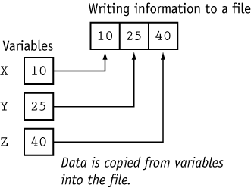
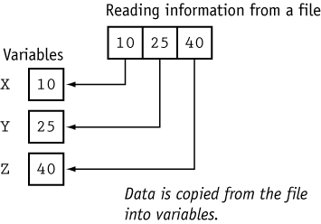
File Processing

Slide 3
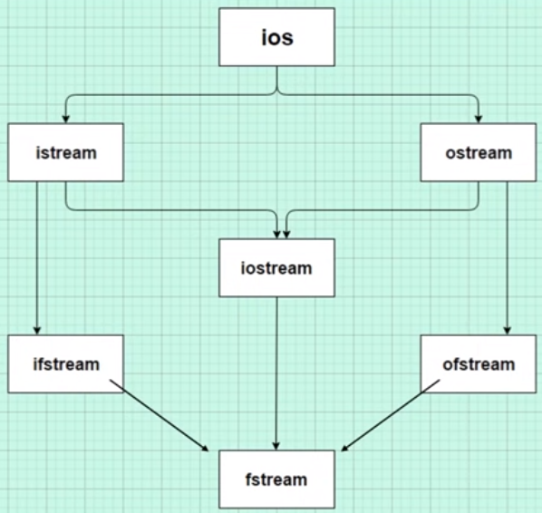
File Processing

Slide 4
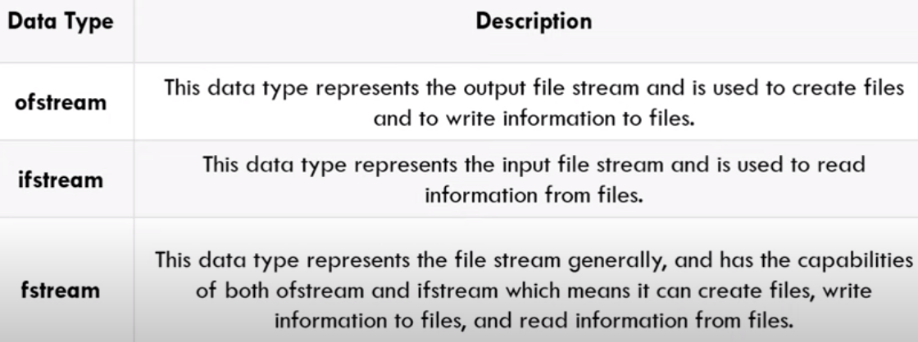
Files in C
 The old C functions, such as fread() and fwrite(), will still work in C++, but they are not so well suited to the object-oriented environment.
 The new C++ approach is considerably cleaner and
easier to implement

Slide 5
File Output
The steps are:
Construct an ostream object.
Connect it to a file (i.e., file open/constructor) and set the
mode of file operation
Perform output operation via << operator
or functions( write(), put() ).
Disconnect (close the file which flushes the output buffer)
and free the ostream object

Slide 6
Open a File
 The first operation generally performed on an object of one of these classes is to associate it to a real file. This procedure is known as to open a file.
 By default, opening an output file creates a new file if the filename does not exist; or truncates it (clear its content) and starts writing as an empty file.

Slide 7
Open a File:Mode
ios::in | Open for input operations.
ios::out | Open for output operations.
ios::binary | Open in binary mode.
ios::ate | Set the initial position at the end of the file. If this flag is not set, the initial position is the beginning of the file.
ios::app | All output operations are performed at the end of the file, appending the content to the current content of the file.
ios::trunc | If the file is opened for output operations and it already existed, its previous content is deleted and replaced by the new one.
11
CS212 Object Oriented Programming in C++

Slide 8
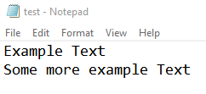
Example 1 Write
#include <iostream> //for I/P and O/P on console
#include <fstream> //for read and write
using namespace std;
int main()
{
fstream myFile;
myFile.open("test.txt", ios::out); //write mode
if(myFile.is_open())
{
//cout<<"Example Text\n";
myFile <<"Example Text\n";
myFile <<"Some more example Text\n";
myFile.close();
}
system("pause>0");
}
Notes:
#include <iostream> //for input and output
#include <fstream> //for read and write
using namespace std;
int main()
{
fstream myFile;
myFile.open("test.txt", ios::out); //write mode
if(myFile.is_open())
{
//cout<<"Example Text\n";
myFile <<"Example Text\n";
myFile <<"Some more example Text\n";
myFile.close();
}
system("pause>0");
}

Slide 9

Example 2 Append?
#include <iostream> //for I/P and O/P on console
#include <fstream> //for read and write
using namespace std;
int main()
{
fstream myFile;
myFile.open("test.txt", ios::out); //write mode
if(myFile.is_open())
{
myFile <<"Example Text 1\n";
myFile.close();
}
myFile.open("test.txt", ios::out); //write mode
if(myFile.is_open())
{
myFile <<“Append Text 2\n";
myFile.close();
}
system("pause>0");
}
Notes:
#include <iostream> //for input and output
#include <fstream> //for read and write
using namespace std;
int main()
{
fstream myFile;
myFile.open("test.txt", ios::out); //write mode
if(myFile.is_open())
{
//cout<<"Example Text\n";
myFile <<"Example Text\n";
myFile <<"Some more example Text\n";
myFile.close();
}
system("pause>0");
}

Slide 10
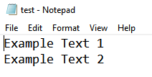
Example 3 Append?
#include <iostream> //for I/P and O/P on console
#include <fstream> //for read and write
using namespace std;
int main()
{
fstream myFile;
myFile.open("test.txt", ios::out); //write mode
if(myFile.is_open())
{
myFile <<"Example Text 1\n";
myFile.close();
}
myFile.open("test.txt", ios::app); //write mode
if(myFile.is_open())
{
myFile <<“Append Text 2\n";
myFile.close();
}
system("pause>0");
}
Notes:
#include <iostream> //for input and output
#include <fstream> //for read and write
using namespace std;
int main()
{
fstream myFile;
myFile.open("test.txt", ios::out); //write mode
if(myFile.is_open())
{
//cout<<"Example Text\n";
myFile <<"Example Text\n";
myFile <<"Some more example Text\n";
myFile.close();
}
system("pause>0");
}

Slide 11
Open a File:Mode
class | default mode parameter
ofstream | ios::out
ifstream | ios::in
fstream | ios::in | ios::out
All these flags operator OR (|).
can be combined
using
the bitwise

Slide 12
File Input
The steps are:
Construct an ifstream object.
Connect it to a file (i.e., file open/constructor) and set the
mode of file operation
Perform input operation via >> operator
or functions(read(), get(), getline() functions.)
Disconnect (close the file which flushes the output buffer)
and free the ostream object

Slide 13

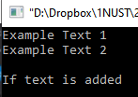
Example 4 Read
#include <iostream>
#include <fstream>
#include <string> //getline function
using namespace std;
int main()
{
fstream myFile;
myFile.open("test.txt", ios::in); //read mode
if(myFile.is_open())
{
string line;
while (getline(myFile,line))
{
cout<< line <<endl;
}
myFile.close();
}
system("pause>0");
}
“If the text is added” added
manually in text.txt?
Notes:
#include <iostream> //for I/P and O/P on console
#include <fstream> //for read and write
#include <string> //for getline function
using namespace std;
int main()
{
fstream myFile;
myFile.open("test.txt", ios::in); //read mode
//input from test.txt to this program
if(myFile.is_open())
{
string line;
while (getline(myFile,line))
// read and write out the text line by line
//by storing text in string line
{ cout<< line <<endl; }
myFile.close();
}
system("pause>0");
}

Slide 14
Formatted File I/O
 In formatted I/O, numbers are stored on disk as a
series of characters.
 Thus 6.02, rather than being stored as a 4-byte type float or an 8-byte type double, is stored as the characters ‘6’, ‘.’, ‘0’, and ‘2’.
 This can be inefficient for numbers with many digits, but it’s appropriate in many situations and easy to implement.
 Characters and strings are stored more or less
normally.

Slide 15

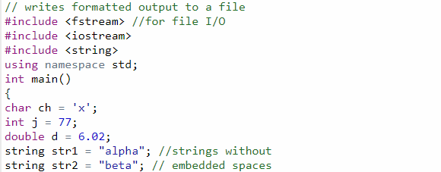
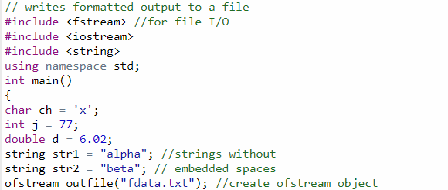
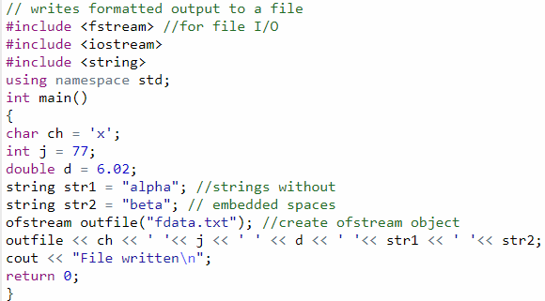
Example 5

Slide 16
Output
 The program writes a character, an integer, a type
double, and two string objects to a disk file.
File Written
x 77 6.02 alpha beta

Slide 17


Example 6
#include <iostream> //for I/P and O/P on console
#include <fstream> //for read and write
#include <string> //for getline function
using namespace std;
int main()
{
int account;
string name;
double balance;
ofstream myFile("client.txt");
cout<<"enter data";
cin >>account>>name>>balance;
myFile <<account<<','<<name<<','<<balance<<endl;
}

Slide 18
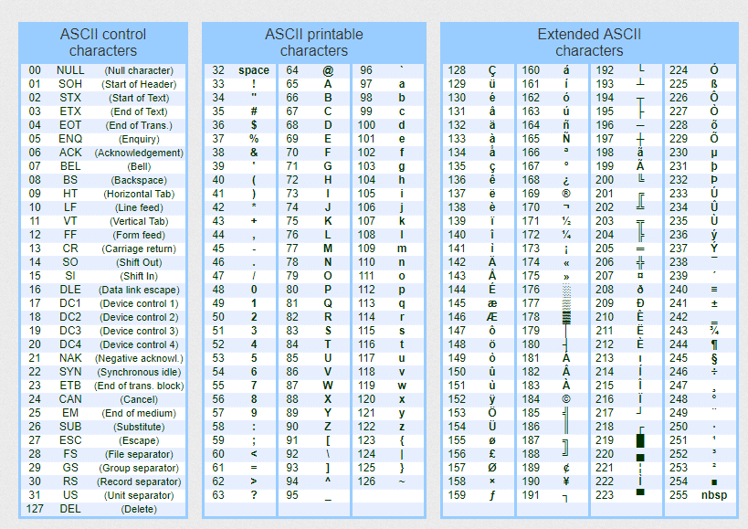
ASCII Table

Slide 19


Text Ciphering – Example 7 and 8
#include <iostream>
using namespace std;
int main()
{
cout<< int('a') <<endl;
cout<< (int)'a' <<endl;
cout<< (int)'A' <<endl;
cout<< (int)'1' <<endl;
cout<< (int)'(' <<endl;
cout<< (int)'=' <<endl;
system("pause>0");
}
#include <iostream>
using namespace std;
int main()
{
cout<< char(97)<<endl;
cout<< char(97)<<endl;
cout<< char(65) <<endl;
cout<< char(49)<<endl;
cout<< char(40)<<endl;
cout<< char(61)<<endl;
system("pause>0");
}

Slide 20
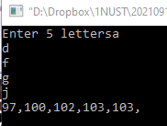
Example 9 – lets cipher a 5 letters word
#include <iostream>
using namespace std;
int main()
{
char c1, c2, c3, c4, c5;
cout<<"Enter 5 letters";
cin>>c1>>c2>>c3>>c4>>c5;
cout<<int(c1)<<','<<int(c2)<<','<<int(c3)<<','<<int(c4)<<','<<int(c4)<<',';
system("pause>0");
}

Slide 21
Assignment 2
Combine the knowledge from file handing and ASCII table
Write your diary/story/secret in a file
Cipher the file using ASCII table so if anyone open that file no one could read it instead see only numbers
Create a program which is going to read from that file. It should convert back numbers into letters (Decipher) and write that text to the console
User should input a story, program cipher story (write sometextfile.txt), and decipher it to the console
Due date: 16 December - a file containing (program and output) deliverable on link that will be provided and in prints in the class.

