Slide 1
CS212 – Object Oriented Programming
Template Functions
Generic functions and Templates
Week – 14
Dr. Khuram Shazhad
mkhuram.shahzad@seecs.edu.pk
Office: A-308

Slide 2
Lecture Outline
Approaches for functions that implement identical tasks for different data types
Function Templates
These define logic behind the algorithms that
work for multiple data types.
Single Parameters
Double Parameters

Slide 3
Templates in C++
Template is simple but very powerful tool in C++
Templates are the enablers of generic programming – coding that is independent of any particular data type.
A template is blueprint or formula for creating generic function or a class
Types
Function templates
Class templates

Slide 4
Function Templates in C++
Function templates are special functions that can operate with generic types
This property enable us to create a function template which can be adapted to more than one type or class without repeating the entire code for each data type separately
Working – pass the data type as a parameter so that we do not need to write same code for different data types – polymorphic behavior
We write a generic function that accept different data types

Slide 5
Approaches for writing Functions
Different approaches for functions that implement identical tasks for different data types
Naïve Approach
Function Overloading
Function Template

Slide 6
Approach 1: Naive Approach
Create unique functions with unique names for each combination of data types:
difficult to keeping track of multiple function names
lead to programming errors

Slide 7
Finding the Maximum of Two Integers
Naive Approach
Here’s a small function that you might write to find
the maximum of two integers.
int maximum(int a, int b, int c)
{
int max = a;
if (b > max) max = b; if (c > max) max = c; return max;
}

Slide 8
Finding the Maximum of Two Floats
Naive Approach
Here’s a small function that you might write to find
the maximum of two float numbers.
float maximum(float a, float b, float c)
{
float max = a;
if (b > max) max = b; if (c > max) max = c; return max;
}

Slide 9
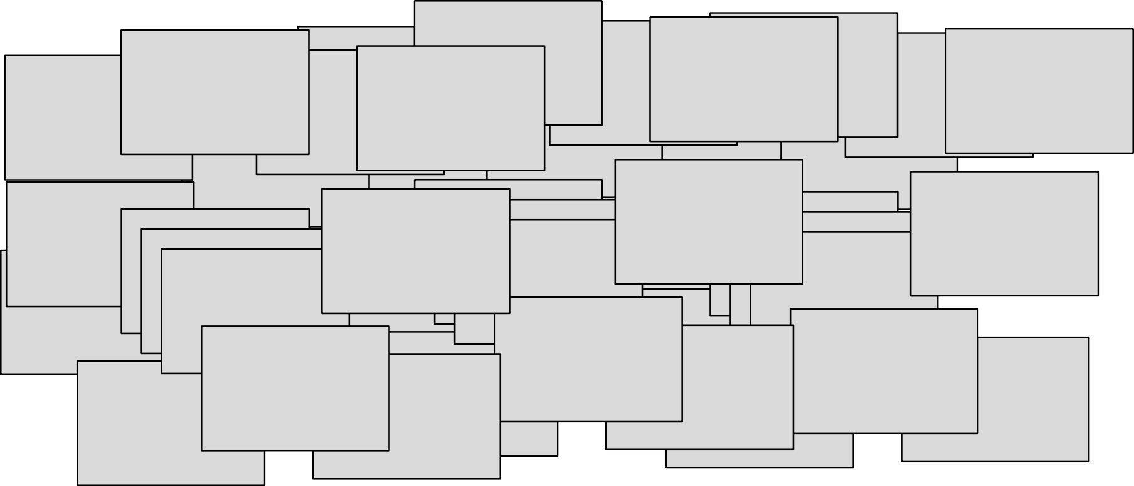
One Hundred Million Functions...
Naive Approach
Suppose your program uses 100,000,000 different data types, and you need a maximum function for
each...
int maximum(Hoo a, Hoo b)
{
_{oo b)} int maxim
{
if (a >
retu
nt maximum( _{else}
retu
if (a > b) }
int maximum(Hoo a, Hoo b)
{
if (a > b)
_{oo b)} int maxim
{
if (a > retu
nt maximum( _{else}
retu
if (a > b) }
int m
{
int maximum(Noo a, N _{if}
{
Foo a, Foo b) ^{e}
;
}
aximum(Hoo a, Hoo
a, Moo b)
(a > b) return a; lse
return b;
return a
b)
i
{
um(Moo
int maximum(Doo a, Doo b)
{
if (a > b)
return a;
else
return b;
}
a, Moo b)
i
_{oo b)} int maxim
{
if (a > retu
nt maximum( _{else}
retu
if (a > b) }
nt maximum(Noo a, N
int maximum(Doo a, Doo b)
{
if (a > b)
return a;
else
return b;
}
Foo a, Foo b)
{
if (a > b) _{el}
return a;
else }
Foo a, Foo b)
Poo a, Poo b)
return a;
a, Moo b) _{se}
return b;
return a else
return b;
i
{
um(Moo
i
{
um(Moo
int maximum(Doo a, Doo b)
{
if (a > b) return a;
else
return b;
}
b)
rn a;
int maximum(Noo a, N
{
if (a > b) return a;
else
return b;
}
if (a > b) return a;
else
return b;
if (a > b) return a
else
return b;
}
int maximum
{
b) rn a;
b) rn a;
rn b;
}
return b;
}
int maximum(
{
if (a > b) return a
else
;
rn b;
rn b;
;
return a; else
return b;
}
int maximum(Knafn a, Knafn b)
{
if (a > b) return a;
else
return b;
int maximum(Boo a, Boo b)
}
int maximum(Knafn a, Knafn b)
{
if (a > b) return a;
int maximum(Koo
; { int maximum(
if (a > b)
{
return b; retu^{in}rn^{t m}a;^{axim}
if (a > b)
^{else {}return a;
returnib;f (a >
^{else} retur
} return b;
else
n b; } r
in
a, Koo b) Joo a, Joo b)
um(Ioo a, Ioo b)
{
(Poo a, Poo b)
}
int maximum(Boo a, Boo b)
{
if (a > b) return a;
else
return b;
}
int maximum(Poo a, Poo b)
{
int maximum(Boo a, Boo b)
{
if (a > b) return a;
else
return b;
}
_{if (a}i>f (_{b}a₎> b)
return a;
Knafn b)
}
}
int maximum(Koo a, Koo b)
if (a > b) return a;
else
return b;
int maximum(Koo a, Koo b)
return a;
{
if (a > b) return a;
else
return b;
{
if (a > b)
return a; else
return b; els
else
else
int maximum(Joo a, Joo b)
int maximum(Joo a, Joo b)
int maxriemtuur^{r}mn^{et}(b^{u}K;^{rn}na^{b}f;n a,
{
if (a > b) return a;
else
return b;
oo a, Loo b)
{
if (a > b)
return a; _{e}
^{else} retur
return b;
oo a, Loo b)
b)
n a;
{}
}
if (a > b) return a;
int maximum(Ioo a, Ioo b)
{
if (a > b) return a;
else
}
int maximum(Ioo a, Ioo b)
{
if (a > b) return a;
else
}
eturn b; else
return b;
}
_{b)} int maximum(Goo
{
if (a > b) return a;
else
return b;
}
}
else
return b;
}
t maximum(Coo a, Coo b)
}
r
eturn b;
int maximum(Goo
{
if (a > b)
return a;
else
return b;
}
}
^{r} int maximum(Coo a, Coo b)
{
if (a > b)
return a; else
return b;
}
{
}
int maximum(L
{
if (a > b) return a;
else
return b;
}
int maximum(Coo a, Coo b)
{
if (a > b) return a;
else
return b;
}
}
}
eturn b;
int
int maximum(Goo
{
if (a > b) return a;
else
return b;
}
maximum(Loo a, Loo a, Goo b)
if (a > b) return a;
else
return b;
a, Goo b)
a, Goo b)
int maximum(L
{
if (a > b) return a;
else
return b;
}
{
if (a > b) return a;
else
return b;
}
}

Slide 10
Approach 2: Function Overloading
The use of the same name for different C++ functions, distinguished from each other by their parameter lists
Eliminates need to come up with many different
names for identical tasks.
Reduces the chance of unexpected results caused by using the wrong function name.

Slide 11
Example 1 of Function Overloading
void Print(
{
cout << cout <<
}
void Print(
{
cout << cout <<
}
void Print(
{
int n )
"***Debug" << endl; "Value is " << n << endl;
char ch )
"***Debug" << endl; "Value is " << ch << endl;
float x )
}

Slide 12
Approach 3: Function Template
A C++ language construct that allows the compiler to generate multiple versions of a function by allowing parameterized data types.

Slide 13
Function Template Syntax
template largely uses the angle brackets:
The less than ( < ) and the greater than ( > ) operators.
For templates, they are always used together
in this form:

Slide 14
Approach 3: Function Template Example
template<class
SomeType>
Template parameter
(class, user defined
type, built-in types)
void Print( SomeType
{
val )
cout << "Value is " <<
}
val << endl;

Slide 15
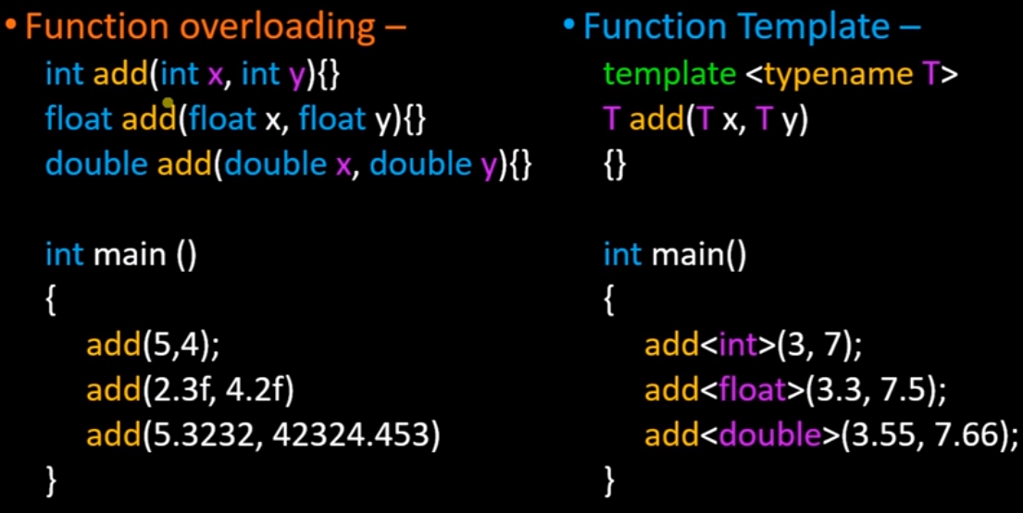
Example 2
Notes:
//Function overloading
#include <iostream>
using namespace std;
int add(int x, int y)
{
return (x+y);
}
int add(float x, float y)
{
return (x+y);
}
int add(double x, double y)
{
return (x+y);
}
int main()
{
cout<<"addition of x and y: "<<add(3,4);
return 0;
}

Slide 16
Example 3.1 – Function Templates
#include <iostream>
using namespace std;
template <typename T>
T add (T x, T y)
{
return (x+y);
}
int main()
{
cout<<"addition of x and y: "<<add<int>(3,4);
return 0;
}
#include <iostream>
using namespace std;
int add(int x, int y) {
return (x+y);
}
int add(float x, float y) {
return (x+y);
}
int add(double x, double y) {
return (x+y);
}
int main()
{
cout<<"addition of x and y: "<<add(3,4);
return 0;
}

Slide 17
Example 3.2 – Using Different data types
#include <iostream>
using namespace std;
template <typename T>
T add (T x, T y)
{
return (x+y);
}
int main()
{
cout<<"addition of x and y: "<<add<int>(3.4f,4.4f);
return 0;
}
#include <iostream>
using namespace std;
template <typename T>
T add (T x, T y)
{
return(x+y);
}
int main()
{
cout<<"addition of integer x and y: "<<add<int>(3,4)<<endl;
cout<<"addition of float x and y: "<<add<float>(3.4f,4.4f)<<endl;
cout<<"addition of double x and y: "<<add<double>(3.44,4.44);
return 0;
}

Slide 18
Function Templates with Multiple
Arguments
template <class atype>
int find(atype a, atype b, int size)
{
….
}

Slide 19
More Than One Template
Argument
template <class atype, class btype> int find(atype a, btype b)
{
….
}

Slide 20
More Than One Template
Argument
We can also define function templates that accept more than one type parameter, simply by specifying more template parameters between the angle brackets. For example:
template <class T, class U> T GetMin (T a, U b) { return (a<b?a:b);
}

Slide 21
Example 3.3 – Switching data types
#include <iostream>
using namespace std;
template <typename T>
T add (T x, T y)
{
return (x+y);
}
int main()
{
cout<<"addition of x and y: "<<add<int>(3.4f,4.4f);
return 0;
}
#include <iostream>
using namespace std;
template <typename T, typename U>
U add (T x, U y)
{
return(x+y);
}
int main()
{
cout<<"addition of integer x and y: "<<add<int,double>(3,4.4;
return 0;
}

Slide 22
Example 2 - Explained
Here, actual type of TYPE would be deduced (determined) by the compiler depending on argument passed to the function.
If PrintTwice is called as PrintTwice(144);
it would be an int,
if you pass 3.14 to this function,
TYPE would be deduced as double type.

Slide 23
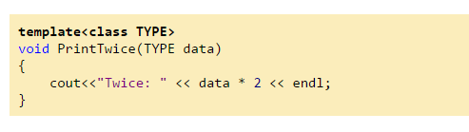
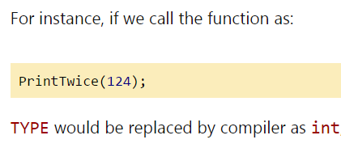
Template Function: PrintTwice

Slide 24


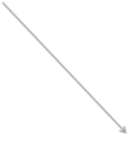


How Compiler Handles Template Functions ?

Slide 25

How Compiler Handles Template Functions ?
It means, in your program, if you call PrintTwice function with int and double parameter types,
– two instances of this function would be generated by compiler:

Slide 26
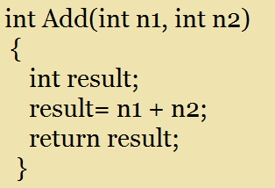
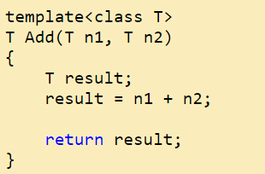
Essentially, the compiler would have to compile the template code
in two phases:
Once for basic syntax checks;
and later for each instantiation of function template

Slide 27
A Template Function for Maximum
This template function can be used with many data types.
Template <class T>
T maximum(T a, T b, T c)
{
T max = a;
if (b > max) max = b; if (c > max) max = c; return max;
}

Slide 28
A Template Function for Maximum
A template prefix is needed immediately before the function’s implementation:
template <class Item>
Item maximum(Item a, Item b)
{
if (a > b)
return a;
else
return b;
}

Slide 29
A Template Function for Maximum
When you write a template function, you choose a data type for the function to depend upon...
template <class Item>
Item maximum(Item a, Item b)
{
if (a > b)
return a;
else
return b;
}

Slide 30
Using a Template Function
Once a template function is defined, it may be used with any adequate data type in your program...
template <class Item>
Item maximum(Item a, Item b)
{
if (a > b)
return a;
else
return b;
}

Slide 31
Example 4
int abs(int n)
{ return (n<0) ? -n : n;}
float abs(float n)
{ return (n<0) ? -n : n;}
template <class T> T abs(T n)
{ return (n < 0) ? -n : n; }

Slide 32

Swapping two variables Example 5.1
#include <iostream>
using namespace std;
void Swap(int& a, int& b)
{
int temp=a;
a=b;
b=temp;
}
void Swap(char& a, char& b)
{
char temp=a;
a=b;
b=temp;
}
int main()
{
int a=5, b=6;
cout<<"Before Swap:"<< a << " , " << b <<endl;
Swap(a, b);
cout<<"After Swap:"<< a << " , " << b <<endl;
char c='c', d='d';
cout<<"Before Swap:"<< c << " , " << c <<endl;
Swap(c, d);
cout<<"After Swap:"<< c << " , " << c <<endl;
}

Slide 33
See problem? Generics! Example 5.2
#include <iostream>
using namespace std;
int main()
{
template <typename T>
void Swap (T& a, T& b)
{
T temp=a;
a=b;
b=temp;
}
void Swap(int& a, int& b)
{
int temp=a;
a=b;
b=temp;
}
void Swap(char& a, char& b)
{
char temp=a;
a=b;
b=temp;
}
int a=5, b=6;
cout<<"Before Swap:"<< a << " , " << b <<endl;
Swap(a, b);
cout<<"After Swap:"<< a << " , " << b <<endl;
char c='c', d='d';
cout<<"Before Swap:"<< c << " , " << c <<endl;
Swap(c, d);
cout<<"After Swap:"<< c << " , " << c <<endl;
}

Slide 34
Example 5.3
int a=5, b=6;
cout<<"Before Swap:"<< a << " , " << b <<endl;
Swap<int>(a, b);
cout<<"After Swap:"<< a << " , " << b <<endl;
char c='c', d='d';
cout<<"Before Swap:"<< c << " , " << c <<endl;
Swap<char>(c, d);
cout<<"After Swap:"<< c << " , " << c <<endl;
}
#include <iostream>
using namespace std;
int main()
{
template <typename T>
void Swap (T& a, T& b)
{
T temp=a;
a=b;
b=temp;
}
template <class Type>
void Swap (Type& a, Type& b)
{
Type temp=a;
a=b;
b=temp;
}

Slide 35
Which one is more efficient in terms of RAM?
Simplifying the Listing:
– Notice that the amount of RAM used by the program is the same whether we use the template approach or actually write three separate functions. The template approaches simply saves us from having to type three separate functions into the source file. This makes the listing shorter and easier to understand. Also, if we want to change the way the function works, we need to make the change in only one place in the listing instead of three places

