Slide 1
CS212 – Object Oriented Programming
Exceptions
Week – 14
Dr. Khuram Shazhad
mkhuram.shahzad@seecs.edu.pk
Office: A-308

Slide 2

Working example
#include <iostream>
using namespace std;
int main()
{
int numerator, denominator, result;
cout<<"Enter Num. and deno. : "<<endl;
cin>>numerator>>denominator;
int result = numerator / denominator;
cout<<"Division is: "<<result;
return 0;
}
What if we divide by zero?

Slide 3

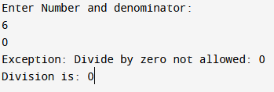
Working example
#include <iostream>
using namespace std;
int main()
{
int numerator, denominator, result;
cout<<"Enter Number and denominator: "<<endl;
cin>>numerator>>denominator;
try
{
if(denominator==0)
{
throw denominator;
}
result = numerator / denominator;//division
}
catch (int ex)
{
cout<<"Exception: Divide by zero not allowed: "<<ex;
}
cout<<"Division is: "<<result;
return 0;
}
#include <iostream>
using namespace std;
int main()
{
int numerator, denominator, result;
cout<<"Enter Num. and deno. : "<<endl;
cin>>numerator>>denominator;
int result = numerator / denominator;
cout<<"Division is: "<<result;
return 0;
}

Slide 4
Working example
#include <iostream>
using namespace std;
int main()
{
int numerator, denominator, result;
cout<<"Enter Number and denominator: "<<endl;
cin>>numerator>>denominator;
try
{
if(denominator==0)
{
throw denominator;
}
result = numerator / denominator;//division
}
catch (int ex)
{
cout<<"Exception: Divide by zero not allowed: "<<ex;
}
cout<<"Division is: "<<result;
return 0;
}
Try Block
Catch Block

Slide 5
Exceptions
Occasionally functions don′t work properly —
even for seasoned C++ programmers.
The traditional means of reporting failure is to
return some indication to the caller.
C++ includes a mechanism for capturing and handling errors called exceptions.
The
handling of error conditions with
exceptions is a key concept to understand.

Slide 6
Exceptions in Real life
In football, if a player has committed a foul, the referee will throw a flag on the ground and whistle the play dead.
A penalty is then assessed and executed.
Once a referee has thrown a penalty flag, what happens next? The players notice that a penalty has occurred and stop play. The normal flow of the football game is disrupted.
Once the penalty has been taken care of, play generally resumes as normal.

Slide 7
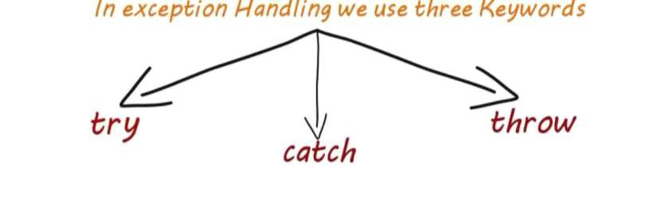
Exceptions: Keywords
A function tries to get through a piece of code. If the code detects a problem, it throws an error indication that the calling function must catch.

Slide 8

Exceptions: Keywords

Slide 9
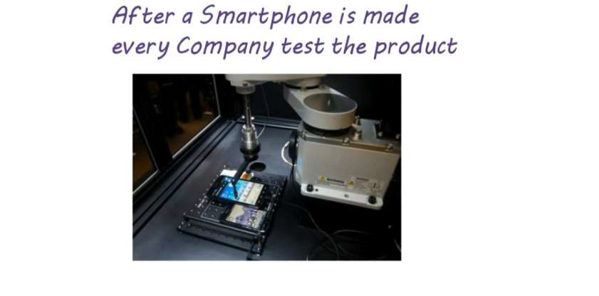
Exceptions: Keywords

Slide 10
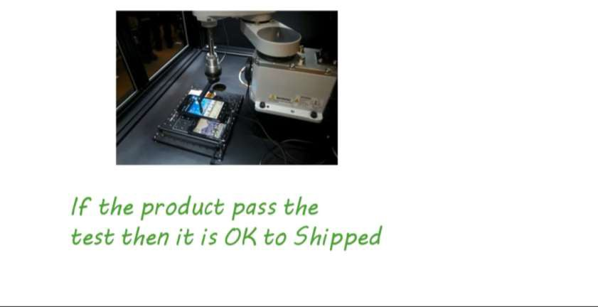
Exceptions: Keywords

Slide 11
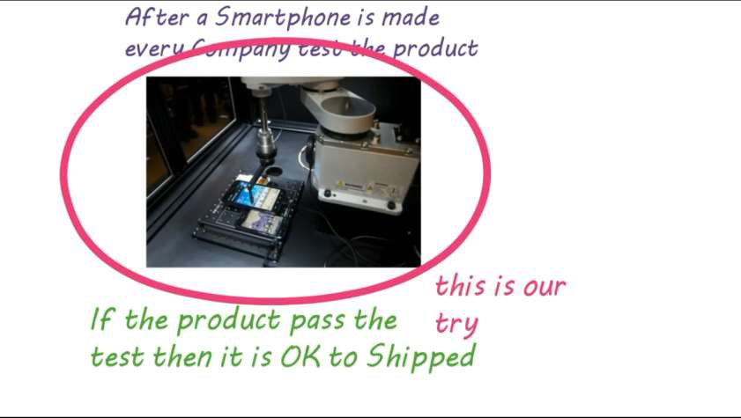
Exceptions: Keyword Try

Slide 12
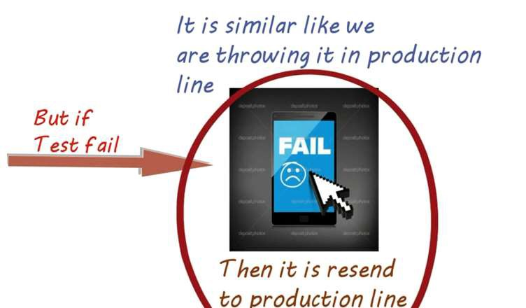
Exceptions: Keyword Throw

Slide 13
But there can be multiple catch statements
Why ···?
Because there can be multiple type of error
Production line
is like our Catch block Who know how to
f ix that error

Slide 14
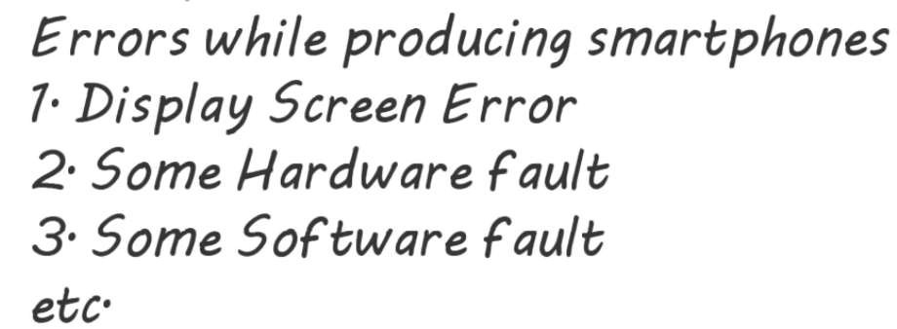

Examples

Slide 15
Exceptions C++
In C++, a throw statement is used to signal that an exception or error case has occurred (think of throwing a penalty flag). Signaling that an exception has occurred is also commonly called raising an exception.
To use a throw statement, simply use the throw keyword, followed by a value of any data type you wish to use to signal that an error has occurred. Typically, this value will be an error code, a description of the problem, or a custom exception class.

Slide 16
Exceptions: Keywords
Try blocks and catch blocks work together –
A try block detects any exceptions that are thrown by statements within the try block, and routes them to the appropriate catch block for handling.
A try block must have at least one catch block immediately following it, but may have multiple catch blocks listed in sequence.
Once an exception has been caught by the try block and routed to a catch block for handling, the exception is considered handled, and execution will resume as normal after the catch block.

Slide 17
Exceptions: Keywords
An exception is thrown by using the throw keyword from inside
the try block. Exception handlers are declared with the keyword catch, which must be placed immediately after the try block.
Catch parameters work just like function parameters, with the parameter being available within the subsequent catch block. Exceptions of fundamental types can be caught by value, but exceptions of non- fundamental types should be caught by const reference to avoid making an unnecessary copy.

Slide 18
Try Syntax
The
code under exception
handling is
enclosed in a try block.
Try
{
……
}

Slide 19
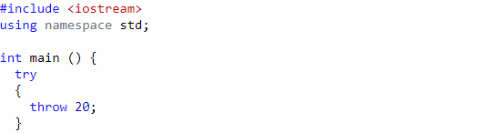
Example 1

Slide 20
Throw
In this example this code simply throws an
exception:
Throw20;
A throw expression accepts one parameter (in this case the integer value 20), which is passed as an argument to the exception handler.

Slide 21
Catch
The
exception
handler is declared with
the catch keyword immediately after the closing brace of the try block.
The
syntax for catch is similar to a regular
function with one parameter.
The type of this parameter is very important, since the type of the argument passed by the throw expression is checked against it, and only in the case they match, the exception is caught by that handler.

Slide 22
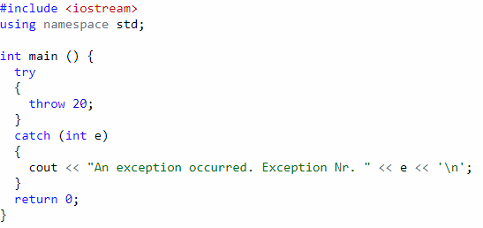
Example 1
An exception occurred. Exception Nr. 20

Slide 23
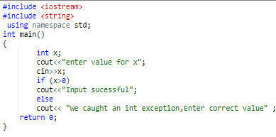
Example 2

Slide 24
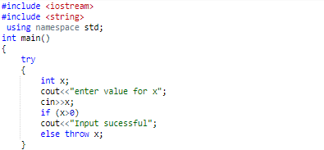
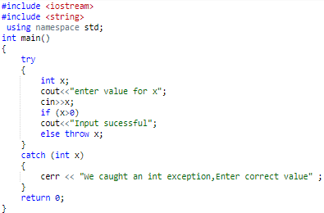
Example 2

Slide 25
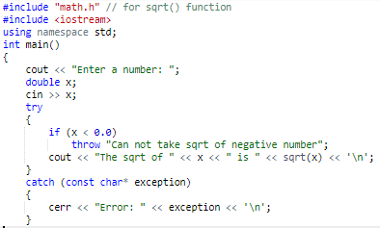
Example 3

Slide 26
Example 3
The user is asked to enter a number. If they enter a positive number, the if statement does not execute, no exception is thrown, and the square root of the number is printed. Because no exception is thrown in this case, the code inside the catch block never executes. The result is something like this:
Enter a number: 9
The sqrt of 9 is 3

Slide 27
Example 3
If the user enters a
throw an exception of type
negative number, we
const char*. block and a
Because we’re within a try
matching exception handler is found, control
immediately transfers to the exception handler. The result is:
const char*
Enter a number: -4
Error: Can not take sqrt of negative number

Slide 28
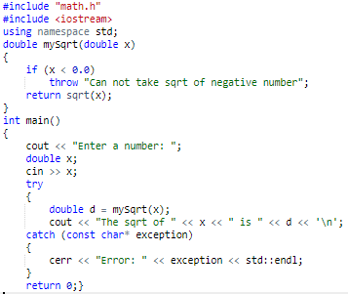
Example 4

Slide 29
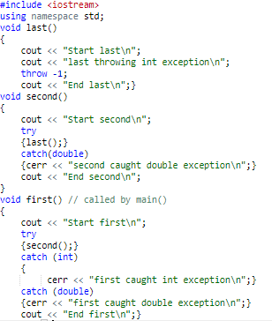
Example 5

Slide 30
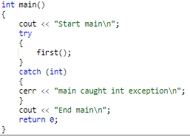
Example 5

Slide 31
Output Example 5
Start main
Start first
Start second
Start last
last throwing int exception
first caught int exception
End first
End main

Slide 32
Catch block
If an exception is routed to a catch block, it is considered
“handled” even if the catch block is empty.
However, typically you’ll want your catch blocks to do something useful.
There are three common things that catch blocks do when
they catch an exception:
First, catch blocks may print an error
Second, catch blocks may return a value or error code back to the
caller.
Third, a catch block may throw another exception. Because the catch block is outside of the try block, the newly thrown exception in this case is not handled by the preceding try block -- it’s handled by the next enclosing try block.

Slide 33
Multiple Catch
Multiple handlers (i.e., catch expressions) can be chained; each one with a different parameter type.
Only
the handler whose argument type
matches the type of the exception specified in the throw statement is executed.

Slide 34
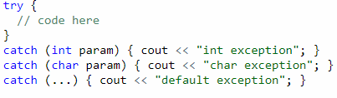
Multiple Catch
If an
ellipsis (...) is used as the parameter
of catch, that handler will catch any exception no matter what the type of the exception thrown. This can be used as a default handler that catches all exceptions not caught by other handlers. Must be placed at the end

Slide 35
Multiple Catch
In this case, the last handler would catch any exception thrown of a type that is neither int nor char.
catch block, not after the throw statement!.
After an | exception | has been handled | the
program, | execution | resumes after the | try-

Slide 36
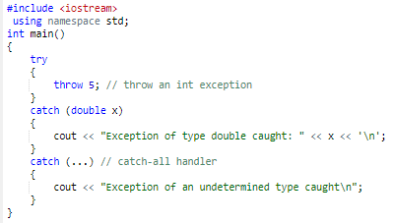
Multiple Catch Example

Slide 37
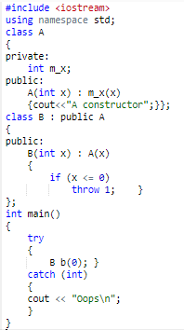
A Constructor Oops

Slide 38
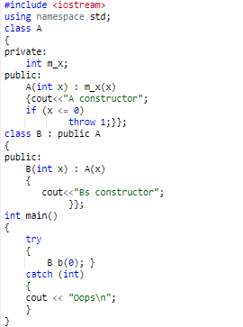
A Constructor Oops

Slide 39

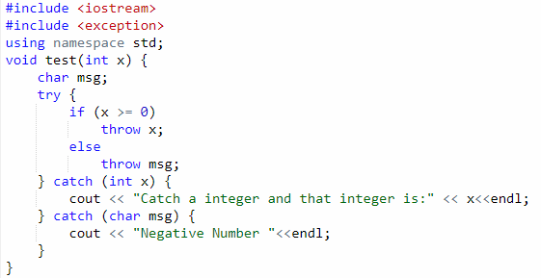


Example

Slide 40
Standard exceptions
The C++ Standard library provides a base class specifically designed to declare objects to be thrown as exceptions. It is called std::exception and is defined in the <exception> header.
Class exception is the standard C++ base class for all exceptions

Slide 41
Standard exceptions
Class | exception | has a | virtual member function
called | what that | returns | a null-terminated character
sequence (of type char *) and that can be overwritten in derived classes to contain some sort of description of the exception
Every exception class that derives directly or indirectly from exception contains the virtual function what, which returns an exception object’s error message.
what() is a public method provided by exception class and it has been overridden by all the child exception classes. This returns the cause of an exception.

Slide 42

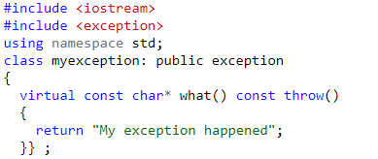

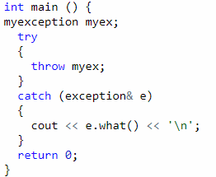
Example

Slide 43
Class runtime_error
file <exception>)—is the C++ standard base
class for representing runtime errors.
Standard Library class runtime_error (defined in header file <stdexcept>).
A derived class of Standard
Library
header
class exception (defined in

Slide 44
Derived class of Class runtime_error
A typical exception | class | that derives from
the runtime_error | class | defines only a
constructor that passes an error-message string
to the base-class runtime_error constructor.

Slide 45
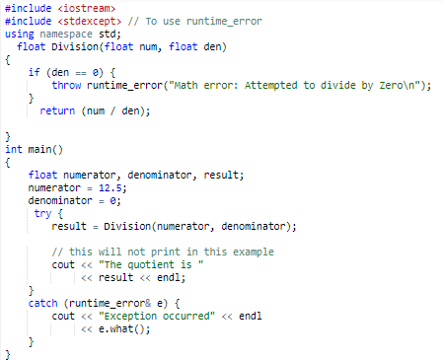
Exception occurred
Math error: Attempted to divide by
Zero

Slide 46
Conclusion
It is a syntax error to place code between a try
block and its corresponding catch handlers.
Each catch handler can have only a single parameter—specifying a comma-separated list of exception parameters is a syntax error.
It is a logic error to catch the same type in two different catch handlers following a single try block.

