Slide 1
Standard Template Library

Slide 2
Contents
Overview
Introduction To STL
Containers
Iterators
Algorithms
Function Objects

Slide 3

Overview
Competitive Programming
Code Fest 2021 (NUST)
Limited time
Code re-use
Resizing
Sort
Search
Advantage (templates)

Slide 4
Overview
STL - Standard template library
Library of what?
Generic classes and functions (components)
HP – Alex and Meng Lee
Why use STL
Re-use: well tested components
Time saving

Slide 5
Overview
STL - Components
Powerful, template-based components
Containers: template data structures
Stores data
Algorithms: data manipulation, searching, sorting, etc.
Work on data
Iterators: like pointers, access elements of containers
Object points to an element in a container
Connects algorithm with the container
Good idea to not to reinvent the wheel
Only an introduction to STL, a huge class library

Slide 6
Overview
Demo
Container:
1 | 3 | 7 | 10 | 19 | …
Iterator – moves as instructed by the Algorithm

Slide 7
STL components overview
•
Container
Container
Data storage, data access and algorithms are separated
Containers hold data
Iterators access data
Algorithms, function objects manipulate data
Allocators... allocate data (mostly, we ignore them)
Algorithm
Container

Slide 8
Container
A container is a way that stored data is organized in memory, for example an array of elements.
Container
Sequential
Associative
Container Adapters

Slide 9
Container ctd-
•
Sequence containers
vector
deque
list
Associative containers
set
multiset
map
multimap
Container adapters
stack
queue
•
•

Slide 10
Sequential Container
vector<T> – dynamic array
Offers random access, back insertion
Should be your default choice, but choose wisely
Backward compatible with C : &v[0] points to the first element
deque<T> – double-ended queue (usually array of arrays)
Offers random access, back and front insertion
Slower than vectors, no C compatibility
list<T> – 'traditional' doubly linked list
Don't expect random access, you can insert anywhere though

Slide 11
Some functions of vector class
-size()
-provides the number of elements
-push_back()
-appends an element to the end
-pop_back()
-Erases the last element
-begin()
-Provides reference to last element
-end()
-Provides reference to end of vector

Slide 12
Vector container
int array[5] = {12, 7, 9, 21, 13 };
Vector<int> v(array,array+5);
12 | 7 | 9 | 21 | 13
v.pop_back();
v.push_back(15);
13
…
12 | 7 | 9 | 21
12 | 7 | 9 | 21 | 15
0 1 2 3 4
12 | 7 | 9 | 21 | 15
For short tutorial and practice
GeeksforGeeks
v.begin();
v[3]
https://www.youtube.com/watch?v=Y29tlyp_jBA
Notes:
Vector as dynamic arrays with the ability to resize itself automatically when an element is inserted or deleted
Store contiguously so that insertion and could be performed using iterators
Adding removing last element take constant time as no resizing is done
Inserting or erasing in the middle is linear in time.
Inserting at the end take the differential time

Slide 13
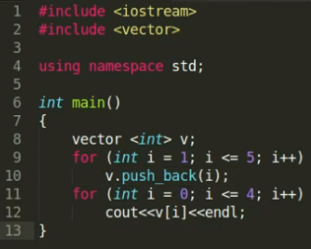
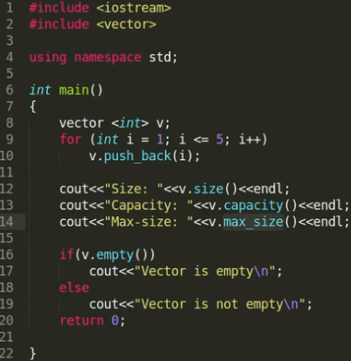
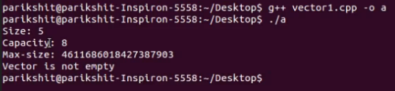

Slide 14
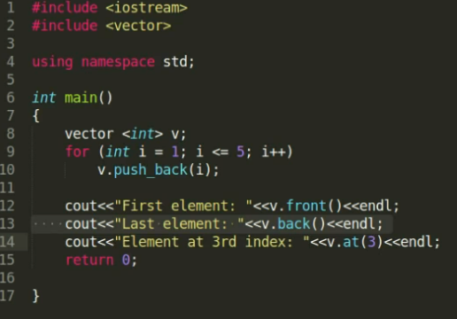

Vector demo

Slide 15
Some function of list class
•
list functions for object t
t.sort()
Sorts in ascending order
t.splice(iterator, otherObject );
Inserts values from otherObject before iterator
t.merge( otherObject )
Removes otherObject and inserts it into t, sorted
t.unique()
Removes duplicate elements

Slide 16
Functions of list class cntd-
•
list functions
t.swap(otherObject);
Exchange contents
t.assign(iterator1, iterator2)
Replaces contents with elements in range of iterators
t.remove(value)
Erases all instances of value

Slide 17

List container
int array[5] = {12, 7, 9, 21, 13 };
list<int> li(array,array+5);
li.pop_back();
li.push_back(15);
13
…
12 9 21
li.pop_front();
12 | 7 | 9 | 21 | 15
li.push_front(8);
12
…
7 | 9 | 21
8 | 12 | 7 | 9 | 21 | 15
li.insert()
7 | 12 | 17
19
21 23
Notes:
Lists are sequence containers that allow non-contiguous memory allocation as compared to vector, list have slow traversal but once a position has been found
Insertion and deletion are fast

Slide 18
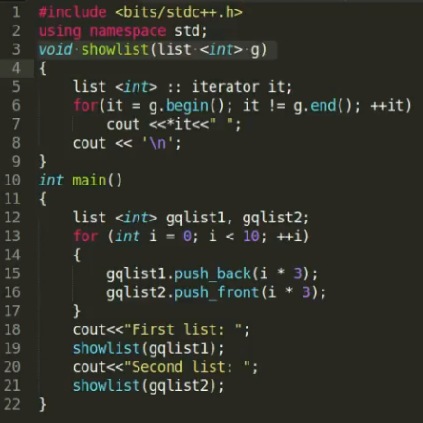


Slide 19
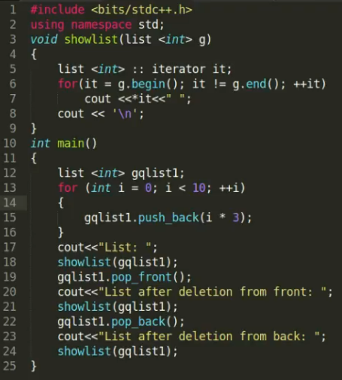


Slide 20
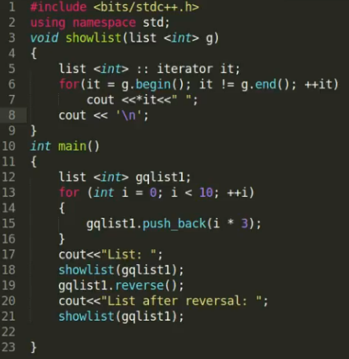

Slide 21
Functions of dequeue class
dequeue functions for object d
-d.front()
-Return a reference (or const_reference) to the first component of d
-d.back()
-Return a reference (or const_reference) to the last component of d.
-d.size()
-Return a value of type size_type giving the number of values currently in d.

Slide 22
Functions of dequeue class contd-
-d.push_back(val)
-Add val to the end of d, increasing the size of d by one.
-d.push_front(val)
-Add val to the front of d, increasing the size of d by one.
-d.pop_back()
-Delete the last value of d. The size of d is reduced by one.
-d.pop_front()
-Delete the first value of d. The size of d is reduced by one.

Slide 23
Associative Containers
Offer O(log n) insertion, suppression and access
Store only weakly strict ordered types (eg. numeric types)
Must have operator<() and operator==() defined and !(a<b) && !(b<a) ≡ (a==b)
The sorting criterion is also a template parameter
set<T> – the item stored act as key, no duplicates
multiset<T> – set allowing duplicate items
map<K,V> – separate key and value, no duplicates
multimap<K,V> – map allowing duplicate keys
– hashed associative containers may be available

Slide 24
Container adaptors
Container adapters
stack, queue and priority_queue
Not first class containers
Do not support iterators
Do not provide actual data structure
Programmer can select implementation
Member functions push and pop

Slide 25
Iterators
•
Iterators are pointer-like entities that are used to access individual elements in a container.
Often they are used to move sequentially from element to element, a process called iterating through a container.
•
vector<int>
17
array_
vector<int>::iterator
4
23
12
Theiterator corresponding to the class vector<int> is of the typevector<int>::iterator
size_
4

Slide 26
Iterators contd-
•
The member functions begin() and end() return an iterator to the first and past the last element of a
container
vector<int> v
v.begin()
array_
17
4
23
12
v.end()
size_
4

Slide 27
Iterators Categories
•
Not every iterator can be used with every container for example the list class provides no random access iterator
Every algorithm requires an iterator with a certain level of capability for example to use the [] operator you need a random access iterator
Iterators are divided into five categories in which a higher (more specific) category always subsumes a lower (more general) category, e.g. An algorithm that
accepts a forward iterator will also work with a bidirectional iterator and a random access iterator
•
•
input
random access
forward
bidirectional
output

Slide 28
Algorithms
Algorithms in the STL are procedures that are applied to containers to process their data, for example search for an element in an array, or sort an array.

Slide 29
For_Each() Algorithm
#include <vector>
#include <algorithm>
#include <iostream> void show(int n)
{
cout << n << ” ”;
}
int arr[] = { 12, 3, 17, 8 }; // standard C array vector<int> v(arr, arr+4); // initialize vector with C array
for_each (v.begin(), v.end(), show); // apply function show
// to each element of vector v

Slide 30
Find() Algorithm
#include <vector>
#include <algorithm>
#include <iostream> int key;
int arr[] = { 12, 3, 17, 8, 34, 56, 9 }; // standard C array vector<int> v(arr, arr+7); // initialize vector with C array vector<int>::iterator iter;
cout << ”enter value :”; cin >> key;
iter=find(v.begin(),v.end(),key); // finds integer key in v if (iter != v.end()) // found the element
cout << ”Element ” << key << ” found” << endl; else
cout << ”Element ” << key << ” not in vector v” << endl;

Slide 31
Sort & Merge
•
Sort and merge allow you to sort and merge elements in a container
#include <list>
int arr1[]= { 6, 4, 9, 1, 7 };
int arr2[]= { 4, 2, 1, 3, 8 };
list<int> l1(arr1, arr1+5); // initialize l1 with arr1 list<int> l2(arr2, arr2+5); // initialize l2 with arr2 l1.sort(); // l1 = {1, 4, 6, 7, 9}
l2.sort(); // l2= {1, 2, 3, 4, 8 } l1.merge(l2); // merges l2 into l1
// l1 = { 1, 1, 2, 3, 4, 4, 6, 7, 8, 9}, l2= {}

Slide 32
Functions Objects
•
Some algorithms like sort, merge, accumulate can take a function object as argument.
A function object is an object of a template class that has a single member function : the overloaded operator ()
It is also possible to use user-written functions in place of pre-defined function objects
•
•
#include <list>
#include <functional> int arr1[]= { 6, 4, 9, 1, 7 };
list<int> l1(arr1, arr1+5); // initialize l1 with arr1 l1.sort(greater<int>()); // uses function object greater<int>
// for sorting in reverse order l1 = { 9, 7, 6, 4, 1 }

Slide 33
Function Objects
•
The accumulate algorithm accumulates data over the elements of the containing, for example computing the sum of elements
#include <list>
#include <functional>
#include <numeric>
int arr1[]= { 6, 4, 9, 1, 7 };
list<int> l1(arr1, arr1+5); // initialize l1 with arr1
int sum = accumulate(l1.begin(), l1.end() , 0, plus<int>()); int sum = accumulate(l1.begin(), l1.end(),0); // equivalent int fac = accumulate(l1.begin(), l1.end() , 0, times<int>());

Slide 34
User Defined Function Objects
class squared _sum // user-defined function object
{
public:
int operator()(int n1, int n2) { return n1+n2*n2; }
};
int sq = accumulate(l1.begin(), l1.end() , 0, squared_sum() );
// computes the sum of squares

