Slide 1
CS212 – Object Oriented Programming
Week 2
Dr Khuram Shazhad
mkhuram.shahzad@seecs.edu.pk
Office: A-308

Slide 2
Outline
Functions in C++
Argument passing by Value
Argument passing by Reference
Argument passing by Pointer/Address
C ++ Environment
C ++ Common Element,
C ++ Tokens
C ++ Streams

Slide 3
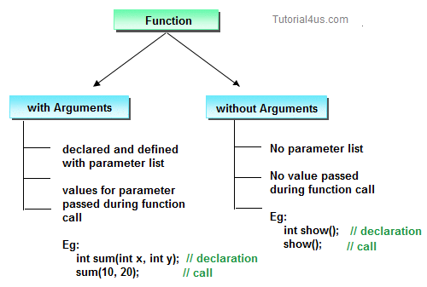
Functions A group of program statements with a unique name that performs a specific task - Reusability and modular approach

Slide 4

Functions – hands on experience
Open following link on your phone: https://www.programiz.com/cpp-programming/online-compiler/
Or Install App

Slide 5
Functions
With arguments
#include <iostream>
using namespace std;
/*to find minimum of two numbers */
int minimum(int a, int b);
int main()
{
int a, b;
cout << "Enter 2 numbers to find minimum:"<<endl;
cin >>a>>b;
int c = minimum(a,b);
cout<<"minumum value is:"<<c<<endl;
return 0;
}
int minimum(int x, int y)
{
if(x<y)
return x;
else
return y;
}
Without Arguments
#include <iostream>
using namespace std;
/*to printSomething */
void printSomething();
int main()
{
printSomething();
return 0;
}
void printSomething()
{
cout<<"oooo I am text on the screen"<<endl;
}

Slide 6
Challenge ☺
Update the code on the previous slides (with arguments) to
Find maximum numbers
Write another function to get sum of the two numbers
Write yet another function with three arguments, it tells product of three numbers entered by a user

Slide 7
Call by Value
Copy of data passed to function
Changes to copy do not change original
Prevent unwanted side effects
Actual and copy arguments will be created in different memory locations
Better in multi-threaded environment
Simple memory management
In given example swapping happened in x and y not a and b.
#include <iostream>
using namespace std;
/*call by value */
void passByValue (int x, int y)
{
int z=x;
x=y;
y=z;
}
int main()
{
int a=5, b=6;
cout<<"Before swapping"<<endl<<"a:"<<a<<" b:"<<b<<endl<<endl;
//call function
passByValue (a, b);
cout<<"Before swapping"<<endl<<"a:"<<a<<" b:"<<b<<endl<<endl;
return 0;

Slide 8
Call by Reference
No copying of data (only reference) which can means less memory
Changes made to the parameter affect the original. Because address is used to access the actual argument.
Actual and copy arguments will be created in same memory location
Many functions/classes can share a single object
Can cause problems in multi-threaded environment
Can return ‘multiple’ values from a function
#include <iostream>
using namespace std;
/*call by value */
void passByReference (int &x, int &y)
{
int z=x;
x=y;
y=z;
}
int main()
{
int a=5, b=6;
cout<<"Before swapping"<<endl<<"a:"<<a<<" b:"<<b<<endl<<endl;
//call function
passByReference (a, b);
cout<<"Before swapping"<<endl<<"a:"<<a<<" b:"<<b<<endl<<endl;
return 0;
}

Slide 9
Call by Address/Pointers
#include <iostream>
using namespace std;
/*call by value */
void passByAddress (int *x, int *y)
{
int z=*x;
*x=*y;
*y=z;
}
int main()
{
int a=5, b=6;
cout<<"Before swapping"<<endl<<"a:"<<a<<" b:"<<b<<endl<<endl;
//call function
passByAddress (&a, &b);
cout<<"Before swapping"<<endl<<"a:"<<a<<" b:"<<b<<endl<<endl;
return 0;
}
Also called Call by or pass by address
Changes done in former parameters are reflected in actual parameters

Slide 10
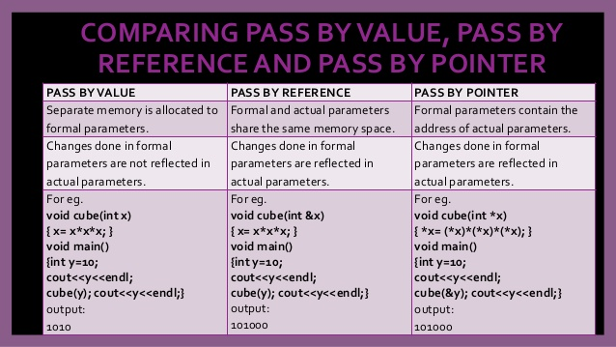
Comparison

Slide 11
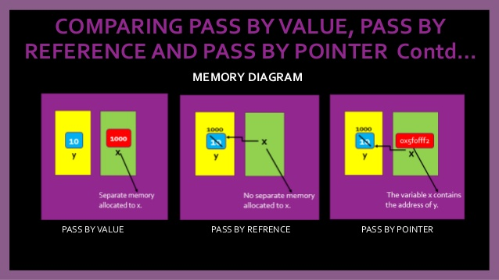
Comparison

Slide 12
A Sample C++ Program
A simple C++ program begins this way #include <iostream> using namespace std; int main() {
And ends this way return 0; }

Slide 13
Parts of Program
Line Comment
// sample C++ program
#include <iostream>
using namespace std;
int main()
{
cout << "Hello, there!";
return 0;
}
Pre processor directive
Which namespace to use
Main function beginning
beginning of block for main
Ending of block for main

Slide 14
Comments
Document programs
Improve program readability
Ignored by compiler
Single-line comment: Begin with //
Multiple-line comment: Begin with /* and end with */
// sample C++ program
/* sample C++
program */
Single Line Comment
Multiple Line Comment

Slide 15
Pre Processor Directive
// sample C++ program
#include <iostream>
using namespace std;
int main()
{
cout << "Hello, there!";
return 0;
}
Pre processor directive

Slide 16
Directives
Lines beginning with a hash sign (#) are directives read and interpreted by what is known as the preprocessor.
They are special lines interpreted before the compilation of the program itself begins.

Slide 17
# include
Both the user and the system header files are included using the preprocessing directive #include. It has the following two forms −
#include <file>
#include "file"

Slide 18
# include <file>, "file"
#include <file> This form is used for system header files. It searches for a file named 'file' in a standard list of system directories.
#include "file" This form is used for header files of your own program. It searches for a file named 'file' in the directory containing the current file.

Slide 19
#include <iostream>
Directive #include <iostream>, instructs the preprocessor to include a section of standard C++ code, known as header iostream, that allows to perform standard input and output operations, such as writing the output of this program (Hello World) to the screen.

Slide 20
Namespace
//SomeLibrary.h void Log ();
//MyLibrary.h bool Log; //App.cpp #include "SomeLibrary.h" #include "MyLibrary.h"
void Bar () { Log();
}
//SomeLibrary.h
//MyLibrary.h
//Compiler error as we don't know which one to use

Slide 21
Namespace
namespace SomeLibrary { void Log ();
}
namespace Mine
{
bool Log;
}
//SomeLibrary.h
//MyLibrary.h

Slide 22
Namespace
#include "SomeLibrary.h" #include "MyLibrary.h"
void Bar () { SomeLibrary::Log(); Mine::Log = true; }
//App.cpp
//Namespace SomeLibrary
//Namespace Mine
annoying to have to add the namespace name each time

Slide 23
Namespace
#include "SomeLibrary.h" #include "MyLibrary.h" using namespace SomeLibrary; void Bar () { Log(); Mine::Log = true; }
//App.cpp
Using namespace
Using namespace
SomeLibrary:: is now redundant
Can still reference symbols in other namespaces

Slide 24
The Using Directive
using namespace std;
A C++ program can be divided into different namespaces.
A namespace is a part of the program in which certain names are recognized; outside of the namespace they’re unknown.
Various program components such as cout are declared within this namespace. If we didn’t use the using directive, we would need to add the std name to many program elements. For example, in our example program we’d need to say
std::cout << “Hello World”;

Slide 25
fig01_02.cpp (1 of 1) fig01_02.cpp output (1 of 1)
1 // Fig. 1.2: fig01_02.cpp
2 // A first program in C++.
3 #include <iostream>
4
5 // function main begins program execution
6 int main()
7 {
8 std::cout << "Welcome to C++!\n";
9
10 return 0; // indicate that program ended successfully
11
12 } // end function main
Single-line comments.
Function main returns an integer value.
Left brace { begins function body.
Preprocessor directive to include input/output stream header file <iostream>.
Function main appears exactly once in every C++ program..
Statements end with a semicolon ;.
Corresponding right brace } ends function body.
Stream insertion operator.
Name cout belongs to namespace std.
Keyword return is one of several means to exit function; value 0 indicates program terminated successfully.
Welcome to C++!

Slide 26
C++ Program
Some common elements in programming languages
Key Words
Programmer-Defined Identifiers
Operators
Punctuation/Separators
White Space

Slide 27
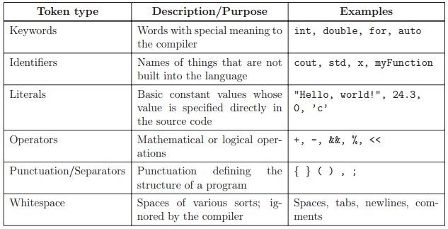
TOKENS
Smallest meaningful symbols in the language

Slide 28
Key Words
Also known as reserved words
Have a special meaning in C++
Can not be used for any other purpose
Key words in the example program
main
using
namespace

Slide 29
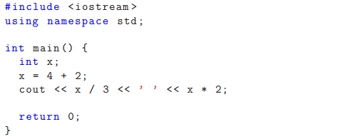
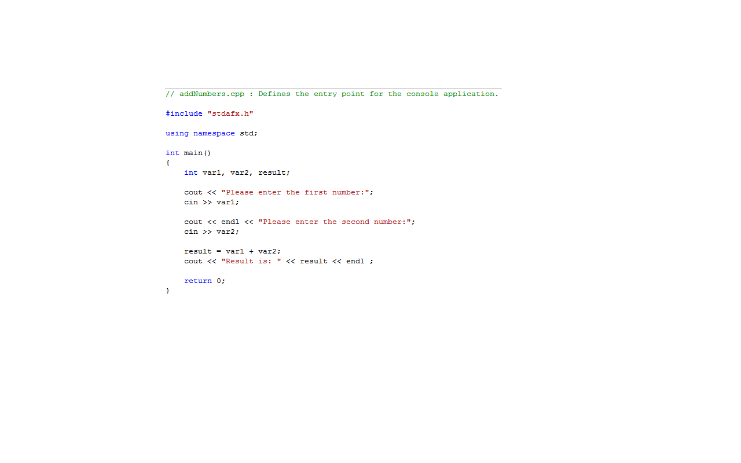
Key Words..

Slide 30
Identifier
Names made up by the programmer. An identifier is the name used to denote labels, types, variables, constants or functions, in a C++ program.
C++ is a case-sensitive language.
Work is not work
Identifiers should be descriptive
Using meaningful identifiers is a good programming practice

Slide 31
Rules for Identifiers
Identifiers must be unique
Identifiers cannot be reserved words (keywords)
int main return
Identifier must start with a letter or underscore, and be followed by zero or more letters (A-Z, a-z), digits (0-9), or underscores
After the first character you may use alphabetic characters, numbers, or underscore characters.
Upper- and lowercase characters are distinct

Slide 32
Rules for Identifiers
VALID
age_of_dog _taxRateY2K PrintHeading ageOfHorse
NOT VALID
age# 2000TaxRate Age-Of-Dog main

Slide 33
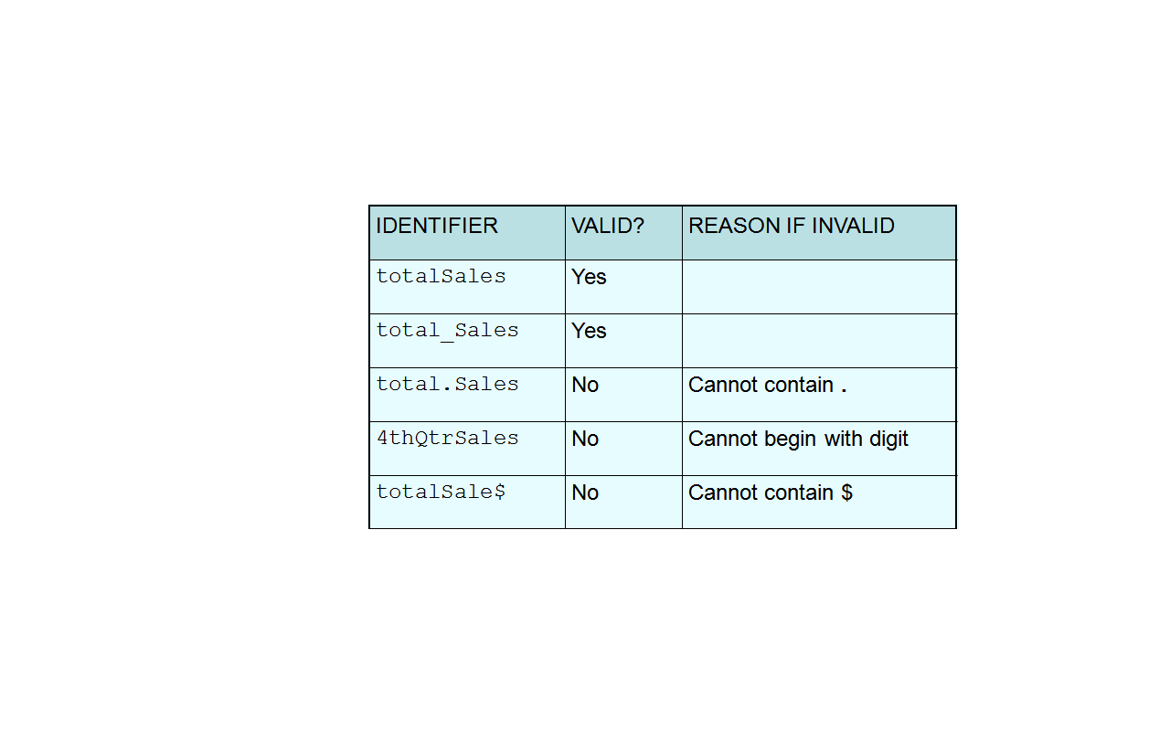
Identifiers..
Some examples of valid and Invalid Identifiers

Slide 34
Identifiers..

Slide 35
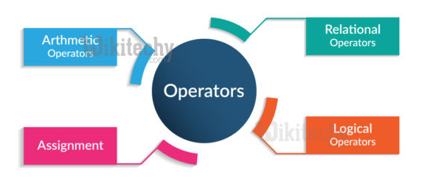
Operators in C++

Slide 36
Operators
Used to perform arithmetic, logical etc operations on data.
Many types of operators
Arithmetic + - * / %
Logical || & !
Assignment =
Conditional ?
Increment ++
Decrement --
Operators used in the example program
+ = << >>
x++ increments the value of variable x after processing the current statement.
++x increments the value of variable x before processing the current statement. Same goes for – decrement.

Slide 37
Increment Example: Predict Output
#include <iostream>
using namespace std;
int main(){
int n1 = 1;
int n2 = ++n1;
int n3 = ++ ++n1;
int n4 = n1++;//
cout << "n1 = " << n1 << '\n'<< "n2 = " << n2 << '\n' << "n3 = " << n3 << '\n'<< "n4 = " << n4 << '\n';}

Slide 38
Operators..

Slide 39
Operators in C++
Stream Operators
Arithmetic Operators
Decision Making – Equality and Relational Operators
Assignment/ Combined Operators
Unary Operators
Logical Operators

Slide 40
Streams
C++ standard libraries provide an extensive set of input/output capabilities
C++ uses type-safe I/O
C++ I/O occurs in streams

Slide 41
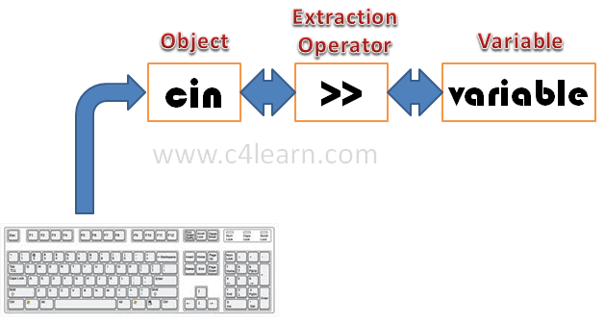
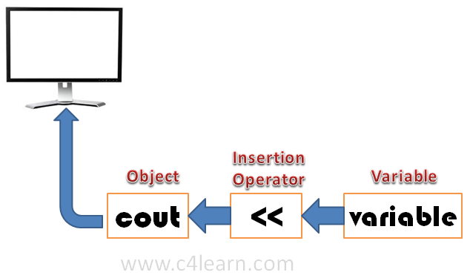
Stream Operators

Slide 42
Stream Operators – Input and Output
C++ treats input and output as a stream of characters.
stream : sequence of characters (printable or nonprintable)
The functions to allow standard I/O are in iostream header file or iostream.h.
Thus, we start every program with
#include <iostream>
using namespace std;

Slide 43
Keyboard and Screen I/O
#include <iostream>
input data
output data
executing
program
Keyboard
Screen
cin
(of type istream)
cout
(of type ostream)

Slide 44
Streams
C++ I/O occurs in streams, which are sequences of bytes
In input operations,
the bytes flow from a device (e.g., a keyboard, a disk drive, a network connection, etc.) to main memory.
In output operations,
bytes flow from main memory to a device (e.g., a display screen, a printer, a disk drive, a network connection, etc.)
Typically time for I/O transfers is much greater than the time the processor requires to manipulate data internally

Slide 45
Formatted vs. Unformatted I/O
C++ provides both “low-level” and “high-level” I/O capabilities
Unformatted I/O
Bytes are transferred
provide high-speed, high-volume transfers but
not particularly convenient (Portability Issues)
Formatted I/O
bytes are grouped into meaningful units, such as integers, floating-point numbers, characters, strings and user-defined types

Slide 46
Library Headers
<iostream>
declares basic services required for all stream-I/O operations
defines the cin, cout, cerr, and clog objects
<iomanip>
declares services useful for performing formatted I/O with parameterized stream manipulators, such as setprecision functions
<fstream>
declares services for file processing.

Slide 47
Operator Overloading and I/O
Operator overloading provides a convenient notation for performing input/output
The left-shift operator (<<)
It is overloaded to designate stream output and is referred to as the stream insertion operator
The right-shift operator (>>)
It is overloaded to designate stream input and is referred to as the stream extraction operator.

Slide 48
Standard Stream Objects
cin is an istream instance and is said to be “connected to” (or attached to) the standard input device, which usually is the keyboard
The compiler determines the data type of grade and selects the appropriate overloaded stream extraction operator

Slide 49
Standard Stream Objects
cout is an ostream instance and is said to be “connected to” the standard output device, which usually is the display screen
cerr is an ostream instance and is said to be “connected to” the standard error device, normally the screen

Slide 50
Insertion Operator ( << )
Variable cout is predefined to denote an output stream that goes to the standard output device (display screen).
The insertion operator << called “put to” takes 2 operands.
The left operand is a stream expression, such as cout. The right operand is an expression of simple type or a string constant.

Slide 51
Output Statements
SYNTAX
cout statements can be linked together using << operator.
These examples yield the same output:
cout << “The answer is “ ;
cout << 3 * 4 ;
cout << “The answer is “ << 3 * 4 ;
cout << Expression << Expression . . . ;

Slide 52
Output Statements (String constant)
String constants (in double quotes) are to be printed as is, without the quotes.
cout<<“Enter the number of candy bars ”;
OUTPUT: Enter the number of candy bars
“Enter the number of candy bars ” is called a prompt.
All user inputs must be preceded by a prompt to tell the user what is expected.
You must insert spaces inside the quotes if you want them in the output.
Do not put a string in quotes on multiple lines.

Slide 53
Output Statements (Expression)
All expressions are computed and then output.
cout << “The answer is ” << 3 * 4 ;
OUTPUT: The answer is 12

Slide 54
Escape Sequences
The backslash (\) is called the escape character.
It tells the compiler that the next character is “escaping” it’s typical definition and is using its secondary definition.
Examples:
new line: \n
horizontal tab: \t
backslash: \\
double quote \”

Slide 55
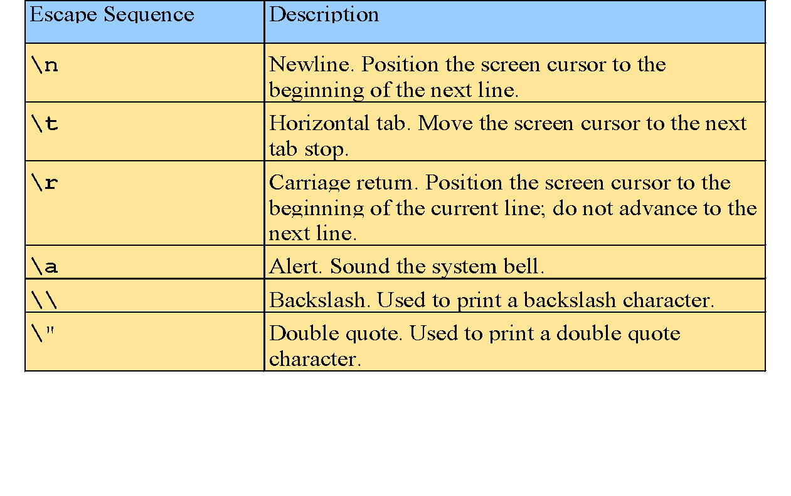
Escape Sequences

Slide 56
Newline
cout<<“\n” and cout<<endl both are used to insert a blank line.
Advances the cursor to the start of the next line rather than to the next space.
Always end the output of all programs with this statement.

Slide 57
fig01_02.cpp (1 of 1) fig01_02.cpp output (1 of 1)
1 // Fig. 1.2: fig01_02.cpp
2 // A first program in C++.
3 #include <iostream>
4 using namespace std;
5 // function main begins program execution
6 int main()
7 {
8 cout << "Welcome to C++!\n";
9
10 return 0; // indicate that program ended successfully
11
12 } // end function main
Single-line comments.
Function main returns an integer value.
Left brace { begins function body.
Preprocessor directive to include input/output stream header file <iostream>.
Function main appears exactly once in every C++ program..
Statements end with a semicolon ;.
Corresponding right brace } ends function body.
Stream insertion operator.
Name cout belongs to namespace std.
Keyword return is one of several means to exit function; value 0 indicates program terminated successfully.
Welcome to C++!

Slide 58
fig01_04.cpp (1 of 1) fig01_04.cpp output (1 of 1)
1 // Fig. 1.4: fig01_04.cpp
2 // Printing a line with multiple statements.
3 #include <iostream>
4
5 // function main begins program execution
6 int main()
7 {
8 std::cout << "Welcome ";
9 std::cout << "to C++!\n";
10
11 return 0; // indicate that program ended successfully
12
13 } // end function main
Multiple stream insertion statements produce one line of output.
Welcome to C++!

Slide 59
fig01_05.cpp (1 of 1) fig01_05.cpp output (1 of 1)
1 // Fig. 1.5: fig01_05.cpp
2 // Printing multiple lines with a single statement
3 #include <iostream>
4
5 // function main begins program execution
6 int main()
7 {
8 std::cout << "Welcome\nto\n\nC++!\n";
9
10 return 0; // indicate that program ended successfully
11
12 } // end function main
Using newline characters to print on multiple lines.
Welcome
to
C++!

Slide 60
Extraction Operator ( >> )
Variable cin is predefined to denote an input stream that comes from the standard input device (keyboard).
The extraction operator >> takes 2 operands.
The left operand is a stream expression, such as cin. The right operand is a variable to which the value input by the user is assigned.

Slide 61
Input Statements
SYNTAX
cin statements can be linked together using multiple >> operator.
Example:
cin >> number1;
cin >> number2;
cin >> number1 >> number2;
cin >> variable >> variable . . . ;

Slide 62
Input Statements
Code:
Output:
int num;
cout<< “Enter number\n \n”;
cin >> num;
Enter number
5

Slide 63
Punctuation
Characters that mark the end of the program.
Characters that separate items in the list.
types of punctuation marks
,
;
Punctuation used in the example program
,
;

Slide 64
Punctuation..

Slide 65
Variables
A variable is a memory address (placeholder) where data can be stored and changed.
Declaring a variable means specifying both its name (identifier) and its data type.
Defining/initializing a variable means giving the variable a value.
When new value placed into variable, overwrites previous value

Slide 66
Variables
In a program a variable has:
Name
Data type
Size
Value
For example int x = 2;
int x;
x=2;
Can also be written as
Data type and Size (4 bytes)
Name
Value

Slide 67
int x, y, z ;
int x; int y; int z ;

Slide 68
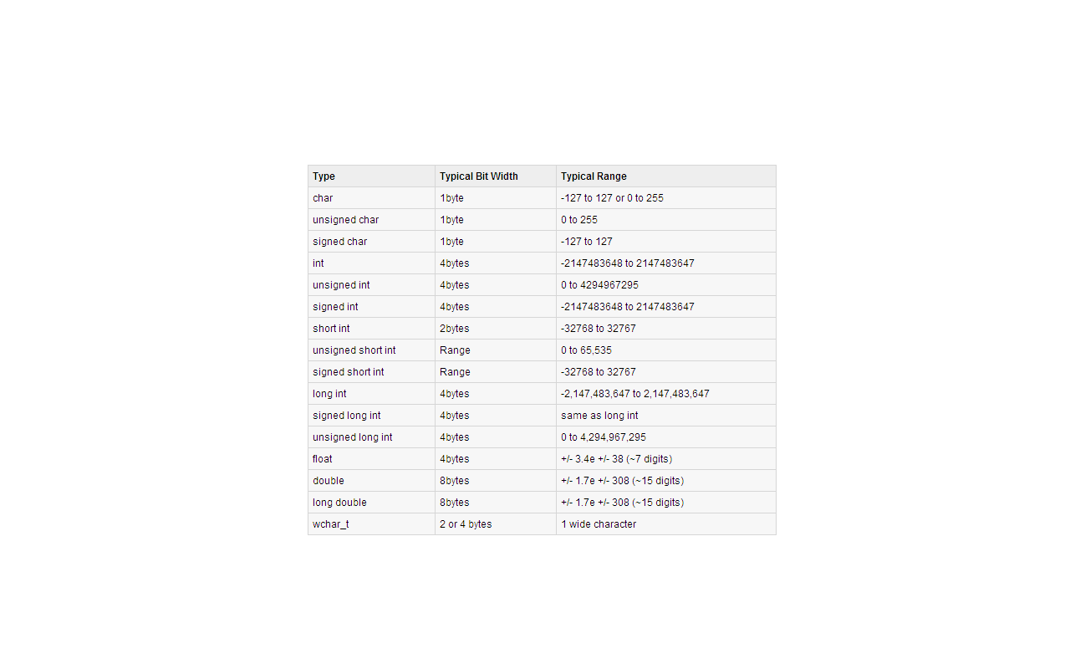
Data Types..

