Slide 1
CS212 – Object Oriented Programming
Week 3
Dr. Khuram Shazhad
mkhuram.shahzad@seecs.edu.pk
Office: A-308
Credits to Ms. Zunaira Zahid

Slide 2
Agenda
Function Prototypes
Function Definitions
Function Call
Need for OOP
How to define a class
How to create objects
How to access class members
How to define a Member Function ?
Includes 3 examples 1.Box 2.Student 3.Gradebook

Slide 3
What is a function?
Functions
are modules of code that
accomplish a specific task.
Functions usually take in data, process it, and return a result.
Once a function is written, it can be used over and over and over again.
Functions can be called from the inside of
other functions
CS212 Object Oriented Programming in C++
3

Slide 4
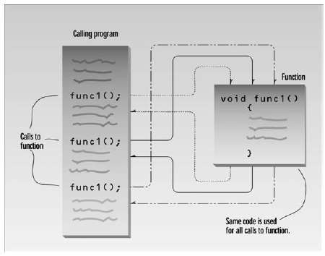
What is a function?

Slide 5






Function Prototypes
A function prototype is a declaration of
a function that specifies the function's name
and type signature but omits the function body.
Return-type
Function-name(parameter-list);
Function signature
Note the semicolon here

Slide 6




Function Definitions
A set of statements that explains what a function
does is called Function Definition.
Return-type
{
Function-name(parameter-list)
statement(s);
}
Here we can have 0, 1 or many parameters

Slide 7
Function Definitions
In an program, a function definition can be written
Before main() function
After main() function
In a separate file

Slide 8









Function Prototype - Example
Return- type
Function
-name
Parameter-
list
int Sum(int
a , int b);

Slide 9






Function Definition - Example
Return- type
Function
-name
Parameter- list
int Sum(int
{
a , int b)
int sum;
sum =
a + b;
Multiple parameters should be separated by commas
return
sum;
}

Slide 10
Function Call
A statement that activates a function is known as a
Function Call.
Function-name(parameter-list);

Slide 11
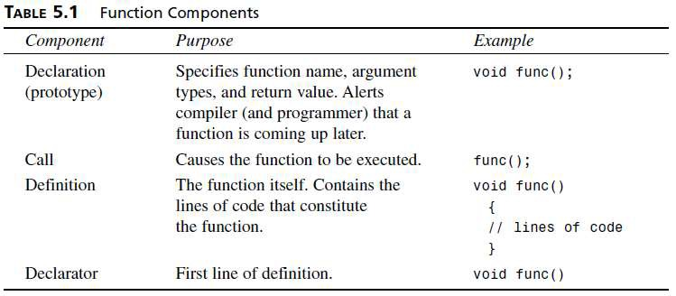
Simple Functions
CS212 Object Oriented Programming in C++
11

Slide 12


C++ Functions
C++ allows the use of both internal and external
functions.
Internal Functions – User defined
•
•
External functions – Pre-defined (e.g., abs, ceil, rand, sqrt, etc.) are usually grouped into specialized libraries (e.g., iostream, stdlib, math, etc.)

Slide 13
Internal Functions
C++ programs usually have the following form:
// include statements
// function prototypes
// main() function – has the function call
// function definitions

Slide 14
Internal Functions
C++ programs usually have the following form:
// include statements
// function prototypes
What if we skip the
prototype here?
// main() function – has the function call
// function definitions

Slide 15
Internal Functions
C++ programs usually have the following form:
Give the function definition before the function is called
// include statements
// function definitions
// main() function – has the function call

Slide 16
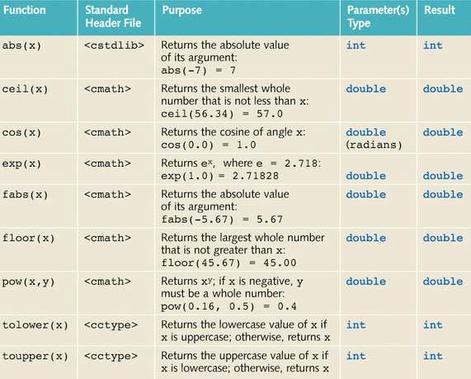
External Functions

Slide 17
Classified by Location
Parameters | Arguments
Always appear in the function definition, or function prototype. | Always appear in a function call.

Slide 18






Parameters & Arguments – Example
#include <iostream>
using namespace std;
int absolute(int a)
{
int r;
r = abs(a); return r;
Parameter
}
int main ()
{
int z;
z = absolute cout << "The
}
Argument
(-5);
result is " << z;

Slide 19

Function Overloading

Slide 20
Function Overloading
Two or more functions having same name but
different argument(s) are known as overloaded functions.

Slide 21
Function Overloading – Examples
int
int
test() { }
test(int a) { }
a) {
float
test(double
}
a, double b) { }
int test(int
Here, all 4 functions are overloaded functions because argument(s) passed to these functions are different.

Slide 22






Function Overloading – Examples
int test() { }
int
test(int a) { }
_{f}O_{l}v_{o}e_{a}rl_{t}oa_{t}d_{e}e_{s}d_{t}f₍u_{d}n_{o}ct_{u}i_{b}o_{l}n_{e}s m_{a}a₎y o{r }may not have
_{in}d_{t}iff_{t}e_{e}re_{s}n_{t}t₍r_{i}e_{n}tu_{t}rn_{a,}typ_{d}e_{o}b_{u}u_{bl}t _{e}it s_{b}h₎ou{ld }have
different argument(s).
Notice that, the return type of all these 4 functions are not same

Slide 23
Function Overloading – Examples
// Error code
int
test(int a) { }
double
test(int b){ }
What is the error here?

Slide 24
Function Overloading – Examples
// Error code
int
test(int a) { }
double test(int
b){ }
The number and type of arguments passed to these two functions are same even though the return type is different. Hence, the compiler will throw error.

Slide 25

Function Overloading – Examples
int
test(int a) { }
b){
double
test(float
}
Will the compiler
throw an error?

Slide 26
Function Overloading – Examples
int
test(int a) { }
b){
double
test(float
}
The is correct because even if the number of arguments is same but the type of arguments is different.

Slide 27


Function Overloading – Example
#include <iostream>
using namespace std;
void void void
display(int); display(float); display(int, float);
int main() {
int a = 5; float b = 5.5;
display(a); display(b); display(a, b);
return 0;
}

Slide 28
Function Overloading – Example continued
void display(int var)
{
cout << "Integer number: " << var << endl;
}
void display(float var)
{
cout << "Float number: " << var << endl;
}
void display(int var1, float var2)
{
cout << "Integer number: " << var1; cout << " and float number:" << var2;
}

Slide 29
Outline
Need for OOP
How to define a class
How to create objects
How to access class members
How to define a Member Function ?
Include 3 examples 1.Box
2.Student 3.Gradebook

Slide 30

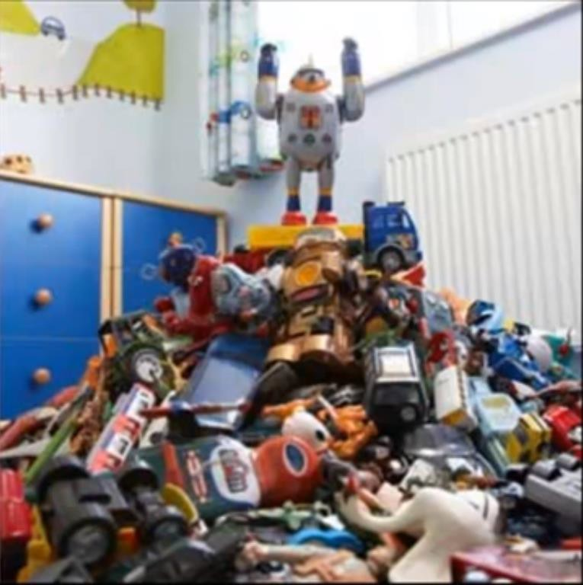

Need for OOP
Find green car without disturbing location of rest of toys
A program in a declarative language is a list of instructions. Few programmers can comprehend a program of more than a few hundred statements unless it is broken down into smaller units

Slide 31

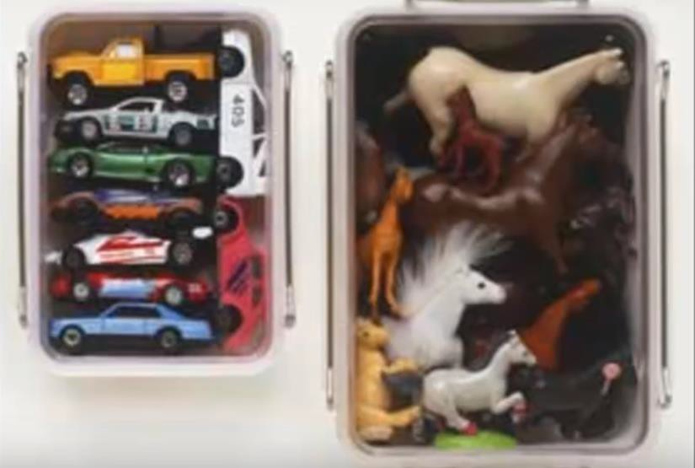


Need for OOP
the function was adopted as a way to make programs more comprehensible to their human creators
Organized into racks, easier to find green car

Slide 32


Need for OOP
unrestricted access to global data
Anyone can take out racks and change arrangement

Slide 33
Problems with Procedural Programming
Major problems with procedural programming
Unrestricted access of functions to global data
No coupling among functions and data, the basis of procedural programming, provide a poor model of the real world.

Slide 34
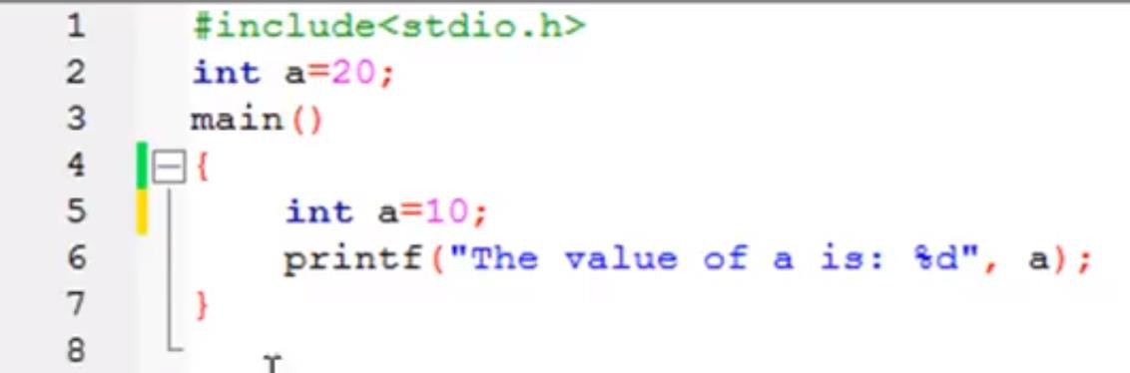
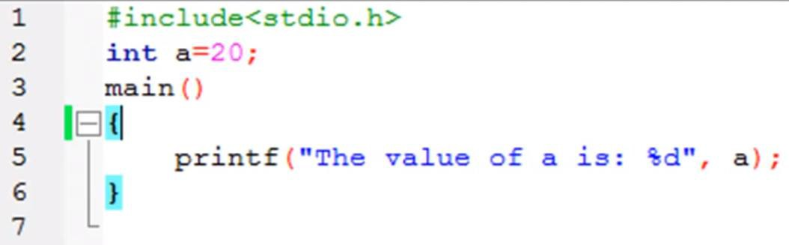
Global and Local Variables
Notes:
#include <iostream>using namespace std;int a=20;int main() { // Write C++ code here // int a=10; std::cout << ("Hello world!", a); return 0;}

Slide 35
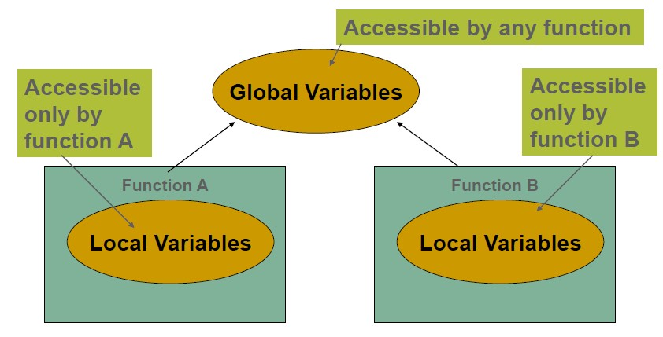
Unrestricted Access

Slide 36
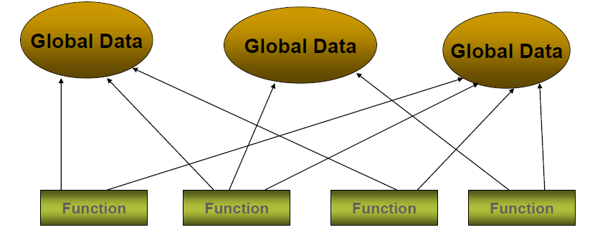
Functions and Data

Slide 37
Need for OOP
OOP was developed to overcome the limitations
of the traditional programming languages
As the programs gets larger in procedural
programming it becomes more complex to
understand the logic
identify bugs
change programs
Software Maintenance
10

Slide 38
OOP Approach
The fundamental idea behind object-oriented
language is to combine into a single unit both
data and
the functions that operate on that data.
Such a unit is called an object

Slide 39
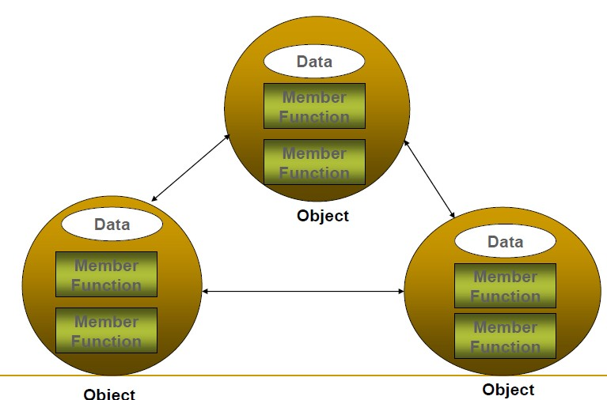
OOP Approach

Slide 40
Why Objects
A new way to think about software
Industrial revolution--reuse software, not rewrite
Increases
programmer productivity
quality of software
understandability of software
lifetime of software

Slide 41
Before we Start - The Bigger Picture
If you become part of a development team in industry, you might work on software systems that contain hundreds or even thousands of classes
In this course, we learn to use well-engineered framework for creating object oriented applications

Slide 42
Lesson 1
How to define a class

Slide 43
Class and Object
class Abc
{
int x;
void display()
{
// some statement
}
};
16

Slide 44
Defining a class with Member Function
The class definition begins with the keyword class followed by the class name
Naming
By convention, the name of a user-defined class begins with a capital letter
For readability, each subsequent word in the class name begins with a
capital letter.
Examples: Student, Employee, Person, GradeBook, ChessBoard
Every class’s body is enclosed in a pair of left and right braces ({
and })
The class definition terminates with a semicolon (;)
17

Slide 45
Access Modifier / Specifier
Class attributes and member functions appear after access
modifier or access specifier
Access specifiers are always followed by a colon ( : )
public:
attribute / function is “available to the public”
It can be called by other functions in the program (e.g. main)
It can be called by member functions of other classes (if any)
private
attribute / function is “not available to the public”
It cannot be called by other functions in the program (e.g. main)
It cannot be called by member functions of other classes (if there are any)

Slide 46
Class
class Abc
{
int x;
void display()
{
// some statement
}
};

Slide 47
Example 1:Class Box
Create a class named Box that has following data
members:
double length // Length of a box double breadth // Breadth of a box double height // Height of a box
20

Slide 48
Example 1: Class Box
class Box { public:
double length; double breadth; double height;
};

Slide 49
Example 2: Class Student
Create a class named Student that has following
data members:
rollNumber name
// Student’s roll number
// Student’s Name

Slide 50
Example 2: Class Student
#include <iostream>
#include <string>
using namespace std; class Student
{
public:
int rollNumber;
string name;
};

Slide 51
Lesson 2
How to create an Object
24

Slide 52
Class and Object
class Abc
{
int x;
void display()
{
// some statement
}
};
int main()
{
Abc obj;
}
// Object of class Abc created

Slide 53
Example 1: Class Box
Create a class named Box that has following data
members:
double length // Length of a box double breadth // Breadth of a box double height // Height of a box
Create 2 Objects of class Box

Slide 54
Example 1: Class Box
class Box { public:
double length; double breadth; double height;
};
int main()
{
Box Box1;
Box Box2;
}

Slide 55
Example 2: Class Student
Create a class named Student that has following
data members:
rollNumber name
// Student’s roll number
// Student’s Name
Create 2 Objects of class Student

Slide 56
Example 2: Class Student
#include <iostream>
#include <string>
using namespace std; class Student
{
public: int rollno;
string name;
};
int main()
{
Student A;
Student B;
}

Slide 57
Lesson 3
Accessing the Data Members
30

Slide 58
Accessing the Data Members
The public data members of objects of a class
can be accessed using
– the direct member access operator (.)

Slide 59
Example 2: Class Student
Create a class named Student that has following
data members:
rollNumber =12345 name = Ali
Access rollNumber and display it

Slide 60
Example 2: Class Student
#include <iostream>
#include <string> using namespace std; class Student
{
public:
int rollNumber=12345;
string name="Ali";
};
int main()
{
Student A;
cout<<A.rollNumber;
}

Slide 61
Example 2: Class Student
#include <iostream> using namespace std; class Student
{
public: int rollno;
string name;
};
int main()
{
Student A;
A.rollno=12345; A.name=“Ali";
cout <<"Name of A is: "<< A.name ;
}

Slide 62
Example 1: Class Box
Using Class Box, create an object and assign it
following values:
height length breadth
5
6
7

Slide 63
Example 1: Class Box
#include <iostream> using namespace std;
class Box { public:
double length;
// Length of a box
double breadth; // Breadth of a box
double height; // Height of a box
};

Slide 64
Example 1: Class Box
int main() { Box Box1;
Box1.height = 5;
Box1.length = 6;
Box1.breadth = 7; cout << Box1.height; return 0;
}

Slide 65
Example 1: Class Box
Using Class Box, create an object and assign it
following values:
height length breadth
5
6
7
Compute volume of the box

Slide 66
Example 1: Class Box
#include <iostream> using namespace std;
class Box { public:
double length;
// Length of a box
double breadth; // Breadth of a box
double height; // Height of a box
};

Slide 67
Example 1: Class Box
int main() {
Box Box1;
double volume = 0; Box1.height = 5;
Box1.length = 6;
Box1.breadth = 7;
volume = Box1.height * Box1.length * Box1.breadth;
cout << "Volume of Box1 " << volume <<endl; return 0;
}

Slide 68
Example 1: Class Box
Using Class Box:
Create 2 Box objects
Assign them height length breath
Compute volume of both objects.

Slide 69
Example 1: Class Box
#include <iostream> using namespace std;
class Box { public:
double length;
// Length of a box
double breadth; // Breadth of a box
double height; // Height of a box
};
Notes:
#include <iostream>
using namespace std;
class Box { public:
double length;
double breadth; // Breadth of a box
double height; // Height of a box
};
int main() {
Box Box1,Box2; double volume = 0;
Box1.height = 5;
Box1.length = 6;
Box1.breadth = 7;
Box2.height = 10;
Box2.length = 12;
Box2.breadth = 13;
volume = Box1.height * Box1.length * Box1.breadth;
cout << "Volume of Box1 : " << volume <<endl;
volume = Box2.height * Box2.length * Box2.breadth; cout << "Volume of Box2 : " << volume <<endl; return 0;
}

Slide 70
Example 1: Class Box
int main() {
Box Box1,Box2; double volume = 0;
Box1.height = 5;
Box1.length = 6;
Box1.breadth = 7;
Box2.height = 10;
Box2.length = 12;
Box2.breadth = 13;
volume = Box1.height * Box1.length * Box1.breadth;
cout << "Volume of Box1 : " << volume <<endl;
volume = Box2.height * Box2.length * Box2.breadth; cout << "Volume of Box2 : " << volume <<endl; return 0;
}
43

Slide 71
Lesson 4
Back to Procedural Programming
44

Slide 72
Back to Procedural Programming
Write a function that:
–Displays message “Welcome to
gradebook
Invoke the function
45

Slide 73
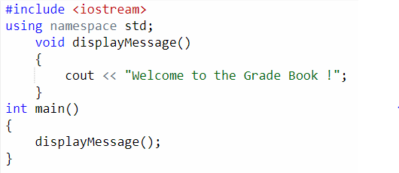
Example 3: Grade Book
46

Slide 74
Lesson 5
Classes with Member functions

Slide 75
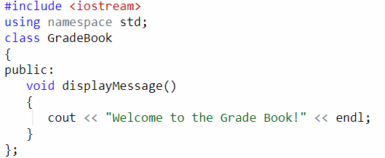
Example 3: Class Grade Book

Slide 76
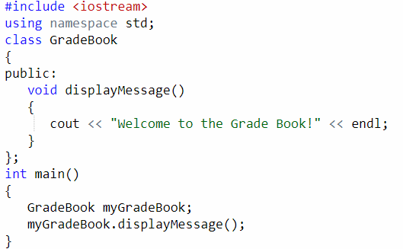
Example 3: Class Grade Book
49

Slide 77
Lesson 6
Function with a Parameter
50

Slide 78

Example 3: Grade Book
Write a function that:
–Prompts User to enter Course Name
–Displays message “Welcome to gradebook for” followed by entered course name
Invoke the function
51

Slide 79
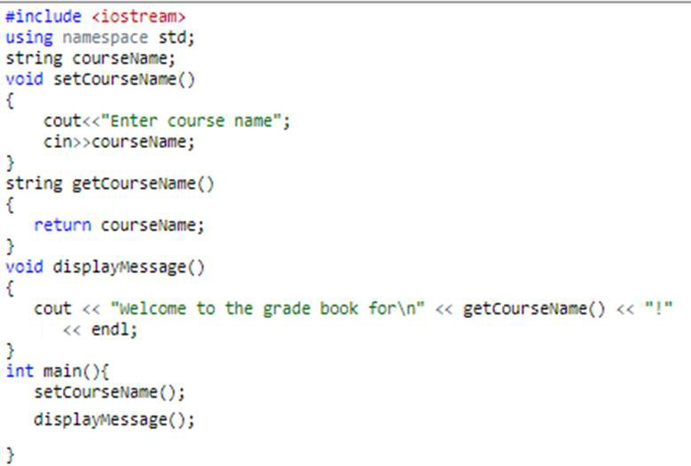
Example –Grade Book

Slide 80
Lesson 7
How to define a Member Function
Continued

Slide 81

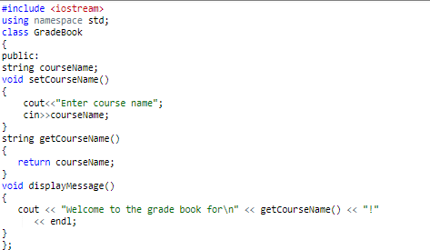
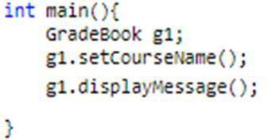
Example – Class Grade Book

Slide 82

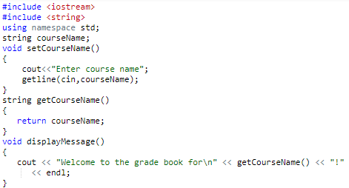

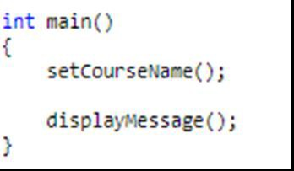
Example – Class GradeBook

Slide 83


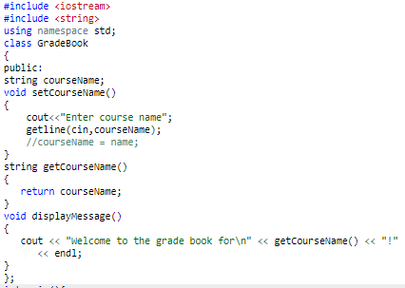



Example – Class GradeBook

Slide 84
Lesson 8
Data Members, set Functions and get
Functions
2

Slide 85
ENCAPSULATION
Member functions in C++, typically provide
the only way to access its data.
If you want to read a data item in an object, you call a member function in the object

Slide 86
ENCAPSULATION
It will access the data and return the value to
you. You can’t access the data directly.
The data is hidden, so it is safe from accidental alteration. Data and its functions are said to be encapsulated into a single entity.

Slide 87
What if everything was declared public
Let
me show you the use of the access
Specifiers with the box example.
5

Slide 88
Example 1: Class Box
#include <iostream> using namespace std;
class Box { public:
int length;
// Length of a box
int breadth; // Breadth of a box
int height; // Height of a box
};
6

Slide 89
Example 1: Class Box
int main() { Box Box1;
Box1.length = -1; cout << Box1.length;
return 0;
}
7

Slide 90
What if everything was declared public
Because the length was in the public section of the class declaration, it can be accessed directly and thus changed using
Box1.length= ...
It could be easily changed to -100
But there are no boxes with negative length!

Slide 91
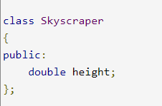
What if everything was declared public
Let
me show you the use of the access
Specifiers with the skyscrapper example.
9

Slide 92
What if everything was declared public

Slide 93
What if everything was declared public
Because the height was in the public section of the class declaration, it can be accessed directly and thus changed using
s.height = ...
It could be easily changed to -10000.0 m.
But there are no skyscrapers with negative height!

Slide 94
What if everything was declared public
We can check the height before assigning it. But in such a case you would have to do it directly in the main class and that is not a very good design.
Why would I assign -10000 to a height of a skyscraper?
12

Slide 95
What if everything was declared public
This can actually happen unintentionally by:
– Obtaining the height by file reading and read the wrong column.
– Computing
the height of the skyscraper the number of floors) and
the
(e.g. from
entered an incorrect formula
function that computes it.
into
13

Slide 96
The set and get method
Solution? Private/Protected Access Modifier
Now you can no longer change the height by writing
s.height = ...
You will get a compilation error.
But how do we assign a value to the height and how will we retrieve it?

Slide 97
The set and get method
To that end we use accessor and mutator
methods (get and set).
In our case we will call them getHeight and
setHeight.
In theory, you can call these functions whatever you like, but calling them get and set makes their functionality understandable.

Slide 98
Getter
To | allow | other to read | the | value of
a | private | data member says | xxx, | you shall
provide a get function (or getter or accessor
function) called getXxx().
A getter need not expose the data in raw format. It can process the data and limit the view of the data others will see. Getters shall not modify the data member.

Slide 99
Setter
To allow other classes to modify the value of a private data member says xxx, you shall provide a set function (or setter or mutator function) called setXxx().
A setter could provide data validation (such as range checking), and transform the raw data into the internal representation.

Slide 100
Data Members of a Class
Attributes are represented as variables (called
data members) in a class definition
Data Members are declared in a class
Each object of a class maintains its own copy of
its attributes in memory
Generally, data members should be declared private and member functions should be declared public
A class comprises of member functions that manipulate the attributes
18

Slide 101
Example 1: Class Box
Using Class Box, create an object and assign it
following values:
length 1
19

Slide 102
Example 1: Class Box
#include <iostream> using namespace std;
class Box { public:
int length;
// Length of a box
int breadth; // Breadth of a box
int height; // Height of a box
};
20

Slide 103
Example 1: Class Box
int main() { Box Box1;
Box1.length = 1; cout << Box1.length;
return 0;
}
21

Slide 104
Example 1: Class Box
Using Class Box, create an object and assign it
following values through getters and setters
length 1
22

Slide 105
#in clude < iost r·e am> #in clu de < st ring> u sing na espace std ;
cla ss Box { private ::: int lengt h :; II Length int b¹rea dt h ; II Breadt int hei,ght :; 11 Height pub¹lic :: int ,getlengt h ( ) | int main(} [ Booc Box.1_; Box1.setlength (1); cout<<Box.1,.get ength( ) ; }
{ retu rn length ; } void setlength ( int a ) { lengt h= a ,; }

