Slide 1
CS212 – Object Oriented Programming
Constructors
Week – 04
Dr. Khuram Shazhad
mkhuram.shahzad@seecs.edu.pk
Office: A-308

Slide 2
Outline
a) Initializing Objects with Constructors

Slide 3
Lesson
Initializing Objects with Constructors

Slide 4
Initializing an Object with Constructor
A constructor is a special kind of class member function that is automatically called when an object of that class is instantiated.
Constructors are typically used to
initialize
member variables of the class to appropriate default or user-provided values, or to do any setup steps necessary for the class to be used (e.g. open a file or database).

Slide 5
Initializing an Object with Constructor
C++ requires a constructor call for each object
that’s created
which helps ensure that each object is initialized properly before it’s used in a program
When an object of class GradeBook is created, its data member courseName is initialized to the empty string by default
What if you want to provide a course name when you create a GradeBook object?

Slide 6
Default Constructor
If a class does not explicitly include a constructor, the compiler provides a default constructor
default constructor provided by C++ : a constructor with no parameters
The default constructor provided by the compiler creates a GradeBook object without giving any initial values to the object’s fundamental type data members

Slide 7
Constructor
When ever an object is created, a special
function is called
The Constructor function
ensure that each object is initialized properly before it’s used in a program
The constructor function is defined inside the class body similar to other functions
If a class does not explicitly include a constructor, the compiler provides a default constructor: a constructor with no parameters

Slide 8
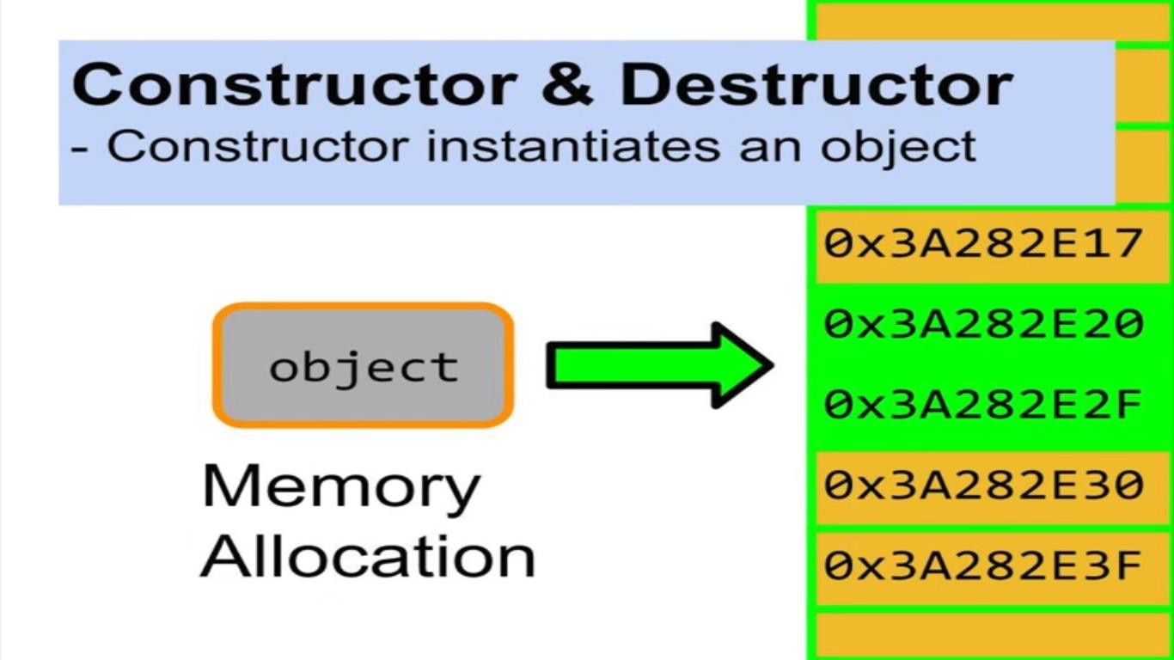
Constructor

Slide 9



Constructor Syntax
Class Box
{
…..
…..
Box(){
The name of the constructor function is same as that of the class
height=0;width=0;length=0;
Constructor functions have no return type not even void
}
};
The parameter list : empty, 1, n

Slide 10
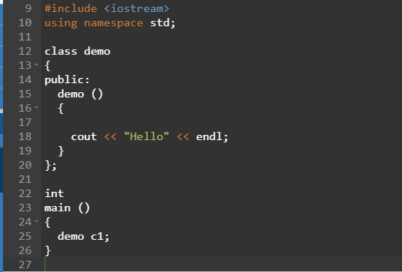
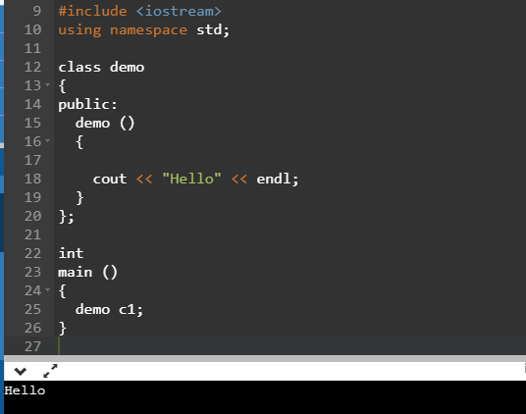
Constructor: Example Output
Notes:
#include <iostream>
using namespace std;
class demo{
public:
demo ()
{ cout << "Hello" << endl;
}
};
int main()
{
demo c1;
return 0;
}

Slide 11
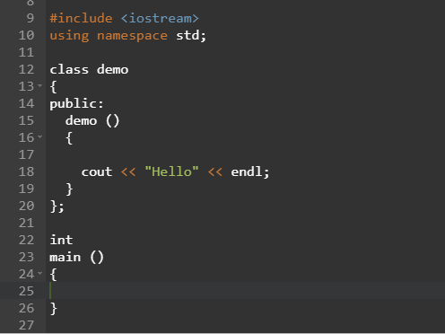

Constructor: Without Object

Slide 12
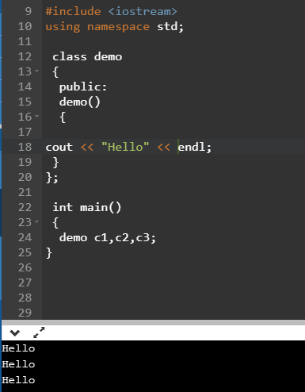
Constructor and Multiple Objects

Slide 13
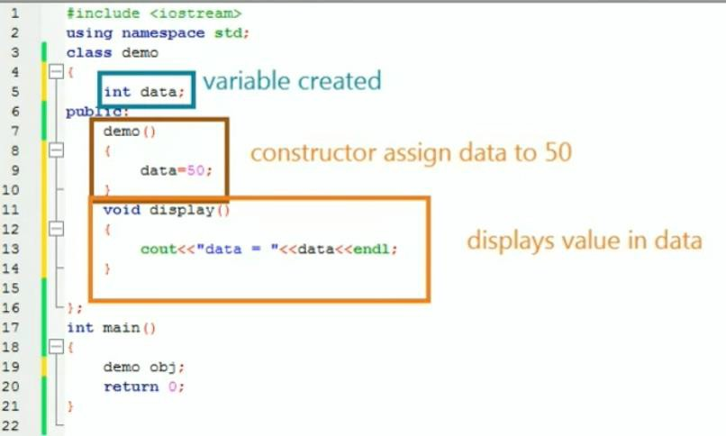
Constructor: Example 2
Notes:
#include <iostream>
using namespace std;
class demo
{
int data;
public:
demo ()
{
data = 50;
}
void display()
{
cout<<"Data = "<<data<<endl;
}
};
int main() {
demo obj;
//obj.display();
return 0;
}

Slide 14
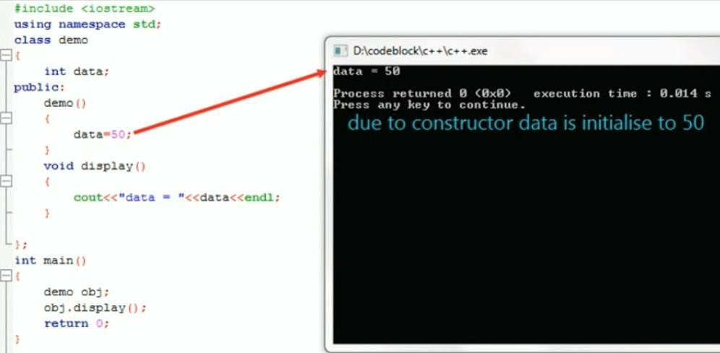
Constructor: Example 2 Output

Slide 15
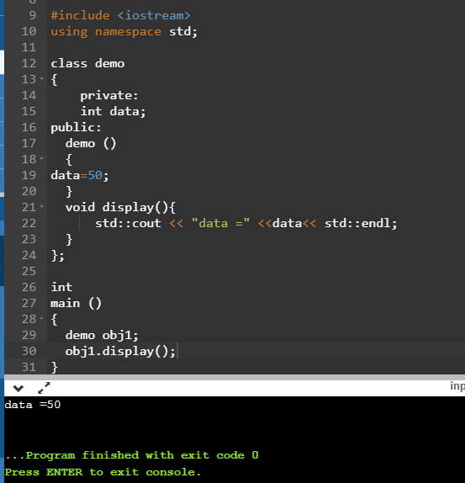
Constructor: Example 2 Output

Slide 16


Basic Characteristics

Slide 17
Constructor Types
Default Constructor
Also called no argument constructor
A constructor with default parameter values
Parameterized Constructor OR Overloaded
Constructor
Simple Parameterized Constructor
Copy Constructor
Initializer list Constructor

Slide 18
Two Ways to Provide a Default Constructor for a Class
A class can get a default constructor in one of two ways:
1. The compiler implicitly creates a default
constructor in a class that does not define a
constructor. Such a constructor does not
An
a
initialize the
uninitialized
class’s data members.
variable typically contains
“garbage” value.

Slide 19
Two Ways to Provide a Default Constructor for a Class
2. You explicitly define a constructor that takes no arguments.
If you define a constructor with arguments, C++ will not implicitly create a default constructor for that class

Slide 20
Constructor – Default Example 1
class Box {
private:
int height; int width; int length;
public:
Box()
{
height = 10;
width = 5;
length = 5;
}
};
void main()
{
Box B1;
}

Slide 21
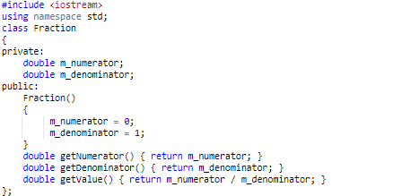

Constructor – Default Example 2
Notes:
#include <iostream>
using namespace std;
class Fraction
{
private:
double m_numerator;
double m_denominator;
public:
Fraction()
{
m_numerator = 0;
m_denominator = 1;
}
double getNumerator() { return m_numerator; }
double getDenominator() { return m_denominator; }
double getValue() {return m_numerator / m_denominator; }
};
int main() {
Fraction frac;
cout<<frac.getValue();
return 0;
}

Slide 22
Parameterized Constructors
While the default constructor is great for ensuring our classes are initialized with reasonable default values, often times we want instances of our class to have specific values that we provide.
Fortunately, constructor is a function, so it can also have parameters
These parameters can be used to do any task
Mainly for initializing the data members
For any other desired functionality in the class

Slide 23
Parameterized Constructors Example 1
class Box {
private:
int height; int width; int length;
public:
Box(int x, int y, int z){
height = x; width = y; length = z;
}
int volume();
};

Slide 24
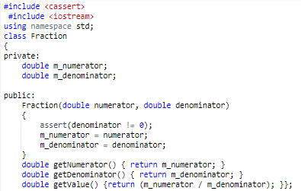
Parameterized Constructors Example 2

Slide 25
Arguments to Constructors
To pass the arguments to constructor we do not
need to call it explicitly.
We pass the arguments to the object.

Slide 26
Arguments to Constructors Example 1
class Box {
private:
int height; int width; int length;
public:
void main()
{
int a, b, c; cin >> a >> b
>>
Box
}
Box(int x, int | y, | int | z){
height = x;
width = y;
length = z;
c;
B1(a,b,c);
}
int volume();
};

Slide 27

Arguments to Constructors Example 2
Notes:
#include <iostream>
//#include <cassert>
using namespace std;
class Fraction
{
private:
double m_numerator;
double m_denominator;
public:
Fraction(double numerator, double denominator)
{
//assert(denominator !=0);
m_numerator = numerator;
m_denominator = denominator;
}
double getNumerator() { return m_numerator; }
double getDenominator() { return m_denominator; }
double getValue() {return m_numerator / m_denominator; }
};
int main() {
Fraction frac(1,2);
cout<<frac.getValue();
return 0;
}

Slide 28
Parameterized Constructors
Example 3
#include <iostream> using namespace std;
class Rectangle {
int width, height;
int main () Rectangle Rectangle
{
rect (3,4);
rectb (5,6);
public: Rectangle (int
{
width = a; height = b;
}
int area ()
{
a, int b)
cout << "rect area: " << rect.area() << endl;
cout << "rectb area: " <<
rectb.area() << endl;
return 0;
}
return (width*height);
}
};
14
Notes:
#include <iostream>
using namespace std;
class Rectangle {
int width, height;
public:
Rectangle (int a, int b)
{
width = a;
height = b;
}
int area ()
{
return (width*height);
}
};
int main () {
Rectangle rect (3,4);
Rectangle rectb (5,6);
cout << "rect area: " << rect.area() << endl;
cout << "rectb area: " << rectb.area() << endl;
return 0;
}

Slide 29
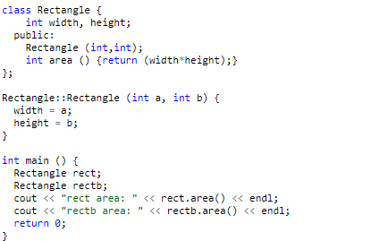





Self Exercise 1
Integers a and b have not been given any values here
Gives an error
What will happen if we miss an argument here?
Error description
error: no matching function for call to 'Rectangle::Rectangle()
………………
candidate expects 2 arguments, 0 provided

Slide 30
Overloaded Constructors
Multiple constructors may be defined
Which
of the two constructors is
executed when an object is created depends on how many arguments are used when an object is defined.
16

Slide 31


Overloaded Constructors
Class Box
{
…
Box(){
A class can have > 1
constructor
height=0;width=0;length=0;
}
Box(int
height
h, int w, int l){
= h;
Overloaded constructors
width = w;
in a class must have different parameter lists
length = l;
}
};
17

Slide 32




Overloaded Constructors Example 1
class Box {
private:
int
int int
public:
height; width; length;
int void main()
{
Box Box
B2; B1(10,
Box(){
height=0;width=0;length=0;
}
Box(int h, int w, int l){
height = h; width = w; length = l;
}
int cal_volume(){
return height*width*length;
}
};
15, 10);
cout | << | B1. | cal_volume();
cout | << | B2. | cal_volume();
}
18
Notes:
#include <iostream>
using namespace std;
class Box {
private:
int width, height, length;
public:
Box(){
height=0;width=0;length=0;
}
Box(int h, int w, int l)
{
height = h; width = w; length = l;
}
int cal_volume()
{
return height*width*length;
}
};
int main () {
Box B2;
Box B1 (10, 15, 10);
cout << "B1 volume: " << B1.cal_volume() << endl;
cout << "B2 volume: " << B2.cal_volume() << endl;
return 0;
}

Slide 33
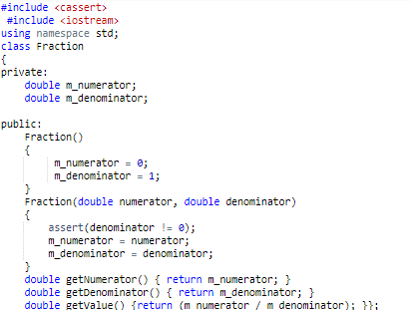
Overloaded Constructors Example 2

Slide 34
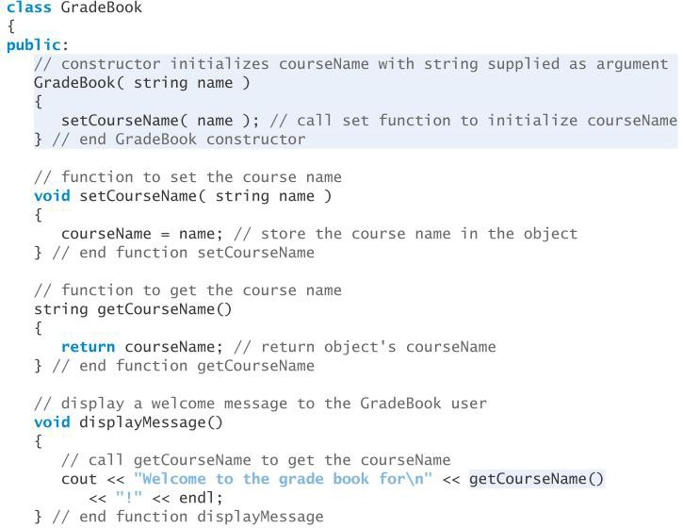

Defining a Constructor

Slide 35
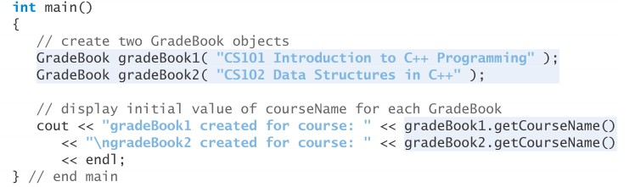
Testing Class GradeBook

Slide 36
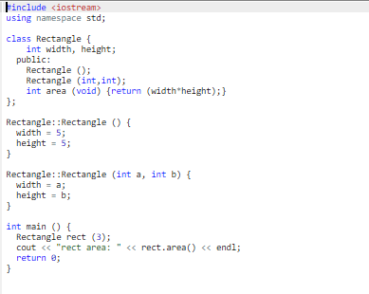


Self Exercise 2
Integers a and b have not been given any values here
What will happen if we miss an argument here?
Error description
Error: no matching function for call 'Rectangle::Rectangle(int)' Note: candidates are Rectangle::Rectangle(int, int)
Candidate expects 2 arguments, 1 provided

Slide 37
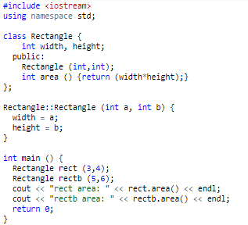
Self Exercise 3

Slide 38
Self Exercise 3
rect area: 12
rectb area: 30

Slide 39
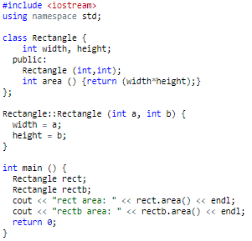
Self Exercise 4

Slide 40




Self Exercise 4
What will happen if we miss an argument here?
error: no matching function for call to 'Rectangle::Rectangle()' candidate expects 2 arguments, 0 provided

Slide 41
Constructor with Default Arguments
Similar to default arguments of functions, constructors may also have default arguments
These arguments are specified in the function prototype, if function is defined outside class body Or in the function header if the function is defined inside the class body.

Slide 42
Constructor with Default Arguments
class
Box { Box::Box(int a,int b,int c){
private:
height=a; width=b; length=c;
}
int height; int width; int length;
Default arguments values are entered here
public:
Box(int a = 5,int
int cal_volume();
};
b =10,int
c = 5); _{int}
Box::cal_volume(){
return length*width*height;
}
int main(){ Box b; b.cal_volume();
}

Slide 43
Constructor with Default initialization Values
class Box {
private:
int height; int width; int length;
public:
Box();
Box(int hval=2, int wval=4,int lval=6); int volume();
};
Box smallbox;

Slide 44
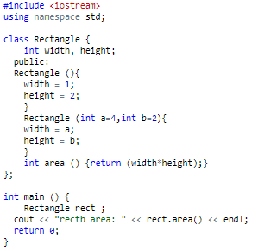
Self Exercise 5

Slide 45
Self Exercise 5
Error call of overloaded 'Rectangle()' is ambiguous

Slide 46
Constructor with Default initialization Values
We will get an error message from the compiler
We have an ambiguous call to an overloaded
function
A call with default parameter values is indistinguishable from a call to default constructor with no parameters
A constructor with default parameter values also serves as default constructor
If you get rid of the constructor with no parameters
than it will compile and execute ok.

Slide 47
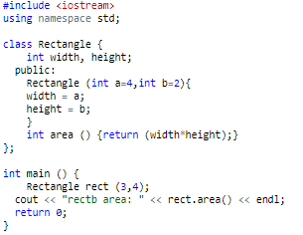
Constructor with Default Arguments

Slide 48
Constructor with Default Arguments
Which Value is
considered?

Slide 49
Constructor with Default Arguments
rectb area: 12

Slide 50
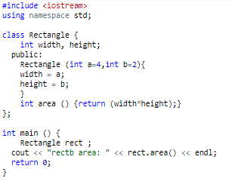
Constructor with Default Arguments

Slide 51



Constructor with Default Arguments
Integers a and b have been given default values
What will happen if we miss both arguments here?

Slide 52
Constructor with Default Arguments
rectb area: 8

Slide 53
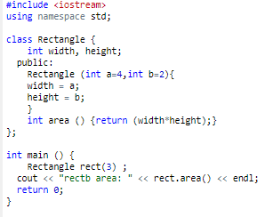
Self Exercise 6

Slide 54
Self Exercise 6
Integers a and b have been given default values
What will happen if we miss an argument here?

Slide 55
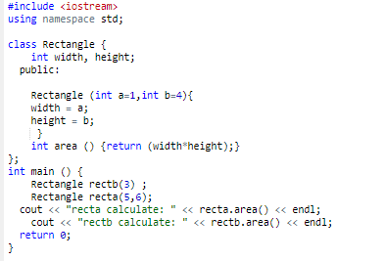
Self Exercise 6
Integers a and b have been given default values

Slide 56


Self Exercise 6
Integers a and b have been given default values
recta calculate: 30
rectb calculate: 12

Slide 57



Self Exercise 6
IMPORTANT FACT
If you miss
a parameter, the
compiler
assumes that missing.
the rightmost
parameter is

Slide 58
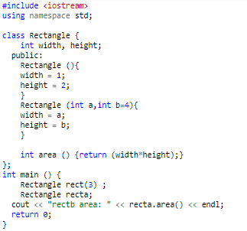
Self Exercise 7

Slide 59
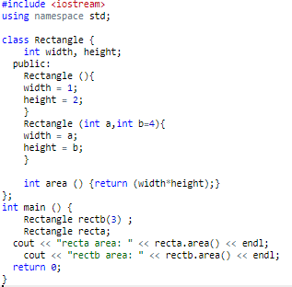





Self Exercise 7
Integers a has not been given default values
recta area: 2
rectb area: 12

Slide 60
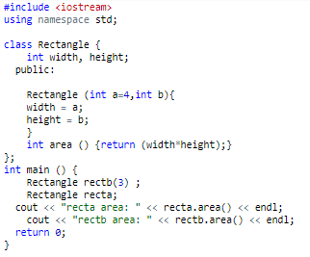
Self Exercise 8

Slide 61





Self Exercise 8
Error: default argument missing for parameter 2 of 'Rectangle::Rectangle(int, int)'
b should also be assigned default value

Slide 62
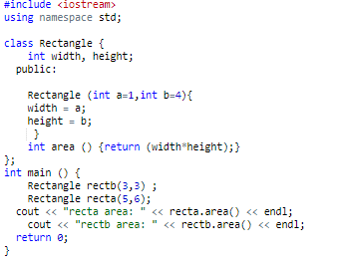
Self Exercise 8

Slide 63


Self Exercise 8
recta area: 30
rectb area: 9

Slide 64



Self Exercise
IMPORTANT FACT
You cannot miss a default argument after the
occurrence of a default argument.

Slide 65
Self Exercise
IMPORTANT FACT
You cannot miss a default
between two arguments
argument in

Slide 66
Single/Multiple Default Argument
If you want a single default argument, make
sure the argument is the last one.
If you want multiple default values, make sure
they are last ones.

Slide 67
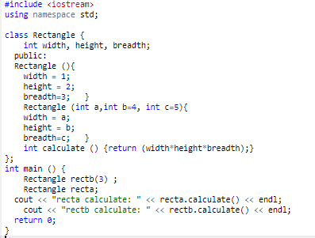
Single/Multiple Default Argument

Slide 68



Single/Multiple Default Argument
recta calculate: 6
rectb calculate: 60

Slide 69
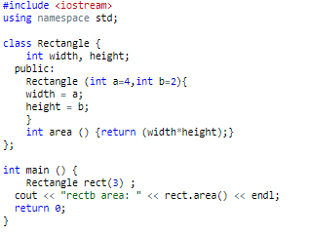
Self Exercise
Integers a and b have been given default values here
What will happen if we miss an argument here?

Slide 70

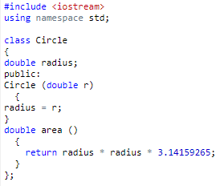
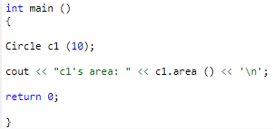
Constructors Exercise

Slide 71
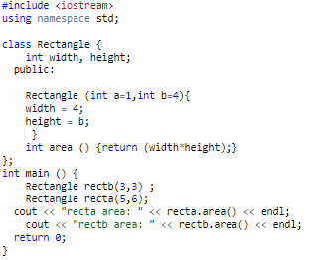
Self Exercise 9

Slide 72
Self Exercise 9
For {width = 4; height = b;}
recta area: 24, rectb area: 12
What if {width = a; height = 4;}
Or
{width = 4; height = 4;}
Notes:
#include <iostream>
using namespace std;
class Rectangle {
//private:
int width, height;
public:
Rectangle (int a=1, int b=4){width = 4; height = b;}
int area () { return width*height;} //output ? width = 4
};
int main () {
Rectangle recta (5,6); //height 6
Rectangle rectb (3,3); //height 3
cout << "rects area: " << recta.area() << endl;
cout << "rects areb: " << rectb.area() << endl;
return 0;
}

Slide 73
Lesson 1
How to validate Data
using
set Functions ?

Slide 74
Data Integrity
Refers to correctness or rationality of a piece
of Data
How to ensure data integrity ?
Making data members private
controlling access, especially write access through public member functions

Slide 75
Data Integrity through set Functions
The public set functions should carefully check
/ scrutinize any attempt to modify the value of
a data member
The programmer has to make sure that each data member is assigned appropriate set of values

Slide 76
Examples
an attempt to set the day of the month to 37
should be rejected
an attempt to set a person’s weight to zero or a negative value should be rejected
an attempt to set a grade on an exam to 185 (when
the proper range is zero to 100) should be rejected
Lets define set Function to ensure data integrity of data member “courseName” in class GradeBook

Slide 77
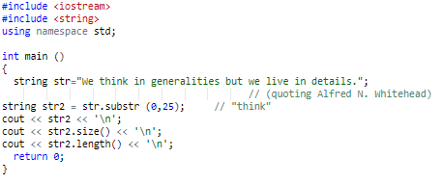
String

Slide 78
setCourseName (string name)
void GradeBook::setCourseName( string
{
name )
if ( name.length() <= 25 ) courseName = name;
if ( name.length() > 25 ) { courseName = name.substr( 0, 25 );
cout << "Name \"" << name << "\" exceeds length (25).\n"
<< "Limiting courseName to first 25 characters.\n" << endl;
} // end if
maximum
}

Slide 79
Calling Set Functions from Constructor
The Constructors must take advantage of data
validation performed in set Functions
Should we duplicate the code ?
–Never

Slide 80
Lesson 3
Member Functions Definition

Slide 81
Member Functions Definition
Member functions can be defined:
Within the class definition or
Separately using scope resolution operator

Slide 82
Within the class definition-Example1
class Box {
private:
double length; // Length of a box double breadth; // Breadth of a box double height; // Height of a box public:
double getVolume() {
return length * breadth * height;
}
};

Slide 83
scope resolution operator Example1
class Box {
private:
double length; // Length of a box double breadth; // Breadth of a box double height; // Height of a box public:
double getVolume();
};

Slide 84
scope resolution operator Example1
double getVolume(void)
{
return length * breadth * height;
}

Slide 85
class Box {
private:
double length; // Length of a box double breadth; // Breadth of a box
double public: double
};
height; // Height of a box
getVolume();
double Box::getVolume() { return length * breadth * height;
}

Slide 86
Within the class definition-Example2
class myclass{
private:
int data; public:
void setdata (int d)
{
data = d;
}
void showdata()
{
cout<< “Data is” <<data<<endl
}
};

Slide 87
scope resolution operator Example2
class myclass{
private:
int data; public:
void setdata (int d){
data = d; }
void showdata()
}; //class definition ends
void myclass::showdata()
{
cout<< “Data is” <<data<<endl; // Member functions definitions
}

