Slide 1

Object Oriented Programming using C++
Constructors Continued
Week – 05-1
Dr. Khuram Shazhad
mkhuram.shahzad@seecs.edu.pk
Office: A-308

Slide 2
Initialization
Class data member cannot be initialized at
declaration time
By default all data members have garbage value
If all members are declared public then, they can be
initialized at object declaration time
Otherwise we require a constructor for this
Object Oriented Programming

Slide 3
Initialization List
Constructor initialize private data members
Through Assignment
For initialization using assignment the data member is created first and then initialized
Through Initializer list
The initial value is used to initialize the data member (private) as it is created

Slide 4
Constructor – Default
class Box {
private:
int height; int width; int length;
public:
Box(); Box(int,int,int); int volume();
};
Box::Box()
{
height = 10;
width = 5;
length = 5;
}

Slide 5
class Box {
private:
int height; int width; int length;
public:
Box();
int volume();
};
Box::Box()
{
height = 10;
width = 5;
length = 5;
}
Box::Box() : height(10),width(5),length(5)
{
}

Slide 6
class Box { private: int height; int width; int length; public: Box(); Box(int,int,int); int volume(); };
 |  | Box::Box(int a, int b, int c) { height = a; width = b; length = c; }
Box::Box(int a, int b, int c) : height(a),width(b),length(c)
{
}

Slide 7

Constructors Example

Slide 8
Initialization List
When a constructor is used to initialize other members, these other members can be initialized directly, without resorting to statements in its body.
This is done by inserting, before the constructor's body, a colon (:) and a list of initializations for class members. For example, consider a class with the following declaration:

Slide 9
Initialization List

Slide 10


Initialization List Example
Class Distance
{
private:
int feet; float inches
public:
Class Distance
{
private:
int feet; float inches
public:
};
Distance(){
feet=0; inches = 0.0;
}
Distance() : feet(0), inches(0.0)
{ }
};

Slide 11

Initialization List Example
Class Distance
{
private:
int feet; float inches
public:
Distance(int ft, float in){
feet = ft; inches = in;
}
};
Class Distance
{
private:
int feet; float inches
public:
Distance(int ft, float in): feet(ft), inches(in)
{ }
};

Slide 12

Initialization List Example
Class Distance
{
private:
int feet; float inches
public:
Distance(){
feet=0; inches = 0.0;
}
}
Class Distance
{
private:
int feet; float inches
public:
Distance(int ft, float in){
feet = ft;
inches = in;
}
Distance() : feet(0), inches(0.0)
{ }
Distance(int ft, float in): feet(ft), inches(in)
{ }
}

Slide 13
Initialization List Example
Box::Box() : length(0),width(1),height(1)
{
cout<< “Box default constructor is called” << endl;
}
Box::Box(double l, double w, double h) : length(l),width(w),height(h)
{
cout<< “Box constructor is invoked” << endl;
}

Slide 14
Default Copy Constructors
Suppose we declare and initialize box object firstBox
with this statement
Box B1(10, 15, 10);
Now we want to create another box object, identical to the first.
We want to initialize 2nd box object with first

Slide 15



Example
void main()
{ Box B1(2, 4, 6); Box B2(B1);
cout <<“volume of 1st box=“
cout << B1.cal_volume()<<endl;
cout <<“volume of 2nd box=“
cout << B2.cal_volume();}
OUTPUT
Box constructor called volume of 1st box=48 volume of 2nd box=48

Slide 16
Default Copy Constructors
Constructor was called only once.
How was B2 object created ??

Slide 17
Default Copy Constructors
The compiler generates a default version of what is
referred to as a copy constructor.
A copy constructor creates an object of a class by initializing it with an existing object of the same class.
The default version of copy constructor creates new object by copying existing object member by member.
You can use the copy constructor in this way for any data types

Slide 18
Default Copy Constructors
The default copy constructor is fine for simple classes
But for many classes that have pointer as members
may produce undesirable results

Slide 19
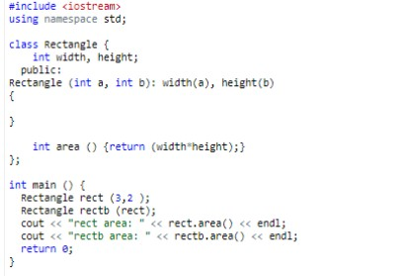
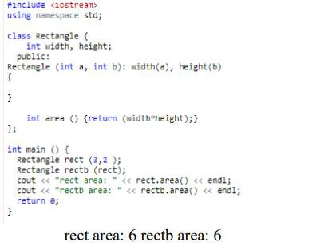
Default Copy Constructors

Slide 20
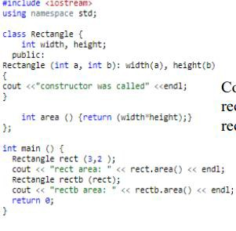
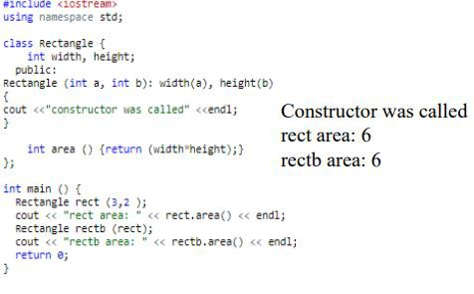



Default Copy Constructors
Output??
20

Slide 21
Destructors
Every Class has a Destructor
If you do not explicitly provide a destructor, the
compiler creates an “empty” destructor

Slide 22
Destructor - Usage
To de-allocate anything that was allocated during
the lifetime of an object
If you have not allocated anything in the lifetime of an object, there is no point in having a destructor in your class

Slide 23
Destructor
A class’s destructor is called implicitly when an
object is destroyed.
an automatic object is destroyed when program execution leaves the scope in which that object was instantiated
➢Scope refers to the life time of an object
➢For Example: The function that created an object is finished, it will automatically call its destructor

Slide 24
Destructors
Task: Opposite to constructor
Classname:: ~Classname( ){
}
A default do-nothing destructor is provided by the compiler.
Only one destructor per function class
No arguments - no return values

Slide 25
Destructors
Public member function automatically called when
an object is destroyed
Destructor name is ~className, e.g.,
Has no return type
Takes no arguments
Only 1 destructor is allowed per class
(i.e., it cannot be overloaded)
~Square

Slide 26
Destructors don'ts
Errors :
❑to attempt to pass arguments to a destructor
to specify a return type for a destructor (even void cannot be specified)
❑to return values from a destructor – to over-load a destructor

Slide 27
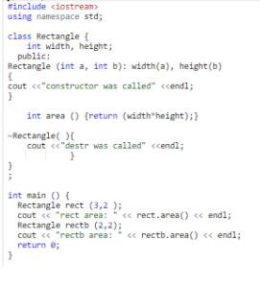
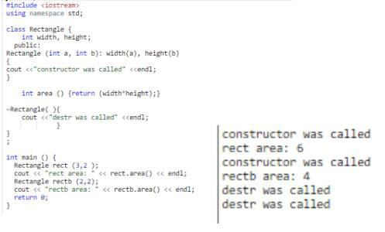
Destructors

