Slide 1
CS212 – Object Oriented
Programming
C++
Scope Rules Static Class Members
Static Member Functions
Constant Variables
Week – 05-2
Dr. Khuram Shazhad
mkhuram.shahzad@seecs.edu.pk
Office: A-308
1

Slide 2
Outline
Scope Rules
Local Variable
Global Variables
Static Variables
Static Class Members
Static Member Functions
Constant Variables
2

Slide 3

Scope Rules
Lesson 1
3

Slide 4
Scope
A scope is a region of a program

Slide 5
Scope of Variables
Broadly speaking there are three places, where
variables can be declared −
Inside a function or a block which are called
local variables.
In the definition of function which are called
formal parameters/parameter-list.
Outside of all functions which are called
global variables.

Slide 6
Local Variables
They can be used only by statements that are inside that function or block of code.
Variables defined local to a function disappear at the end of the function scope.
Local variables are not known to functions
outside their own.

Slide 7
Local Variables – Example
#include <iostream>
using namespace std;
int someFunction()
{
int a, b; // Local
int c;
variable
declaration
Output
// initialization a = 10;
b = 20;
c = a + b;
return c;
error: 'a' was not declared in this scope
error: 'b' was not declared in this scope
}
int main ()
{
cout << someFunction(); cout << a << b;
}

Slide 8
Global Variables
Defined usually on top of the program.
Will hold their value throughout the life-time
of a program.
Can be accessed by any function.
Available outside the scope of the function, so it can be accidentally changed.

Slide 9
Global Variables
#include <iostream>
using namespace std;
// Global variable declaration and initialization int g = 20;
int main ()
{
cout << g; return 0;
}
Output
20

Slide 10
Global Variables – Example
#include <iostream>
using namespace std;
// Global variable declaration int g;
int main ()
{
// Local variable int a, b;
Output
declaration
30
// Initialization
a | = | 10;
b | = | 20;
g | = | a + b;
cout << g;
return 0;
}

Slide 11
Global Variables – Example
#include <iostream>
using namespace std;
// Global variable declaration & int g = 10;
int main ()
{
// Local variable declaration int a, b;
initialization
Output
30
// Initialization
a | = | 10;
b | = | 20;
g | = | a + b;
cout << g;
return 0;
}

Slide 12
Global Variables – Example
#include <iostream>
using namespace std;
// Global variable declaration int g = 10;
void display(int g) {
cout << g << endl;
10
10
30
}
Output
int main ()
// Local
{
variable declaration
int a, b;
cout << g << endl; display(g);
// Initialization
a = 10;
g = a +
cout <<
b = 20;
b;
g << endl;
}

Slide 13
Local & Global Variables – Naming
A program can have same name for local and global variables But
value of local variable inside a function will take preference.

Slide 14
Global Variables – Example
#include <iostream>
using namespace std;
// Global variable declaration int g = 10;
void display(int g) {
cout << g << endl;
Output
9
9
30
}
int main ()
// Local
{
variable declaration
int a, b;
int g=9;
cout << g << endl; display(g);
// Initialization
a = 10;
g = a +
cout <<
b = 20;
b;
g << endl;

Slide 15
Local Variables
i = 1
i = 1
i = 1
i = 1
i = 1
i = 1
i = 1
i = 1
#include <iostream> using namespace std;
void func() { int i=0;
cout << "i = " << ++i << endl; _{Output}
}
int main() {
for(int x = 0; x < 10; x++)
func();
}
i = 1
i = 1

Slide 16
Local and Global Variables
When you call the function again, storage for the local variables is created anew and the values are re-initialized.
If you want a value to be retained, you can define a global variable.
inadvertently changed.
But global | variable is available | outside | the
scope of | the function, so | it can | be

Slide 17
Global Variables
#include <iostream> using namespace std; int i=0;
void func() {
cout << "i = " << ++i << endl;
}
int main() {
for(int x = 0; x < 10; x++)
func();
}
i = 1
i = 2
i = 3
i = 4
i = 5
i = 6
i = 7
i = 8
i = 9
i = 10
Output

Slide 18

Static Variables
Lesson 2
18

Slide 19
Static Variables
To solve this issue we can create a static variable and give it an initial value.
The initialization is performed only the first time the function is called, and the data retains its value between function calls. This way, a function can “remember” some piece of information between function calls.
The second meaning of static is related to the first in the “unavailable outside a certain scope” sense.

Slide 20
Static Variables
The beauty of a static variable is that it is unavailable outside the scope of the function, so it can’t be inadvertently changed. This localizes errors.
The second meaning of static is related to the first in the “unavailable outside a certain scope” sense.

Slide 21
Static Variables
#include <iostream> using namespace std; void func() {
static int i=0;
cout << "i = " << ++i << endl;
}
int main() {
for(int x = 0; x < 10; x++)
func();
}
i = 1
i = 2
i = 3
i = 4
i = 5
i = 6
i = 7
i = 8
i = 9
i = 10
Output

Slide 22

static qualifier in OOP
Lesson 3
Data member
Member function
22

Slide 23
Common Data
What to do if you want to have some data common or shared across ALL objects in a class?
For example, in StudentResult Class
you want to keep track of how many objects
have been created OR
You want a data member that contains the average percentage of all students.
Or total number of students

Slide 24
Common Data
We can define class members static using static keyword
No matter how many objects of the class are created, there is only one copy of the static member
A static member is shared by all objects of the
class

Slide 25
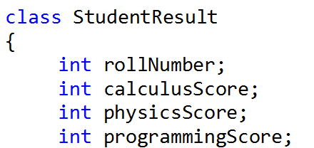

Static Data Member
If you want to have some data entity common to or shared across every object of a class, you make that data member “static”
};

Slide 26
Static Data Member
A static member is shared by all objects of the class and contains “class-wide” information (i.e., a property that is shared by all instances and is not specific to any one object of the class).
The
keyword static preceding class data
member means that there is only one copy of that member that is common to all instances of the class.

Slide 27
One copy shared by all objects
student1 | student2 | student3 | student4
9 | 34 | 28 | 12
80 | 79 | 65 | 85
75 | 79 | 65 | 85
95 | 79 | 65 | 85
4

Slide 28
Scope of static data
Static data members have class scope. It is visible only within the class, but its lifetime is the entire program.
It continues to exist even if there are no objects of the class.

Slide 29
Static Data Member
Static
members can be declared public,
private or protected.
Static data member is initialized by default to
0.
If you want a different initial value, a static
data member can be initialized once

Slide 30
Static Data Member
student1 | student2 | student3 | student4
9 | 34 | 28 | 12
80 | 79 | 65 | 85
75 | 79 | 65 | 85
95 | 79 | 65 | 85
4
const
static

Slide 31
Static Data Member
Static
statements.
The variable’s declaration appears in the
class definition
but the variable is actually defined outside
the class
member data requires two separate

Slide 32
Static Data Member Initialization
All static data is initialized to zero when the first object is created, if no other initialization is present
We can't put initialization in the class definition but it can be initialized outside the class
Initialization is done by redeclaring the static variable, using the scope resolution operator :: to identify which class it belongs to.

Slide 33
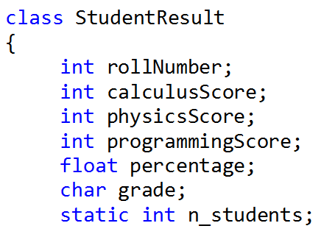
Static Data Member: Declaration
The variable’s declaration appears in the class definition
};

Slide 34

Static Data Member: Definition
but
the variable is actually defined
outside the class
};
};

Slide 35
Separate Declaration and Definition
Why is this two-part approach used?
If static member data were defined inside the class , it would violate the idea that a class definition is only a blueprint and does not set aside any memory.

Slide 36
Accessing static data of a class
To access a public static class member when no objects of the class exist, simply prefix the class name and the binary scope resolution operator (::) to the name of the data member.

Slide 37
Accessing static data of a class
To access a private class member, you need a member function.
To access a private static class member, you
need a static member function.

Slide 38
Static Member function
A static member function is a service of the class, not of a specific object of the class.
By declaring a member function static, you
make it independent of any particular object.
It can be called even when no objects of that
class exist.

Slide 39
Static Member function
Static member functions can only access static data members
Non-static methods can access both static and
non-static data members.

Slide 40
Box Class
Box Class Declaration
class Box { private:
int height, width, length; public:
Box ();
Box (int, int, int); void display();
};
41

Slide 41
Box Class
Box Implementation Program
#include <iostream> using namespace std;
Box::Box(){
height = width = length = 10;
}
….
….// Implementation of member functions continues
…….
42

Slide 42
Box Class
Box Class Declaration
class Box { private:
int height, width, length; public:
static int countBox; // Declaration Box ();
Box (int, int, int);
void display();
};
43

Slide 43
Box Class
Box Implementation Program
#include <iostream> using namespace std;
int Box::countBox = 0; // Definition
Box::Box(){
countBox++;
height = width = length = 10;
}
….
….// Implementation of member
…….
functions continues
44

Slide 44
Box Class
Client Program
#include <iostream> using namespace std; void main()
{
Box B1;
cout << Box::countBox << endl; Box B2;
Box::countBox=9;
cout << B2.countBox << endl;
}
45

Slide 45
Static Member function
static class variables (or data members)
“Class-wide” data
Property of class, not specific to object of class
Efficient when single copy of data is enough
It mainly represents the shared data
Only the static variable has to be updated
Only accessible to objects of same class

Slide 46
Static Member function
Initialized
exactly once in the
class
implementation file
Exist even if no objects of class exist
Life span: program START to program END
Can be public, private or protected

Slide 47
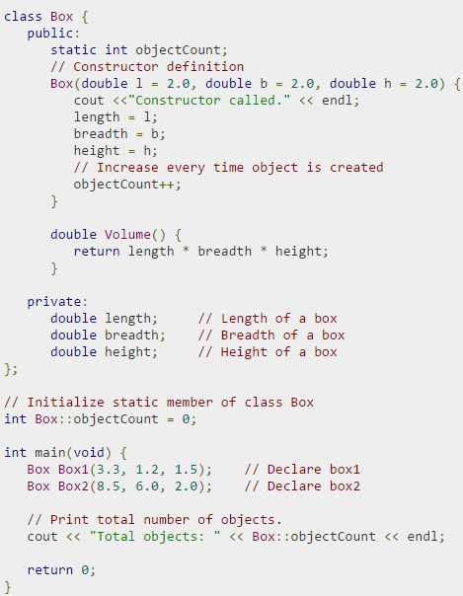
Example
48

Slide 48
Example
49

Slide 49
Example
50

Slide 50
Example
class Car {
private:
static int n; // class variable
//Allocating and initialising static data member
int Car::n = 0;
//Implementation of member functions
Car::Car() {
n++;
}
int Car::getN() { return n;
}
Car::~Car() { n--;
}
int a; public:
Car();
// instance variable
static int getN();
};
void main() {
cout << Car:: getN(); // called without obj
Car c1, c2, c3;
cout << Car::getN();
}
51

Slide 51

Const Variables
Lesson 1
52

Slide 52
const using #define
#define PI 3.14159
Everywhere you used PI, the value 3.14159
was substituted by the preprocessor
For example it specifies that the identifier PI will be replaced by the text 3.14159 throughout the program.
not recommended in C++

Slide 53
const Variables
• C++
introduces the concept of a named
constant that is just like a variable, except that
its value cannot be changed.
The modifier const tells the compiler that a name represents a constant.
Any data type, built-in or user-defined, may be
defined as const.

Slide 54
const Variables
If you define something as const and then attempt to modify it, the compiler will generate an error.
A const has a scope, just like a regular variable,

Slide 55
const Variables
The keyword const (for constant) precedes the data type of a variable.
It specifies that the value of a variable will not change throughout the program.
In C++, a const must always have an initialization value
const int x = 10;

Slide 56
const Variables
const qualifier is used to prevent variables from being modified
Any attempt to alter the value of a variable defined with this qualifier will elicit an error message from the compiler.
Compiler error: cannot modify a constant variable

Slide 57
const Variables Example
#include <iostream> using namespace std;
Output:
const double pi = 3.14159
int main ()
{ double r=5.0; // radius double circle; circle = 2 * pi * r; cout << circle;
}
31.4159

Slide 58
const Variables Example
#include <iostream> using namespace std;
Output:
#define PI 3.14159
int main ()
{ double r=5.0; // radius
double circle; circle = 2 * PI * r;
cout << circle;
}
31.4159

Slide 59

const qualifier in OOP
Lesson 2
Data member
Member function
Object
60

Slide 60
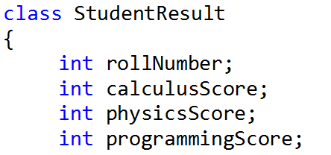
StudentResult Class
What
if I want that roll
number
should not be modified
};

Slide 61
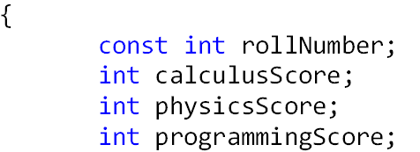
const Data Member
A data member whose value cannot be modified, once initialized.
};

Slide 62
Initializing a const Data Member
A const variable has to be declared within the class, but it cannot be defined in it.
We need to define the const variable outside
the class.

Slide 63
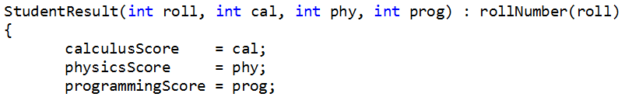
Initializing a const Data Member
const data members must be initialized using
member initializer list
};

Slide 64
const data in all objects
const
student1 | student2 | student3 | student4
9 | 34 | 28 | 12
80 | 79 | 65 | 85
75 | 79 | 65 | 85
95 | 79 | 65 | 85

Slide 65
2- const Member function
A const member function guarantees that it will never modify any of its data.
candidates for being made const because they
don’t need to modify any data.
Member | functions | that do | nothing but
acquire | data from | an object | are obvious

Slide 66
3- const Object
Any const member function that attempts to change a member variable or call a non-const member function will cause a compiler error to occur.

Slide 67
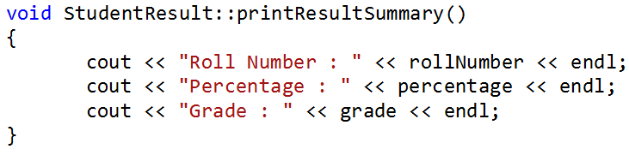
2- const Member function
Example

Slide 68
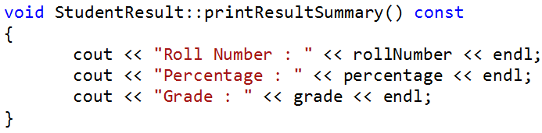
2- const Member function
To declare a member function as const, you need to add the keyword const at the end of the function declaration.

Slide 69
3- const Object
When an object is declared as const, it cannot be modified
34
80
75
95
83.33
A
student1

Slide 70
3- const Object
When an object is declared as const, it cannot be modified
34
80
75
95
83.33
A
student1

Slide 71
3- const Object
For any object that you declare to be const, you can only call member functions that are also declared to be const.

Slide 72
class Something{
public:
int m_nValue; Something() {
void ResetValue() {
m_nValue = 0; } m_nValue = 0; }
void SetValue(int nValue) {
m_nValue = nValue; }
int GetValue() { return m_nValue; }
};
int main(){
const Something cSomething; cout<<cSomething.m_nValue; return 0; }
Output
0
73

Slide 73
class Something{
public:
int m_nValue;
Something() {
void ResetValue() {
m_nValue = 0; }
m_nValue = 0; }
void SetValue(int nValue) {
m_nValue = nValue; }
int GetValue() { return m_nValue; }
};
int main(){
const Something
cSomething.m_nValue = 5;
return 0; }
Error
74

Slide 74
class Something{
public:
int m_nValue;
Something() {
void ResetValue() {
m_nValue = 0; }
m_nValue = 0; }
};
int main(){
const Something cSomething;
cSomething.ResetValue();
return 0; }
Error
75

Slide 75
class Something{
public:
int m_nValue;
Something() {
m_nValue = 0; }
void SetValue(int nValue) {
m_nValue = nValue; }
};
int main(){
const Something cSomething; cSomething.SetValue(5); return 0; }
Error
76

Slide 76
class Something{
public:
int m_nValue;
Something() {
int GetValue() {
m_nValue = 0; }
return m_nValue; }
};
int main(){
const Something cSomething; cSomething.GetValue(); return 0; }
Error
77

Slide 77
class Something{
public:
int m_nValue;
Something() {
int GetValue() const {
m_nValue = 0; }
return m_nValue; }
};
int main(){
const Something cSomething; constructor cSomething.GetValue();
return 0; }
// calls default
Output 0
78

Slide 78

Mutable Data Members
Lesson 3
79

Slide 79
Mutable Data Members
We may need to allow certain selected data members of a class to be altered, even if the object was declared as const.
To accommodate such a situation you need to be able to exempt a particular data member from the const-ness of an object and you need to be able to alter the value of the exempt data member in a const member function.
You can do both by declaring a data member as
mutable

Slide 80
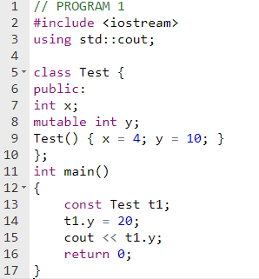
Mutable Data Members: Program 1
Output
20

Slide 81
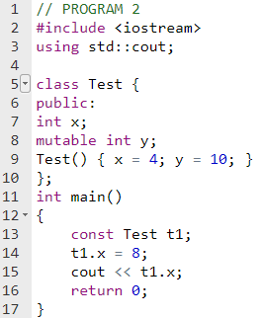
Mutable Data Members:Program 2
Output
error

Slide 82
constructors and destructors
const can't be used for constructors and destructors
The purpose of a constructor is to initialize field values, so it must change the object. Similarly for destructors.
This is because const objects should initialize their member variables, and a const constructor would not be able to do so.

