Slide 1
Object Oriented Programming
Using C++
Friend Functions and Classes

Slide 2

Lesson:Friend Functions and Classes

Slide 3
Friends
▶ Any data which is declared private inside a class is not
accessible from outside the class.
▶ A function which is not a member or an external class can never access such private data.
▶ The concepts of encapsulation and data hiding dictate that nonmember functions should not be able to access an object’s private or protected data.
▶ The policy is, if you’re not a member, you can’t get in. However, there are situations where such rigid discrimination leads to considerable inconvenience..

Slide 4
Friends
▶ But there may be some cases, where a programmer will need access to the private data from non-member functions and external classes. C++ offers some exceptions in such cases.
▶ A class can allow non-member functions and other classes to access its own private data, by making them as friends.

Slide 5
Friend Functions
Friend
function,
function
which
is a special
type of the the
declares
inside
access
class. Friend function can
private, protected and public data of the class.
A Friend Function of a class is defined outside that class scope but it has the right to access all private and protected
members of the class
50

Slide 6
Friend Functions
A keyword friend is used before return
type of the function declaration/prototype.
Although, the prototypes of friend functions appear in the class, but they are not considered as member functions
51

Slide 7
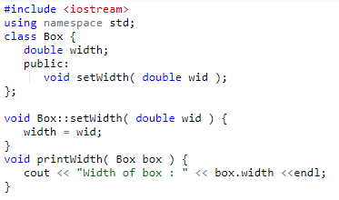
Friend Functions
52

Slide 8
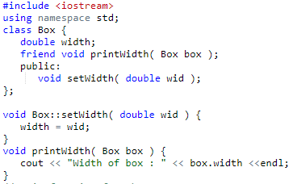
Friend Functions
Enable us to access private data from non-member functions. How?
53

Slide 9
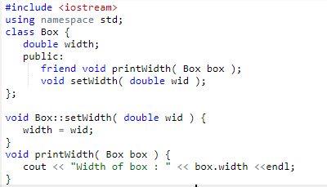
Friend Functions
A keyword friend is used before return type of the function declaration/prototype.
54

Slide 10
Friend Functions
can be anywhere inside class either in private or public section
55

Slide 11
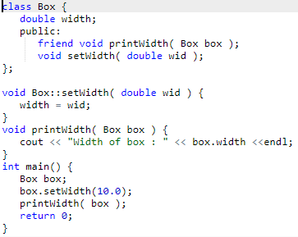
Friend Functions
56

Slide 12
Temperature Class
▶ Create a Temperature class to represent temperature
in Celsius.
▶ Provide a parameterized constructor to initialize
Celsius value to user provided value
57

Slide 13

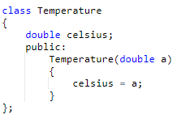
Temperature Class
58

Slide 14
Temperature Class
▶ Update the class to include a non member function tempfahrenheit that returns value of temperature converted from Celsius to Fahrenheit
▶ 1 Celsius=33.8 Fahrenheit
59

Slide 15
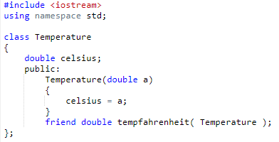
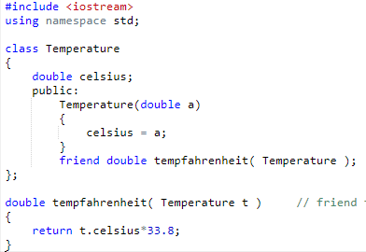
Temperature Class
60

Slide 16


Temperature Class
Temperature in celsius : 676
61

Slide 17
Class Members as Friend
▶ We can also make a function of one class as a friend of
another class.
▶ We do this in the same way as we make a function as
a friend of a class.
▶ The only difference is that we need to write class_name :: in the declaration before the name of that function in the class whose friend it is being declared.
▶ The friend function is only specified in the class and its entire body is declared outside the class. It will be clear from the example
62

Slide 18
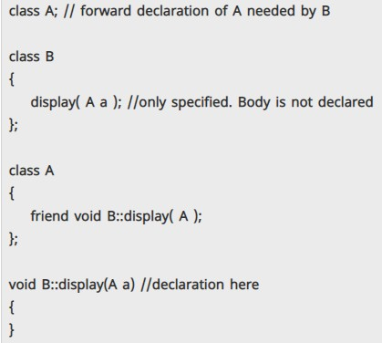
Class Members as Friend
63

Slide 19

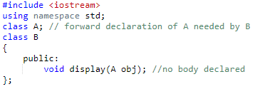

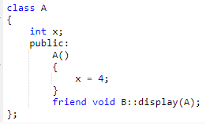


Class Members as Friend
64

Slide 20

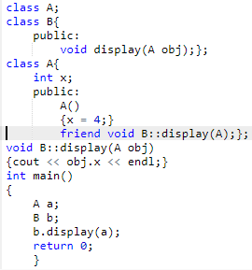
Class Members as Friend
65

Slide 21

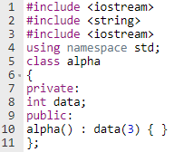
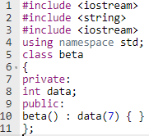
Friend Functions as Bridges
Imagine that you want a function to operate on
objects of these two different classes.

Slide 22
Friend Functions as Bridges
friend int frifunc(alpha, beta); //friend function

Slide 23

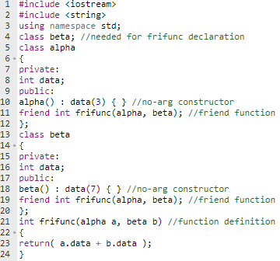
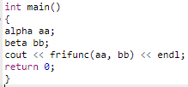
Friend Functions as Bridges
Forward Declaration

Slide 24
Friend Functions and Classes
▶ Once a non-member function is declared as a friend, it can access the private data of the class
▶ Similarly when a class is declared as a friend, the friend class can have access to the private data of the class which made this a friend
▶ To make a function as a friend of a class, it is declared inside the class either in private or in public section with keyword friend before its declaration

Slide 25
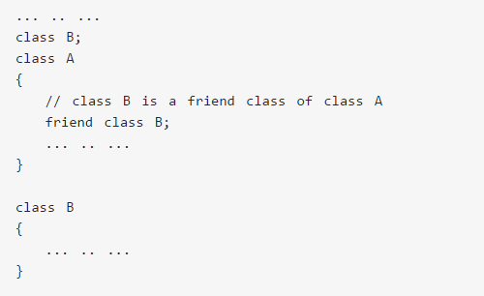
Friend Classes in C++
70

Slide 26
Friend Classes in C++
▶ When a class is made a friend class, all the member
functions of that class becomes friend functions
▶ all member functions of class B will be friend functions
of class A
▶ any member function of class B can access the private and protected data of class A
▶ But, member functions of class A cannot access the data
of class B.
71

Slide 27


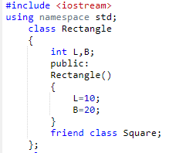
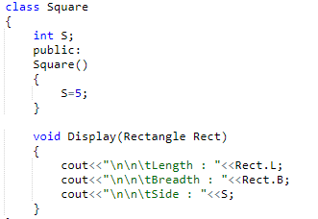

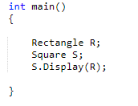
Friend Class
Length : 10
Breadth : 20
Side : 5

Slide 28
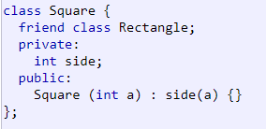
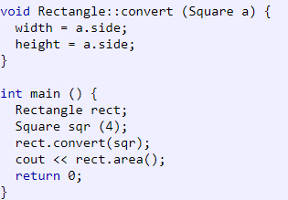

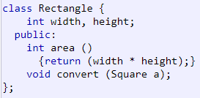
Friend Classes Example
Output: 16

Slide 29
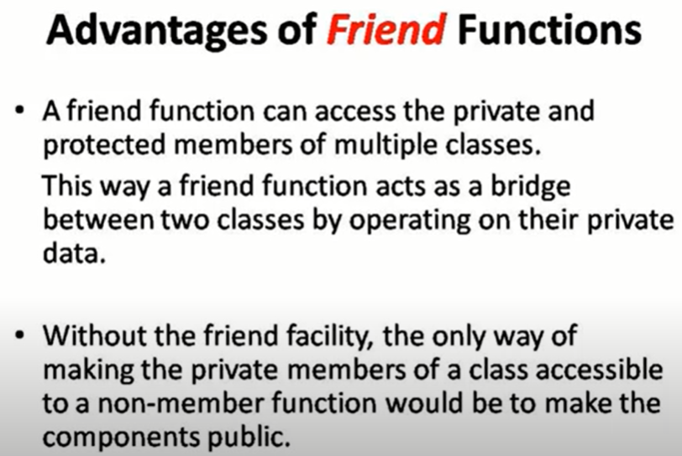
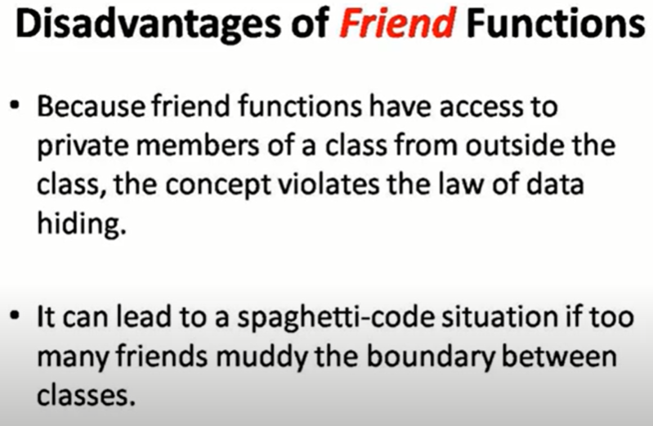
Properties of friendship
Friendship is granted not taken
Not symmetric
Not transitive

