Slide 2
CS212 – Object Oriented
Programming
Inheritance
Week – 08
Dr. Khuram Shazhad
mkhuram.shahzad@seecs.edu.pk
Office: A-308

Slide 3
Inheritance
To inherit attributes and methods from one class to another
Inheritance
Derived
Base Class
Derived class (child) – the class that inherits from another class
Base class (parent) – the class being inherit

Slide 4
Road Map
Why Inheritance
What is Inheritance
Syntax
Access Specifiers
Types of Inheritance
Objects as Function Arguments

Slide 5


Why Inheritance
Lesson 1
5

Slide 6
Why inheritance should be used?
In each of the classes, you would be copying the same code for walk and talk for each character.
If you want to add a new feature - eat, you need to implement the same code for each character. This can easily become error prone (when copying) and duplicate codes.

Slide 7
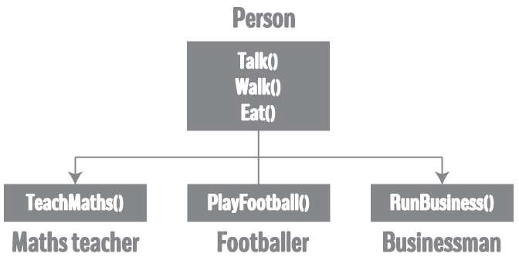
Better Approach

Slide 8
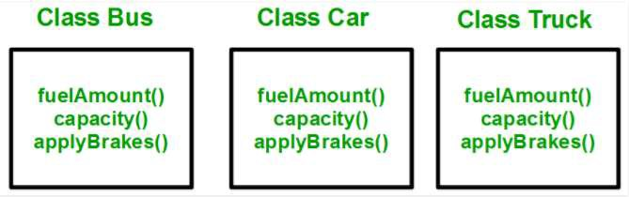
Why inheritance should be used?
Above process results in duplication of same code 3 times. This increases the chances of error and data redundancy. To avoid this type of situation, inheritance is used

Slide 9
Why inheritance should be used?
Why customize or enhance classes?
Reusability
– Saves time during program development by taking advantage of proven, high-quality software.
Reliability
Conceptualization and overall design of program

Slide 10

What is Inheritance
Lesson 2
12

Slide 11
Inheritance
Inheritance is everywhere in real life.
•
When you were born, you inherited your parents
genes, and acquired physical attributes from both of them -- but then you added your own personality on top.
Technological products (computers, cell phones, etc…) inherit features from their predecessors (often used for backwards compatibility).
For example, the Intel Pentium processor inherited many of the features defined by the Intel 486 processor, which itself inherited features from earlier processors.

Slide 12
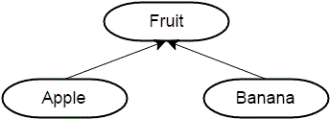
Inheritance
All fruits have a name, a color, and a size.
We also know that fruit undergoes a ripening process, by which it becomes edible.

Slide 13
Inheritance
Although apples and bananas are different fruits, both have in common that they are fruits.
Simple logic tells us that anything that is true of fruits is also true of apples and bananas.

Slide 14
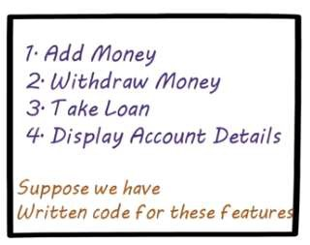
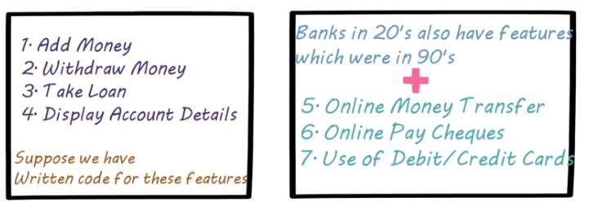
Banks
Olden Days
Modern day

Slide 15
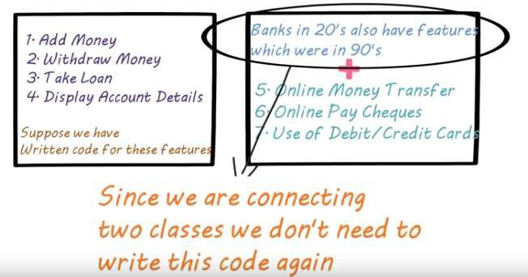
Banks
Olden Days
Modern day

Slide 16

Banks
Olden Days
Modern day

Slide 17
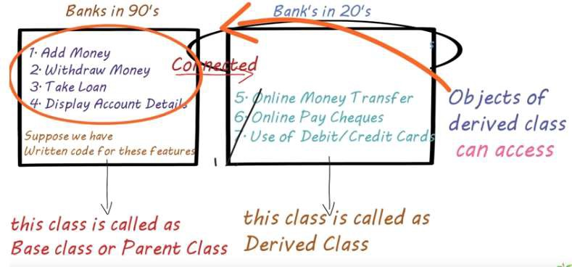
Banks
Olden Days Modern day

Slide 18
Inheritance
Inheritance
is one of the key features of
Object-oriented programming in C++. It allows user to create a new class (derived class) from an existing class(base class).
The derived class inherits all the features from the base class and can have additional features of its own.

Slide 19
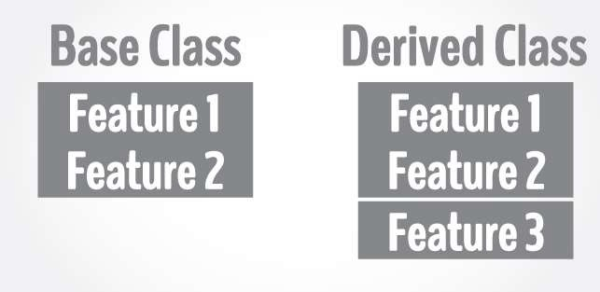
Inheritance

Slide 20
Thinking About Bicycles
A tandem bicycle is a kind of bicycle
Bicycle with two seats
A mountain bicycle is a kind of bicycle
Bicycle with shocks
A racing bicycle is a kind of bicycle
Lightweight aerodynamic construction
Tandem, mountain, and racing bicycles are specialized
bicycles

Slide 21
Inheritance
Be able to create specialized program objects without starting from scratch
Inheritance programming specialization
is the object-oriented
mechanism for

Slide 22




Inheritance
Ability to define new classes of objects using existing
classes as a basis
The new class inherits the attributes and behaviors of the parent classes
New class is a specialized version of the parent class
Bicycle
is-a relationships
Mountain Bikes
Racing Bikes
Tandem Bikes

Slide 23




Inheritance
A natural way to reuse code
Programming by extension rather than reinvention
Object-oriented paradigm is well-suited for this style of programming
Terminology
Base class (superclass)
Derived class (subclass)
Bicycle
is-a relationships
Mountain Bikes
Racing Bikes
Tandem Bikes

Slide 24
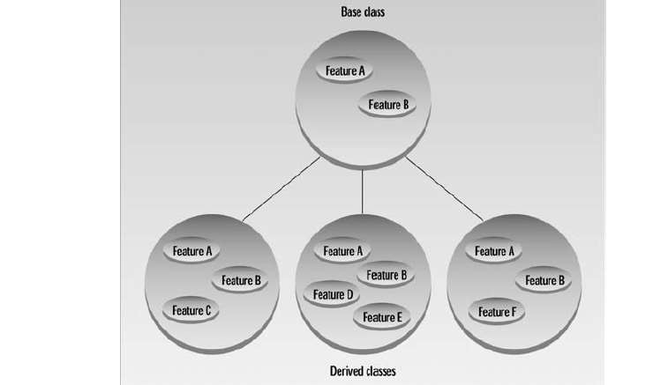
Inheritance
A process of creating new classes (derived class) from existing (base) class.
CS212 Object Oriented Programming in
C++
31

Slide 25
Class Inheritance
Base class
Shape class
Derived
class
Derived
class
Circle
class
Triangle
class
Isosceles Triangle
Equilateral Triangle
Right-angle Triangle

Slide 26
Specialization – Generalization
Specialization goes down the way.
Shape class
Circle class
Triangle class
Isosceles Triangle
Equilateral Triangle
Right-angle Triangle
Generalization goes up the way.
Shape class
Circle class
Triangle class
Isosceles
Triangle
Equilateral
Triangle
Right-angle
Triangle

Slide 27
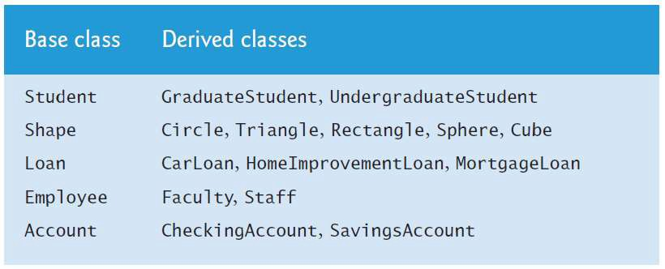
Examples
CS212 Object Oriented Programming in
C++
35

Slide 28

Inheritance Syntax
Lesson 3
36

Slide 29
Inheritance Syntax
•
The simplest example of inheritance requires two
classes:
a base class and a
derived class
The base class OR super-class does not need any special
syntax.
The derived class OR subclass on the other hand, must
indicate that it’s derived from the base class.
This is done by placing a colon after the name of the derived class, followed by a keyword such as public and then the base class name.

Slide 30
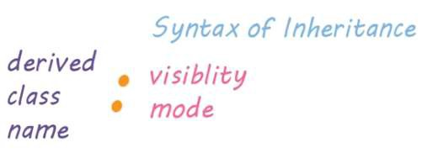
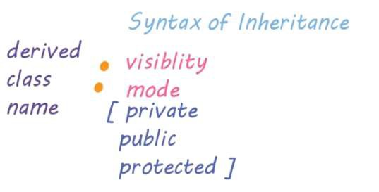
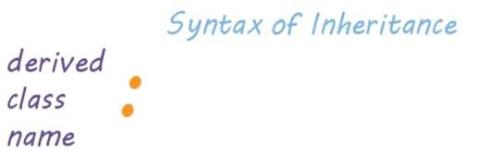
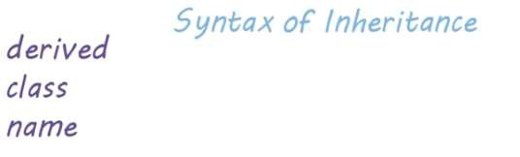
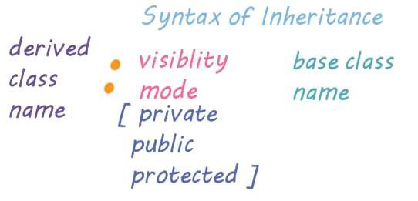

Syntax

Slide 31
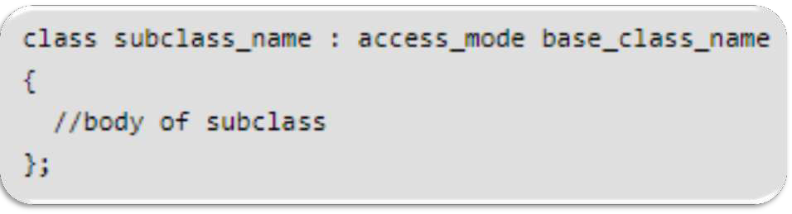
Syntax: Single Inheritance
name of the sub
class
name of the
base class
mode in which you want to inherit this sub class
Note: private member of the base class will never get inherited in the sub class.

Slide 32

Syntax: Multiple Inheritance
name of the sub
class
Coma separated names of
base classes
mode in which you want to inherit this sub class
Note: private member of the base class will never get inherited in the sub class.

Slide 33
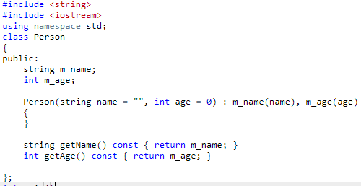
Person Class

Slide 34
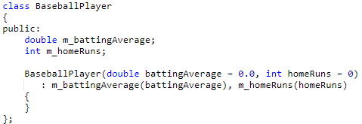
BaseBall Player Class
Now, we also want to keep track of a baseball player’s
Name
Age

Slide 35
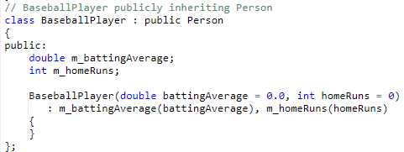
BaseBall Player Class

Slide 36
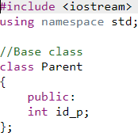

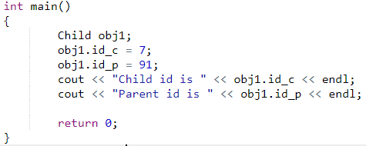
Example
Output: Child id is 7 Parent id is 91
49

Slide 37

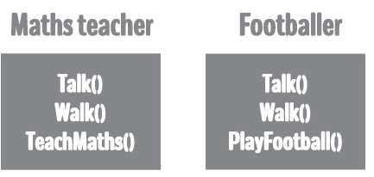

Example

Slide 38
Example

Slide 39
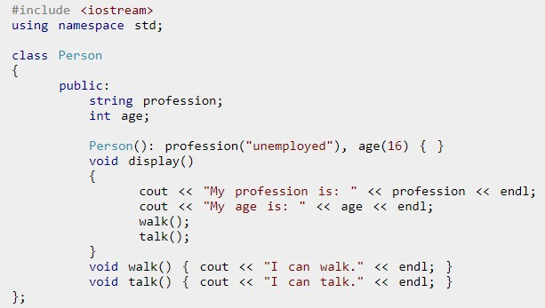
Base Class: Person

Slide 40
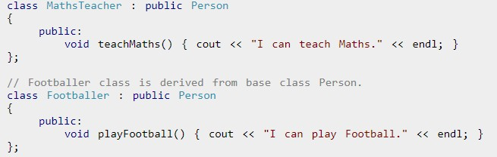
Derived Classes

Slide 41
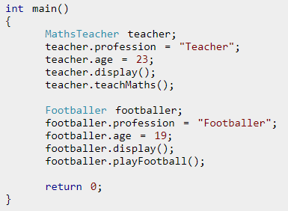
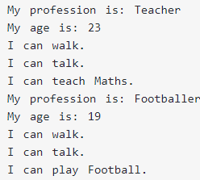
Test Class

Slide 42

Access Specifiers
Lesson 4
55

Slide 43
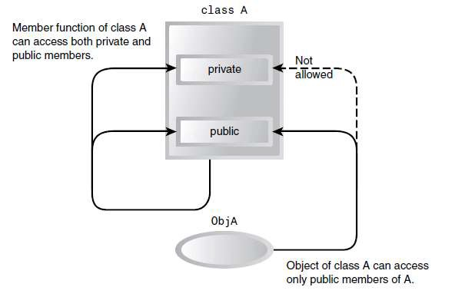
Access Specifiers Without Inheritance

Slide 44
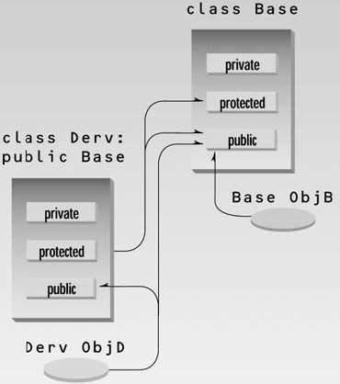
Access Specifiers With Inheritance

Slide 45
Access Control for Public Inheritance
An object of a derived class inherits all the member data and functions of the base class.
Private members
Not visible in the derived class.
The derived class may access them only through the
public interface of the base class.
Protected Data members
Visible in the derived class.
The derived class may access protected members
directly.

Slide 46
Access Control for Public Inheritance
Access Specifier In Base Class | Accessible from Base Class | Accessible from Derived Class | Accessible from Objects Outside Class
public | yes | yes | yes
protected | yes | yes | no
private | yes | no | no

Slide 47
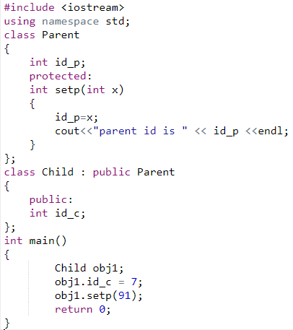
Example: Protected Access Control
error: 'int Parent::setp(int)' is protected int setp(int x)

Slide 48

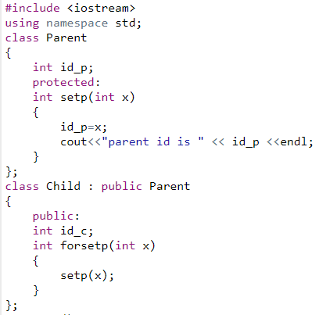
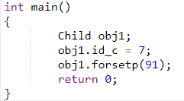
Example: Protected Access Control
parent id is 91

Slide 49

Modes of Inheritance
Lesson 6
62

Slide 50
Modes of Inheritance: Public
class Base
{ };
class Derived : public Base
{ };
public members of the base class become public members of the derived class;
protected members of the base class become
protected members of the derived class; and
private members of the base class become inaccessible within the derived class.
63

Slide 51
Modes of Inheritance: Public
class Base
{ };
class Derived : public Base
{ };
Base Derived
private: x protected: y public: z
x not accessible y protected
z public
64

Slide 52
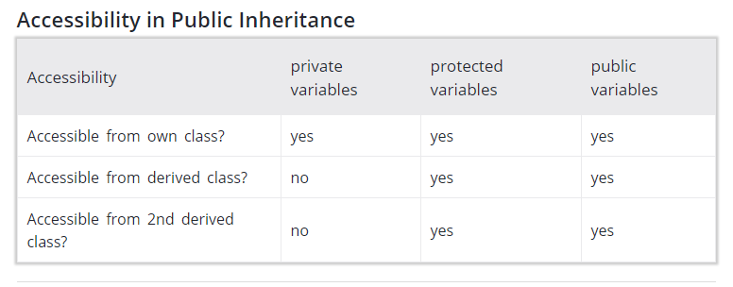
Modes of Inheritance: Public
65

Slide 53
Modes of Inheritance: Protected
class Base
{ };
class Derived : protected Base
{ };
public members of the base class become protected members of the derived class;
protected members of the base class become
protected members of the derived class; and
private members of the base class become inaccessible within the derived class.
CS212 Object Oriented Programming in
C++
66

Slide 54
Protected Inheritance
class Base
{ };
class Derived : protected Base
{ };
Base Derived
private: x protected: y public: z
not accessible
protected z protected
67

Slide 55
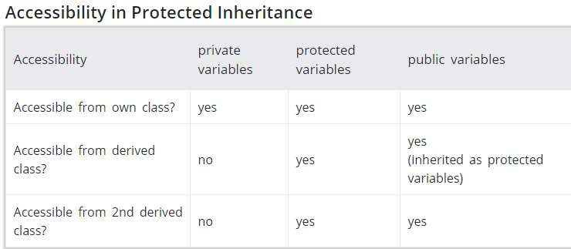
Protected Inheritance
68

Slide 56
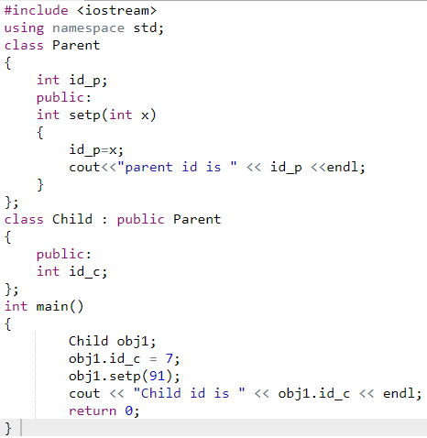
Example
Output: Parent id is 91 Child id is 7
69

Slide 57
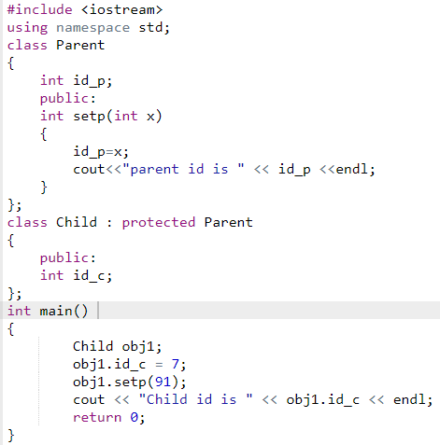
Example
error: 'int Parent::setp(int)' is inaccessible int setp(int x)
70

Slide 58
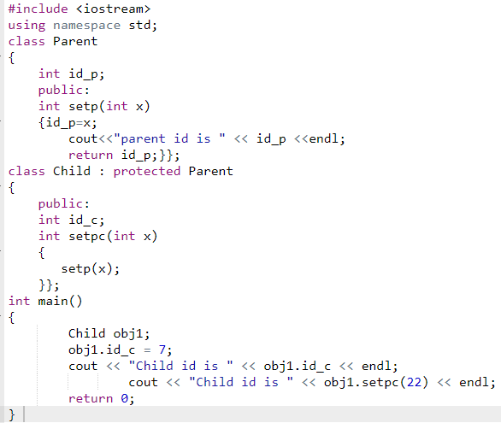
Example
Output: Child id is 7 Child id is 22 (parent ID)
71

Slide 59
Modes of Inheritance: Private
class Base
{ };
class Derived : private Base
{ };
public members of the base class become private members of the derived class;
protected members of the base class become
private members of the derived class; and
private members of the base class become inaccessible within the derived class.
CS212 Object Oriented Programming in
C++
72

Slide 60
Modes of Inheritance: Private
class Base
{ };
class Derived : private Base
{ };
Base Derived
private: x protected: y public: z
x not accessible y private
z private
73

Slide 61
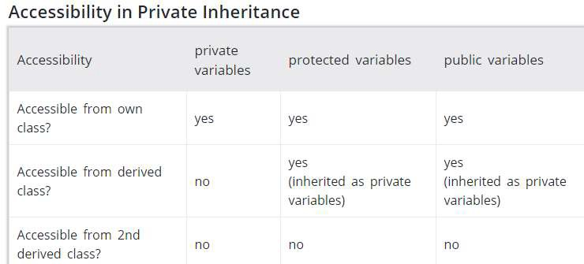
Modes of Inheritance: Private
74

Slide 62
Example
class Shape {
protected:
int width, height;
public:
void setDims (int a, int b){ width=a; height=b;}
};
class Rectangle: public Shape {
public:
int area ( ) {
return (width * height);
}
};

Slide 63
Example
Design an application, teachers and the
principal (director) in a school
Create a test program to show functionality of both classes by only using Principal class objects.

Slide 64
Design
Class Name teacher
Attributes: name, age, numOfStudents Function: setName()
Class Name Principal
Attributes: name, age, numOfStudents school_name, numOfTeachers Function: setSchool()

Slide 65
Test Program - Inheritance Example
class Teacher{
// Base class
private:
string name;
int age, numOfStudents; public:
void setName (new_name){
int main()
{Teacher t1;
Principal p1;
t1.setName(" Teacher 1");
p1.setName(" Principal 1");
p1.setSchool(“ElementarySchool");
name = new_name;
return 0;
}
}
};
class Principal
: public
Teacher {
string school_name;
p1 object can also access, in
int public:
numOfTeachers;
addition to its own member
function
setSchool(), the
function from
void setSchool(s_name){
school_name = s_name;
}};
member
Parent (Base),
setName().
which is

Slide 66
Types of Inheritance
Single inheritance
Multiple inheritance
Multi level inheritance
Hybrid inheritance
Hierarchical inheritance

Slide 67
Single Inheritance
Class A
Class A {
Public:
void func() {
cout<<“Inherited”;
}
};
Class B : public A {
};
int main () {
B b;
b.func();
}
Class B
Class A public and protected attributes become public attributes of Class B. How about protected?

Slide 68
Multiple Inheritance
Class A {
Public:
void Afunc() {
cout<<“Func A \n”;
}
};
Class B {
Public:
void Bfunc() {
cout<<“Func B \n”;
}
Class C: public A, public B {
};
int main () {
C c;
c.Afunc();
c.Bfunc();
}
Class A
Class A
Class B
Class A&B public and protected attributes become public attributes of Class C.

Slide 69
Multi Level Inheritance
Class A {
Public:
void Afunc() {
cout<<“Func A \n”;
}
};
Class B: public A {
Public:
void Bfunc() {
cout<<“Func B \n”;
}
Class C: public B {
Public:
};
int main () {
C c;
c.Afunc();
c.Bfunc();
}
Class A
Class B
Class A
When we inherited Class B (both data members and functions) in Class C, we also inherited Class A indirectly.

Slide 70
Hybrid Inheritance
Class A
Class B
Class C
Class D public and protected attributes of Class B, C, & A. Hybrid of what?
Class D
Hybrid of Multiple and multi level inheritance

Slide 71
Hybrid Inheritance
Class A
Class B
Class C
Class B
Class C
Class B
Class C

Slide 72
Test your skills - Practice
Class FirstFloor {
int Rooms;
Protected:
void give();
Public:
void take();
};
Class SecondFloor: private FirstFloor {
int Labs;
Public:
void put();
void get(); }; Class TopFloor: public SecondFloor {
int Roof;
Public:
void enter();
void exit(); };
What type of inheritance
Write the names all the members (data members and member function), which are directly accessible by the member function get() of the class SecondFloor?
Write the names of all the members, which are accessible by the member function exit() of class TopFloor().
Write the names of all the members, which are directly accessible by the object T of class TopFloor() declared in the main() function.
Notes:
https://www.youtube.com/watch?v=7ZfEp71tIec

Slide 73
Objects as Function Arguments

Slide 74
Objects as Function Arguments
▶ In C++ we can pass class’s objects as function arguments and also return them from a function the same way we pass and return other variables.
▶ No special keyword or header file is
required to do so.
▶ To pass an object as an argument we write the object name as the argument while calling the function the same way we do it
for other variables.
74

Slide 75
Function definition
Return type function_name(data_type variable_name)
{
…………..
}
Return type function_name(class_name object_name)
{
…………..
}
75

Slide 76
Function Call
Object_name.function_name(variable_name)
Object_name.function_name(object_name)
76

Slide 77
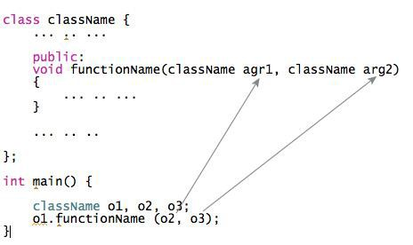
Function definition and Call
77

Slide 78

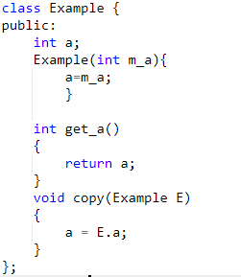

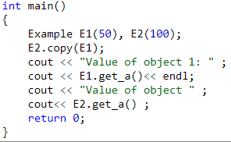


Objects as Function Arguments
22

Slide 79
Objects as Function Arguments
23
Members functions of invoking
object can refer to its data directly

Slide 80

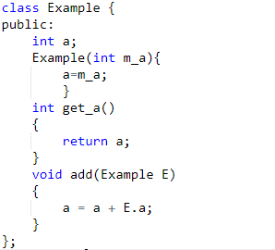

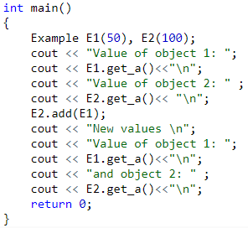
Objects as Function Arguments
24

