Slide 1
CS212 – Object Oriented Programming
Pointers
READ: C++ How to Program
Chapter 08 – (Section 8.1 – 8.4)
Week – 09
Dr. Khuram Shazhad
mkhuram.shahzad@seecs.edu.pk
Office: A-308

Slide 2
RoadMap for Today
Pointer Variable Declarations and Initialization
Pointer Operators (?)
Pass by Reference with Pointers

Slide 3
Computer Memory
A variable is a name for a piece of memory that holds a value.
When our program instantiates a variable, a free memory address is automatically assigned to the variable, and any value we assign to the variable is stored in this memory address.

Slide 4

Computer Memory
int a = 100;
Each variable is assigned a memory slot (the size depends on the data type) and the variable’s data is stored there
Memory address:
1020
1024
1032
…
…
100
…
…
a
Variable a’s value, i.e., 100, is
stored at memory location 1024
int a = 100;

Slide 5
Computer Memory
int a;
When this statement is executed by the CPU, a piece of memory from RAM will be set aside.
For the sake of example, let’s say that the variable a is assigned memory location 1024.
Whenever the program sees the variable x in an expression or statement, it knows that it should look in memory location 1024 to get the value.

Slide 6
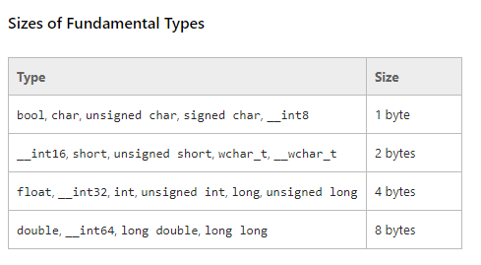
Fundamental Types

Slide 7
The address-of operator (&)
The address-of operator (&) allows us to see what memory address is assigned to a variable. This is pretty straightforward:

Slide 8
The address-of operator (&)
#include <iostream>
Using namespace std;
int main()
{
int x = 5;
cout << x << '\n';
cout << &x << '\n';
return 0;
}
5
0027FEA0
// print the value of variable x
// print the memory address of variable x

Slide 9
The dereference operator (*)
Getting the address of a variable isn’t very useful by itself.
The dereference operator (*) allows us to access the value at a particular address.

Slide 10
The dereference operator (*)
#include <iostream>
int main()
{
int x = 5;
cout << x << '\n';
cout << &x << '\n';
cout << *&x << '\n';
return 0;
}
5
0027FEA0
5
// print the value of variable x
// print the memory address of variable x
// print the value at the memory address of variable x

Slide 11
Pointers
A pointer is a variable that holds a memory address as its value.

Slide 12
Pointers
A pointer is a variable used to store the address of a memory cell.
We can use the pointer to reference this memory cell
pointer
Memory address:
1020
1024
1032
…
…
100
…
…
…
integer

Slide 13
Pointers
A pointer is a variable used to store the address of a memory cell.
We can use the pointer to reference this memory cell
Memory address:
1020
1024
1032
…
…
100
…
1024
…
integer
pointer

Slide 14
Declaring a pointer
Pointer variables are declared just like normal variables, only with an asterisk between the data type and the variable name.
type* pointer_name;
//or
type *pointer_name;

Slide 15
Declaring a pointer
Declaration of Pointer variables
type* pointer_name;
//or
type *pointer_name;
where type is the type of data pointed to (e.g. int, char, double)
Examples:
int *n; // pointer to an integer
double *dp; // pointer to a double
float *fp; // pointer to a float
char *ch // pointer to character
type *
Name of pointer

Slide 16
Declaring a pointer
Syntactically, C++ will accept the asterisk:
next to the data type
next to the variable name,
or even in the middle.
Asterisk is not a dereference. It is part of the pointer declaration syntax.

Slide 17
Declaring a pointer
int *iPtr; // a pointer to an integer value
double *dPtr; // a pointer to a double value
int* iPtr2; // also valid syntax (acceptable, but not favored)
int * iPtr3; // also valid syntax (but don't do this)
int *iPtr4, *iPtr5; // declare two pointers to integer variables

Slide 18
Declaring a pointer: Best practice
When declaring a pointer variable, put the asterisk next to the variable name.
However, when returning a pointer from a function, it’s clearer to put the asterisk next to the return type:
1 | int* doSomething();

Slide 19
Assigning a value to a pointer
Just like normal variables, pointers are not initialized when declared.
If not initialized with a value, they will contain garbage.
Since pointers only hold addresses, when we assign a value to a pointer, that value has to be an address.

Slide 20
Assigning a value to a pointer
To get the address of a variable, we use the address-of operator:
int value = 5;
int *ptr = &value;
// initialize ptr with address of variable value

Slide 21
Address Operator &
Memory address:
1020
1024
1032
…
88
100
…
…
…
a
b
#include <iostream>
using namespace std;
void main(){
int a, b;
a = 88;
b = 100;
cout << "The address of a is: " << &a << endl;
cout << "The address of b is: " << &b << endl;
}
Result is:
The address of a is: 1020
The address of b is: 1024

Slide 22
Pointer Variables
The value of pointer p is the address of variable a
A pointer is also a variable, so it has its own memory address
Memory address:
1020
1024
1032
…
88
100
…
1024
…
a
p
int a = 100;
int *p = &a;
cout << a << " " << &a <<endl;
cout << p << " " << &p <<endl;
Result is:
100 1024
1024 1032

Slide 23
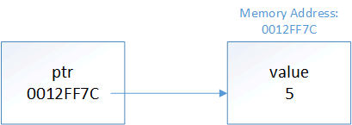
Assigning a value to a pointer
This is where pointers get their name from -- ptr is holding the address of variable value, so we say that ptr is “pointing to” value.

Slide 24
Assigning a value to a pointer
#include <iostream>
using namespace std;
int main()
{
int value = 5;
int *ptr = &value;
// initialize ptr with address of variable value
cout << &value << '\n';
// print the address of variable value
cout << ptr << '\n'; // print the address that ptr is holding
return 0;
}
return 0;
}
0012FF7C
0012FF7C

Slide 25
Assigning a value to a pointer
The type of the pointer has to match the type of the variable being pointed to: int iValue = 5;
double dValue = 7.0;
int *iPtr = &iValue; // ok
double *dPtr = &dValue; // ok
iPtr = &dValue;
// wrong -- int pointer cannot point to the address of a double variable
dPtr = &iValue;
// wrong -- double pointer cannot point to the address of an int variable

Slide 26
Assigning a value to a pointer
Note that the following is also not legal:
int *ptr = 5;
This is because pointers can only hold addresses, and the integer 5 does not have a memory address.
If you try this, the compiler will tell you it cannot convert an integer to an integer pointer.
C++ will also not allow you to directly assign literal memory addresses to a pointer:
double *dPtr = 0x0012FF7C;
// not okay, treated as assigning an integer literal

Slide 27
Assigning a value to a pointer
Note that the following is also not legal:
int *ptr = 5;
This is because pointers can only hold addresses, and the integer 5 does not have a memory address.
If you try this, the compiler will tell you it cannot convert an integer to an integer pointer.
C++ will also not allow you to directly assign literal memory addresses to a pointer:
double *dPtr = 0x0012FF7C;
// not okay, treated as assigning an integer literal

Slide 28
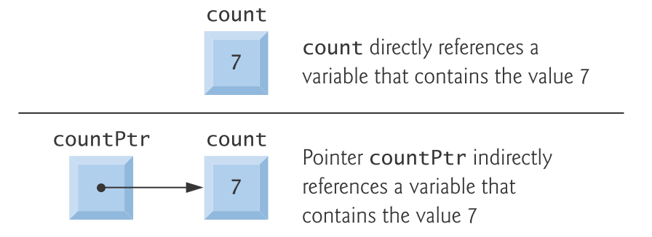
Pointers: Example 1
int count = 7;
Int *countPtr;
countPtr= &count

Slide 29
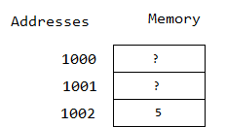
Pointers: Example 2
int x =5;

Slide 30
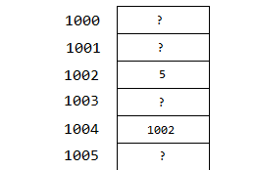
Pointer
Pointers are like variables, instead of holding a number, they hold an address.
Address of x? & x
int* ptr = & x;
// let's say 'ptr' is placed at address 1004
x
ptr

Slide 31
Pointers: Example 2
int x;
int* ptr = & x;
cout << x;
// <- this will print '5' because the contents of the x' box contains 5
cout << ptr;
// <- this will print '1002' because the contents of the 'ptr' box contains 1002

Slide 32
Dereferencing pointers
There are two special operators that are used with pointers
& (Address of Operator)
* (indirection operator or dereferencing
Operator)

Slide 33
Pointer Operators
The & is a unary operator that returns the memory address of its operand
* is a unary operator that returns the value of the variable at the address specified by its operand
The second operator is *, and it is a complement of &.

Slide 34
Dereferencing pointers
Once we have a pointer variable pointing at something, the other common thing to do with it is dereference the pointer to get the value of what it’s pointing at.
A dereferenced pointer evaluates to the contents of the address it is pointing to.

Slide 35
Indirection operator *
A variable name directly references a value, and a pointer indirectly references a value
Memory address:
1020
1024
1032
…
88
100
…
1024
…

Slide 36
Indirection Operator *
We can access the value stored in the variable pointed to by using the dereferencing operator (*),
Memory address:
1020
1024
1032
…
88
100
…
1024
…
a
p
int a = 100;
int *p = &a;
cout << a << endl;
cout << &a << endl;
cout << p << " " << *p << endl;
cout << &p << endl;
Result is:
100
1024
1024 100
1032

Slide 37
Indirection operator *
int x;
int* ptr = & x;
cout << x;
cout << *ptr;
x
ptr

Slide 38
Indirection operator *
Here, the * symbol is the indirection operator.
So *ptr will look in the ptr box, see that it contains 1002,
Then will go to address 1002, and print the contents of that box which is 5
And since box 1002 contains ‘5', that's what it will print.

Slide 39
Dereferencing pointers
int value = 5;
cout << &value;
// prints address of value
cout << value;
// prints contents of value
int *ptr = &value; // ptr points to value
cout << ptr; // prints address held in ptr, which is &value
cout << *ptr; // dereference ptr (get the value that ptr is pointing to)
0012FF7C
5
0012FF7C
5

Slide 40
Dereferencing pointers
This is why pointers must have a type.
Without a type, a pointer wouldn’t know how to interpret the contents it was pointing to when it was dereferenced.
It’s also why the type of the pointer and the variable address it’s being assigned to must match.
If they did not, when the pointer was dereferenced, it would misinterpret the bits as a different type.
Notes:
// Characters
#include <iostream>
using namespace std;
int main()
{
char c = 'A';
char* p = &c;
cout << c << endl;
cout << &p << endl;
}
//arrays of char and integers
#include <iostream>
using namespace std;
// Driver Code
int main()
{
// Character array b
char b[] = "abc";
// Integer array
//int a[] = { 1, 2, 3 };
// Pointer to character array
char* c = &b[0];
// Print the value of c
cout << c << endl <<&c;
}

Slide 41
Reassigning pointers
int value1 = 5;
int value2 = 7;
int *ptr;
ptr = &value1; // ptr points to value1
cout << *ptr; // prints 5
ptr = &value2; // ptr now points to value2
cout << *ptr; // prints 7

Slide 42
Reassigning pointers
When the address of variable value is assigned to ptr, the following are true:
ptr is the same as &value
*ptr is treated the same as value

Slide 43
The size of pointers
The size of a pointer is dependent upon the architecture the executable is compiled for –
a 32-bit executable uses 32-bit memory addresses -- consequently, a pointer on a 32-bit machine is 32 bits (4 bytes).
With a 64-bit executable, a pointer would be 64 bits (8 bytes). Note that this is true regardless of what is being pointed to

Slide 44
The size of pointers
char *chPtr; // chars are 1 byte
int *iPtr; // ints are usually 4 bytes
cout << sizeof(chPtr) << '\n'; // prints 4
cout << sizeof(iPtr) << '\n'; // prints 4
As you can see, the size of the pointer is always the same. This is because a pointer is just a memory address, and the number of bits needed to access a memory address on a given machine is always constant.

Slide 45
Don’t get confused
Declaring a pointer means only that it is a pointer: int *p;
Don’t be confused with the dereferencing operator, which is also written with an asterisk (*). They are simply two different tasks represented with the same sign
int a = 100, b = 88, c = 8;
int *p1 = &a, *p2= &b, *p3 = &c;
cout << a <<endl << b << endl << c;
cout << p1 <<endl << p2 << endl << p3;
cout << *p1 <<endl << *p2 << endl << *p3;

Slide 46
null Pointer
Pointers should be initialized to 0, NULL or an address of the corresponding type either when they’re declared or in an assignment.
A pointer with the value 0 or NULL “points to
nothing” and is known as a null pointer.
Symbolic constant NULL is defined in several standard library headers to represent the value 0.

Slide 47
Example
#include <iostream>using namespace std;
int main ()
{
int *ptr =NULL;
cout <<"the value of ptr is:“<<ptr;
return 0;
}
How to check null
Pointer?
//using following syntax to check for a null pointer
if (ptr) {
/*succeed of ptr is not null */
}
if(!ptr) { /*succeed of ptr is null */ }

Slide 48
The dereferenced pointer
The dereferenced pointer may also be used to receive an input value as in
cin >> *yPtr;

Slide 49
Common Programming Errors
Dereferencing an uninitialized pointer could cause a fatal execution-time error
OR
It could accidentally modify important data and allow the program to run to completion, possibly with incorrect results

Slide 50
Common Programming Errors
An attempt to dereference a variable that is not a pointer is a compilation error
Dereferencing a null pointer is often a fatal execution-time error.

Slide 51
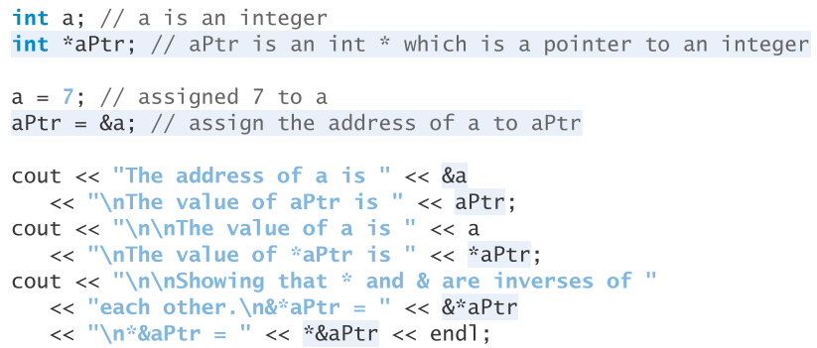
Trace Output

Slide 52
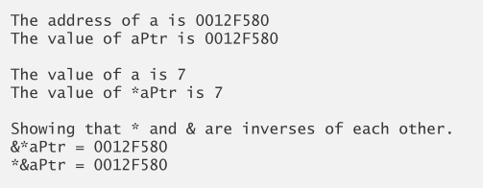
Trace Output

Slide 53
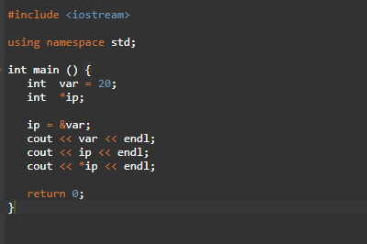

Trace Output

Slide 54
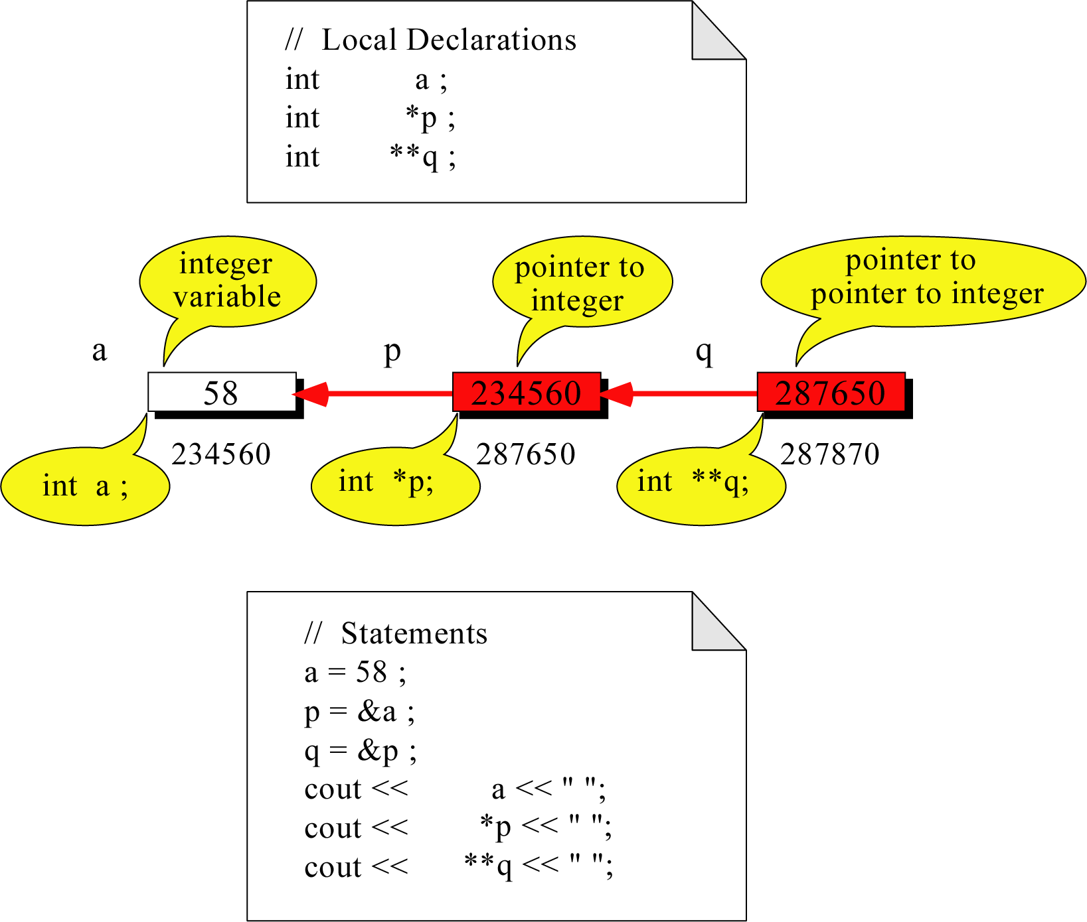
Pointer to Pointer
What is the output?
58 58 58

Slide 55
C++ - Passing arguments to a function
There are three ways in C++ to pass arguments to a function
Pass-by-value
Pass-by-reference with pointer arguments
You can use pointers and the indirection operator (*) to accomplish pass-by-reference

Slide 56
Example – Call & Pass(Address)-by-Value
#include <iostream>
using namespace std;
/*call by value */
void passByReference (int &x, int &y)
{
int z=x;
x=y;
y=z;
}
int main()
{
int a=5, b=6;
cout<<"Before swapping"<<endl<<"a:"<<a<<" b:"<<b<<endl<<endl;
//call function
passByReference (a, b);
cout<<"Before swapping"<<endl<<"a:"<<a<<" b:"<<b<<endl<<endl;
return 0;
}
#include <iostream>
using namespace std;
/*call by value */
void passByAddress (int *x, int *y)
{
int z=*x;
*x=*y;
*y=z;
}
int main()
{
int a=5, b=6;
cout<<"Before swapping"<<endl<<"a:"<<a<<" b:"<<b<<endl<<endl;
//call function
passByAddress (&a, &b);
cout<<"Before swapping"<<endl<<"a:"<<a<<" b:"<<b<<endl<<endl;
return 0;
}

Slide 57
Memory Segments
The memory that a program uses is typically divided into a few different areas, called segments:
The code segment
The bss segment
The data segment
The heap
The call stack

Slide 58
Memory Segments
Code segment
The code segment (also called a text segment), where the compiled program sits in memory. The code segment is typically read-only.
bss segment
The bss segment (also called the uninitialized data segment), where zero-initialized global and static variables are stored.

Slide 59
Data segment
Data segment
The data segment (also called the initialized data segment), where initialized global and static variables are stored.
Heap
The heap, where dynamically allocated variables are allocated from.
Call stack
The call stack, where function parameters, local variables, and other function-related information are stored.

