Slide 1
Deep Learning for Tabular Structure Recognition
Presented by:
Muhammad Ahmed Mohsin
Muhammad Umer
Tariq Umar

Slide 2
TableNet: A brief overview
The model utilizes a base network that is initialized with pre-trained VGG-19 features.
The model takes a single input image and produces two different semantically labelled output images for tables and columns.
TableNet approach used ICDAR 2013 data set for detection.
The model can generalize to other datasets with minimal fine tuning, thereby enabling transfer learning.

Slide 3
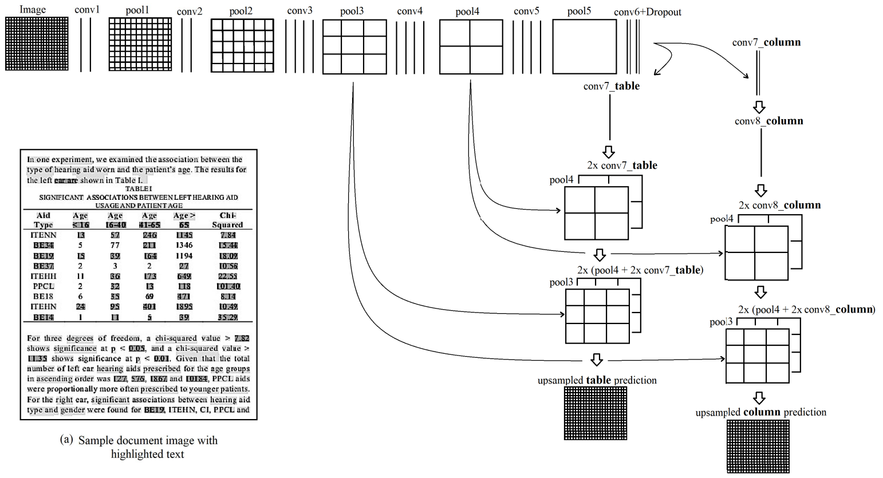
Original Architecture

Slide 4
Proposed Model Changes
Taking advantage of contour detection
Tesseract performs best when scaled image is at least 300 DPI; this serves as the basis of image processing pipelines
Using advanced erosion-dilation algorithms to mitigate False Positives

Slide 5
Dataset
For the training of our model, we used the Extended Marmot Dataset, open-sourced by the authors of the original paper
To shape it in accordance with the proposed pipeline, we upscaled resolution of each image
The dataset currently lacks annotations for decoding rows as a separate entity

Slide 6
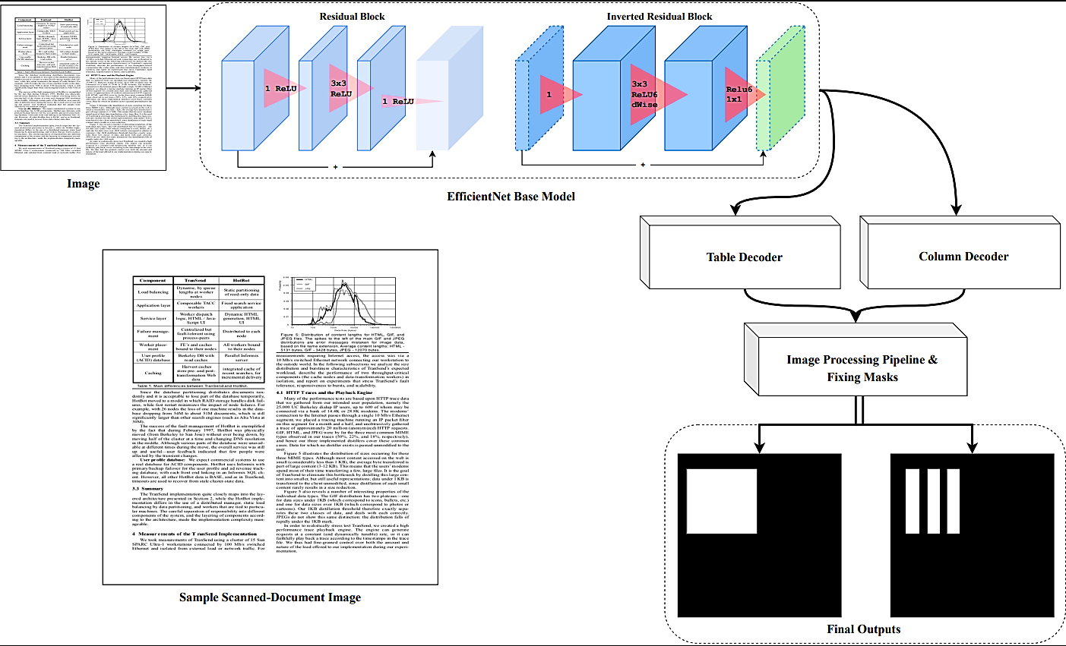
Proposed Model Architecture

Slide 7
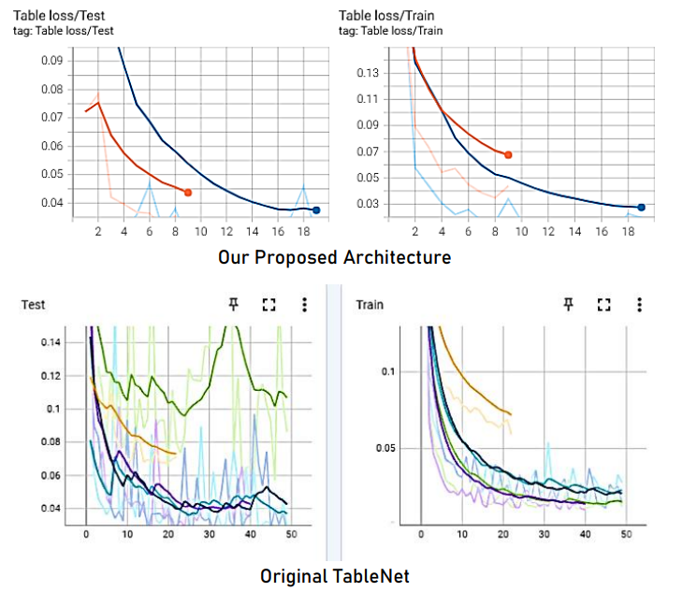
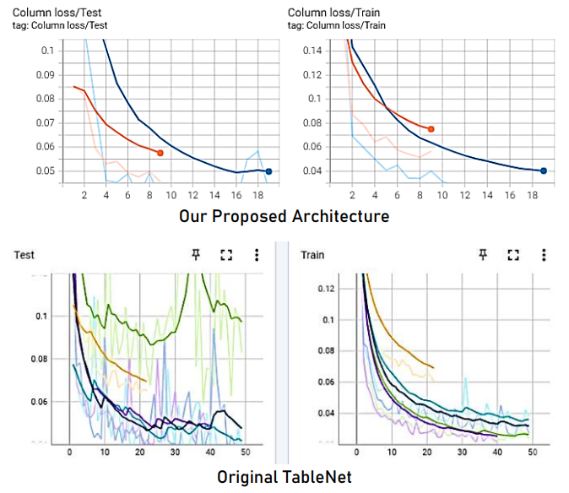
Training Curves

Slide 8
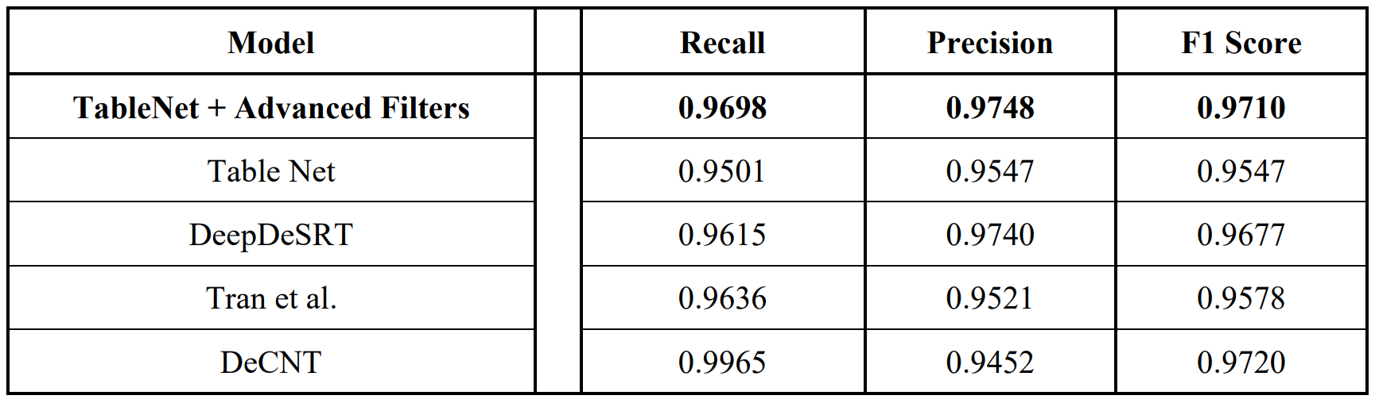
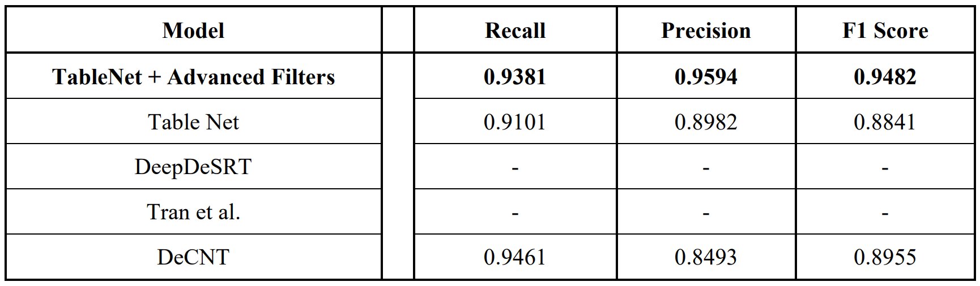
Performance Metrics Against SOTA Models
On ICDAR 2013 Dataset
On MARMOT Dataset

Slide 9
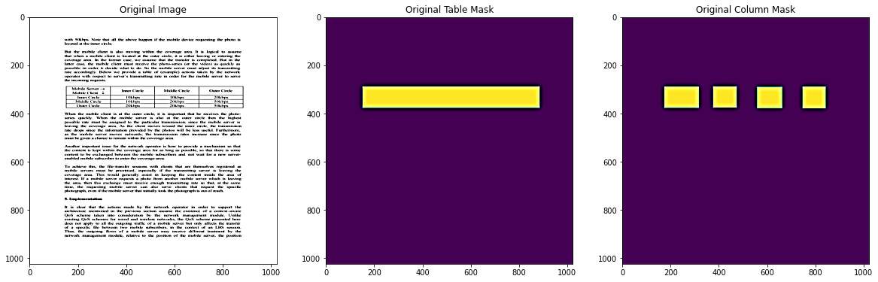
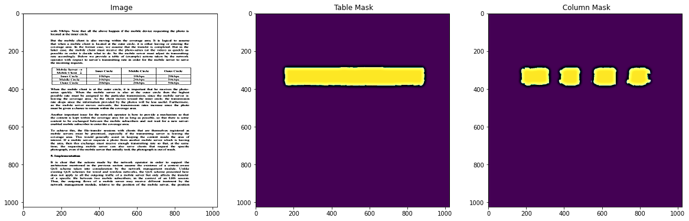
Inference: Predictions

Slide 10
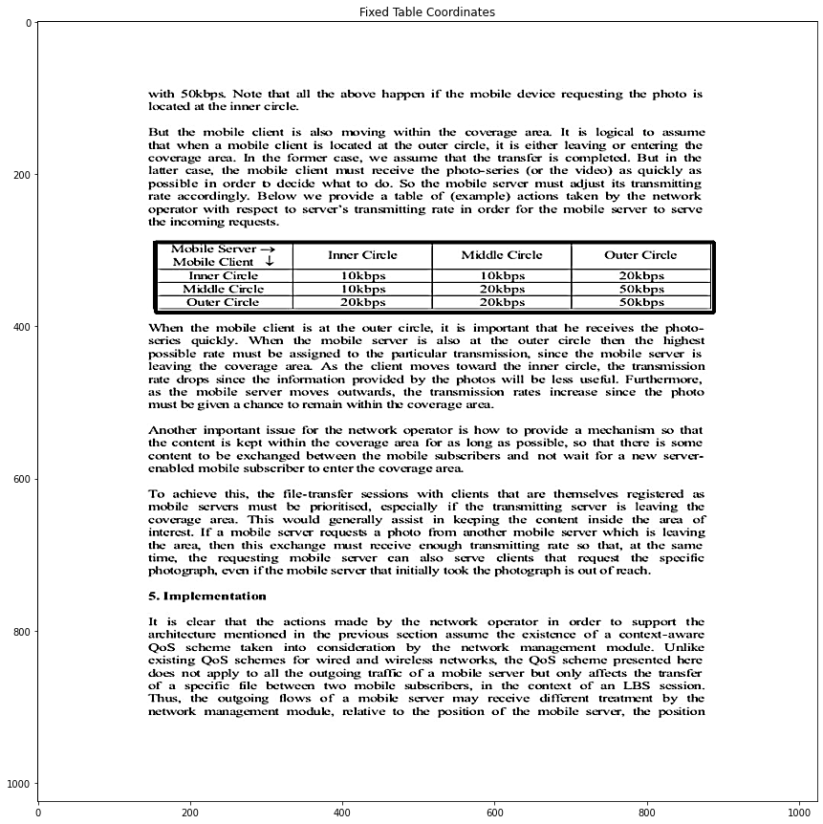
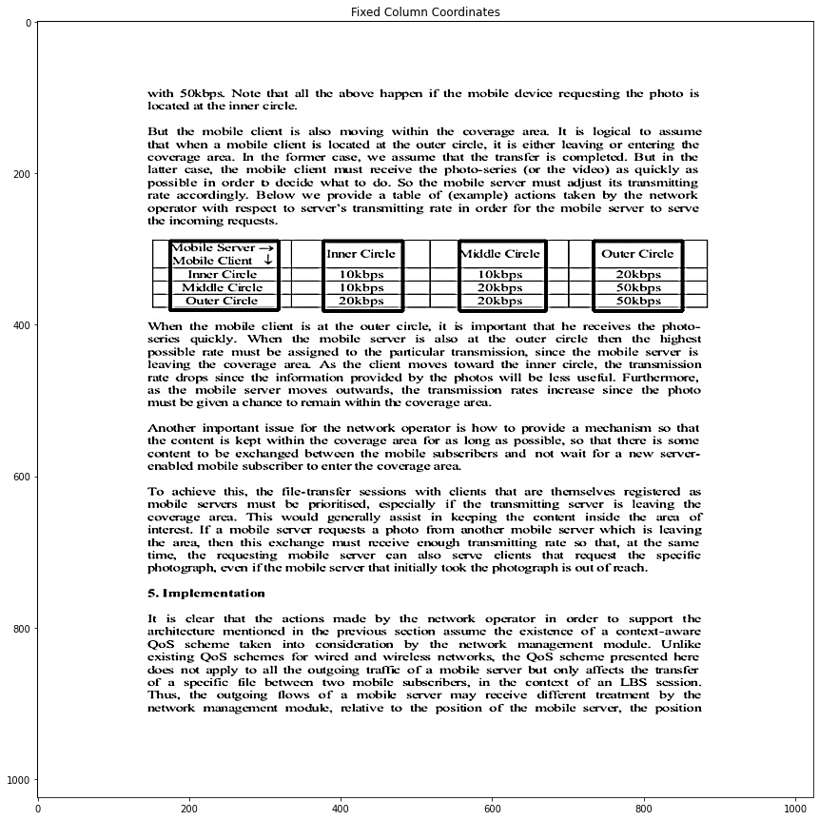
Inference: Fixing Masks

Slide 11
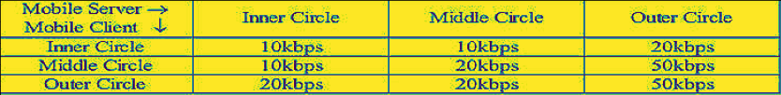
Inference: OCR
Mobile Server > Inner Circle Middle Circle Outer Circle
Mobile Client a2
Tnner Circle 1OKBpS 1Okbps 2OKBps
Middle Circle TOkbps 20kbps S0kbps
Outer Circle 2Okbps 20kbps SOkbps
As cropping an image to ROI and upscaling it 300 DPI is not lossless, discrepancies arise
For this reason, inferences yield better results on PDFs than on images (.png, .jpeg, etc.)

Slide 12
Future Work
Manual annotation of rows in the Extended Marmot Dataset
Implementing a separate decoder for detection of Rows in tables
Using Bitmap compatible filters

Slide 13
Thank You
Any Questions?

