Slide 1
S.W.O.T ANALYSIS

Slide 2
About the company
UPer Crust Pies is a specialty meat and fruit pie cafe in Michigan’s Upper Peninsula that sells hot, ready-to-go pies and frozen take-home options, as well as an assortment of fresh salads and beverages. The company is planning to open its first location in downtown Silica town and is very focused on developing a business model that will make it easy to expand quickly and that opens up the possibility of franchising.

Slide 3
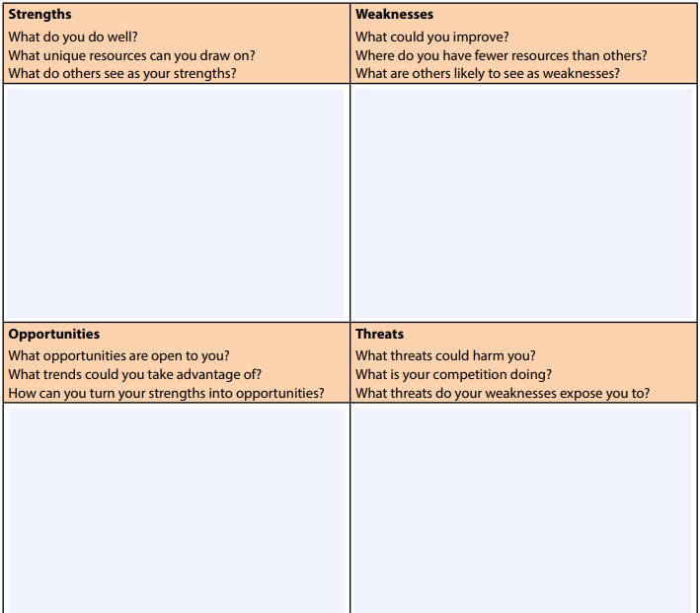

Slide 4
STAR Technique

Slide 5
S Situation
T Task
A Action
R Result

Slide 6
Write about an occasion when you had to complete a task under a tight deadline.
Have you ever gone above and beyond the call of duty?
What do you do when a team member refuses to complete his or her quota of the work?

