Slide 1
Communicating to Persuade
Chapter 11
Technical Communication
Process and Product
By
Gerson & Gerson
7th Ed.

Slide 2


Slide 3

The Rhetorical Triangle

Slide 4
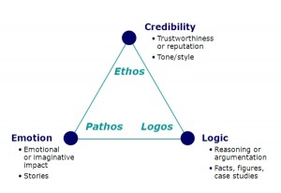

Slide 5
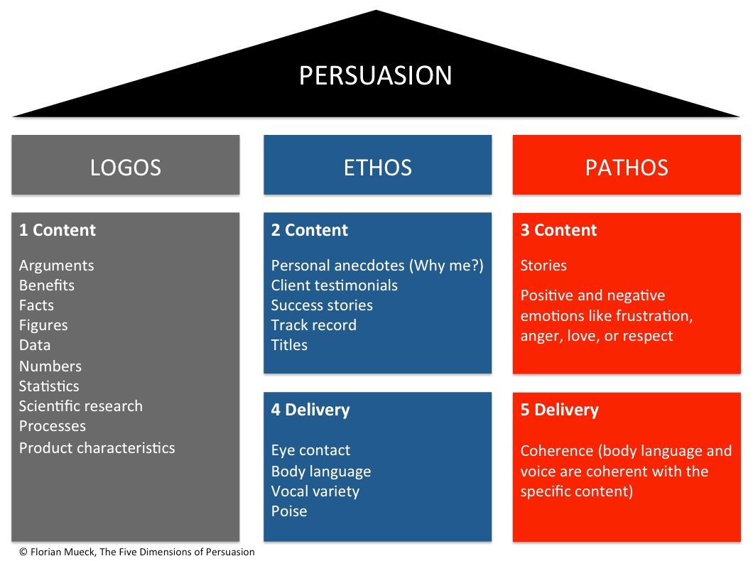

Slide 6
ARGU
Arouse audience involvement in introduction
Refute opposing points of views
Give proof to develop your thoughts
Urge action

Slide 7
Arouse audience involvement in introduction
Use an anecdote
Start with a question
Let facts and figures enhance the credibility
Appeal to the senses
Use comparison and contrast to highlight the point
Either create a feeling of comfort, ease, and well-being OR a feeling of discomfort, fear and anxiety

Slide 8
Refute opposing points of views
Recognize and admit conflicting views
Let the audience know that you understand their concern
Provide evidence
Allow for the alternatives

Slide 9
Give proof to develop your thoughts
State facts and figures, elucidate theories, give references from the previous experiences/history

Slide 10
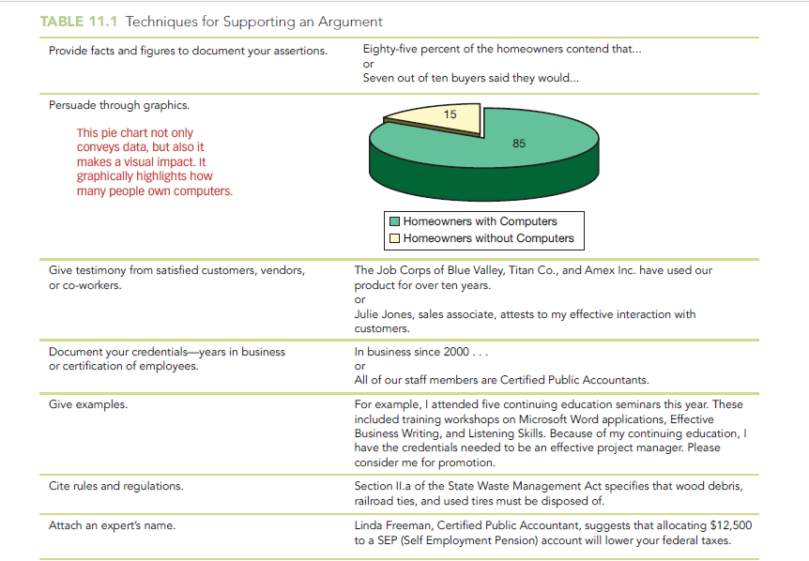

Slide 11
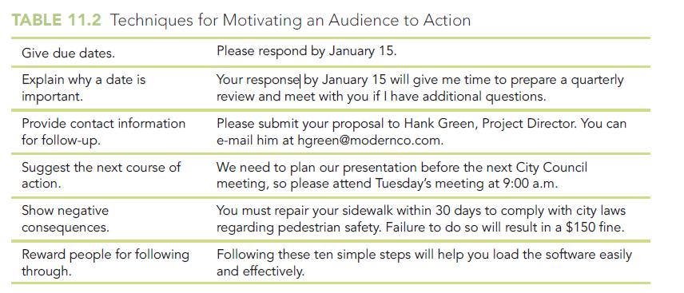
Urge Action
Motivate your audience to action

Slide 12
HOME ASSIGNMENT
Thorough Reading of the Chapter

