Slide 1
Message Composition- I
The AIDA Model

Slide 2
Introduction
AIDA
Attention (Awareness or Attract)
Interest
Desire
Action

Slide 3
It is an advertising effect model
Identifies the stages that an individual goes through during the process of purchasing a product or service
The AIDA model is commonly used in digital marketing, sales strategies, and public relations campaigns.
Use the AIDA model for writing a piece of text that has the ultimate objective of getting others to take action.

Slide 4
Attention: The first step in marketing or advertising is to consider how to attract the attention of consumers.
Interest: Once the consumer is aware that the product or service exists, the business must work on increasing the potential customer’s interest level.
Desire: After the consumer is interested in the product or service, then the goal is to make consumers desire it, moving their mindset from “I like it” to “I want it.”
Action: The ultimate goal is to drive the receiver of the marketing campaign to initiate action and purchase the product or service

Slide 5
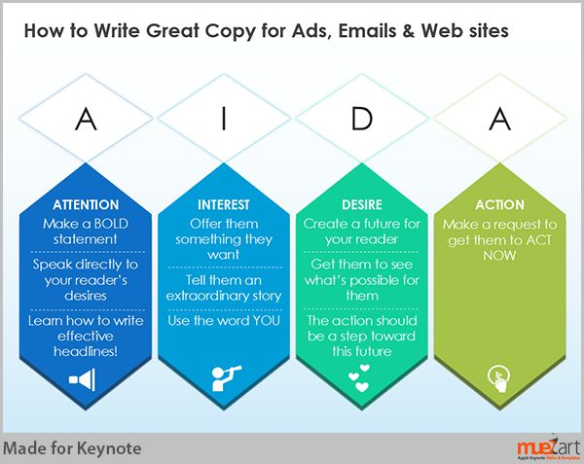
the AIDA model says that Awareness leads to Interest, which further leads to Desire, and finally, Action.

Slide 6
Attention/ Awareness/ Attract
A consumer comes across the Brand
First impression
The attention part is overlooked by many marketers.
Don’t just assume that everyone is already aware of your product.
One of the best approaches to attracting consumer attention is what’s called “creative disruption” – breaking existing patterns of behavior through a highly creative message.
Placing advertisements in unexpected situations or locations. This is often referred to as guerrilla marketing.
Creating shock in advertisements through provocative imagery.
An intensely targeted message. This is also referred to as personalization.
Essentially, the goal is to make consumers aware that a product or service exists.

Slide 7
Interest
Creating interest is generally the hardest part.
Make sure that advertising information is broken up and easy to read, with interesting subheadings and illustrations.
Focus on what is most relevant for your target market in relation to your product or service, and on conveying only the most important message you want to communicate to consumers.
The highlight of the product communication should point to the consumer’s needs.
Leading to the consumer going an extra step in looking up the product to see how it benefits him.

Slide 8
Desire
The second and third steps of the AIDA model go together.
Building interest in a product or service
It is important that you help customers realize why they ‘need’ this product or service.
Benefits that ideally make consumers want the product more and more.
Infomercials do this extremely well by showing the product being used in several creative situations.
Convey to the audience the value of the product or service, and why they need it in their life.

Slide 9
Action
The last step of the AIDA model is getting your consumer to initiate action.
The advertisement should end with a call to action – a statement that is designed to get an immediate response from the consumer.
For example, Netflix uses persuasive text to convince the consumer to try their free trial. Netflix communicates how convenient their product is and highlights its value, then urges consumers to sign up for a free trial.
Good advertising should elicit a sense of urgency that motivates consumers to take action RIGHT NOW. One commonly used method for achieving this goal is making limited time offers (such as free shipping).

Slide 10
https://www.youtube.com/watch?v=gRNOhahNUBs

